Slide 1









An-Najah National University
Implementing Lean Six Sigma DMAIC Methodology in AL-Hijaz Chocolate Factory

Slide 2













Slide 3
About
Us

Slide 4



About
Us
Sara Masri
Batool Almasri
Nour Al-Asaad
Tuqa Daraghmeh

Slide 5
Introduction

Slide 6






Introduction
1
AL-Hijaz Chocolate Factory Overview
  Established in 2005, ISO 22000 certified
  6 Production Lines
Chocolate Cooking
One Shot
1
4
Manual
Dragées
2
5
Dipping
Packaging & Stickering
3
6
Chocolate Production Process
Receiving Raw Material
Cooking & Preparation
Chocolate Fillings
Several Production Lines
Manual Production Line
Packaging
PTSD, CPTSD, and Trauma Definitions

Slide 7
AL-Hijaz Chocolate Factory Overview
  Established in 2005, ISO 22000 certified
  Their careful selection of ingredients - cocoa, sugar, cocoa butter, oil, & milk
  6 production lines
Chocolate Cooking
One Shot
1
4
Manual
Dragees
2
5
Dipping
Packaging & Stickering
3
6
Introduction
2
Chocolate Production Process
Receiving Raw Material
Cooking & Preparation
Chocolate Fillings
Several Production Lines
One Shot Production Line
Packaging

Slide 8

AL-Hijaz Chocolate Factory Overview
  Established in 2005, ISO 22000 certified
  Their careful selection of ingredients - cocoa, sugar, cocoa butter, oil, & milk
  6 production lines
Chocolate Cooking
One Shot
1
4
Manual
Dragees
2
5
Dipping
Packaging & Stickering
3
6
Introduction
2
Chocolate Production Process
Receiving Raw Material
Cooking & Preparation
Chocolate Fillings
Several Production Lines
One Shot Production Line
One Shot Production Line
Packaging

Slide 9
Literature Review

Slide 10



Literature Review
3
Lean Manufacturing
Six Sigma
  Lean focuses on eliminating waste (Muda)
  Goal: do more with less
  Lean is widely applied in food manufacturing to improve flow and efficiency
  Setup time is a major source of Waiting and Overprocessing waste
Six Sigma focuses on reducing variation and defects
Lean Six Sigma combines:
    Speed (Lean)
    Accuracy & Consistency (Six Sigma)
Kaizen
Kaizen = Continuous, Incremental Improvement
Small changes lead to long-term impact
Supports sustainability of improvements after implementation

Slide 11
DMAIC Methodology

Slide 12






DMAIC Methodology
4
Define
Measure
Analyze
Improve
Control
SIPOC
Data Collection
I-MR Chart
SOPs
Control Plan
Tools Implemented:
Project Charter
Fishbone Diagram
Process Capability Analysis
SMED
Process Flowchart
Pareto Chart
Scatter Plot
Normality Test & Histogram

Slide 13
Results
&
Analysis
Define Phase
5
Define Phase
Setup Time
Period needed to bring a production line from a non-operational state to full running capacity
One Shot Production Line
in HCF
Responsible for crafting several of the factory’s best-selling brands - Gourmet, Revera, Best, and Dragées Avola
Challenges During
Setup Phase
Waiting Time, Long Machine Setup Time, & Electrical Interruptions

Slide 14
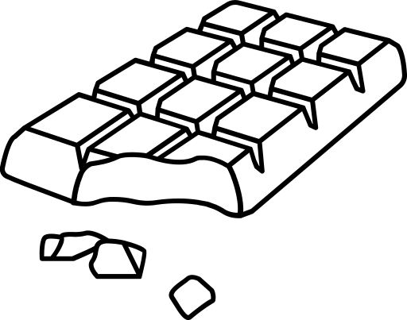



Define Phase
6
Define Phase Tools
Fishbone Diagram
Process Flowchart
Define Phase
5
Define Phase
________
________
Project Charter
SIPOC Analysis
Setup Time
Period needed to bring a production line from a non-operational state to full running capacity
One Shot Production Line
in HCF
Responsible for crafting several of the factory’s best-selling brands - Gourmet, Revera, Best, and Dragées Avola
Challenges During
Setup Phase
Waiting Time, Long Machine Setup Time, & Electrical Interruptions

Slide 15
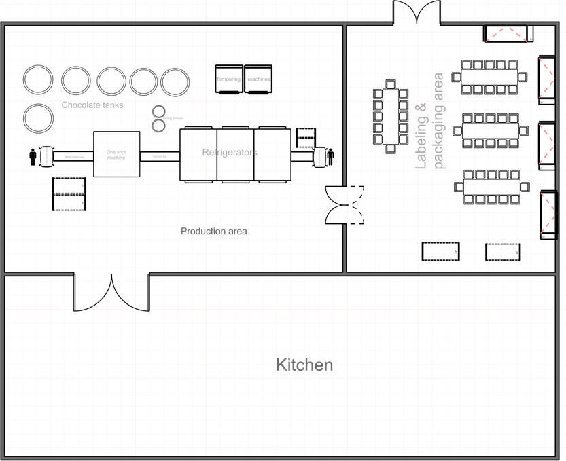

Define Phase
6
Define Phase Tools
Fishbone Diagram
Process Flowchart
________
________
Project Charter
SIPOC Analysis
Define Phase
7
Factory Layout
Organized smooth workflow
Easy access to materials, minimal delays
One Shot Line:
2 Tempering → KCM → Cooling

Slide 16
Define Phase
7
Factory Layout
Organized smooth workflow
Easy access to materials, minimal delays
One Shot Line:
2 Tempering → KCM → Cooling

Slide 17
Define Phase
8
Project Charter
Project Sponsor | Al-Hijaz Chocolate Factory (HCF)
Team Leader | Prof. Yahya Saleh
Project Title | Implementing Lean Six Sigma DMAIC Methodology in reducing the setup time in the One Shot production line
Part I:
Problem Definition & Purpose
The problem is the long time in the setup for a One Shot production line. The goal is to prepare the production line, machines, and ensure that there isn’t any residue from the previous day in order to reduce the possibility of errors, reduce time, and improve efficiency.
Part II:

Slide 18











Define Phase
10
Production Processes Description
Raw Material Receipt
Raw Material Inspection
Chocolate Preparation
Filling Preparation
Forming Process
Quality Assurance
Wrapping
Stickering
Packaging
Final Storage for the
Produced Chocolate
Define Phase
9
Business Case
The setup process takes about 125 minutes, which is longer than expected every morning to prepare and preheat the machines before production begins. This delay results in workers' idle time. The overprocessing and lack of a standardized preparation procedure led to inefficiency, reduced productivity, and higher operating costs.
Enablers / Risk Mitigation | Barriers / Risks
Conduct daily meetings with all team members All team members are consistently present and responsive Clear understanding of the work methodology Team members have relevant experience in similar projects Strong awareness and engagement from the team Good knowledge of industry standards and quality requirements | Lack of visits to the process location, which results in inadequate understanding of the process’s implementation Not enough time Difficulty reaching the workplace due to many challenge
Support Estimates
Top management has to recommend what is required and assist us in gathering all the information needed for the improvement process. Also, we need the support and assistance of the Quality Department.
Key Player |  | Scope
Sponsor | Eng. Zahra Tamimi | The project focuses on analyzing and reducing the wastes in the One Shot production line.
Team Leader | Dr. Yahya Saleh
Team Member | Batool, Nour, Sara, & Tuqa

Slide 19
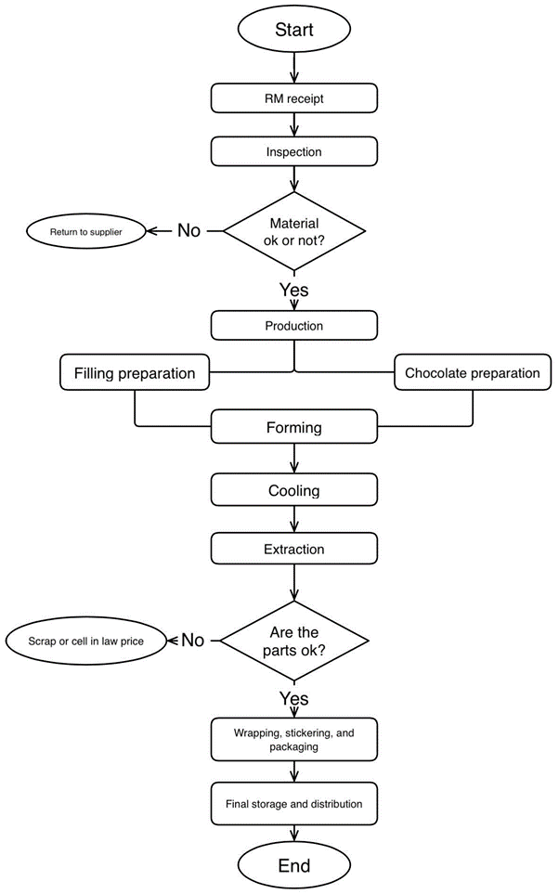
Define Phase
11
Define Phase
10
Production Processes Description
Process Flowchart
Raw Material Receipt
Raw Material Inspection
Chocolate Preparation
Filling Preparation
Forming Process
Quality Assurance
Wrapping
Stickering
Packaging
Final Storage for the
Produced Chocolate

Slide 20
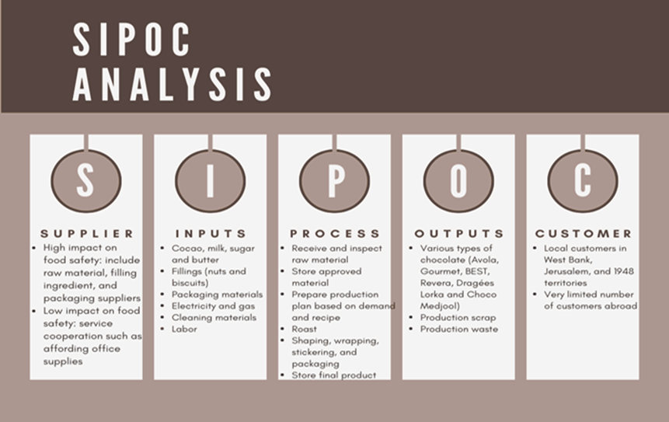
Define Phase
11
Process Flowchart
Define Phase
12
SIPOC gives a high-level view of chocolate production, linking suppliers, inputs, processes, outputs, and customers to ensure efficiency, quality, and food safety
Notes:
17

Slide 21


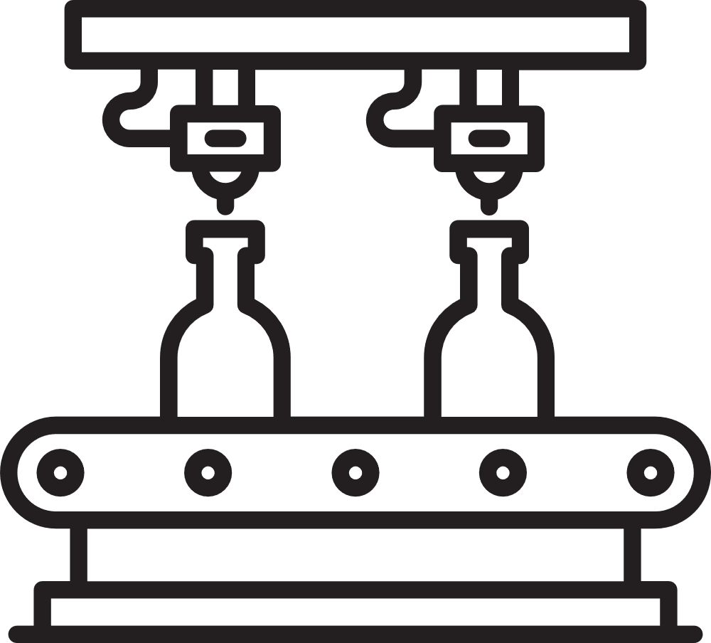


Define Phase
12
SIPOC gives a high-level view of chocolate production, linking suppliers, inputs, processes, outputs, and customers to ensure efficiency, quality, and food safety
Measure Phase
13
Die Exchange in KCM
Target: 15 min (rarely achieved)
Overlap: die + chocolate + filling changes
Machine: 4 dies → 3 nozzles + 1 nuts
Delays: poor planning / urgent orders / weak coordination
Project Goal: Reduce delays
Notes:
17

Slide 22
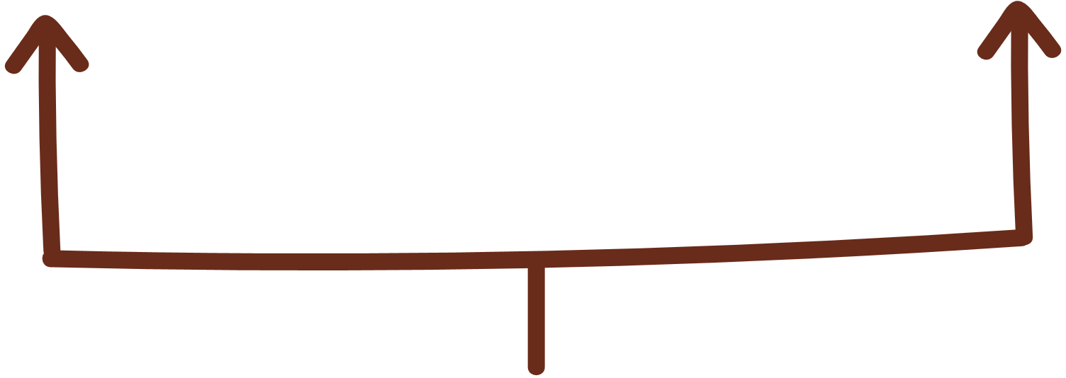



Measure Phase
13
Die Exchange in KCM
Target: 15 min (rarely achieved)
Overlap: die + chocolate + filling changes
Machine: 4 dies → 3 nozzles + 1 nuts
Delays: poor planning / urgent orders / weak coordination
Project Goal: Reduce delays
Measure Phase
14
Reasons for Delays
Acceptable
Unacceptable
  Poor planning
  Last‑minute production decisions
  Weak coordination between departments
  Switching filling type (instead of die)
  Ensuring cavities filled correctly
Notes:
17

Slide 23
Measure Phase
15
Measure Phase
14
Chocolate Change & Impact on Die Exchange
Reasons for Delays
Major Contributor to Long Changeover
Required Actions to Prevent Quality Issues
Cleaning
Mold Scraping
Removal of Contaminated Chocolate
Temperature Readjustment
Switching between chocolate colors (Dark ⇒ Milk)
Switching between chocolate types (Compound ⇒ Real)
Acceptable
Unacceptable
Problem: Color Contamination
Impact on Die Exchange
  Poor planning
  Last‑minute production decisions
  Weak coordination between departments
  Switching filling type (instead of die)
  Ensuring cavities filled correctly
Affects Taste
Affects Color
Affects Product Conformity
Process can extend to 30+ minutes
Notes:
17

Slide 24
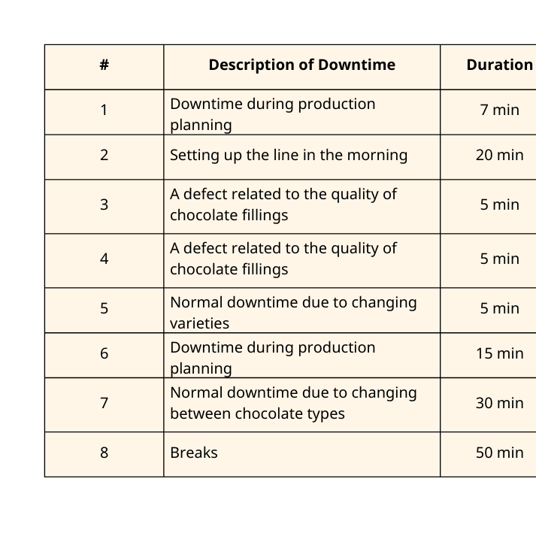
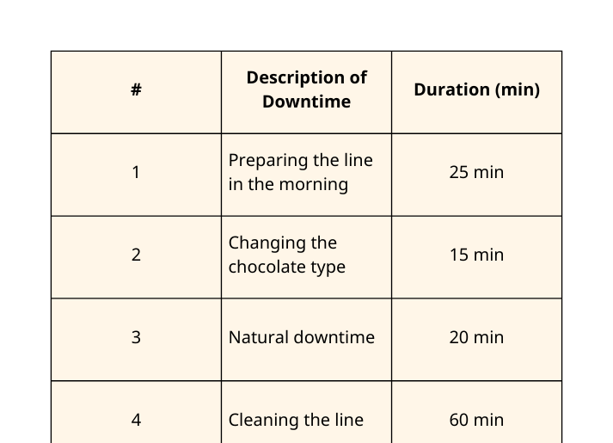
Measure Phase
15
Chocolate Change & Impact on Die Exchange
Major Contributor to Long Changeover
Required Actions to Prevent Quality Issues
Cleaning
Mold Scraping
Removal of Contaminated Chocolate
Temperature Readjustment
Switching between chocolate colors (Dark ⇒ Milk)
Switching between chocolate types (Compound ⇒ Real)
Problem: Color Contamination
Impact on Die Exchange
Affects Taste
Affects Color
Affects Product Conformity
Process can extend to 30+ minutes
Measure Phase
16
Monitoring Machine Downtime on the KCM Machine
  The One Shot production line was monitored over 22 operational days
Daily Machine Downtime Summary
(Production Quantity: 600 units, 3 Workers)
Daily Machine Downtime Summary
(Production Quantity: 2364 units, 3 Workers)
Total Downtime = 137 min
Total Setup Time = 87 min
Total Changeovers = 2 times
Total Downtime = 163 min
Total Setup Time = 120 min
Total Changeovers = 1 time
Notes:
17

Slide 25
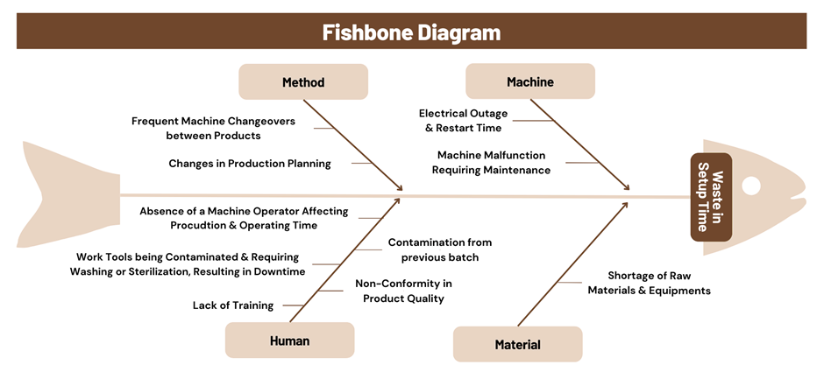
Measure Phase
17
Root Causes of Long Setup Time
Measure Phase
16
Monitoring Machine Downtime on the KCM Machine
  The One Shot production line was monitored over 22 operational days
Daily Machine Downtime Summary
(Production Quantity: 600 units, 3 Workers)
Daily Machine Downtime Summary
(Production Quantity: 2364 units, 3 Workers)
Total Downtime = 137 min
Total Setup Time = 87 min
Total Changeovers = 2 times
Total Downtime = 163 min
Total Setup Time = 120 min
Total Changeovers = 1 time
Notes:
17

Slide 26
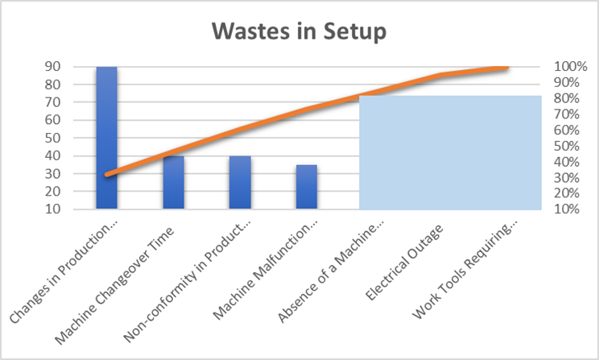
Measure Phase
17
Root Causes of Long Setup Time
Measure Phase
18
Pareto Chart
Pareto chart shows that most setup-time waste comes from a few major causes. Changes in production planning, Machine Changeover Time, Product Non-conformity, & Machine Malfunctions together account for about 73% of wasted time.
Notes:
17

Slide 27
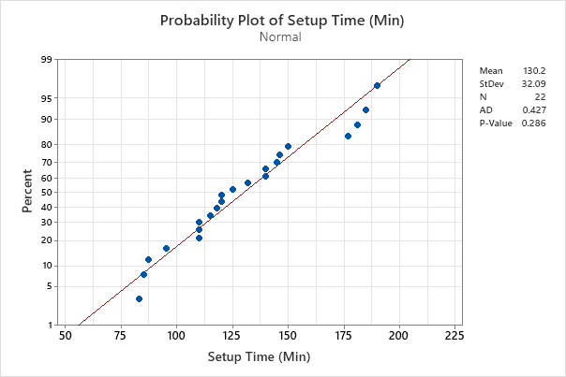
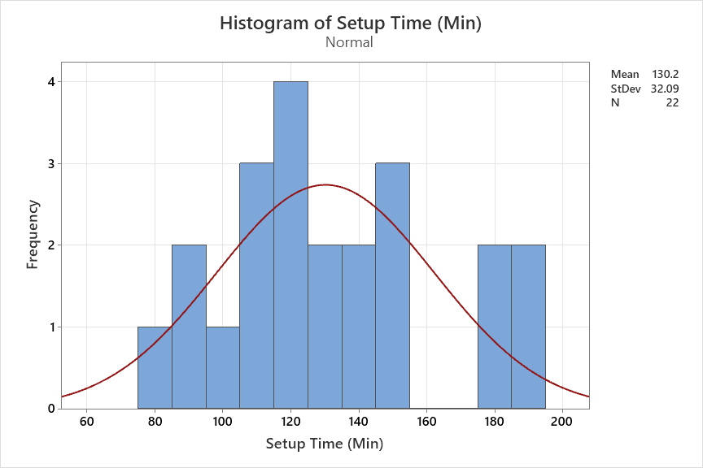
Measure Phase
19
Normality Assessment of Setup Time
Measure Phase
18
Pareto Chart
Normality test results show that the setup time data are normally distributed (p-value = 0.286 > 0.05). The histogram indicates setup times ranging from 80 to 200 minutes with noticeable variability, highlighting inconsistency in the process.
Pareto chart shows that most setup-time waste comes from a few major causes. Changes in production planning, Machine Changeover Time, Product Non-conformity, & Machine Malfunctions together account for about 73% of wasted time.
Notes:
17

Slide 28
Measure Phase
19
Normality Assessment of Setup Time
Normality test results show that the setup time data are normally distributed (p-value = 0.286 > 0.05). The histogram indicates setup times ranging from 80 to 200 minutes with noticeable variability, highlighting inconsistency in the process.

Slide 29
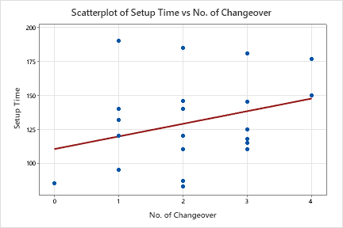
Measure Phase
20
Scatter Plot
The scatter plot shows a positive relationship between changeover frequency and setup time, where more changeovers lead to longer setup times and reduce One Shot Line efficiency.

Slide 30
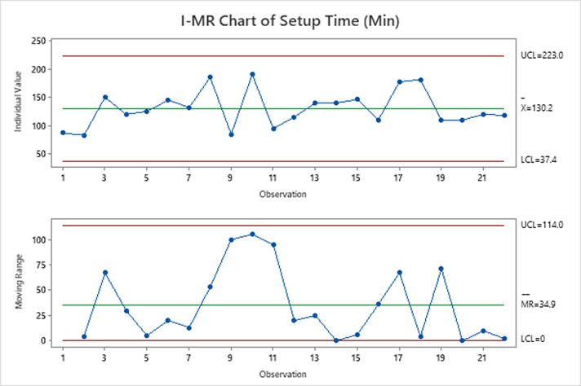
Analyze Phase
21
The I-MR chart shows high variability in setup time, with several points near the UCL (223 minutes)
Large MR spikes at observations 9-11 indicate significant process instability
I-MR Chart
The wide control limits (LCL = 37.4, UCL = 223) confirm that the setup process is not in control and requires improvement

Slide 31
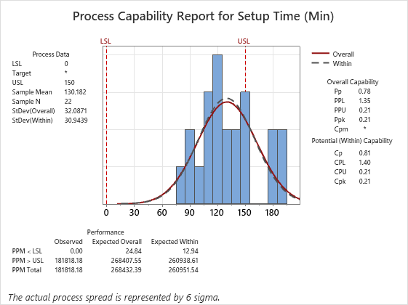
Improve Phase
23
Observe the Process
Review steps with all teams
SMED Analysis
Standardize Steps to reduce errors
Streamline Internal Steps
Analyze Phase
22
Externalize Changeover Steps
Process Capability Analysis
1
Process Capability Analysis performed with USL = 150 minutes
1
1
Setup time ranged from 83 to 190 minutes
1
1
1
Process mean is approximately 130 minutes
1
V
Capability indices are low (Cp = 0.81, Cpk = 0.21)
V
The process is not capable of consistently meeting the specification limit and needs improvement

Slide 32
Improve Phase
23
Observe the Process
Review steps with all teams
SMED Analysis
Standardize Steps to reduce errors
Streamline Internal Steps
Externalize Changeover Steps

Slide 33
Current Die Exchange Activities & Time Breakdown (Before SMED)
24
Step | Activity | Type | Time (min)
1 | Turn off KCM | Internal | 0.5
2 | Loosen & remove bolt (quick-release) of die | Internal | 1
3 | Lower & remove old die | Internal | 1.5
4 | Move old die aside to its assigned position through transport carts | Internal | 1.5
5 | A worker ensures that the required pistons used matches the die as specified in the die report | External with 4 | —
6 | Bringing the next die from the oven through carts, aligning it carefully, & inserting it in the KCM | Internal | 2.5
7 | Tighten bolts on new die | Internal | 2
8 | Clean chocolate & filling nozzles to ensure proper flow | Internal | 2
9 | Unclog & clean any blocked nozzle cavities | Internal | 1
10 | Cast a sample mold & inspect it for defects before production | Internal | 3
Total |  |  | 15 min

Slide 34
Improved Die Exchange Activities & Time Breakdown (After SMED)
25
Step | Activity | Type After | Time (min)
1 | Turn off KCM | Internal | 0.5
2 | Loosen & remove bolt (quick-release) of die | Internal | 1
3 | Lowering & removing old die | External | —
4 | Old die transported by helper after restart | External | —
5 | Staging the new die near the machine beforehand | External | —
6 | Align & insert new die using marked pins | Internal | 2.5
7 | Tighten bolts & alignment verification | Internal | 1.5
8 | Clean chocolate & filling nozzles to ensure proper flow | Internal | 2
9 | Unclog & clean any blocked nozzle cavities | External | —
10 | Cast a sample mold & inspect it for defects before production | Internal | 2.5
Total |  |  | 10 min
Improve Phase
26
SMED Applied
1. Converted to External
2. Internal Steps Improved (still internal but faster)
Tasks | Expected Saving
Lower & remove old die | 1.5 min
Transporting old die to storage after machine restarts by helper | 1.5 min
Preheating/cleaning nozzle cavities before die change | 1 min
Internal Steps | Before | After | Saving
Turn off KCM | 0.5 | 0.5 | —
Loosening & removing (quick-release) bolts | 1 | 1 | —
Align & insert new die | 2.5 | 2.5 | —
Cleaning chocolate & fillings nozzles | 2 | 2 | —
Tightening bolts | 2 | 1.5 | 0.5 min
Trial cast mold (standardized once) | 3 | 2.5 | 0.5 min

Slide 35
Improve Phase
27
Develop SOPs for the Production Line
Providing Raw Material & Work Instructions
Improve Phase
Machine Downtime Development
Future Developments
Improve Phase
26
SMED Applied
1. Converted to External
2. Internal Steps Improved (still internal but faster)
Tasks | Expected Saving
Lower & remove old die | 1.5 min
Transporting old die to storage after machine restarts by helper | 1.5 min
Preheating/cleaning nozzle cavities before die change | 1 min
Internal Steps | Before | After | Saving
Turn off KCM | 0.5 | 0.5 | —
Loosening & removing (quick-release) bolts | 1 | 1 | —
Align & insert new die | 2.5 | 2.5 | —
Cleaning chocolate & fillings nozzles | 2 | 2 | —
Tightening bolts | 2 | 1.5 | 0.5 min
Trial cast mold (standardized once) | 3 | 2.5 | 0.5 min

Slide 36
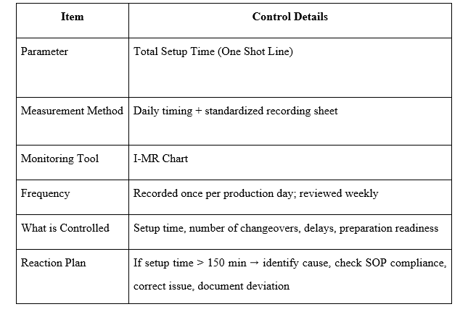
Control Phase
Improve Phase
27
28
Control Plan for Monitoring Setup Time
Develop SOPs for the Production Line
Providing Raw Material & Work Instructions
To maintain performance monitoring of the One-Shot line
Improve Phase
To document common setup times, changes in setup times, and any potential problems in the setup process
Machine Downtime Development
Future Developments
Operators will write the setup times and changeovers daily, shift supervisors will authenticate the documents, and the system will be in control

Slide 37
Control Phase
28
Control Plan for Monitoring Setup Time
To maintain performance monitoring of the One-Shot line
To document common setup times, changes in setup times, and any potential problems in the setup process
Operators will write the setup times and changeovers daily, shift supervisors will authenticate the documents, and the system will be in control

Slide 38
Conclusion
&
Recommendations
Conclusion
29
Through the use of structured root-cause tools - such as Pareto analysis, I-MR charts, & Process Capability studies - the sources of loss became clearer, enabling more precise and effective improvement intervention
The introduction of standardized procedures (SOPs), SMED techniques, & Improved Workflow Organization successfully eliminated non-value-added internal activities and accelerated setup progression
Integrating Lean Six Sigma into chocolate manufacturing environments can substantially enhance productivity, reduce waste, and strengthen operational reliability

Slide 39
Recommendation
30
1
Strengthening Standardization & Documentation
2
Implementing Continuous SMED Development
3
Improving Production Scheduling & Communication
4
Enhancing Worker Training & Skill Utilization
5
Keeping the Process Applying Control Charts
Conclusion
29
Through the use of structured root-cause tools - such as Pareto analysis, I-MR charts, & Process Capability studies - the sources of loss became clearer, enabling more precise and effective improvement intervention
The introduction of standardized procedures (SOPs), SMED techniques, & Improved Workflow Organization successfully eliminated non-value-added internal activities and accelerated setup progression
Integrating Lean Six Sigma into chocolate manufacturing environments can substantially enhance productivity, reduce waste, and strengthen operational reliability

Slide 40

Recommendation
30
1
Strengthening Standardization & Documentation
2
Implementing Continuous SMED Development
3
Improving Production Scheduling & Communication
4
Enhancing Worker Training & Skill Utilization
5
Keeping the Process Applying Control Charts
Thank You !!

Slide 41
Thank You !!

