Slide 1
An Integration Design for A Wedding Hall
Prepared By:
Anan Fattouh
Bahaa Shalhoub
Haya Qtait
Supervisor: Dr. Ahmed Al Haj Saleh

Slide 2
Contents of presentation
Project Description
Architectural Design
Environmental Design
Structural Design
Electrical Design
Mechanical Design
Project Management &Quantity Surveying

Slide 3
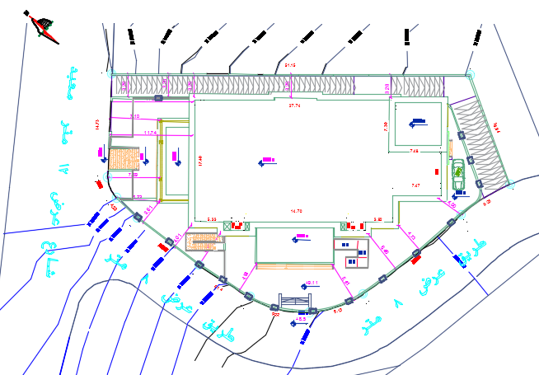
Project Site
The project is a wedding hall with an area of 3790 square meters, the total area for land is 1477 m2, and is located in two different streets on BeitWazan road west of Nablus, where the hall is about 7 km from the city center.

Slide 4
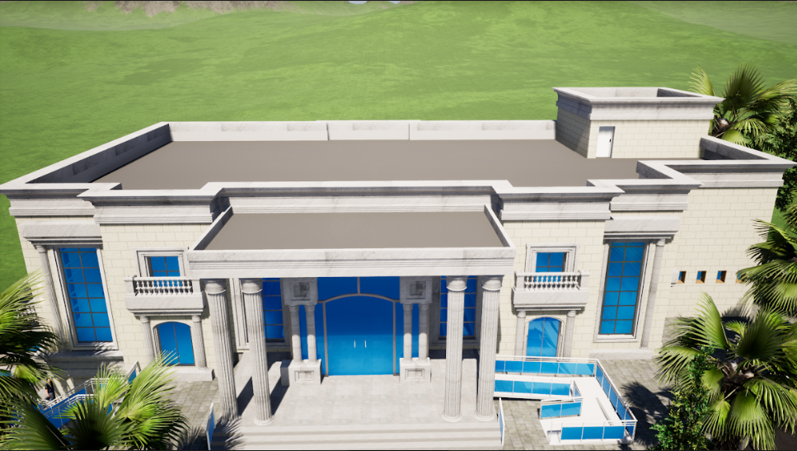
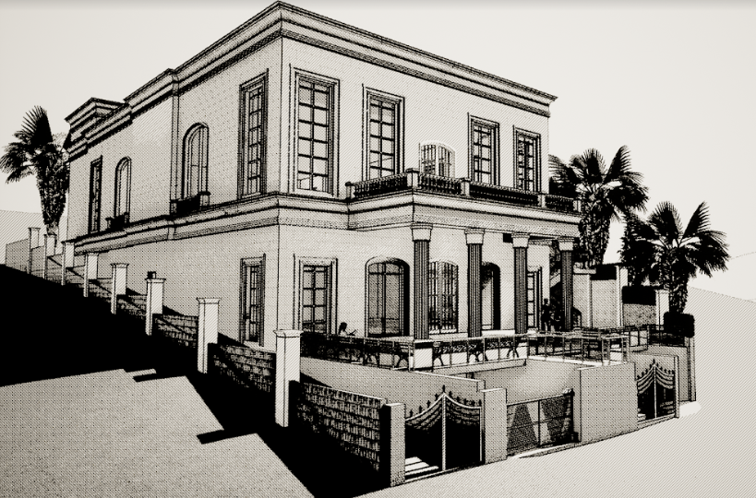
Project Description
It consisting of three floors: main hall, men's hall, parking and public services department, and the halls are designed to serve more than 500 people.

Slide 5
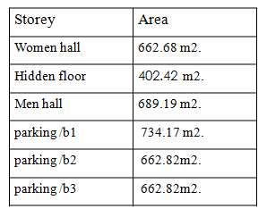
Project Description
Zones in the building:
Main hall.
Men hall.
Parking’s.
Administration room.
Kitchen.
Store.
Water closets.
Lobby, corridors and entrance.
Staircases.
Control room.
Service room.

Slide 6
Architectural design

Slide 7
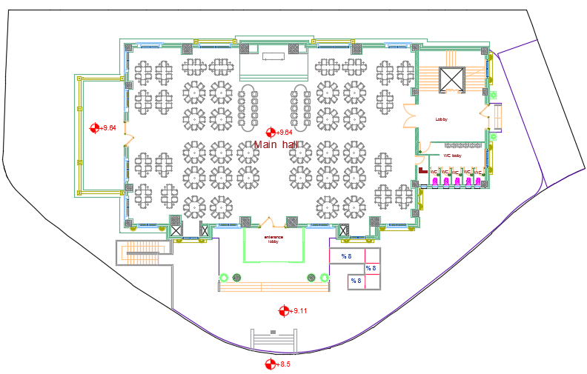
Architectural Design
First floor plan

Slide 8
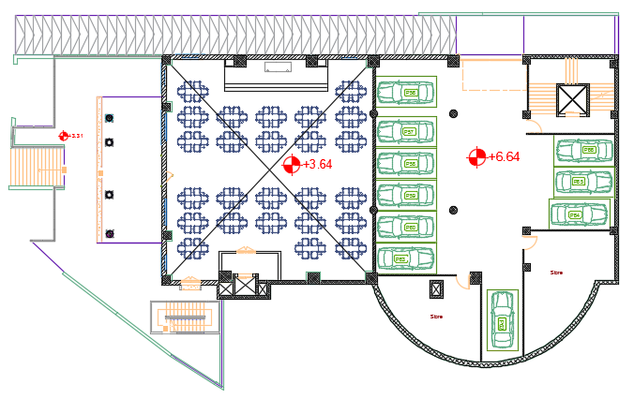
Architectural Design
Hidden floor plan

Slide 9
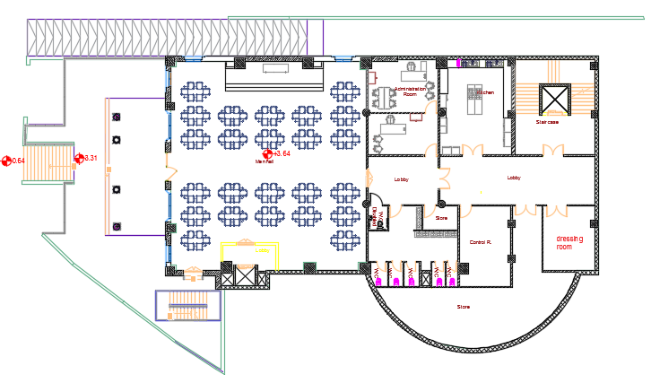
Architectural Design
Ground floor plan

Slide 10
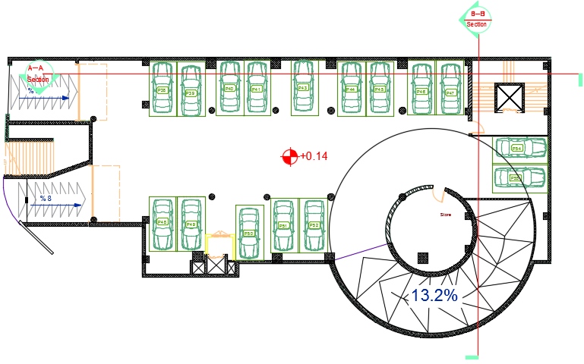
Architectural Design
First basement plan

Slide 11
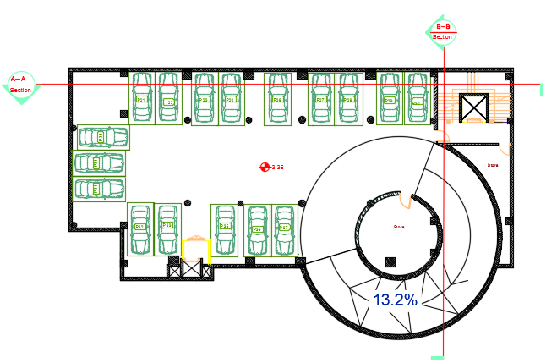
Architectural Design
Second basement plan

Slide 12
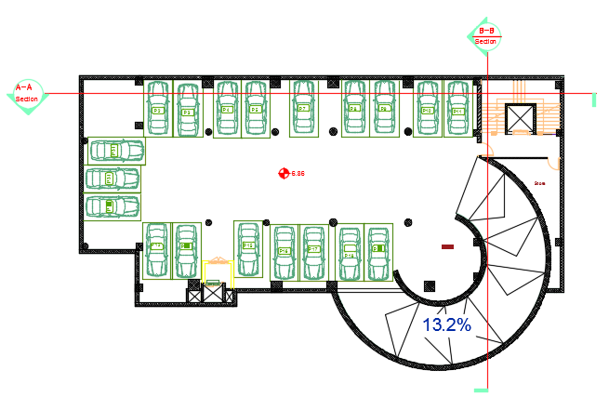
Architectural Design
Third basement plan

Slide 13
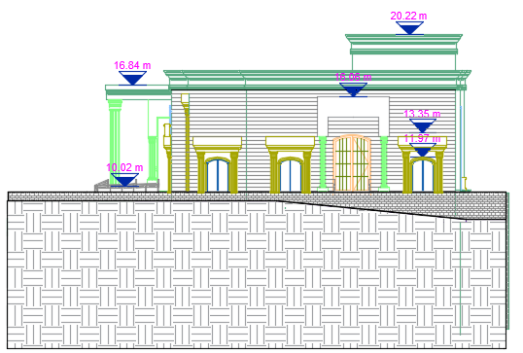
Architectural Design
South east elevation

Slide 14
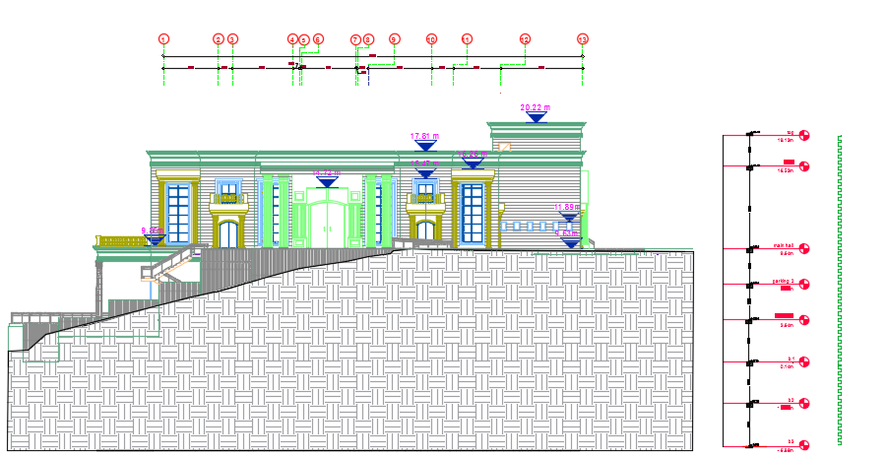
South west elevation
Architectural Design

Slide 15
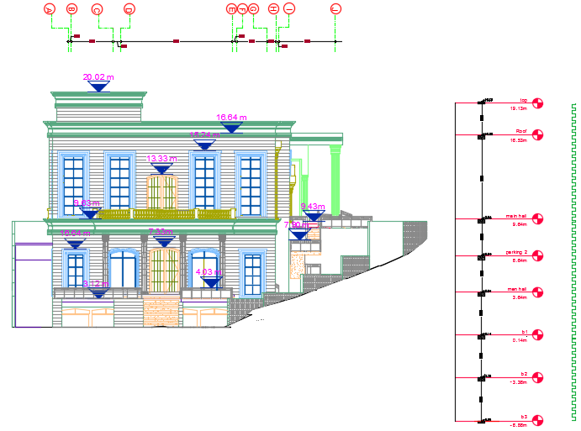
North western elevation
Architectural Design

Slide 16
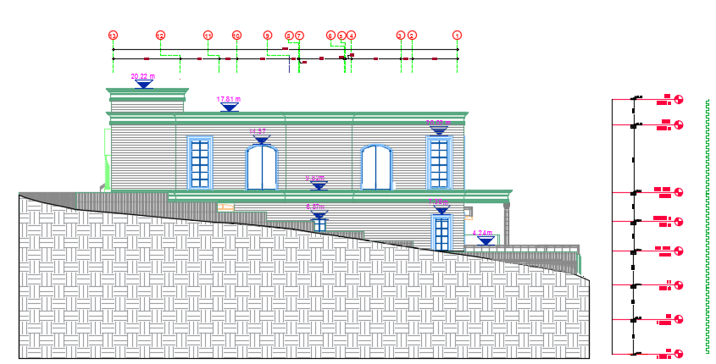
North east elevation
Architectural Design

Slide 17
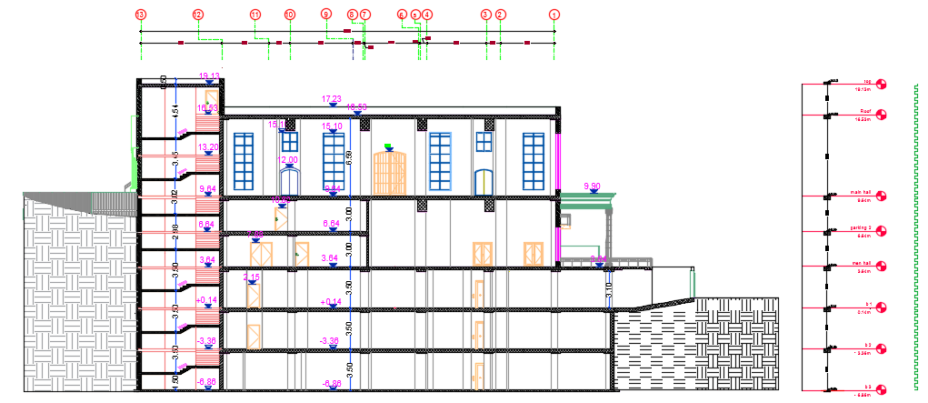
Section A-A
Architectural Design

Slide 18
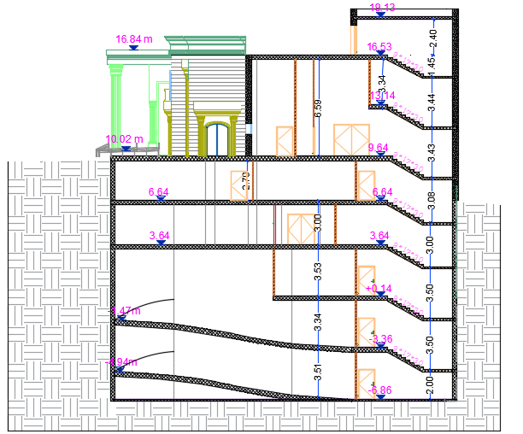
Section B-B
Architectural Design

Slide 19
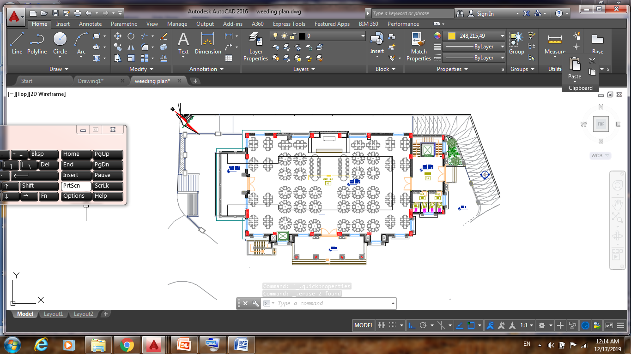
Comparison between old design and new design
main hall
Before modifications
After modifications

Slide 20
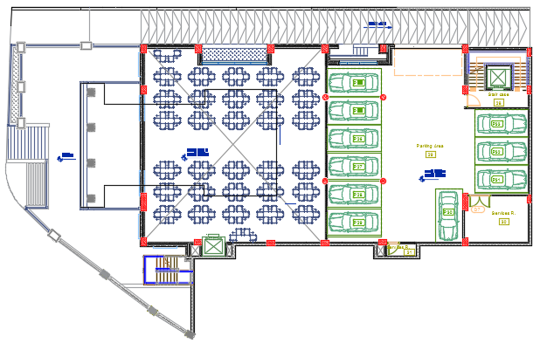
Comparison between old design and new design
Hidden floor.
Before modifications
After modifications

Slide 21
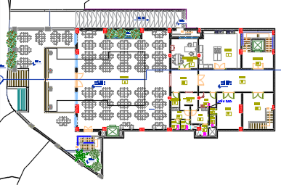
Comparison between old design and new design
men hall
Before modifications
After modifications

Slide 22
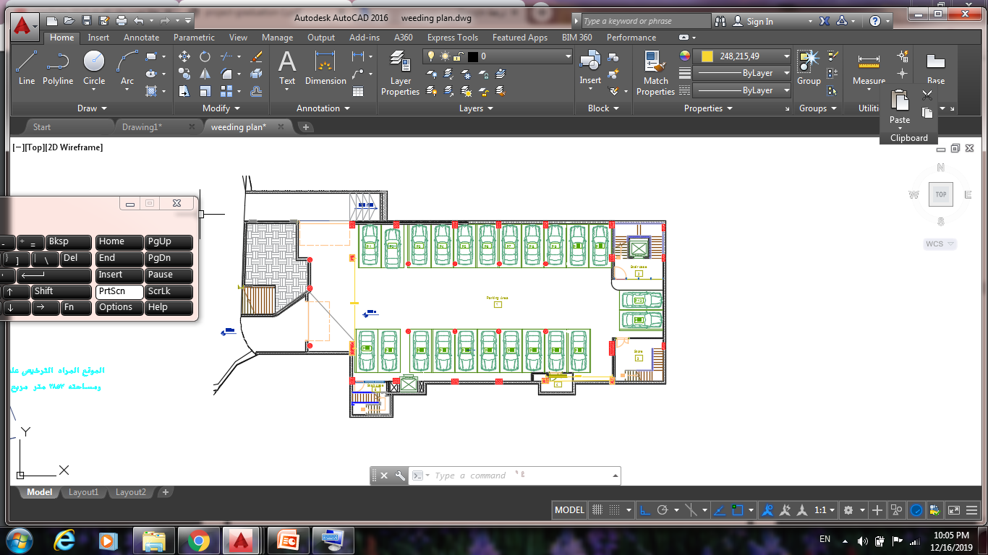
Comparison between old design and new design
parking
Before modifications
After modifications

Slide 23
parking
The new parking: Second basement
The new parking: Third basement

Slide 24
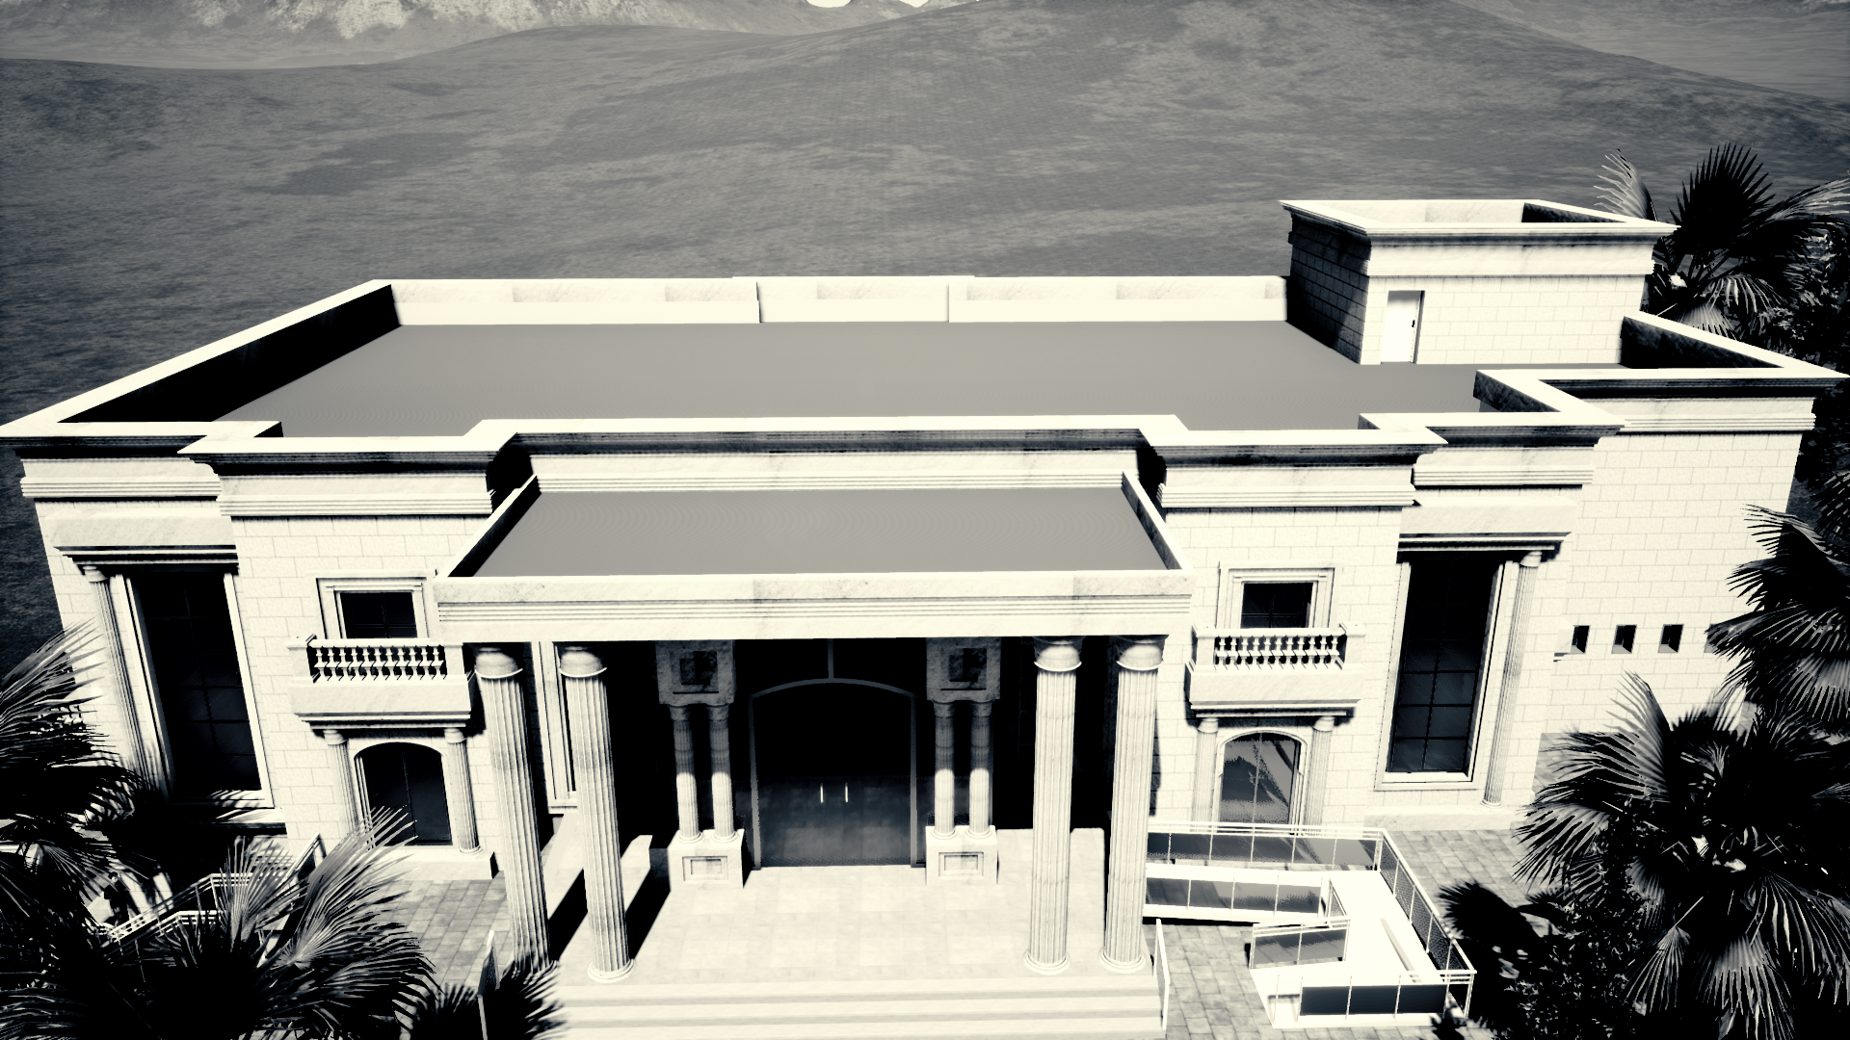

Slide 25
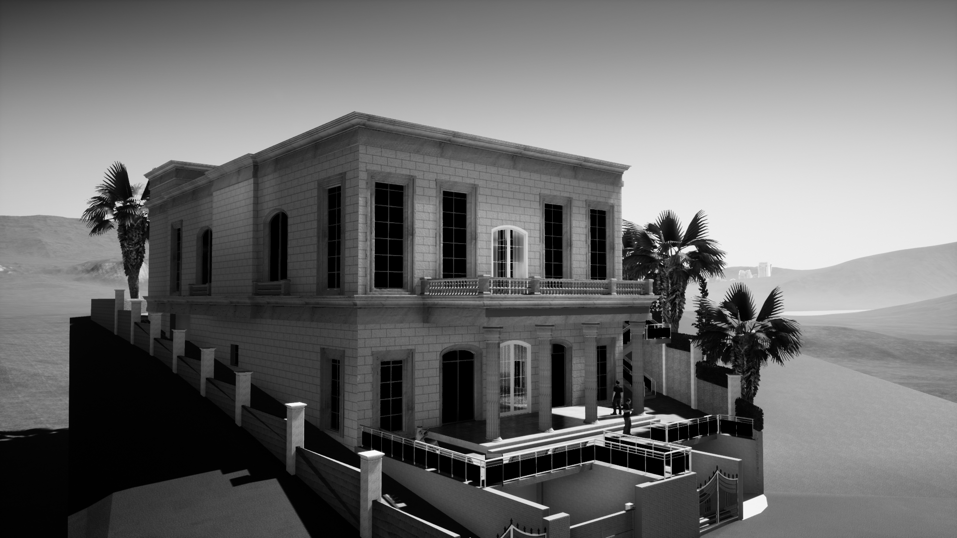
Render for the Wedding Hall

Slide 26
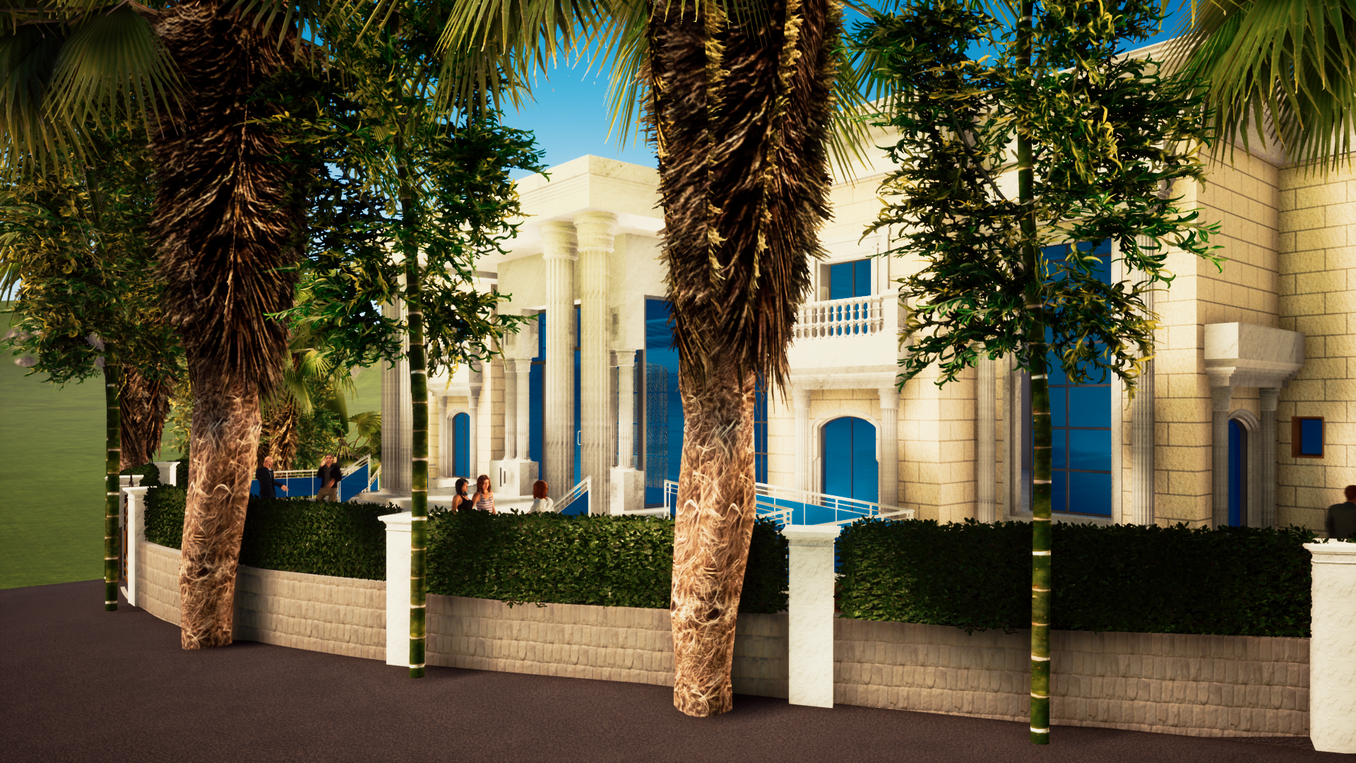

Slide 27
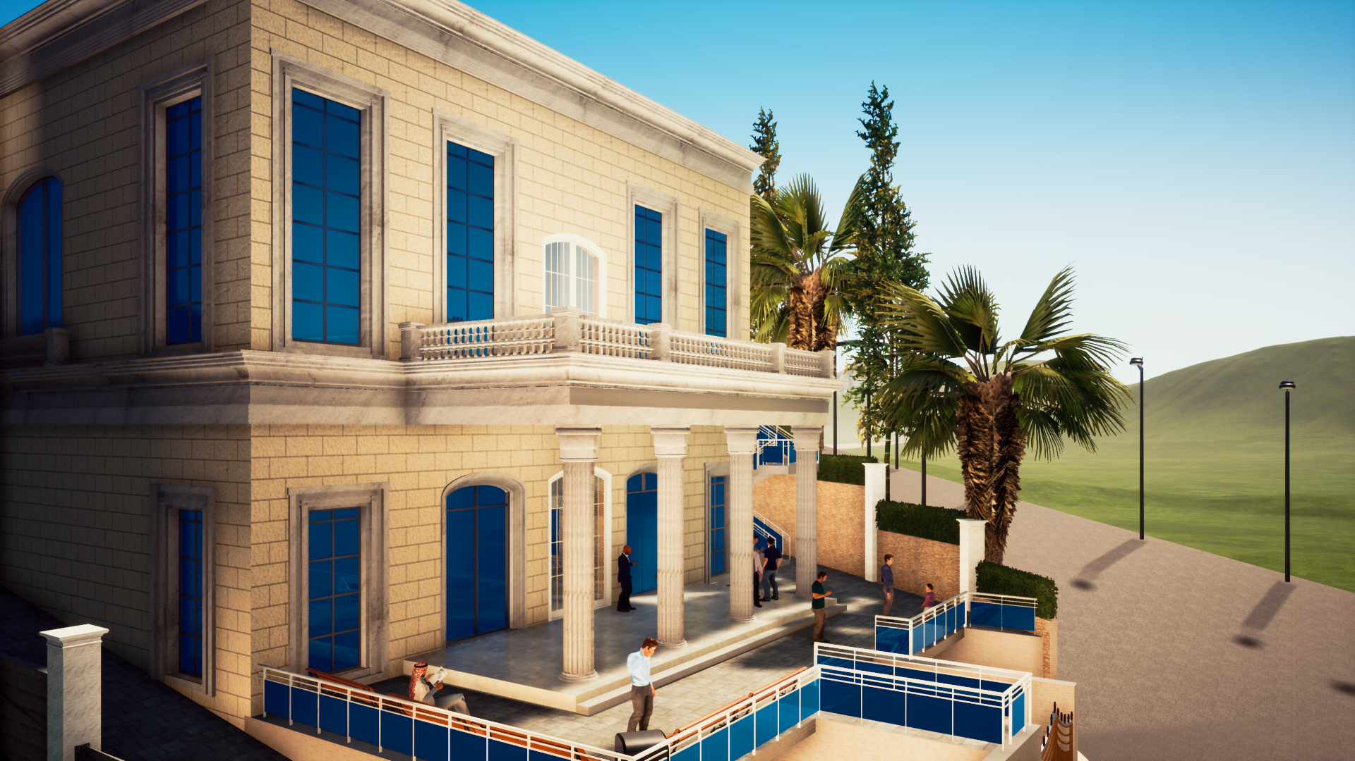

Slide 28
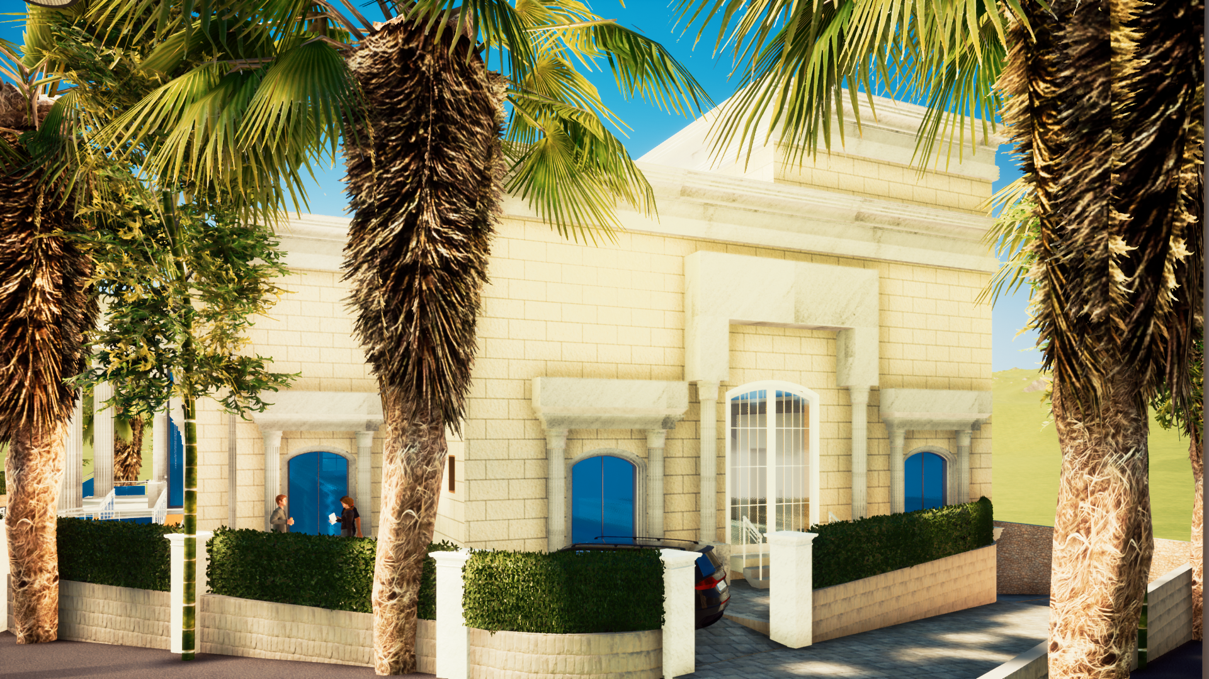

Slide 29
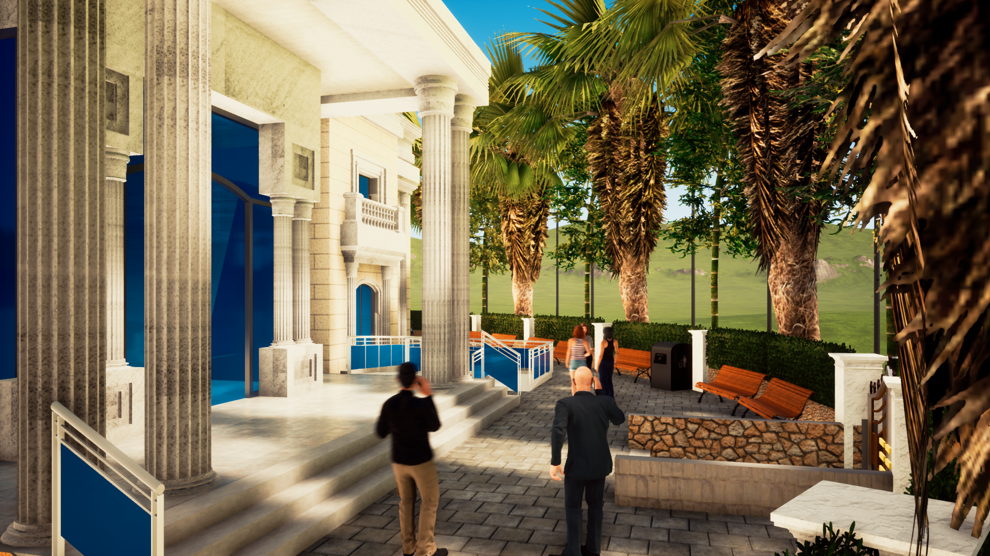

Slide 30
Environmental Design

Slide 31
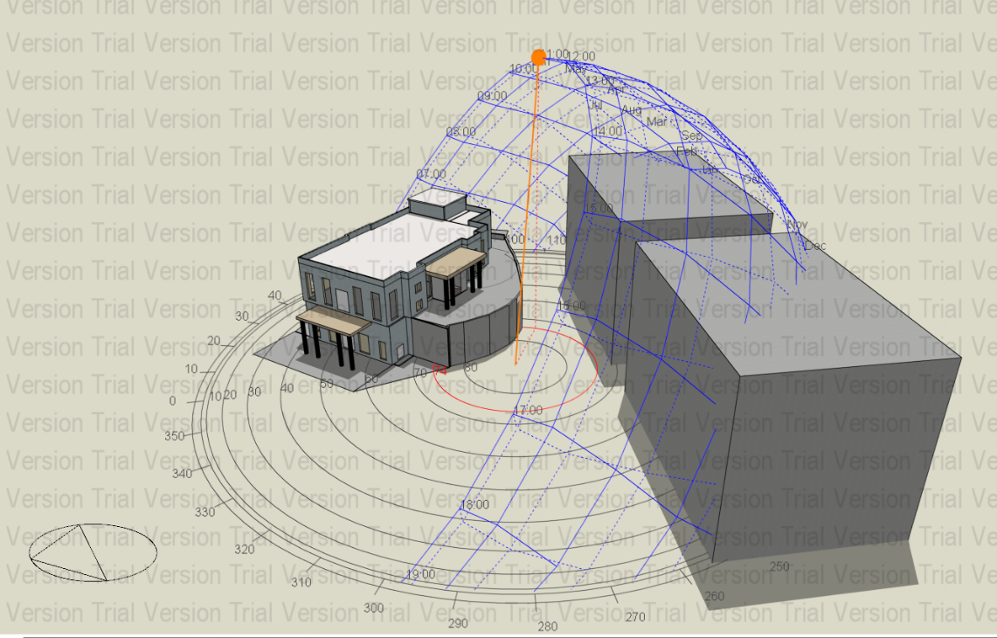
Design Builder
The model of the Hall from Design Builder
After

Slide 32
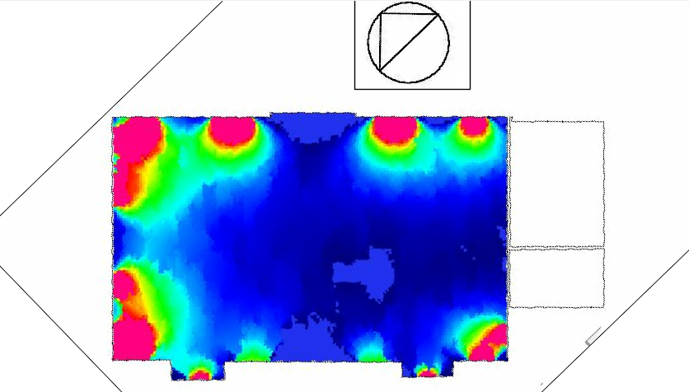
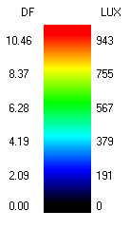
Daylight analysis for the model for the first floor
First Floor

Slide 33
Thermal Design

Slide 34
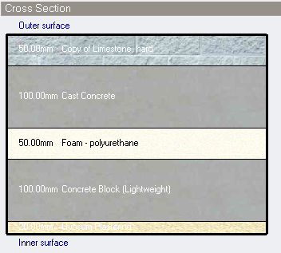
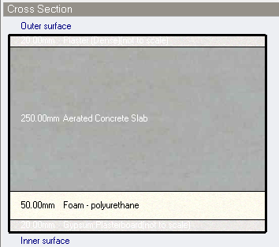
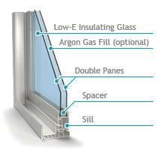
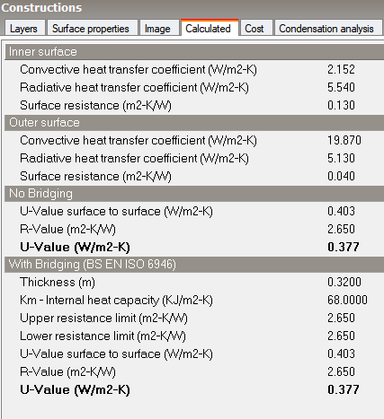

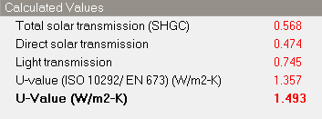
Summary for the materials that were used in the walls and slabs in the Hall.
External wall
slabs
Windows

Slide 35
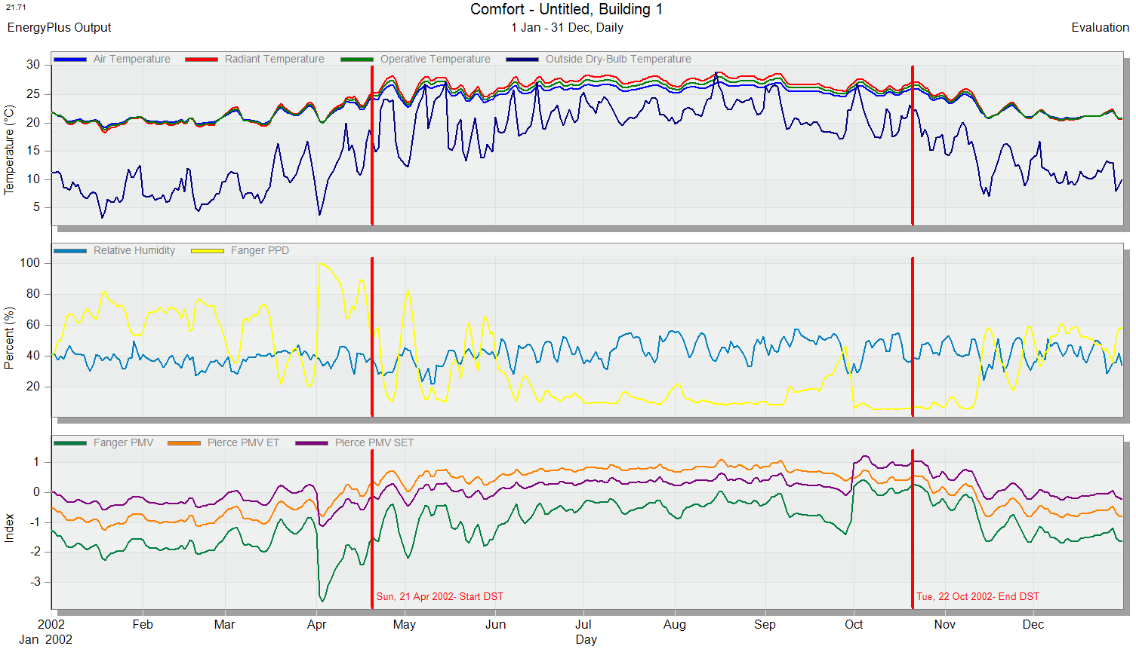
The comfort graph for the faculty from Design Builder

Slide 36
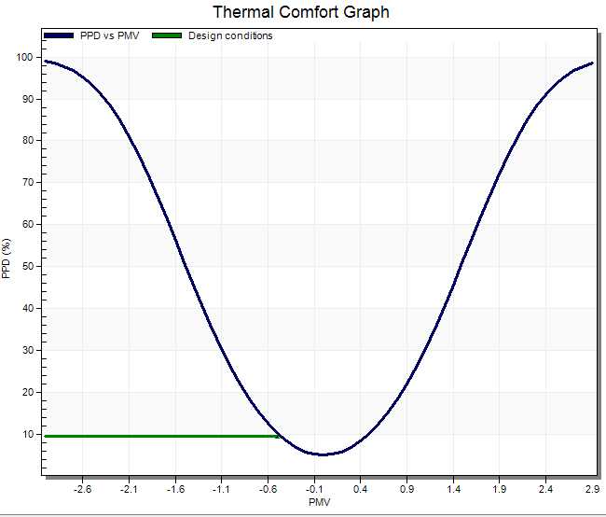

According to “pierce PMV SET-the predicted mean vote” the value is = - 0.47 (between -0.5 &0.5)
% people dissatisfied (PPD) =9.47 <10%

Slide 37
PV s analysis and design

Slide 38
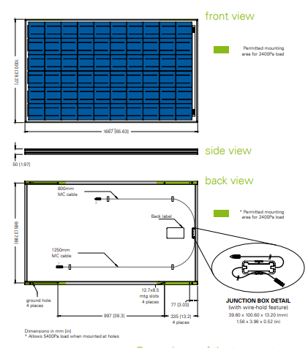
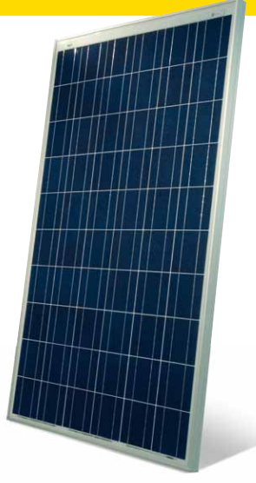
The module are used:
225W Photovoltaic module BP 3225T:

Slide 39
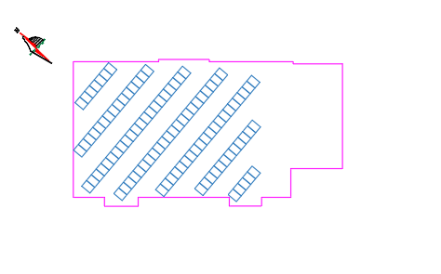
Tilt portrait configuration: 100 modules
we will use 100 modules 5 strings each string with 20 modules.
And using 5 inverters each with a capacity of 3.8kw (320V-630V) operating voltage.
Modules
Number of modules used | 100
Area (m^2) | 147
Capacity | 22.9 kwp
Produced energy | 39.85 MWH/YEAR
Immp | 41.6 A
Capacity | 3.8 kw
Operating voltage | 320-630 volt
Number of inverters | 5

Slide 40
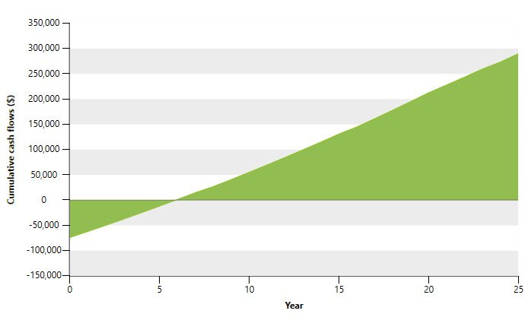
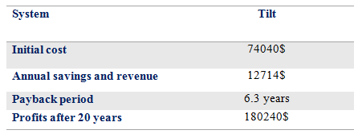
Cash flow diagram:

Slide 41
Structural
Design

Slide 42
Structural Design
This structural design was done by using the following codes:
ACI-318R-14 for reinforced concrete structural design
ASCE 7 2010 for load combinations
UBC – 97 for earthquake design

Slide 43
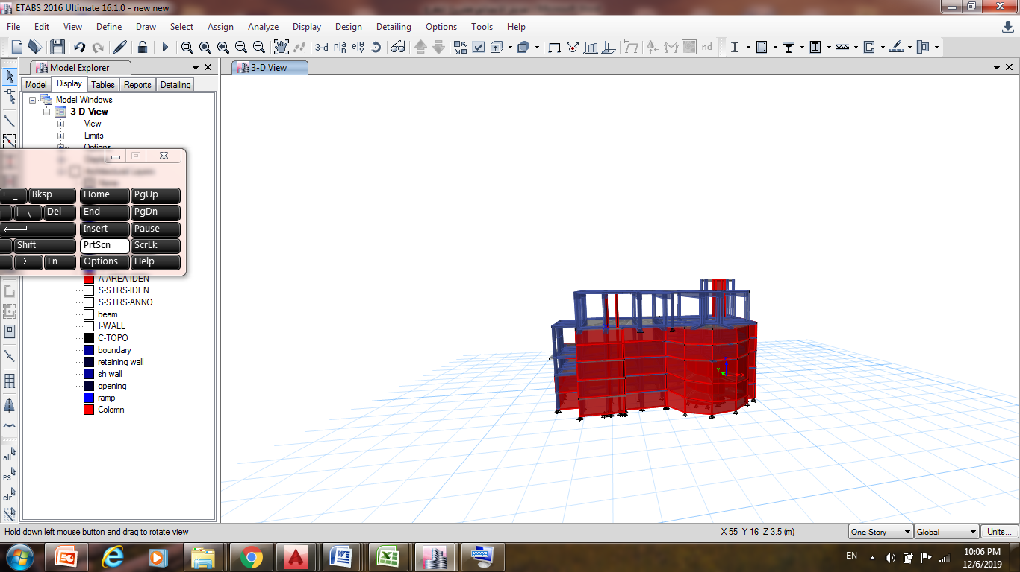
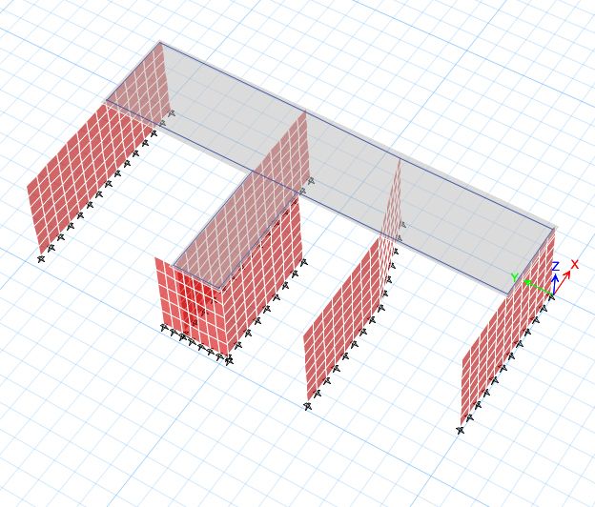
Structural Design
The building consists of two blocks that were separated due to the difference in the levels of block.
Block 1
Block2

Slide 44
Structural Design
Block1:
The Structural system used in this project is one way solid slab with dropped beams and some of spans are 2way solid slab.
3D Model in Etabs

Slide 45
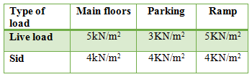
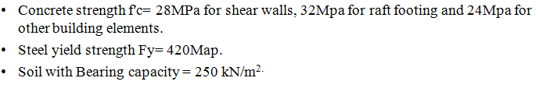
Design data
Loads
Materials used in this project:

Slide 46
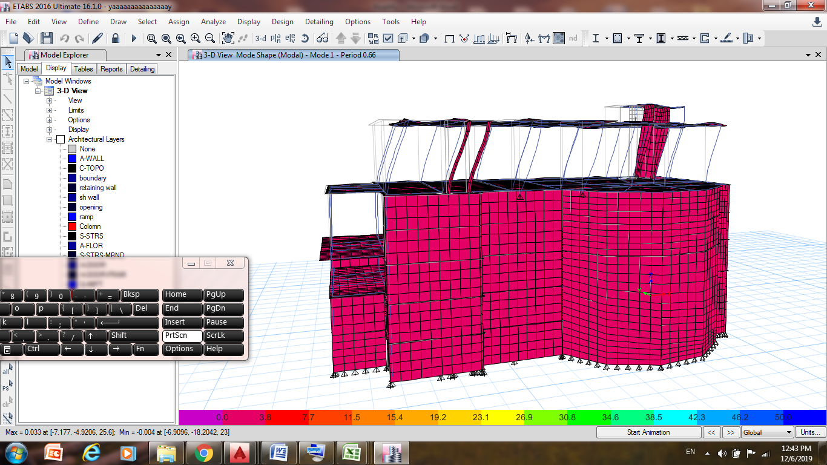
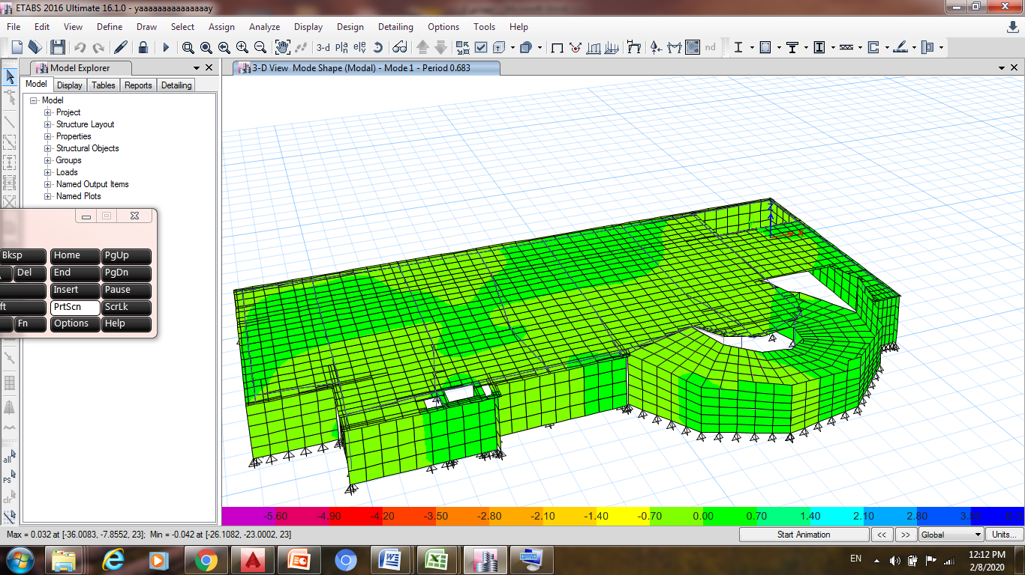
3D model in ETABS
Structural Design
Etabs checks:
1.Compatibility check is ok.

Slide 47
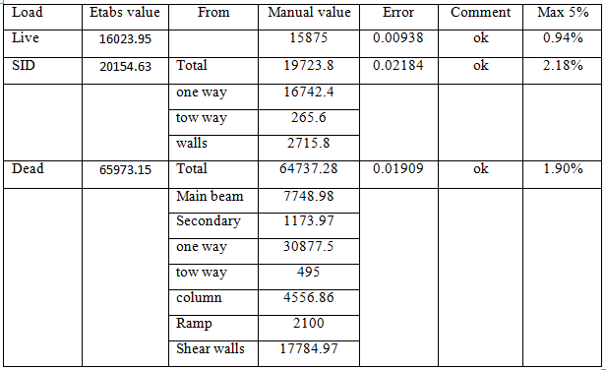
Structural Design
Etabs checks:
2. Equilibrium check is ok.

Slide 48
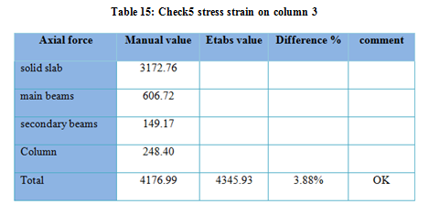
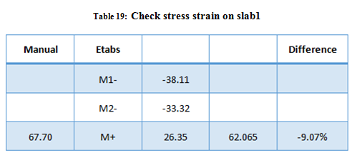

Structural Design
Etabs checks:
3. Checks stress strain
Check is ok.

Slide 49

Design data
Seismic design data

Slide 50


Structural Design
Etabs checks:
1. Time period check

Slide 51

Structural Design
Etabs checks:
2. Base shear check
check is OK

Slide 52


Structural Design
Etabs checks:
3. Drift check

Slide 53


Slab and beams deflection in Sixth floor.
Etabs checks:
4. Deflection Check

Slide 54

Slab Design
Slab reinforcement for story6

Slide 55

Slab design
Slab reinforcement for story1, 2&3

Slide 56


Slab section:
Structural Design

Slide 57


Columns :
Structural Design
Columns centre lines plans

Slide 58

Columns :
Structural Design
Columns detailing table

Slide 59



Columns :
Structural Design
Figure 147: Columns sections
Figure 148: Longitude & horizontal Sections in column 90*90 cm.

Slide 60


Structural Design
Beams :
First floor beams
Hidden floor beams

Slide 61


Structural Design
Beams :
Ground floor beams
First basement beams

Slide 62

Structural Design
Beams :
basement 2&3 beams

Slide 63


Beams :
Structural Design
Longitude & Horizontal Sections in beam2.

Slide 64

Beams :
Structural Design
Horizontal Sections in all beams

Slide 65

Structural Design
Shear walls :
Location of shear wall

Slide 66

Structural Design
Shear walls :

Slide 67


Structural Design
Shear walls detailing :
Horizontal section in shear wall 1
Vertical section in the shear wall1& mat footing

Slide 68

Structural Design
Basement wall design

Slide 69

Structural Design
Basement wall design

Slide 70

Structural Design
Basement wall detailing

Slide 71


Stairs design :
Structural Design
detailing of stair

Slide 72


Structural Design
foundations:
Footing in block1

Slide 73

Structural Design
foundations:
Single footing :

Slide 74


Structural Design
foundations:
Single footing :
Horizontal & Vertical section at F3

Slide 75

Structural Design
foundations:
Mat footing :

Slide 76



Mat footing Checks:

Slide 77


Mat footing Checks:
Wide shear checks
Punching shear checks

Slide 78

Detailing for mat footing :
The reinforcement in the mat footing in the X-direction

Slide 79

Detailing for mat footing :
The reinforcement in the mat footing in the Y-direction

Slide 80

Detailing for mat footing :
Longitudinal section in Raft

Slide 81


Slide 82
Electro-Mechanical Design

Slide 83










Artificial lighting
      The selected Luminaires
    Lighting with switches

Slide 84





Illuminance result from DIALux evo for the main hall .

Slide 85






Result from DIALux evo for the ground floor.
Kitchen
Office
Lobby WC
Lobby
Men's hall

Slide 86


Result from DIALux evo for the site.

Slide 87




Sockets plan for the kitchen & offices
The electrical load of power, lighting and loud speaker system in the ground floor
  Distribution boards in all floor of the building

Slide 88


The electrical load of power, lighting and loud speaker system in the main distribution board 1
The electrical load of elevators and HVAC system in the main distribution board 2

Slide 89
Acoustical Design

Slide 90

The spaces that were designed acoustically in the facility
  Main hall
  Men's hall
The absorption coefficient for the finished material

Slide 91


Reverberation time(RT60):
The reverberation time for the main hall according to Sabine
The limit of the reverberation time in the hall (1.5 - 2.5)
The reverberation time for the men's hall according to Sabine
The limit of the reverberation time in the hall (1.5 - 2.5)

Slide 92





Sound Transmission Loss (STC)
The sound transmission loss (STC) for the internal walls between different spaces in the faculty is more than the limit = 45 dB (Egan, n.d.)
The OITC for the external walls = 59dB more than the standard = 55 dB (Egan, n.d.), so it is ok for the external walls

Slide 93


Impact Insulation Class (IIC)
The Impact insulation class for the floor = 60 dB and the calculated IIC for the floor should be more than 50 dB, so it is ok.

Slide 94



Loud speaker
The direct SPL distribution in the main hall
Main hall

Slide 95
HVAC system

Slide 96


HVAC system
Using VRF (Variable Refrigerant Flow) HVAC system
The components of this system is from Daikin company.
Form Design Builder program results for the building:
The total heating load capacity = 54 kW
The total cooling load capacity = 117 kW.
The outdoor unit will be chosen according to cooling load due to larger load than heating load. Using from Daikin company the outdoor unit VRV IVX(REYQ408XA) model with 34 (ton) capacity.

Slide 97

Indoor unit selection
Fan coil units will be selected according to design capacity and volumetric flowrate for each space, which was obtained for Design builder program:-
Block | Design capacity (kw) | Flow rate (m³/s)
Men Hall | 20.87 | 1.27
Offices | 26.85 | 1.07
Main Hall | 69.94 | 4.08
Totals | 117.66 | 6.42
The Total volumetric flow rate is 6.42 m³/s. Two indoor units used in Men hall with 4-Ton capacity and four for main hall with 6Ton capacity. The Fan coil selected from Daikin Company.
Daikin Fan coil .

Slide 98


Diffuser
Ducts sizing
By using Revit duct size will be calculated depending on airflow for each diffuser with maximum duct height is 45cm.
Figure 14 : 3d model for linear diffuser

Slide 99

The distribution of the ducts and diffusers in the first floor.

Slide 100

The distribution of the ducts and diffusers in the ground floor .

Slide 101


Car parking ventilation
First basement floor ventilation
Second and third basement floor ventilation

Slide 102
Mechanical Design

Slide 103

Mechanical system
Water consumption
The daily Usage = total persons in the building *( Litres per head per day ,from the table
= 520 * 15 = 7800 liter/day
. Assuming the water supply from Water Authority is every 5 days
5* 7800 =39000 Liter
the total number of tanks needed is four tanks.
manual water supply and treatment

Slide 104

Water supply system
Zone 1:- W.C
zone 1 (w.c) | Fixture type | occupancy | type of supply | Number | Fixture unit | Total
Main hall floor | w.c | Public | Flush tank | 5 | 5 | 25
Men's hall floor | w.c | Public | Flush tank | 6 | 5 | 30
Total (F.U) |  |  |  |  |  | 55
Total number of F.U’s = 55 F.U $→GPM=30$
Diameter of the pipes for zone 1
Zone 1 (wc) | Diameter | losses
Vertical pipe | 2 | 1.14
Horizontal pipe | 1 | 3.16
Branch pipe | 0.75 | 0.746
Total loss |  | 5.046 Psi

Slide 105


Zone 2:- Lavatory
zone 2 (Lavatory) | Fixture type | occupancy | type of supply | Number | Fixture unit | Total
Main hall floor | Lavatory | Public | Faucet | 6 | 2 | 12
Men's hall floor | Lavatory | Public | Faucet | 12 | 2 | 24
Total (F.U) |  |  |  |  |  | 36
Total number of F.U’s = 36 F.U $→GPM=23$
Diameter of the pipes for zone 2
Zone 2 (wc) | Diameter | losses
Vertical pipe | 2 | 1.26
Horizontal pipe | 1 | 3.11
Branch pipe | 0.5 | 0.8
Total loss |  | 5.17 Psi

Slide 106

Drainage system
6'' diameter pipes between manholes.
2" diameter horizontal pipe for Kitchen Sink which connects the floor drain.
2" diameter horizontal pipe for lavatory which connects the floor drain.
4'' diameter for stacks.
4" diameter horizontal pipe for Water closet (W.C) which connects the main drainage.

Slide 107

Rain water on roof

Slide 108

Drainage pipes and manhole on the First floor
1- Storm water manhole: (green).
2- Gray water manhole: (blue).
3- Black water manhole: (black).

Slide 109
Firefighting and Safety

Slide 110





Components of fire fighting system
1. Extinguisher
2-Fire alarm system
3- Smoke detector
4- Hose station
5- Sprinkler system

Slide 111



Slide 112

The evacuation plan for first floor

Slide 113

The evacuation plan for ground floor

Slide 114
Quantity Surveying and Cost Estimation

Slide 115
Quantity Surveying
The total cost of the faculty is 6,578,185 NIS and the total area of the facility building is 3790 m² which means that the total unit cost per m² is 1736 NIS/ m².
Sub Structure Work | 1307402 NIS
Super Structure | 1833400 NIS
Finishes Work | 2273424 NIS
Electrical work | 873564 NIS
Mechanical work | 290395 NIS

Slide 116
Percentage for each work from total cost of the facility

Slide 117


