Slide 1
An-Najah National University
Faculty of Engineering
Electrical &Telecommunication Engineering Department
Distance Protection and Monitoring Of a prototype Power Substation Using GSM Technology
Supervisor:
Dr.Kamel
by:
Azhar Jaber
Israa Salem

Slide 2
Contents:
•Introduction.
• Existing Problems.
Objectives.
Methodology.
Hardware Implementation.
Software Implementation.
Result and Discussion.
• Advantages.
• Applications.
• Conclusion.

Slide 3
Introduction
♦ Distance protection is one of the most important and sophisticated forms of substation protection.
♦ A power system consists of different components such as generators, transmission lines, transformers (step up and step down), loads, switches and capacitor banks.
♦ The degradation of the quality of the power supplied by the substation is quickly detected and a appropriate action is done to recover the quality of the power

Slide 4
Existing Problems
♦ Sometimes when the power substation site far and need to monitor and control the equipment exist there.
♦ If we had a sudden interrupt of this equipment maybe damage it. So we need something practical to monitor and control power substation equipment remotely.
♦ In this project we decide to build a system which can provide a remote monitoring and control for the power substation by using GSM wireless communication.

Slide 5
Objective
♦ The objective of this project is to maintain the power quality of substation system by developing a wireless communication link to monitor and control equipment.
♦ To allow an accessible remote control of devices all over the world through the use of GSM modem that is attached and connected by a mobile phone

Slide 6
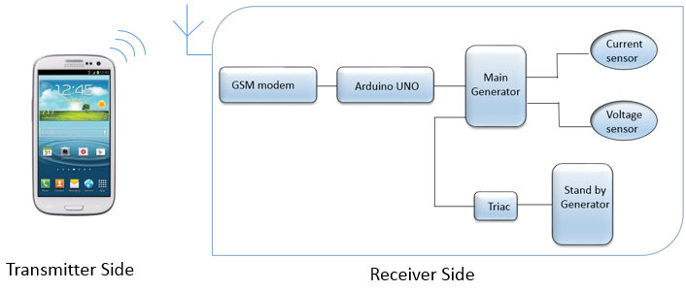
Methodology
The system has to be inserted between the user and the substation it consist of transmitter and receiver.

Slide 7
Components
♦ Arduino Uno:
The Arduino Uno is a microcontroller board based on the ATmega328, it has 14 digital input/output pins (of which 6 can be used as PWM outputs), 6 analog inputs, a 16 MHz ceramic resonator, a USB connection, a power jack, an ICSP header, and a reset button.

Slide 8
Components
♦ GSM Modem (SIM 900) :

Slide 9
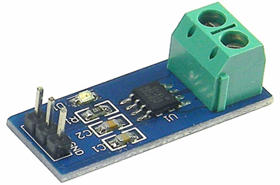
Components
♦ Current Sensor (ACS721 ):

Slide 10
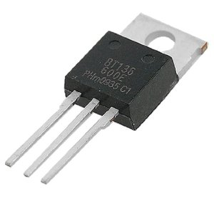
Components
♦ Electrostatic Switch (Triac) :
Is a member of the THYRISTOR family can be used for protecting the transformer instead of using relays

Slide 11
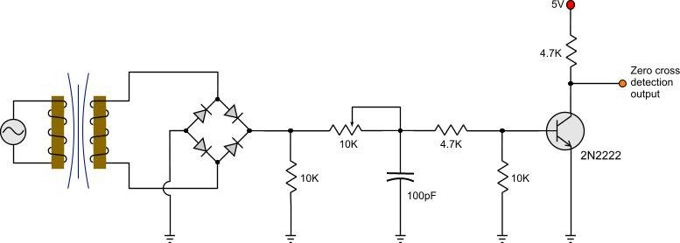
Hardware Implementation
As a first step of hardware system implementation we have built a zero-crossing circuit (as shown in figure) to give a pulse to the electrostatic switch (triac).

Slide 12
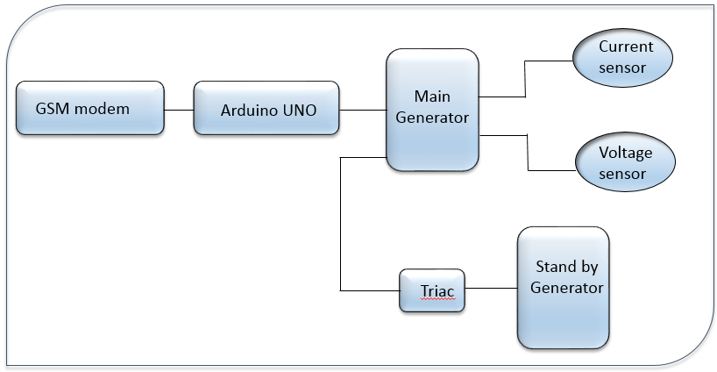
Hardware Implementation

Slide 13
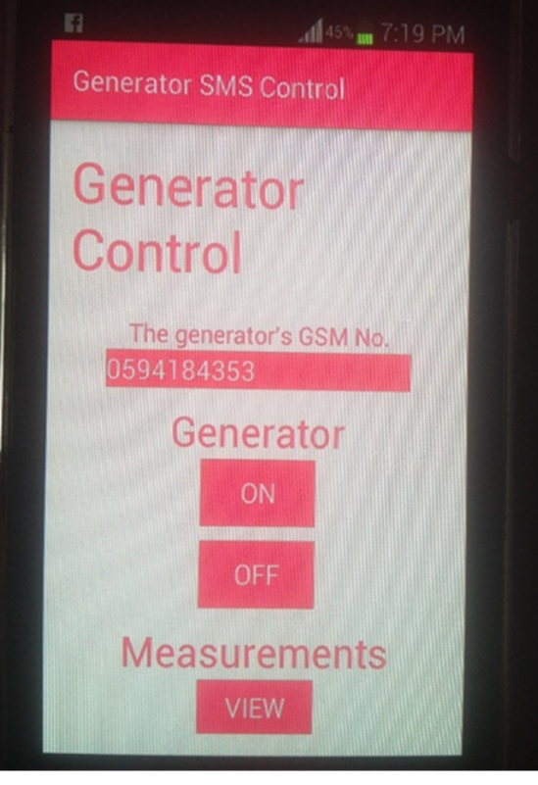
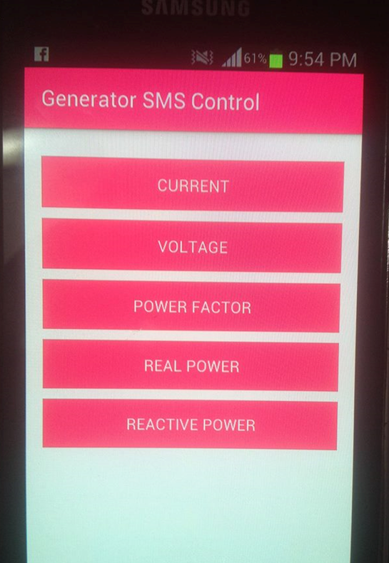
Software Implementation

Slide 14
Software Implementation
By entering a GSM modem number at transmitter side and click to view measurement icon on mobile application a list of options as current, voltage and power factor appeared.
This order sends to GSM modem that connect with Arduino microcontroller which take a reading values from sensors then it reply and send SMS message contain a reading values to mobile phone(transmitter).
Then if the received value exceeds than threshold value the stand by generator turned on else don’t do something.

Slide 15
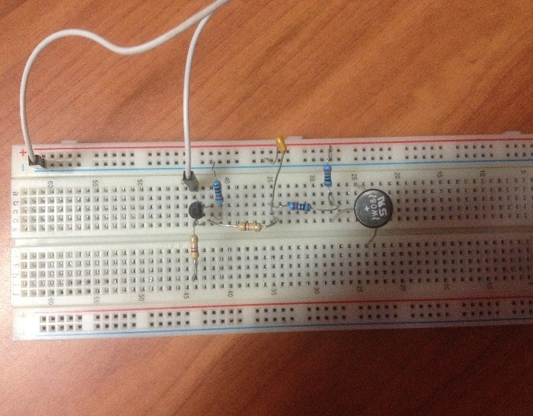
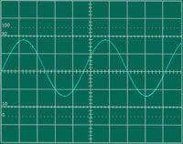
Result and Discussion
We have built a zero-crossing circuit to give a pulse to the electrostatic switch (triac) which connected to the Arduino Uno. And the output of this circuit which appear on the oscilloscope as shown.

Slide 16
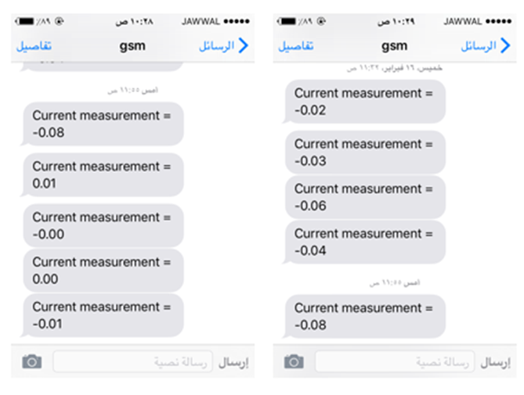
Result and Discussion
To emphasize that the current values measured by current sensor as the same we have received at phone. We applied a variable voltage source with resistance, the current sensor could read different values according to the trial test as shown it was almost the same

Slide 17
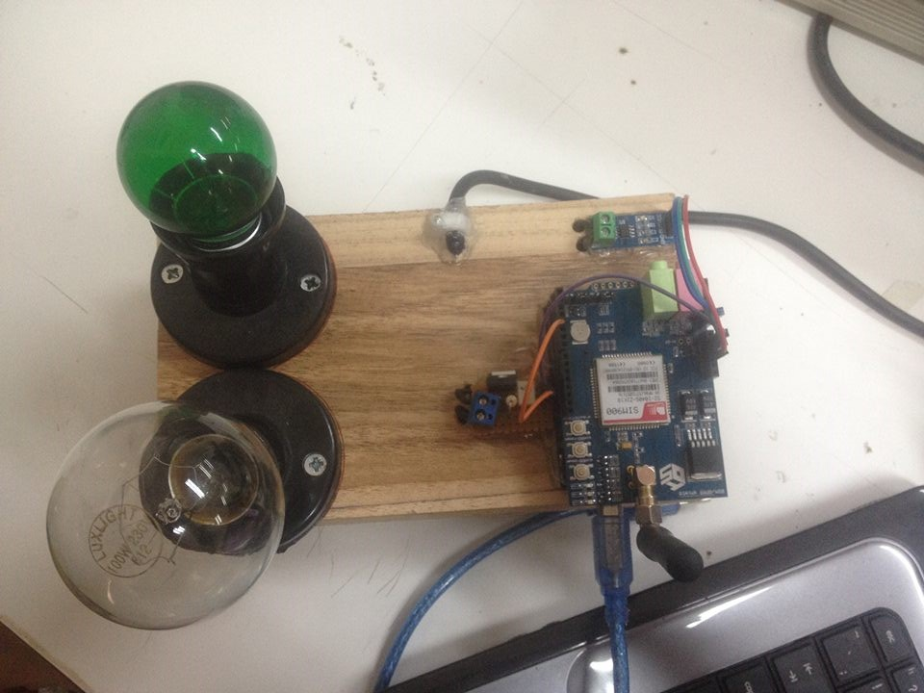
Result and Discussion
The hardware model of the proposed system was built as shown:

Slide 18
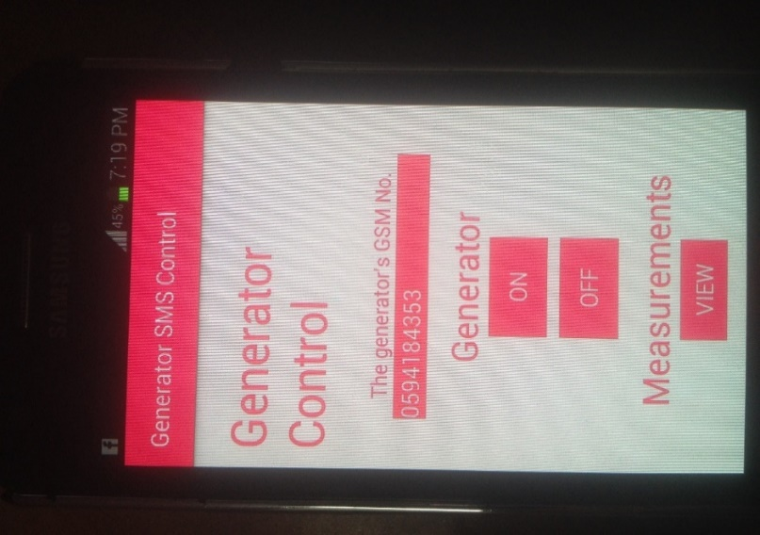
Result and Discussion
The software part was implement:

Slide 19
Result and Discussion
By entering a GSM modem (SIM900) number at transmitter side (substation) and click to view measurement icon on mobile application a list of options will appear as current, voltage and power factor.
By selecting an option from the list an order will be sent to GSM modem that is connected to the Arduino microcontroller which will take the reading value from sensors, then it reply and send a SMS message containing the reading to mobile phone (operator).

Slide 20
Result and Discussion
After we build the system we run the project and reading current values on mobile phone the first generator which is connected to the sensors was ON and the second one was OFF (the lamp have been used as generator).
when we received current value over than threshold we turn a second generator (Stand by generator) ON to share the load with the main generator.

Slide 21
Application
♦ In industries to monitor different modules located at different places.
♦ Distribution Points (DP) where the huge amount of power distribution takes place.
♦ In the rural areas which are far away from the main stations.
♦ Monitoring and controlling the home appliances.

Slide 22
Advantages
The status of various devices can be monitored and controlled from anywhere.
♦ The operation of the system is very simple and can be used by anyone with a basic knowledge of operating mobile phones.

Slide 23
Conclusion
♦ The GSM based monitoring of substation is quite useful as compared to manual monitoring and also it is reliable as it is not possible to monitor always the load current or voltage manually.
♦ After receiving of message of any abnormality we can take action immediately to prevent any catastrophic failures of substation equipments.

Slide 24
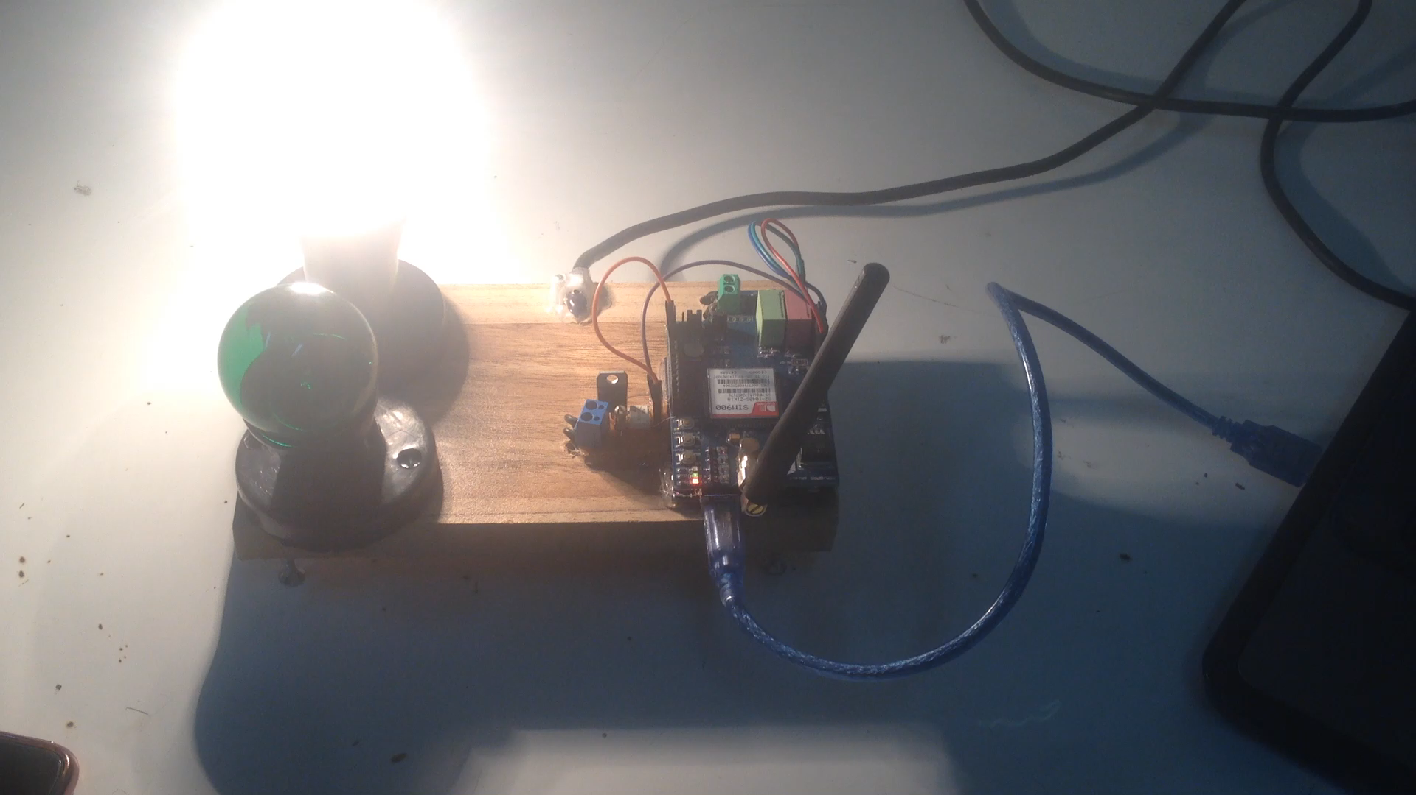

Slide 25
THANK YOU…

