Slide 1

Design of a wastewater collection network for the southern part of Tubas
Prepared by: Sarah Mansour
Under supervision of: Dr. Mohammad N. Al-Masri
Fall 2021

Slide 2
OUTLINE
Introduction
Objectives
Study Area
Methodology
Modeling and Design
Results
Recommendations and Conclusions

Slide 3

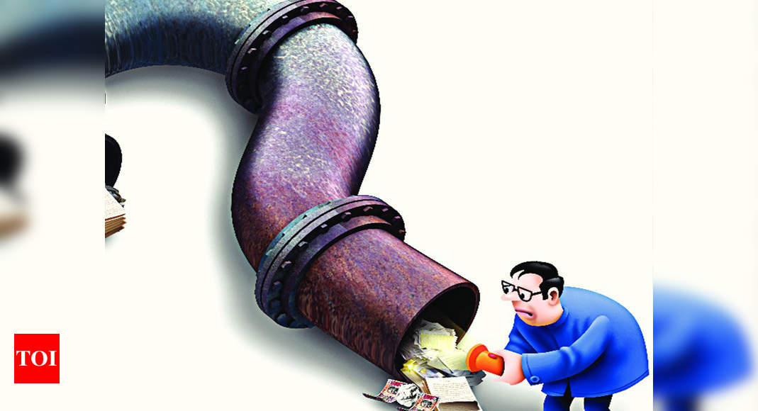
Introduction

Slide 4
objectives
Design a wastewater collection network for the southern part of Tubas using Sewer CAD
Estimating the total cost of the network

Slide 5
Study area
Tubas
Location
Topography
Population
Climate
Water situation

Slide 6
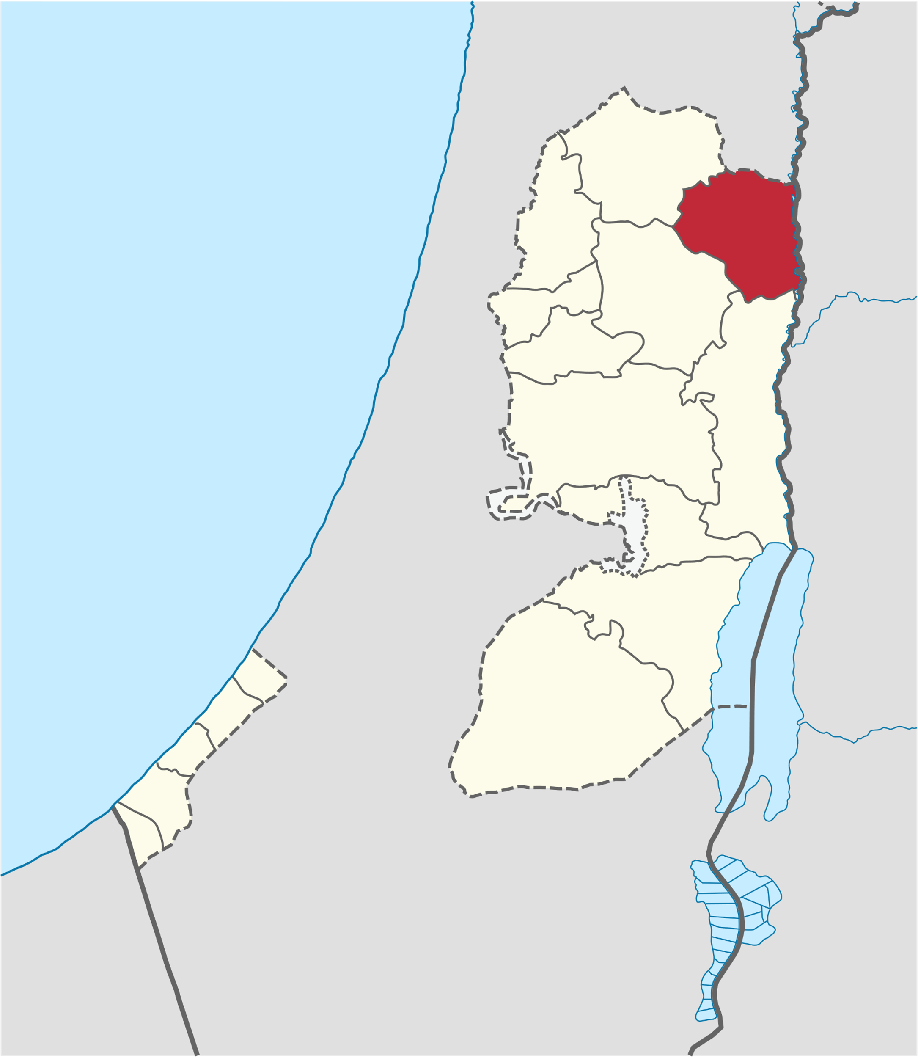
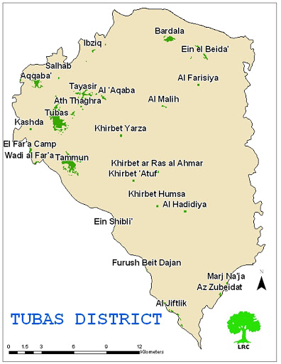
Location
Tubas is a Palestinian city in the northeastern West Bank, located northeast of Nablus west of the Jordan Valley.

Slide 7
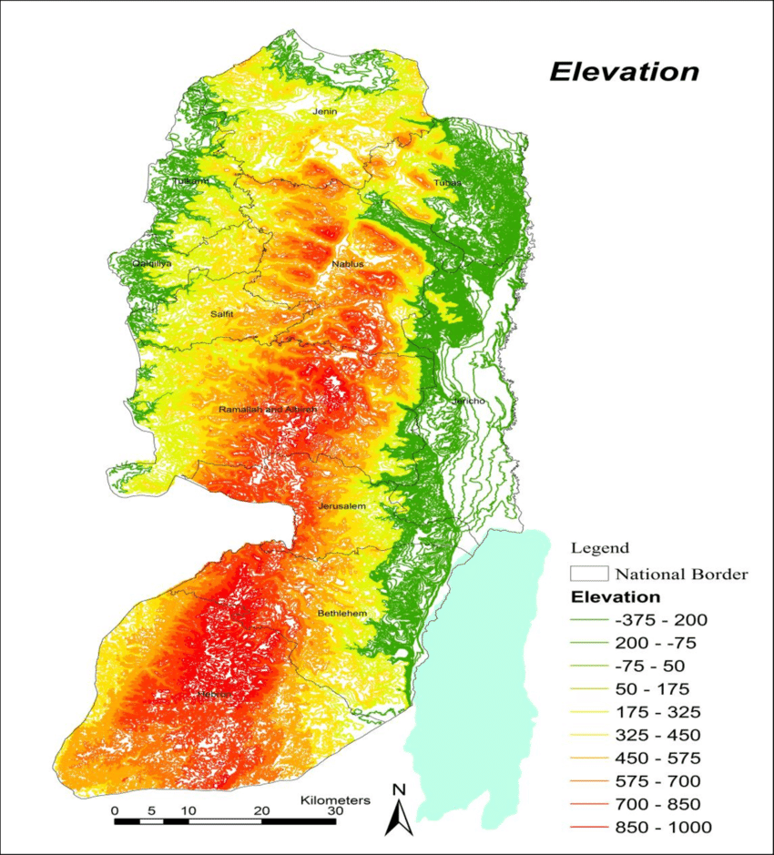
Topography
Tubas located in the hills of the West Bank at the moderate elevation of 362 m above sea level.

Slide 8
Population

Slide 9
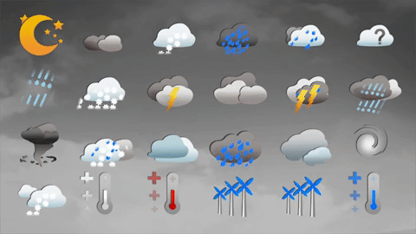
Climate
Tubas has a moderate climate; the summer is hot and dry, and the winter is cold and wet, the average annual temperature 21ᵒᶜ (70 ᵒF), and the average annual humidity rate is 56%. And the average annual rainfall is 329 mm.

Slide 10

Water Situation
The main sources for water in Tubas are Tamun and Tubas wells. The first one; covers part of Tuabs city and Tamun city, but the second one covers the second part of Tubas city.
In addition, the city also has a water reservoir with a capacity of 900 m³ and it has another one with a 1000m³ capacity. This is primarily used to provide water to the city for 7/24 that means for 24hr all the day of the week.

Slide 11




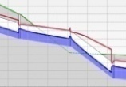

Methodology
Determination of the topic
Collection of Data
Estimation of the wastewater load
Determination of the manhole location
Construction of the network
Design of the network
Presentation the result
Estimation of cost

Slide 12

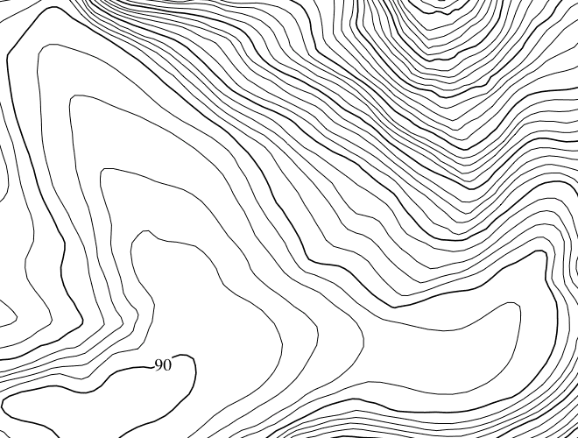
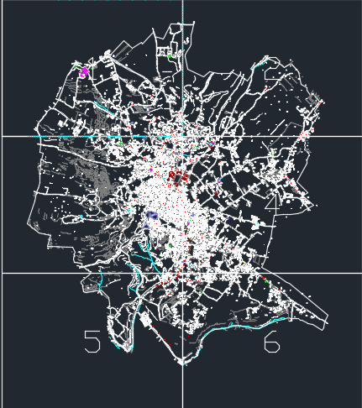

Data collection
By:
Visiting the Municipality
Using Auto CAD files and Contouring Map
Making interviews and phone calls with a specialist's engineers
Ended in visited the site.

Slide 13
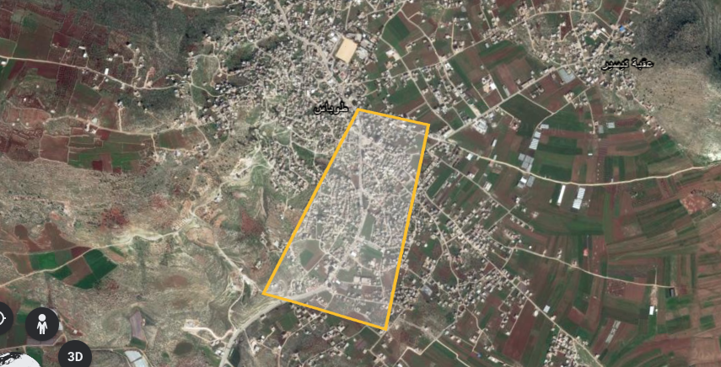
Study area

Slide 14
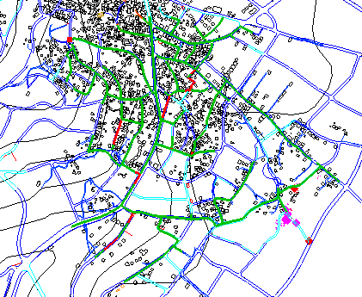
Network plan

Slide 15
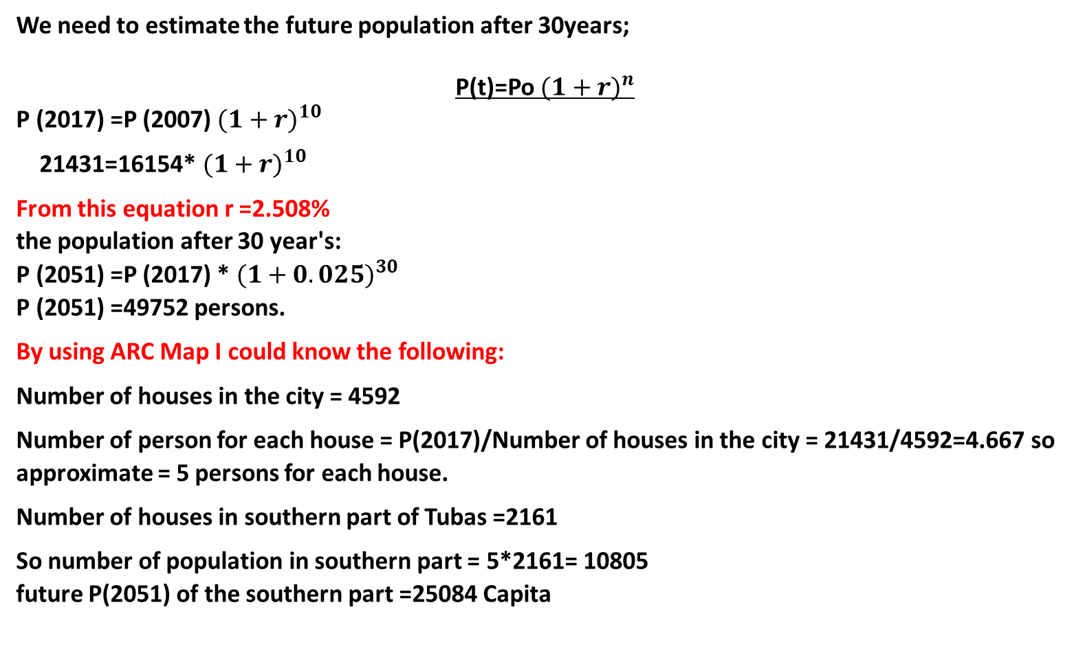
Unit load estimation
We need to estimate the future population after 30years;
P(t)=Po ${(1+r)}^{n}$
P (2017) =P (2007) $(1+r)^{10}$
21431=16154* ${(1+r)}^{10}$
From this equation r =2.508%
the population after 30 year's:
P (2051) =P (2017) * ${(1+0.025)}^{30}$
P (2051) =49752 persons.
By using ARC Map I could know the following:
Number of houses in the city = 4592
Number of person for each house = P(2017)/Number of houses in the city = 21431/4592=4.667 so approximate = 5 persons for each house.
Number of houses in southern part of Tubas =2161
So number of population in southern part = 5*2161= 10805
future P(2051) of the southern part =25084 Capita

Slide 16
Water demand = 120 L/C-day
W to WW% = 80%
Maximum hourly factor = 4
Infiltration rate = 5%
Number of manholes = 459
Population for one manhole = total population/total number of manhole = 25084/459=54.649 approximately its = 55 capita/one manhole
The load of each manhole can be computed by Excel using the following equation:
Load per manhole=population per manhole x (water demand x W to WW% x PHF + infiltration x water demand x W to WW%)
= 54.549 * ( (120*80%*4)+(5%*120*80%)) = 21247.6235 L/day-manhole =21.25cm/d
Unit load = (120*80%*4)+(5%*120*80%) = 388.8 L/c-day
Total load for the southern part = 25084 * ((120*80%*4)+(5%*120*80%)) = 9752659.2 L/d = 9752.66 cm/d

Slide 17
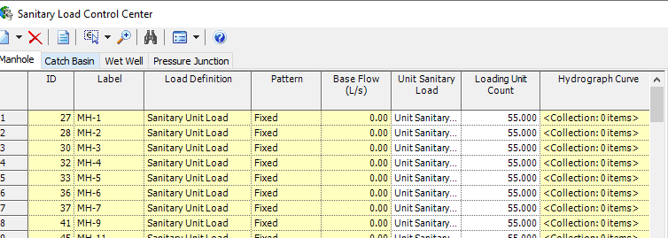
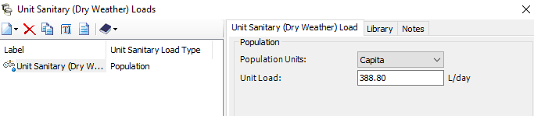
Then I defined the load as unit sanitary load based on population

Slide 18
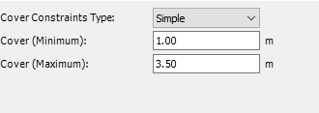

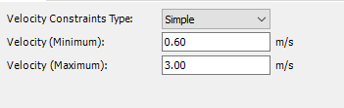
Deign constrains
Cover
Slope
Velocity

Slide 19
Results
Number of manholes= 459
Number of outfalls = 1
Diameters : 8, 10, 12-inches
The length of the network= 10876.4 m
approximately = 10.8764 km = 11km

Slide 20
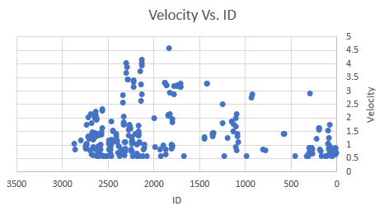

Slide 21
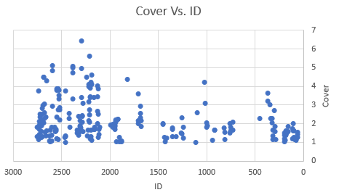

Slide 22
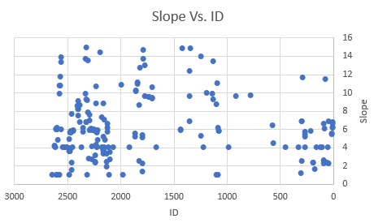

Slide 23
Hydraulic and Energy Grade Line

Slide 24
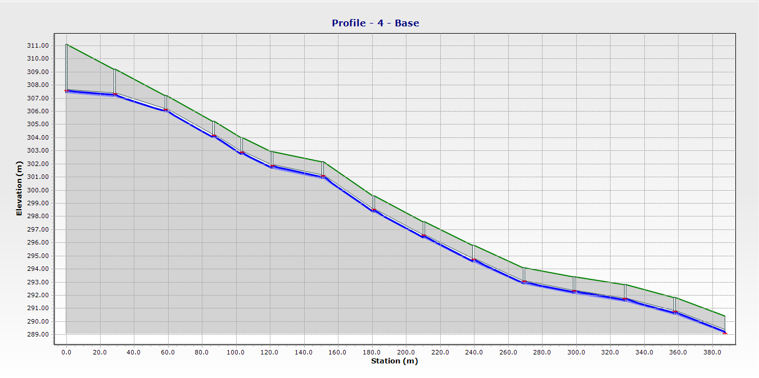

Slide 25
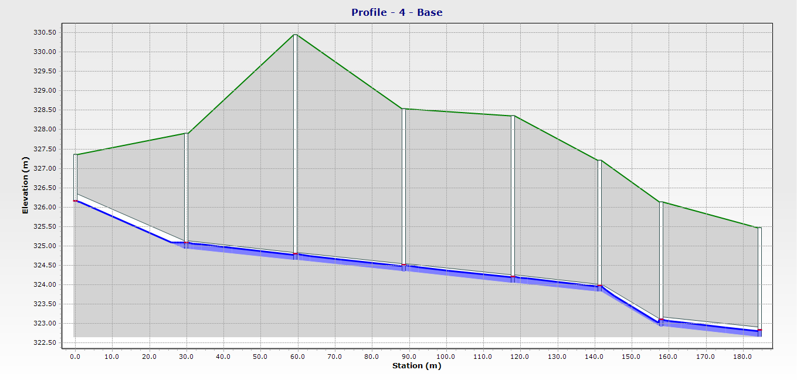

Slide 26
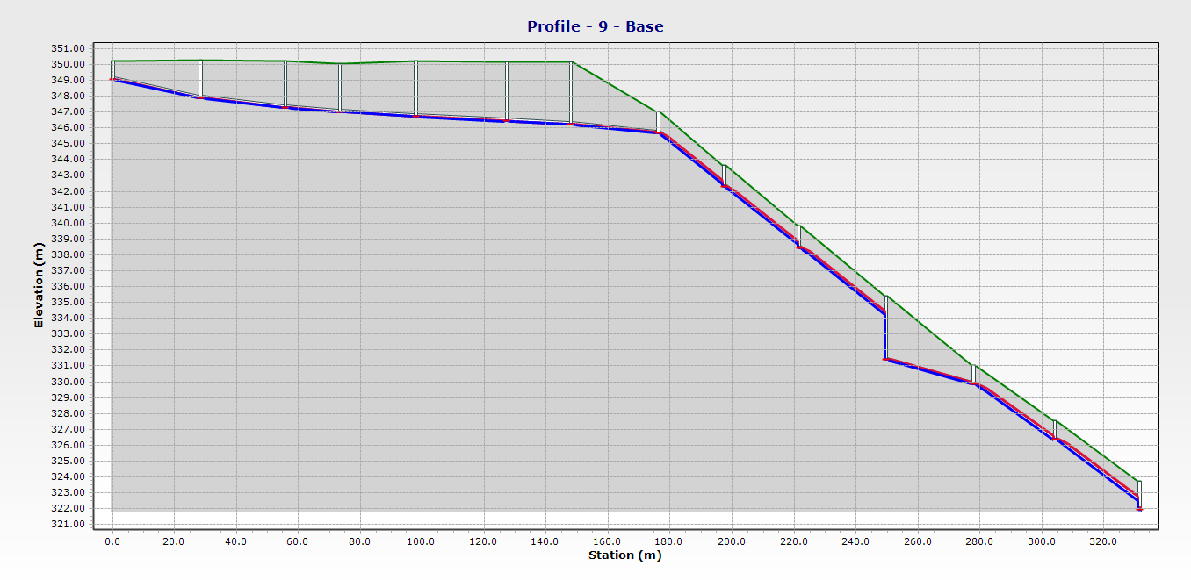

Slide 27
Cost Estimation of the wastewater collection network
Excavation cost
Total cost of the network
Cost of pipe
Cost of manhole
Cost of Re-paving

Slide 28
Excavation cost
Excavation cost is calculated in (linear meter), and it depends on the length, depth of excavation and diameters of conduits.
Intervals (m) | Unit Price ($/m)
1 up to 2 | 35
2 up to 3 | 50
3 up to 4 | 70
4 up to 5 | 95
5 up to 6 | 125

Slide 29

Depth of excavation = Average conduit cover (m) + Diameter of the pipe (m) + Depth of sand under the pipe (0.15 m).
Cost/excavation's depth ($/m) = length(m) * Unit price for specific depth($/m)
Example: for CO-1
Depth of excavation= 0.15+0.2+1= 1.35m
Cost/excavation’s depth= 30*35= 1050$
The total cost of excavation = 479,244.5$

Slide 30
Cost of pipes
The cost of pipes calculated in (linear meter), it depends on the length, diameter and material of pipe.
The material used is PVC[Poly vinyl chloride]
The network has an 8'', 10'' and 12-inch diameter pipes.
Then the total cost of pipes= sum of total length of pipes multiplied by cost per linear meter according to its diameter.
Diameter (in) | Unit price ($/m)
8 | 13
10 | 20
12 | 30
The total cost of sewer = 172632.4 $

Slide 31
Cost of Manhole
Cost of manholes calculated in linear meter.
Diameter of all manholes in the project is 1m.
Depth of manholes equal = ground elevation – invert elevation
I used intervals to calculate the cost of each components
MH element | Dimensions | Cost
Cone | 100x75 | 105$
Cover | 100x20 | 70$
Base | 100x60 | 105$
 | 100x80 | 120$
Ring | 100x30 | 57$
 | 100x40 | 61$
 | 100x50 | 61$

Slide 32
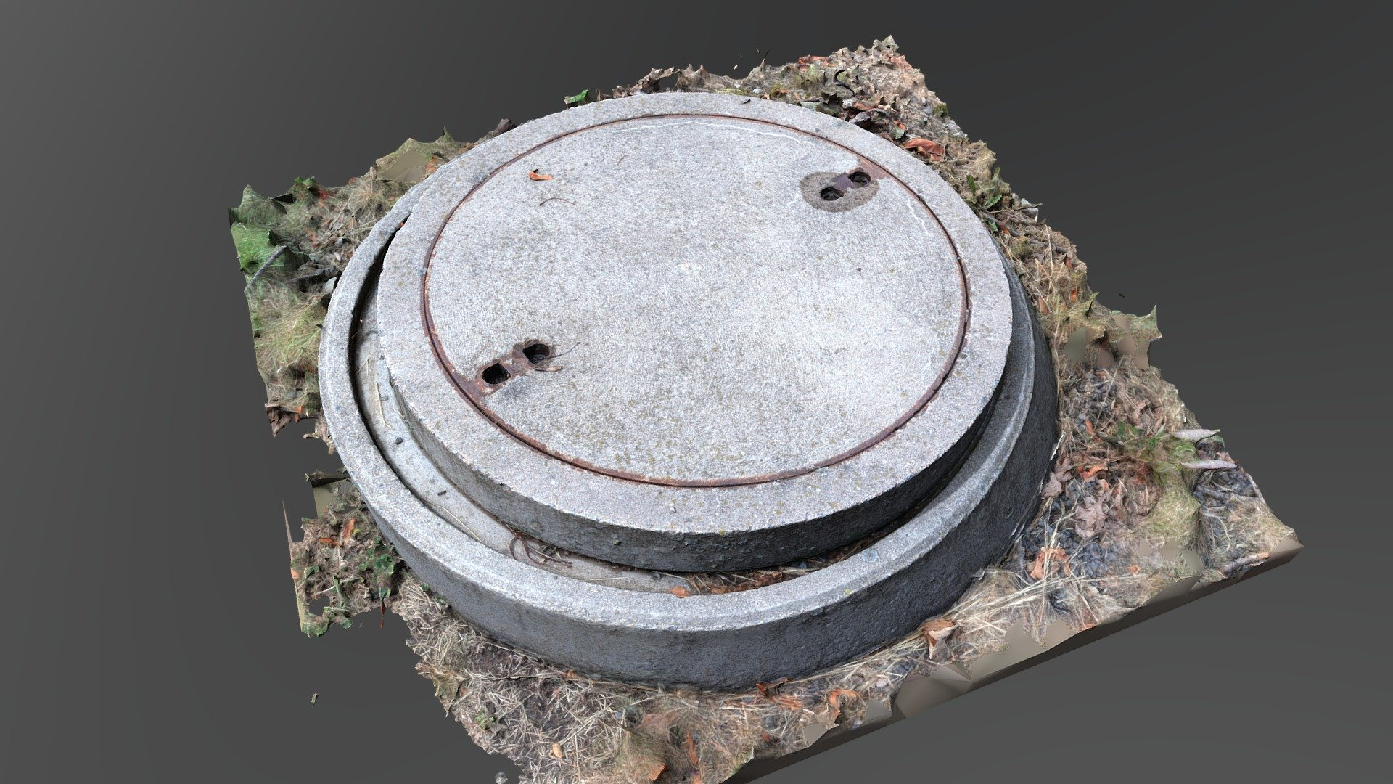
Total Number of manholes = 459 manhole
Total Cost of Cover = 32,270$
Total Cost of Cone = 48,405$
Total Cost of Base = 36,965$
Total Cost of Ring = 23,897$
Total Cost of manholes = Sum. of all the previous cost = 141,537$

Slide 33
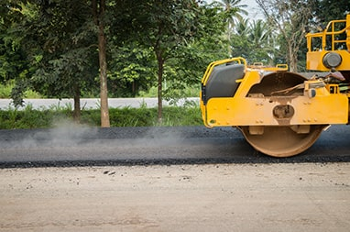
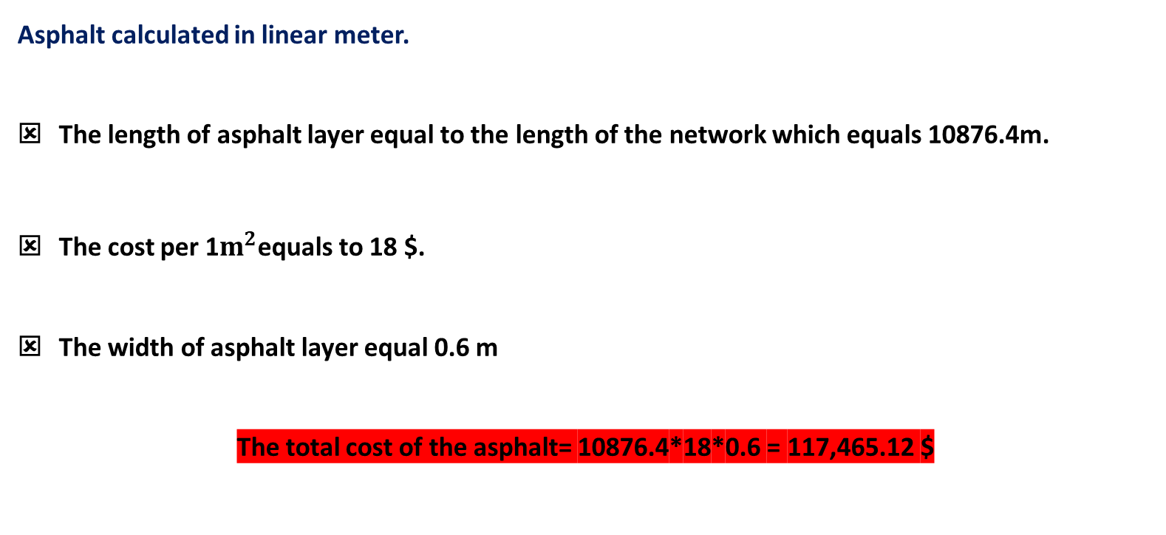
Cost of Re-paving
Asphalt calculated in linear meter.
The length of asphalt layer equal to the length of the network which equals 10876.4m.
The cost per 1$m^{2}$equals to 18 $.
The width of asphalt layer equal 0.6 m
The total cost of the asphalt= 10876.4*18*0.6 = 117,465.12 $

Slide 34
The total cost of the wastewater network
Item | Cost $
Excavation | 479244
Sewer | 172632
Manholes | 141537
Asphalt | 117465
Total Cost | 910,869
Cost/m | 84
Cost/Person | 85

Slide 35

There's a need for representative data
There must be a detailed survey of the country
Check the number of houses that are not connected or expected to be connected
There's a lot of problem that I have had in this design, so for anyone who wants to study this project in the future there is a very likely possibility of use a pump so that led to decrease the depth of the cover.
Recommendations

Slide 36


