Slide 1
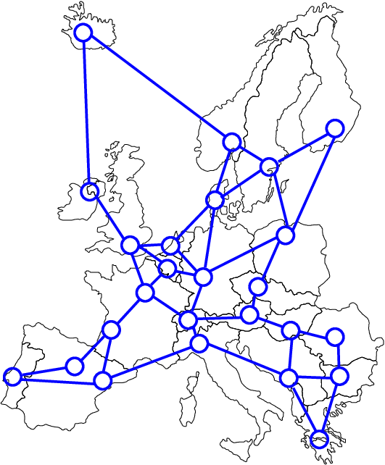

Graduation project (2)
“La MAGIE ARZ”
Network design for Al_Arz company

Slide 2

Group members :
Raghad Bani Odeh.
Raghda Amer.
Baha Joudeh.
Supervised by:
Dr. Mohammad Othman.

Slide 3

Out line:
Introduction.
Literature Review
Methodology
Results and Analysis
Discussion
Conclusions and Recommendations

Slide 4
Introduction : Company Background
Al-Arz factory is one of the biggest ice cream factories in Palestine.
1950
humble beginning (By simply producing ice to cool water and store food.)
Al Arz grew into a successful producer of high quality ice cream.
2007
he first step towards exporting
acquired HACCP certificate
Near Future
Investment projects as an extension of the company.
opening of the company's special selling store.

Slide 5
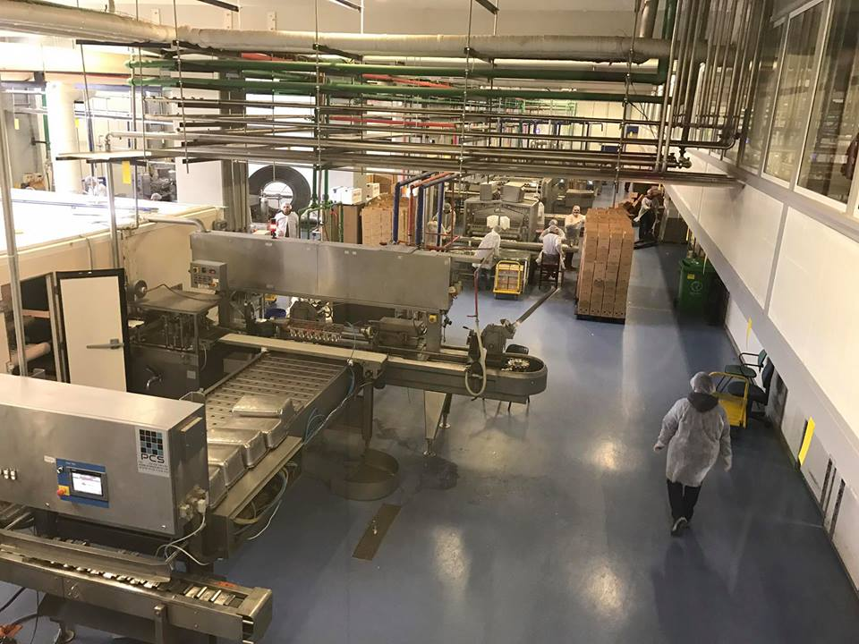
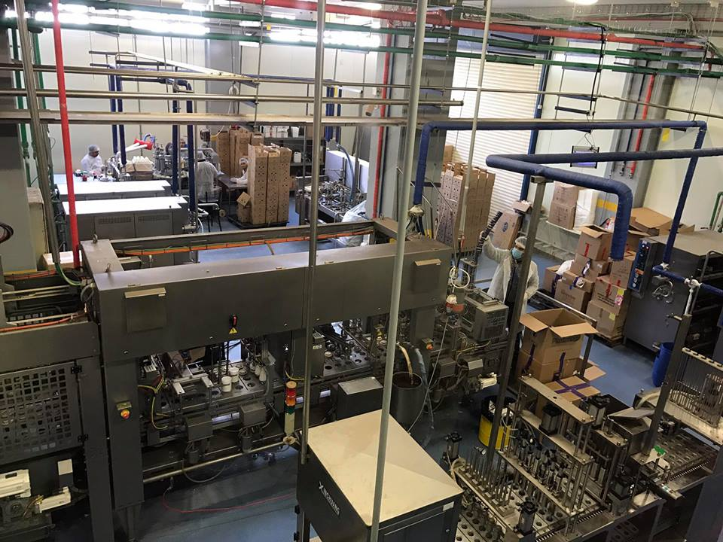

Slide 6
Problem statement :
As one of the Palestinian products, Al-Arz products are facing stiff competition from other local and imported products in particular "Israeli products", which makes constant threats to all local products.
While the company has a desire of establishment entrepreneurial projects aim to raising the name of Al-Arz and encourage consumers to buy their products. And make them in direct contact with the consumer.

Slide 7
Goal :
Is to develop a model that helps to determine the locations of distinctive selling points of Al-Arz company.
Subtract a business plan and marketing plan .
Suggest some layout designs and internal division of the store .
Research in finance by conducting feasibility study.
Output :
The output of this model helps to add a new competitive advantage in distribution network so that the company has direct points of sale to the consumer with Al_Arz brand.

Slide 8
literature review

Slide 9
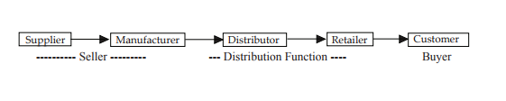
supply chain management and Network design:

Slide 10
Optimization models :
Transportation model
Network Optimization Models
Supply | Cost pre unite distributed |  |  |  | Source
 | Distention
S1 | N | 3 | 2 | 1 | 1
S2 |  |  |  |  | 2
S3 |  |  |  |  | 3
Sm |  |  |  |  | M
 | Dn | D3 | D2 | D1 | Demand

Slide 11
Market strategy:
Offers products to only one group of customers .
Offers products to many kinds of customers
Offers low-price products to customers
Focused cost-leadership strategy.
Cost leadership strategy.
Focused differentiation strategy.
Differentiation strategy.
Offers unique or distinctive products to customers

Slide 12
International Success Company:
Mental
Magnum
Haagen Dazs

Slide 13

Methodology:
Define the problem and scope the work effort of the project team.
Evaluate the current network .
Data gathering(Survey).
Optimization Model.
Business Plan
&
layout design.
Feasibility Study .
Analysis .

Slide 14
Problem description:
Developing the company's distribution network to include special sale points for the consumers to get their satisfactions through the competitive advantages , improving the level of reputation of al-Arz company , in addition to increase the market share and so the results will be more profitable .

Slide 15
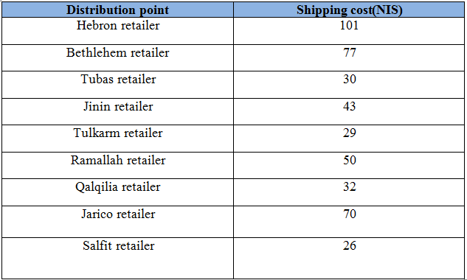
Data gathering: shipping cost :

Slide 16
Value | Information
10 machines | Number of machine in all factory
8 million liter of ice cream per month | Capacity of Factory.
250 workers | Number of worker
3 shifts ( at Summer ) , each shift 8 : hours Morning shift : 8 p.m _4 a.m Evening shift : 4 a.m_12 p.m Night shift : 12 p.m _8 p.m | Number of shifts

Slide 17
Capacity of production lines
Capacity | Section
90.000 | BTC
45.000 | GMF
42.000 | SLC
48.000 | Cups
25.000 | Icy
43.000 | Frola
293.000 | Total

Slide 18
Cities demand
Demand(unit) | Demand (%) | City
70320 | 24% | Nablus
38090 | 13% | Jenin
38090 | 13% | Hebron
64460 | 22% | Ramallah
14650 | 5% | Tulkarm
11720 | 4% | Qalqelia
11720 | 4% | Jericho
5860 | 2% | Tubas
35160 | 12% | Bethlehem
2930 | 1% | Salfit
293.000 | 100% | Total

Slide 19
Nablus demand
Demand(unit) | Demand (%) | Region
21096 | 30% | Rafedia
17580 | 25% | Al_Dowar
7032 | 10% | Sama Nablus
14064 | 20% | Northern Mountain
10548 | 15% | Eastern region
70320 | 100% | Total

Slide 20
Coordinates of cities
Vertical coordinate (Y) | Horizontal coordinate (X) | city
750.89 | 552.491 | Nablus
811.388 | 559.609 | Jenin
565.836 | 500.89 | Hebron
658.363 | 538.256 | Ramallah
781.139 | 502.669 | Tulkarm
747.331 | 493.772 | Qalqelia
653.025 | 582.74 | Jericho
795.374 | 591.637 | Tubas
612.1 | 538.256 | Bethlehem
713.525 | 582.74 | Salfet

Slide 21
Nablus coordination's
Vertical coordinate (Y) | Horizontal coordinate (X) | Regions
686.833 | 502.669 | Rafedia
588.968 | 575.623 | Al_Dowar
564.057 | 725.089 | Sama Nablus
464.413 | 584.52 | Northern Mountain
161.922 | 483.096 | Eastern region

Slide 22
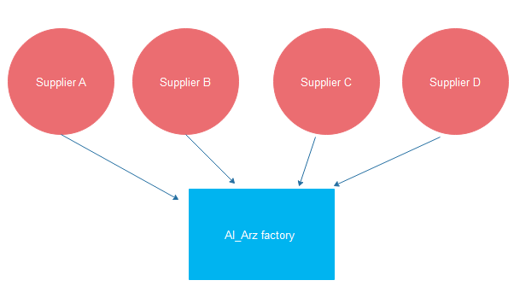
Evaluate the current network:
network from suppliers to the company :

Slide 23
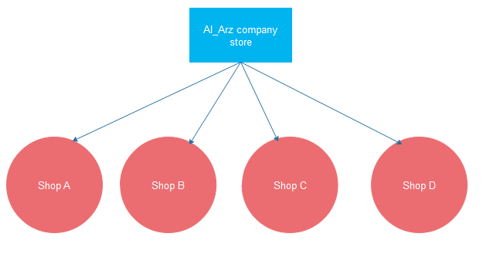
Network from company to customer in Nablus:

Slide 24
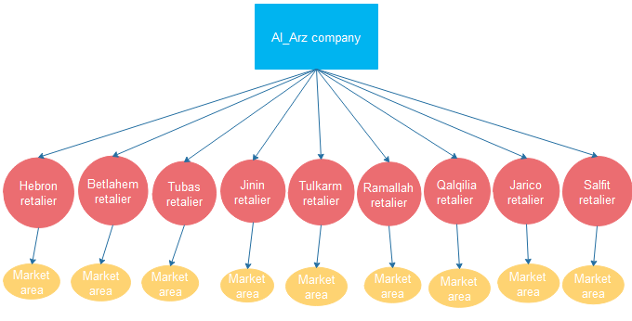
Network from company to customer in other cities:

Slide 25
Survey
“Customers survey “

Slide 26
The prefer location for a new store :
59.2% prefer Rafedia street for this store
30.4 % prefer Al_dawar
3.2% prefer Sama Nablus
The remaining they don’t prefer exact location , their answer was "anywhere'

Slide 27
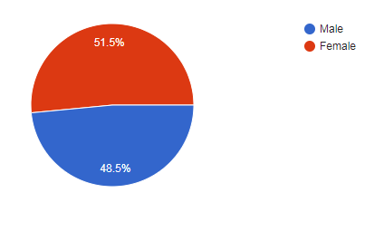
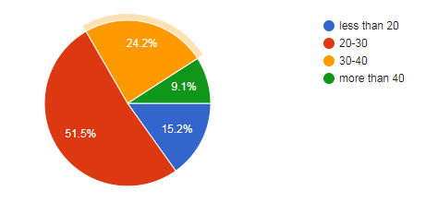
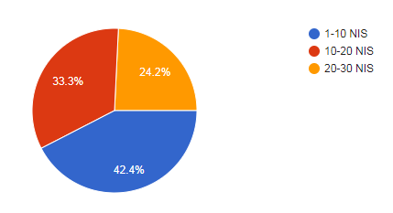
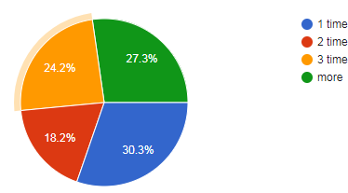
Customers survey for feasibility study

Slide 28
Supermarkets owners survey:

Slide 29
SWOT analysis
Strengths(S):
Customer base loyalty
Strong market position
Reach all cities in the West Bank
Summer and Winter products
Exported to many outside country
Variety in prices
Exported to many outside country
Weakness (W):
Ice-cream production stopped in winter period
High price for new products
Lack of sufficient diversity in their products
Lack of consideration feedback from customers
Other competitors have higher quality than their products
Weak marketing system

Slide 30
Opportunities (O):
Increase the market share
New flavors
Products quality
More of using technology in customer services and distribution network
Consumer loyalty
Consumer satisfaction
Top quality locally
Consumer desire for its products all the year
Threats (T):
Israeli products competition
some consumers will direct to the competing product because it is high quality
loss of the desired product from Al-Arz let consumer take competing product

Slide 31
Optimization Model :
Excel model . we use the following variables:
X: Horizontal coordinate
Y: Vertical coordinate
D: Demand
F: Transportation cost
And d: distance which equals : SQR ((a-X)^2+(b-Y)^2)
while a,b : (Horizontal coordinate, Vertical coordinate) for new location
the objective function we used was:
MIN Z = (transportation cost *distance*Demand)

Slide 32
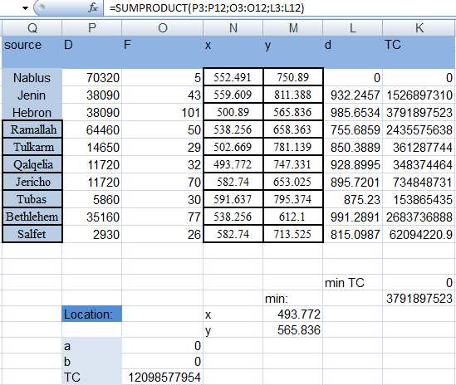
Cities model:

Slide 33
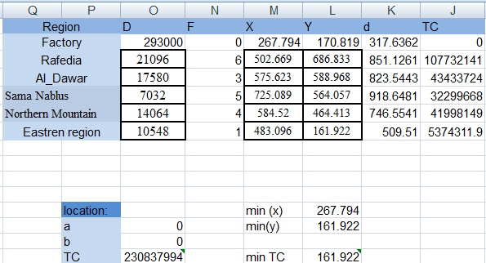
Nablus model :

Slide 34
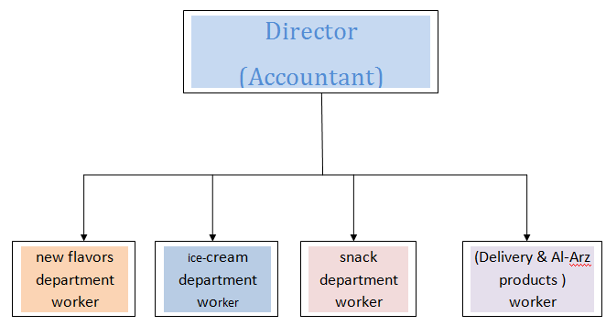
Biasness plan :
La magin Arz
Products and Services:
single-serve
Take-home packs
Catering packs
Keys to Success:
1_ Provide top quality product
2_ Competitive prices
Sale mechanism:
_Direct selling
_Delivery
Who will compete ?
Israile products Rukab's ice-cream in Ramallah Stickhouse Palestine in
Family Ice-Cream Akher_Al meshwar ice-cream in Nablus Ramallah

Slide 35
Flow Chart (inside the shop):

Slide 37
Flow chart ( work between shop and factory )

Slide 39
:Feasibility study
la MAGIE ARZ | Project name
Refrigerator Storage, Display Refrigerators, Small stove and ice-cream filling machine | Machinery and equipment
Rafedia street \Nablus\Palestine | Location
5 | Man power
Ice-Cream | Raw materials (Goods)
Water , electricity | Facilities

Slide 40
Ice-Cream products | Product / Service
Providing products directly to the consumer and facilitating the access of products to the local market, raising the name of the company in the local market and increase the market share . | Social and economic benefits

Slide 41
Financial summary :
157,300 | The cost of the project
200,000 | Working capital
370,000 | Cost of fixed assets
120,000 | Expenses of incorporation
1,034,880 | Expected income in the first year

Slide 42
Initial investment :
Item | Annual cost
machines and the equipments | 31,300
Furniture | 3,000
Decorative , painting costs and workers' wages | 120,000
Banner | 3,000
Total | 157,300

Slide 43
Running cost :
Annual cost | Item
60,000 | Rental
90,000 | Man power (5)
8,400 | Water and electricity
6,000 | Telephone bill
1,500 | Internet bill
1,320 | Gas cylinder(2 per month)
3,456 | Cleaning materials
60,000 | Food expenses
4,800 | General maintenance
60,000 | Advertising
295,476 | Total

Slide 44
Net income calculations
for first year | Cost
295,476 | Running cost
3,875 | Depreciation
1,034,880 | Yearly income
735,529 | Yearly Net income

Slide 45
Payback Period: 1.21 years that equal ≈ 15 months
Rate of return (for the first year) " ROR" 3.577 %

Slide 46
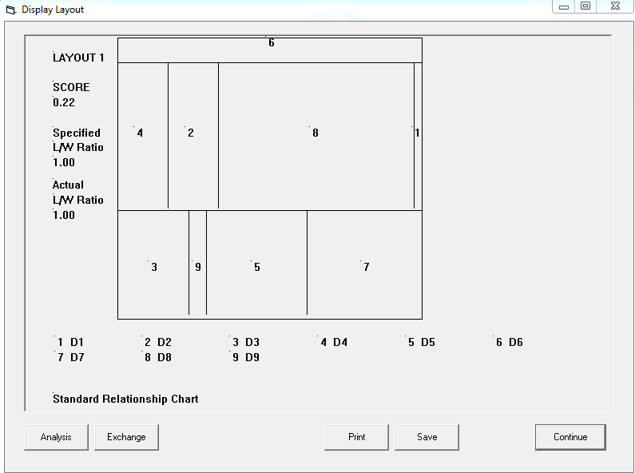
Layout

Slide 47
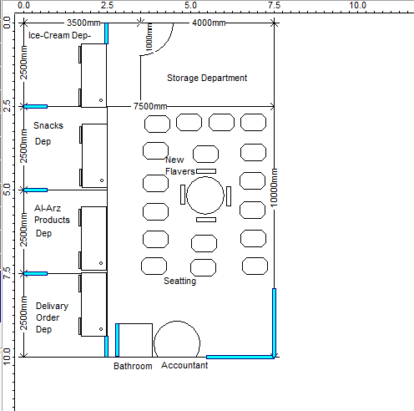
Suggested designs :

Slide 48
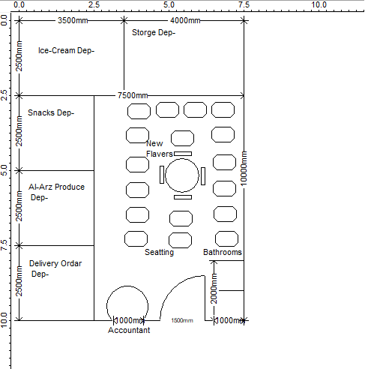

Slide 49
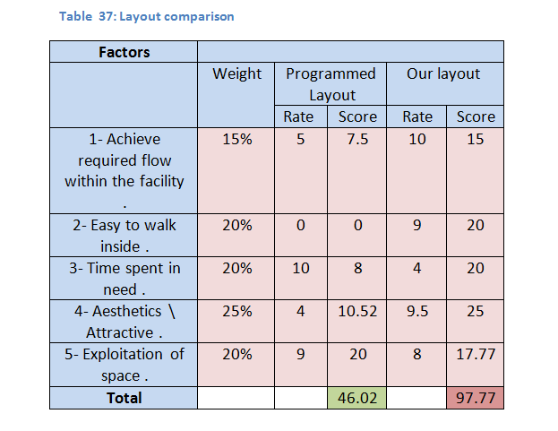
The layout which has the highest total score is our layout , so that we will choose the new layout for our project .

Slide 50
Improvements plans
Marketing Plan
Quality assurance Plan
Principles of safety and health Conditions
Food Safety

Slide 51
Recommendations :
Provide new products, designs and flavers .
The target market includes ages up to 35 , this age is characterized by his desire to experiment with everything that is new in form and taste.
It is advisable to re-examine the start and stop times of the production process.
Applied safety factors inside the shop
Adherence to the project development plans to achieve the objectives set and develop the idea to reach the extension of the project in all cities .

Slide 52
Conclusion :
The future vision is to create a chain of shops that includes all the governorates of the country, aspire to add new services inspired by the experiences of previous companies and unique to serve the local market and achieve the greatest percentage of consumer satisfaction ,Our project idea will return more profit and advantages to the company , it helps it to achieve their vision to become the leader company in ice-cram industry in Palestine .

Slide 53

Future Plan :
Finally , Belief that there are always opportunities for future development and growth although the Current success , to be the top in the market .

Slide 54


