Slide 1
Design Of Water Distribution And WASTE WATER COLLECTION Networks For Asira Al-Shmaliya
Prepared By :
Bara’ Maher Milhim
Islam Majed Hassoun
Mohammad Khalid Sawalha
Submitted to :
Dr. Abdelhaleem Khader

Slide 2
Outline
Objectives and significance of the project
Study area
Methodology
Modeling , Analyzing and design
Results and conclusions

Slide 3
Objectives
Design efficient water distribution network for Asira Al-Shamaliya village.
Design waste water collection network for Asira Al-Shamaliya

Slide 4
Significance of work
The water network in Asira Al-Shamaliya doesn’t work efficiently or effectively, since it has high percentage of loss which reaches 35% of water supply
This redesign Asira's network to minimize the loss of water and improve its’ efficiency as much as possible.
The residents of Asira ash-Shamaliya dispose their sewage using cesspits. Cesspits have many environmental problems. Accordingly, we have to design a wastewater collection network for Asira Ash-Shamaliya

Slide 5
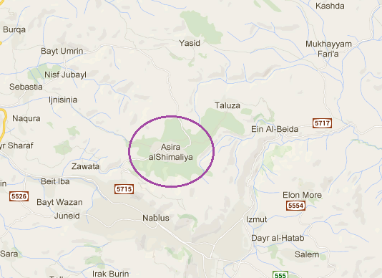
Study area
Asira Al-Shamaliya is a Palestinian town in the Nablus Governorate, located six kilometers north of Nablus in the northern West Bank
A total urban area of the village about ​​39,000 donoms
Water resources : Asira doesn't has its own resource of water, so it gets its water from wadi El-bathan and Taloza wells.

Slide 6
Methodology
Data Collection
Designing
Data analysis
Selection of the study area
Giving recommendations

Slide 7
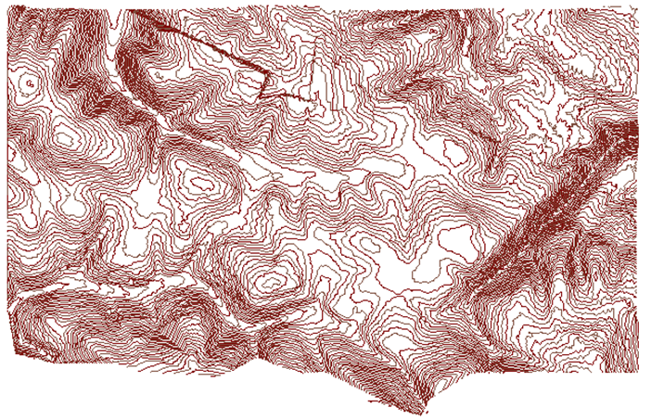
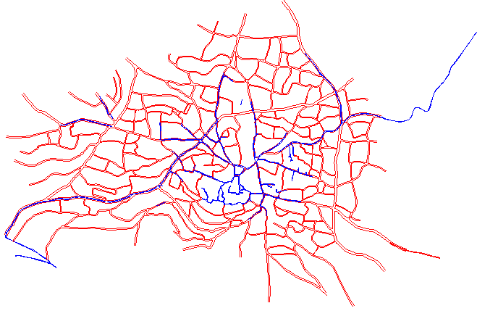
Data collection
Contour map
Road network
Structural plan (Houses distribution)
Boundary of study area (border of village)
Reservoir location
Population number and
the population growth rate
Demand per capita

Slide 8
Water Distribution network
(Analyzing , Designing and modeling)

Slide 9
Data analyzing
Population forecasting
Our design period is 35 years.
We use this equation : Pn=P(1+r) ^{n}:
Population = 7556*(1+.027)⁴²
= 23134 persons

Slide 10
Data analyzing
Demand forecasting
Water demand for population in Asira al-Shamaliya is 4000 m³ per week and the population is 9105 person
demand per capita is 4000×1000 / 7× 9105 = 63 L/c-d
The person consumption is less than 120 L/c-d, so the assumption is ok.
Qd = (Future population) * L/c-day * hourly factor
= 23134 * 120 * 3
= 8328.237 m³/day.

Slide 11
Designing
Design considerations
Velocity : The minimum and maximum allowable velocities are 0.3 and 3.0 m/s
Pressure :The value of the pressure on each junction should be between “20 – 100” mH2O
Cost : The design (from the designs meet the first tow consideration ) , with least cost.

Slide 12
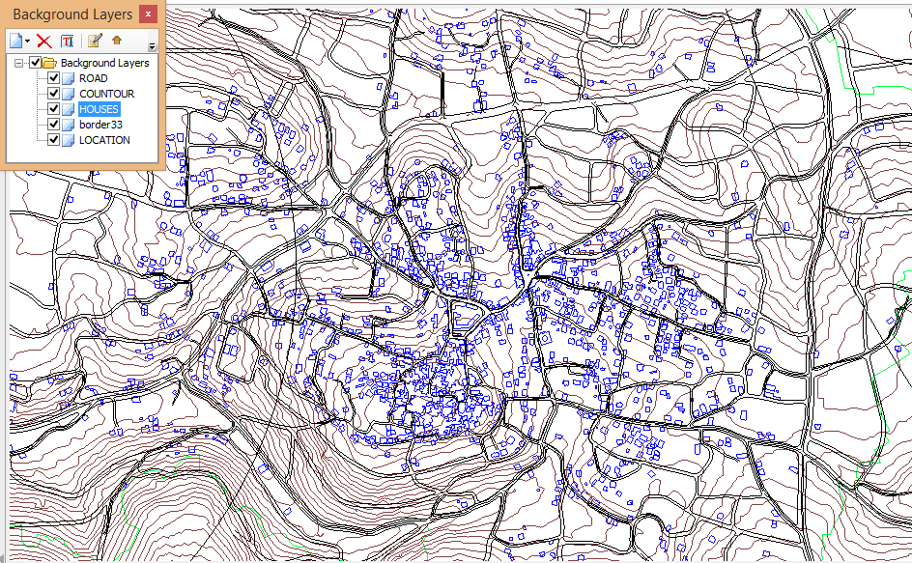
Modeling
Inserting the data to WaterCAD
Allocation of junctions and reservoir
Drawing pipes
Add contour file to determine the elevations of junctions and reservoir and length of pipes using TRex tool.

Slide 13
Modeling
Apply Thiessen polygon theory to determine the service area of each junction
Adding the total demand using load builder tool.
Run the model

Slide 14
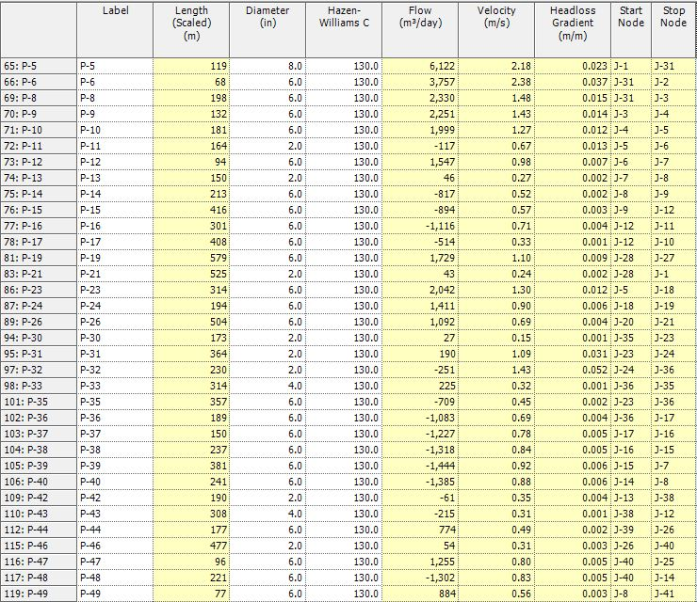
Results
Pipes table

Slide 15
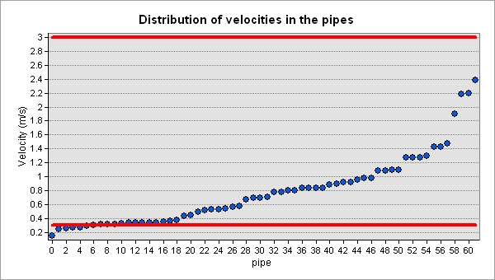
Results
Velocities :
The problem of high velocity was solved by enlarging the pipe diameter .
While decreasing the pipe diameters for those with lower velocities than 0.3m/s

Slide 16
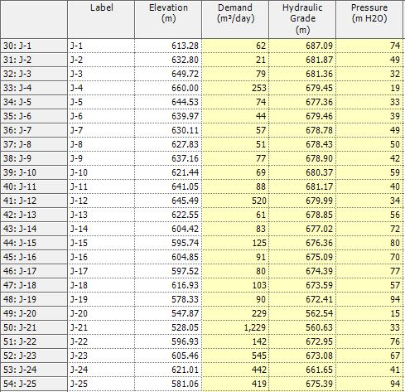
Results
Junctions table

Slide 17
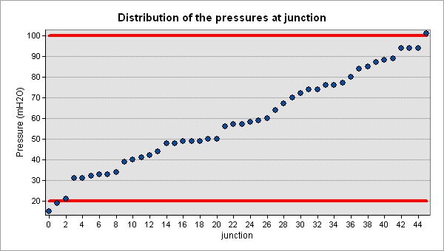
Results
Pressures
In the case of high pressure ( higher than 100 mH2O ) we use PRV ( pressure reducing valve )

Slide 18
Wastewater Collection network
(Analyzing , Designing and modeling)

Slide 19
Data analyzing
Population forecasting
Our design period for wastewater network is 15 years.
We use this equation : Pn=P(1+r) Where:
Population = 7556*(1+.027)²³
= 13945 persons

Slide 20
Data analyzing
estimation of the waste water generation per capita .
Wastewater generation rate is 80%.
Peak factor is 4.
Infiltration rate is 20% from consumed water.
We calculated the waste water generation per capita as follow.
WWG/capita-day = 0.8* water consumption L/c-day * (hourly factor + infiltration percent)
WWG/capita-day = 0.8*120*(4+0.2)
= 403.2 L/capita-day.

Slide 21
Designing
Design considerations
The least conduit diameter is 8 inch "203.2 mm".
used conduit is a circular PVC conduit.
partial flow with a percentage of 75%.
Sump depth is zero.

Slide 22
Average velocity
  minimum velocity is 0.6 m/s
  maximum velocity is 3 m/s
Slope
  minimum slope is1% .
  maximum slope is 15% .
Cover
  The minimum cover should at least be 1 m.
  The maximum cover should not exceed 5 m.

Slide 23
Modeling
Adding needed data to sewerCad
Allocation of manholes and outfalls.
Drawing Conduits.
Add contour file to determine the elevations of Manholes and outfall and length of Conduits using TRex tool.
Exporting these data as shapefile.
Using ArcHydro tool to determine the served area by each manhole.
Assigning design load on each manhole.
Run the model.

Slide 24
Manhole design load Calculation
To determine the design load on each manhole we need the following data :
Served area by each manhole (determined using ArcHydro).
Population density .
WWG/capita-day .

Slide 25
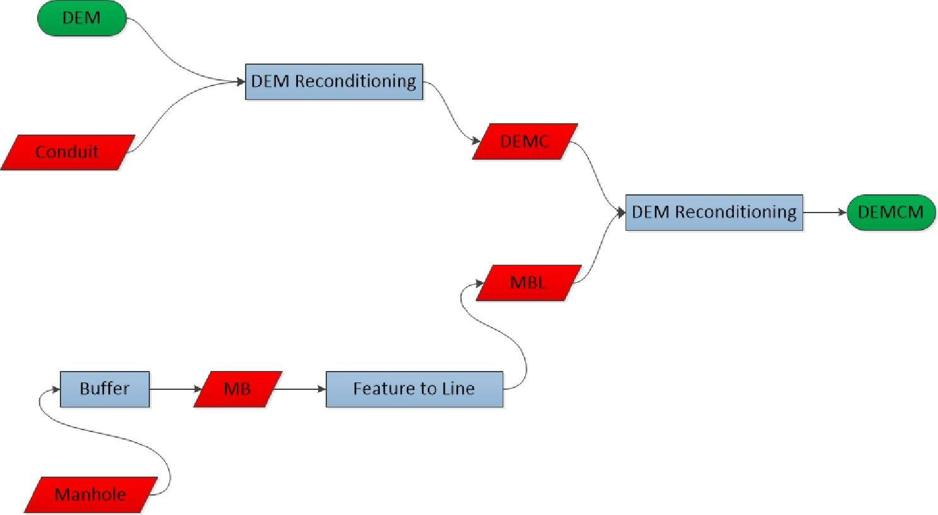
Served area for each manhole

Slide 26
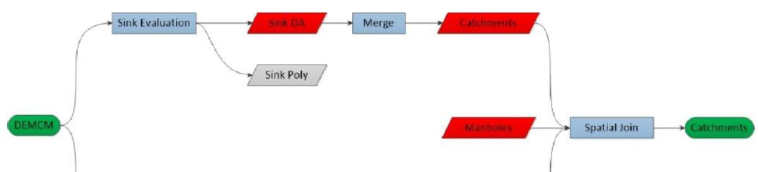
Population density= 13945/3539379 = 0.004 capita/m²
WWG/capita-day =403.2
Manhole load = Population density*Area*WWG/capita-day

Slide 27
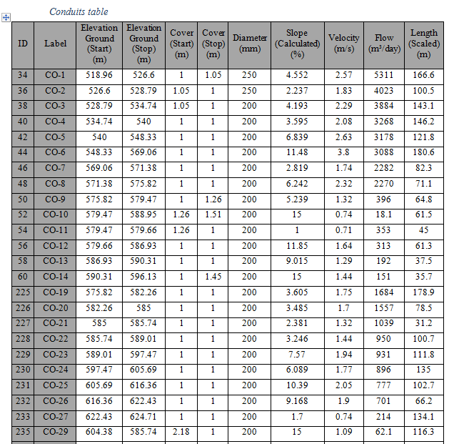
Results

Slide 28
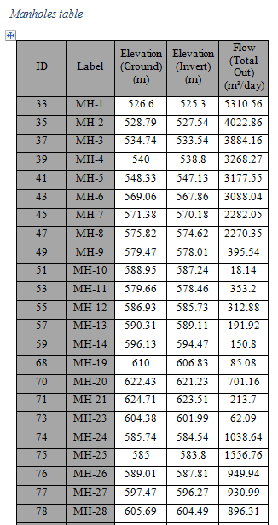
Results

Slide 29
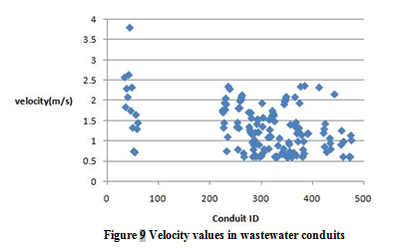
Results
Velocities :

Slide 30
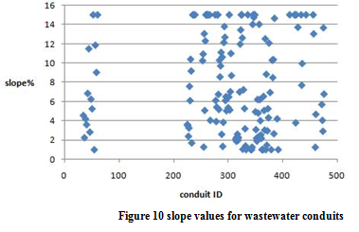
Results

Slide 31
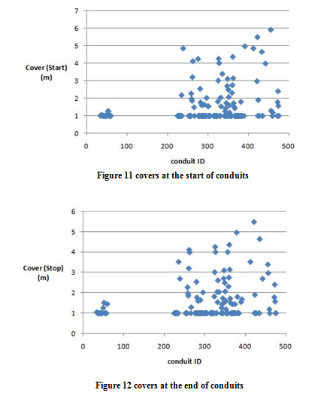
Results
Conduit cover

Slide 32
BOQ for sewer network
Item | Cost ($)
Excavation | 194898
Pipes | 99770
Manholes | 43271
Labor | 59580
Re-paving | 196860
Base coarse | 29529
Sand | 66440
Total cost | 630548
Cost/1 m | 64

Slide 33
Conclusion and Recommendations
we recommend replacing the current water network and constructing a waste water collection network because of the great damage caused by cesspits on the environment and groundwater, In addition to seepage problems and expenses

Slide 34
Thank YOu

