Slide 1
ETHER: An Adaptive Solar Tracking System
Mohammad Raed & Mohammad Matar
Supervisor: Dr. Suleiman Abu Kharmeh

Slide 2
Table of contents
01
02
03
04
05
Introduction
Workflow & Implementation
FPGA Kalman Filter
Analysis & Results
Conclusion & Future Work

Slide 3
01
Introduction

Slide 4
What is ETHER?
ETHER is an intelligent dual-axis solar tracker.
To maximize solar energy capture
FPGA-accelerated filtering
Embedded control
IoT monitoring

Slide 5
Project Context & Motivation
Global Need
Rising demand for renewable energy, with solar as a key sustainable source.
Problem
Fixed solar panels capture limited energy; traditional trackers are either simple but noisy, or advanced but impractical.
Goal
Design a high-precision, adaptive solar tracker using a heterogeneous architecture that is both accurate and deployable.

Slide 6
Why This Matters
1
2
3
Solar trackers can increase energy yield by a high margin compared to fixed panels.
Real-time filtering reduces mechanical wear and improves system lifespan.
Wireless monitoring enables remote operation and performance analytics.

Slide 7
Key Features
1
2
Real-time noise reduction with adaptive spike rejection.
Real-time data visualization & remote control via web/mobile.
FPGA- Accelerated Kalman Filter
IoT Dashboard with Live Monitoring
Adaptive Dual-Axis Solar Tracking
Fail-Safe & Modular Design
Increases energy capture while reducing mechanical wear.
System remains operational even if FPGA or WiFi fails.
3
4

Slide 8
02
Workflow & Implementation

Slide 9
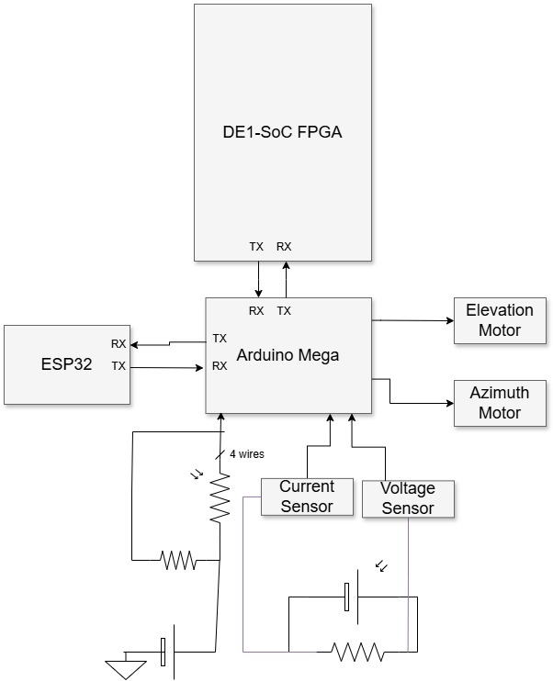
Architecture
ETHER is built on a three-layer architecture:
Arduino Mega 2560 – Sensor & Actuation Layer Handles real-time sensor reading and motor control.
DE1-SoC FPGA – Computation Layer Accelerates the Kalman filter for noise reduction and predictive tracking.
ESP32 – Communication Layer Provides wireless connectivity and a real-time monitoring dashboard.
1
2
3

Slide 10
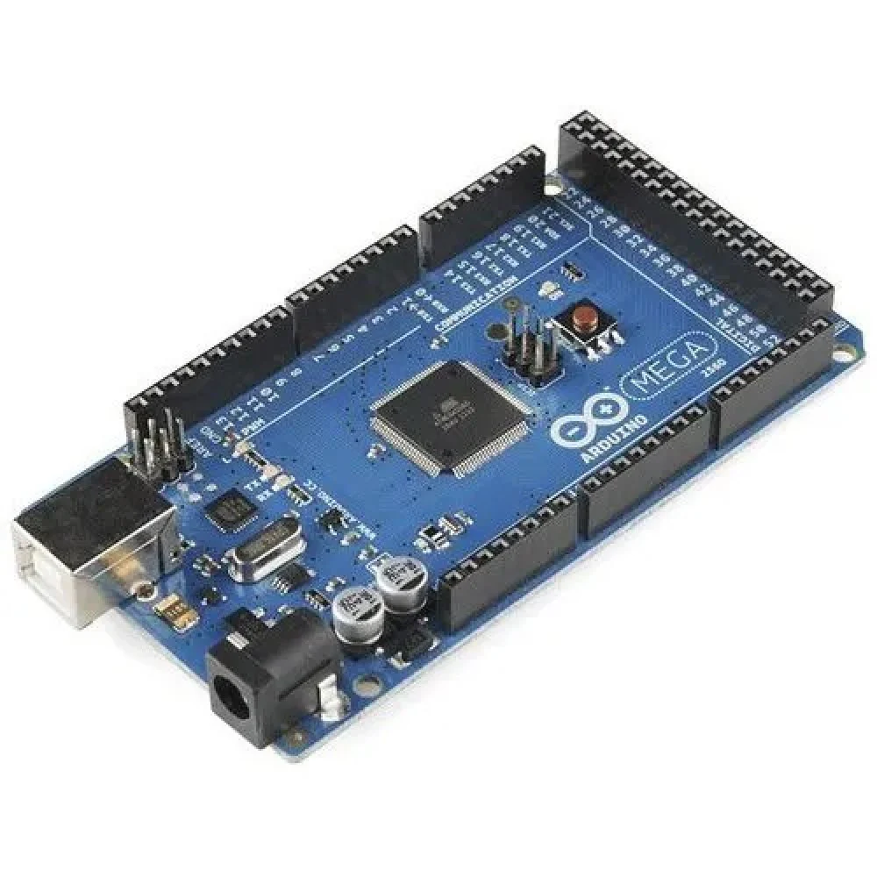
Workflow & Implementation
Arduino Workflow
1) Sensor Reading Reads 4 LDR sensors and Converts analog values to light intensity differences
2) PID Control Computes azimuth & elevation errors and applies tuned PID gains to generate raw angle commands
3) Communication A) Sends raw angles to FPGA via UART B) Receives filtered angles back C) Falls back to raw angles if FPGA times out

Slide 11
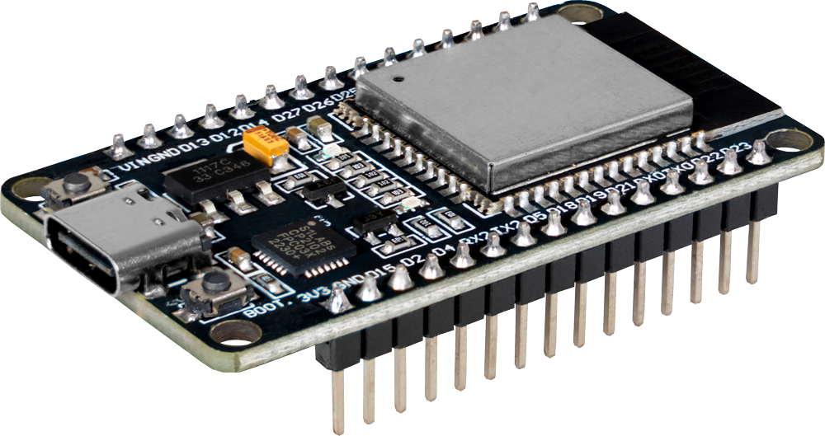
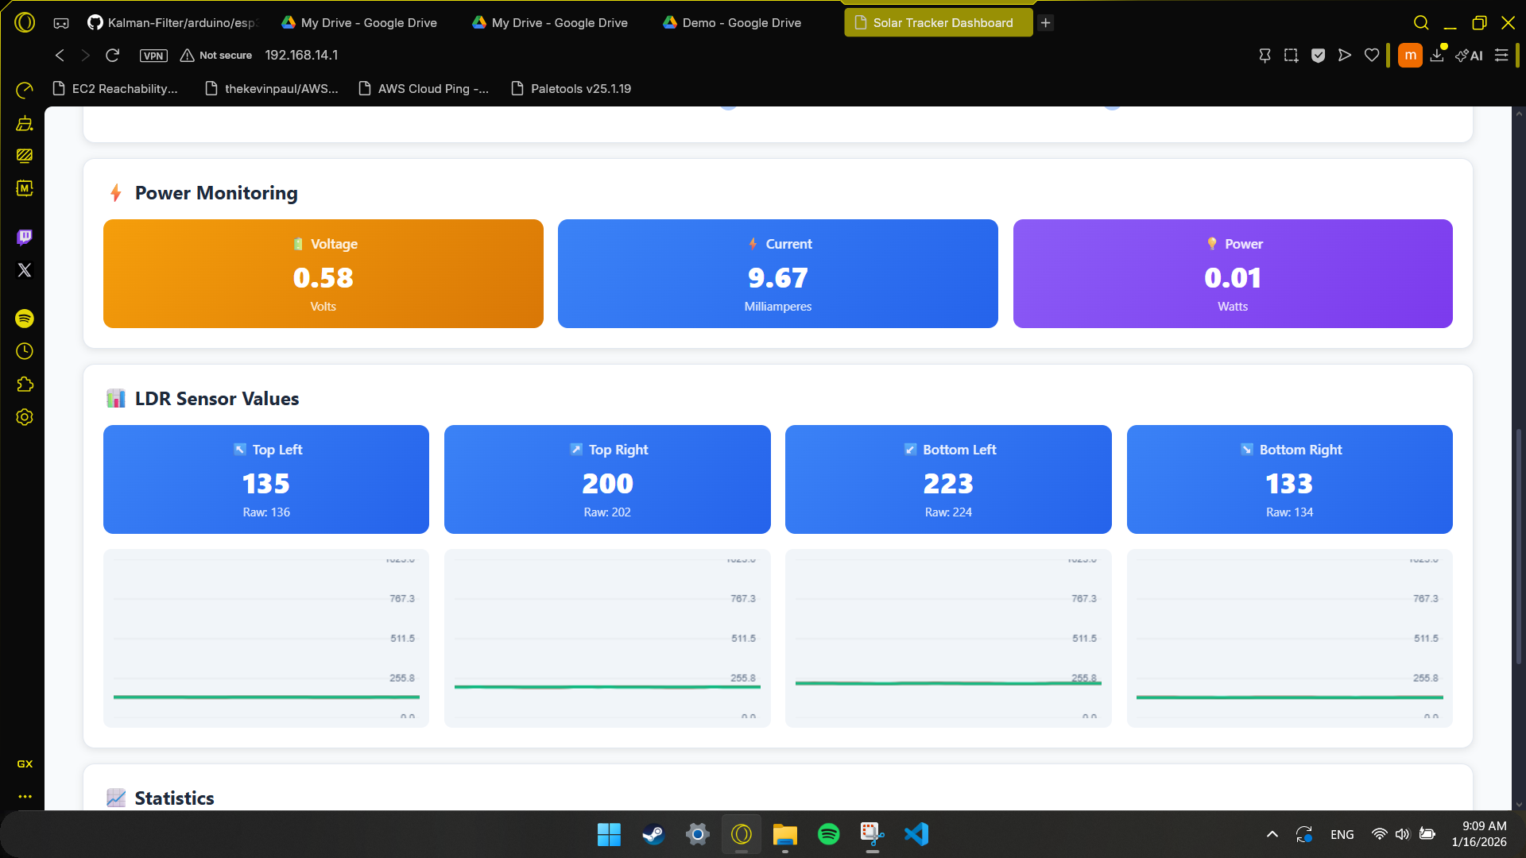
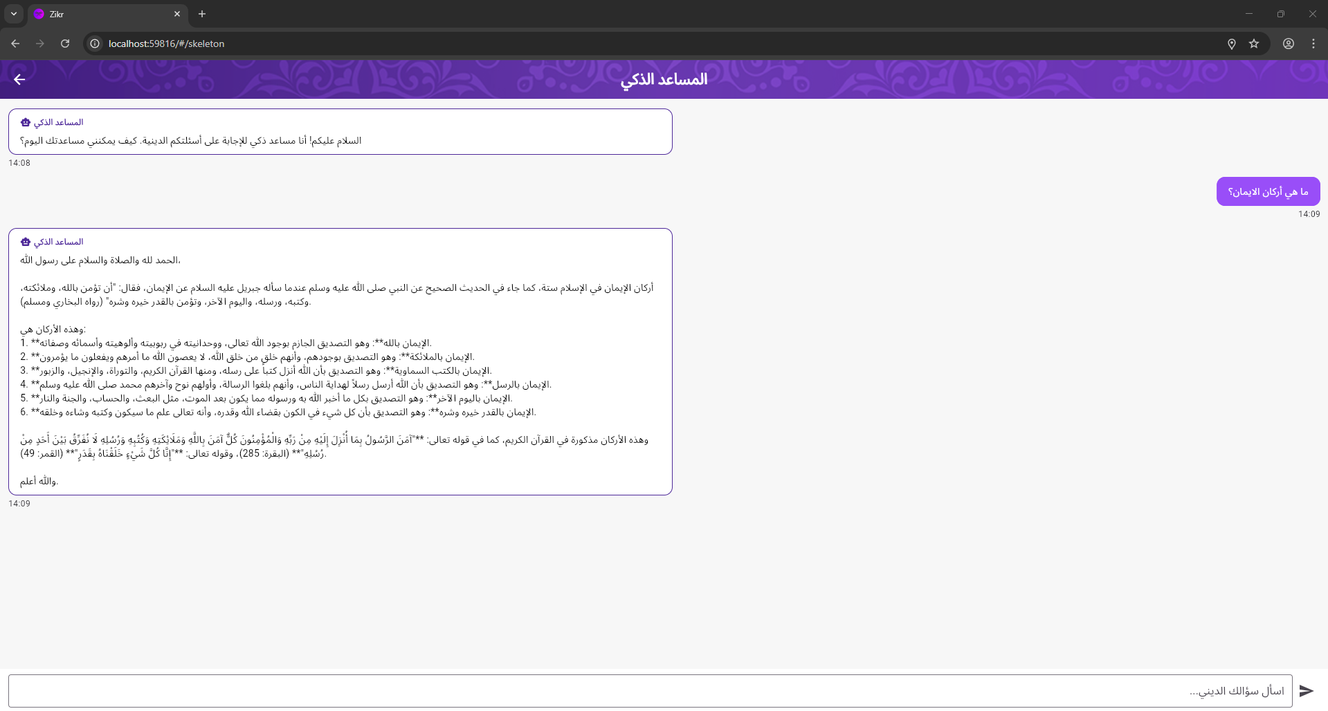
Workflow & Implementation
ESP32 Dashboard & IoT Features
Web-Based Interface Hosted on ESP32 as a WiFi Access Point
Real-Time Display Shows raw vs. filtered angles, LDR values, servo positions, power stats
Interactive Controls Manual servo positioning via sliders
Multi-Client Support Accessible from any device with a browser

Slide 12
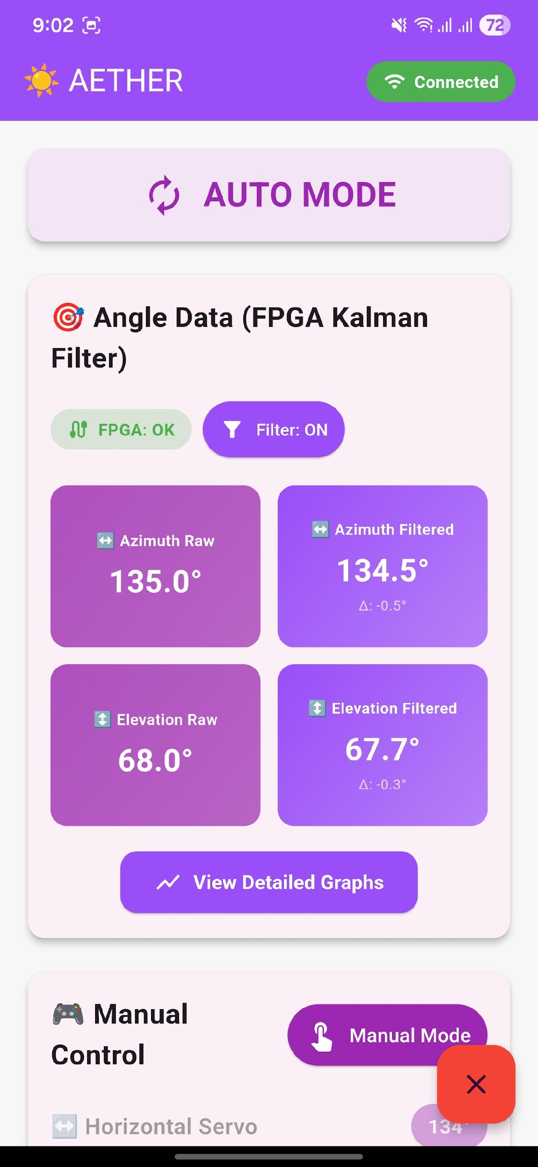
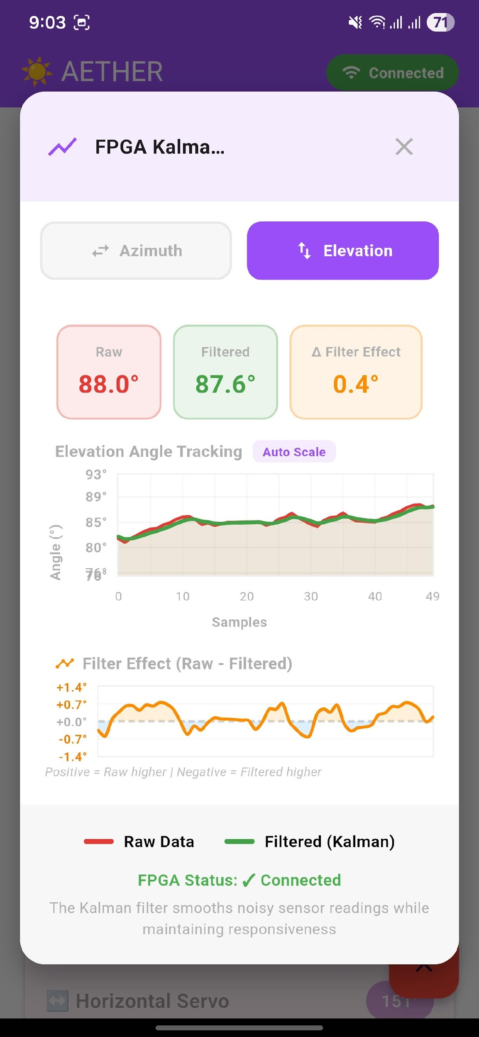
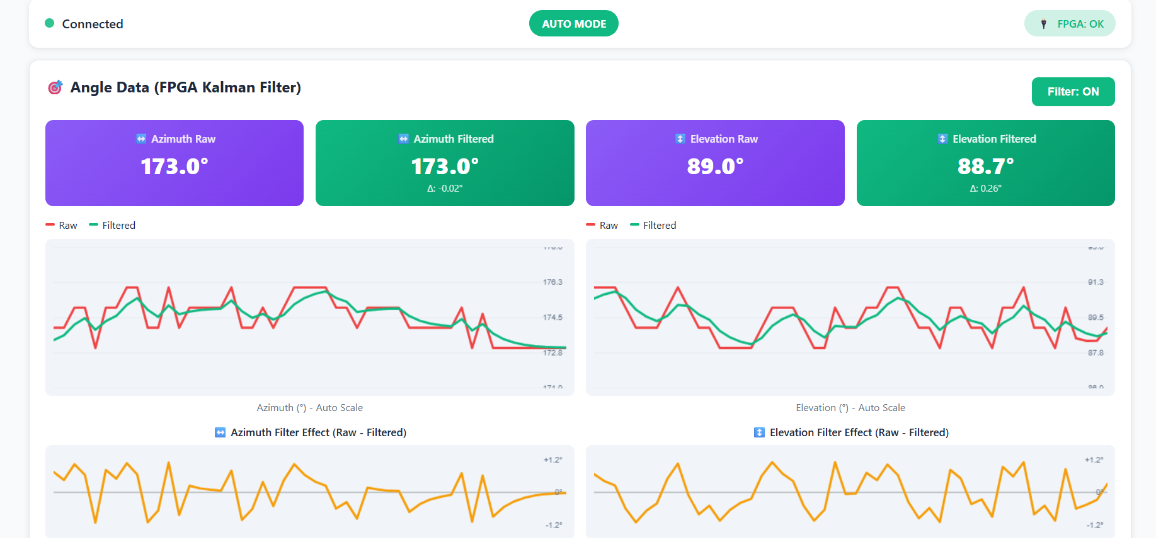
Dashboard (Angle Monitoring Screen)

Slide 13
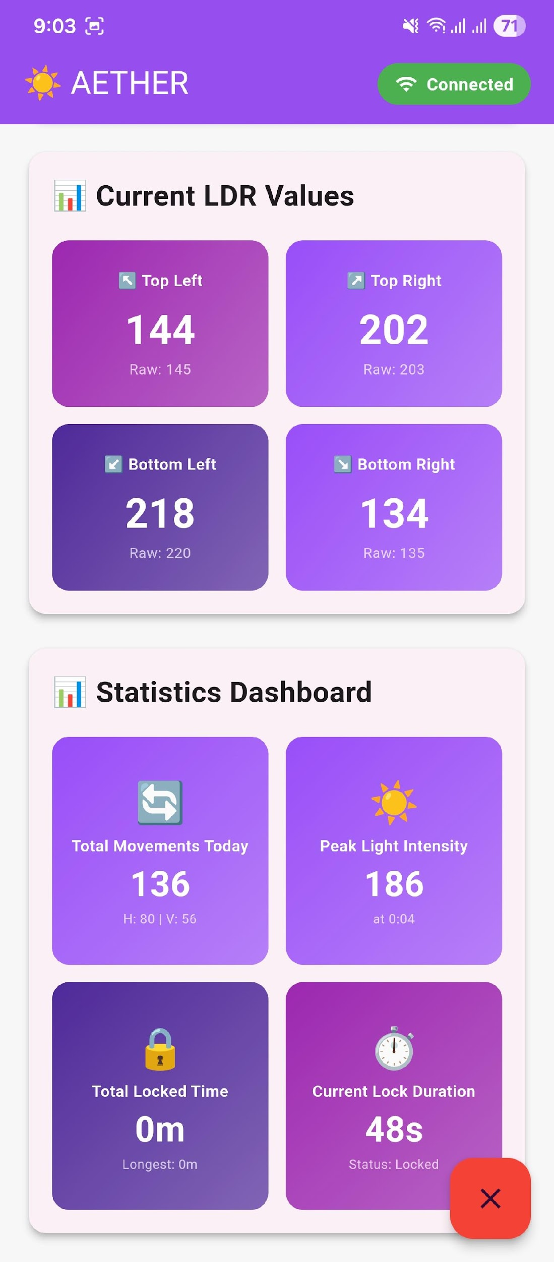
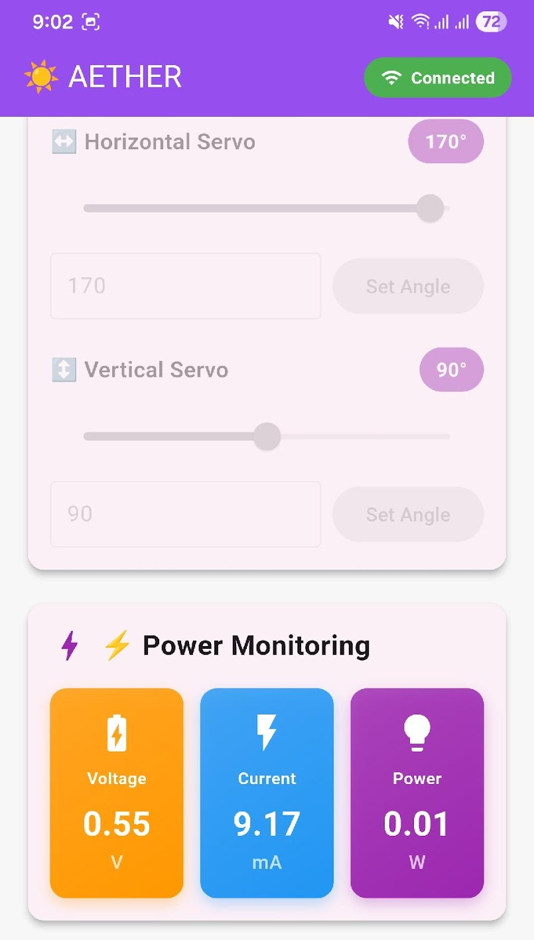
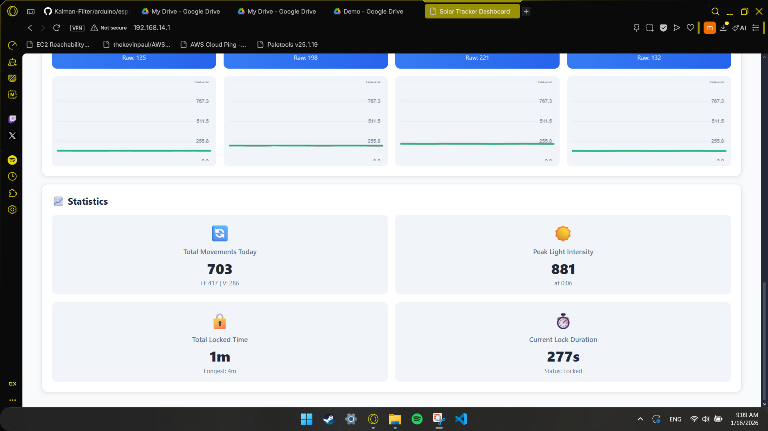
Dashboard (Sensor Dashboard)

Slide 14
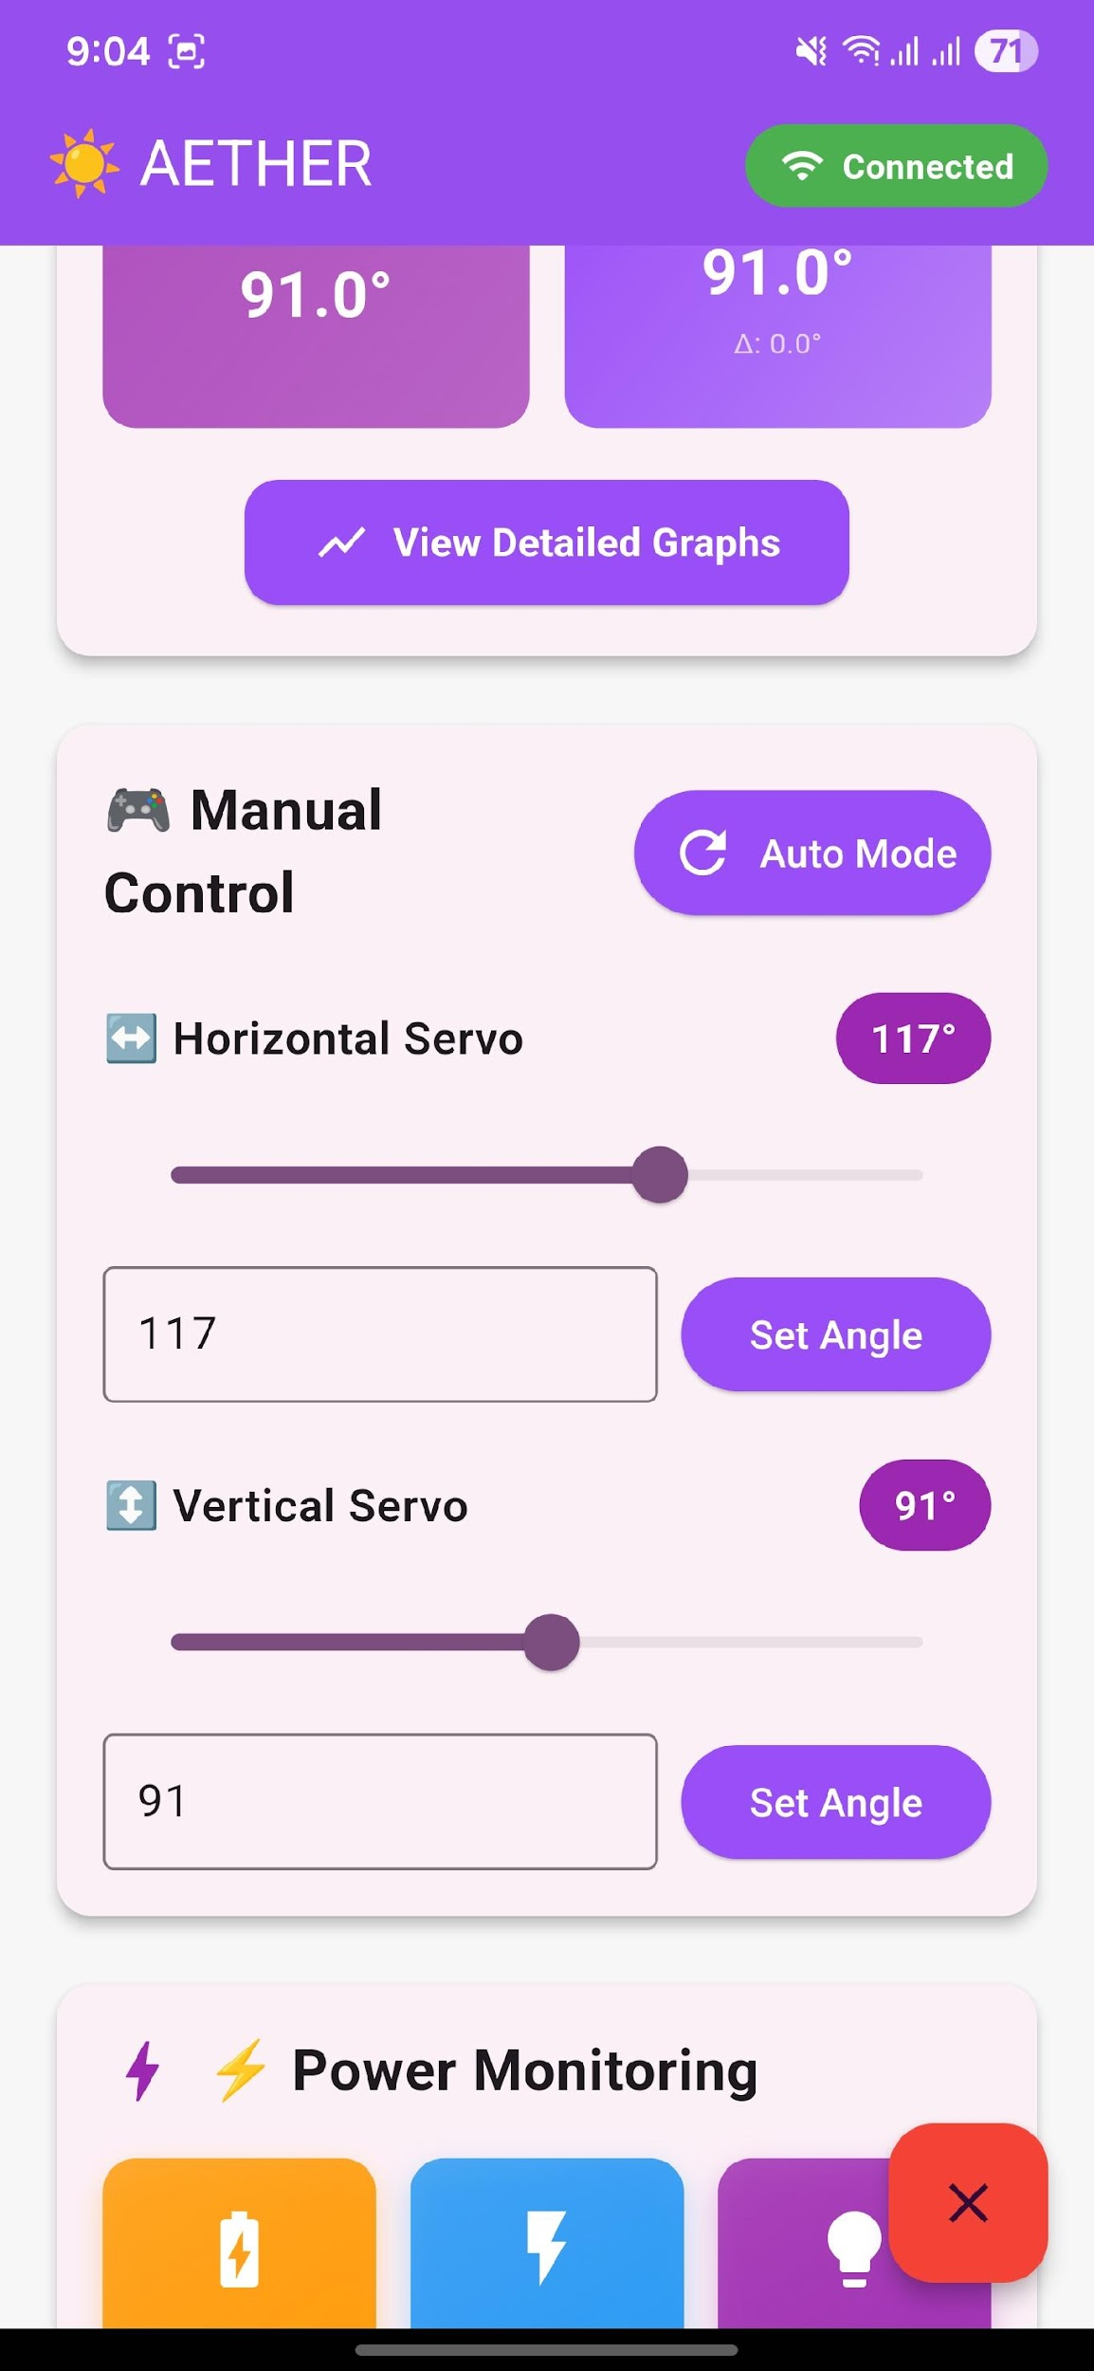
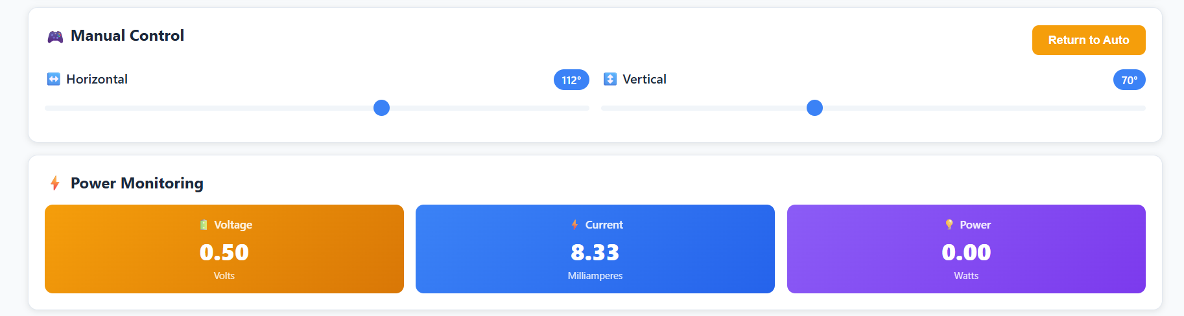
Dashboard (Manual Control Panel)

Slide 15
Key Implementation Choices
Modular firmware
Each platform runs independent code, communicating via clean serial protocols
Fail-safe operation System continues tracking even if FPGA or ESP32 fails

Slide 16
03
FPGA Kalman Filter

Slide 17
The Problem
LDR sensors provide noisy, unreliable angle data.
A standard microcontroller filtering this data is slow and compromises system responsiveness.
We need real-time, high-speed filtering to provide clean signals to the motor controller.

Slide 18
The Solution
Implement an Adaptive Scalar Kalman Filter directly in FPGA hardware.
The filter predicts the sun's position and optimally fuses this prediction with new sensor data.

Slide 19
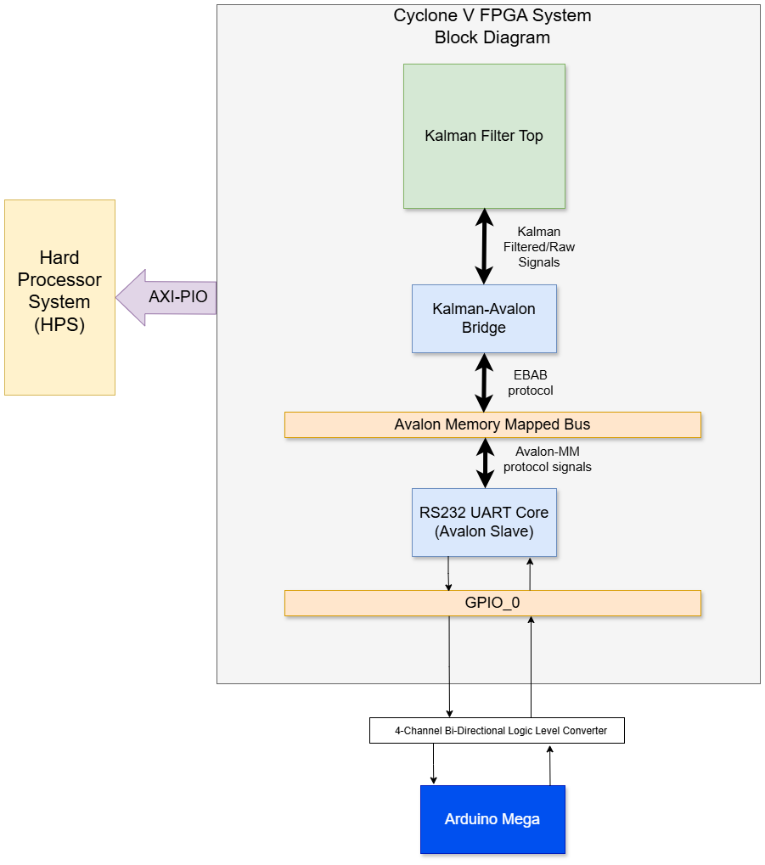
Top-Level Architecture

Slide 20
Top-Level Architecture
Our Implementation in FPGA Hardware:
Dual Kalman Filter Cores
Kalman-to-Avalon Bridge
UART Controller
Avalon-MM Interconnect connecting everything
PIO Ports enabling processor monitoring

Slide 21
Top-Level Architecture –cont.
Key Principle: All components communicate via the standard Avalon-MM bus, creating a modular, integrated hardware system where each part has a specialized role.

Slide 22
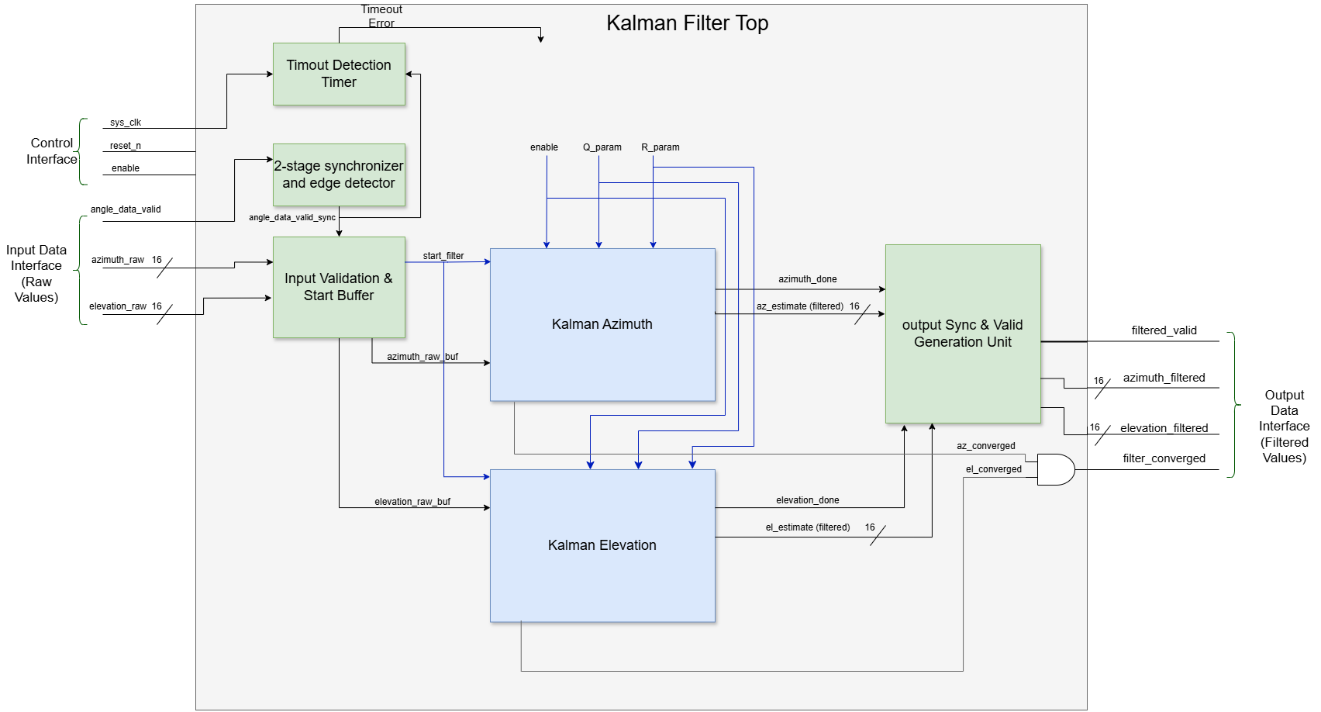
The Kalman Filter Module
Core Design: Two independent, parallel filter cores
Key Design Choices:
Fixed-Point Arithmetic (Q9.7)
Parallel & Pipelined Execution
Adaptive Noise Rejection

Slide 23
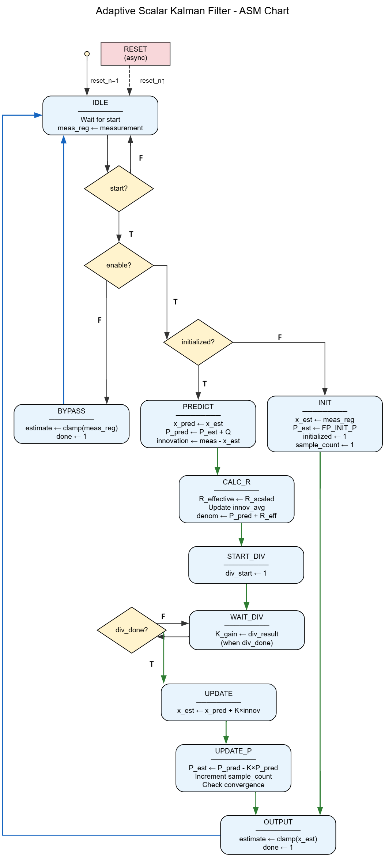
How it Works: The Filter’s ASM
The filter's operation is orchestrated by a simple, deterministic state machine in hardware:
PREDICT
CALCULATE R
COMPUTE GAIN
UPDATE
OUTPUT
This hardware ASM ensures precise, repeatable timing (29 Cycles), which is critical for stable real-time control.
Notes:
PREDICT: (State Prediction) Projects the previous state estimate $x_{est}$ forward using the system model. For our quasi-static sun, this is $x_{pred}=x_{est}$. Also, updates the error covariance $P_{pred}=P_{est}+Q$, where $Q$ is the process noise, modeling uncertainty from time passing.
CALCULATE R: (Adaptive Measurement Noise) Calculates the innovation ( $z−x_{pred}$ ) and dynamically scales the measurement noise covariance $R$ based on its magnitude. This adaptive step makes the filter robust to outliers.
COMPUTE GAIN: (Kalman Gain Calculation) Computes the optimal weighting factor, the Kalman Gain $K=P_{pred}/\left(P_{pred}+R\right)$. This gain dictates how much to trust the prediction vs. the new measurement.
UPDATE: (State Update) Fuses the prediction and measurement: $x_{est}=x_{pred}+K⋅\text{innovation}$. This yields the new minimum mean-square error (MMSE) state estimate.
OUTPUT: (Covariance Update & Output) Updates the error covariance for the next cycle: $P_{est}=\left(1−K\right)⋅P_{pred}$. The new optimal estimate $x_{est}$ is then output to the motor controller.

Slide 24
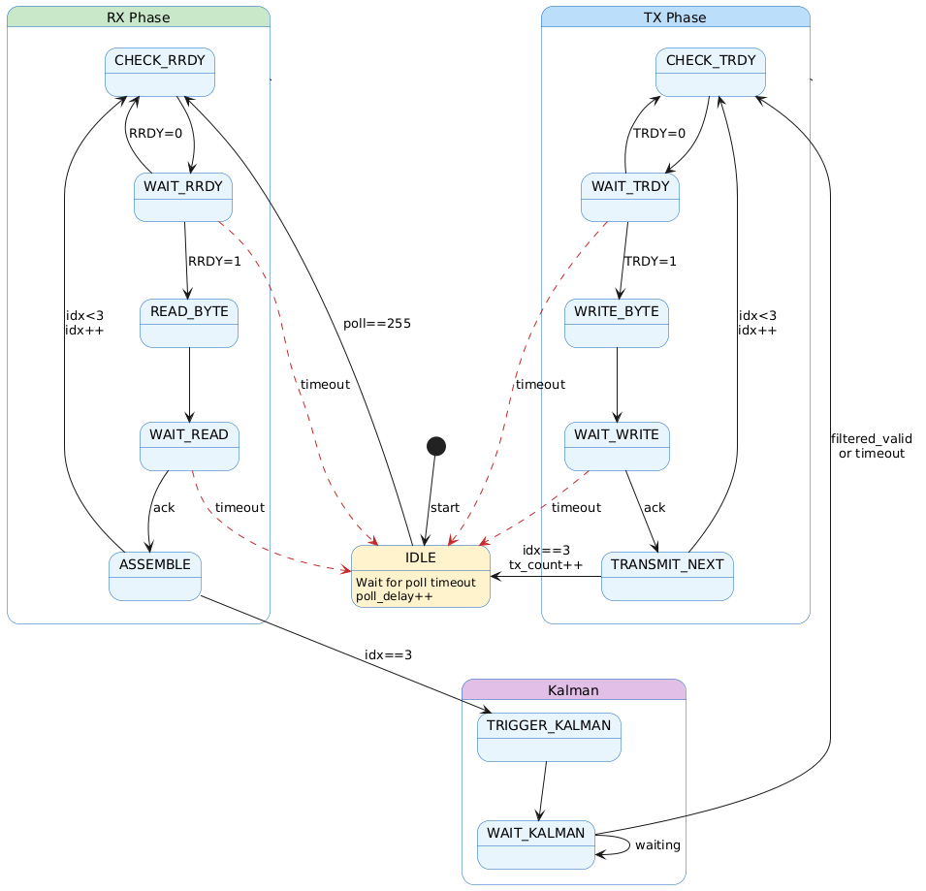
Data Transfer: The EBAB-Kalman Bridge
Interfaces Kalman filter with Avalon-MM
Polls UART, assembles 4-byte angle data
Triggers Kalman filter and returns results
Handles all bus timing and flow control

Slide 25

04
Analysis and Results

Slide 26
Testing Methodology: Kalman Filter Verification
Goal: Prove the filter works correctly under various conditions.
Method: Comprehensive SystemVerilog simulation with 7 realistic test scenarios (5,000 samples each).

Slide 27
Kalman Verification –cont.
Test Scenarios Include:
Normal Tracking: With mild noise.
Noise & Spikes: With severe noise spikes.
Sudden Changes.

Slide 28
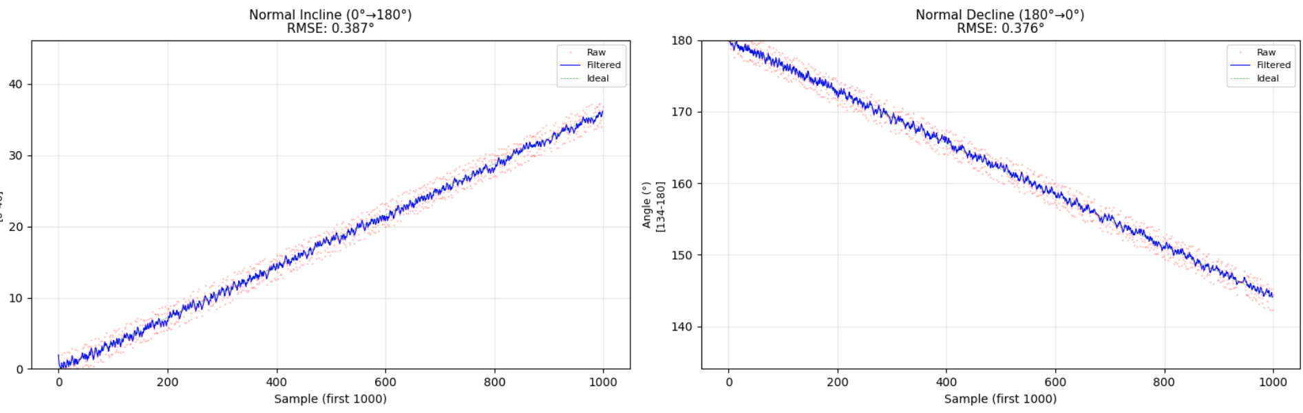
Normal Incline/Decline

Slide 29
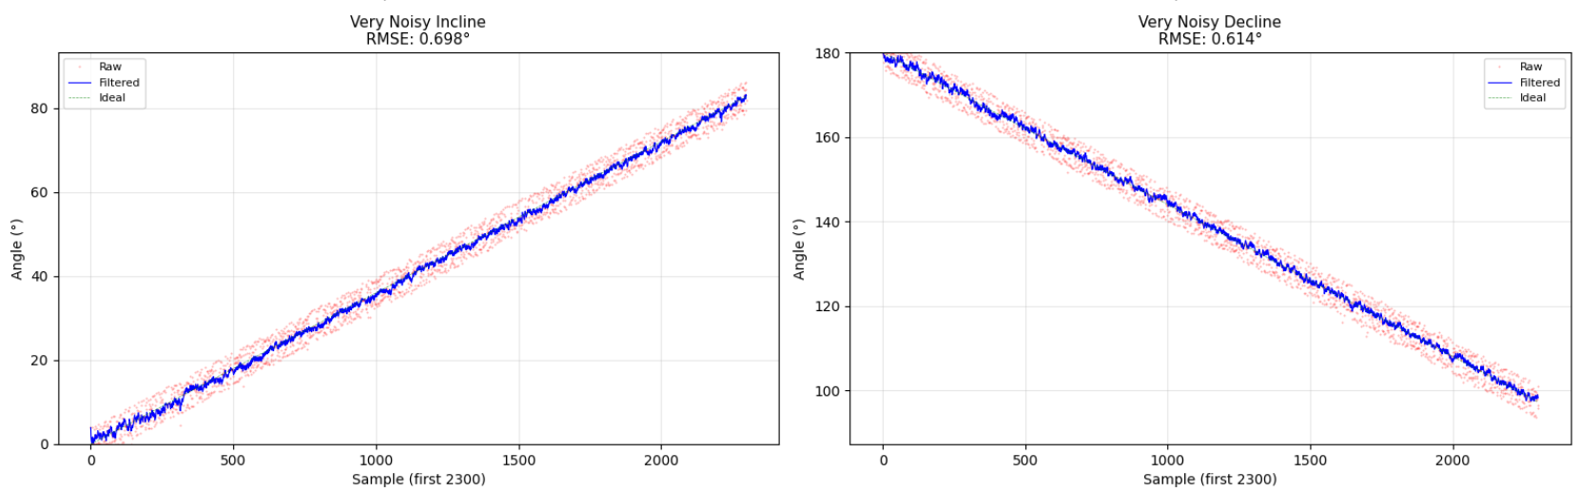
Noisy Incline/Decline

Slide 30
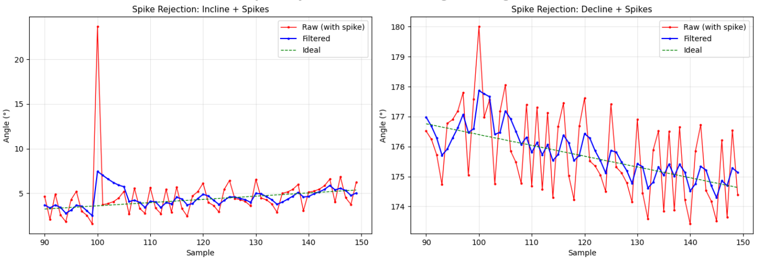
Spike Rejection

Slide 31
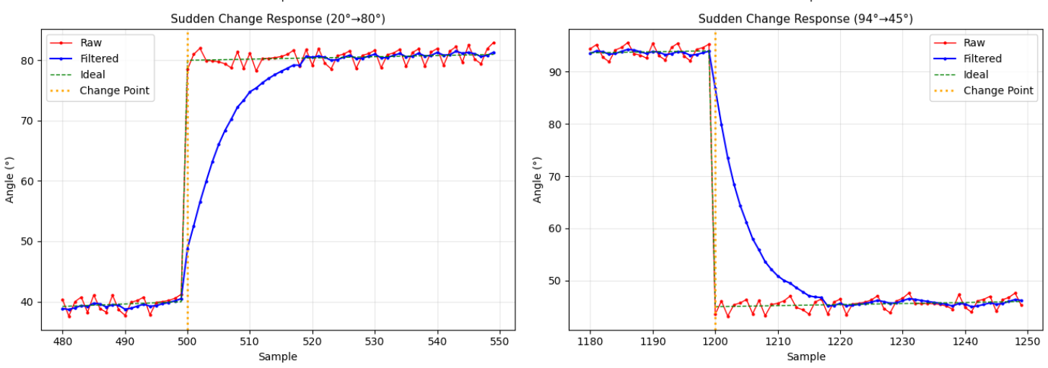
Sudden Change Response

Slide 32
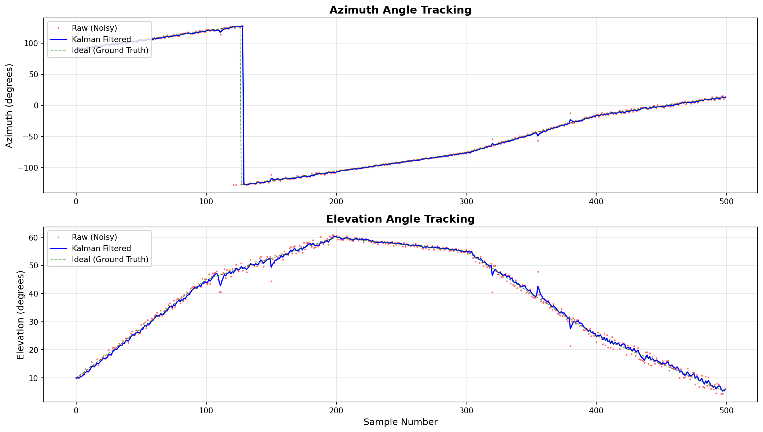
AI Track: RAG Fatawa Chatbot

Slide 33
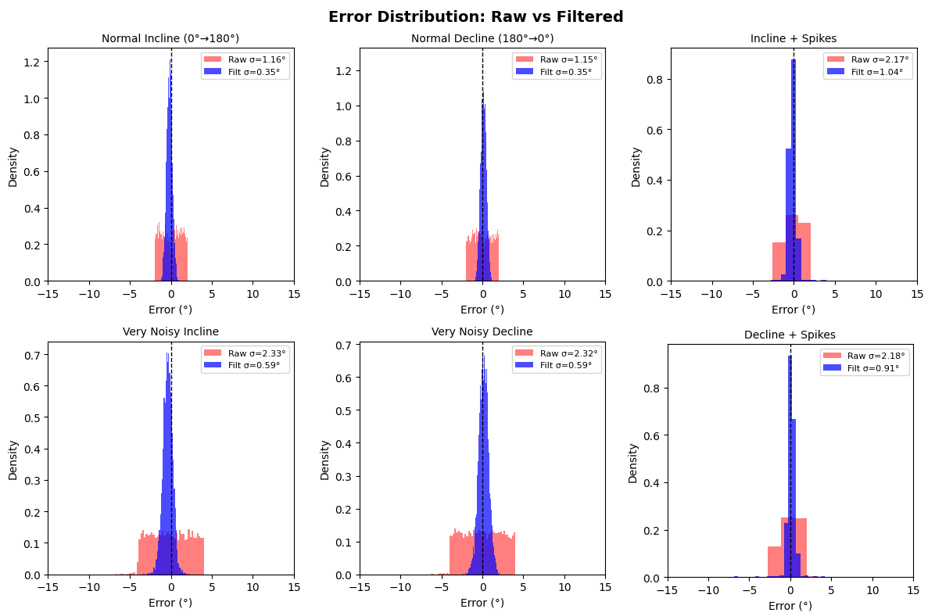

Slide 34
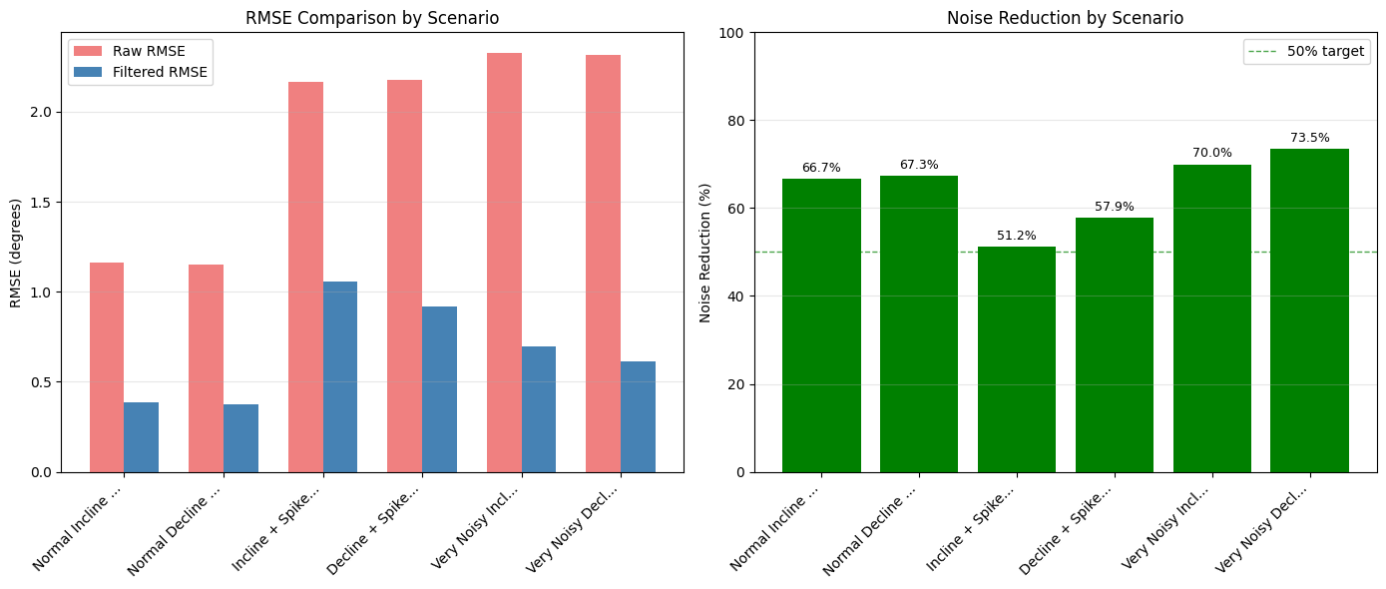
Performance Summary

Slide 35
FPGA Utilization
Logic Elements: 14%
DSP Blocks: 18%
Total block memory: 28%
Available Headroom → FPGA capacity is available for future upgrades

Slide 36
05
Conclusion & Future Work

Slide 37
Conclusion
Built a working heterogeneous solar tracker (Arduino, FPGA, ESP32)
FPGA Kalman filter reduced sensor noise by 51-74%
Proved that specialized, heterogeneous architecture works effectively
Created a blueprint for high-performance embedded systems

Slide 38
Future Work
Self-Optimizing Filter: Use the on-chip ARM processor to dynamically adjust filter parameters.
FPGA Power Optimization: Implement advanced techniques like clock gating, dynamic frequency scaling, and low-duty-cycle operation during stable periods
3. Machine Learning Integration: Enhance existing monitoring capabilities to integrate a machine learning for fault detection and power degradation.

Slide 39
Thanks
Any questions?

