Slide 1


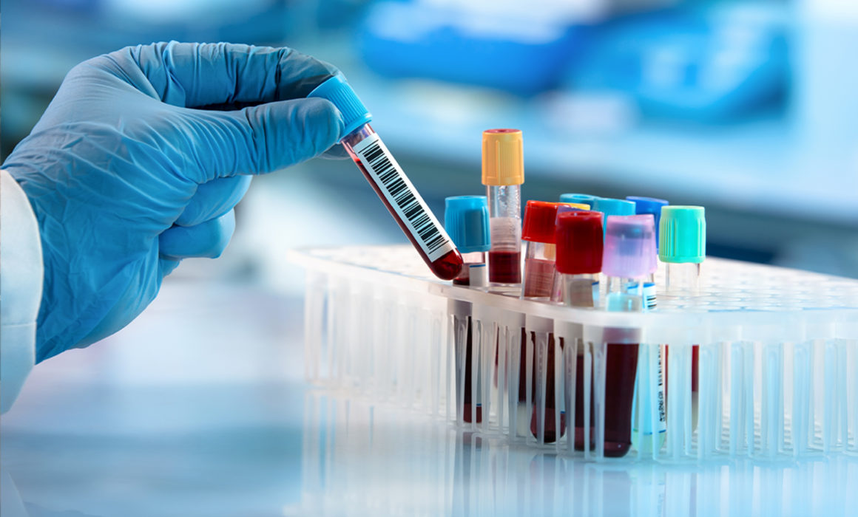
MIS
2022
Graduation Project
Applying data mining algorithm on Al-hakim CBC data to prepare for a disease’s prediction application

Slide 2



Our team
D
I
A
L
Aya Ramadan
Lara Break
Dania Taqtouq
Ikhlas Amer
Supervised By:
M
Dr.Maher Abu-Baker

Slide 3
1
Introduction
2
Project Goal
content
3
Tools Used
Table of contents
4
Data Mining Work Flow
5
Descriptive statistic
6
Algorithms
7
The Result
3

Slide 4
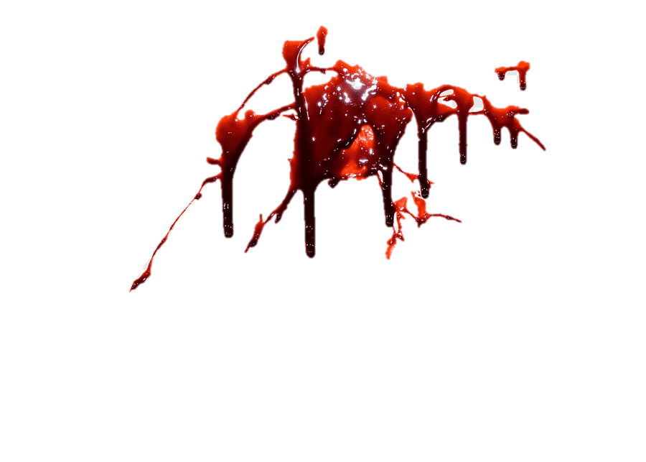
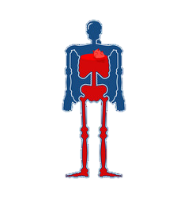
Introduction
CBC : A complete blood count is a blood test used to evaluate the overall health and detect a wide range of disorders.
These tests are included in the CBC: Hb, HCT, Lymphocytes, MCH, MCHC, MCV, Neutrophile, PLT, RBCs, WBCs.

Slide 5
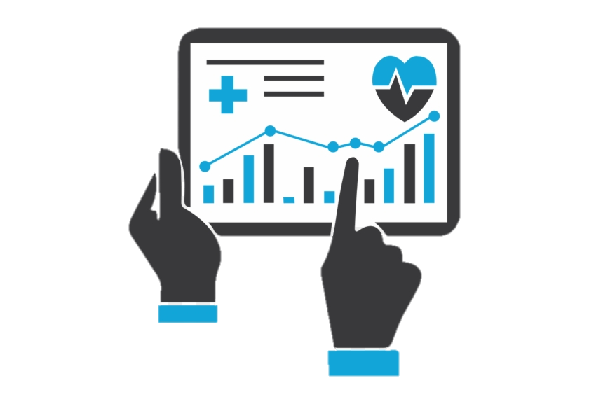
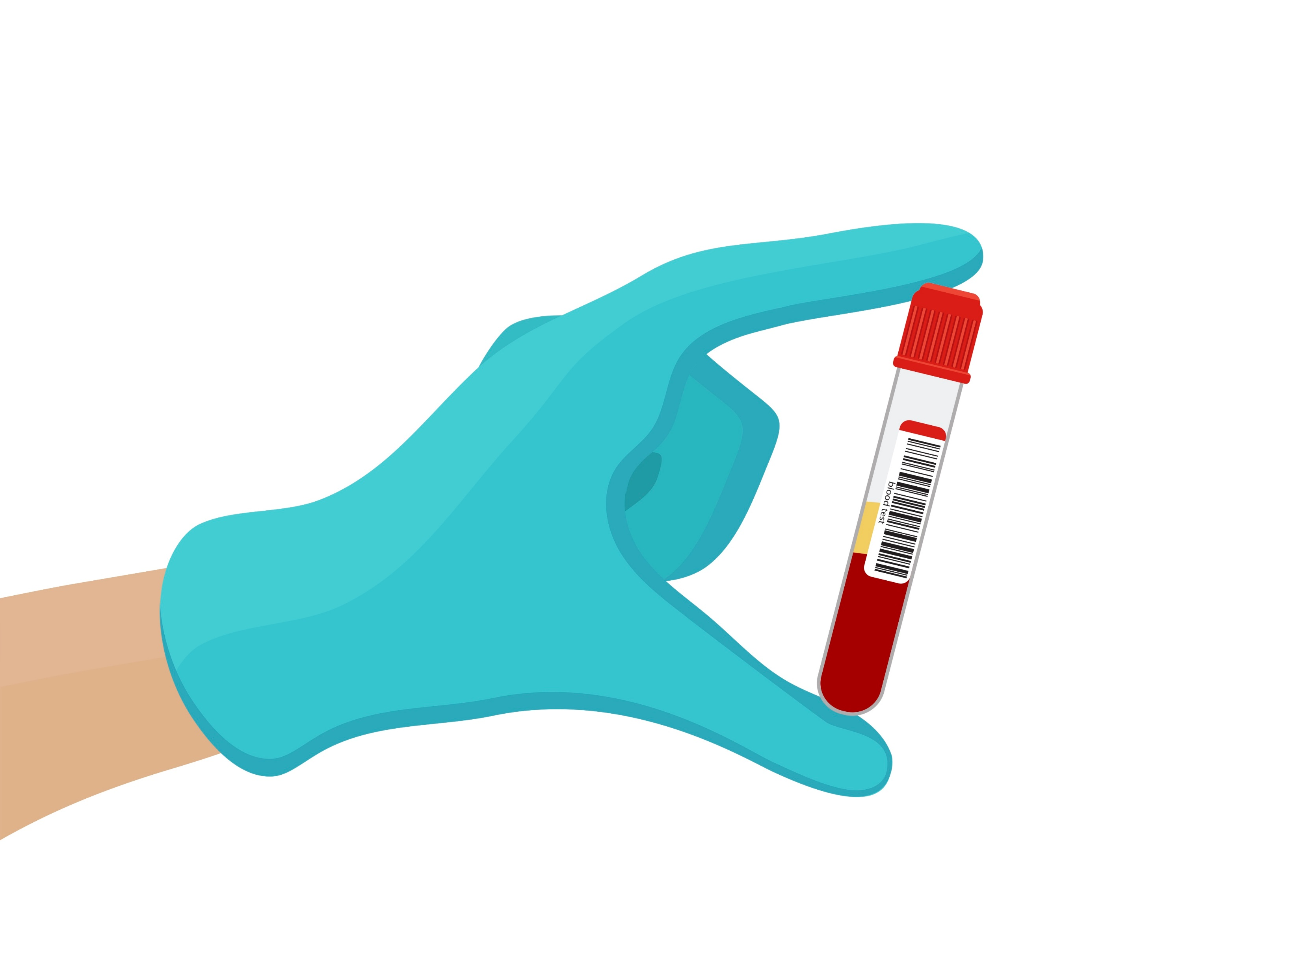
Project Goal:
Use data mining application and algorithm to prepare for medical automated system.

Slide 6




Tools Used
Excel
Python
Anaconda
Jupyter

Slide 7

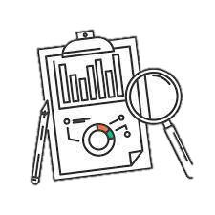

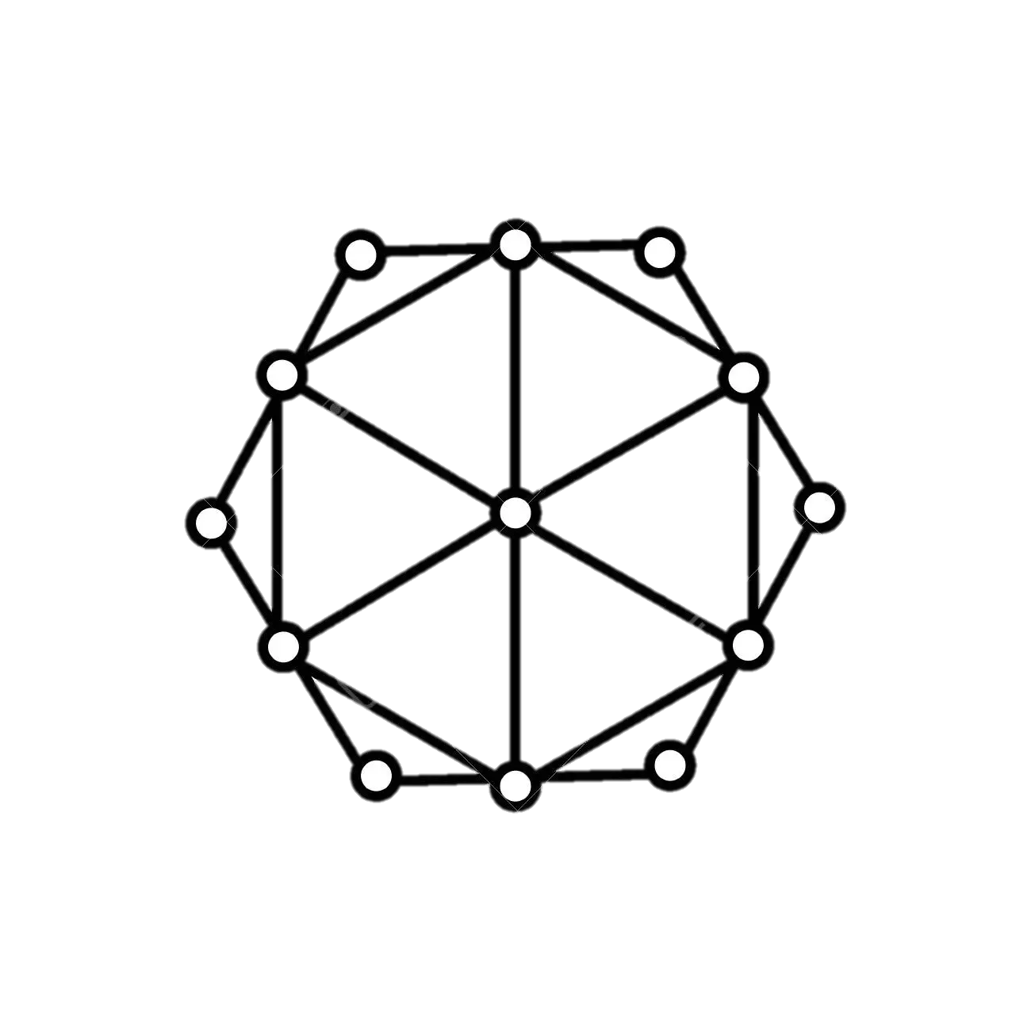
Data Mining Work Flow
01
02
03
04
Obtaining
data
Data
understanding
Data
preparation
Modeling

Slide 8


OUR JOURNEY
01
Obtaining Data
1

Slide 9

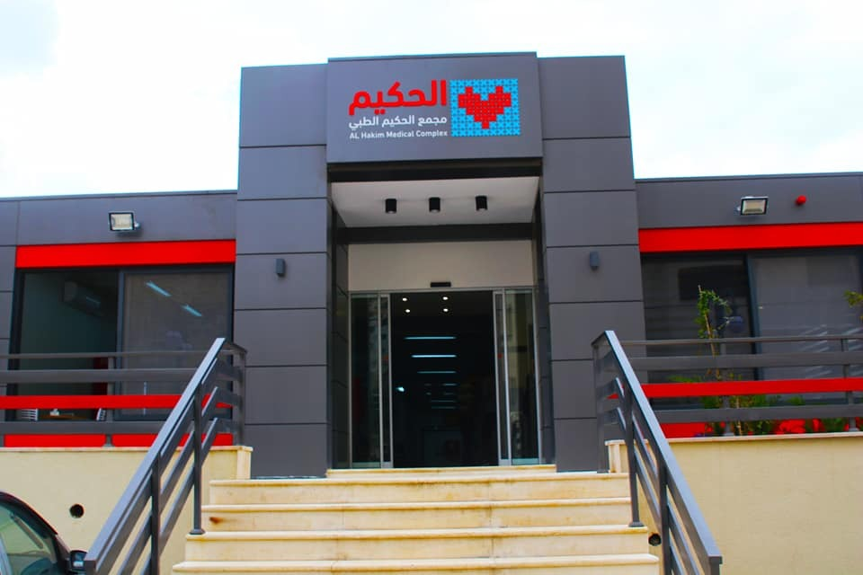

Obtaining Data
We got CBC data from Al-Hakim Medical Complex because we need real data, and this is what Data Mining requires.

Slide 10
OUR JOURNEY
02
Data Understanding
2

Slide 11
Our Dataset
We had 174,000 patients’ records, and 12 attribute sets. These 174,000 records have gone under the processing step to settle into 10,000 patients records, and 15 attribute sets with new attribute "cluster id" that indicate which cluster the patient belong.

Slide 12
OUR JOURNEY
03
Data preparation
3

Slide 13
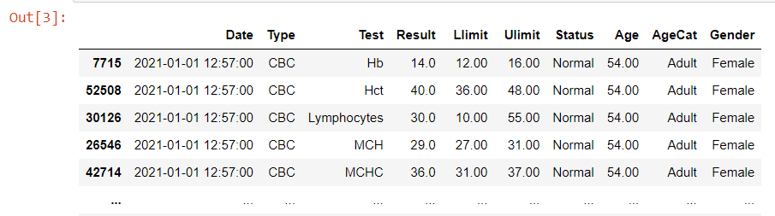
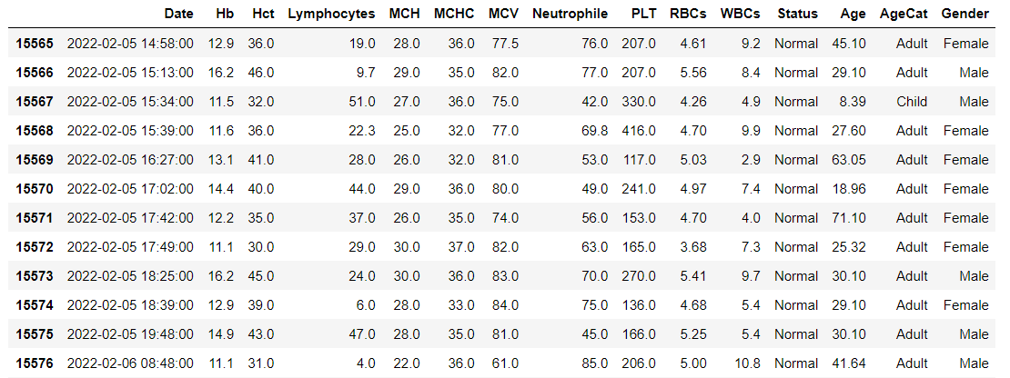
Every 10 record was represent one patient
Each record represents one patient and the tests he performed

Slide 14
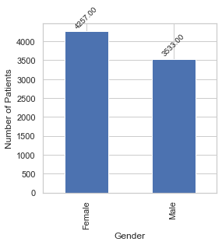
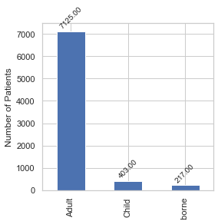
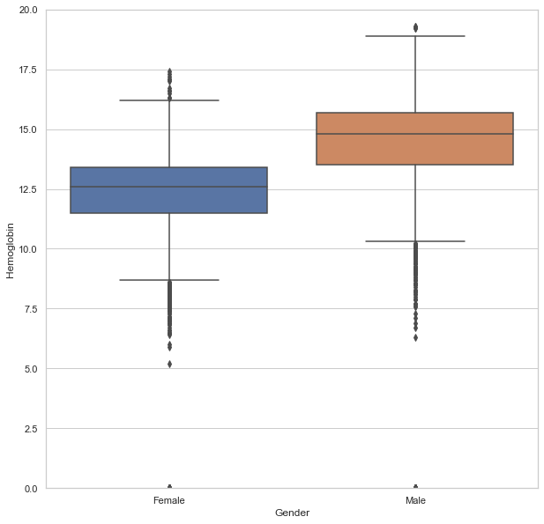



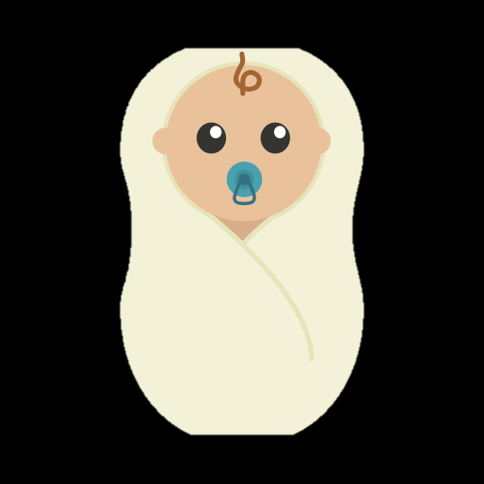

Descriptive statistics

Slide 15
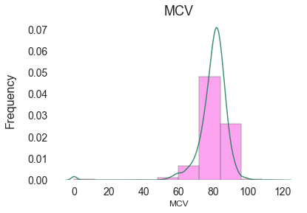
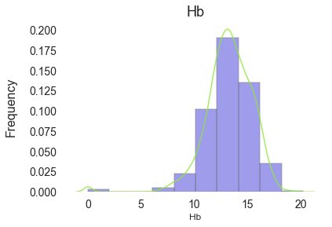
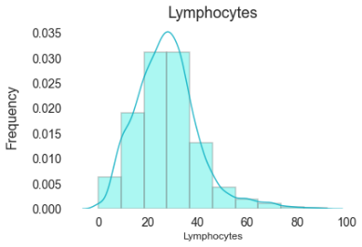
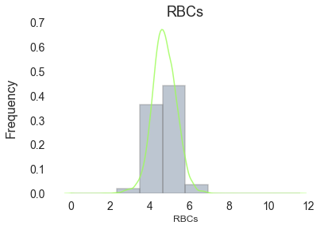
Ensure that the data is normally distributed
Mean: | Test:
13.255128 | Hb
37.784121 | Hct
27.596021 | Lymphocytes
28.120501 | MCH
35.034891 | MCHC
79.816239 | MCV
64.194881 | Neutrophile
240.772786 | PLT
4.733117 | RBCs
8.307985 | WBCs
Normal range for male = 80 – 100
Normal range for female = 80 -97
Normal range for male = 13.2 – 17.5
Normal range for female = 12 -16

Slide 16
OUR JOURNEY
04
4
Modeling

Slide 17

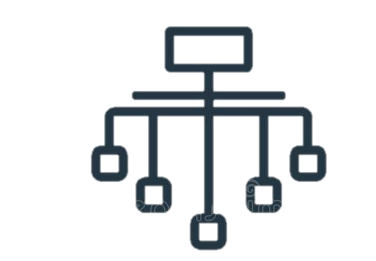
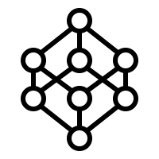
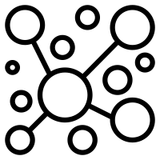
4 Algorithms was applied , which are:
Association rule
Clustering
Classification
Prediction

Slide 18
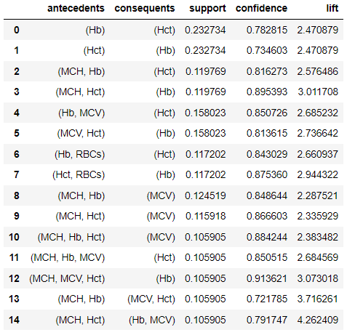
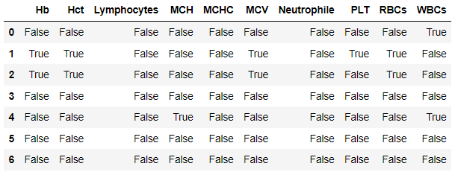
1. Association rule
Apriori algorithm

Slide 19
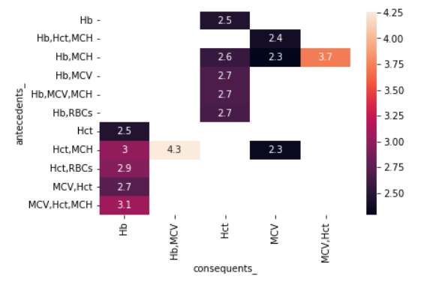
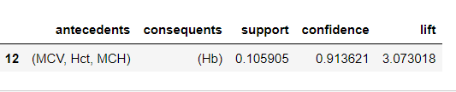
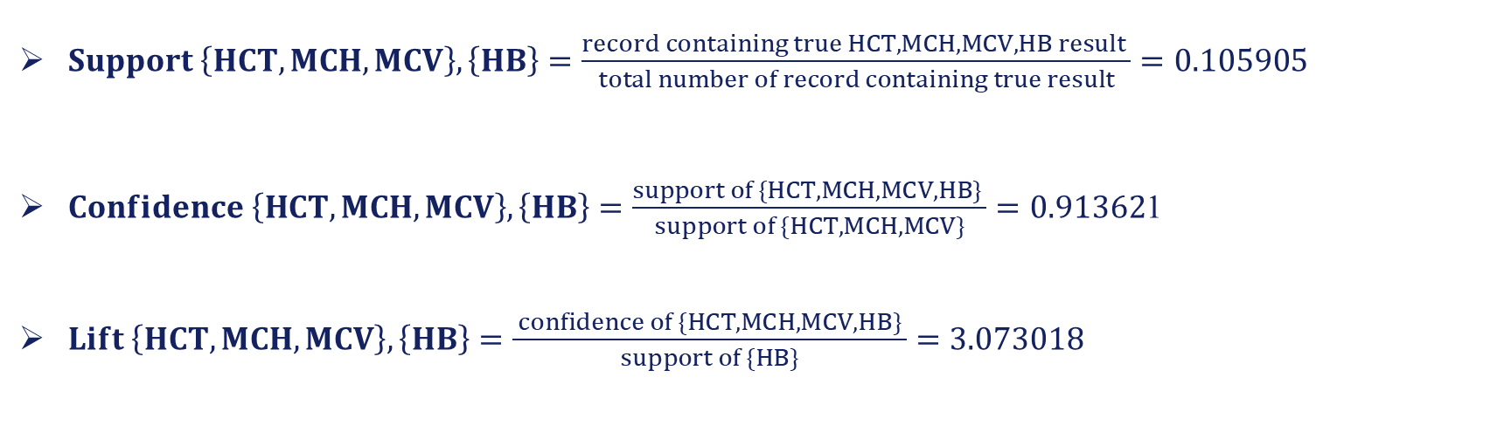
The end result shows a relationship between those tests :
$Support \left\{HCT, MCH,MCV\right\}, \left\{HB\right\}=\frac{record containing true HCT, MCH,MCV,HB result }{total number of record containing true result}=0.105905$
$Confidence \left\{HCT, MCH,MCV\right\}, \left\{HB\right\}=\frac{support of \{HCT, MCH,MCV,HB\} }{support of \{HCT, MCH,MCV\}}=0.91362$1
$Lift \left\{HCT, MCH,MCV\right\}, \left\{HB\right\}=\frac{ confidence of \{HCT, MCH,MCV,HB\} }{support of \{HB\}}=3.073018$

Slide 20

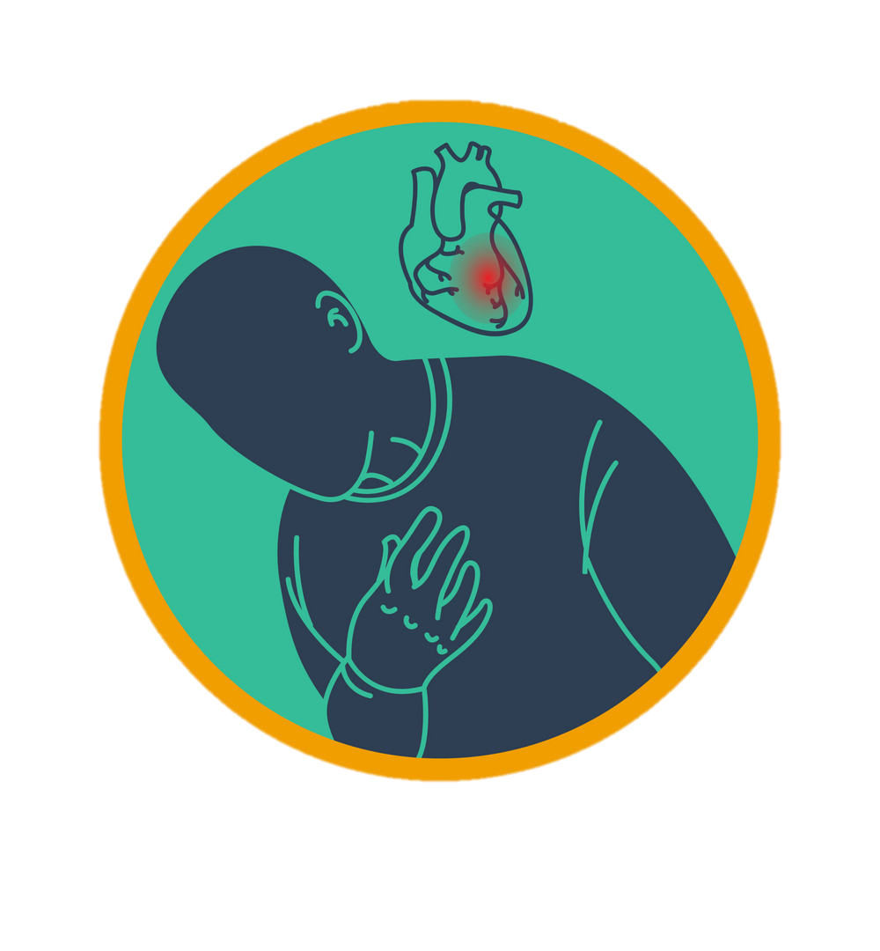
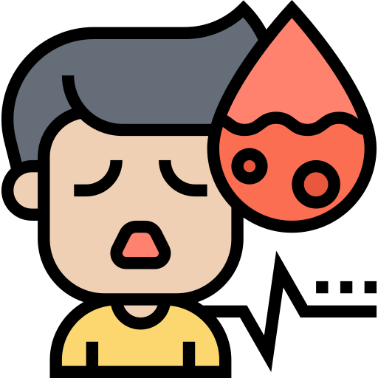
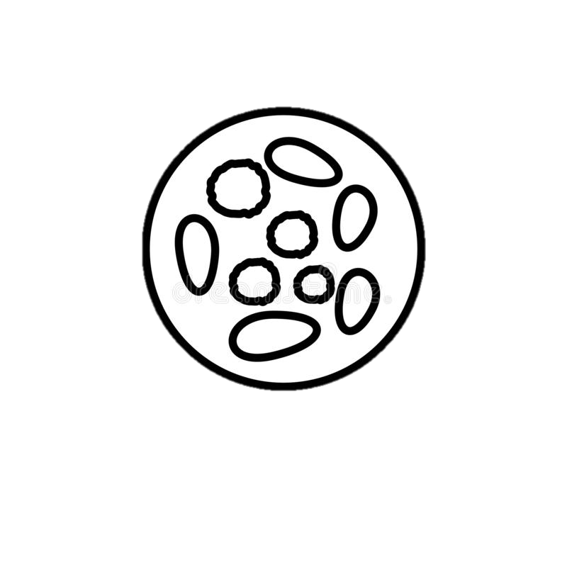

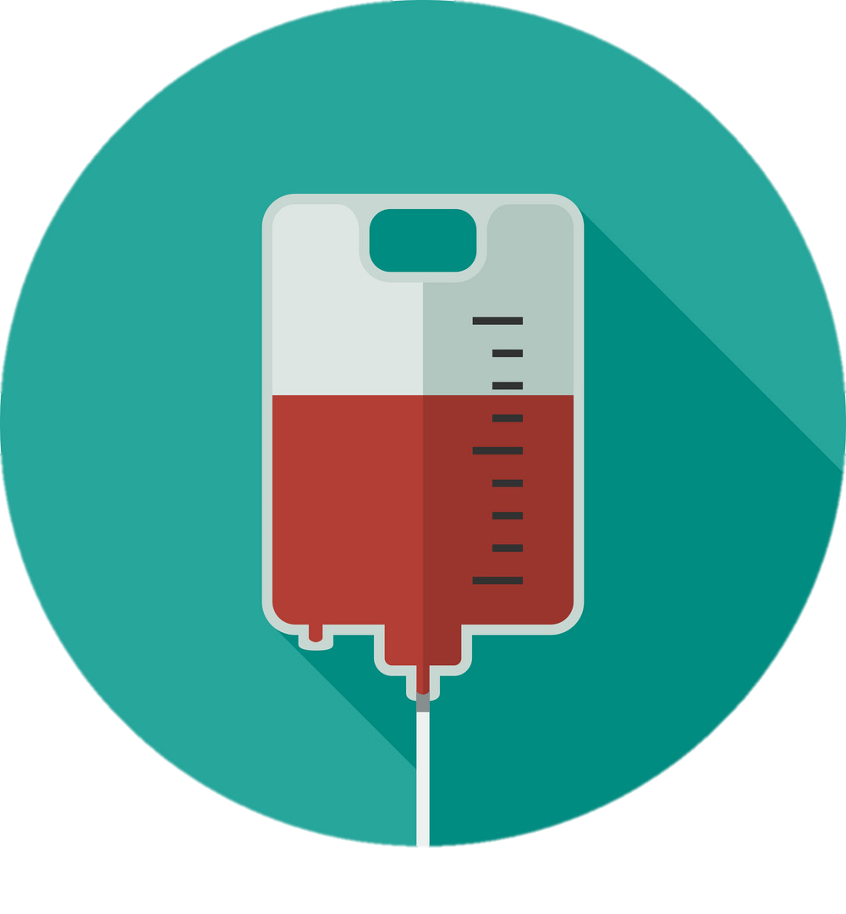
Refer to references :
Low results indicates :
High results indicates :
Anemia
Heart disease
Patient is a smoker
( needs to donate blood)
Thalassemia

Slide 21
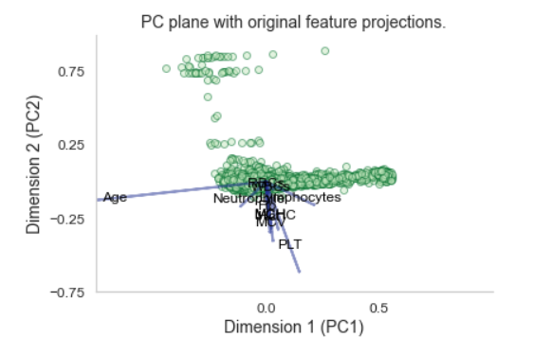
Principal component analysis (PCA)
The main aim of using PCA :
Reduce the dimensionality of large data sets, but at the same time minimize information loss.
PCA is used to obtain a two-dimension (2D) visualization of all tests through convert a number of interrelated variables to fewer non-interrelated variables, to calculate the major components that have the greatest impact.

Slide 22
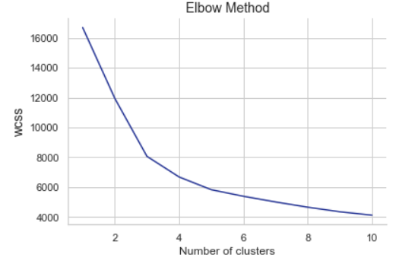
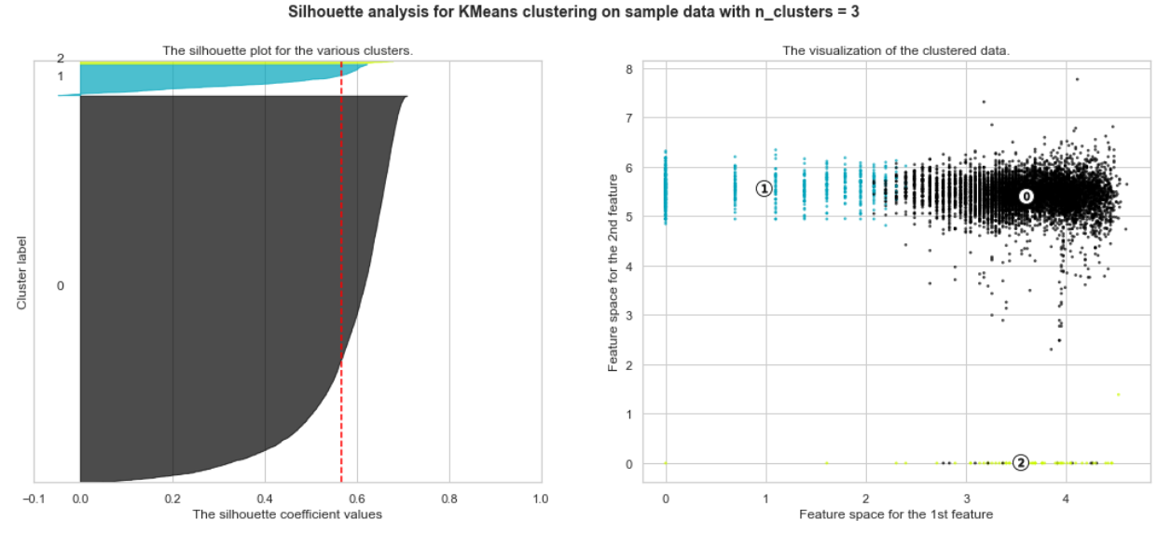
2. Clustering :
Two methods were used to determine the number of clusters:
Elbow method
Silhouette
3
The previous methods emphasize the number of three clusters

Slide 23
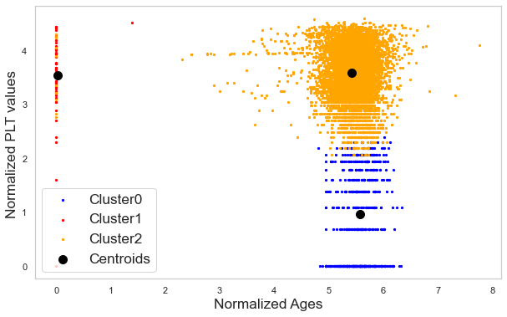
2. Clustering :
K-means clustering
The K represents the number of cluster , and it turned out as shown from the graph that the number of cluster is 3.

Slide 24
3. Classification
Three methods were used:
1. Support Vector Machine classifier (SVM)
2. Random Forest Classifier (RFC)
3. Neural Network (NN)

Slide 25
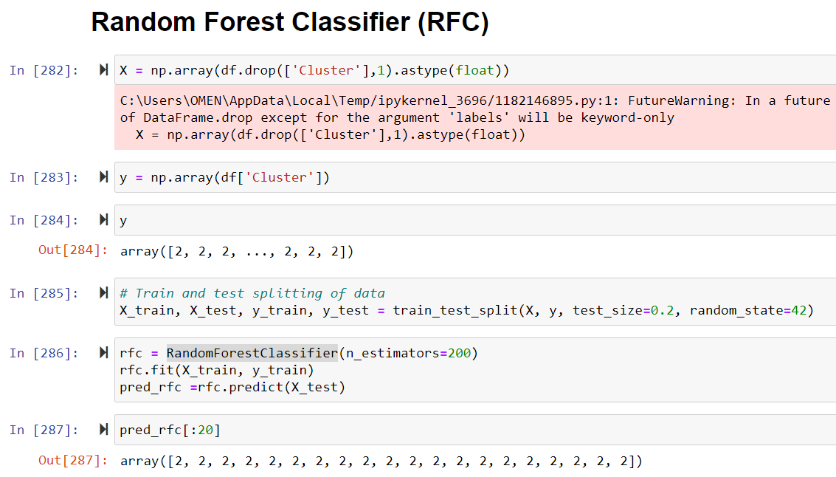
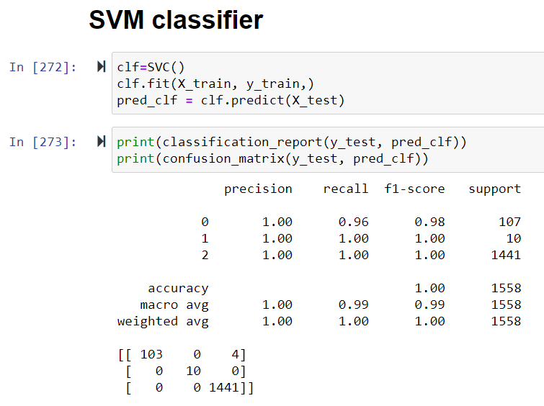
1. Support vector machine (SVM)
CBC data set is divided into the training data set and test data set, the test data set is 20% of the data set.

Slide 26
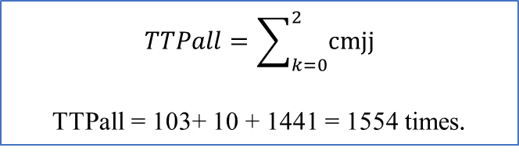


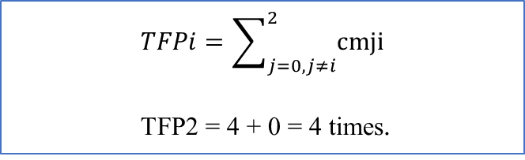
$$TTPall=\sum_{k=0}^{2}{cmjj}$$
TTPall = 103+ 10 + 1441 = 1554 times.
$$TFPi=\sum_{j=0,j≠i}^{2}{cmji}$$
TFP2 = 4 + 0 = 4 times.
Confusion Matrix
Class | 0 | 1 | 2
0 | 103 | 0 | 4
1 | 0 | 10 | 0
2 | 0 | 0 | 1441
$$TFNi=\sum_{j=0,j≠i}^{2}{cmij}$$
TFN1 = 0 + 0 = 0 times.
$$TTNi=\sum_{j=0,j≠i}^{2}{}\sum_{k=0,k≠i}^{2}{cmjk}$$
TTN1 = 103+ 1441 + 4 = 1548 times

Slide 27
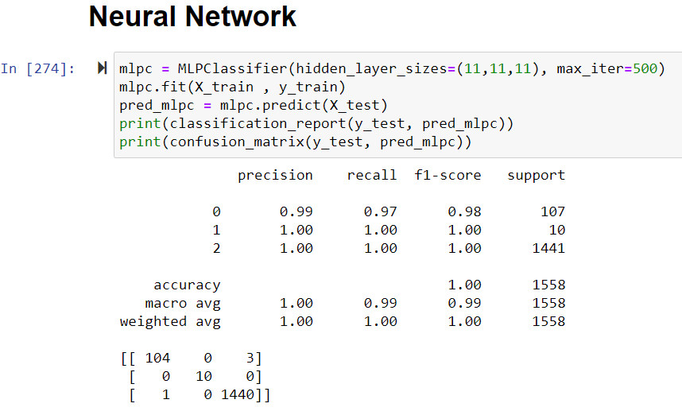
2. Random Forest Classifier (RFC)
Class | 0 | 1 | 2
0 | 1440 | 0 | 1
1 | 0 | 10 | 0
2 | 2 | 0 | 105
(n_estimators=200) indicate to the number of trees in the forest.
3. Neural Network (NN)
Class | 0 | 1 | 2
0 | 104 | 0 | 3
1 | 0 | 10 | 0
2 | 1 | 0 | 10

Slide 28

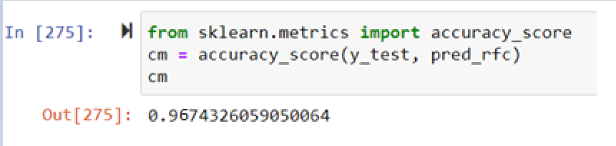
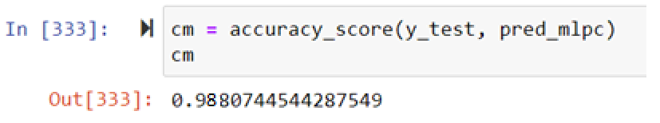
The accuracy of the three classification methods
SVM
Finally, we conclude that SVM classifier can be used to predict whether a patient will belong to the cluster id (class) 0, 1, or 2 with a high degree of accuracy (99%).
RFC
NN

Slide 29
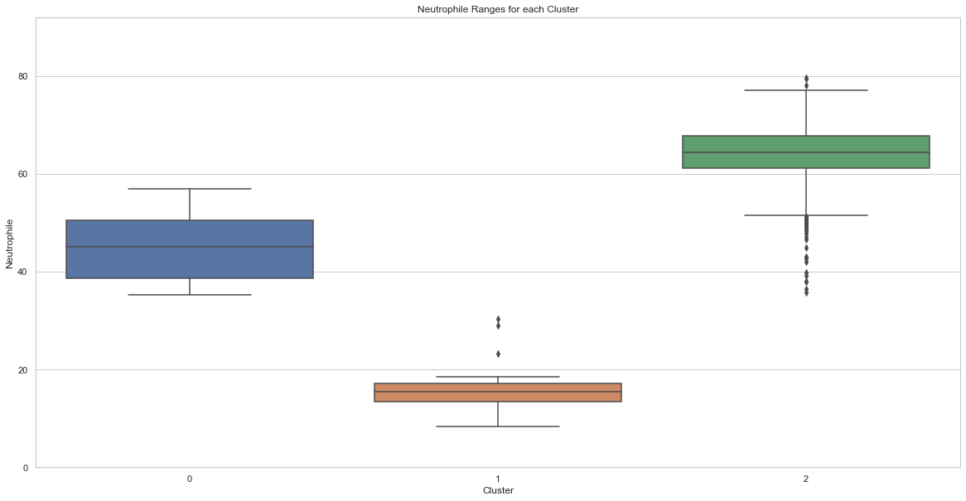
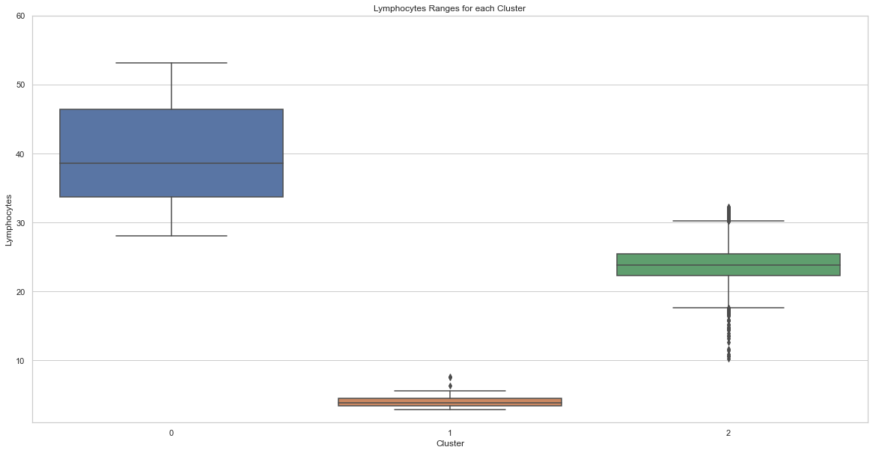
Test ranges for each cluster
Range for cluster 0 : 35 - 55
Range for cluster 1 : 15 - 20
Range for cluster 2 : 50 - 75
Range for cluster 0 : 28 – 52
Range for cluster 1 : <=10
Range for cluster 2 : 18 - 30

Slide 30
Test | Cluster 0 | Cluster 1 | Cluster 2
Hb | 10.5 - 14.2 | <= 6 | 14.5 - 15.8
Hct | 28 - 40 | <= 15 | 40 - 48
Lymphocyte | 28 - 52 | <=10 | 18 - 30
MCH | 22 - 32 | <=7 | 25 - 35
MCHC | 29 - 42 | <=10 | 28 - 44
MCV | 58 - 92 | <= 20 | 65 - 110
Neutrophile | 35 - 55 | 15 - 20 | 50 - 75
PLT | 170 - 360 | <= 50 | 140 - 320
RBCs | 4.6 - 4.7 | 3.9 - 4.1 | 4.9 - 5
WBCs | 6.8 - 8.8 | 4.5 - 5.2 | 6 - 7.4
The table shows the ranges for each of the tests in each cluster, noting that the clusters differ from one test to another.

Slide 31
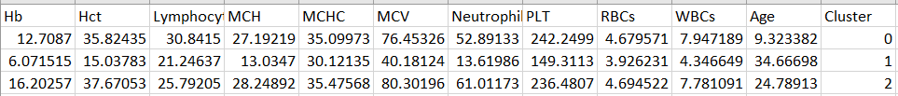
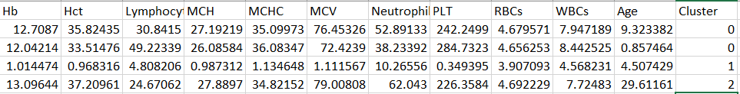
The Result
This is how the final excel file looked like, which contains a classification of each patient to which cluster the patient belongs to
Now ,we have complete preparation for the future
Medical Automated System

Slide 32
Thank You !
Any Question ?

