Slide 1
Liver Disease Prediction Using Machine Learning Algorithms
Proposed by :
Worood Hanani
Areej Awad
Supervisor : Dr. Saed Tarapiah

Slide 2
  Introduction:
Many people suffer from liver diseases but they have no idea about them .When the disease start spreading it is very difficult to determine it despite of issues that have been affected on the person and have been damaged it. the liver continues to work even if it a partial damage and therefore it is extremely necessary to detect the disease early and know the problem which reduces Life risks for patient life’s . This project shows an intelligent system that performs the task of detecting whether a person, has liver disease or not early using machine learning algorithms.

Slide 3
Project Objectives:
This project aims to implement a system for early detection of disease, based on machine learning algorithms depends in a medical examinations and data for another patient in medical image processing. The system allows the results appear to the patient.

Slide 4
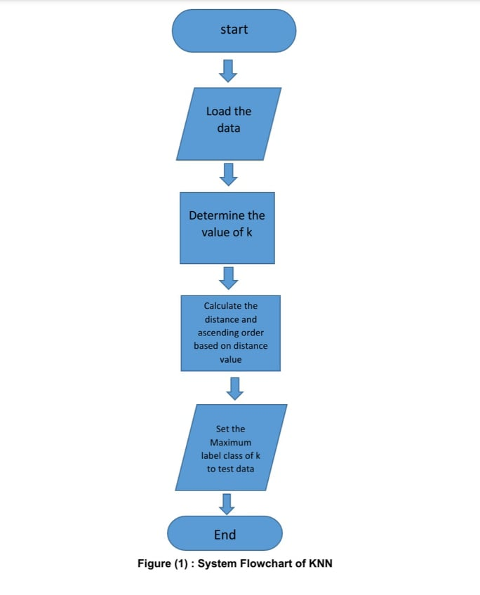
K – Nearest Neighbor(KNN):

Slide 5
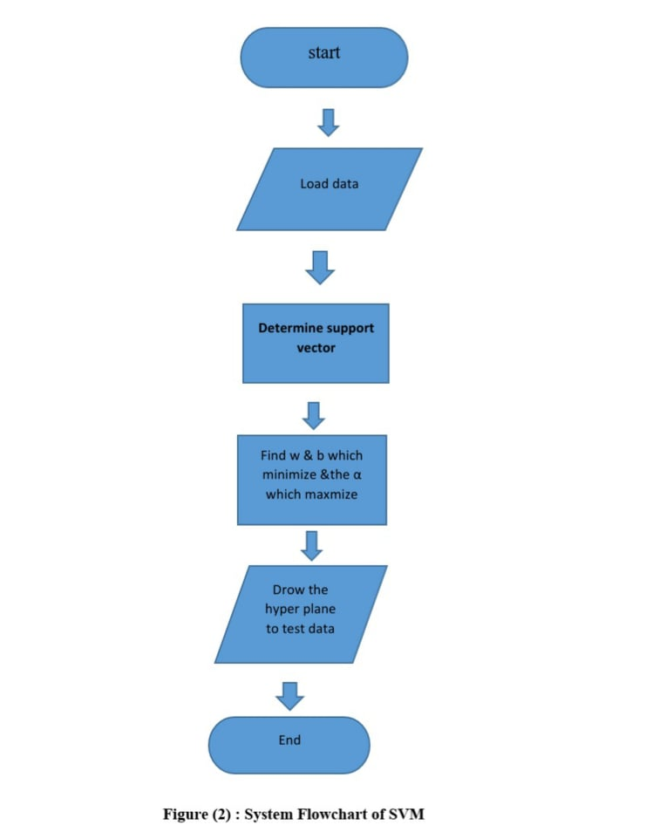
Support-vector machine(svm):

Slide 6
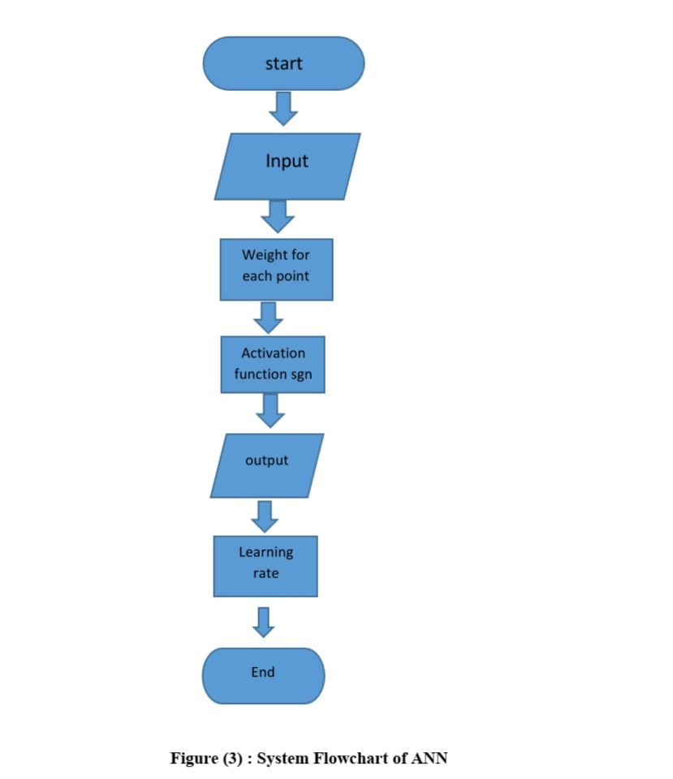
Artificial neural network(ANN):

Slide 7
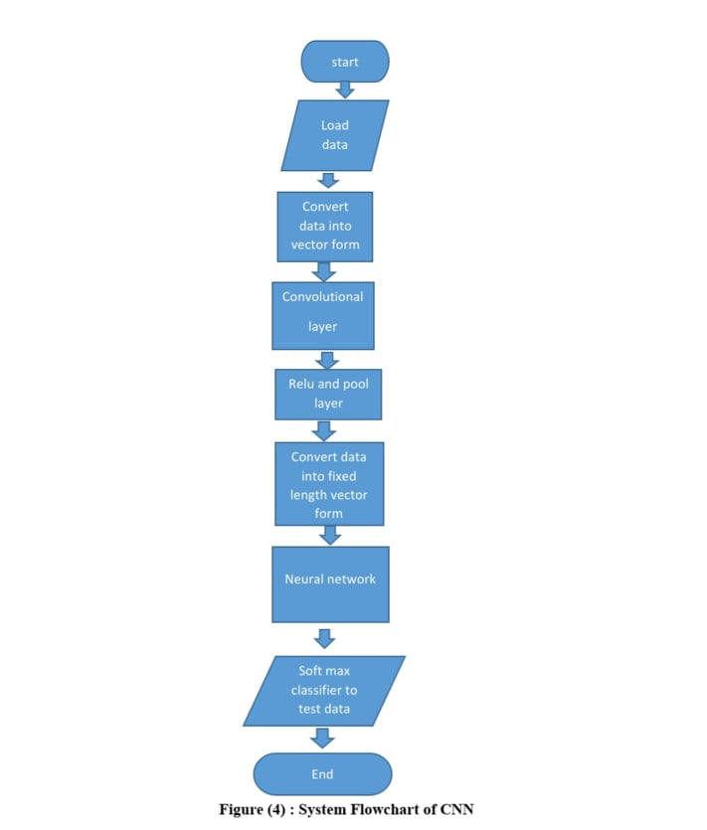
Convolutional Neural Network(CNN):

Slide 8
Data set:
No. | Attribute | Description
1. | Age | Age
2. | Gender | Meal , Femal
3. | TB | Total Bilirubin
4. | DB | Direct Bilirubin
5. | ALP | Alkaline phosphatase
6. | Sgpt | Alamine phosphatase
7. | Sgot | Total proteins
8. | Tp | Albumin
9. | ALB | Albumin
10. | A/G ratio | Albumin and Globulin Ratio
Tabel 2: Parameters used to predicts desease

Slide 9
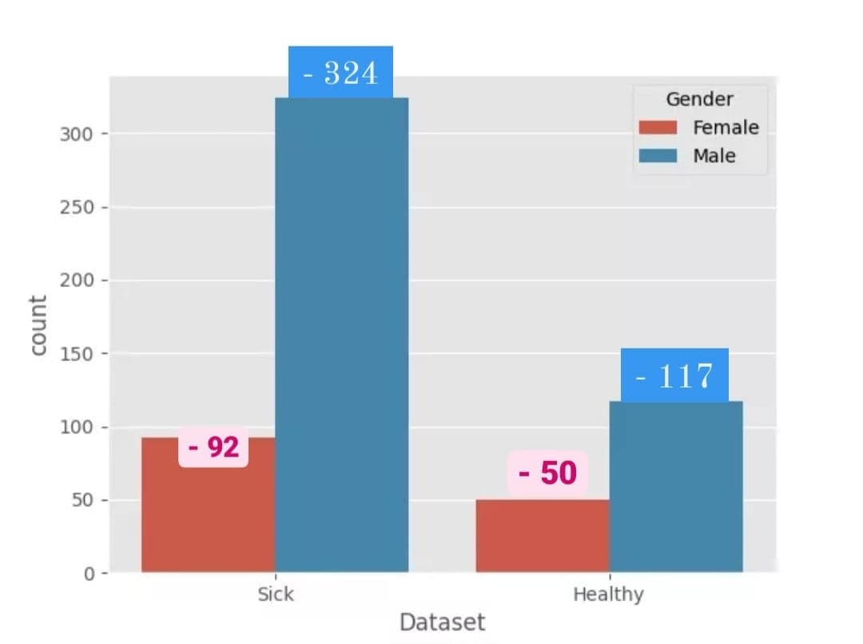
Ruselts and Analysis:
Figure (5): The number of patient and non-patient (KNN algorithm)

Slide 10
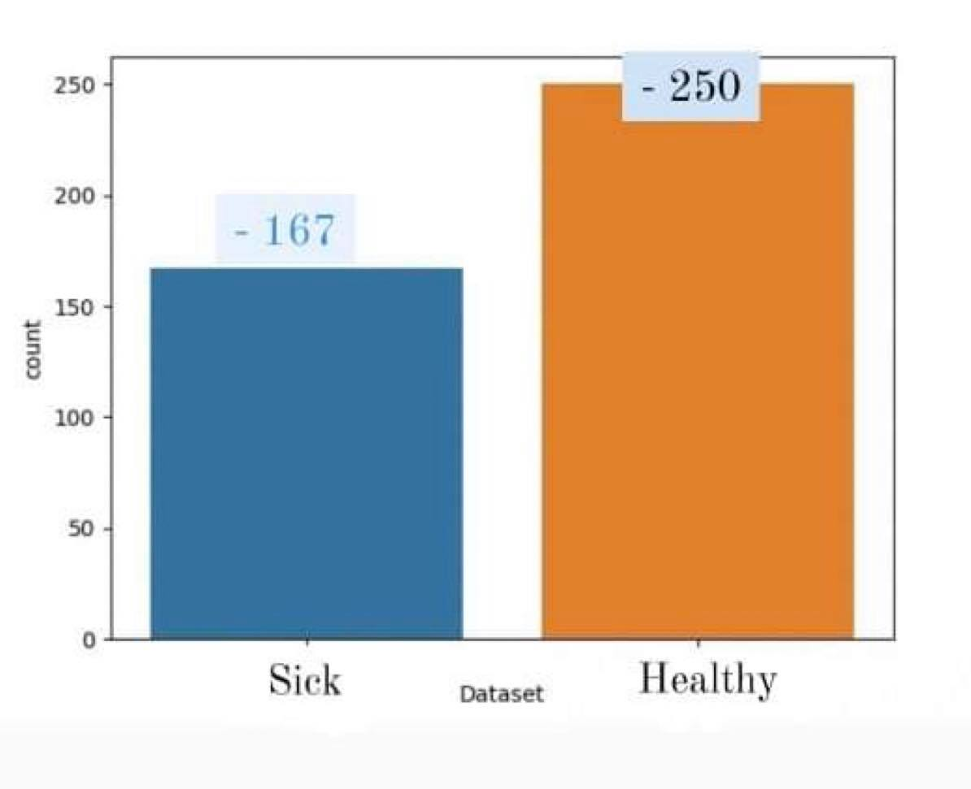
Figure (6): The number of patient and non-patient( of SVM algorithim)

Slide 11
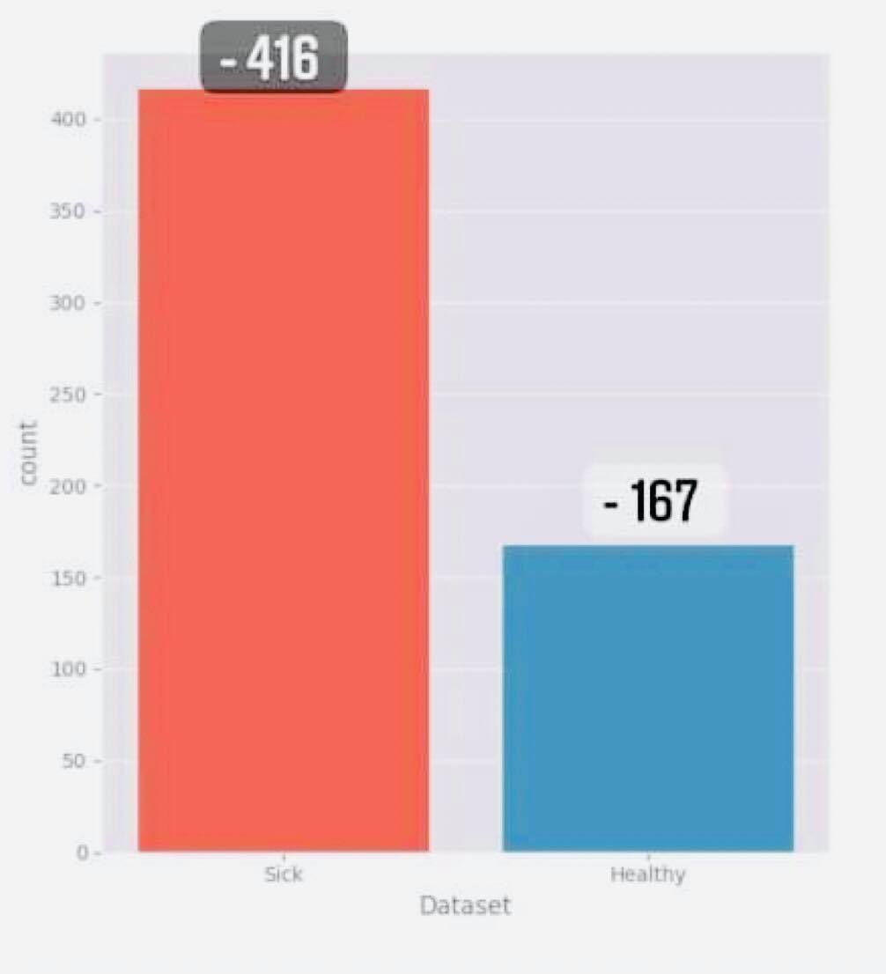
Figure (7): The number of patientand non-patient( of ANN algorithim)

Slide 12
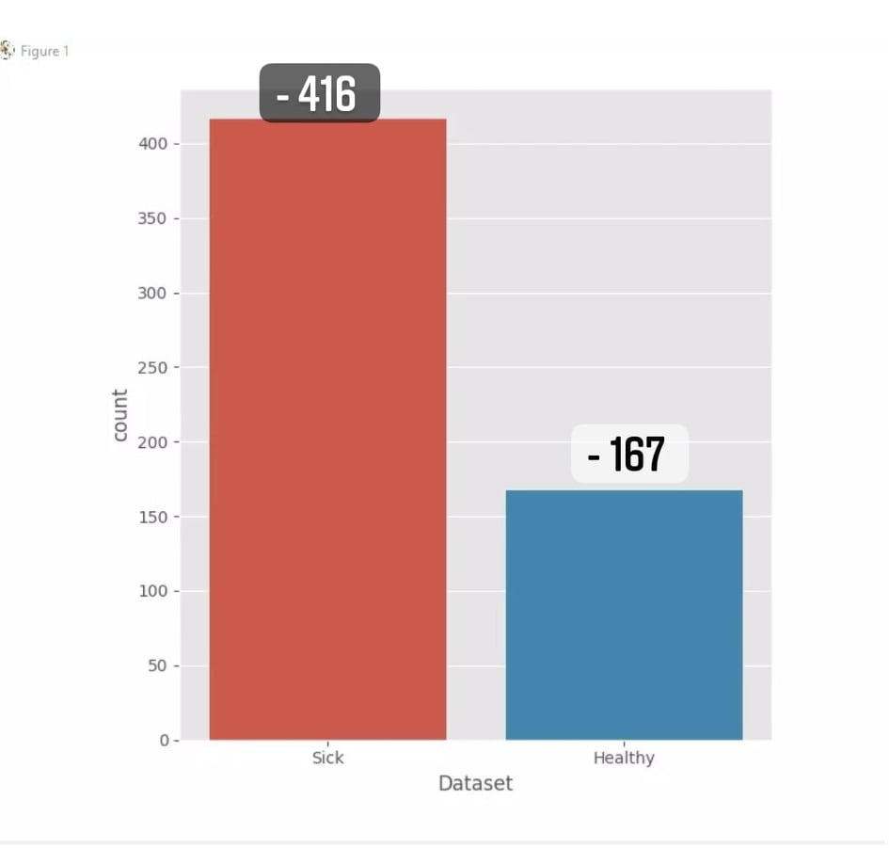
Figure (8): The number of patientand non-patient( of CNN algorithim)

Slide 13
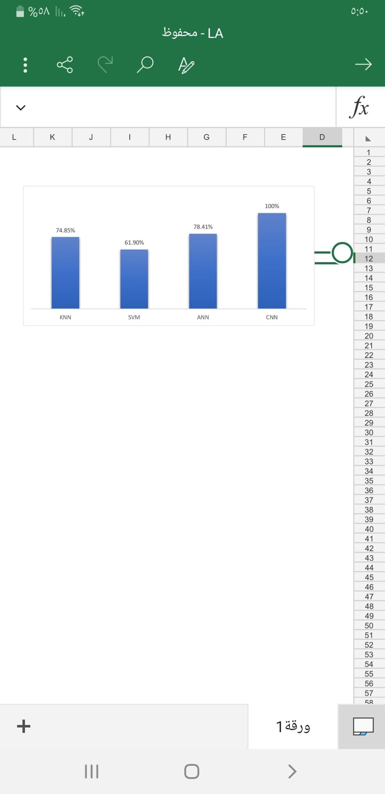
Figure (9): Accuracy Comparison Graph

Slide 14
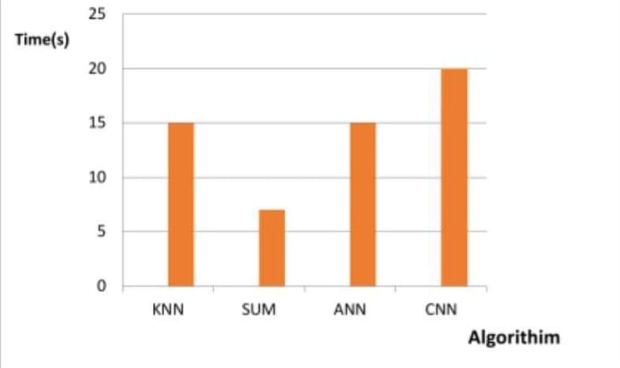
Figure (10) : Time Comparison Graph

Slide 15
Development of GUI:
A graphical user interface (GUI) is a visual way to interact with a computer. Items in the GUI that provide information, indicate Actions the user can take. The GUI is created using HTML, python The system will predict whether the patient has a disease or not coach model.

Slide 16
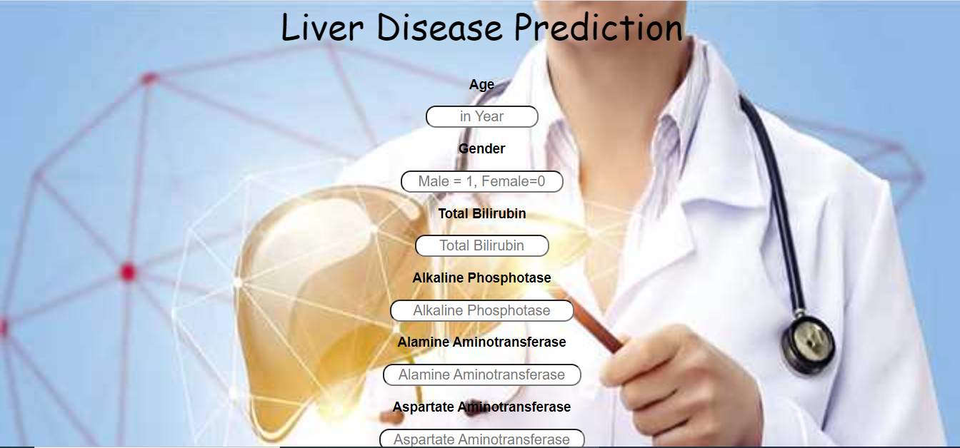
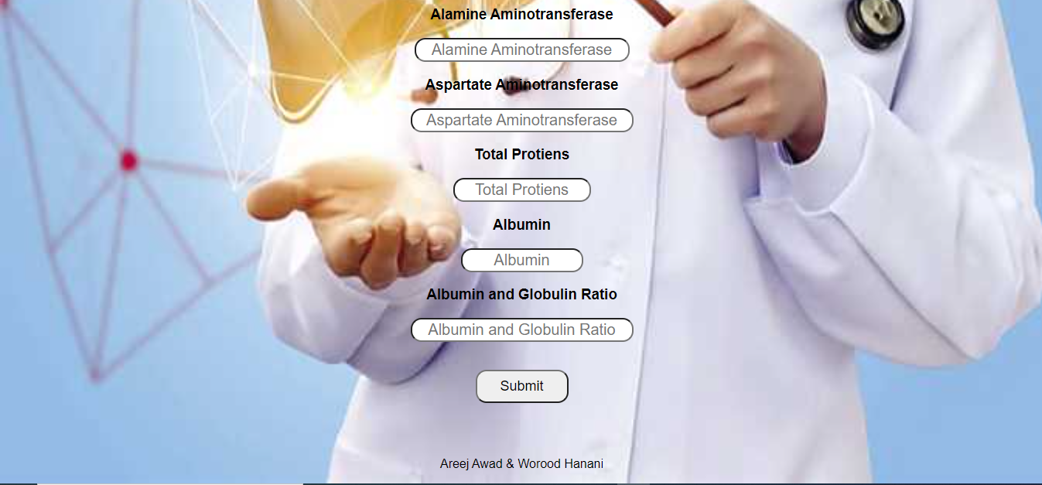
GUI development using html and python.

Slide 17
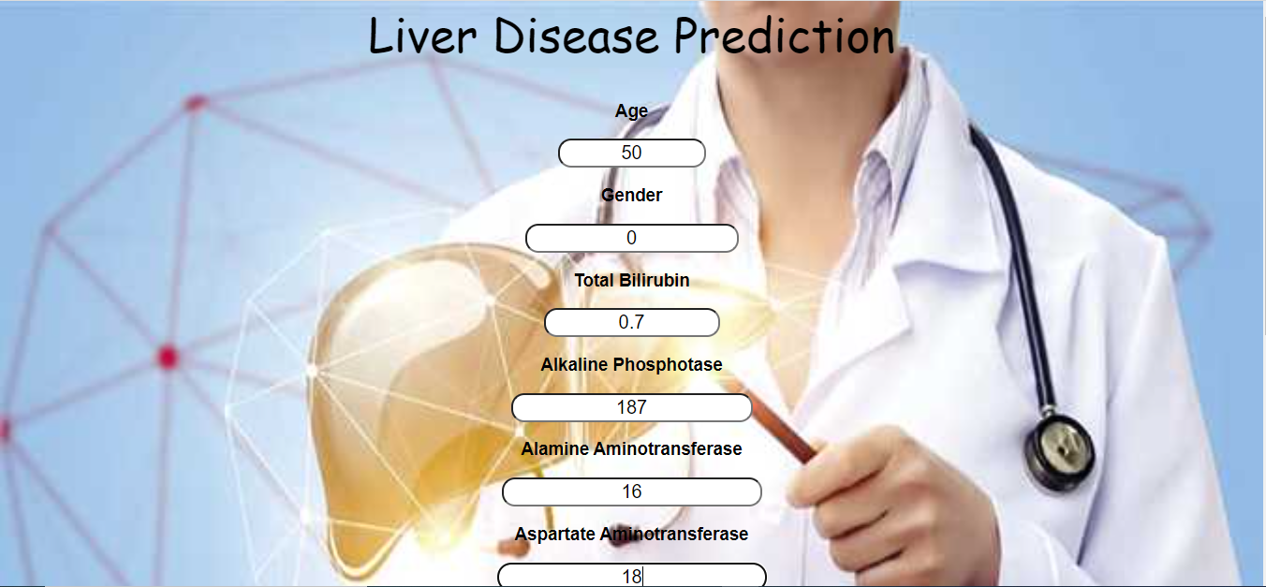

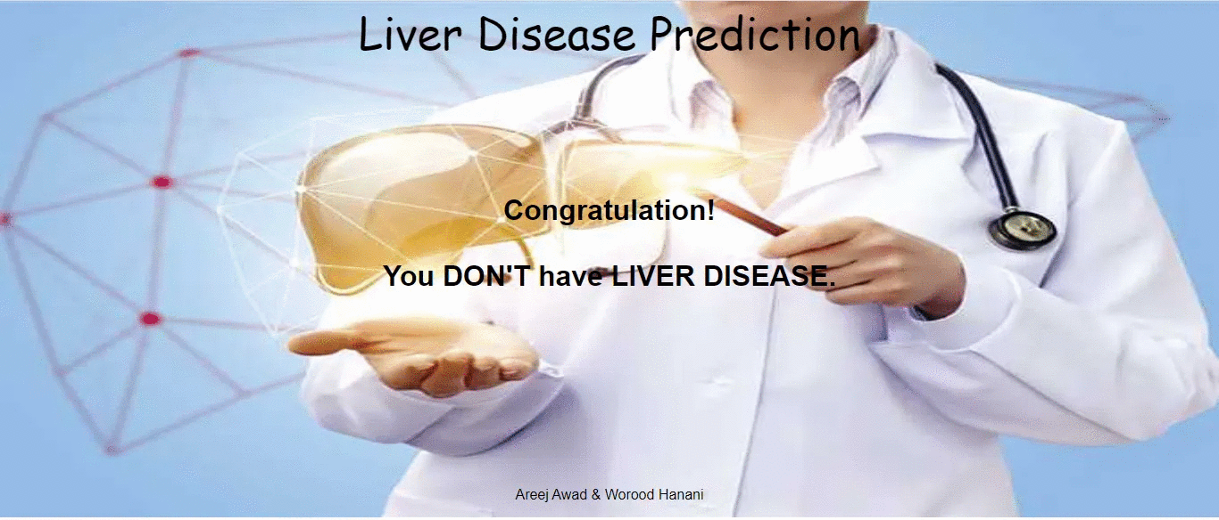
A sample result of do not have liver disease

Slide 18
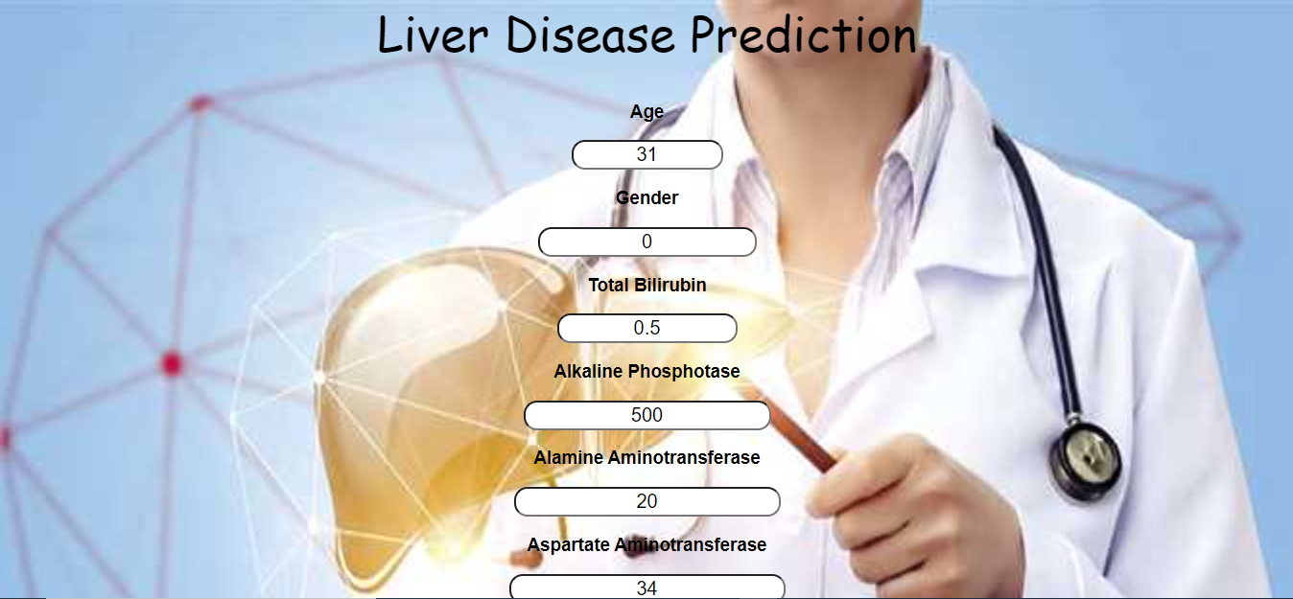
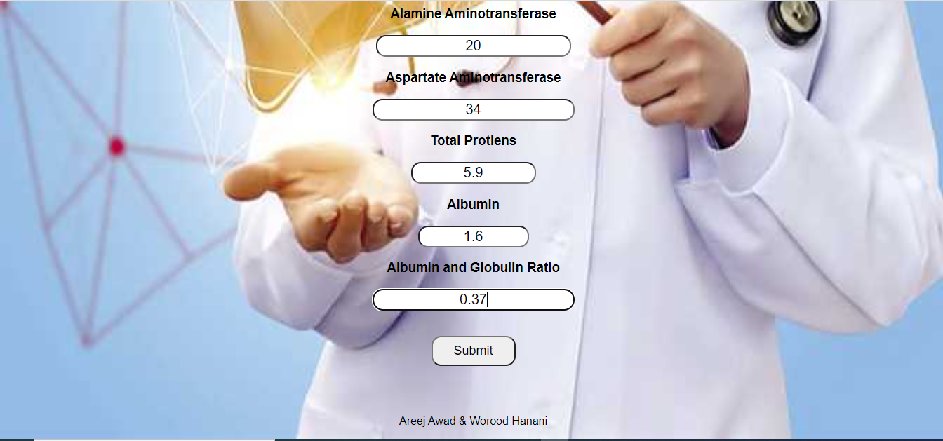
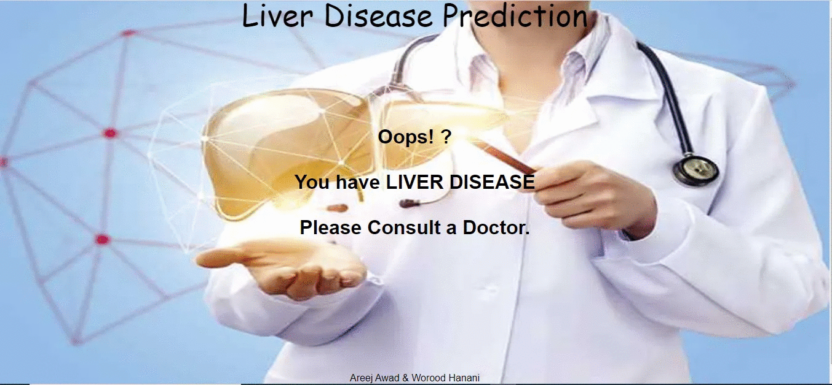
A sample result have liver disease

Slide 19
Conclusion:
In this project we classify the patient from healthy Individual. For classification we use different algorithm and implemented it in python and at the end its find out that Covliotinal neural network (CNN) predict high accuracy than other machine learning algorithm. The system predicts the result by using the parameter which helpful to find out the patient has liver disease or not. GUI is developed on html and python.

Slide 20
Recommendations:
This project presented an overview of machine learning algorithms that help in detecting liver disease and comparing them, and found that the algorithm cnn is the best algorithm and building a model based on it to detect disease, and it is possible in the near future to add the following improvements:
• First: Building a model on modern mobile phones using Java Android.
• Second: the modification of the GUI to website , databases are included for each patient, whereby the examinations are constantly modified, it is possible to detect the disease in a much shorter time.
• Third: More improvement in the images of the liver organ that the CNN algorithm relies on.

Slide 21
Think You

