Slide 1
smart irrigation System Using Internet Of Things
MADE BY: Walaa Dwikat & Ola Hantoli
SUPERVISOR: Eng. Haya Samaneh

Slide 2
Outline:
Introduction
Problem
Project Description
Objectives and Importance
Literature Review
Used Tools
Project Sections
Hardware part.
Software part (website).
Results and Discussion.
Constraints.
Conclusion and Future work.

Slide 3
Problem
Greenhouse care requires a great deal of time and effort on the part of
farms to take care of them in order for them to grow well.
The inability to monitor the greenhouse continuously and know the needs of
cultivated plants and suitable environmental conditions so that they grow fully and
mature fruits,

Slide 4
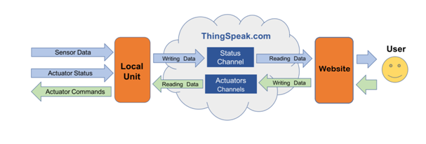
Project Description
it is a hardware project supported by a website .
the main tasks :
Determining the type of crop to be grown in the greenhouse to provide suitable conditions for its growth , It also provides self-control in the event that the farmer wants to do so.
being able to monitor the status of the greenhouse

Slide 5
Objectives and Importance
Our project serves the Palestinian farmers to facilitate the farming process and its management, by starting some of them using technology in agriculture, we provide them with a system through which we look to their comfort and obtain agricultural products with the best health and food safety and avoid losses.

Slide 6
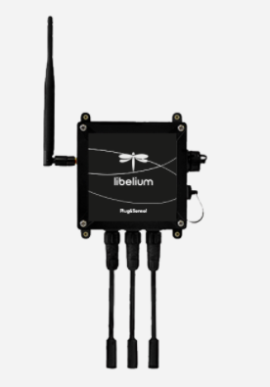
Literature Review
After researching, we found that this system in the form and method that we designed does not currently exist in Palestine, but there is something close to it.
As they only use a specific system to control the water pumps.
** this project is located outside Palestine in technologically countries.
Through research, we found a device that contains many sensors.
Notes:
And This platform consists of a robust waterproof enclosure with specific external sockets to connect the sensors, the solar panel, the antenna and even the USB cable in order to reprogram the node. It has been specially designed to be scalable, easy to deploy and maintain.
There are many models for it, some of which are specialized in Smart Agriculture and Smart Agriculture Xtreme(2).

Slide 7
Used Tools
The software are developed using:
phpstorm
sql Database
Thingspeak server .
Arduino IDE
Hardware components:
Arduino uno
esp8266
sensors(DHT22 , soil moisture , LDR )
fans , peltier module , pumps , LEDs
relays ,wires

Slide 8
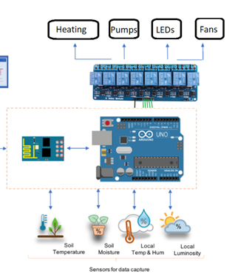
Project Sections
1- Hardware part
Notes:
Block Diagram

Slide 9
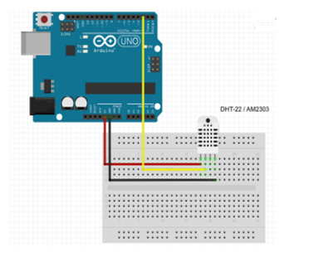
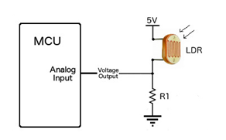
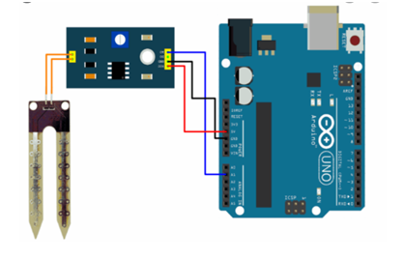
light sensor
DHT22 sensoe
soil moisture sensor

Slide 10
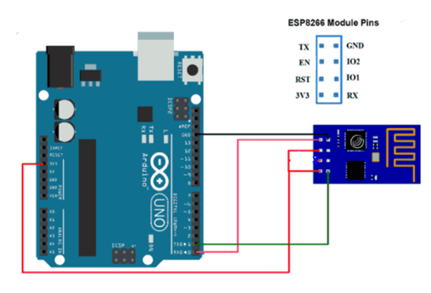
esp8266 WIFI Module

Slide 11
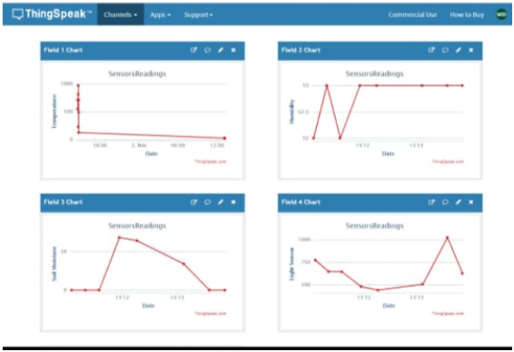
ThingSpeak Server

Slide 12
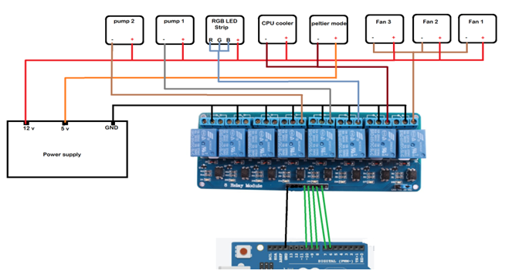

Slide 13
2- Website
We built a website so that the farmer would be able to monitor the greenhouse
status and control it remotely.

Slide 14
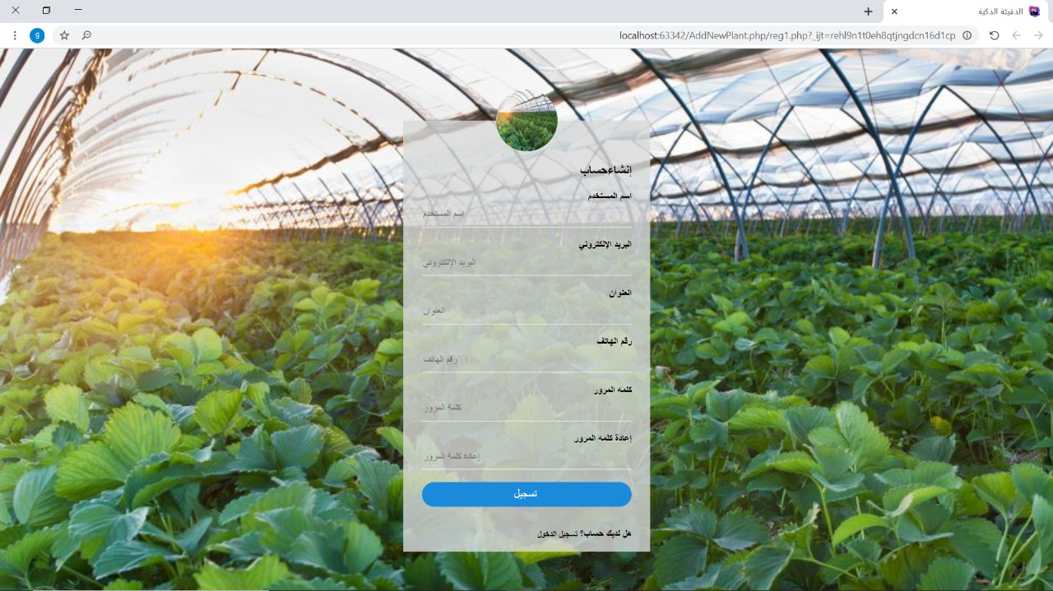
Sign Up Page

Slide 15
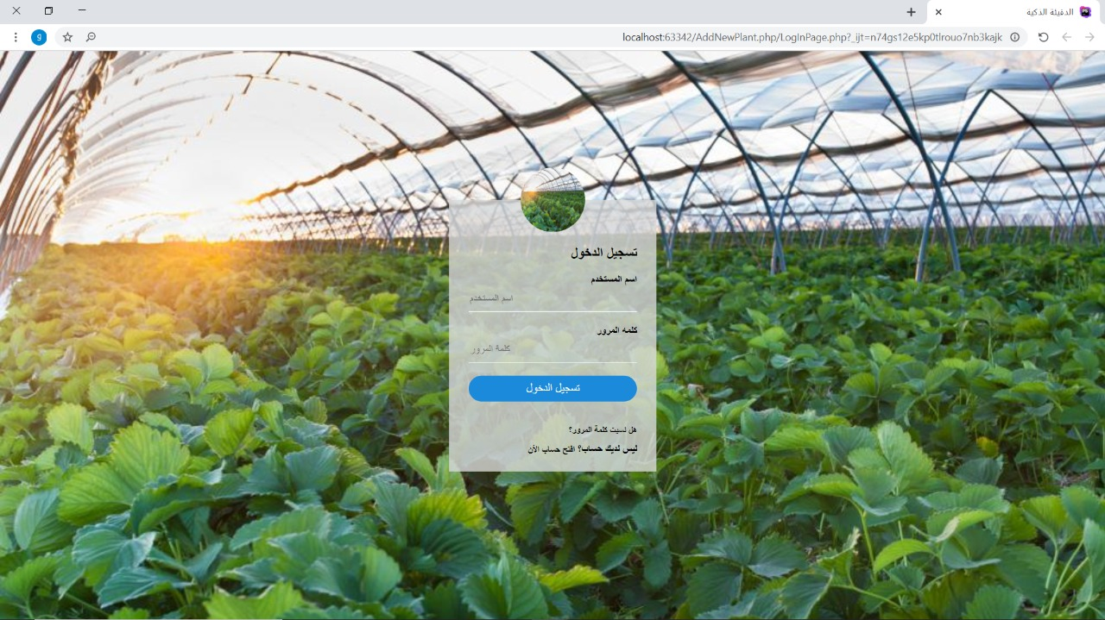
Log In Page

Slide 16
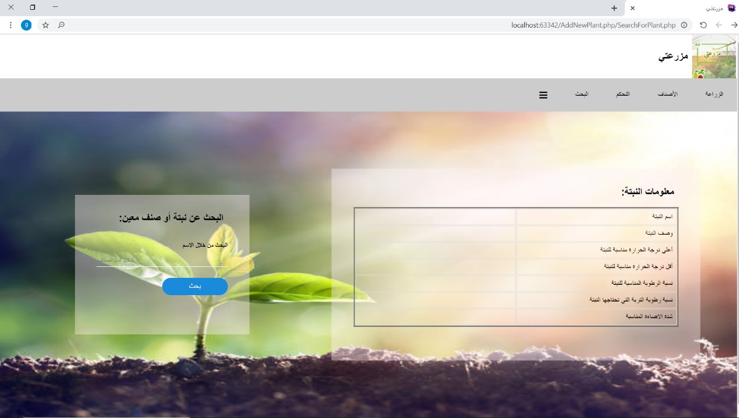
Search for a crop Page

Slide 17
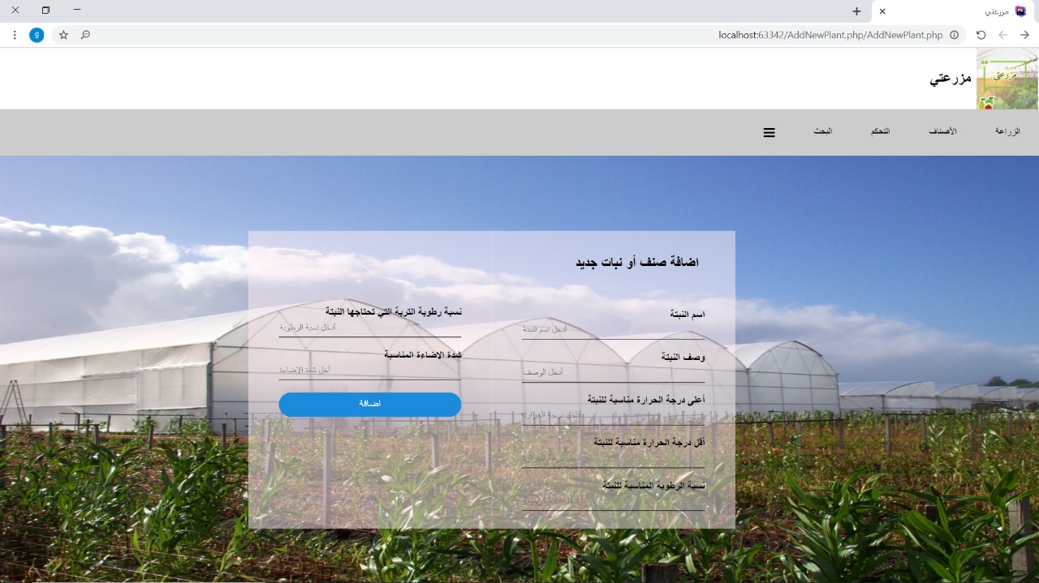
Add new crop page

Slide 18
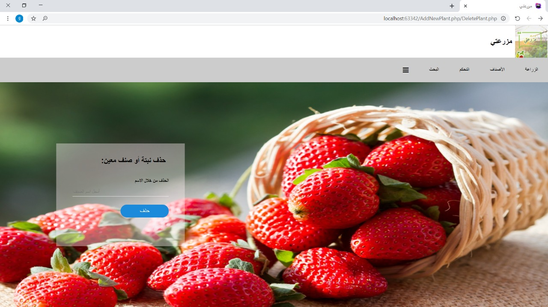
Delete Specific Crop Page

Slide 19
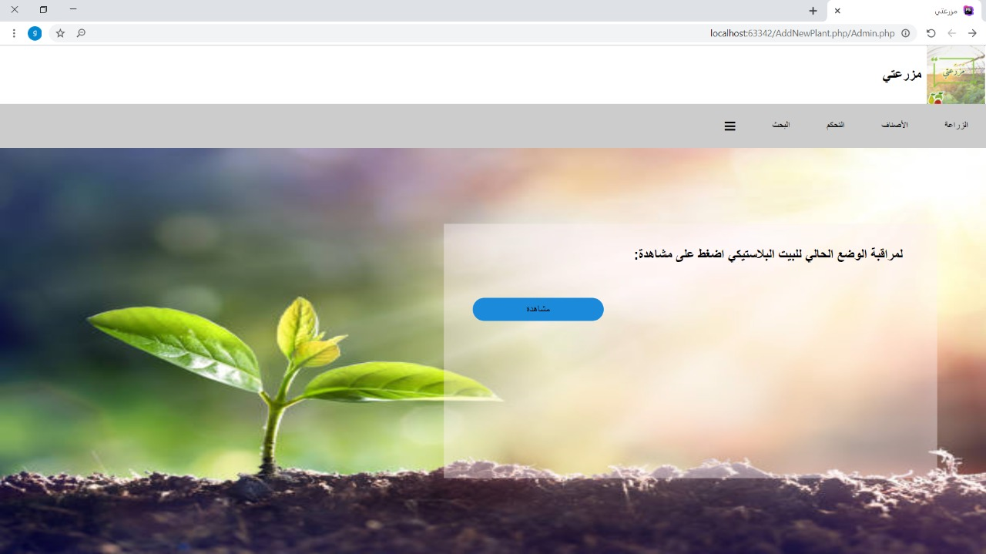
Monitoring Page

Slide 20
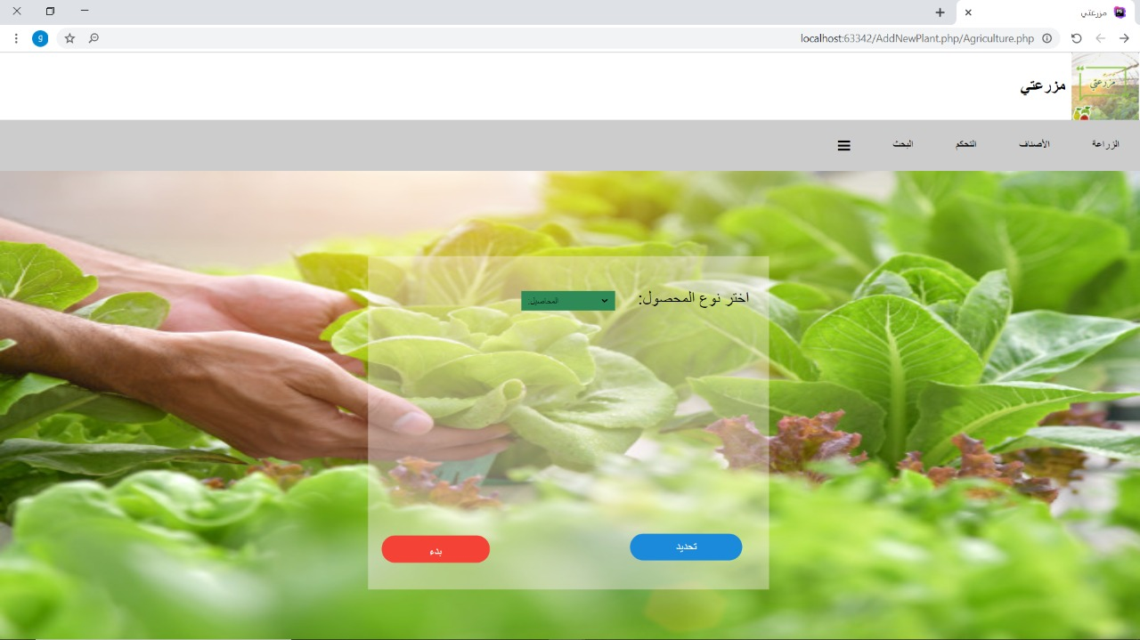
Planting a New Crop Page

Slide 21
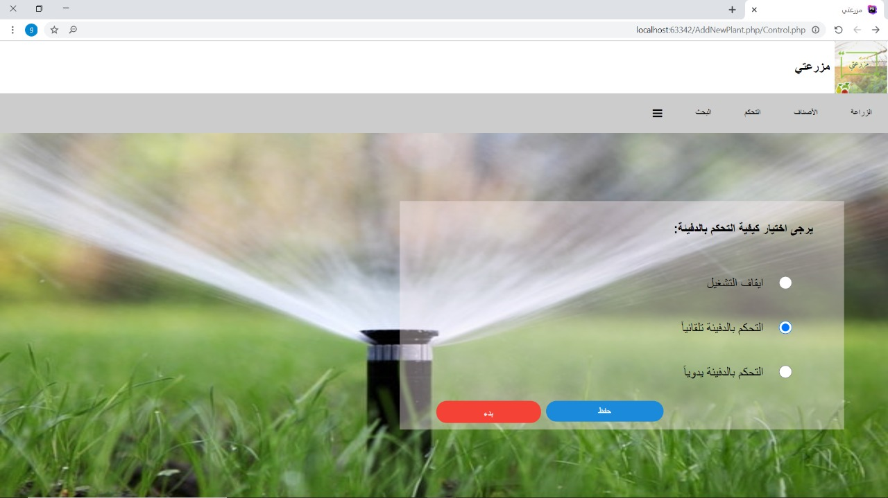
Controlling Page

Slide 22
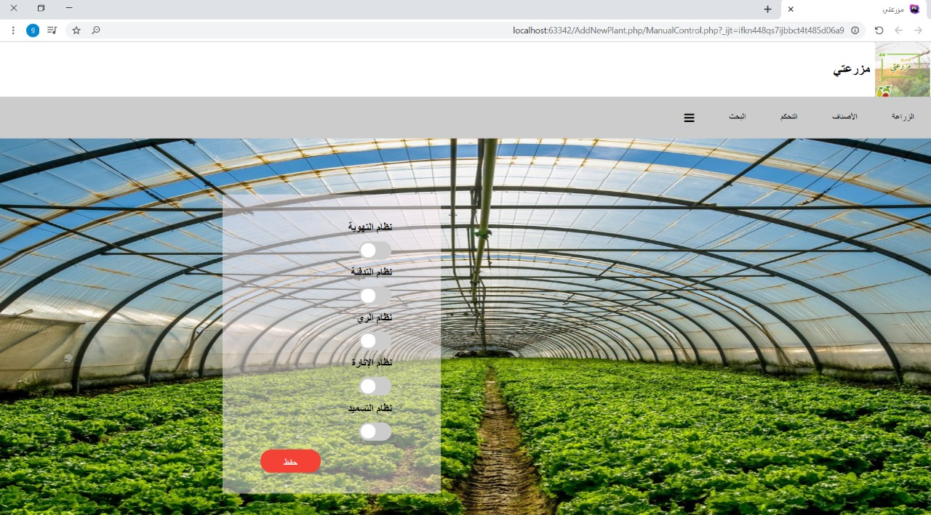
Manual Controlling Page

Slide 23
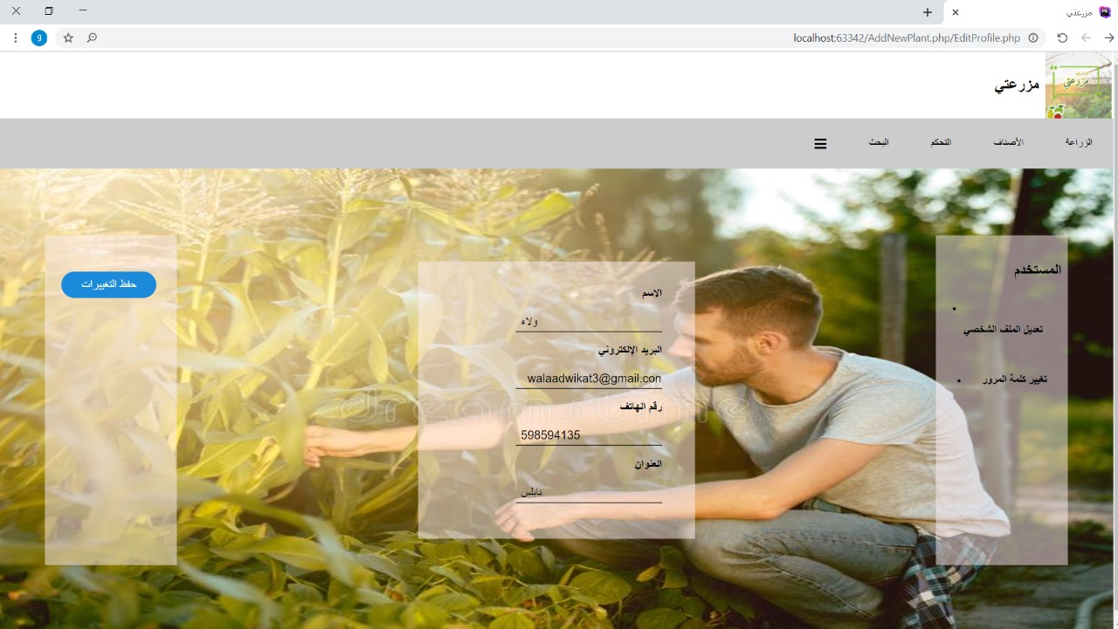
Profile Page

Slide 24
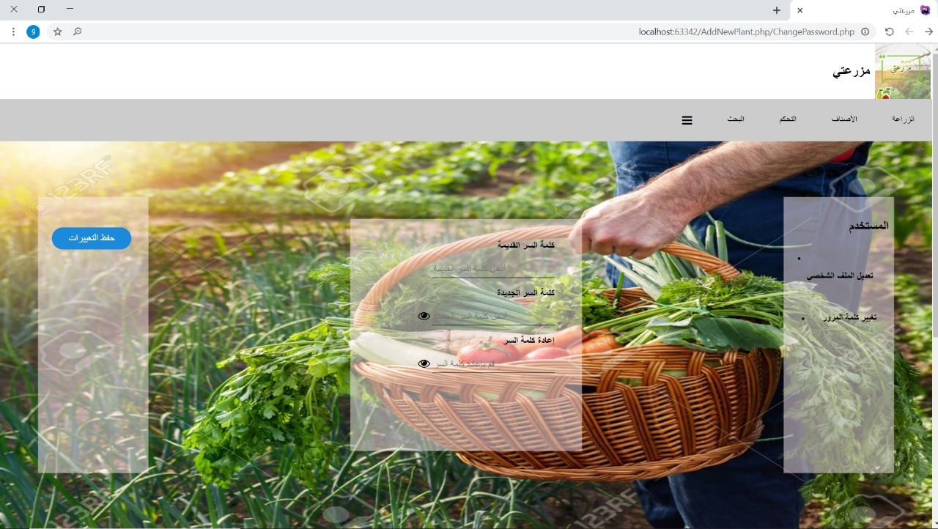
Change Password Page

Slide 25
Thingspeak server
We used this server to :
1- First Channel used to write and read the sensor values
we have these fields in this channel:
- temperature
- humidity
- soil moisture
-light

Slide 26
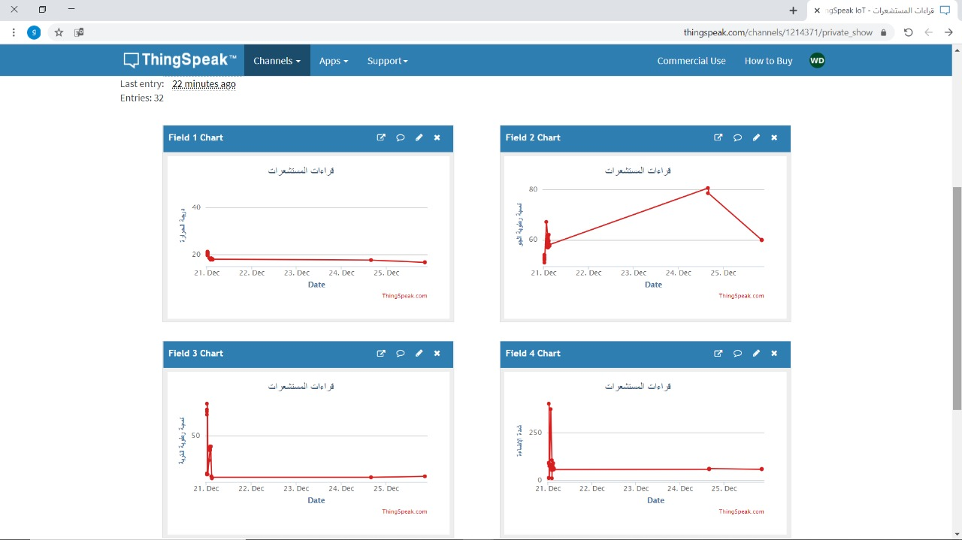

Slide 27
Thingspeak
Second channel used to store the crop information to be planted, where this
data is read inside the Arduino code, so that the greenhouse is automatically
controlled according to these values compared to the current sensors values.
we have these fields in this channel:
- ID of plant
- Minimum temperature
- Maximum temperature
- Humidity
- Soil moisture
- Light
- Controlling type id

Slide 28
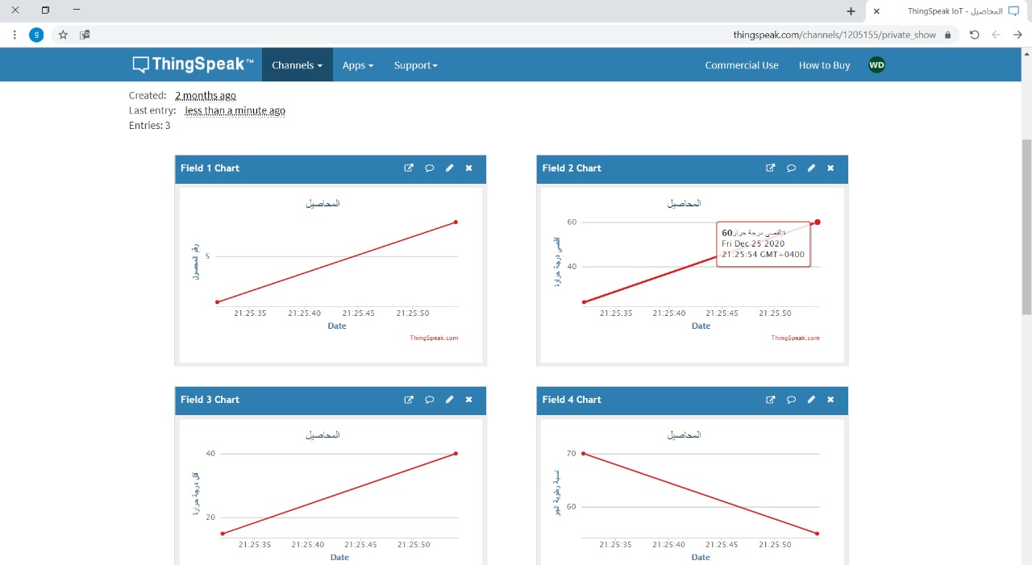

Slide 29
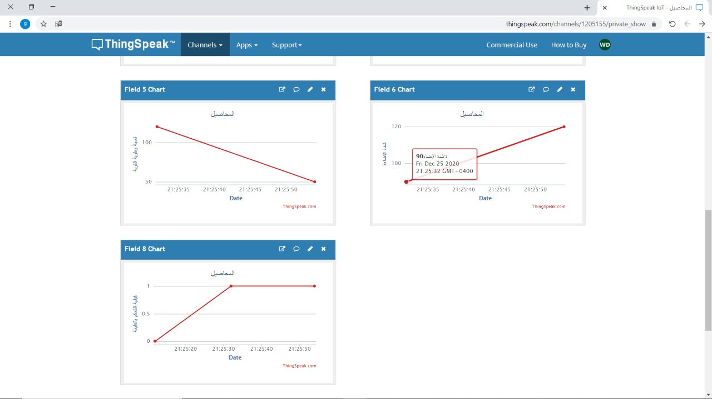

Slide 30
Thingspeak
Third Channel it’s for the devices in the greenhouse to read and write their
status when the farmer controls it manually.
we have these fields in this channel:
- Ventilation system
- Heating system
- Lighting system
- Fertilization system
- Irrigation system

Slide 31
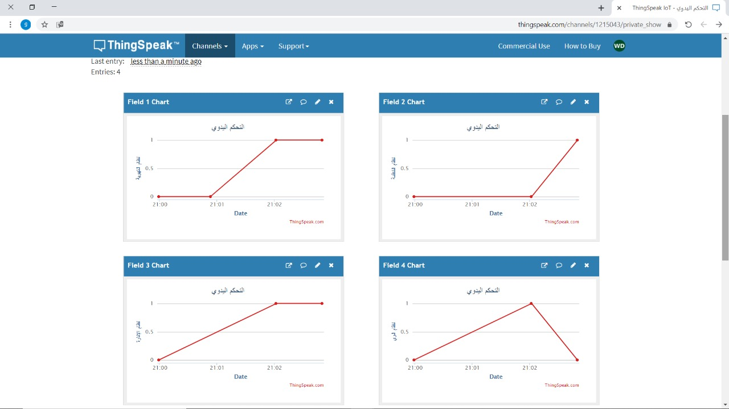

Slide 32
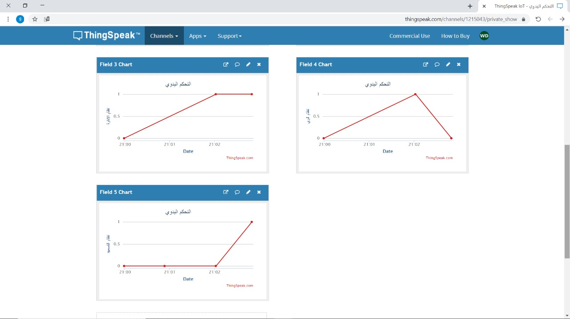

Slide 33
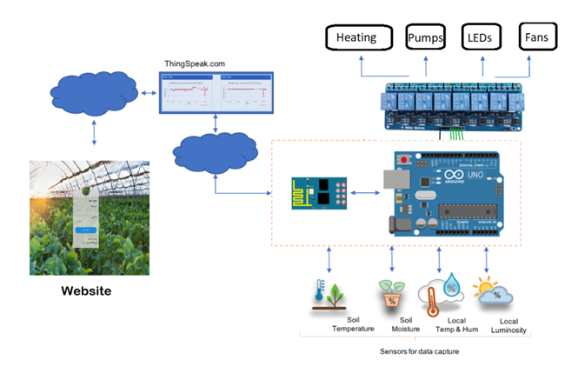
Results and Discussion

Slide 34
Results and Discussion
There are many benefits resulting from using such a project, including:
To maintain food safety and quality and improve production.
Avoid spreading the disease between crops and control the infection.
Providing automatically irrigation and fertilization systems.
Reducing manual Intervention and saving time, manpower and effort on the farmer.
Maintaining an ideal climate for plantings.
Saving a large amount of water.
Monitor & control greenhouse conditions to develop new products in food growing.
Also, this system can be used to handle the hydroponic system easily.

Slide 35
Constraints
The appearance of the Corona virus.
presence of all the electronic components was difficult
.did not have sufficient information about agriculture.
weakness of the Internet

Slide 36
Conclusion and Future work
By the end this project presented to help the Palestinian community, it aims to help farmers and to facilitate them by providing an automatic system to control the greenhouse and a remote control system as it aims to Improving agricultural productivity by preserving the environment and a suitable climate for crops inside the greenhouse.
Future work
add a simple circuit to determine the percentage of water in the tank.
And we could also add an Image Processing system with artificial intelligence to determine the stage of growth (maturity) of the agricultural crop inside the greenhouse.
Also, we can analyze the values ​​on the thing speak server to predict the diseases and infections that can be found in the agricultural crop according to the status in it.

