Slide 1


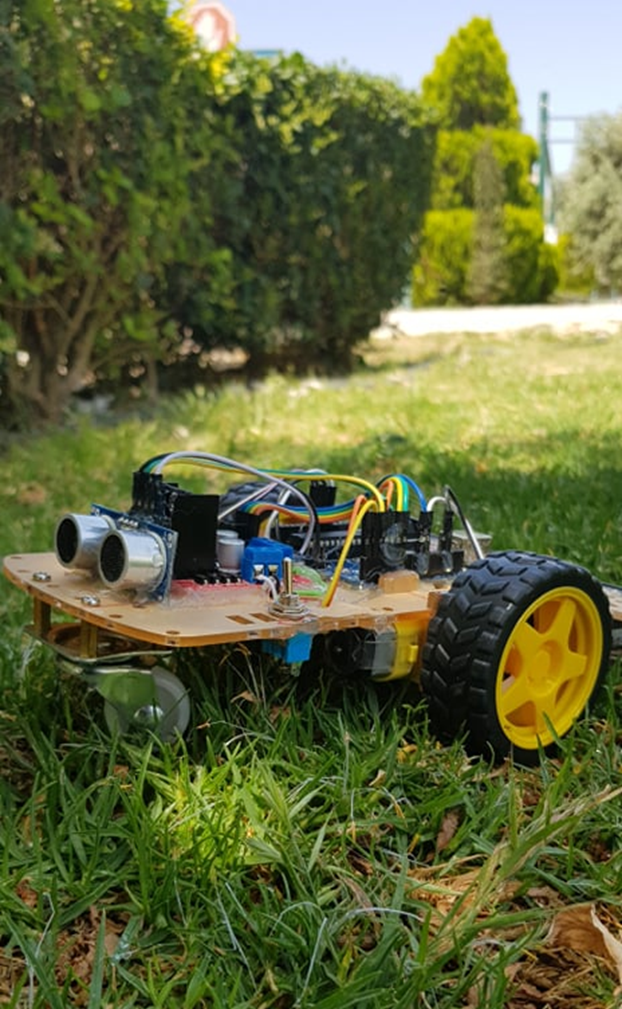
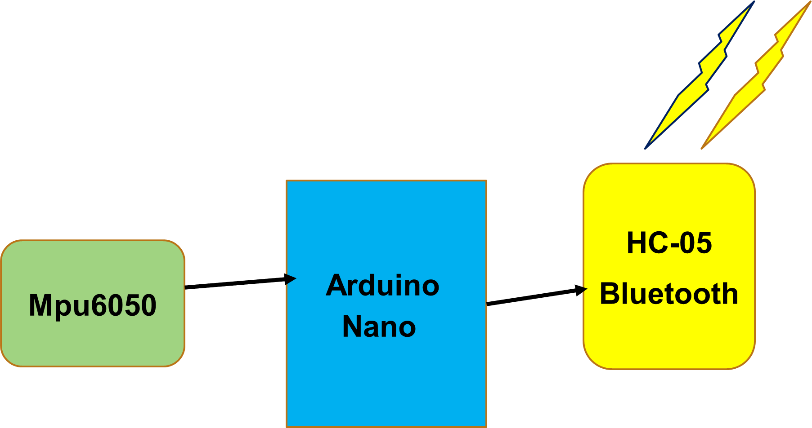

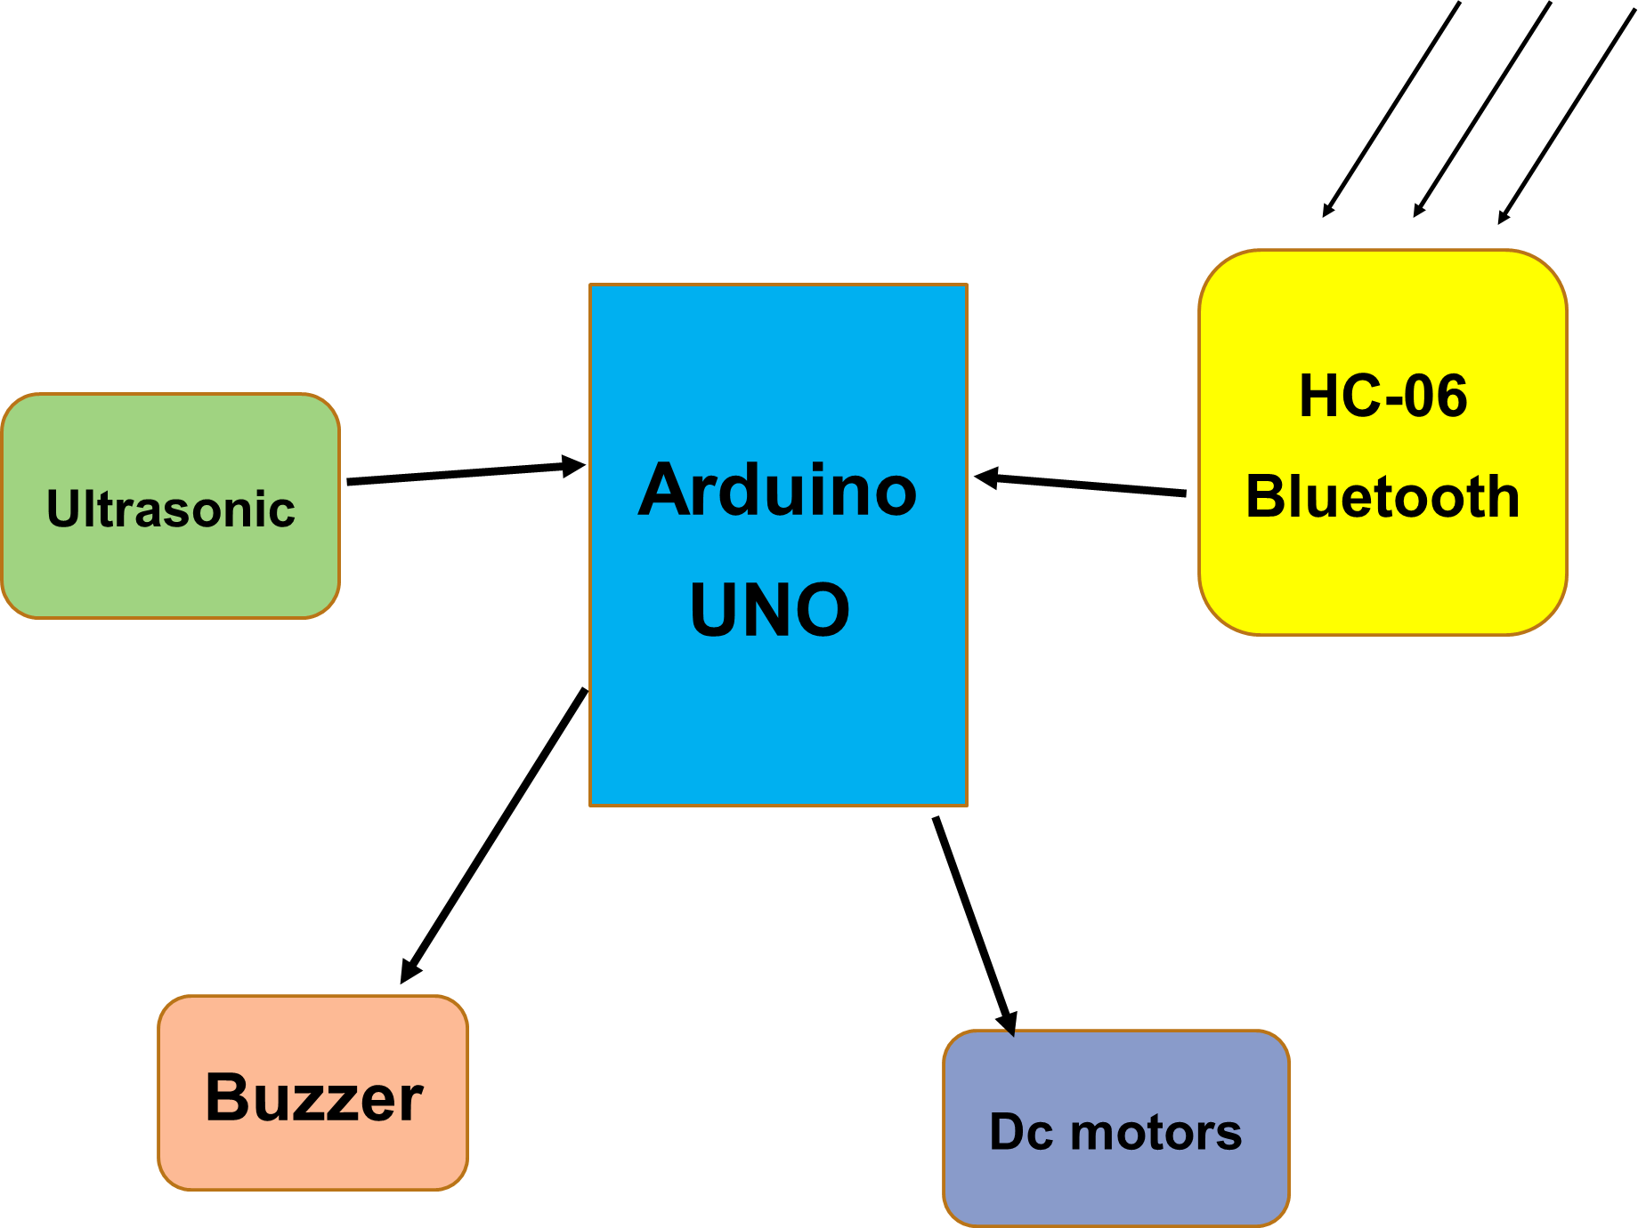
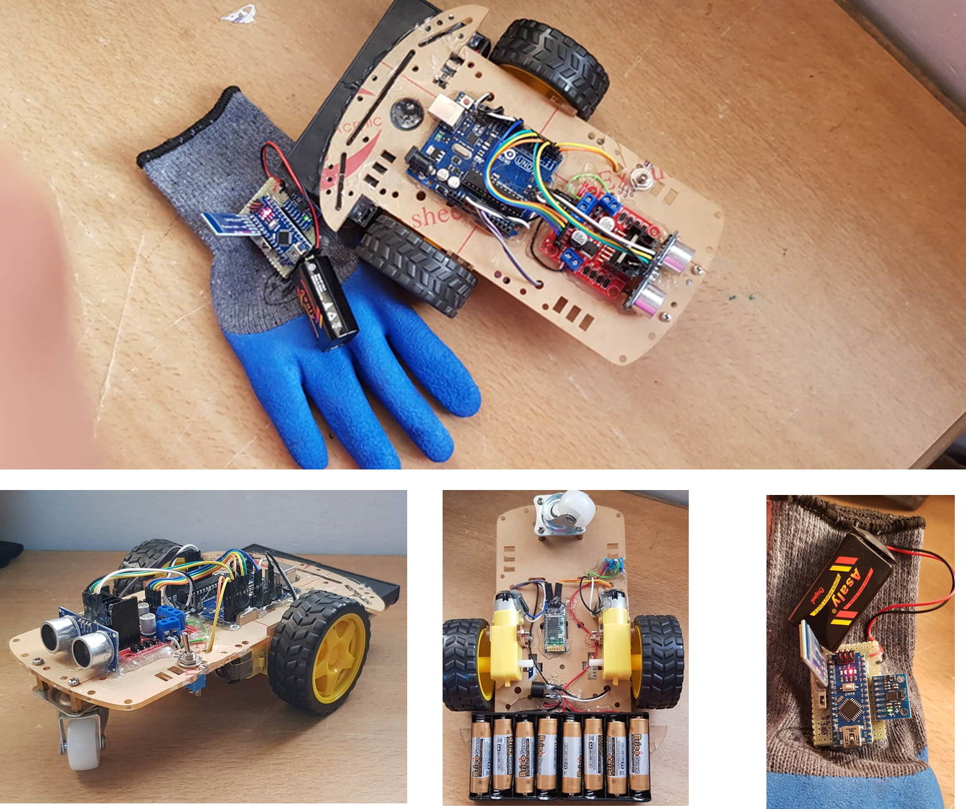
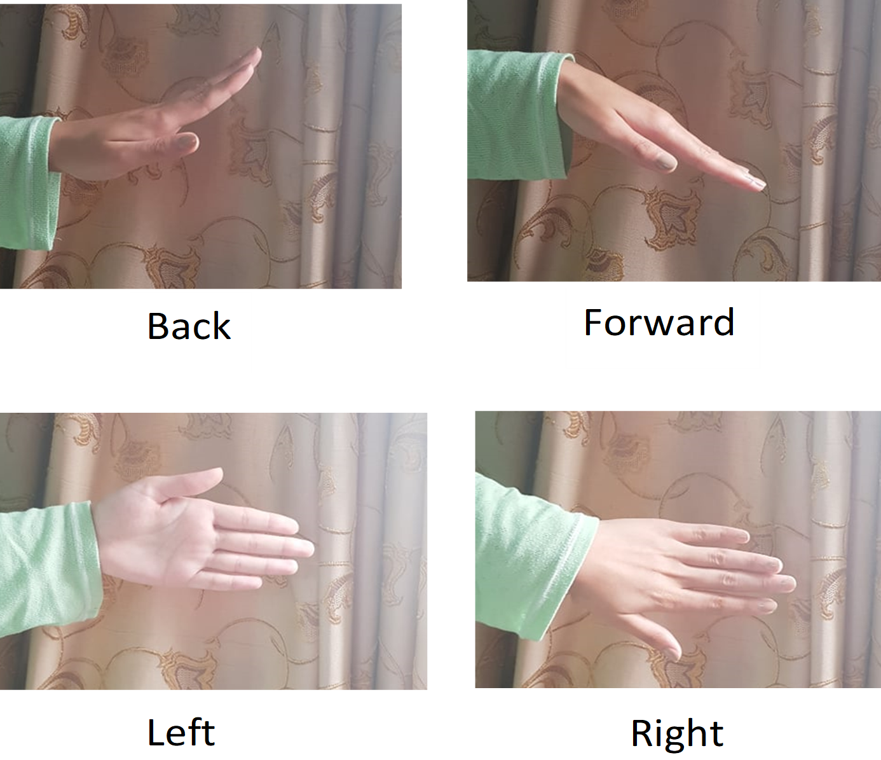
Wireless robot controlled by hand gesture
supervisor, Dr.Saed Tarapiah
Waed Al Haj 11422032
Al Najah University “Engineering department”
Introduction
Nowadays, robotics is becoming one of the most advanced in the field of technology. The applications of robotics mainly involve in automobiles, medical, construction, defense and also used as a fire fighting robot to help the people from the fire accident. But, controlling the robot with a remote or a switch is quite complicated.
Reasons of using hand gesture
robot ???
1-controlling the robot with hand gesture is easier .
2-Very helpful for handicapped and physically disabled people.
.3-Gestures can be used to control interactions for entertainment purposes such as gaming to make the game player's experience more interactive or immersive.
4-Surveillance robot has lot of indoor applications in warehouses, shopping malls, hospitals and large single floor buildings.
5- used in power plants, war fields, harbors, airports and construction sites for inspections.
How it is work ??
Stages of the project is: •1-transmitter stage
2-Receiver stage
Results
Mpu6050 is the most important part of the project and hand gesture depends on it also. It sends data to Arduino Nano. then data send it to the Bluetooth module HC-05. In the meantime, HC-05 communicate with HC-06 which is in receiver. HC-06 moves data to Arduino UNO, which is on receiver part. These data tell whether to move left, right, stop, back or front.so I control Dc motors. Ultrasonic send distance information, which is in between robot and obstacles, to Arduino UNO to decided if it is more or less than 50. If it was less than 50 the buzzer will make loud sound to warn the user to move the robot far away of the obstacle, to maintain safe for the robot.
Overview of transmission and receiver structure
and results.
Figure A: neque dignissim, and in aliquet nisl et umis.
Figure : the transmitters stage. Procedure.
Future work
1- try to improve the project due to some problems. The on-board batteries occupy a lot of space and are also quite heavy.
2- add more sensor like temperature, light and etc. Add LCD and GPS module, which make the robot more effective.
3- use WIFI module on the robot to transfer video life to a screen.
4- make it more suitable of real-life usage such as firefighter robot, surveillance robot and emergency robot.
5- study more about gesture recognition and try to add it in the robot system.
Figure : the receiver stage. Procedure.
Acknowledgment :acknowledgements
First of all, a very deep appreciation to my project supervisora, Dr.Saed Tarapiah for his patient and enthusiasm when guide me for this project and also the opportunity he gives allow me to learn how to work well. He taught me how to create and appreciate a good scientific project that helps other researchers to build on it. I would like to thank our supervisory members. Last and not least a big thank for every one support me especially my parents.
Conclusion
This project allows user to control a robotic Car using simple hand movements through Bluetooth Communication. from Far away.
Whole project compenet
Department or Office name goes here
School, College or Division name goes here
buffalo.edu
Thank you .Feel free to ask any question .!!

