Slide 1

The Effectiveness Of Green Features On Life Cycle Cost - Aqqaba Green School
BY
Abeer Barham
Laila Abu-Waar
Ru’a Deeb
Under supervision of :Eng. Reema Nassar

Slide 2
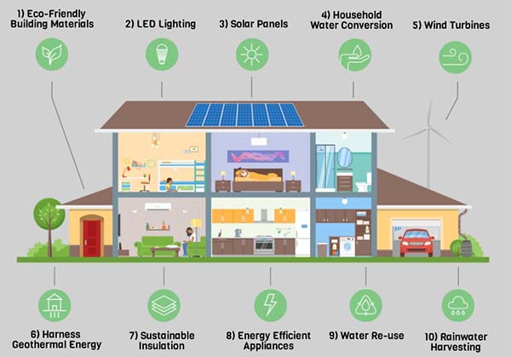

Slide 3

Thus, green building forms an efficient application for this principle which can be defined as the building that takes into account environmental considerations from planning, design, construction, operation and maintenance to the demolition of the building itself , by maximizing the use of sustainable resources that causing less pollution and waste.

Slide 4


Slide 5
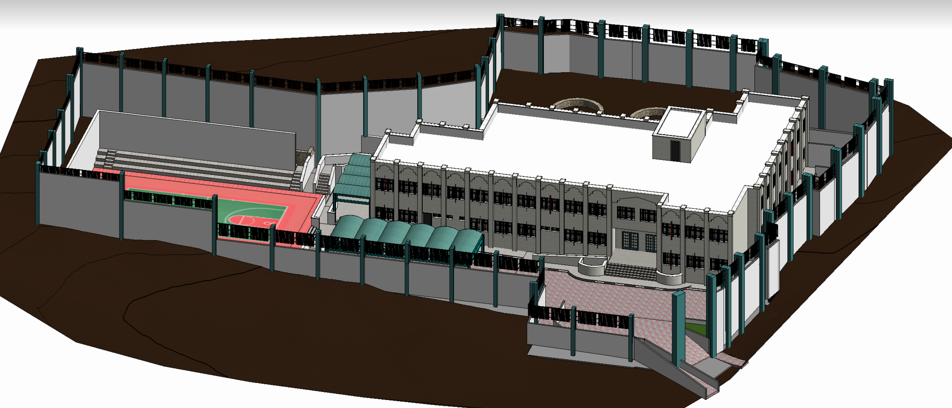
Architectural model.

Slide 6
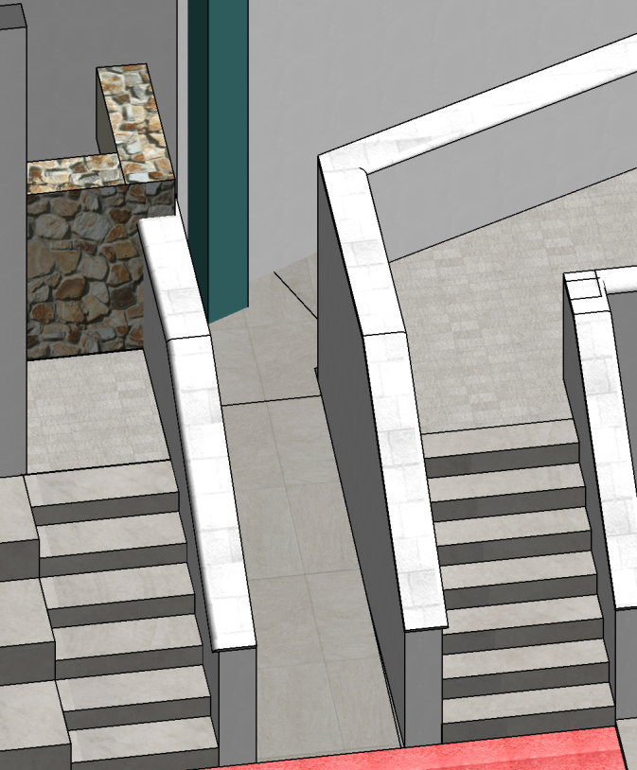
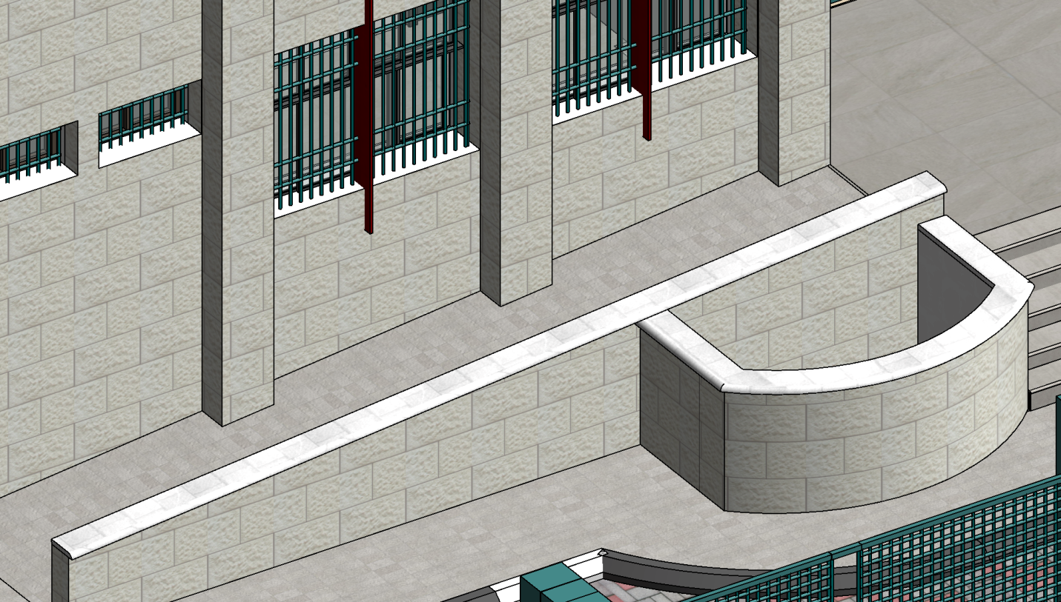
Ramps

Slide 7
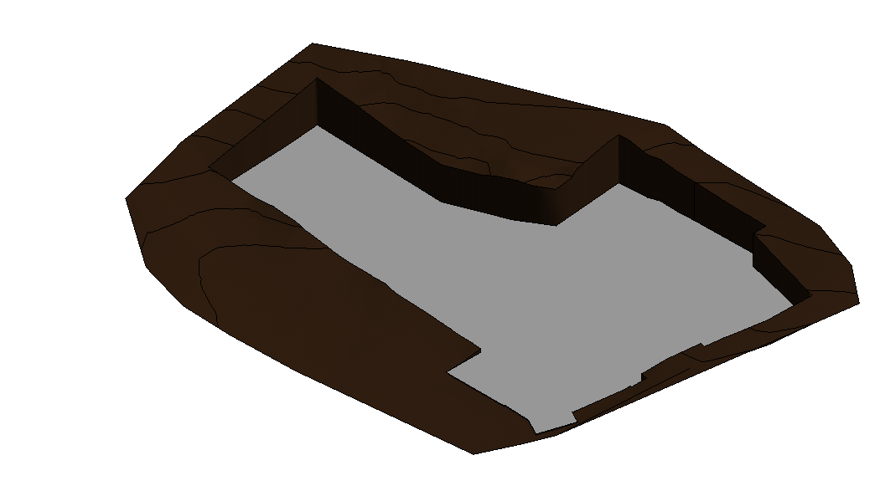
Site Modeling

Slide 8
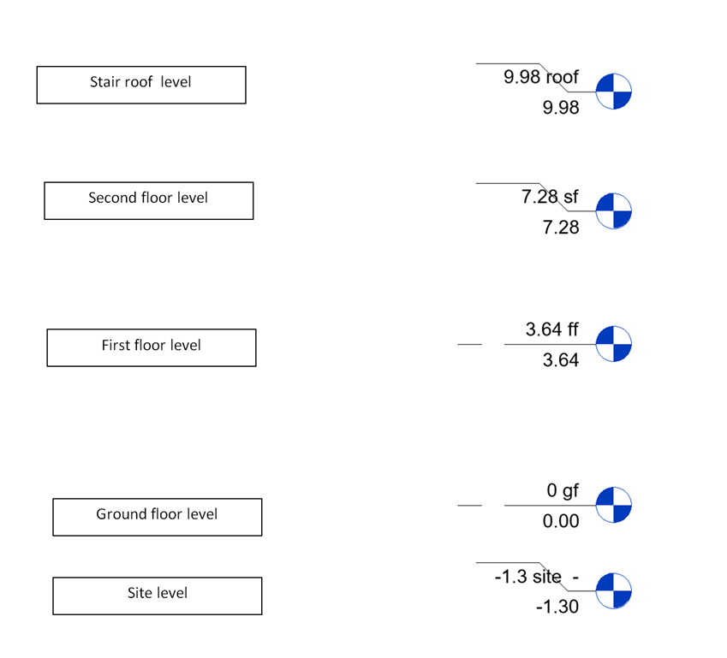
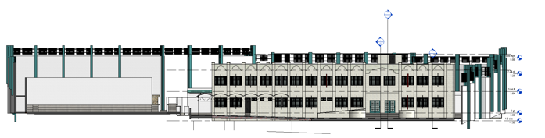
Levels

Slide 9
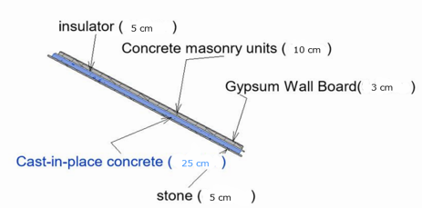
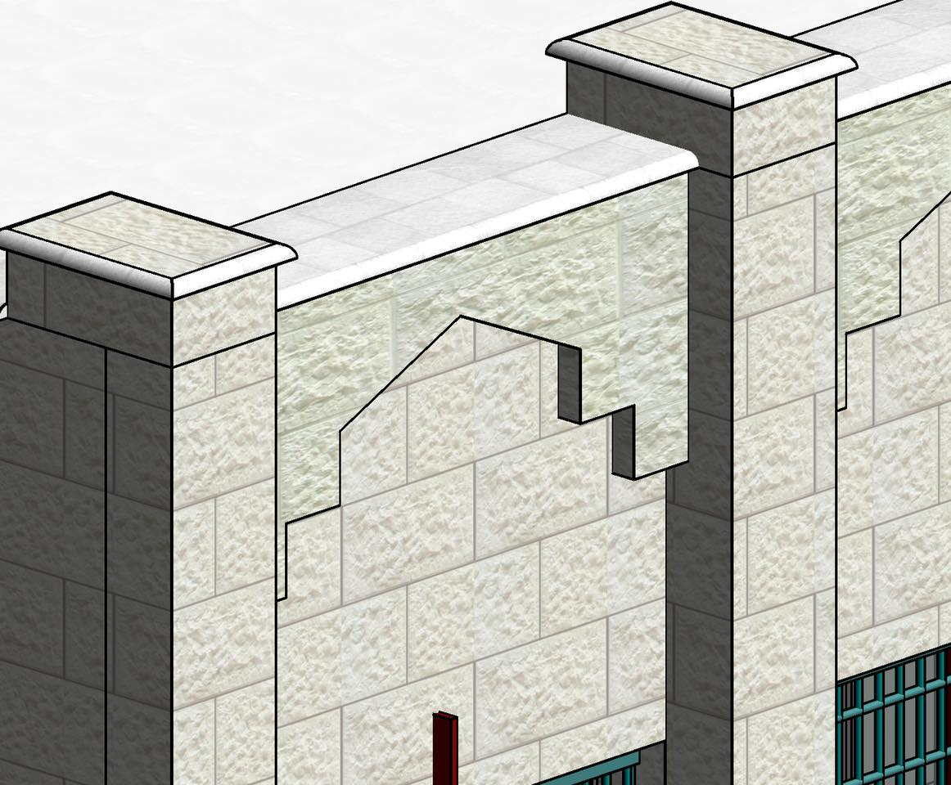
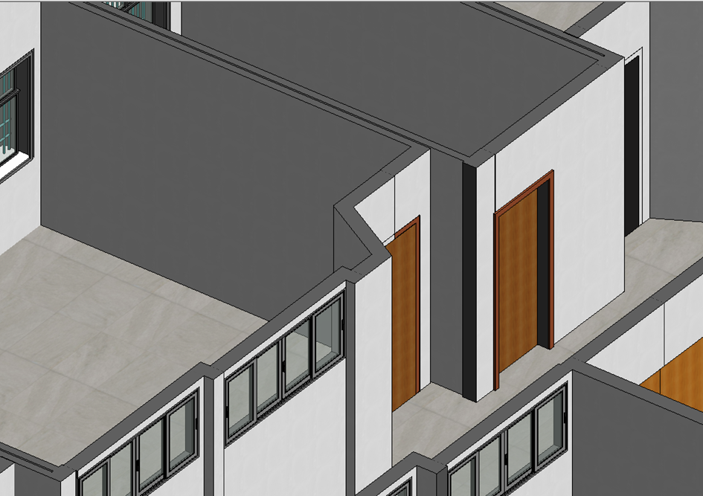
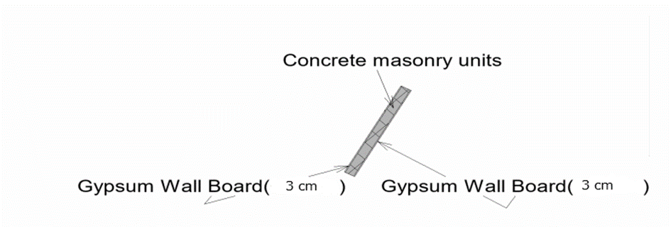
Walls

Slide 10
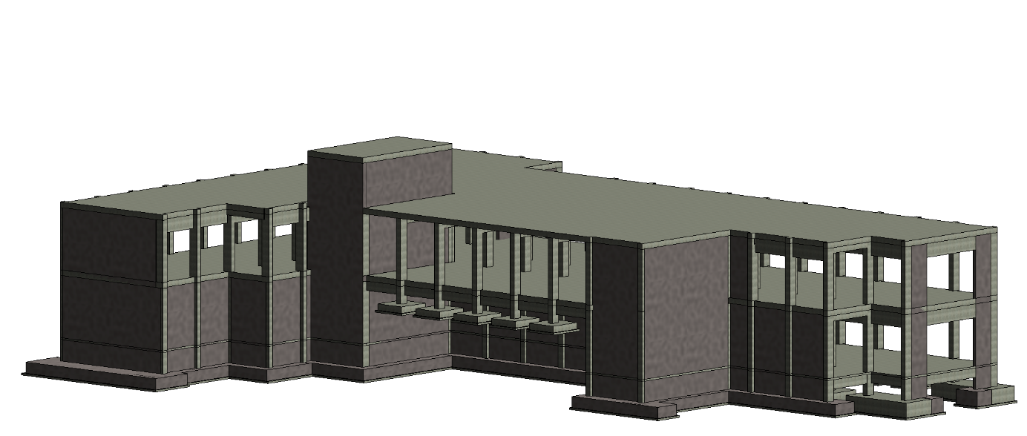
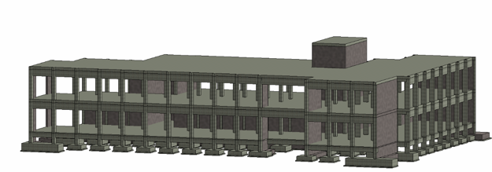
Structural Model

Slide 11
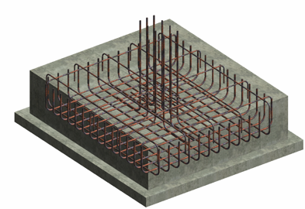
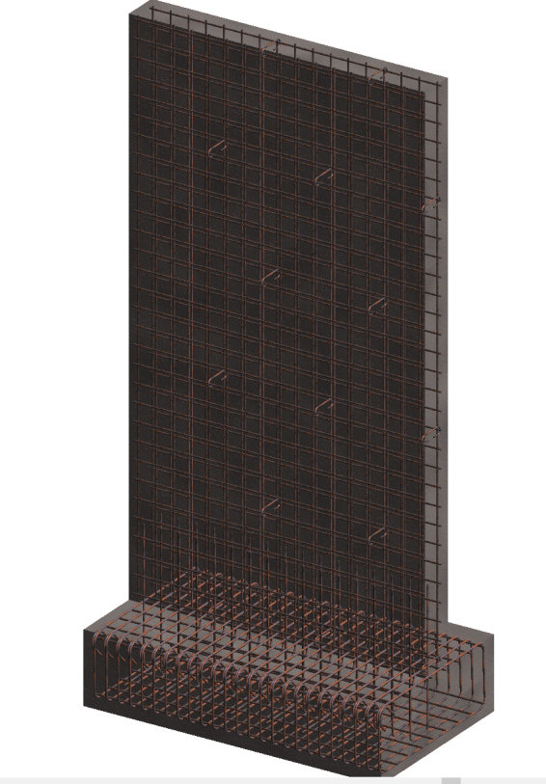
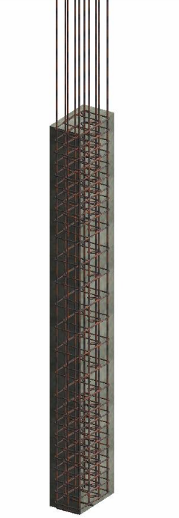
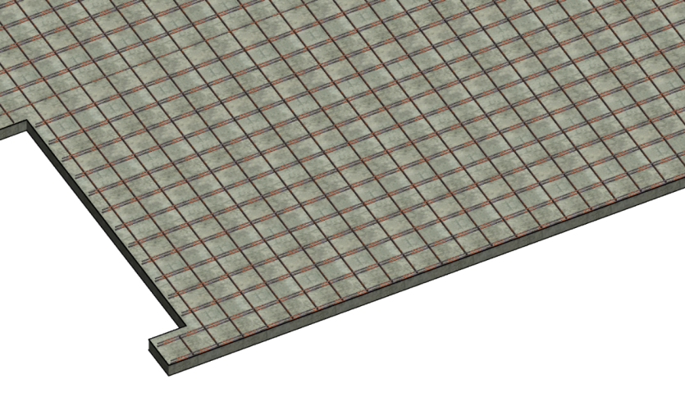
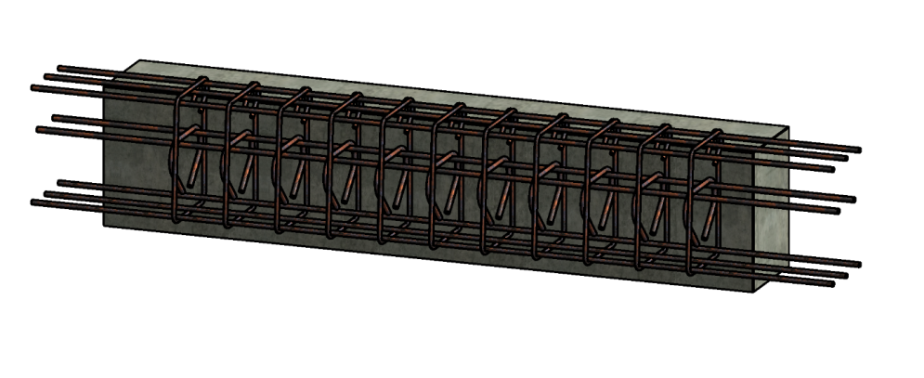
Footing
Column
Shear Wall
Ground beam
Slab

Slide 12
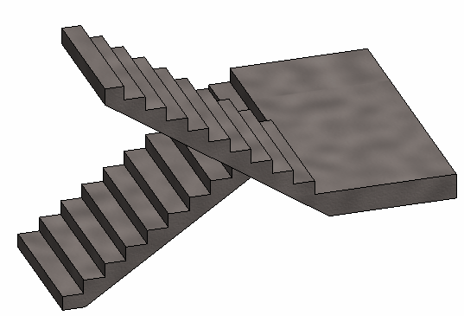
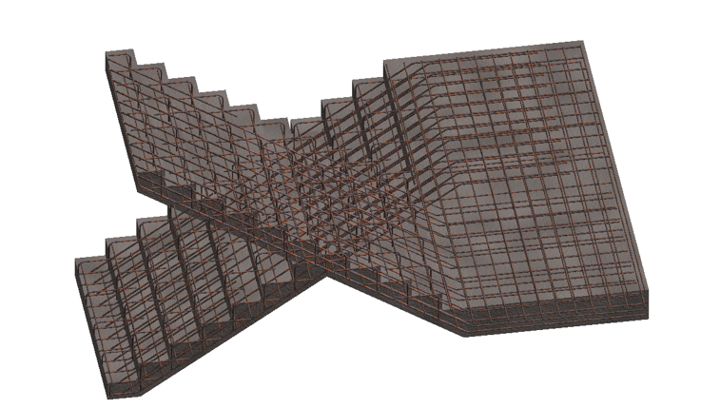
Stair

Slide 13
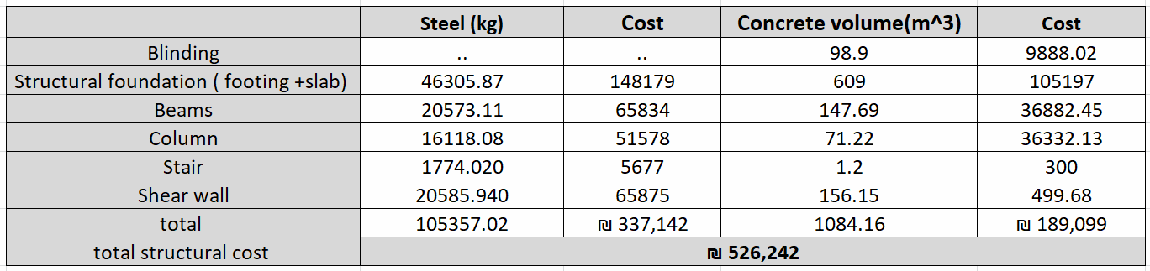
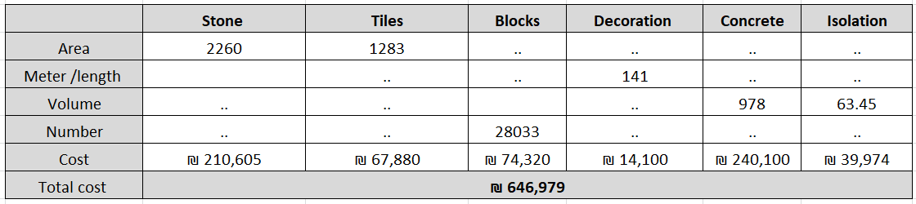

Construction total cost
Total cost = 1,551,221 ₪
Additional cost due to green features = 120,000 ₪
The total cost of the project =1,671,221 ₪

Slide 14
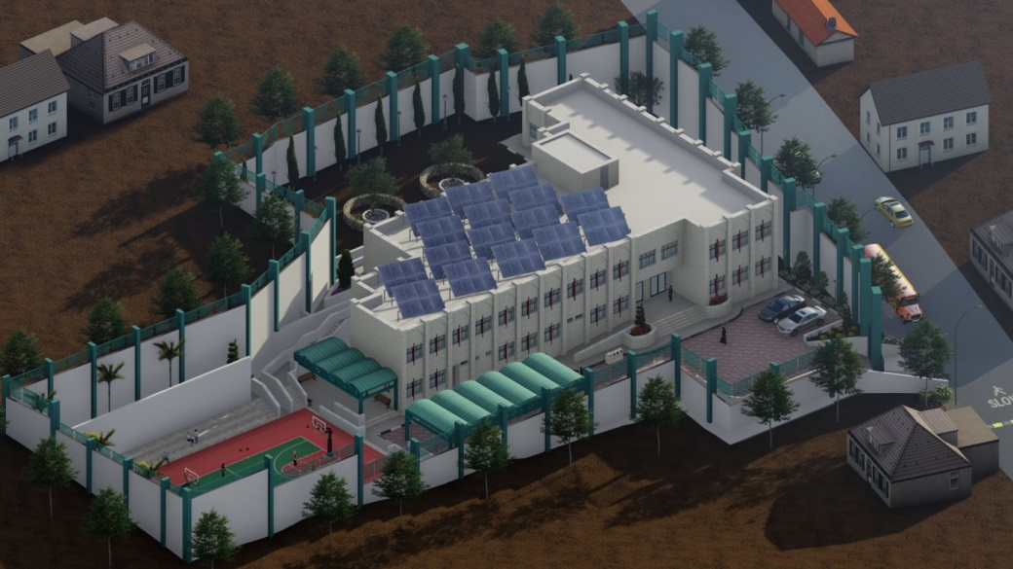
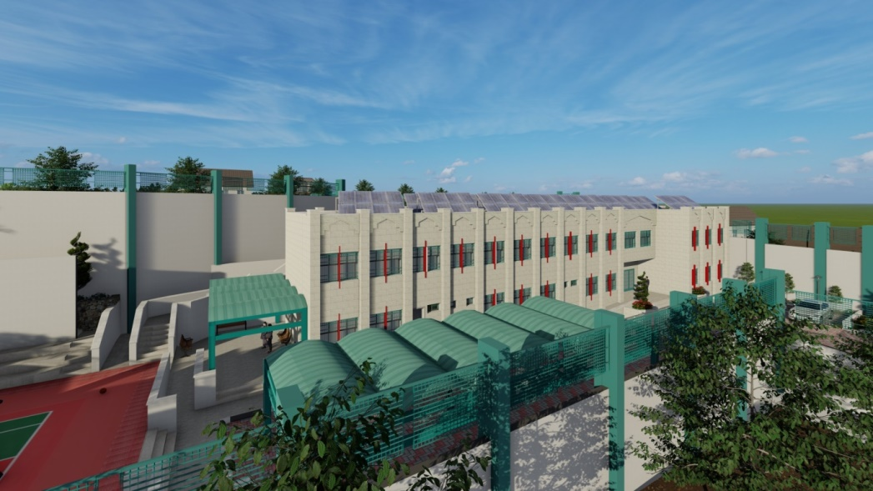
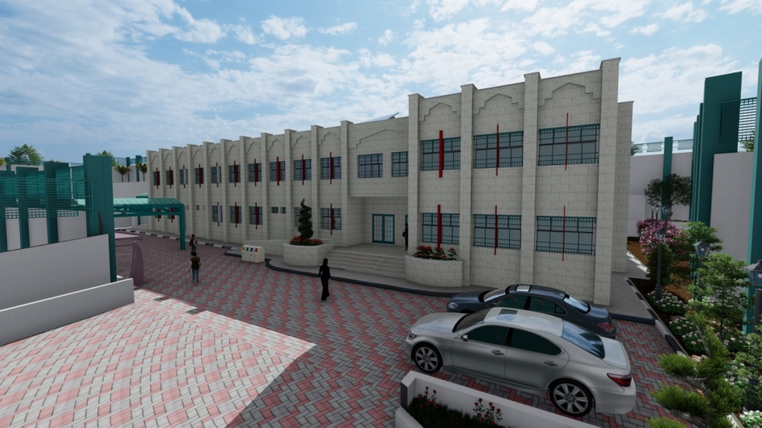
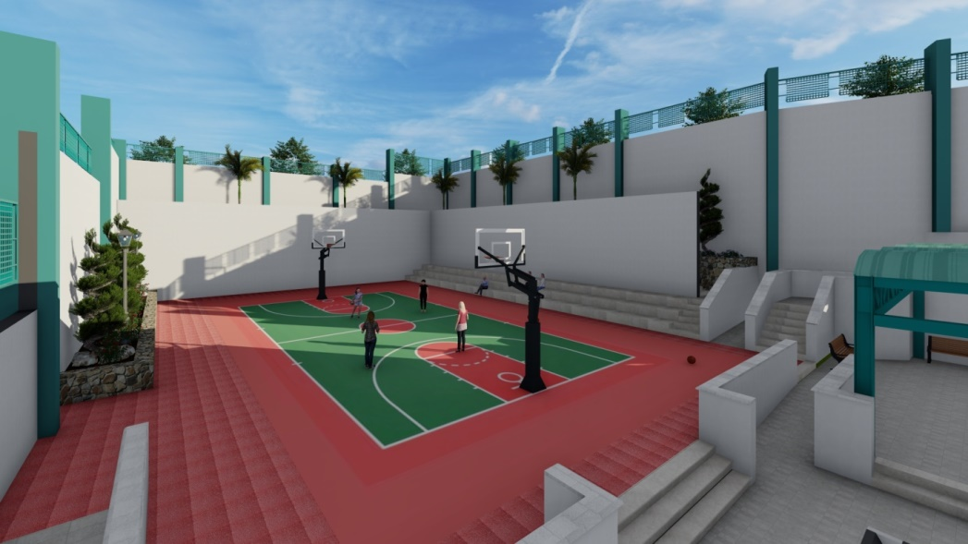
Lumion 12.

Slide 15
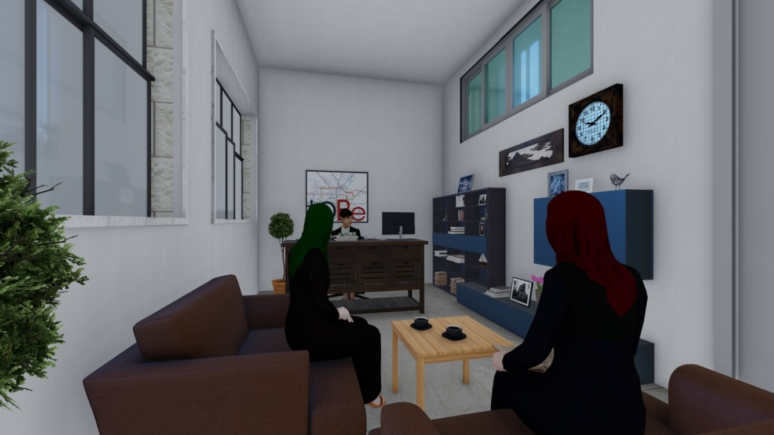
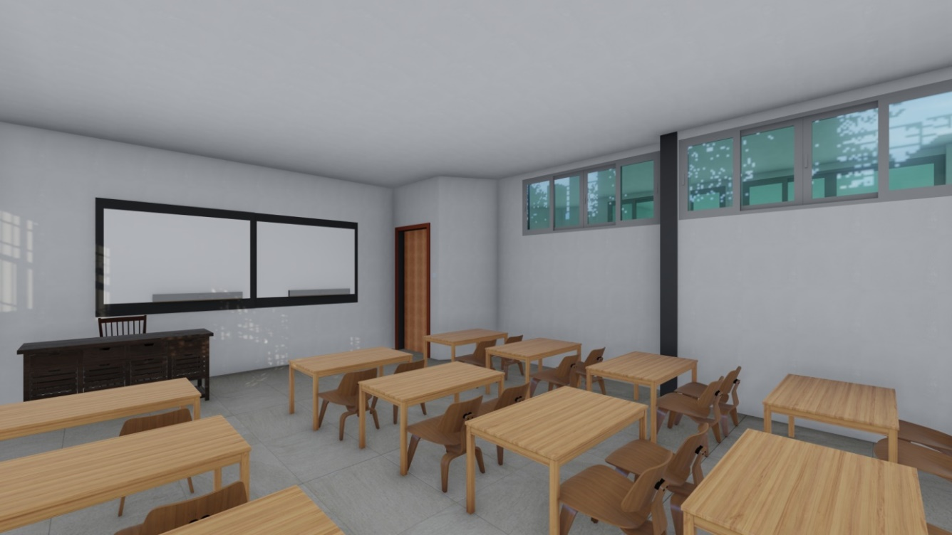

Slide 16
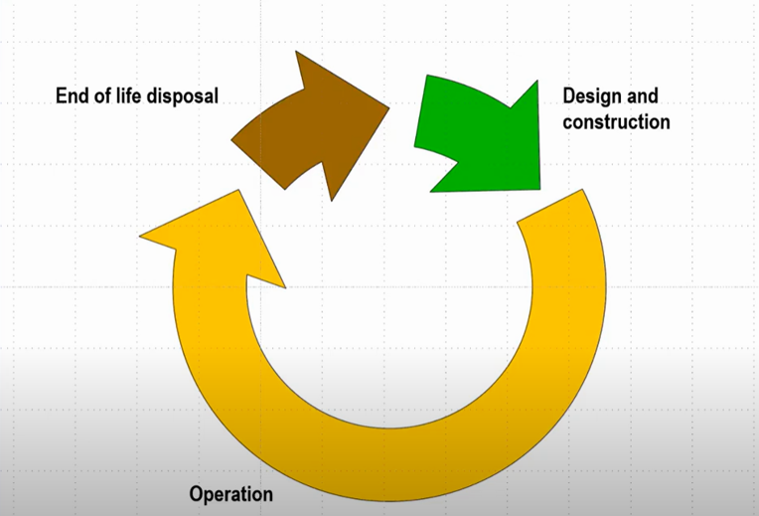
Life cycle cost calculations:

Slide 17

Inflation Rate
A report by the Monetary Authority showed that Palestine is experiencing relatively high inflation rates due to rising in prices of commodities in the world markets, especially energy, where inflation rates reach to 3.7% . This value has been adopted in our project .
Once the inflation rate is determined, the change in cost can be calculated using equation

Slide 18
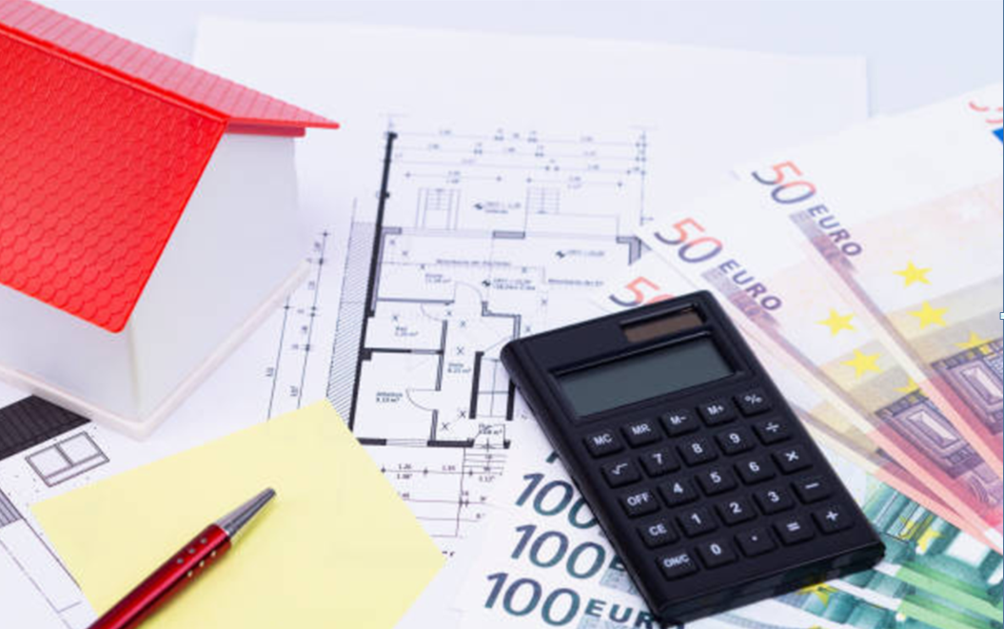
Life cycle cost includes :
Construction cost :
Operating cost :
-Energy cost
-Water cost
-Maintenance

Slide 19
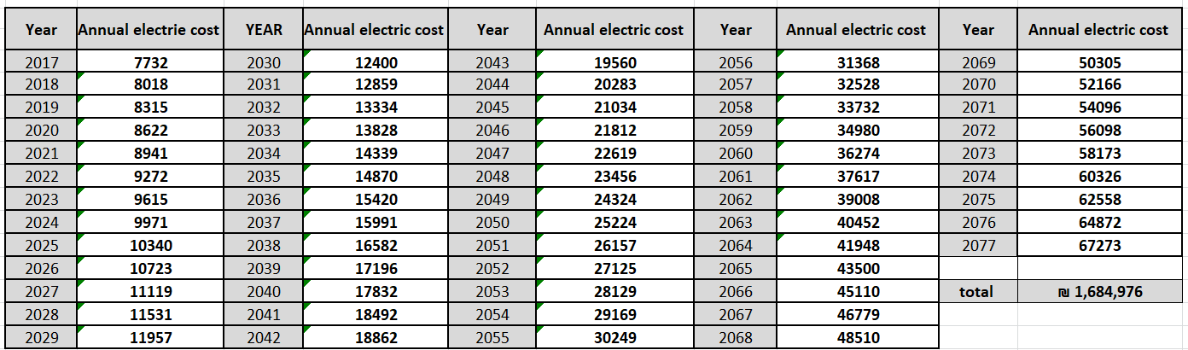
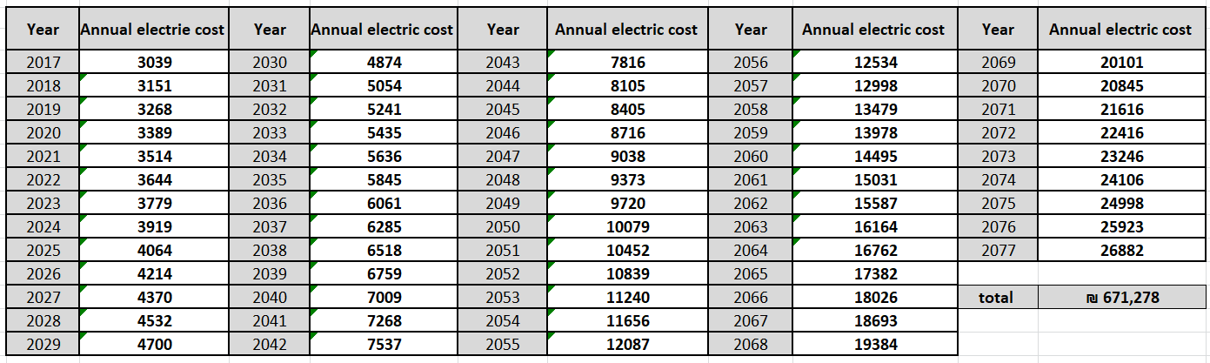
Estimated life cycle energy cost for the case study without considering pv structure production
Estimated life cycle energy cost for the case study

Slide 20
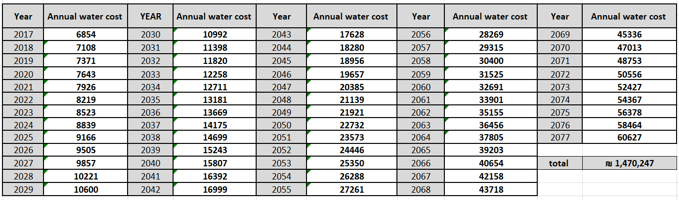
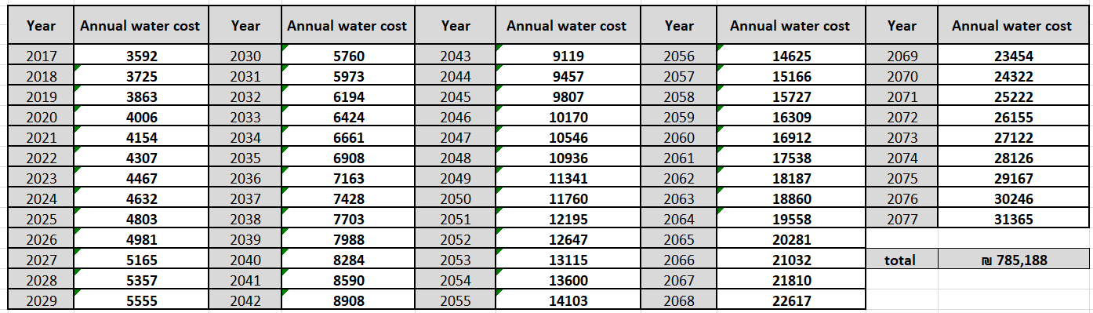
Estimated life cycle water cost for Deir-istia school
Estimated life cycle water cost for the case study

Slide 21
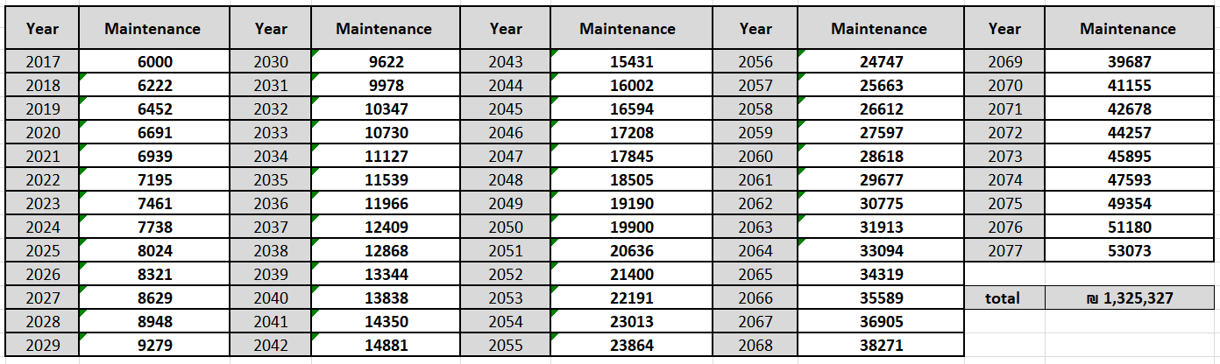
Estimated maintenance life cycle cost for the case study

Slide 22
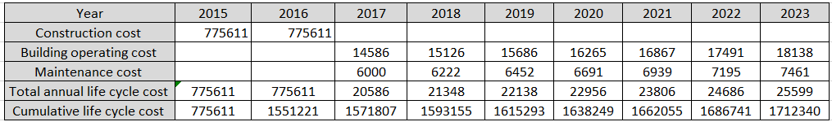
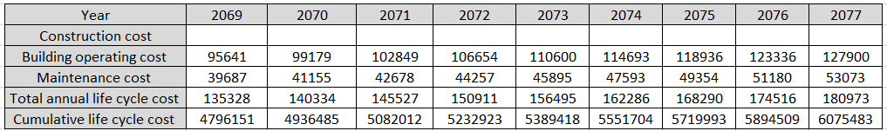
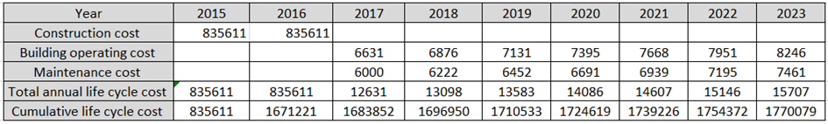
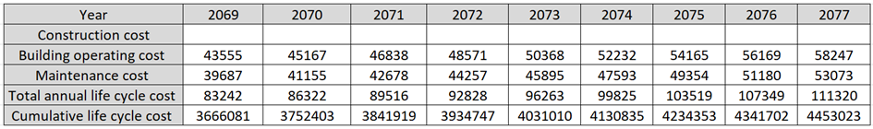
Life cycle cost for Aqqaba school if it was without green features
Life cycle cost for Aqqaba green school

Slide 23
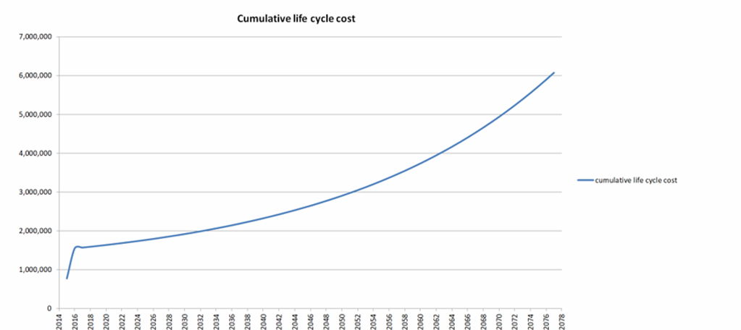
cumulative life cycle cost for Aqqaba school if it was without green features

Slide 24
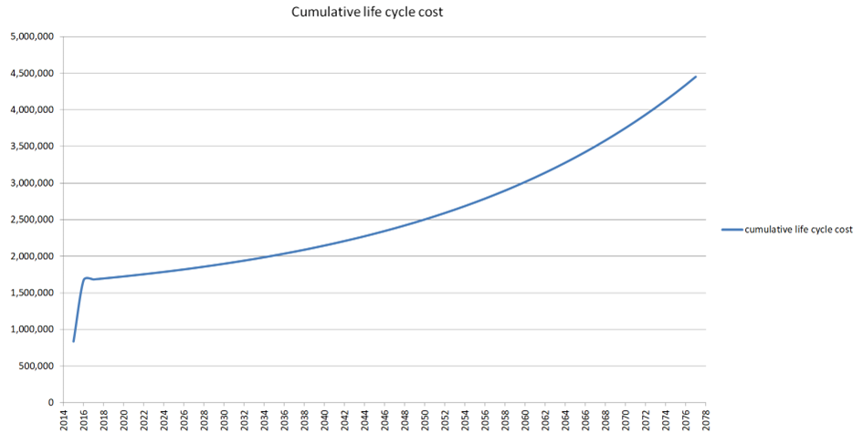
cumulative life cycle cost for Aqqaba green school

Slide 25
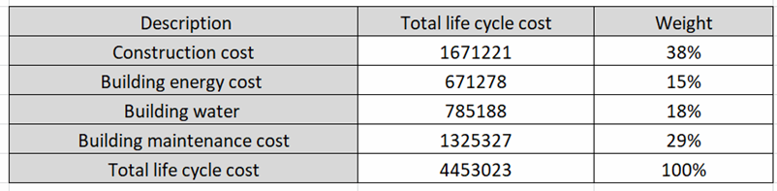
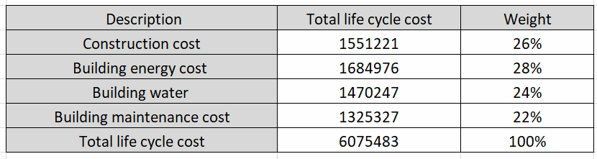
Results
Total life cycle budget summary for the case study
Total life cycle budget summary for the case study without green features

Slide 26
Conclusion
-The construction cost in the green buildings exceeded the traditional building by 12%, , it is noted that an amount of 1,622,460 has been saved, which covers almost the entire construction cost of the building.
-The energy consumption cost constitutes the greatest percent in traditional buildings which has a negative impact on the environment and human beings, while in green buildings it is approximately fifty percent less.
-In green buildings water consumption has been reduced by about 6%
-It was found that the percent of life cycle cost is 2.9 times more than construction cost of traditional building while is was 1.7 times less in green buildings , which is normal, because the construction cost of green building is greater.

Slide 27
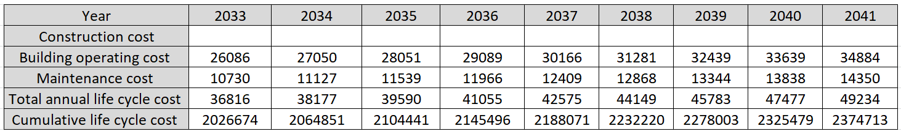
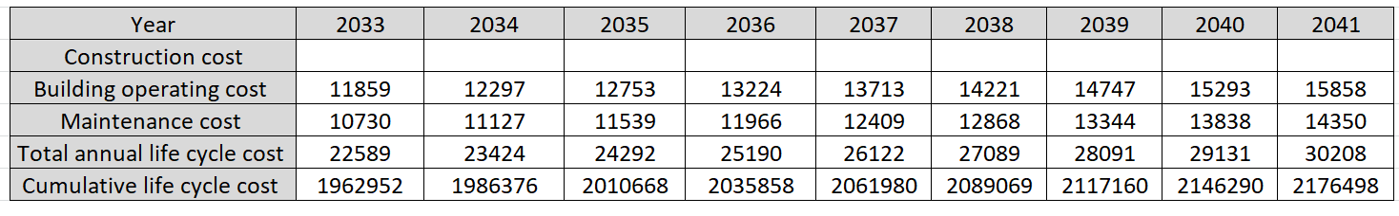
-20 years later , the difference in cumulative total Cost in both cases covers the additional initial construction cost due to green features

