Slide 1

COFFEE
MACHINE
PRESENTED BY
Osamah Abdullah Ibrahim Asad
SUPERVISED
Eng. Saed Tarapiah

Slide 2

Components
LIST OF CONTENTS
Introduction
Future Work
Any Questions ?
Constraints
Features

Slide 3


INTRODUCTION
The Coffee Machine project is an innovative hardware system designed to automate the process of preparing coffee in a hygienic and efficient way. It consists of four main stages, each responsible for a specific task in the process

Slide 4



CONSTRAINTS
Lack of time and difficulty in transportation to obtain certain parts.
Difficulty in handling some electronic components .
Finding an appropriate mechanism for all
stages of the project with the simplest components.

Slide 5

FEATURES
Four-Stage Automation
Mobile App Control using bluetooth Hygienic & Efficient Design
User-Friendly Interface

Slide 6
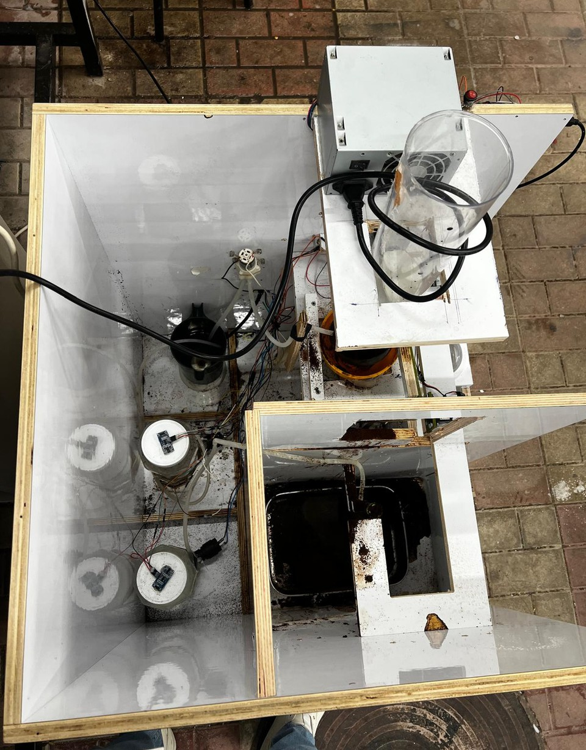
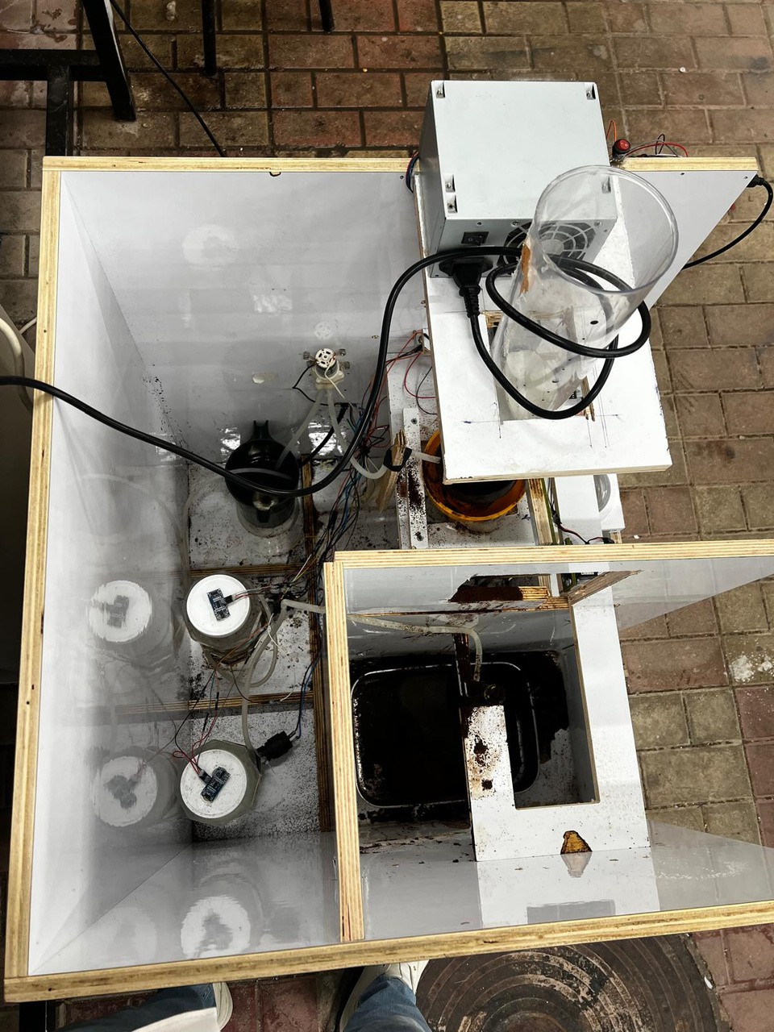

Slide 7
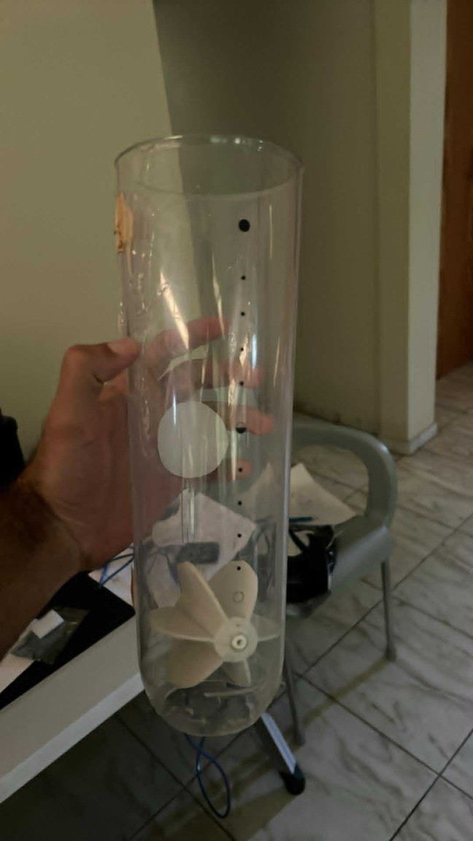
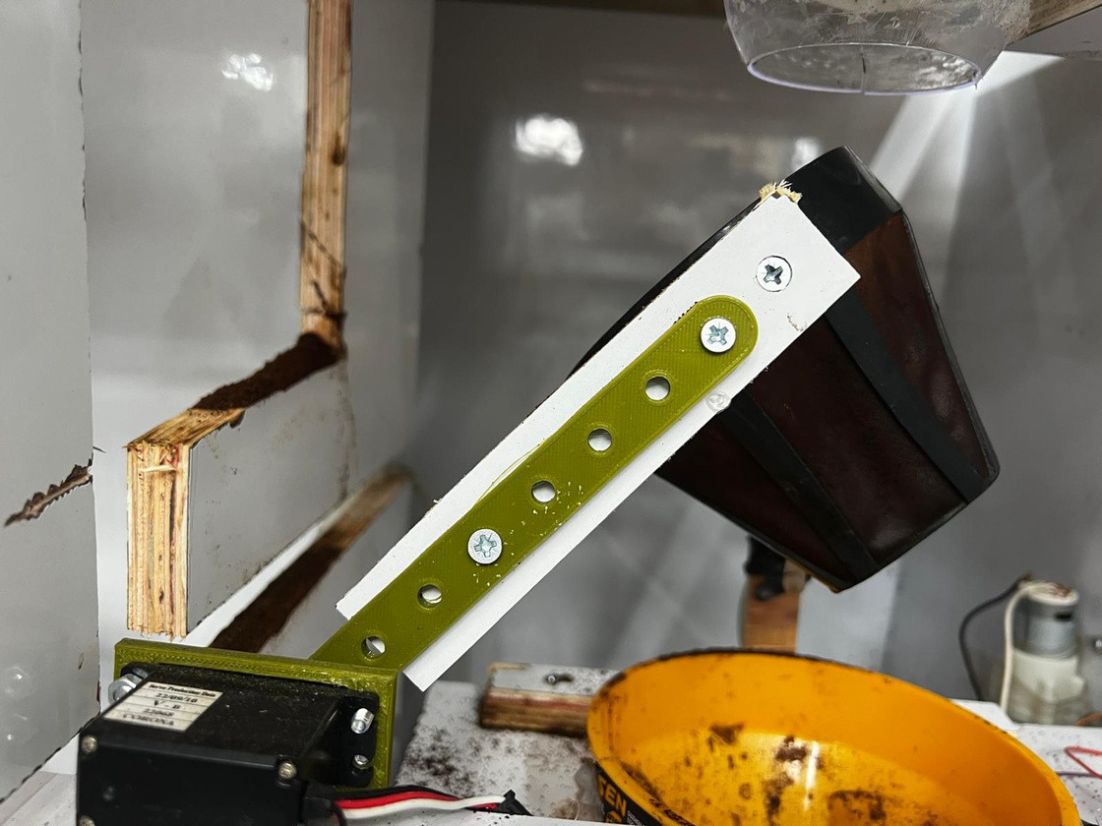
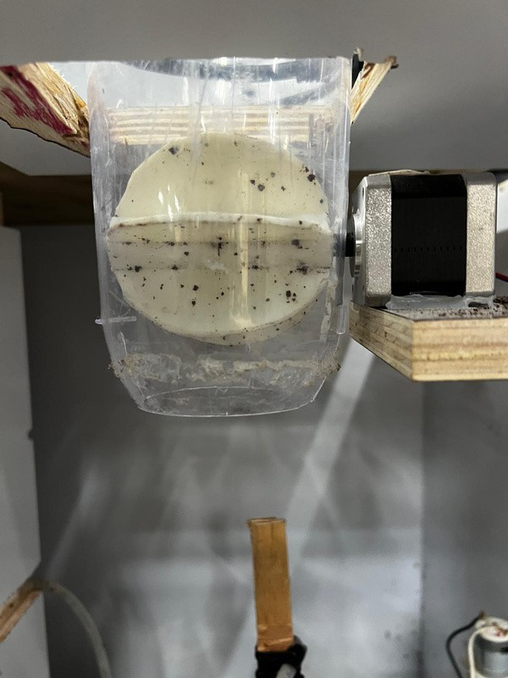
COFFEE DISPENSER
COFFEE FILTER

Slide 8
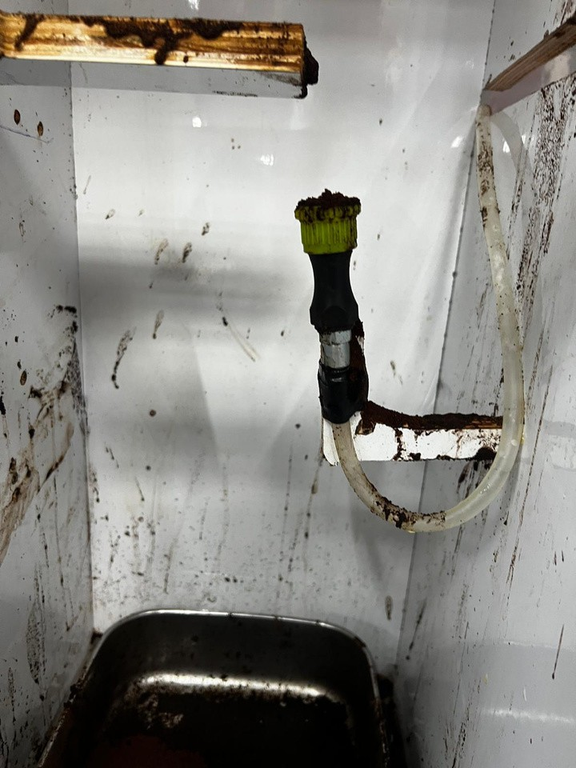
WASHING AREA

Slide 9
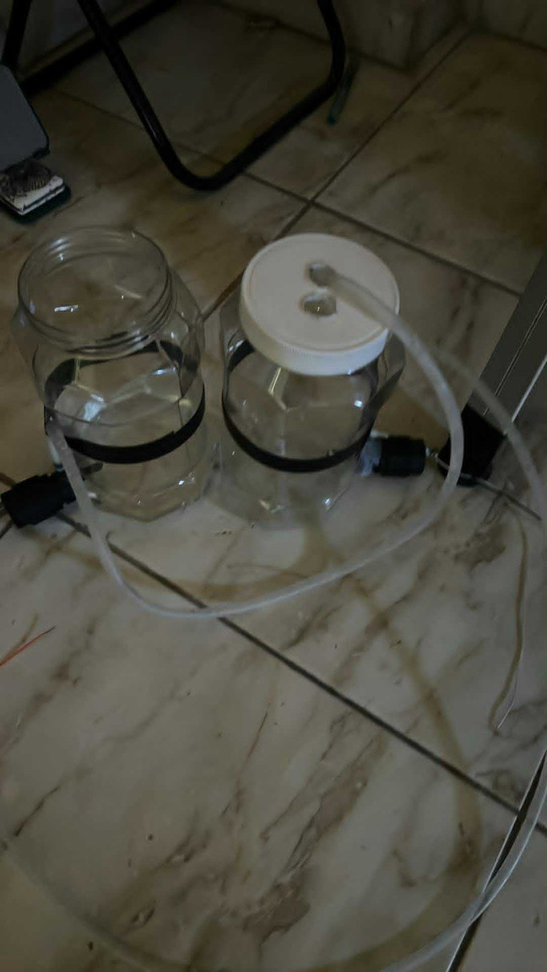
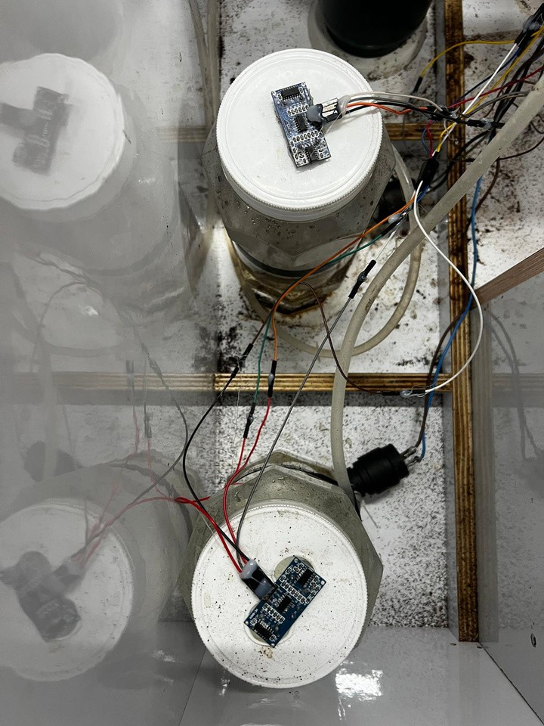
WATER TANKS

Slide 10
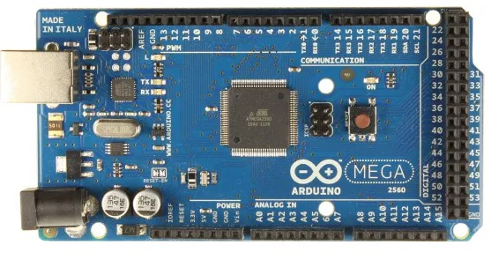

HARDWARE PART
Arduino Mega 2560 Control: Centralized control using an Arduino Mega 2560 ensures coordination of all motors, sensors, and pumps, allowing for efficient operation and easy programmability.

Slide 11
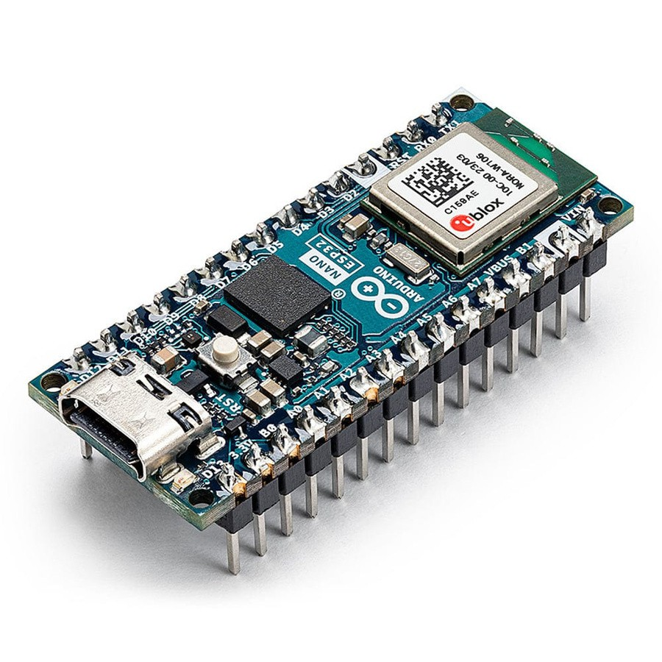
HARDWARE PART
ESP32 Control: The ESP32 microcontroller provides advanced connectivity and
p rocessing capabilities, enabling seamless integration with mobile app lications for real-time event handling and remote control.
Additionally, the ESP32 manages LCD display operations, ensuring dynamic user feedback and smooth

Slide 12
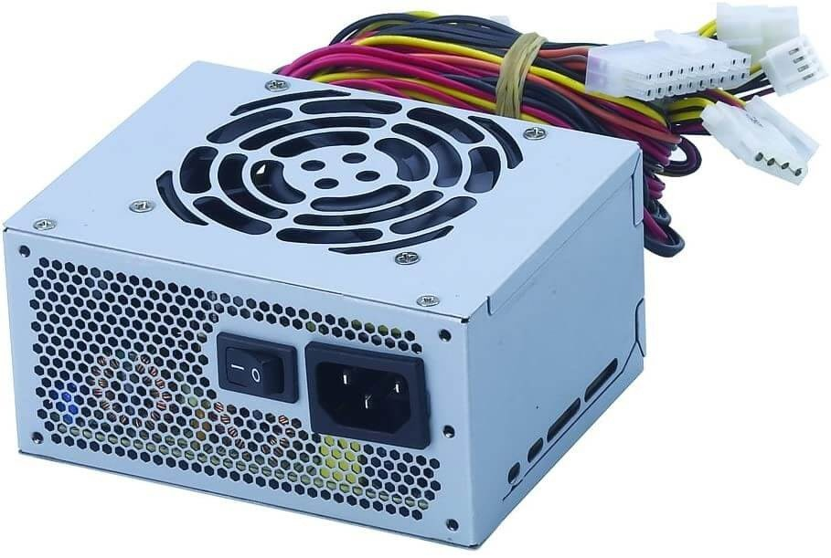
HARDWARE PART
Power Supp liers: Power Supply provide 12 volt & 5 volt for all project components

Slide 13
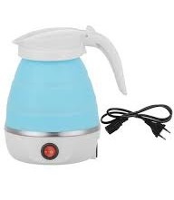
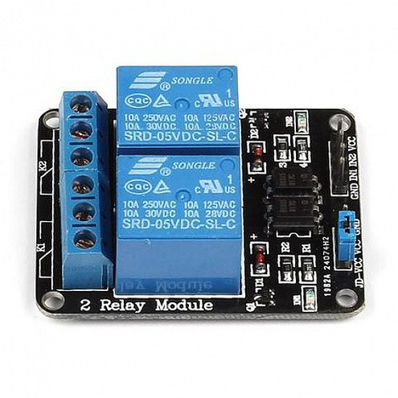
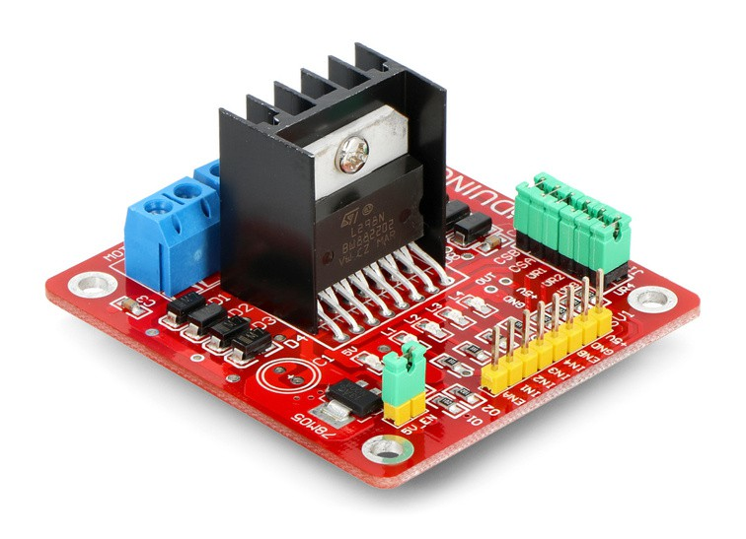
HARDWARE PART
Water Heater 220 V: for heating the water
channel relay:for controlling heater and water pumps
LN298N:for controlling stepper motors

Slide 14
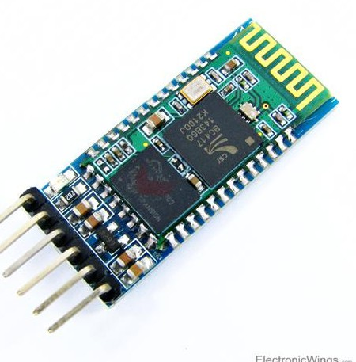
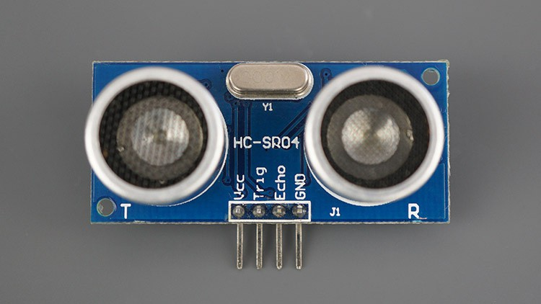
HARDWARE PART
HC-
05:bluetooth module
Ultrasonic sensor

Slide 15
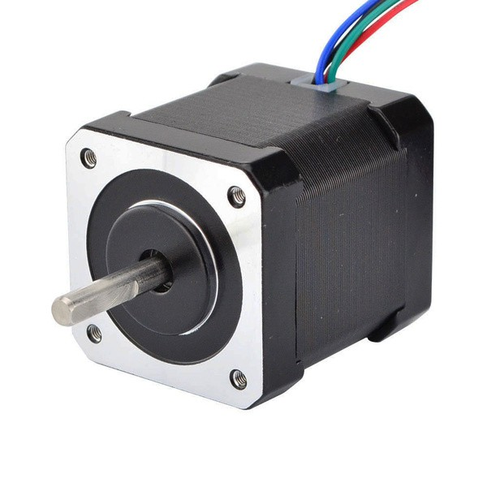
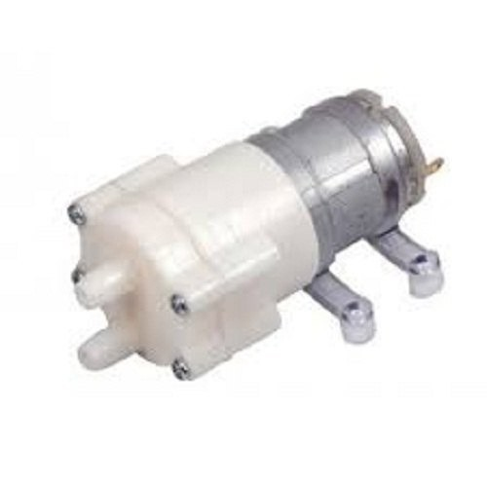
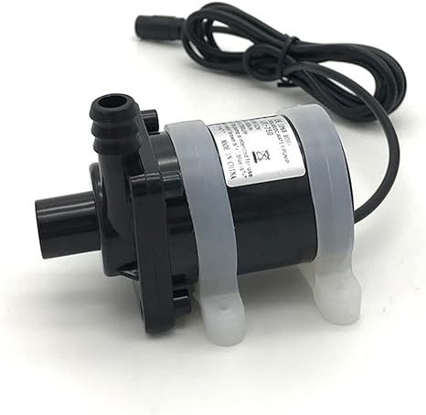
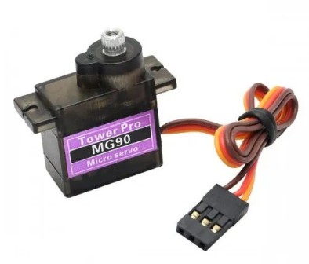
HARDWARE PART
stepp er motor
Water Pump
Servo Motor

Slide 16
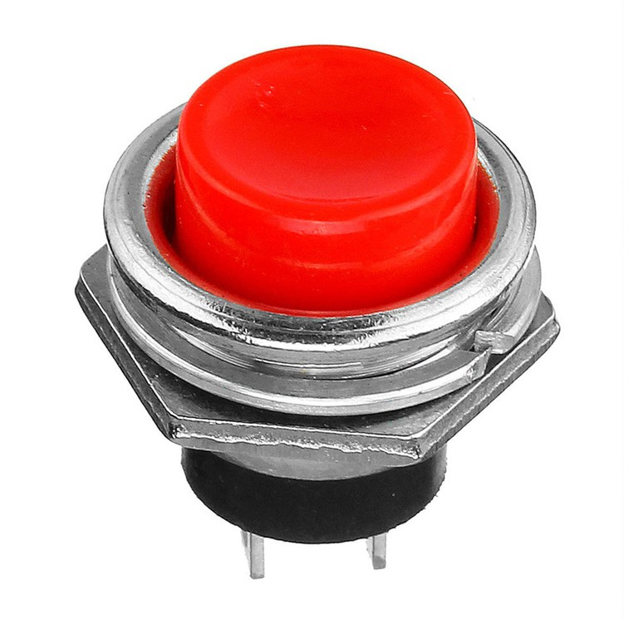
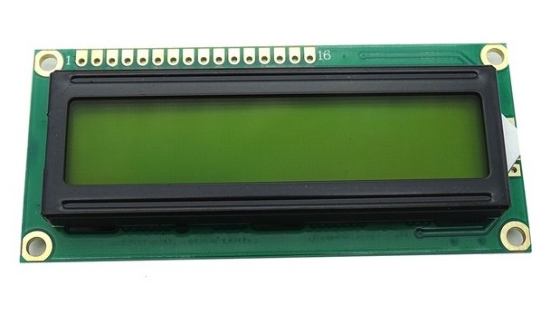
HARDWARE PART
16x4 LCD
Push Button

Slide 17
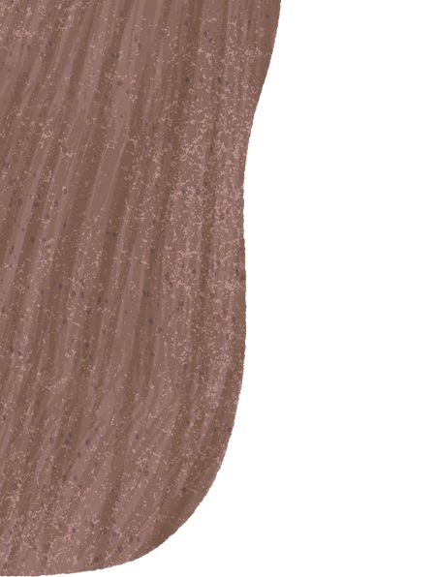
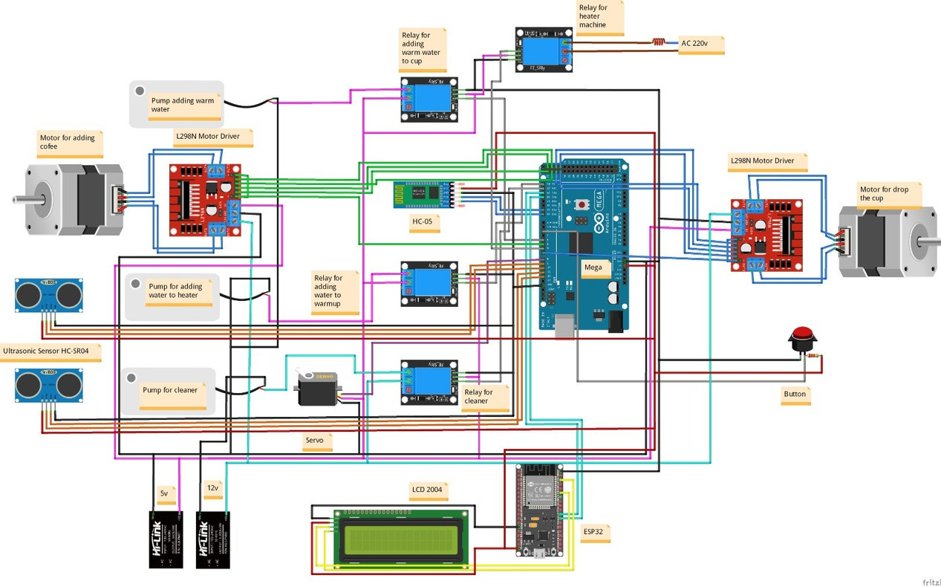

SCHEMATIC FOR PROJECT ELECTRONICS

Slide 18
FUTURE WORK
Add multiple cup sizes and an intelligent cup- size detection system.
Integrate a smart sugar dispensing module.
Enable mobile application control through wireless connectivity.

Slide 19
Any Questions?

Slide 20



THANK
YOU

