Slide 1



An-Najah National University
Graduation Project 2
Faculty of Engineering
and Information Technology
Grass Cutting Robot
Prepared by : Haneen Yaqoub & Rana Mara’beh
Supervised by: Dr. Abdullah Rashed

Slide 2

contents
01
Background of the project
02
Features
03
Goals
04
Tools and equipments

Slide 3
01
Background
of the project

Slide 4
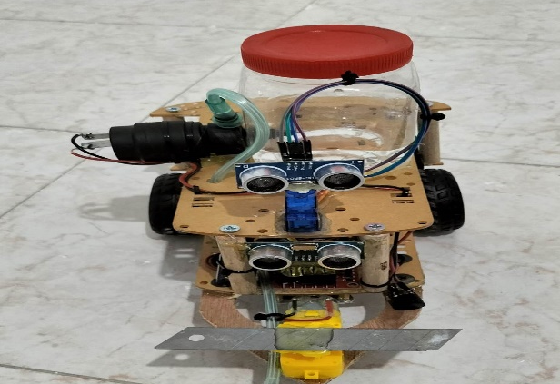
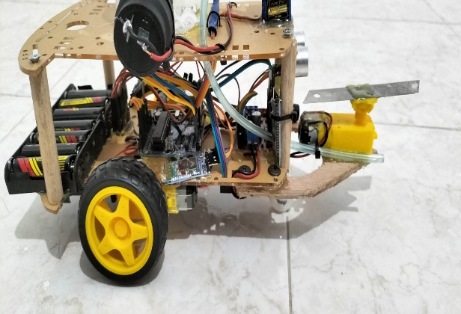
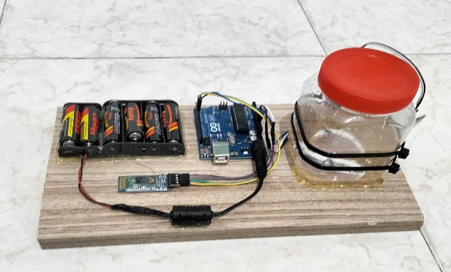
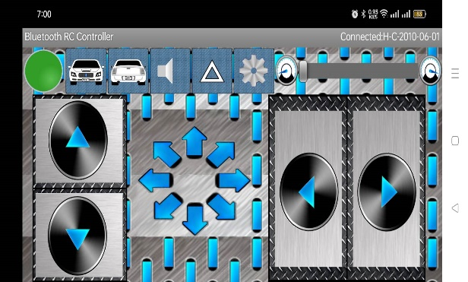
Background of the project
Grass cutting robot that helped the gardener caring the garden
It includes cutter connected over a dc motor
It includes a water pump that pumping water due to the soil moisture
We control the movement using the Bluetooth RC Controller App

Slide 5
02
Features

Slide 6
Features
1
2
3
4
cutting
Avoiding obstacles
Pumping due to Soil moisture
Automatic movement

Slide 7
Goals
03

Slide 8
Goals
01
Less Work
Less Time
02
03
Less Gardeners
04
Less Water

Slide 9
Tools and
equipments
04

Slide 10
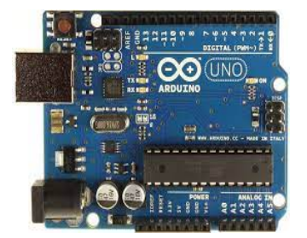
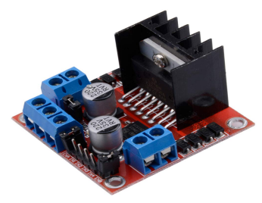
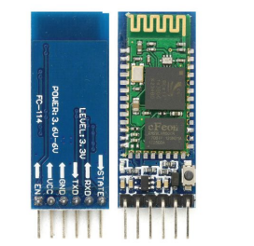
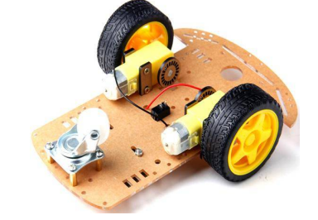
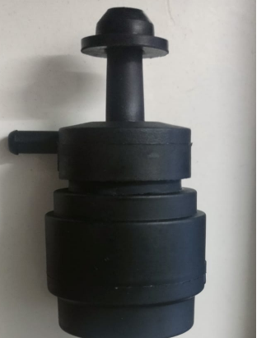
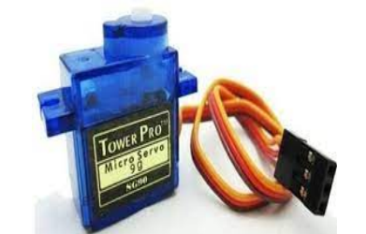
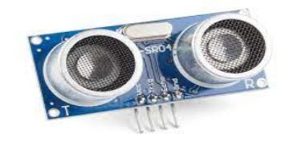
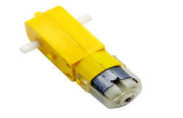
Tools and equipments
Arduino car
Arduino uno
H Bridge
Bluetooth HC-05
Ultrasonic sensor
Water pump
DC motor
Servo motor

Slide 11
Thank You

