Slide 1
Table of Contents
01
02
03
04
Introduction
Project Execution
UniTrade feature
Constraints

Slide 2
UniTrade
Software project

Slide 3
01
Introduction

Slide 4
Problem
University students purchase so many items each semester. However, students need change every semester, so they find themselves with unwanted items.
Students use platforms like Facebook to conduct these searches, but their posts often get lost among other unrelated posts.

Slide 5
objective
Time saving.
Create a beneficial exchange among university students.
Money saving.
Efficient Goods exchange.
Innovative services.

Slide 6
UniTrade
Is a platform for university students to sell their unwanted items to their peers, creating a beneficial exchange among students.

Slide 7
02
Project Execution

Slide 8
System Architecture
Presentation Layer (Frontend)
Business Logic Layer (Backend)
Data Access Layer
Database Layer
External Services Layer

Slide 9
System Architecture
A layered Architecture approach was used:
  Presentation Layer: Manages user interface and user experience.
  Business Logic Layer: Core processing of the application.
  Data Access Layer: Manages data transactions and communication with the database.
  Database Layer: Data storage and management.
  External Services Layer: Integration with external services.

Slide 10
Technologies used
Backend:
  Node.js.
  Express framework.
Database:
  MYSQL workbench.
  Firebase.
Backend and Database:
  Nodemon: automatically restarting the node application when the file changes.
  Firebase Storage: to store images.
For Frontend:
  Flutter framework.

Slide 11
03
UniTrade Features

Slide 12
Mobile Application
User side

Slide 13
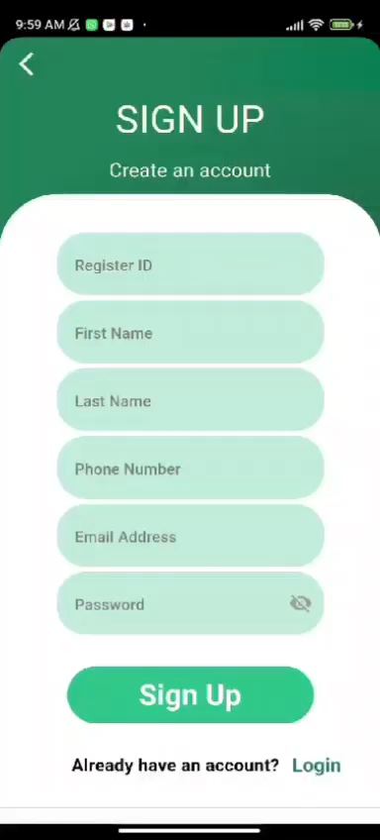
Sign up page

Slide 14
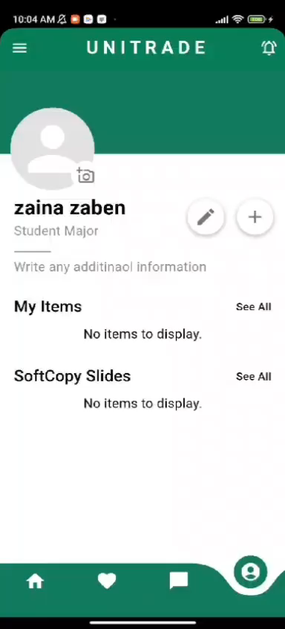
Edit user profile

Slide 15
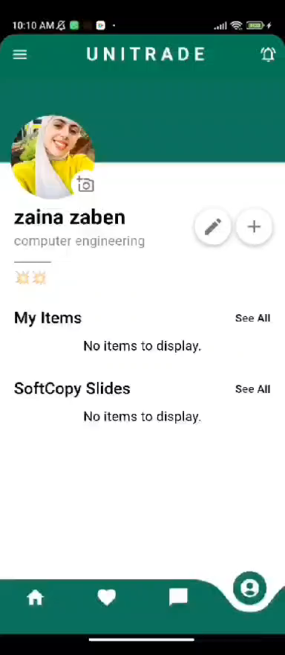
Upload item

Slide 16
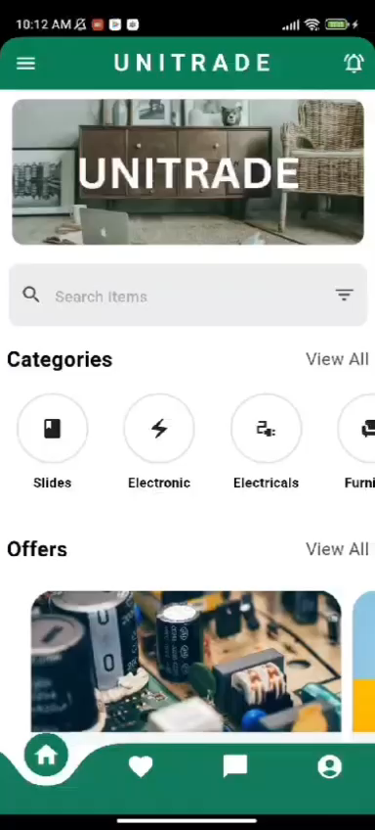
Delete Item

Slide 17
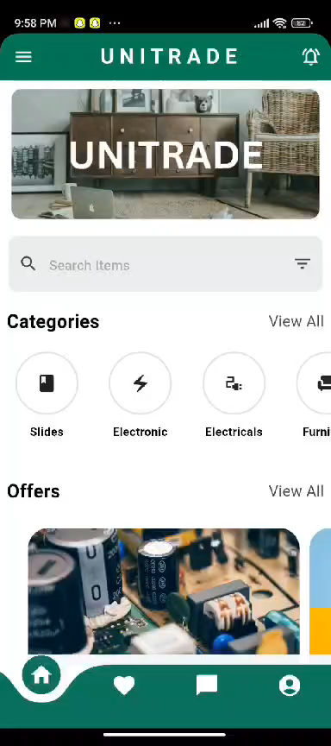
Add Item to Favorite

Slide 18
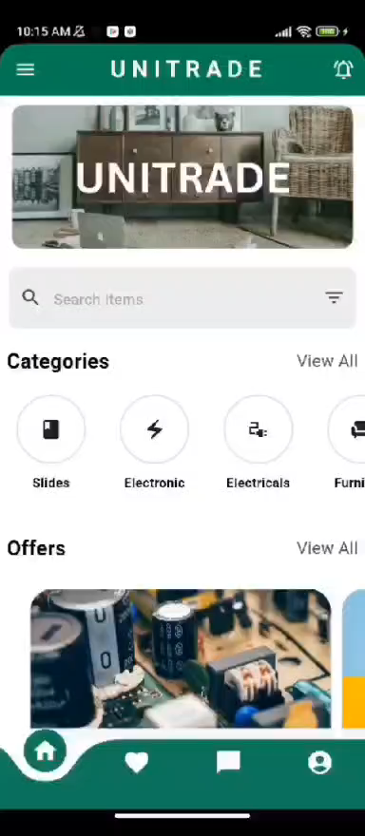
Chatting and Reserve an Item

Slide 19
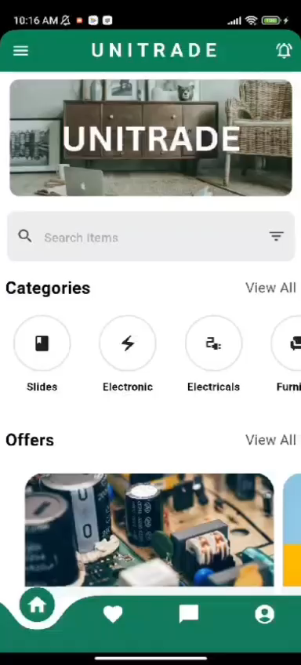
Report Item

Slide 20
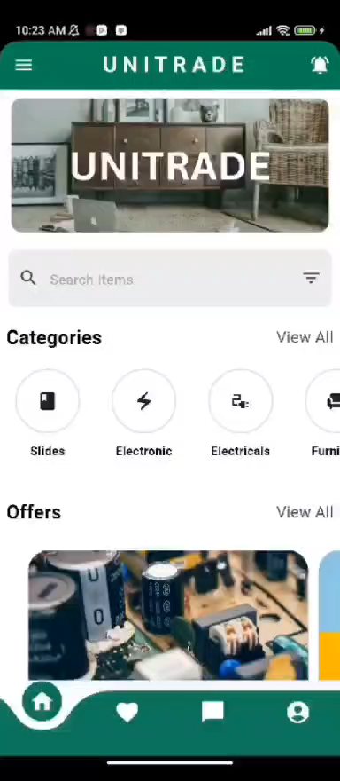
See Reserved Notification

Slide 21
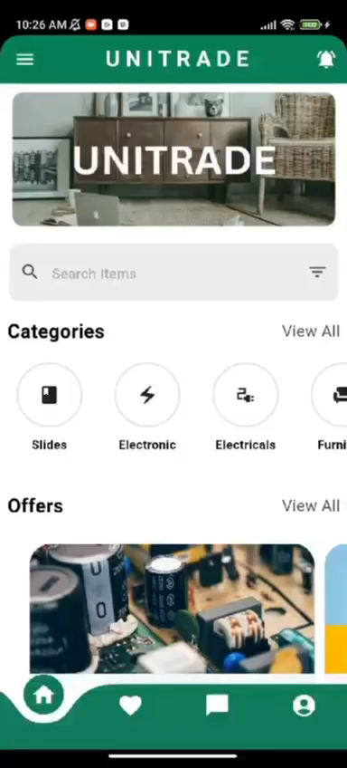
Decline reservation

Slide 22

Accept reservation

Slide 23
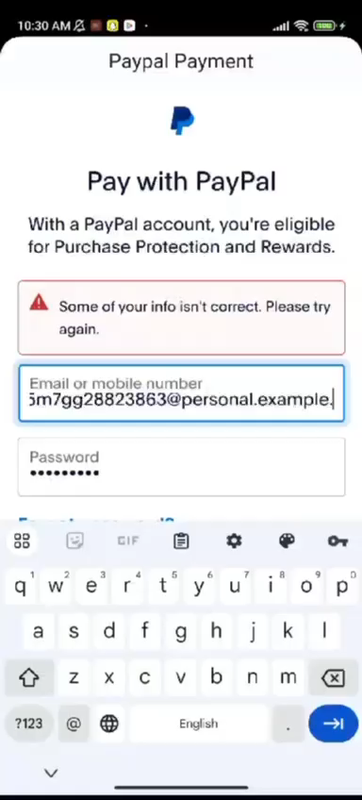
Paypal payment

Slide 24
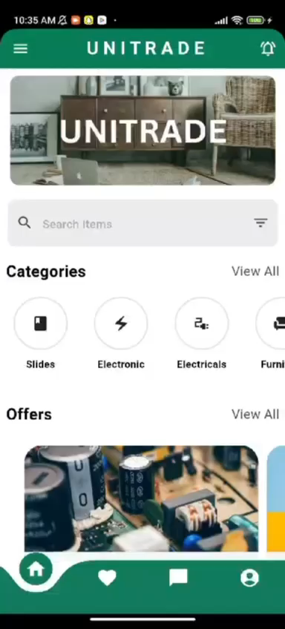
HomeMade meals

Slide 25
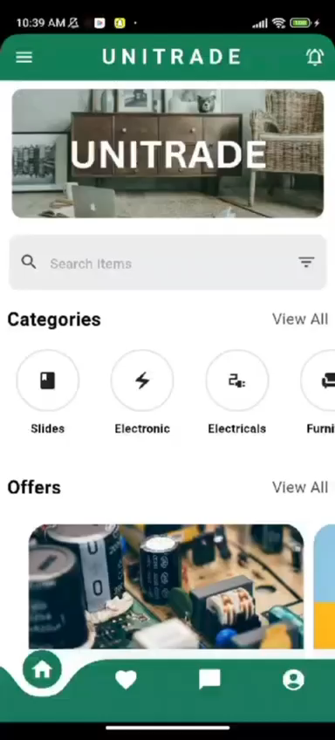
Preview slides

Slide 26
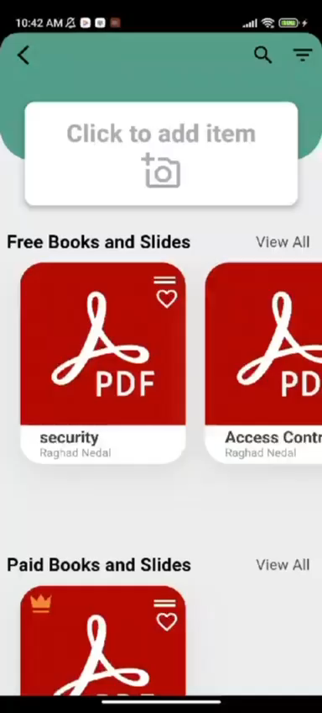
Download slides

Slide 27

Search items

Slide 28

Offers

Slide 29
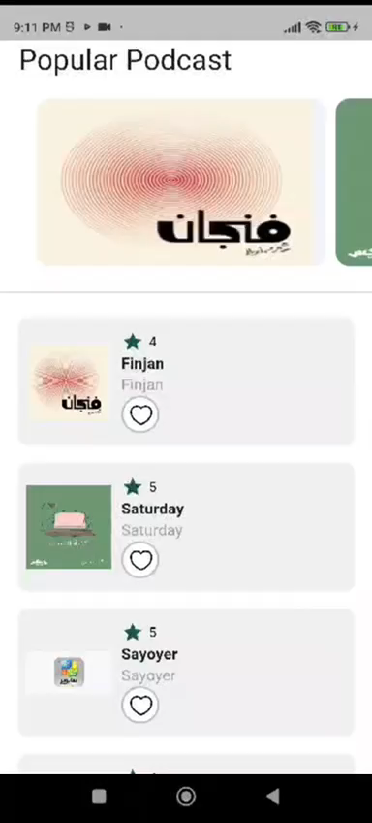
Podcast page

Slide 30
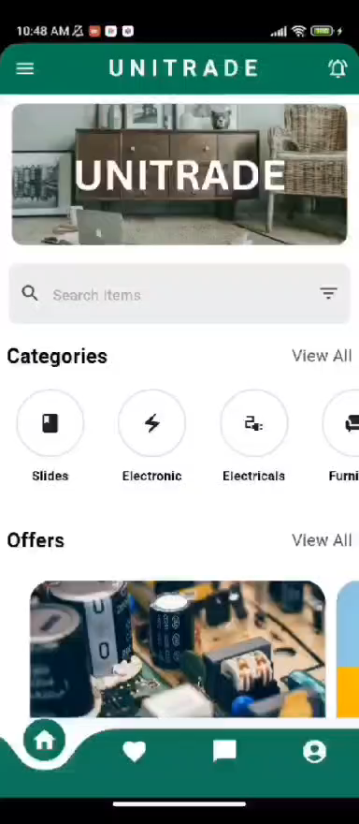
Loyality point

Slide 31
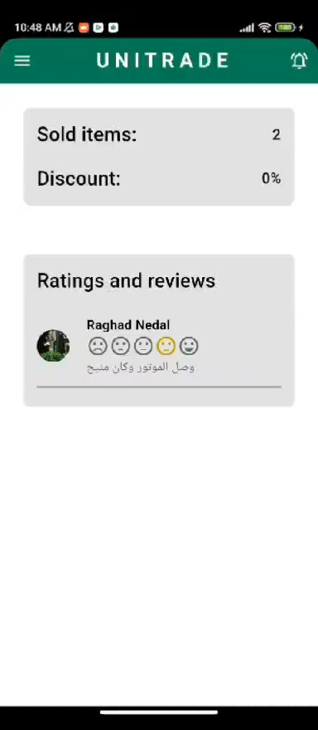
Help page

Slide 32
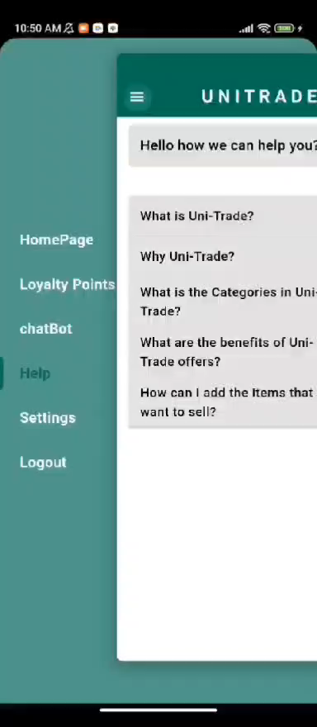
Setting page

Slide 33
Mobile Application
Admin side

Slide 34
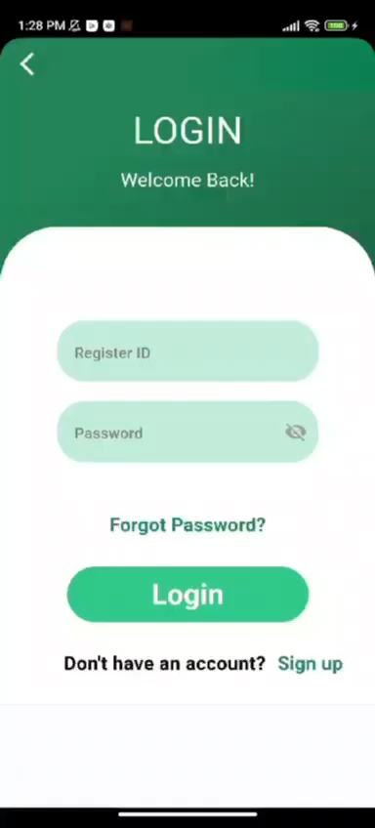
Admin Home page

Slide 35
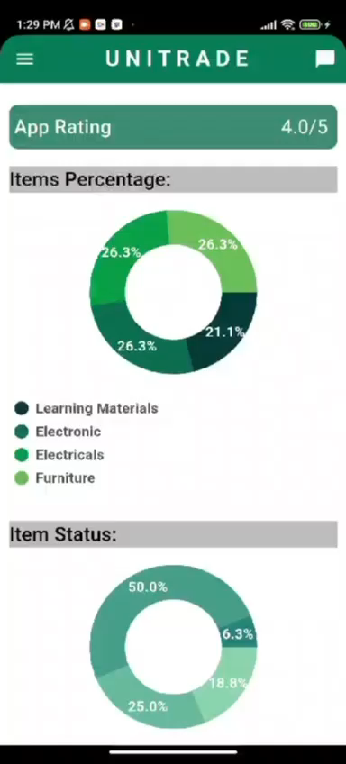
Admin Search pages

Slide 36
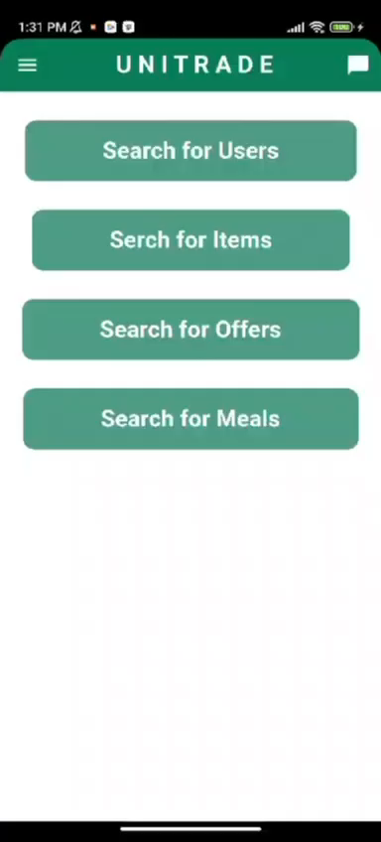
Admin User page

Slide 37
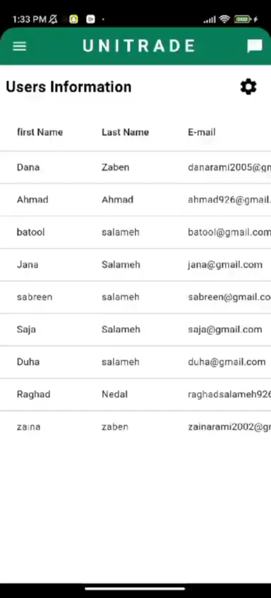
Admin Offer page

Slide 38
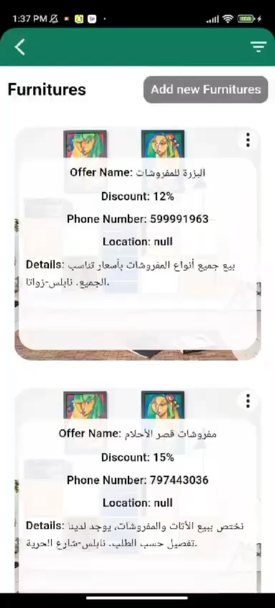
Admin Meal page

Slide 39
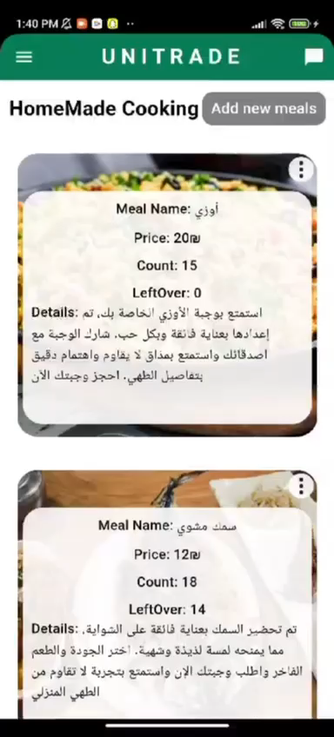
Admin Item page

Slide 40
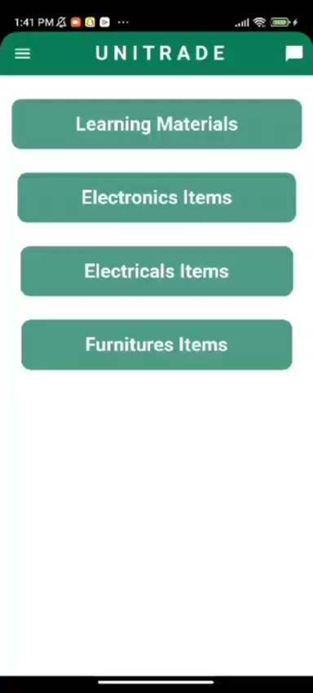
Admin Rate page

Slide 41
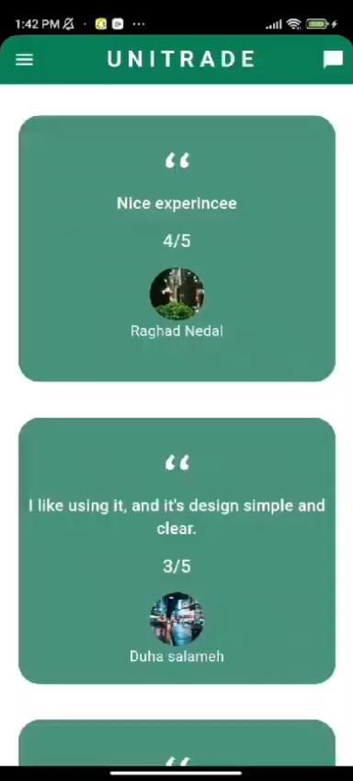
Admin Feedback page

Slide 42
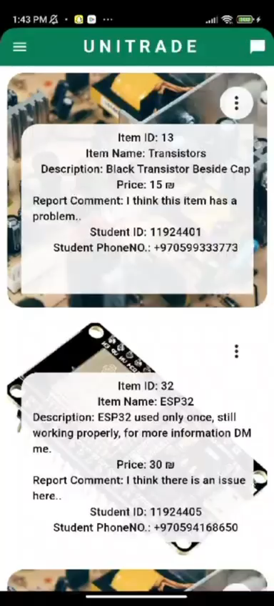
Admin Chat page

Slide 43
Website
User & Admin side

Slide 44
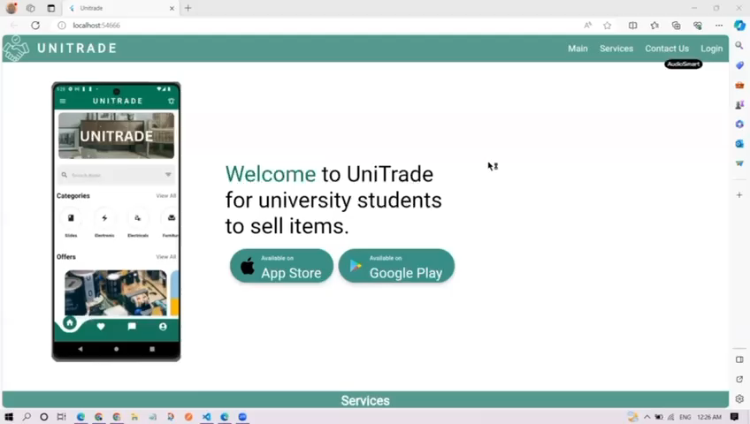

Slide 45
04
Constraints

Slide 46
Constraints
Connecting the applications that we used to develop UniTrade and making the emulator work was challenging.
Understanding the causes of exceptions and errors in the code has not always been straightforward.
As new dependencies were added and frequent updates occurred, it sometimes clashed with our existing infrastructure.
Find a way to download a PDF file and upload pictures from code to a cloud to show them in the UniTrade application and website.

Slide 47
05
Future work

Slide 48
Future work
Improve the chat system.
Add a recommendation system.
Enable users to upload multiple images and videos for items.
Improve the delivery mechanism.

Slide 49
Thank You
Do you have any questions?

