Slide 1

MAKANI ANDROID APPLICATION
Prepared by:
Asma’ Hamayel
Alaa Shaheen

Slide 2
What is Makani
Makani is an android application.
It supports Google maps capabilities like: GPS, assign location, search about location and add new information to Google map.

Slide 3
Why Makani
To learn more about Geo-location applications and handling the data in such maps applications.
To learn more about Google API's maps technologies.
The Application supports retrieving data from Google and retrieving the data from our distributed database.

Slide 4
Cont.
Using this application, we could bring information about places in Palestine.
Users can share their information and rate other users' places information.

Slide 5
Cont.
It allows users to add new information about certain places, add pictures, videos, audios and description.
It contains two parts: Client side and Server side.

Slide 6
Requirements
Functional Requirements
Search: Search about places and details about it.
Add: add new places or information about these places.

Slide 7
Cont.
Log In: log in into the application.
Log Out: log out from the application.
Exit: exit from the application.

Slide 8
Requirements
    Non Functional Requirements
Security: the application has security property by:
- If the user want to log in he must enter his user name and password.
- If the user hasn’t an account in our application he can’t see any of users’ posts.

Slide 9
Cont.
Scalability: The application can contain many users at a time and can be scalable to have more users.
Usability: our application is user friendly and easy to use.

Slide 10
Background
Our application contains three parts:
1. Database.
2. API.
3. Android Application.

Slide 11
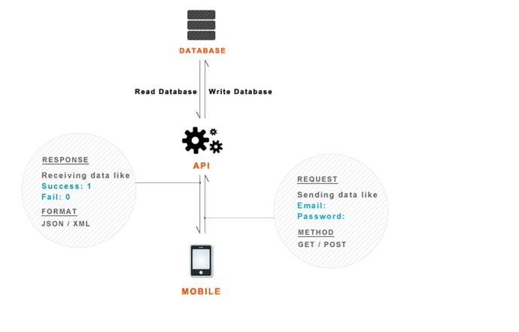
Application Parts
Figure ‎1‑1: connect android with database among API

Slide 12
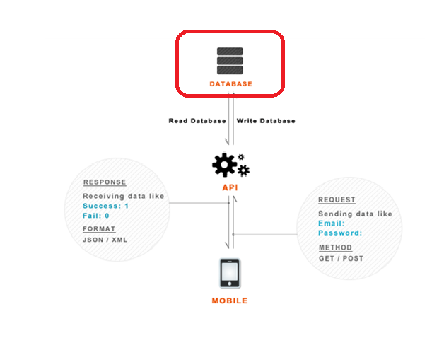
Application Parts
Figure ‎1‑2: connect android with database among API

Slide 13
Database Design
Our database is My SQL database (PHP My Admin) on hosting website.
it contains four tables:
- Users Table.
- Places Table.
- Rating Table.

Slide 14
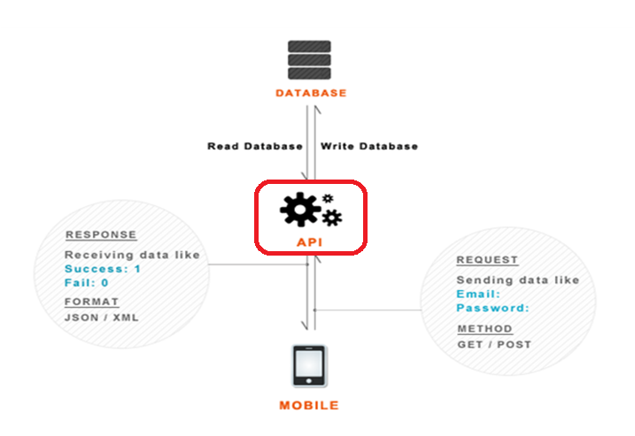
Application Parts
Figure ‎1‑3: connect android with database among API

Slide 15
API Design
We stored data and retrieved it by PHP script.
the data is sent to the server using HTTP requests.
The response from server is JSON.
The PHP scripts on the server send queries to the database to select data for a place or a user, or to store data about a place or a user.

Slide 16
Requests to the PHP Scripts:
We used Apache HttpClient library that simplifies handling HTTP requests.
We retrieved and sent data via the HttpClient class.
The HttpClient uses HttpUriRequest to send and receive data. Important subclass of HttpUriRequest are HttpGet and HttpPost.

Slide 17
Handling the responses of the PHP Scripts
We extracted the data that returned from the PHP scripts using json library.
JSON, Java Script Object Notation, is a text-based open standard designed for human readable data interchange.
The JSON format is often used for serializing and transmitting structured data over a network connection.

Slide 18
Cont.
We used JSON parser class that has a method which will make http request to get JSON data and returns a JSON Object.
In order to parse the JSON data we used pluggable streaming library.

Slide 19
Cont.
This library includes:
- Jackson Factory : based on the popular Jackson library which is considered as the fastest in terms of parsing/serialization speed.
Jackson Factory is a java file that uses json factory, json parser, and json response all together

Slide 20
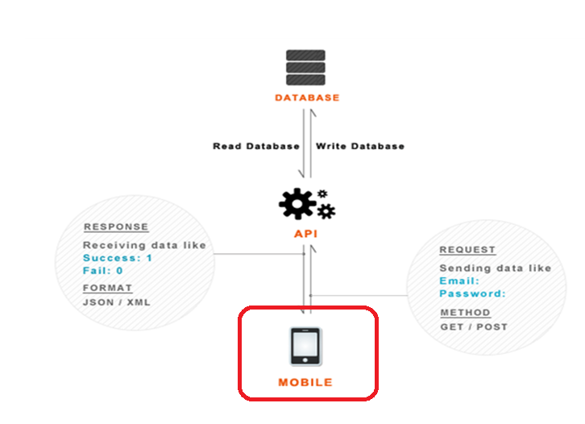
Application Parts
Figure ‎1‑4: connect android with database among API

Slide 21
    Android Application
Our android application consist of:
Manifest File : this file contains the permissions like:
- Internet Permissions.
- Network State Permissions.
- GPS location Permission.
- GPS location Coarse Permission.

Slide 22
Cont.
Layout Files.
SRC folder.
Library folder.
Drawable Folder.

Slide 23
Technologies used in our project
Using Google Maps in Android:
In order to use Google Map in your application you should obtain Google Maps API Key.
Extract the MD5 fingerprint.

Slide 24
Cont.
Using<com.google.android.maps.MapView> element to display the Google Maps in your activity.
Using the <RelativeLayout> element to position the map within the activity.

Slide 25
Cont.
Android defines a package called com.google.android.maps which includes:
MapActivity.
MapView.
MapController.
Itemized overlay.
GeoPoint.

Slide 26
Google Maps API
Google Map API Includes:
Google Places API.
Places AutoComplete API.
Geocoding API.

Slide 27
Google Places API
It is a service that returns information about Places.
Place requests specify locations as latitude/longitude coordinates.
Google places API support the following request:
- Place Search.
- Place Details.
- Places Autocomplete.

Slide 28
Cont.
In order to use the Google places API in the application we should install and integrate these jars libraries:
1. google-api-client-1.10.3-beta.jar 2. google-api-client-android2-1.10.3-beta.jar (only for SDK >= 2.1) 3. google-oauth-client-1.10.3-beta.jar 4. google-http-client-1.10.3-beta.jar 5. google-http-client-android2-1.10.3-beta.jar (only for SDK >= 2.1) 6. google-http-client-android3-1.10.3-beta.jar (only for SDK >= 3.0) 7. gson-2.1.jar 8. guava-11.0.1.jar 9. jackson-core-asl-1.9.4.jar 10. jsr305-1.3.9.jar 11. protobuf-java-2.2.0.jar

Slide 29
Places Autocomplete API
We used it to return the full address of a place based on the text search.
It connects to the Google API service to return the data.
The service responds with a list of Places matching the text string, the requested types, and any location bias that has been placed.

Slide 30
Geocoding API
Geocoding is the process of converting addresses into geographic coordinates.
It provides a direct way to access a geocoder via an HTTP request.
The output is returned as JSON.

Slide 31
  GPS
we used android Location API in addition to mobile GPS in order to overcome GPS limitations.
Android contains the android.location package which provides the API to determine the current geo position which contains:
- LocationManager.
- LocationProvider.
- LocationListener.
Notes:
LocationManager: The class provides access to the location service. It also provides facility to get the best Location Provider.
LocationProvider: It’s an abstract superclass for location providers. A location provider provides periodic reports on the geographical location of the device.
LocationListener: Provides callback methods which are called when location gets changed. The listener object has to be registered with the location manager.

Slide 32
  Async Task
It is a class in the android that enables proper and easy use of the UI thread.
allows to perform background operations and publish results on the UI thread without having to manipulate threads and/or handlers.

Slide 33
Cont.
An asynchronous task is defined by 3 generic types called: Params, Progress, and Result.
It contains 4 methods called: onPreExecute, doInBackground, and onProgressUpdate and onPostExecute.
Notes:
In our application we used the AsyncTask Class to create asynchronous task to retrieve information from Google Places API every time that the application needs to connect to bring data from Google database and view them on a list in the user interface.

Slide 34
Application in depth
When the application starts:
Run Dashboard Activity to show if the user is logged in or not.
If not logged in, call the Register Activity, the user fill in details, then it connects to PHP script to store the users information in the database.
Then switch to the Login Activity.

Slide 35
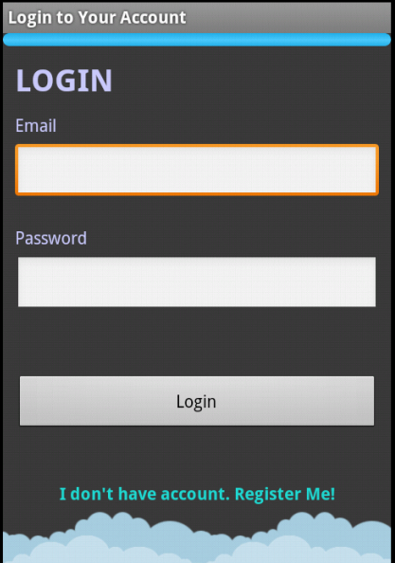
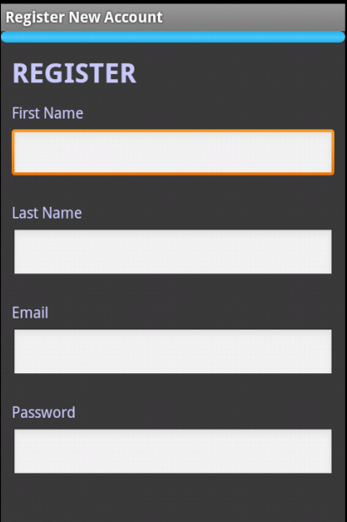
LOGIN and REGISTER Activities
Figure1.5:LogIn activity
Figure1.6:Register activity

Slide 36
Main Activity
The Map view is representing the main activity, which is the map of the current location.
It checks if the user has internet access otherwise it will ask to connect to the internet.
It brings the current location either from GPS or from Wi-Fi Access using the Location API in Android

Slide 37
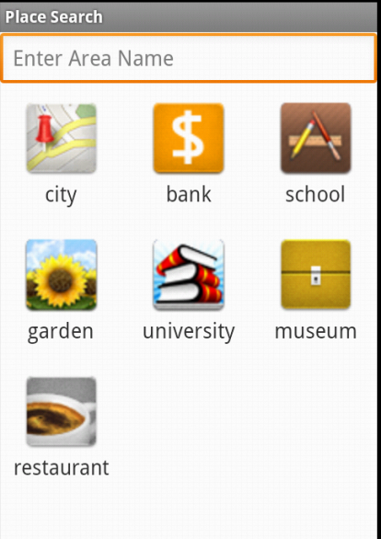
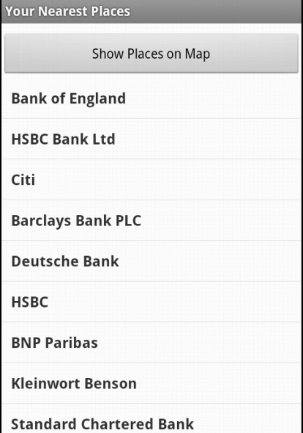
Snap shot from application
Figure ‎1‑7: Place Search Activity
Figure ‎1‑8: Places List
Notes:
When the application has the current location, it sends in the background a request to the Google Places API to bring the information about all the places of all types in the current location and show all the markers on the map. This is done using an Async Task that send the HTTP request to the Places API

Slide 38
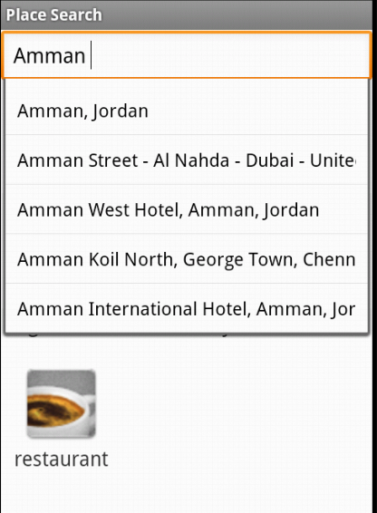
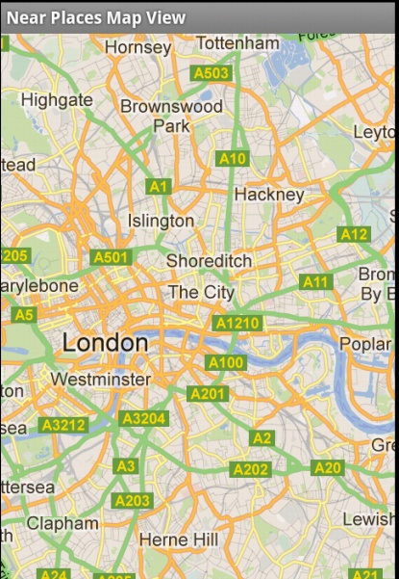
Snap shot from application
Figure ‎1‑9: AutoComplete Form Activity
Figure ‎1‑10: Map Activity

Slide 39
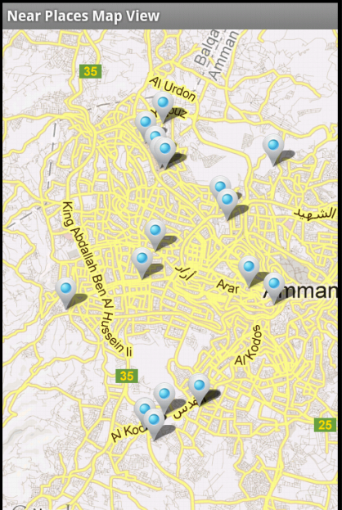
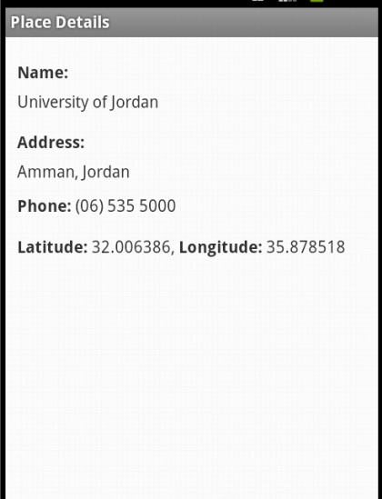
Snap shot from application
Figure ‎3‑7: Places Map with Markers
Figure ‎3‑8: Place Details

Slide 40
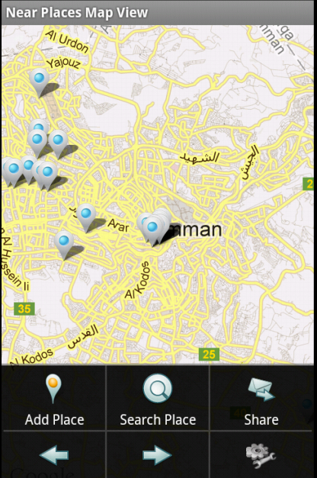
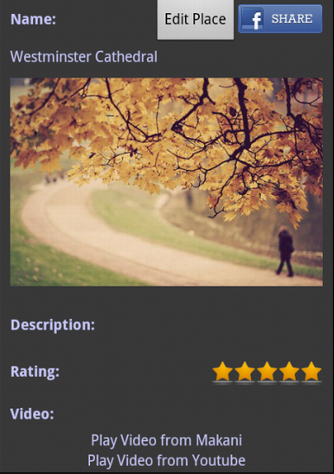
Snap shot from application
Figure ‎1‑11: Menu in the Map Activity
Figure ‎1‑12:Place in details

Slide 41
Conclusion
On Server
Build Database
Using PHP My Admin
API
Write PHP Scripts to be the interface or API btw Database and Application.
Final Results
Application connects both to API and to Google Database
Application connects to Google API's and connects to Distributed Database to bring the data and show it on map.
Google API's
Figure ‎1‑13: Methodology in the Project

Slide 42
Conclusion
In this project we achieve the following:
      We built a full functional application that allow a user to go through the internet to Google Map, find places and post information about different types of Places.
      A user could find information about universities, schools, banks, museums, restaurants, airports, etc.

Slide 43
Cont.
      A user can view pictures about the place. Also he can post pictures for a certain place.
A user can view the video about the place, and he can post other videos too.
      This project can manage access many users on the same application, so it is a distributed application with distributed database.
This Application connects to Google API's, it uses Google Maps API to view the data on the map.

