Slide 1

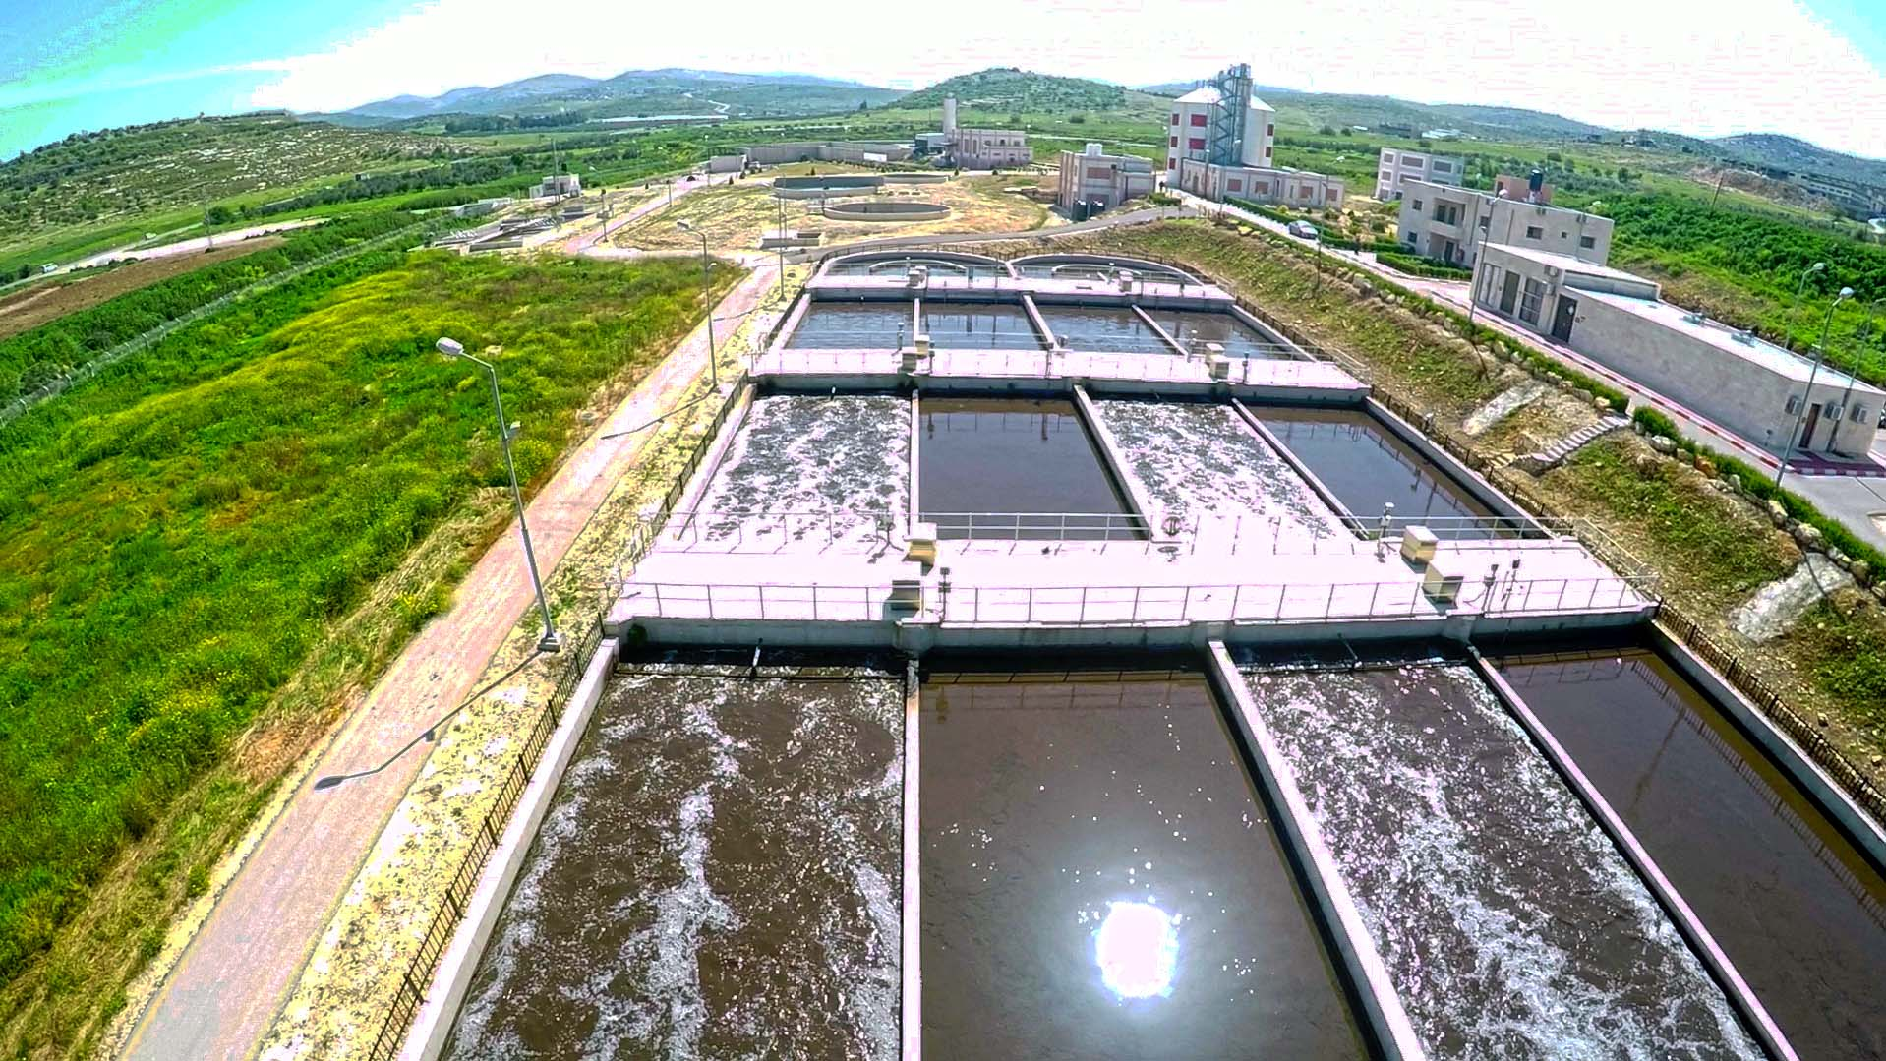
An-Najah National University
Mechanical Engineering Department
Wastewater Treatment using Advanced Oxidation Process Combined With Magnetic Mechanism Design
Presented by: Abdalkareem Arman
Emad Salahat
Yazan Haj Taher
Supervisor : Dr. Ihab Surakji
Committee Members:
Dr. Adel Al-Juaidi
Eng. Luqman Herzallah
Jan 16th, 2020

Slide 2

Outlines
Introduction
Literature Reviews
Optimization, Design and Fabrication
Methodology
Cost Estimation
Conclusion, Final Remarks and Contributions
Results
1
2
3
4
5
6
7

Slide 3

Introduction

Slide 4
Introduction
Optimization
Design
Fabrication
Methodology
Cost Estimation
Conclusion
Final Remarks
and Contribution
Literature Review
Results
Water Consumption in Palestine
4

Slide 5
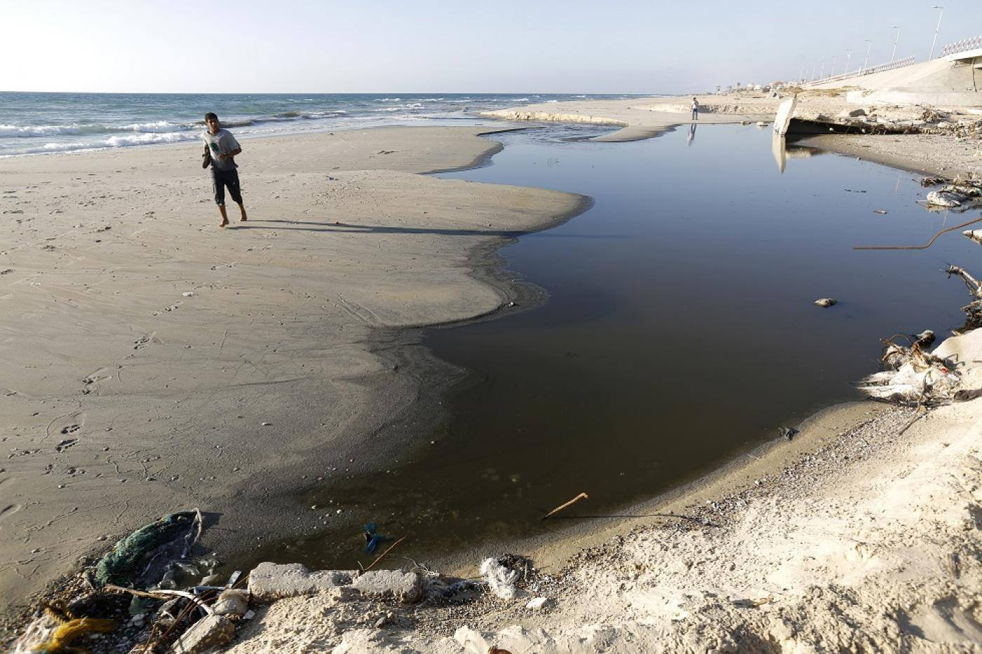
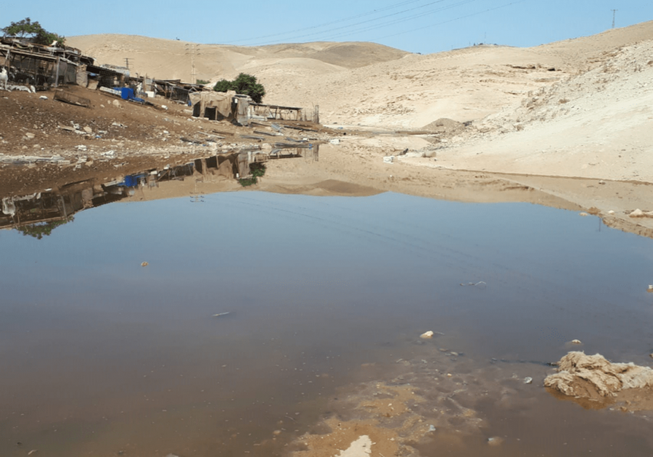
Introduction
Optimization
Design
Fabrication
Methodology
Cost Estimation
Conclusion
Final Remarks
and Contribution
Literature Review
Results
Wastewater in Palestine
Sewerage leakage in Gaza- strip
Sewerage leakage in rural areas of Jerusalem

Slide 6
Introduction
Optimization
Design
Fabrication
Methodology
Cost Estimation
Conclusion
Final Remarks
and Contribution
Literature Review
Results
Wastewater Treatment in Palestine
Municipal Slaughterhouse of Nablus
6

Slide 7

Literature Review

Slide 8
Introduction
Optimization
Design
Fabrication
Methodology
Cost Estimation
Conclusion
Final Remarks
and Contribution
Literature Review
Results
Advanced Oxidation Process (AOP)
Its a process based on producing hydroxyl radicals of (·OH) , which is a strong attacker to the organic pollutants.
AOP has many techniques for producing (·OH) as shown in figure.
Hydroxyl radicals (·OH)
Hydrogen Peroxide (${ H}_{2}O_{2}$)
Hydrogen Peroxide (〖 H〗_2 O_2)
Ultra Violet (UV)
Ozone ($O_{3}$)
Ozone (𝑂_3)

Slide 9
Introduction
Optimization
Design
Fabrication
Methodology
Cost Estimation
Conclusion
Final Remarks
and Contribution
Literature Review
Results
Techniques Used in AOP.
·OH
Highly Reactive
Easily Generated
Powerful Oxidant
Harmless
(Fenton Process)
What is it?
Fe⁺²
$${ H}_{2}O_{2}$$
〖 H〗_2 O_2
(·OH)

Slide 10
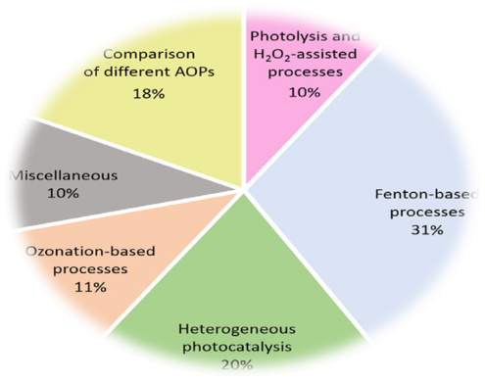
Introduction
Optimization
Design
Fabrication
Methodology
Cost Estimation
Conclusion
Final Remarks
and Contribution
Literature Review
Results
Techniques Used in AOP.
(Fenton Process)
Why is it recommended?
Fenton Process
Occurred at room temperature
Higher Efficiency
Less Equipment Requirements
RIBEIRO, A. R., NUNES, O. C., PEREIRA, M. F. & SILVA, A. M. 2015. An overview
on the advanced oxidation processes applied for the treatment of water pollutants defined in the recently launched Directive 2013/39/EU. Environment international, 75, 33-51.

Slide 11

Optimizing, Design and Fabrication

Slide 12

Introduction
Optimization
Design
Fabrication
Methodology
Cost Estimation
Conclusion
Final Remarks
and Contribution
Literature Review
Results
Optimization
Parameters to be optimized:
The Amount of the Agent ($H_{2}O_{2})$ with Mixing Time.
The Amount of the Agent (${Na}_{2}S_{2}O_{8}$) with Mixing Time.
The Mixing Type.
The Magnetic Field.

Slide 13
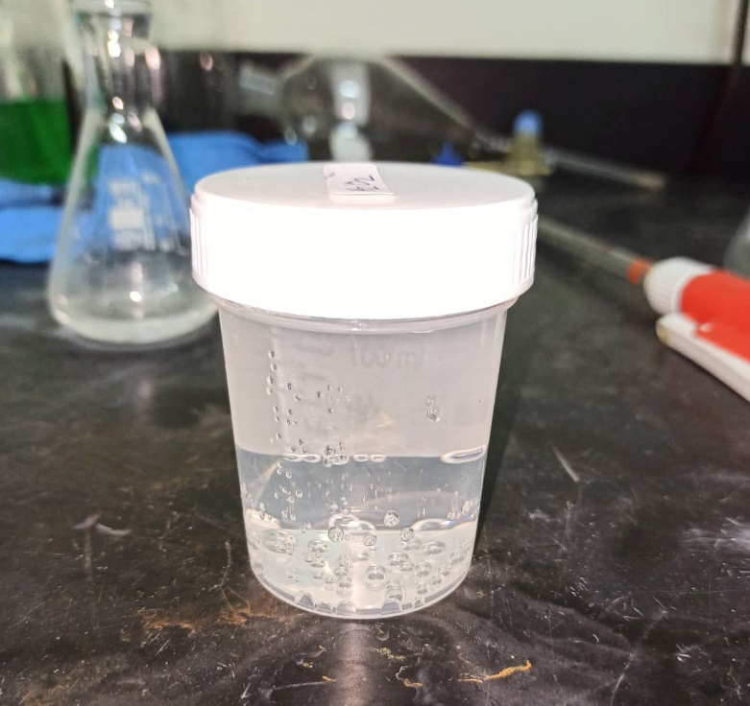
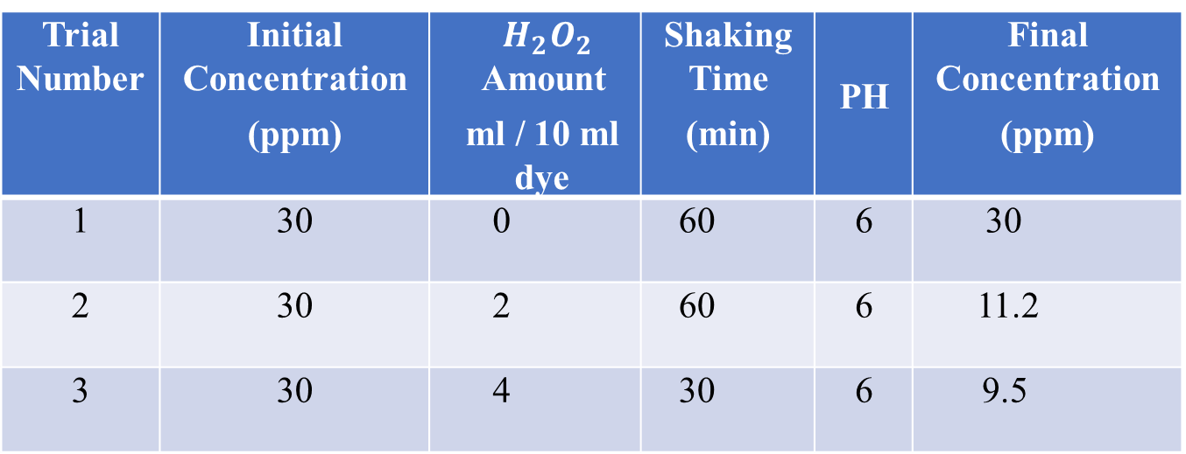
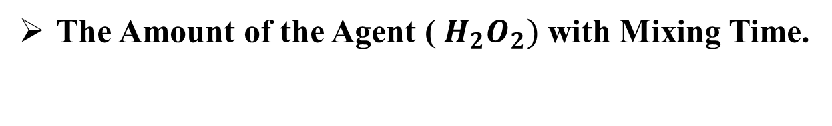
Introduction
Optimization
Design
Fabrication
Methodology
Cost Estimation
Conclusion
Final Remarks
and Contribution
Literature Review
Results
The Amount of the Agent (${ H}_{2}O_{2})$ with Mixing Time.
Trial Number | Initial Concentration (ppm) | ${ H}_{2}O_{2}$ Amount ml / 10 ml dye | Shaking Time (min) | PH | Final Concentration (ppm)
1 | 30 | 0 | 60 | 6 | 30
2 | 30 | 2 | 60 | 6 | 11.2
3 | 30 | 4 | 30 | 6 | 9.5

Slide 14
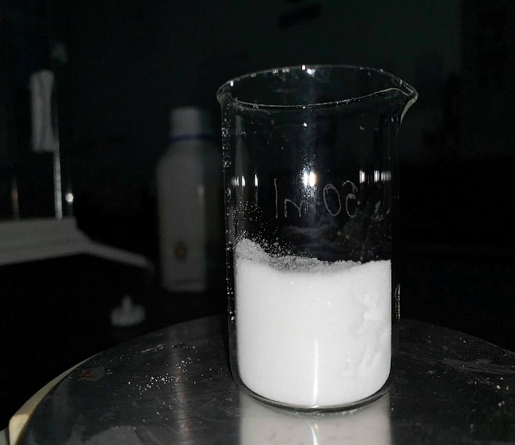
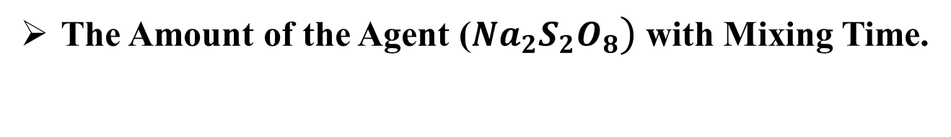
Introduction
Optimization
Design
Fabrication
Methodology
Cost Estimation
Conclusion
Final Remarks
and Contribution
Literature Review
Results
The Amount of the Agent (${Na}_{2}S_{2}O_{8})$ with Mixing Time.
Trial Number | Initial Concentration (ppm) | Na₂S₂O₈ Amount g / 10 ml dye | Shaking Time (min) | PH | Final Concentration (ppm)
1 | 30 | 0.5 | 30 | 6 | 4.057
2 | 30 | 1 | 30 | 6 | 1.886
3 | 30 | 2 | 30 | 6 | 1.623

Slide 15
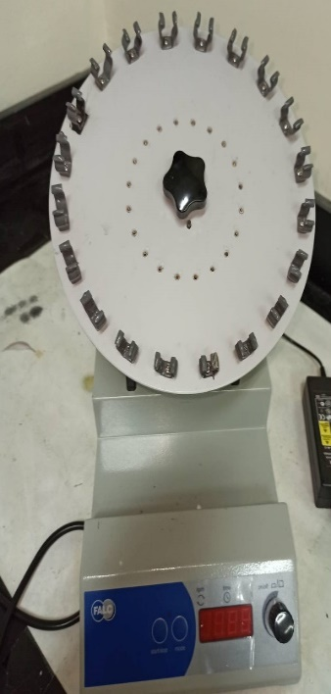
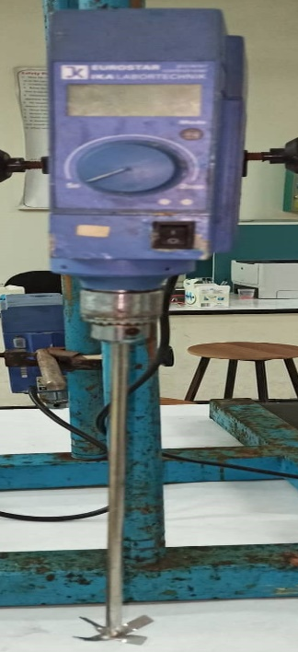
Introduction
Optimization
Design
Fabrication
Methodology
Cost Estimation
Conclusion
Final Remarks
and Contribution
Literature Review
Results
Mixing Type
Trial Number | Initial Concentration (ppm) | Shaker Speed (rpm) | Conventional Mixer Speed (rpm) | Final Concentration (ppm)
1 | 30 | 40 | -- | 9.5
2 | 30 | -- | 200 | 25
3 | 30 | -- | 300 | 10.65
4 | 30 | -- | 400 | 5.5

Slide 16
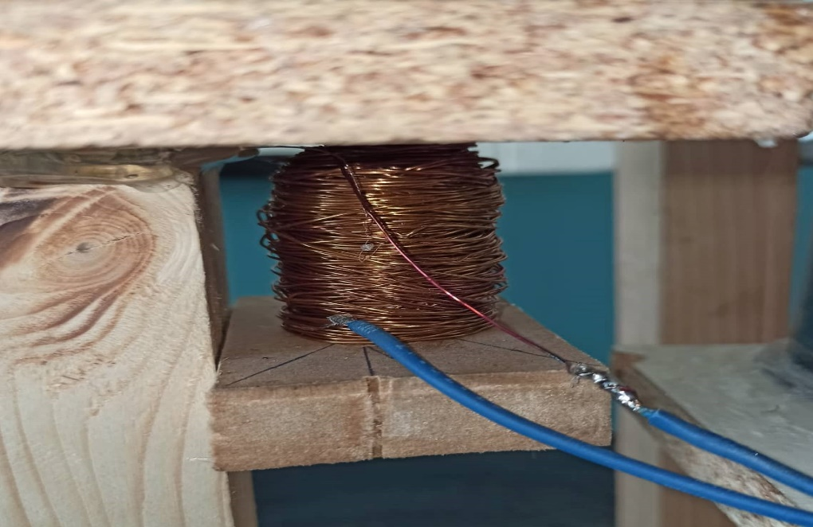
Introduction
Optimization
Design
Fabrication
Methodology
Cost Estimation
Conclusion
Final Remarks
and Contribution
Literature Review
Results
The Magnetic Field
Trial Number | Coil length (m) | Result
1 | 10 | Not Effective
2 | 30 | Effective with side effect
3 | 50 | Effective with no effect

Slide 17
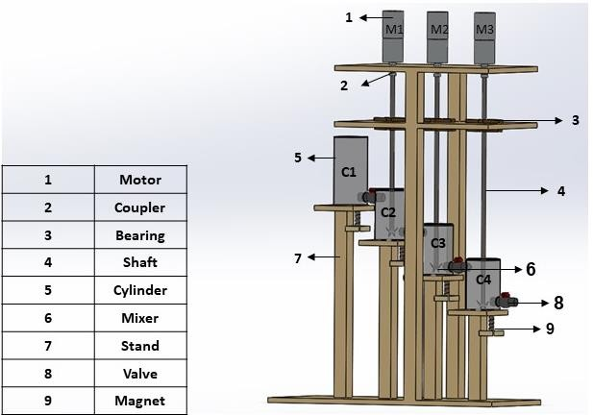
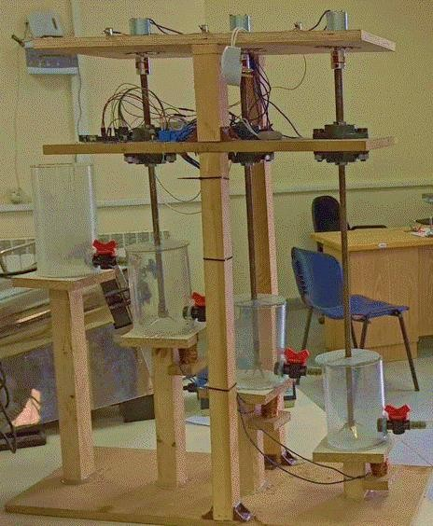
Introduction
Optimization
Design
Fabrication
Methodology
Cost Estimation
Conclusion
Final Remarks
and Contribution
Literature Review
Results
Design and Fabrication: (How Does the Treatment Run?).

Slide 18

Methodology

Slide 19
Introduction
Optimization
Design
Fabrication
Methodology
Cost Estimation
Conclusion
Final Remarks
and Contribution
Literature Review
Results
Literature Review
Experimental Setup and Device Design
Evaluation the Cost of the Process
Effect of (${ Fe}_{3}O_{4})$
Effect of (〖 𝐅𝐞〗_𝟑 𝐎_𝟒)
Effect of Catalysts Used

Slide 20

Results
20

Slide 21
Introduction
Optimization
Design
Fabrication
Methodology
Cost Estimation
Conclusion
Final Remarks
and Contribution
Literature Review
Results
Results Gained by Using the Hydrogen Peroxide Agent ${ (H}_{2}O_{2})$
Initial Concentration
(30ppm)
Amount of the Catalyst
(Fe₃O₄)
(6g)
Final Concentration (0 ppm)
(Pure)
Amount of the Agent
(${ H}_{2}O_{2}$)
(80 ml)
Amount of the Agent
(〖 H〗_2 O_2)
(80 ml)
The mixing Time
(10min)
21

Slide 22
Introduction
Optimization
Design
Fabrication
Methodology
Cost Estimation
Conclusion
Final Remarks
and Contribution
Literature Review
Results
Results Gained by Using the Sodium Persulfate Agent ${(Na}_{2}S_{2}O_{8})$
30 ppm
120 ppm
200 ppm
Amount of the catalyst used
(Fe₃O₄$)$
(6g)
Amount of the catalyst used
(Fe₃O₄)
(6g)
Amount of the Agent used
$${(Na}_{2}S_{2}O_{8})$$
(60 g)
Amount of the Agent used
〖(𝑁𝑎〗_2 𝑆_2 𝑂_8)
(60 g)
The mixing Time
(10min)
Final Concentration (0 ppm)
(Pure)
22

Slide 23
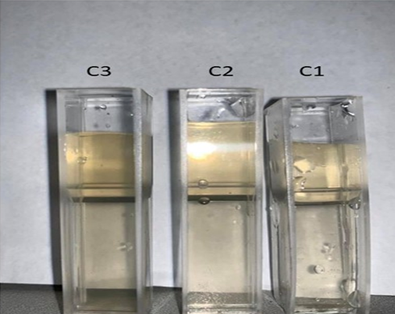
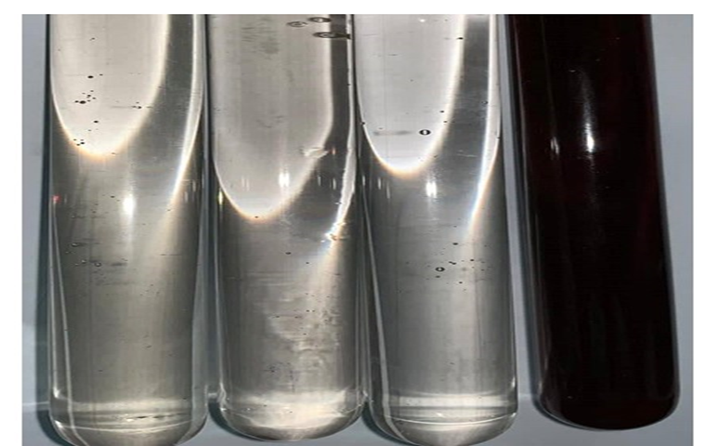
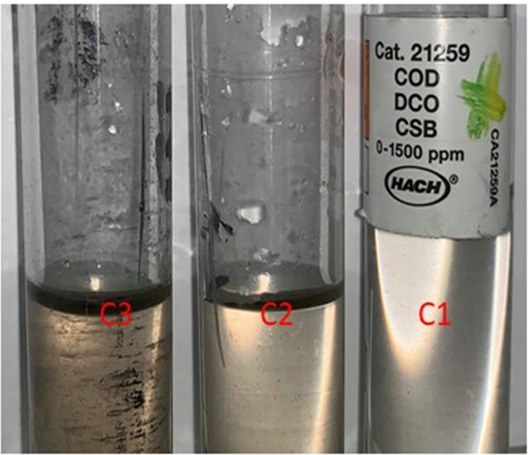
Introduction
Optimization
Design
Fabrication
Methodology
Cost Estimation
Conclusion
Final Remarks
and Contribution
Literature Review
Results
Results Gained by Using the Sodium Persulfate Agent ${(Na}_{2}S_{2}O_{8})$
C3
C2
C1
30 ppm CV Dye
120 ppm CV Dye
200 ppm CV Dye
22

Slide 24
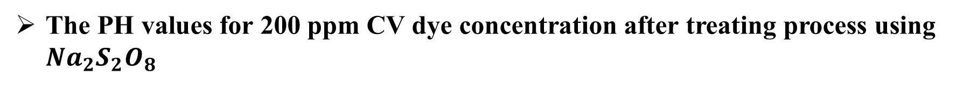
Introduction
Optimization
Design
Fabrication
Methodology
Cost Estimation
Conclusion
Final Remarks
and Contribution
Literature Review
Results
The PH values for 200 ppm CV dye concentration after treating process using ${Na}_{2}S_{2}O_{8}$
The Concentration (ppm) | Cycle Number | Cylinder Number | PH Degree
200 | 1 | 1 | 3.10
 |  | 2 | 2.72
 |  | 3 | 2.50
 | 2 | 1 | 3.04
 |  | 2 | 2.52
 |  | 3 | 2.32
 | 3 | 1 | 2.12
 |  | 2 | 2.16
 |  | 3 | 2.22
22

Slide 25
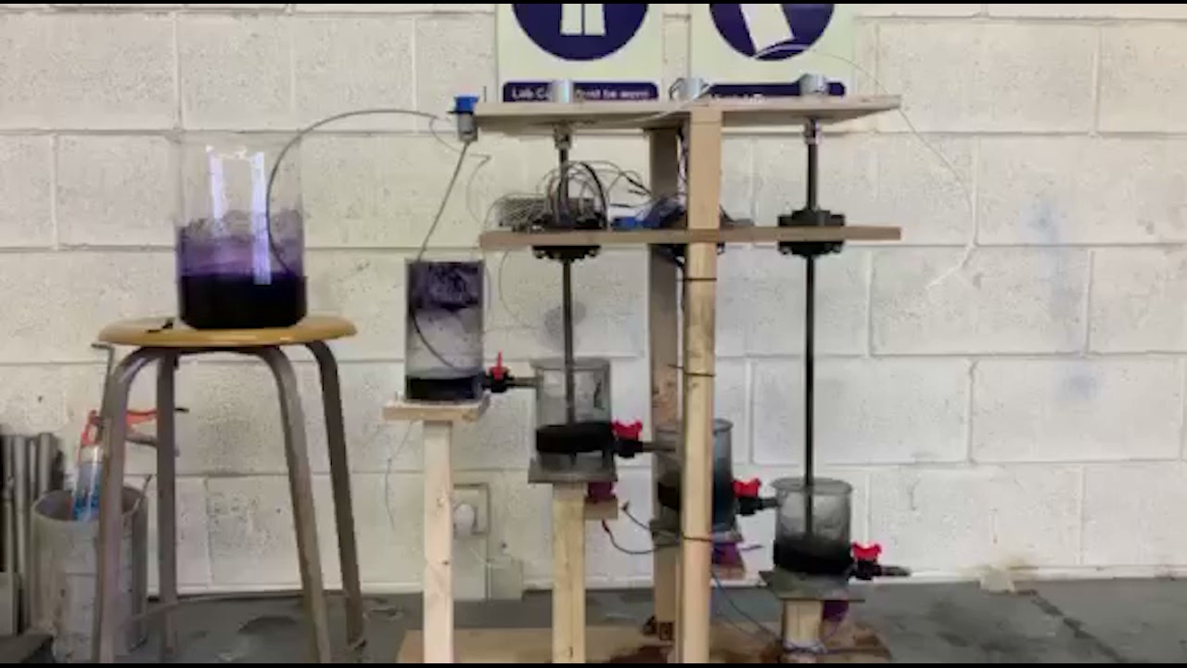
Introduction
Optimization
Design
Fabrication
Methodology
Cost Estimation
Conclusion
Final Remarks
and Contribution
Literature Review
Results

Slide 26

Cost Estimation
23

Slide 27
Introduction
Optimization
Design
Fabrication
Methodology
Cost Estimation
Conclusion
Final Remarks
and Contribution
Literature Review
Results
Components | Cost (ILS)
Four Fiber glass cylinders | 300
Three motors with rotation speed 300rpm | 300
Three couplers | 150
Four valves “16mm” diameter And pipes | 25
A Pump with flow rate = 1mL/sec | 75
Three magnets | 150
Three shafts with Three blades | 80
24

Slide 28
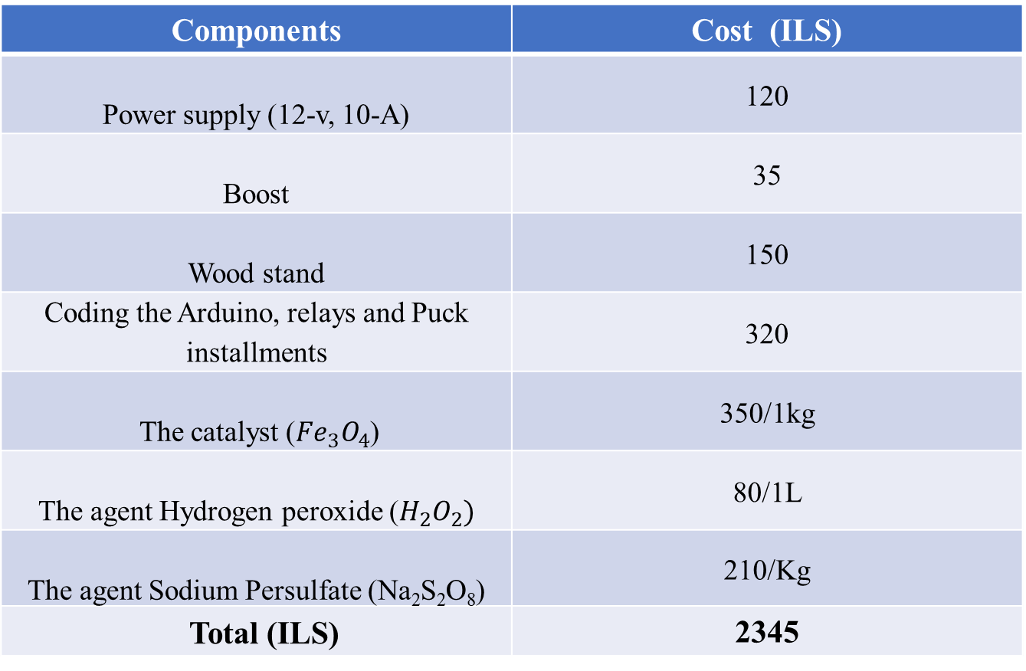
Introduction
Optimization
Design
Fabrication
Methodology
Cost Estimation
Conclusion
Final Remarks
and Contribution
Literature Review
Results
Components | Cost (ILS)
Power supply (12-v, 10-A) | 120
Boost | 35
Wood stand | 150
Coding the Arduino, relays and Puck installments | 320
The catalyst (${Fe}_{3}O_{4}$) | 350/1kg
The agent Hydrogen peroxide ($H_{2}O_{2})$ | 80/1L
The agent Sodium Persulfate (Na₂S₂O₈) | 210/Kg
Total (ILS) | 2345
25

Slide 29
Limitations
Experiment Runs
Time
Tools and Materials
25

Slide 30

Conclusion

Slide 31
Introduction
Optimization
Design
Fabrication
Methodology
Cost Estimation
Conclusion
Final Remarks
and Contribution
Literature Review
Results
Conclusion
The effect of the catalyst used (Fe₃O₄).
Experimental setup and design calculations.
Final Remarks
Scale-up the wastewater treatment device.
Making a regeneration design for the catalyst.
Contribution
Enhancing the treatment design by making a regeneration design for the catalyst.
Reducing the time and increasing the amount of treated wastewater.
Feasibility Study.
Four Stages for continues wastewater flow.
Using the agent Sodium Persulfate for low costs.
Using the Sodium Persulfate agent for reducing costs.

Slide 32
Thank You!

