Slide 1
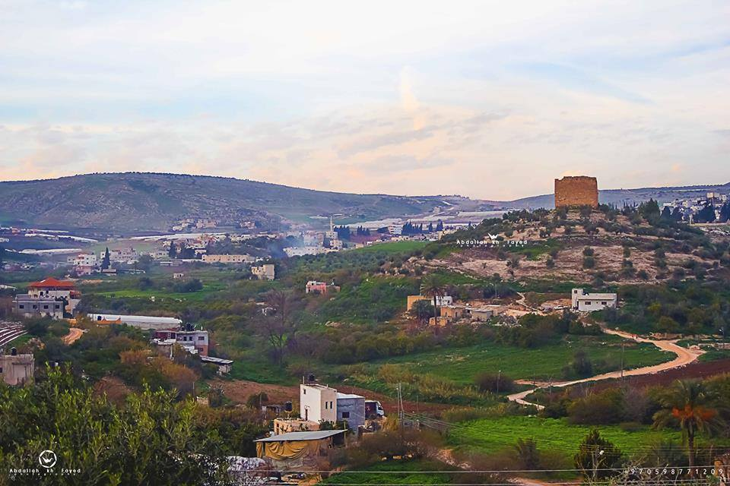
Analysis and Design of Al-Faria Water Distribution Network and The Wastewater Collection Network
Prepared by :
Monera Jarrai
Hadeel Janajreh
Rasha Swalha
supervisor: Dr.
Anan Jayyousi

Slide 2
Outline:
Introduction
Objectives
Methodology
Results
Conclusion & Recommendations

Slide 3

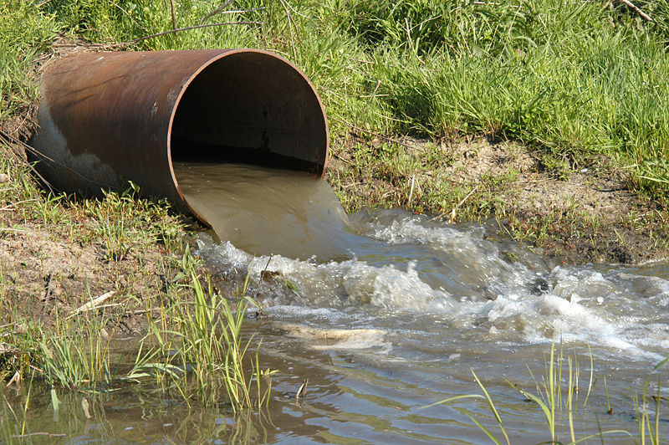
Introduction:
The most important element to the human being in our live is water, where 80% of water demand is converted to wastewater.

Slide 4

For that our project will be discuss the design of water distribution network and analysis the wastewater collection network in Al Faria region by using waterCAD, sewerCAD programs.

Slide 5
Study area
Why Al-Faria ?
The main reason that we are residents of AL Faria.
Al-Faria has a problems in the existing WDN and has no WWN which is disposal from the wastewater by cesspits.
Also data is available and accessible .

Slide 6
:Location
AL-FARIA is a Palestinian village, which is located 5 km to the south west of Tubas city, in the north eastern part of West Bank.

Slide 7
Population:
approximately of 5500 capita.
Area:
Is approximately 3000 dunums.
2500 dunums are classified as agricultural area.
Climate:
Al-Faria has a moderate climate, the average annual temperature is 20°C and the average annual humidity is 59%.

Slide 8
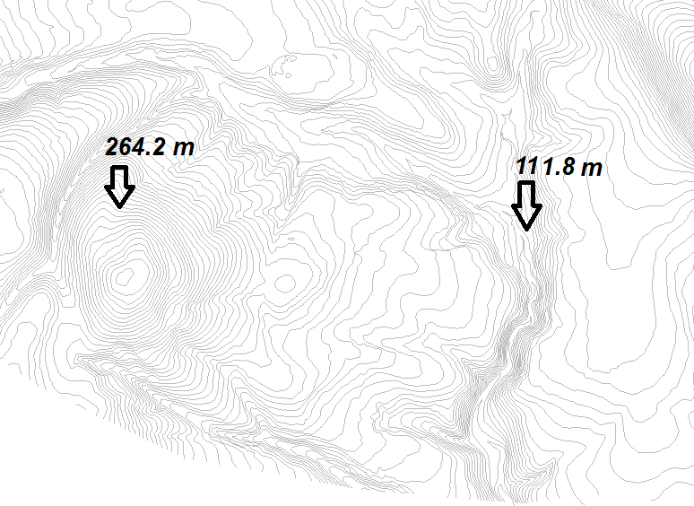
Topography :
It's a valley area surrounded by mountainous, and it is
at moderate an elevation of 150 m above sea level.

Slide 9
Objectives:
Analysis and design the WDN for AL Faria area using WaterCAD.
Determine the cost for the project.
Draw new WWN and only analysis it by sewerCAD.

Slide 10
Methodology:
For WDN:
Select study area
Collect data
Analyze the outcome of questionnaire
Start using WaterCAD
Get the results
Make preliminary run
Calculate the cost
Solving the problems

Slide 11
For WWN:
Collect data
Start using sewerCAD
Calculate generated wastewater
Distribute manholes
Select study area
Design and analysis sewage network
Make preliminary run
Get the result

Slide 12
The Questionnaire:
40 houses were questioned
The main reason from questioner is defined the average daily consumption (L\C\d) .

Slide 13
The average daily consumption= 198.3 L\C\d
Demand = Consumption/ 1- %UCF
%UCF = 0.3
Present Demand = 283 L\C\d
Future demand = 120 + 106 = 224 L\C\d

Slide 14
The questions represented in some curves and pie charts:
Relation between family member & average consumption

Slide 15
Relation between house area & average consumption

Slide 16
Percentage of Agricultural Land and Gardeners home:

Slide 17
Part I
Water distribution network

Slide 18
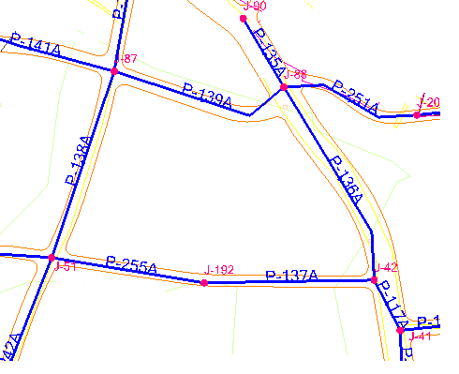
Our Network:
In our network the plans of the network were not present at the Council village for this reason we have to redraw the network through a network of roads by using WaterCAD program.

Slide 19
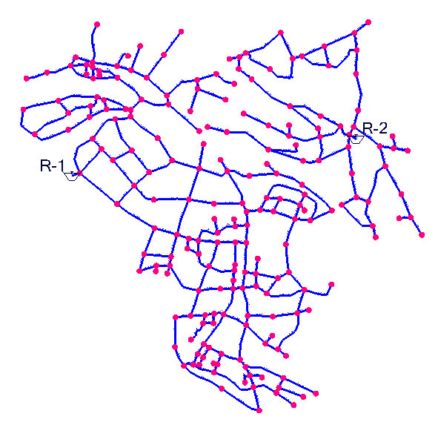
Network Component:
2 Reservoir
1 Pump
262 Pipes
208 Nodes

Slide 20
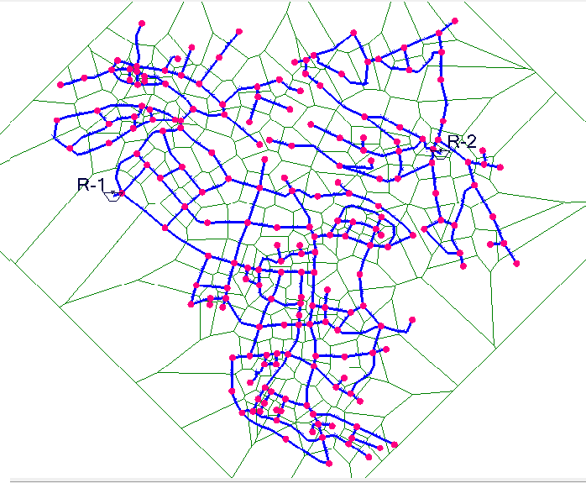
Demand calculation:
Thiessen polygon method used
The main idea of
divide the surface area into polygons.

Slide 21
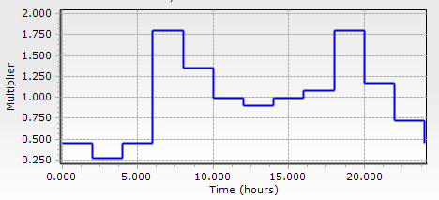
Analysis the existing network in steady state
pressure (10 – 120 )mH2O
project constrain
Velocity (0.3 – 2 ) m\s
Future demand = 224 L\C\d
Design in unsteady case

Slide 22
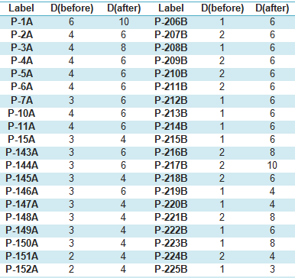
Solving problems by modify the network:

Slide 23
Results:
Length of pipe :
The total length of pipes equal 27088 m .
There are 2 types of pipe material:
Steel
galvanized iron

Slide 24
Max pressure = 112 m H2O

Slide 25
Max velocity = 1.92 m\s

Slide 26
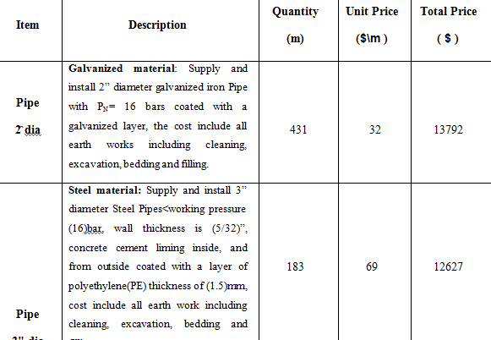
Cost and Bill of Quantities
The total cost for the project is 812,264$

Slide 27
Part II
Preliminary Analysis of the wastewater network:

Slide 28
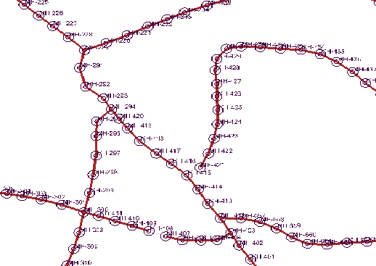
Draw the Network:
Length of conduit will not exceed 30 m.
Avoid making closed loops.
Putting manholes every intersection and curves

Slide 29
Load Calculation :
Area (m²) | # Of Manholes | Area (m²) | # Of Manholes
205000 | 106 | 497533 | 163
385100 | 205 | 393359 | 158
110630 | 83 | 231564 | 93
343252 | 145 | 151934 | 83

Slide 30
Average wastewater generation for each manhole(L\day) =
{(Area covered by each manhole)*(population density)* (water consumption) * (infiltration) * (Peak factor)} / (# of manholes in that area).

Slide 31
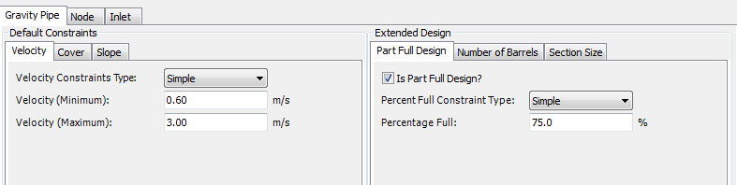
Constraints for WWN:
Velocity : acceptable limits (0.6 – 3)m\s
Slope : acceptable limits (1 – 12 )%
Cover depth : acceptable limits (1 – 3.5)m

Slide 32
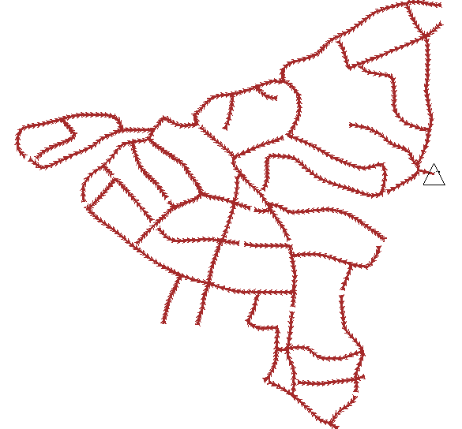
In our Network:
836 Manholes
836 Conduit
1 Outfall
PVC material

Slide 33
Diameters used In our Network:

Slide 34
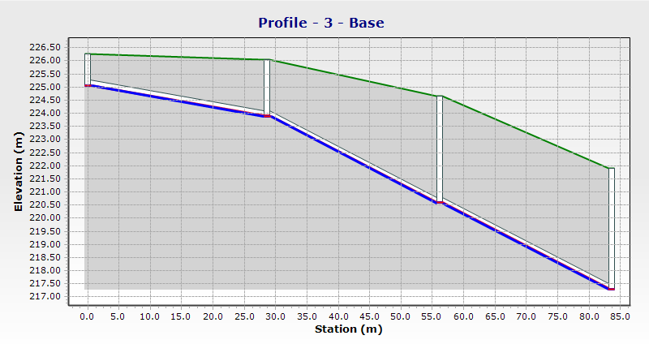

Slide 35
Conclusion :
A full design of water network that will meet the requirement for the next 30 years.
Analysis wastewater network without solving problems so we recommend Not implementing it only after solving the problems.

Slide 36
Recommendation:
We recommend Al Faria Village Council to consider this proposal to construct the water network.
To construct the wastewater collection network because of the problems caused by cesspits on the environment and groundwater
To make wastewater treatment plan (WWTP) to avoid the pollution of the environment caused by the wastewater

Slide 37



