Slide 1

Redesign of the Building of the Faculty of Architecture in Nablus City
An-Najah National University
Faculty of Engineering
Building Engineering Department
Graduation Project-2
Prepared by:
Diala Nairat
Doaa Nabeel
Olfat Dweikat Wara’ Tubaileh
Supervisor :
Dr. Mutasim Babaa

Slide 2
CONTENTS:
Architectural
Site and location
Environmental design
Mechanical Design
Electrical Design
Structural Design
BOQ

Slide 3
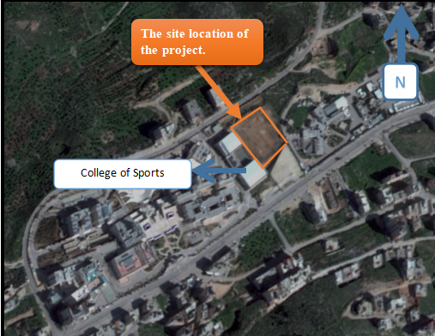
Site Analysis:
Location: The location is situated at An-Najah National University New Campus near the College of Sports .
The project is located in western of Nablus city in Palestine, which is located about 30 miles north of Jerusalem on the north west bank; Nablus is about 565 m above sea level..

Slide 4
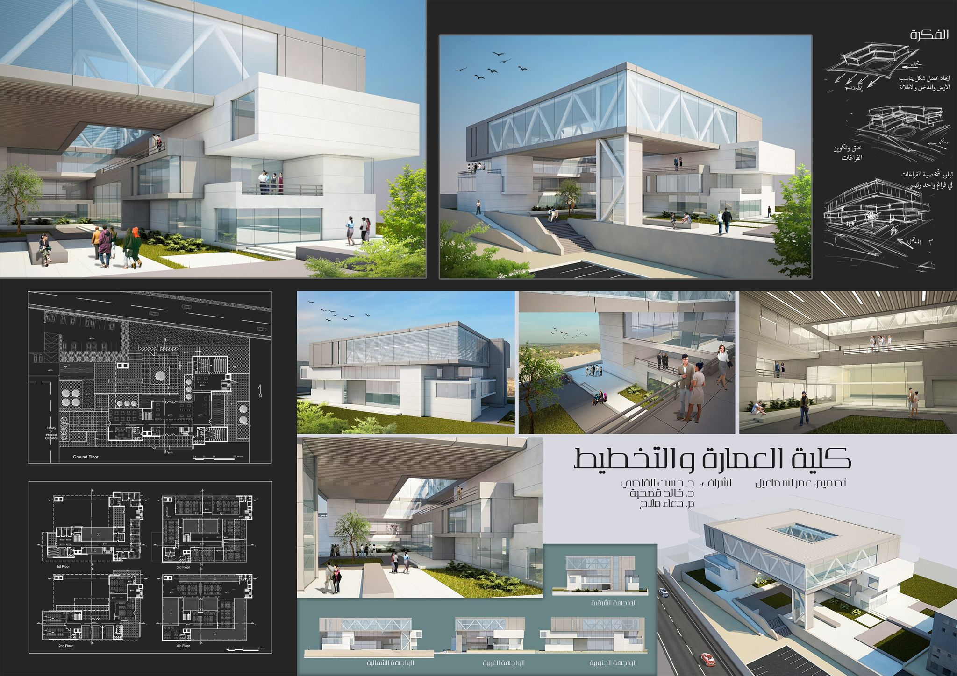
The 3D model for the original architectural plan.

Slide 5
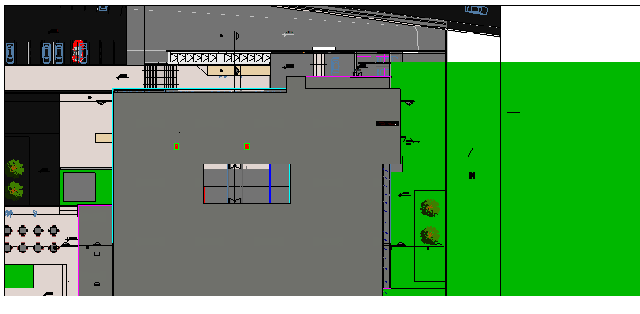
Architectural Design
Site plan

Slide 6
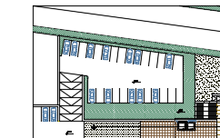
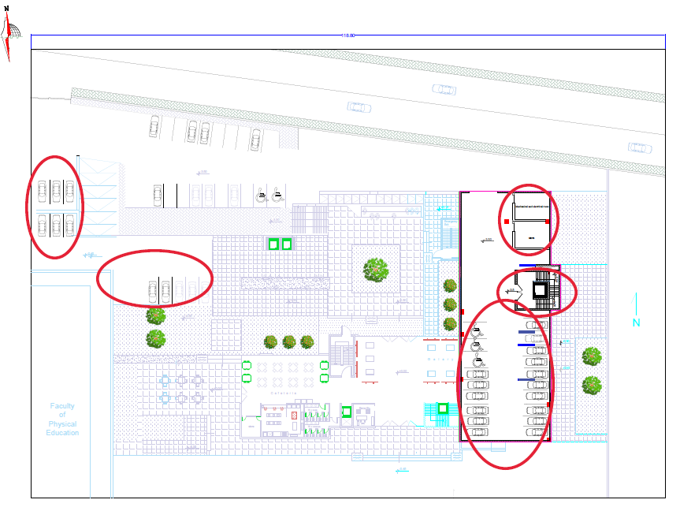
Architectural Design
Basement floor with the site
Old car parking
New car parking

Slide 7
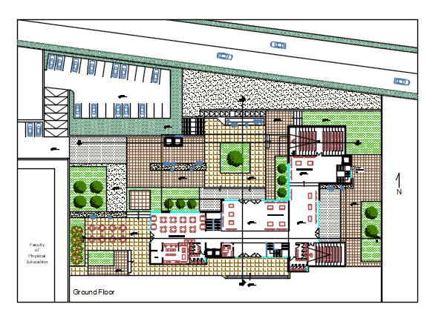
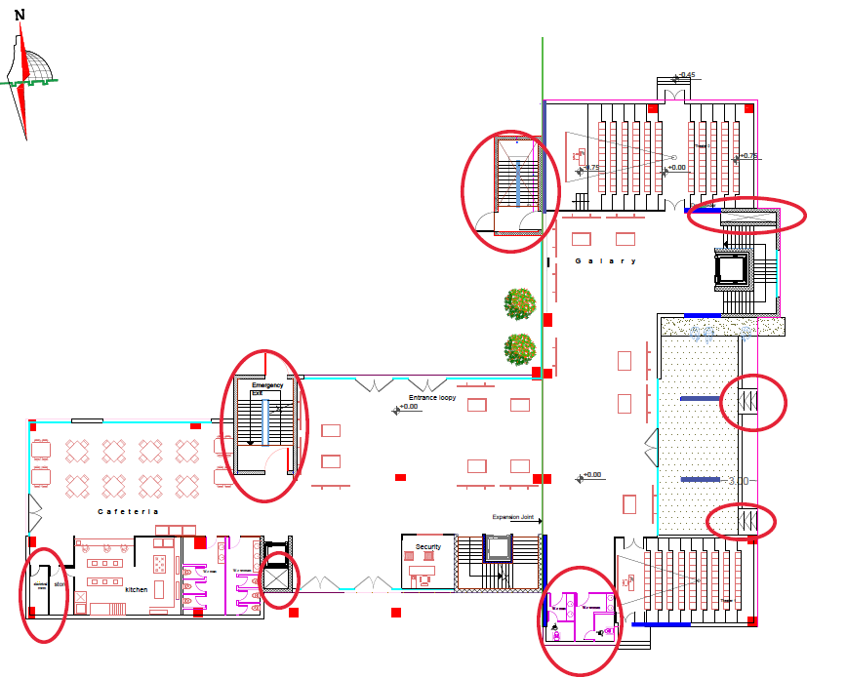
Architectural Design
Ground floor with site:
Old building
New building

Slide 8
Architectural Design
Ground floor:
The main entrance

Slide 9
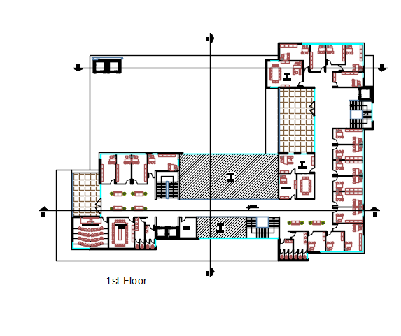
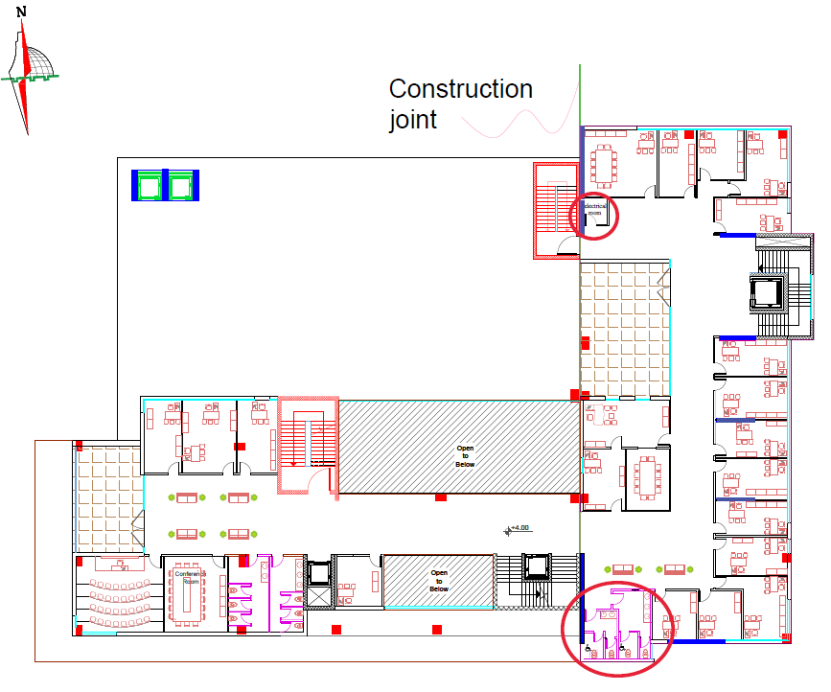
Architectural Design
First floor:
Old building
New building

Slide 10
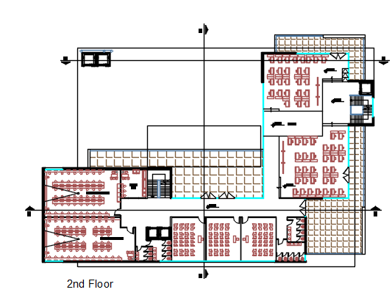
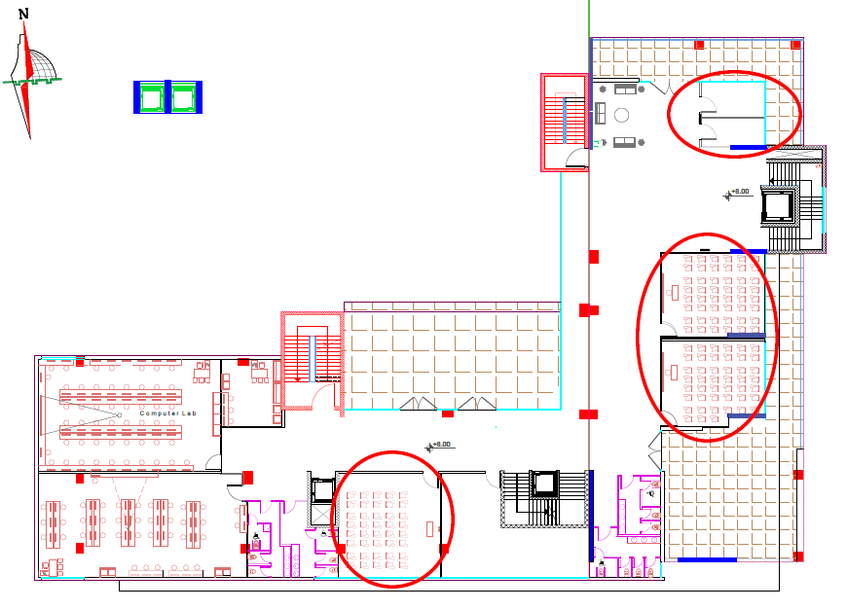
Architectural Design
Second floor:
Old building
New building

Slide 11
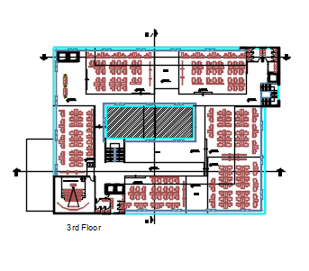
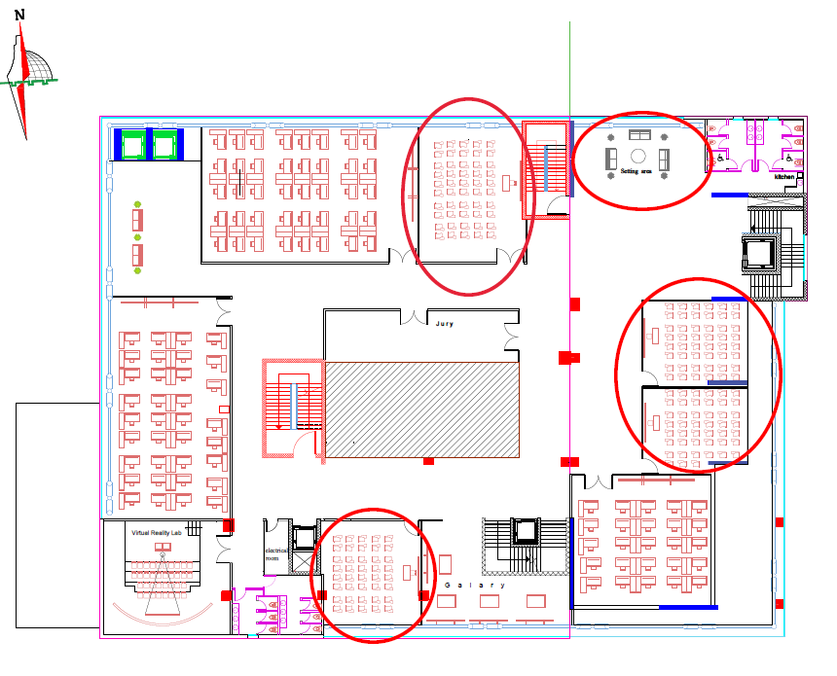
Architectural Design
Third floor:
Original Design
Modified Design

Slide 12
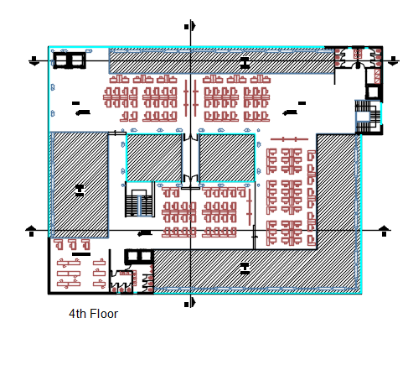
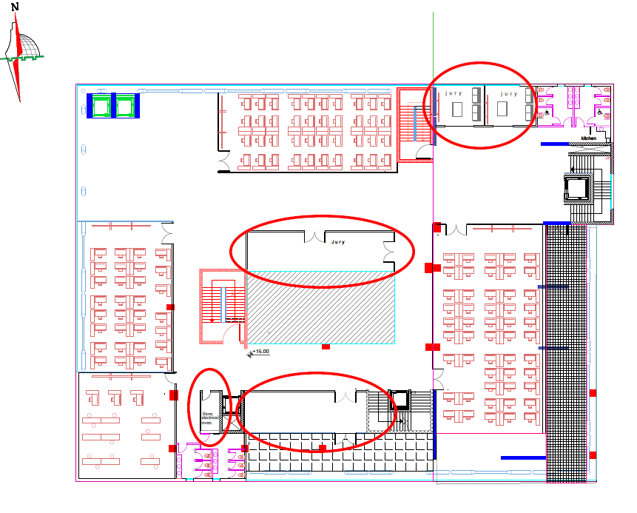
Architectural Design
Forth floor:
Old building
New building

Slide 13
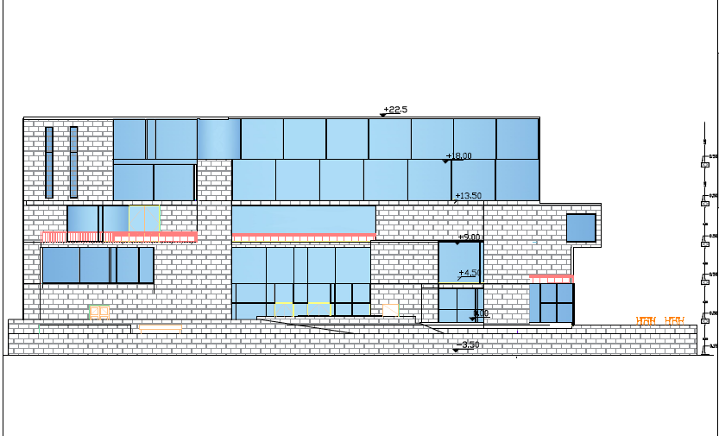
Architectural Design
North Elevation:

Slide 14
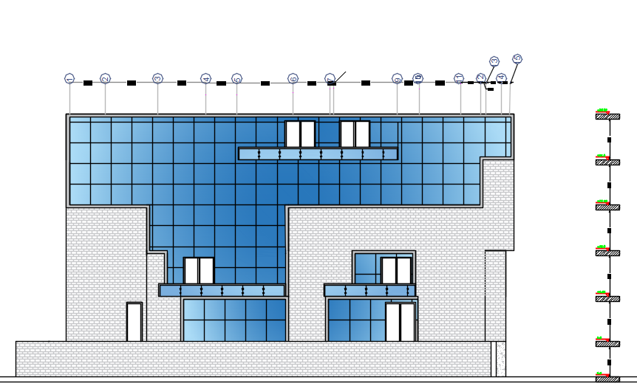
Architectural Design
East Elevation:-

Slide 15
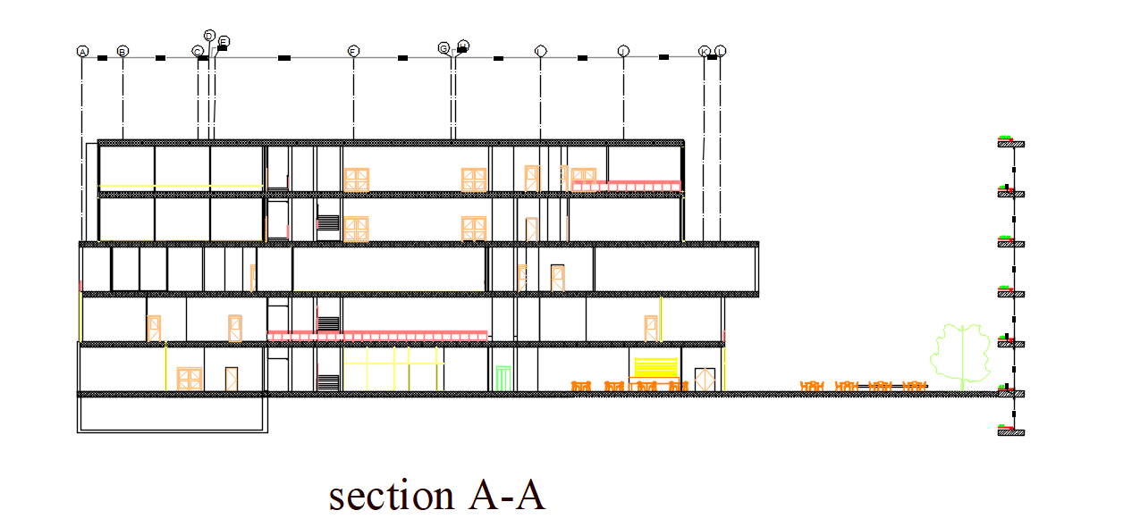
Sections:-

Slide 16
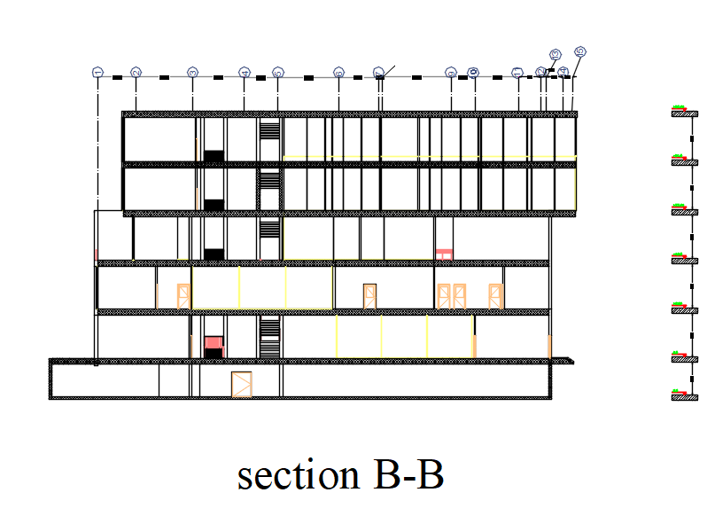

Slide 17
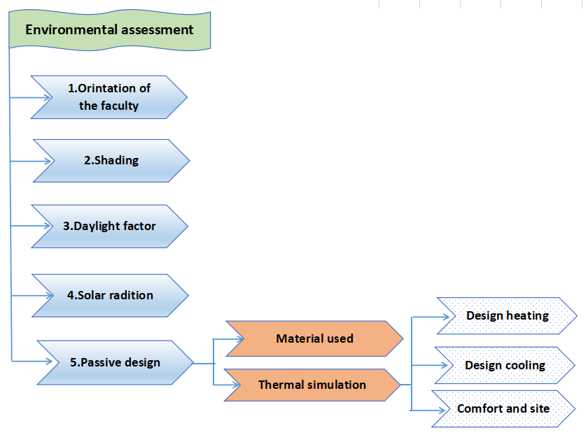
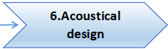
Environmental Design:

Slide 18
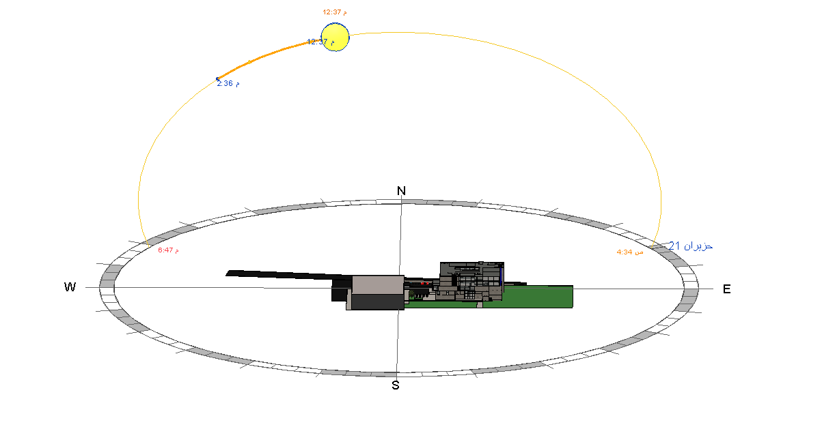
Building orientation:

Slide 19
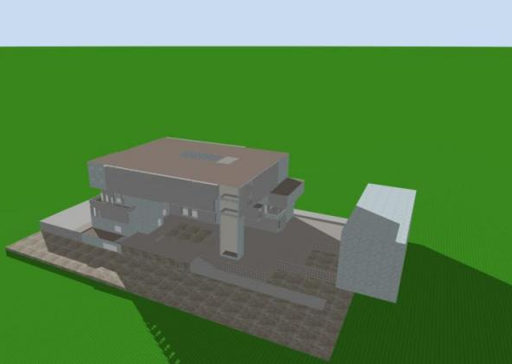
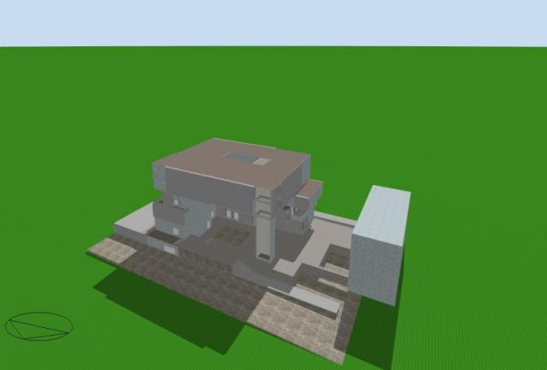
Shading system:
In Summer Day
at 8:00 A.M
at 12:00 P.M

Slide 20
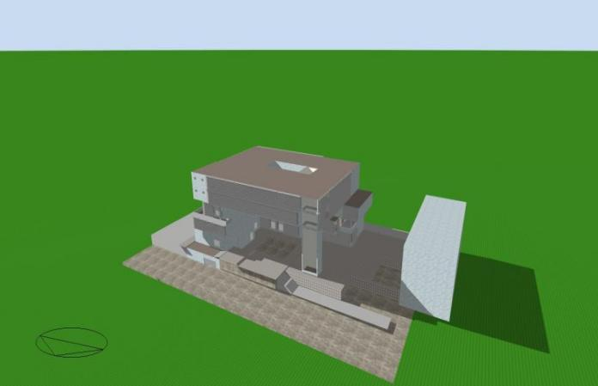
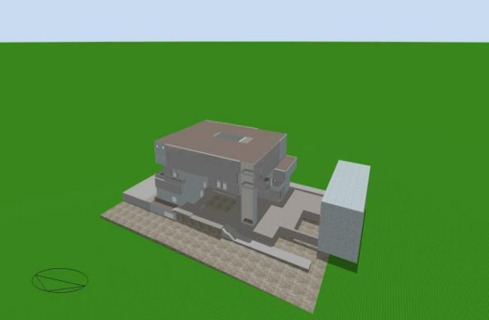
Shading system:
In winter Day
at 12:00 P.M
at 8:00 A.M

Slide 21
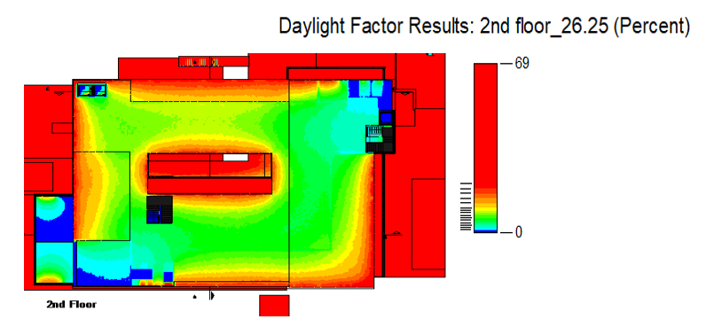
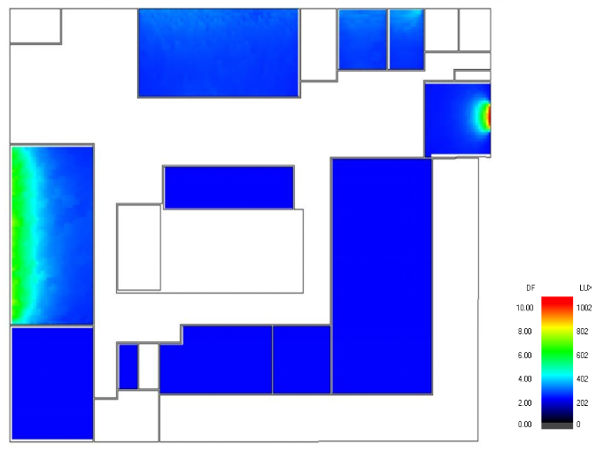
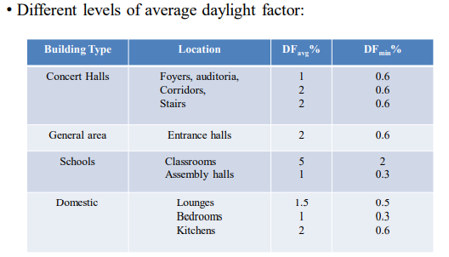
Day lighting analysis:
Before
AFTER

Slide 22
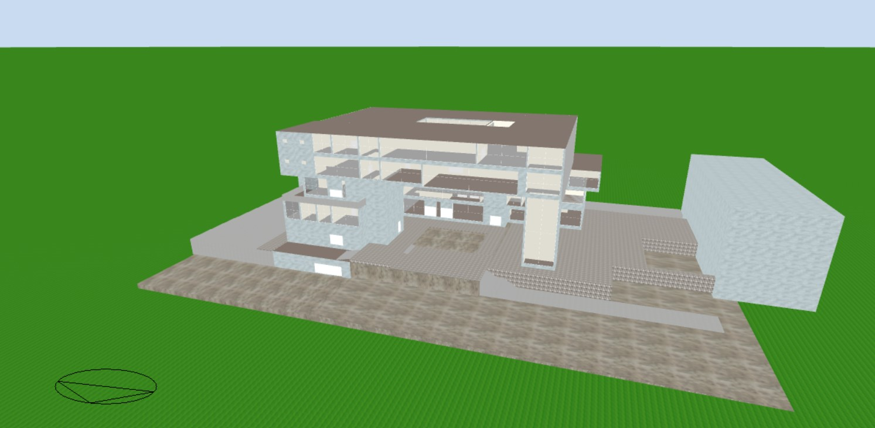
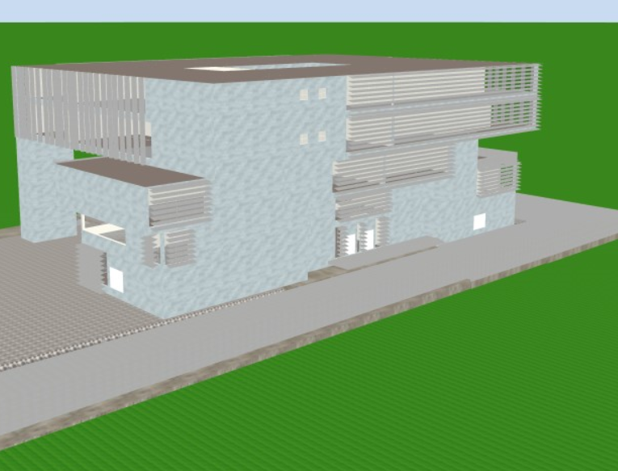
Environmental Modifications :
Main modification for day lighting:
Horizontal louvers on the southern façade
Vertical louvers on the eastern facade
Before
AFTER

Slide 23
MATERIAL Properties :
U-value for Building envelope

Slide 24
Heating and cooling loads:
Floor | Heating design load (KW)
Ground Floor | 133.34
1st Floor | 155.28
2nd Floor | 80.02
3rd Floor | 103.81
4th Floor | 107.58
total | 580.66
cooling design load (KW) | 631.56

Slide 25
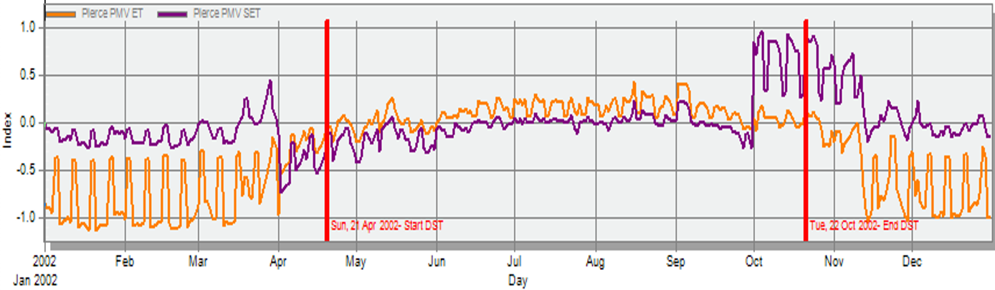
Thermal comfort:
Comfort PMV-set

Slide 26
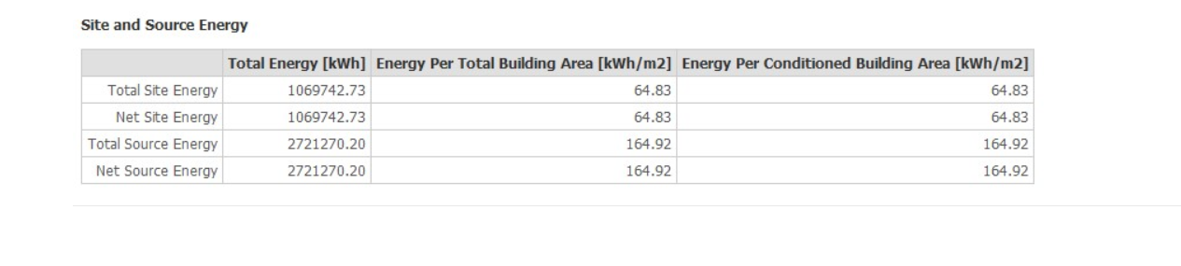
Thermal comfort:
the faculty's site and source energy is 64.83 kWh/m2, while the The site and source energy is 411.7 (Portfolio Manager, n.d.), so the faculty is in good shape.

Slide 27
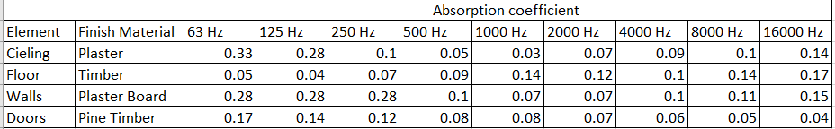

Acoustical Design:
Absorption Coefficient.
RT60

Slide 28
Acoustical Design:
Sound Transmission Class (STC):
 | Accepted Value (dB) | Achieved Value (dB)
Walls | 50 | 53
Ceiling | 50 | 72
Impact Insulation Class (IIC):
 | Accepted Value (dB) | Achieved Value (dB)
Floor | 60 | 61

Slide 29
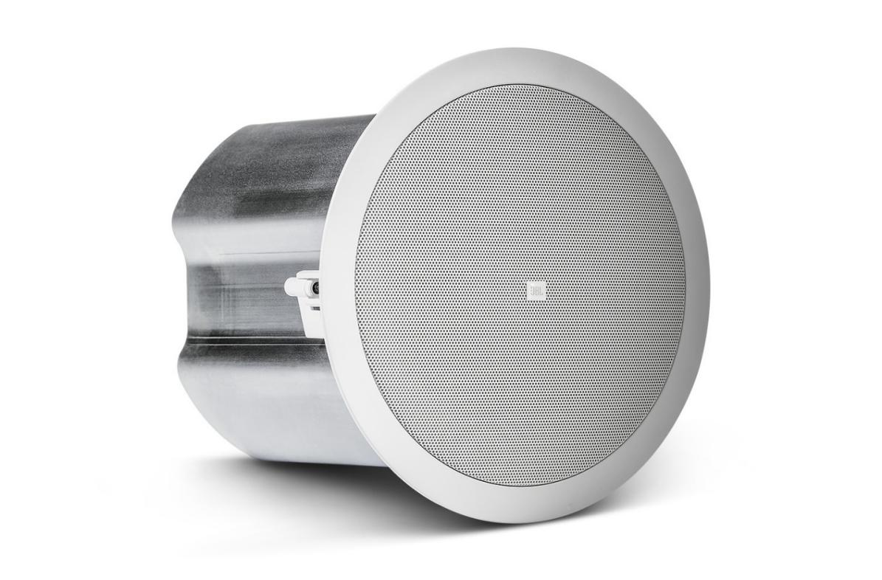
Acoustical Design:
Loud Speakers
Used type: Control 16C/T

Slide 30
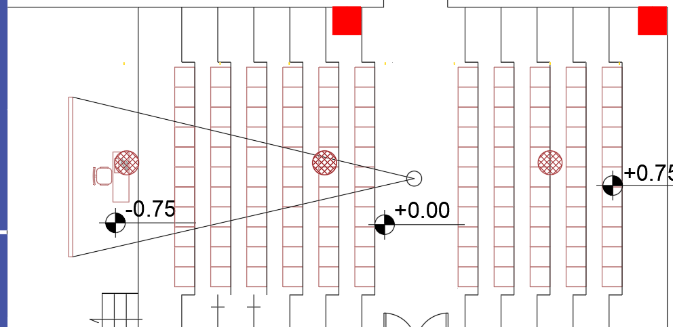
Acoustical Design:
Speakers distribution in an auditorium:

Slide 31
Mechanical design:
Water system
Drainage system
Fire Figting
HVAC system
Elevators

Slide 32
Drainage system
2" diameter: The branch diameter connects the lavatory to the floor drain.
4" diameter: the main stacks line's.
4" diameter: water closet (WC) to the main stack.
6" diameter: between manholes.

Slide 33
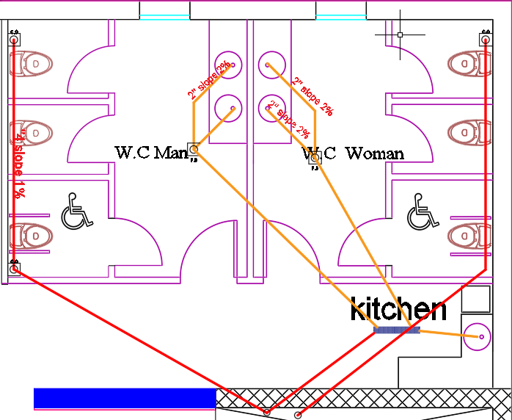
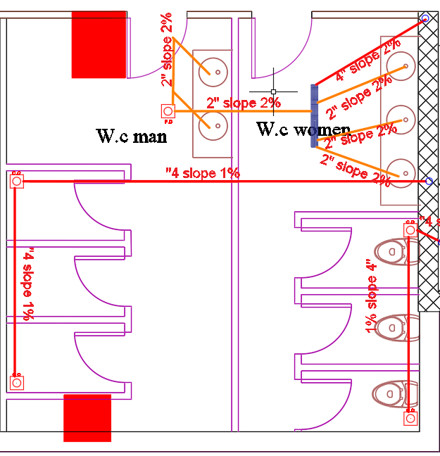
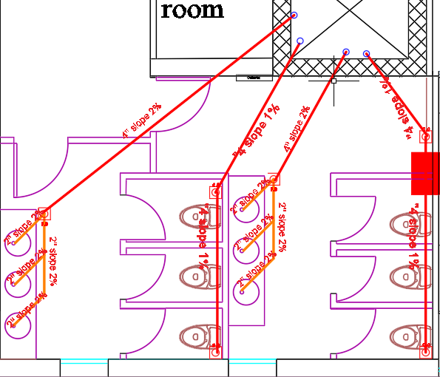
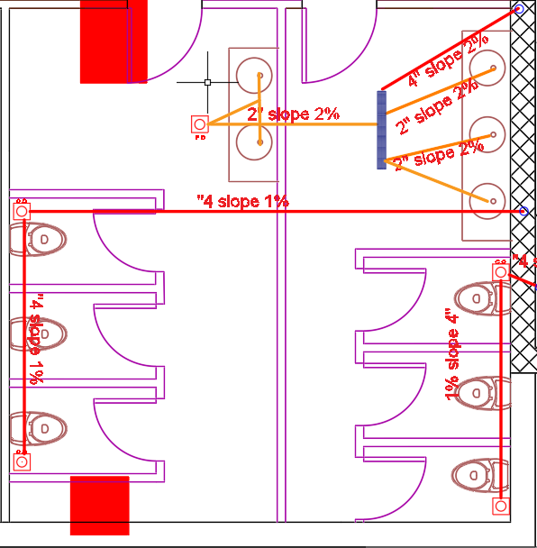
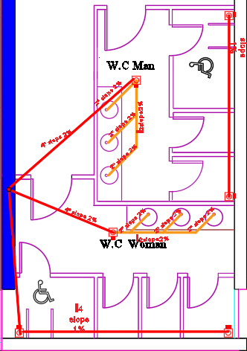
Third Floor
Fixture Type | Number of functions | Weight of fixtures in unit | Total number
W.C | 12 | 4 | 48
Lavatory | 10 | 2 | 20
Kitchen sink | 1 | 2 | 2
 | Total |  | 70
The total fixture units for the all floors.
Ground Floor
Fixture Type | Number of functions | Weight of fixtures in unit | Total number
W.C | 8 | 4 | 32
Lavatory | 9 | 2 | 18
Kitchen sink | 3 | 2 | 6
 | Total |  | 56
Fourth Floor
Fixture Type | Number of functions | Weight of fixtures in unit | Total number
W.C | 12 | 4 | 48
Lavatory | 10 | 2 | 20
Kitchen sink | 1 | 2 | 2
 | Total |  | 70
First Floor
Fixture Type | Number of functions | Weight of fixtures in unit | Total number
W.C | 10 | 4 | 40
Lavatory | 10 | 2 | 20
 | Total |  | 60
Second Floor
Fixture Type | Number of functions | Weight of fixtures in unit | Total number
W.C | 13 | 4 | 52
Lavatory | 12 | 2 | 24
 | Total |  | 76

Slide 34
The diameters that would be used in the faculty for vent, stack, drainage, and sewer are seen in the table below.
Fixture | Diameter | Slope | Pipe type
Vent | 4” | 0% | PVC
Stack | 4” | 0% | PVC
Drainage | 4” | 1% | PVC
Sewer | 2” | 2% | PVC
Drainage between Manholes | 6” | 1% | PVC

Slide 35
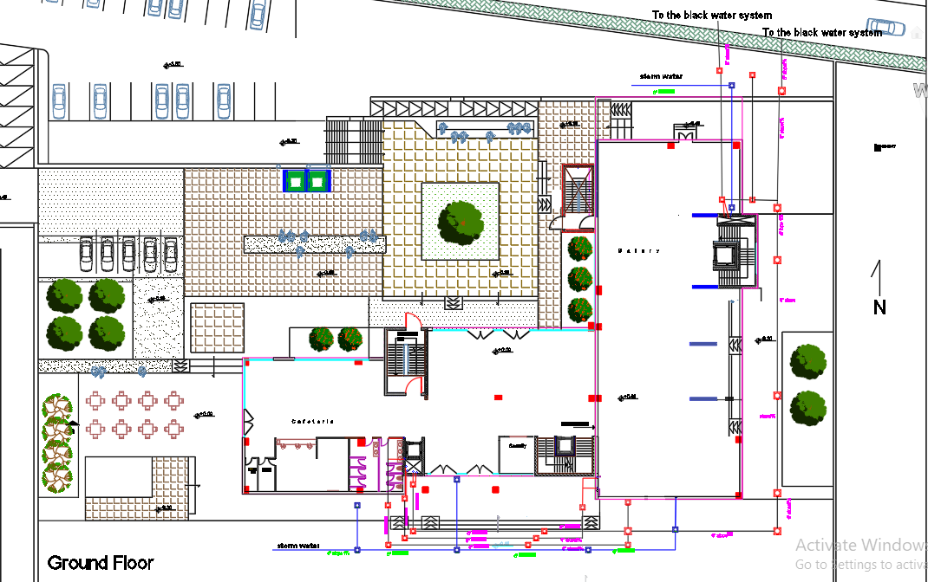
Manholes plan

Slide 36
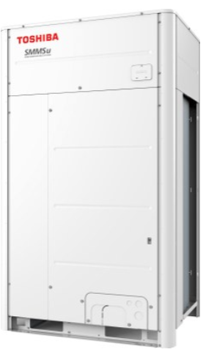
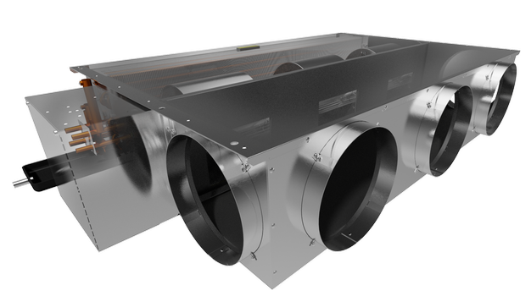
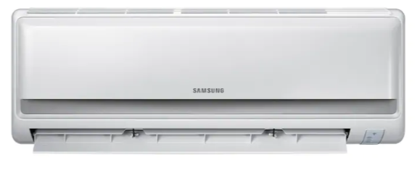

HVAC system
Total cooling load is 631.56 Kw
Total Heating load is 580.66 Kw
System used is VRF
The components of this system is from TROX ,TOSHIBA and Samsung company.
Outdoor unit:
10 unit with a capacity of 67
kw for each unit.
Indoor unit:
Diffusers (60*60): TROX Company will be used with flow rate 0.25 m³/s, 0.20 m³/s and 0.16 m³/s (ADTT/375).
Fan coli: From TROX Company
with flow rate of 0.84 m³/s (FWD18AF).
Split unit:From Samsung Company with flow
rate of 0.1 m³/s

Slide 37
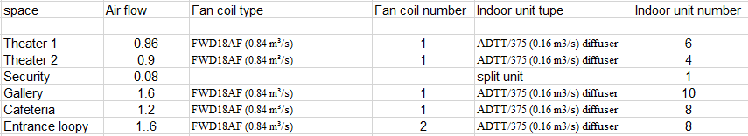
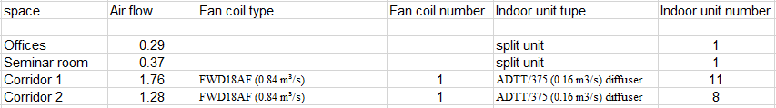
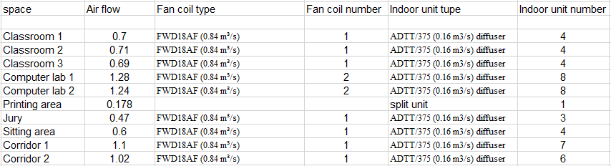
The number of fan coils, diffuser and split units that was used in the ground floor
The number of fan coils, diffuser and split units that was used in the first floor
The number of fan coils, diffuser and split units that was used in the second floor

Slide 38
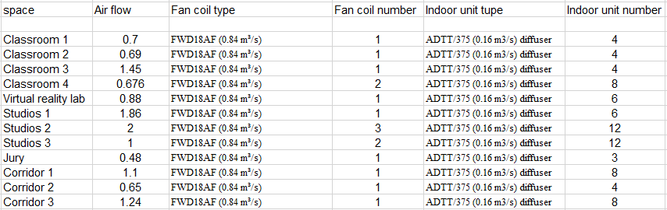
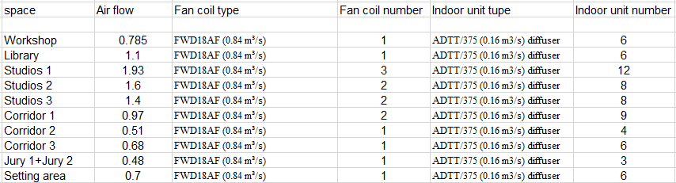
The number of fan coils, diffuser and split units that was used in the third floor
The number of fan coils, diffuser and split units that was used in the fourth floor

Slide 39




Table : The diameter for the duct in the theater 1 in the ground floor
The diameter for the duct in the theater 2 in the ground floor.

Slide 40




The diameter for the duct in the Entrance loopy in the ground floor.
The diameter for the duct in Cafeteria in the ground floor.

Slide 41


The diameter for the duct in Gallery in the ground floor.

Slide 42


Figure, shows the distribution of the ducts and the fresh air ducts for the Ground floor.
Figure, shows the distribution of the ducts and the fresh air ducts for the first floor.

Slide 43


Figure, shows the distribution of the ducts and the fresh air ducts for the Second floor.
Figure, shows the distribution of the ducts and the fresh air ducts for the Third floor.

Slide 44

Figure, shows the distribution of the ducts and the fresh air ducts for the Fourth floor.

Slide 45
Water supply system:
the faculty will be designed for 600 persons with 15 liters for each per day.
The total number of people consuming water in the faculty=600+50=650 persons
consuming water in the faculty=650*15=9750 liters/day=9.75 m3/ day

Slide 46
Water supply system:
Number of tanks = 7tank.
Pipes Diameter and losses
selection of Diameters(inch) |  |  |  | losses(psi)
pipes | zone1 | zone2 | zone3 | zone1 | zone2 | zone3
vertical pipes | 2 | 2 | 2 | 6.75 | 6.75 | 1.3
horizontal pipes | 1.5 | 1.5 | 1.5 | 0.15 | 0.06 | 0.43
branch pipes | 3/4 | 3/4 | 3/4 | 2.54 | 10.91 | 3.13

Slide 47


Water supply system:
Water supply system plan {ground floor}

Slide 48
Fire system:
The firefighting systems that we used:
1: Detection and notification system.
2: Suppression System.
3: Emergency signs and Exist.
4: Evacuation plans .

Slide 49









The different types of sprinkler in the faculty
The different types of the extinguisher

Slide 50


DistrebutionThe fire fighting systems
Ground floor
4th floor

Slide 51


Evacuation plans: for Ground floor: for basement:

Slide 52

Evacuation plans: for forth floor:

Slide 53

the overlab between systems in the false ceiling for ground floor

Slide 54

Elevator Design:
The assessment on the number of elevators will depend on the distribution of the elevators and if the number is enough or not by engineering sense. The distribution of the elevators is good and the number is enough for all the student and stuff.

Slide 55
Electrical Design:
Socket distribution
Artificial lighting

Slide 56

Electrical Design:
Power plan for first floor:

Slide 57
Artificial Lighting
One of the important parts of building design is visual comfort, so we should make spaces appropriate and convenient for the spectators.
Project goals for artificial lighting:
Have the highest standards of performance.
Satisfy illumination requirements for each selected space.
Ensure maximum visual satisfaction.

Slide 58

Lighting Plan for First Floor:

Slide 59
Illuminance and Glare
Illuminance (lux)
 | Recommended | Achieved
Studio | 400 | 400
Jury | 200 | 262
Auditorium | 500 | 502
Head of department | 150 | 158
Kitchen | 500 | 523
Library | 100 | 116
Glare
 | Recommended | Achieved
Studio | 14.8 | <10
Jury | <10 | <10
Auditorium | 18.2 | <10
Head of department | 13 | <10
Kitchen | <10 | <10
Library | 19.7 | <10

Slide 60







Slide 61



Socket plan for a computer lab:
The electrical load of power and lighting for the building:
Main distribution board of circuit breaker in the fourth floor:

Slide 62
Uniformity and Reflection Factor
Uniformity:
It denotes the ratio of minimum to average illuminance.
Reelection Factor:
The reflection is defined as the ratio of the luminous flux reflected by the surface to the luminous flux emitted by the lamp, the reflection factors for building surfaces are provided in table.
 | Reflection factor (%)
Ceiling | 50
Wall | 88
Floor | 25

Slide 63

Structural Design
Codes and Loads
Loads
Live Load = 5 kN/$m^{2}$
SID = 4 kN/$m^{2}$
Eq Load coefficients (UBC-97)
R = 5.5 , I = 1
Z = 2B (Nablus) , Cv= 0.2 , Ca = 0.2
Soil Profile (SB)
Codes
UBC-97 for Earthquake design
ACI 318-14 for RC structure design
ASCE-7 For load combinations
AISC 360-10 Code for Steel Design

Slide 64
Structural Design
Materials
Concrete B350 fc= 28Mpa
Reinforcing Steel fy = 420 Mpa
Steel Section Grade 50 (A992)
Final Design Sections
U-Boots Slab with Thickness 50 cm
Solid slabs with Thickness 15 cm
Different Dimensions of Steel Sections
Column Dimensions ( 70*70 , 80*50 , 100*70 cm)
Walls Thickness 30 cm
Structural System
U-Boot Slab
Solid Slabs with steel system

Slide 65


Slide 66


Slide 67
Models Checks
Compatibility Check
Equilibrium Check
Internal Forces Check
Seismic design Checks
Period Check
Modal Mass participation ratio (MMPR)
Base Shear Check
Drift Check

Slide 68

Seismic design Checks for block 1
Period Check
Ta = 0.562 sec , T(from ETABS) = 0.75 sec , T (Limit) = 0.78 so the check is ok
Modal Mass participation ratio (MMPR)
The summation of mass is greater than 90% for first 15 modes so the check is ok
Base Shear Check
Shear results from ETABS are greeter than results from manual calculation so the check is ok
Vx = 3782 kN , Vy = 5362 kN
Drift Check

Slide 69

Seismic design Checks for block 2
Period Check
Ta = 0.50 sec , T(from ETABS) = 0.66 sec , T (Limit) = 0.70 so the check is ok
Modal Mass participation ratio (MMPR)
The summation of mass is greater than 90% for first 16 modes so the check is ok
Base Shear Check
Shear results from ETABS are greeter than results from manual calculation so the check is ok
Vx = 5260 kN , Vy = 6311 kN
Drift Check

Slide 70

Footing Layout

Slide 71

Slabs

Slide 72


Slabs

Slide 73


Columns Sections

Slide 74


Drop Beams Section

Slide 75



Steel Design

Slide 76

Steel Design

Slide 77




Steel Connections C1

Slide 78




Steel Connections SPCA

Slide 79


Retaining Wall Design

Slide 80

Stair Design

Slide 81
Quantity surveying:
The total cost of the project = 24,030,279 Nis , with total are a of the building = 9000 m²
The unit cost of the project = 2670 Nis
Earthwork work = 1,095,000 Nis
Foundation work = 772,648 Nis
Structural work = 10,436,498 Nis
Finishes work = 7,096,913 Nis
Electrical work = 377,700 Nis
Mechanical and Safety work = 2,137,200 Nis
Site work = 2,114,320 Nis

Slide 82

Percentage of Activates cost for the project

Slide 83


