Slide 1

An-najah National University
Faculty Of Engineering
Industrial Engineering Department
“Assessment & Development Of Palestinian Blood ”Bank System
Prepared by:
Alaa Sarhan
Haneen Tanni
Raya Khwayre
Razan Assaf
Supervisor: Dr. Ayham Jaaron
23/5/2012

Slide 2
Project Outline
Literature Review
Current Assessment
Methodology
Development.
Conclusion & Recommendations.
Introduction.
Objectives.

Slide 3

Introduction
Research, development, and innovation.
Political Situation.
Economical conditions.
contact with national blood banks in order to keep up with what's new regards blood transfusion systems.
Ensuring the delivery of health services in high quality and safe.
Human safety.

Slide 4
Main Objective
Increase the efficiency and effectiveness of the Palestinian Blood Bank System.
Specific Objectives:
Studying the current situation in the blood bank system to identify the opportunities for improvement.
Developing forms to document the donor issues and tests results.
Making Benchmarking based on the Publications of WHO.

Slide 5
LITERATURE REVIEW
Information Management system in blood banks
Laboratory Record Documentation.
Management of blood transfusions.
Blood supply and demand.
Training Management.
Nagurney (2009, 2010b), Yu, and Qiang (2011)
Blood Donation:
Blood Donors.
Blood Donor Registration.
Donor Selection.
Safety donors selection process.
Brodheim et al. (1975)

Slide 6
LITERATURE REVIEW CONT….
Blood Inventory Management
Ordering Policies.
Issuing Policies.
Godson. Tetteh (2008),
Quality Management in Blood Bank System
Quality Assurance in Blood Transfusion Service.
Quality Assurance Program.
Laboratory Quality Assurance Scheme.

Slide 7
Methodology
Justification of methodology
(yin,2003 ) observed that in a good case study, the investigator should make the effort to develop the system.
The Reliability, and the external validity of information will increase if multiple sources of evidence are used, like the proposed two case studies
(Eisenhardt, 1989) the choice of the studied organization, should be based according to replication logic.

Slide 8
Data Collection
Interviews
Interview with blood bank managers.
Interview with blood bank employees.
Analysis of Documents and Records
Forms , tables, … The main focus of this document is on the different input needed for the development of a data base for the blood transfusion centers and donors

Slide 9
Current Assessment Of Palestinian Blood Bank System

Slide 10
Current Assessment
Palestinian Blood Bank System
Decentralized
No job description
No organizational structure
No standard procedures
No monitoring system
No unified quality system

Slide 11
Case Study (1): (Tulkarem Blood Bank)

Slide 12
Process flow chart of Tulkarem blood bank
Reception
Inspection the donor's data by
Donor Screening
Blood Donation
Blood Tests
Blood Storage
Written in a file

Slide 13
Case Study (2) : (Rafedya Blood Bank)

Slide 14
Process flow chart of Rafedya blood bank
Reception
Inspecting the donor
Data from the inspection
Written in a file
Written in computer
Donor Screening
blood
laboratory tests
Blood Storage
Written in a file

Slide 15
Fishbone diagram for problems in Palestinian Blood Bank System
Quality control
Information System
No Preventive Maintenance
No automated system
No checking for the donor
Less of record and forms
No Quality control for equipments
Problems in blood bank system
No unified inventory system
Lack of staff
Lack of Training
Blood inventory
Human

Slide 16
Benchmarking & Development

Slide 17
Development Fields
Blood Issue.
Labeling, Preservation and Storage.
Organizational Structure and Job Description.
Information System.
Quality System.

Slide 18
Organizational Structure and Job Description

Slide 19
Organizational Structure
Central Blood Bank
Regional blood banks
General director of blood banks
Quality Control & monitoring Department
Donation Department
Labs Department
General Services
Administrative affairs
Campaigns Division
Withdrawing blood units Division
Donor Selection and screening Division
Maintenance Department
Division of Blood units tests
Transportation Division
Procurement Department
Computer & statistics Division
Queries Division
Continuous training Division

Slide 20
Job Description
Job responsibilities | Designation
Supervise of overall function. Policy making. Reporting to the management system. | Director
Tests and making report under supervision of sr. resident Rerecord maintaining Indenting Stock checking. | Technician
Physical checking of donor. Phlebotomy. Assisting the technician. | Nursing staff
Dispatching records to the other departments. Maintaining of log book. Receiving requisition and patient registration. | Attainder

Slide 21
Job Description CONT……
Job responsibilities | Designation
All aspects of donor selection and donor safety. | The blood bank medical director.
1. Direction and operation of transfusion service. 2. Compliance with all applicable regulations and requirements. 3. Selecting the source(s) of blood (the director may refuse to use blood from any given source at his/her sole discretion). 4. Establishment and implementation of written standard operating procedures. 5. Ensuring competency of and delegating responsibilities to staff. | The director of transfusion services.

Slide 22
Job Description CONT……
1. Direction and operation of the blood bank. 2. Compliance with all applicable regulations and requirements. 3. Establishment and implementation of written standard operating procedures. 4. Ensuring competency of and delegating responsibilities to blood bank staff. 5. Investigation of cases of possible transfusion-transmitted diseases. | The blood bank director .

Slide 23
Blood Donation Issues

Slide 24
Blood Donation issues
Blood Donation Issues
Blood Collection
Post Donation Care
Selection of bags
Qualifying Test
Management of adverse reactions
Donor Screening
Blood Collection Preparation
Criteria for Donor Selection

Slide 25
The purposes of Blood Donation activities
Activity | Purpose
Criteria for Donor Selection | Assessing suitability of donor for blood donation.
Donor Screening | Physical examination of the donor.
Blood Collection Preparation | Solutions and method for preparing phlebotomy site.
Selection of Bags | Choice of bag depending on component to be prepared.
Blood Collection | Assessing suitability of donor for blood donation.
Post donation care | Attend to any adverse reactions in the immediate post-donation period.
Management of adverse reactions in a donor | Any adverse reaction in the immediate post-donation period requires to be attended to.

Slide 26
Benchmarking the current situation in blood banks based on WHO standards
Current | WHO standards
There is no limitation about the weight in the procedures. | The donor should not be less than 45 kilograms.
There is no requirement for respiratory diseases. | The donor should be free from acute respiratory diseases.
There is no limitation about the temperature in the procedures. | o Oral temperature 37.5 C +/- 0.2C (98.6F =/- 0.5F)
The prevention period of the person who made surgery is six month. | The prevention period of the person who made surgery should be one year.
There is no limitation about the vaccinations. | The prevention period of the person who took vaccination Should be one year and generally based on it's type.
Ask the donor about it's weight and enter it. | The weight, blood pressure should be tested.
There is no limitation about the pulse in the procedures. | Pulse regular, between 60 and 100 beats / minute.
There is no limitation about the pressure in the procedures. | o Systolic blood pressure not > 160 mm of Hg. o Diastolic pressure not > 100 mm of Hg.

Slide 27
Benchmarking CONT….
Current | WHO standards
There is no checking of the expiry date of the bag. | The should inspect the expiry date of the bag.
There is no data was written on the bag . | There are many date should be written on the bag, such as: type of the bag, manufacturer's name. batch number.
There is no criteria about using the right bag's type. | Use single bag when; 1. Components are not to be separated from that unit. 2. When autologous blood is collected for patients e.g. elective surgery. 3. Therapeutic phlebotomy is being performed on a patient.

Slide 28
Benchmarking CONT….
Current | WHO Standards
There is no refreshment area. | The donor should be observed for another 10 minutes in the refreshment area.
There is no examination of the donor after the blood donation. | Inspect the venepuncture site before the donor leaves the donor room.
Check pulse and blood pressure. | Check and write pulse and blood pressure.

Slide 29
Labeling, preservation and storage of blood and components

Slide 30
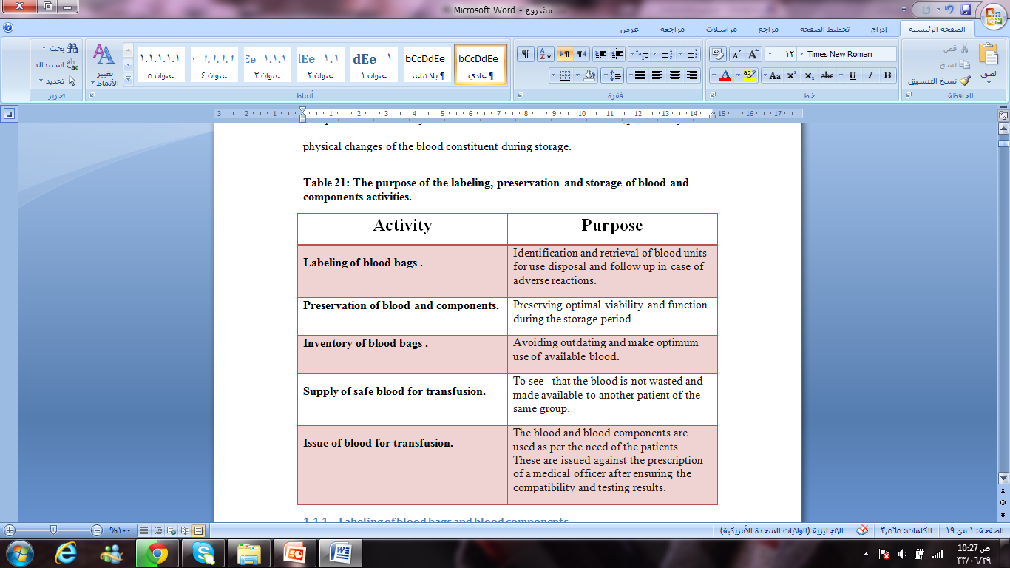
The purpose of the labeling, preservation and storage activities

Slide 31
Benchmarking the current situation in blood banks based on WHO standards
WHO standards | Current status
The labels are printed and color coded for all components as per blood groups. | There is color labeled according to blood type.
Write clearly the unit number, date of collection and expiry and the volume on each label as per the grouping register records. | Unit number ,expiry date and the volume be written on label .
After the bags are labeled , then ask a second technician to double check with the records. | There is no double check on the number and group on the bags.
Monitor to ensure the storage conditions to be appropriate and correct for each product. Monitor the temperature of all storage areas with continuous graphic recorder. Change the charts every week. Check the alarm system every month. | There is monitor for temperature only for refrigerator but without graphic records, and there is no check on the alarm system every month , as a result of no preventive maintenance.

Slide 32
Benchmarking CONT…
Inventory is maintained on a day to day basis. After labeling the units , register kept in the main red cell laboratory. | There is daily inventory check ,but there is no inventory register for this .
For some reason or the other, it may not be required by the patient and it is returned to the blood bank, issue this unit safely to another patient. | There is supply of safe blood for transfusion, and that is achieved by first-in-first-out (FIFO) policy.
These are issued against the prescription of a medical officer after ensuring the compatibility and testing results. | There is no issue resistor for blood transfusion.

Slide 33

Form for monitoring temperature for Refrigerator (tem/time) chart

Slide 34
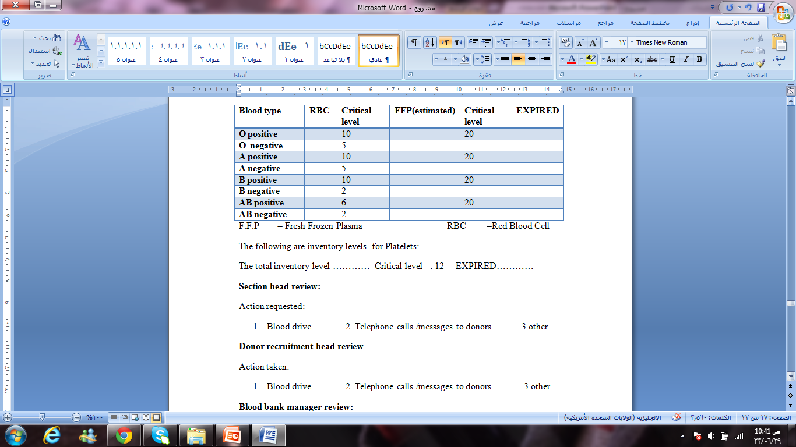
Daily inventory Register

Slide 35
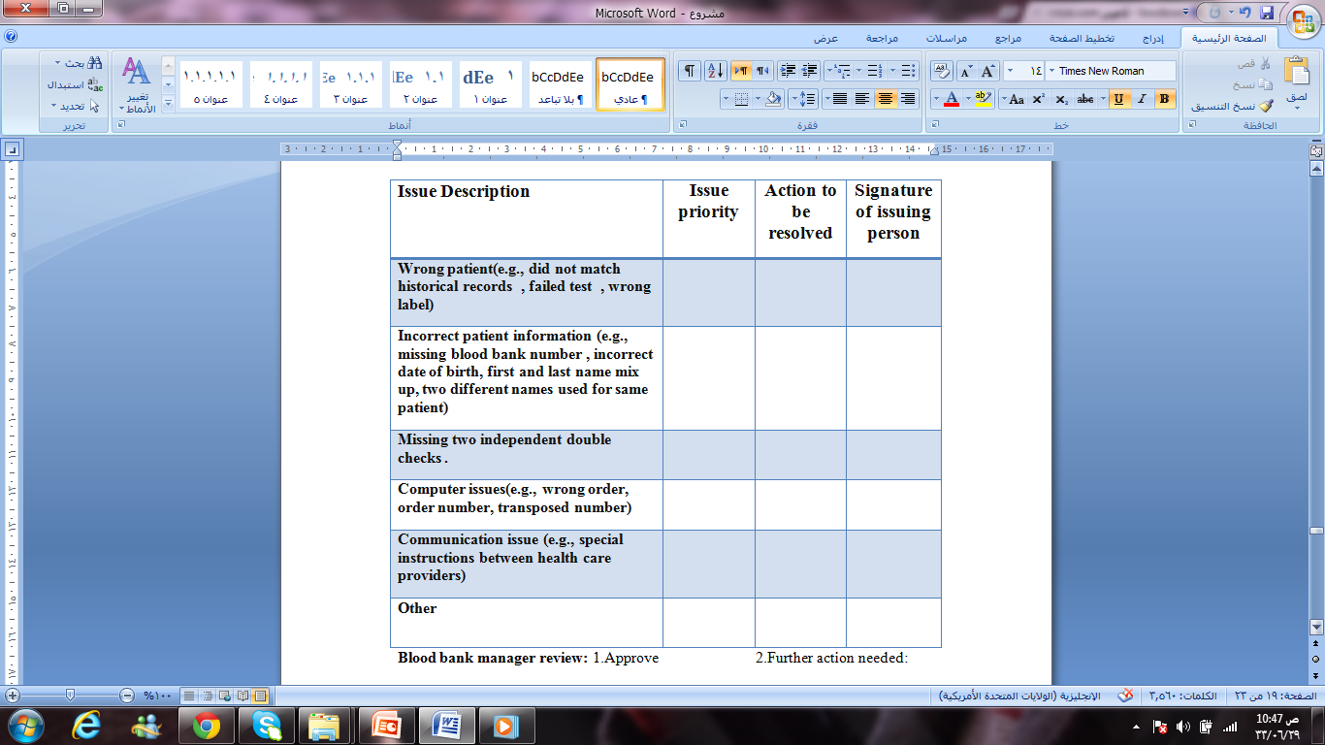
Issue Register for Blood Transfusion

Slide 36
Quality System

Slide 37
QUALITY CONTROL/ASSURANCE Department in blood bank system
Quality in blood bank system
Monitoring and Evaluation
Quality policy
Quality plan
Quality Manual
Procedures
Work instructions
Training staff

Slide 38
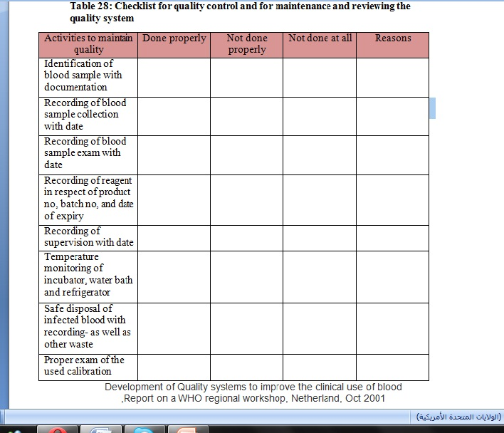
Checklist for quality

Slide 39
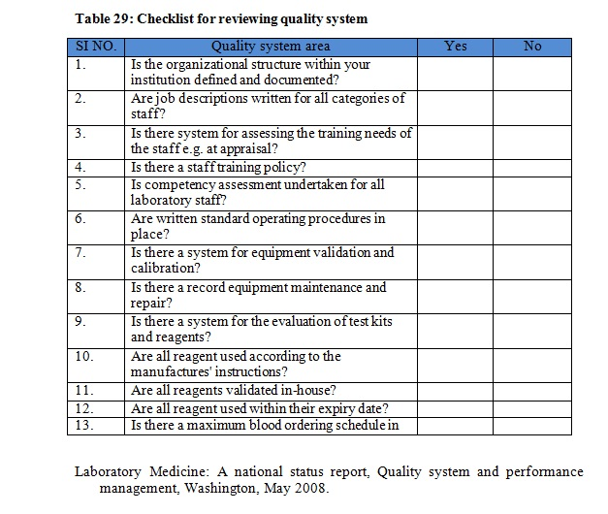

Slide 40
Benchmarking the current situation in blood banks based on WHO standards
After benchmarking the current situation in blood banks based on the checklist standards, we notice the following needs for development in this section:
Each blood bank should have a specialized department of quality control\assurance
Ensuring that SOPs for all QC/QA unit activities exist and define the QC/QA unit's responsibility for performing SOP review
The department should have the all validity to inspect and examine and monitor by watching or by forms that determine the sets of some process in blood bank system

Slide 41
Benchmarking CONT….
Each blood bank should maintain detailed standard operation procedure manual, as well as records (forms, resistors, labels) for preservation, storage
Corrective or preventive action, maintenance
In each blood bank must have sufficient amount of forms to ensure the enforcement of quality in all blood bank and that the base of our development in quality control system

Slide 42
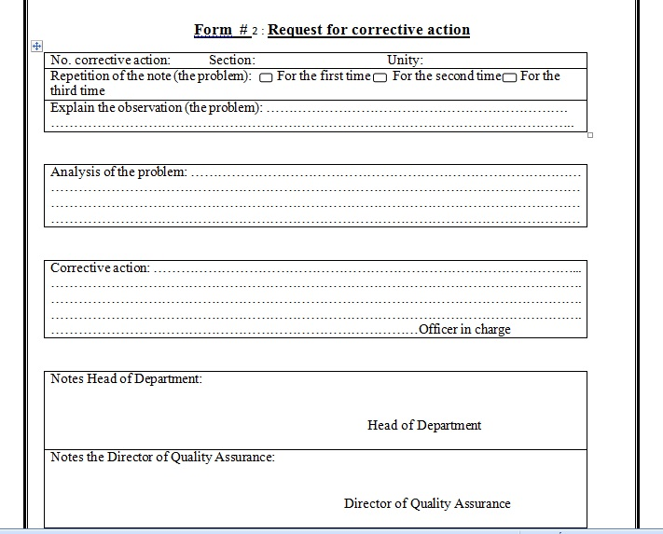

Slide 43
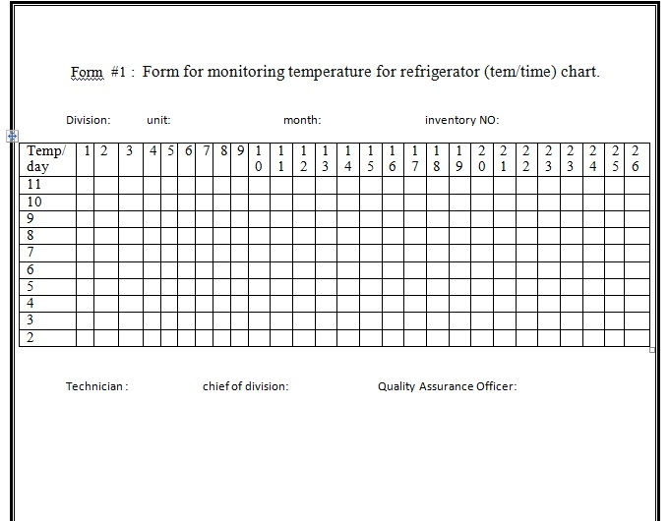

Slide 44
CONCLUSIONS &RECOMMENDATIONS

Slide 45
CONCLUSIONS
Demonstrating an Assessment and a Development of _Blood Bank System in Palestine.
Benchmarking and Gap analysis of current situation in local Blood Banks system according to World Health Organization WHO standards.
Increasing efficiency of the Blood Bank System

Slide 46
Recommendation
Each blood bank should develop its own set of Standard Operating Procedures.
Recruitment of non-paid, voluntary blood donors should be strengthened further.
Information Systems could enhance, which include forums, records and register for each procedure.
IT Support Staff should been provided to the Blood Bank by Ministry of Health MOH.
Establishing Quality Control Department.

Slide 47
Recommendation CONT…..
Continuation of technical assistance, including training and capability strengthening.
Establishing Organization Management Structure, this will include a Board of Directors, a Financial Director, and Quality Managers.
Establishing a Central Blood Bank which covers all the hospital's needs.

Slide 48

Thank you

