Slide 1


e-Knowledge Point System
Team Members
Laith AboShamat
Zainab Nassif
Supervisor
Safa'a AbuJarour

Slide 2

What's scheduled for today?
01
Focus group and interviews
02
Literature review
03
Use case
04
Methedology
05
Discussion
06
Recommendations

Slide 3


Introduction
e-Knowledge is a Platform where users earn points by sharing knowledge, instead of traditional points, these points can then be exchanged for various rewards, such as access to research resources or even funding for future research projects.
And the goals of this point system are:
  Sharing knowledge.
  Better scientific research skills.
  Improving Community Responsibility.

Slide 4


Research Gap
Despite the growing popularity of digital point systems for trading knowledge between users, there is a lack of empirical research on the effectiveness and efficiency of such systems in promoting knowledge exchange and learning among users.

Slide 5






Research Questions
  1.
How can user data in knowledge-based services and cryptocurrencies be protected through effective security measures and regulatory frameworks?
  3.
How to improve user engagement and knowledge sharing between users?
  2.
What are the principles of design to improve usability and facilitate effective interaction?
  4.
How can user participation in online knowledge-based services be incentivized, and what impact do different types of incentives have on user engagement ?

Slide 6
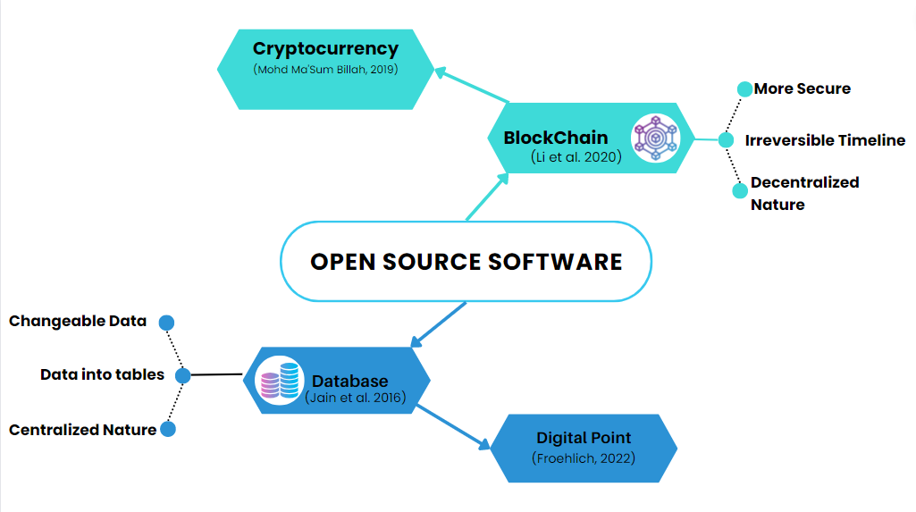

Slide 7

Literature review
Cryptocurrencies and Blockchain offer a combination of risks and benefits that warrant careful consideration.
Risks, benefits and how to motivate students to use e-Knowledge Point System.
(Cheah and Fry, 2015)
(Tasca, 2018).

Slide 8
Literature review(cont.)
Al-Salihy, A., &amp; Al-Khasawneh, M. (2013). Database Security Regulations and their Impact on Data Warehousing. International Journal of Computer Applications.
Bevan, (2009), “What is The Difference between the Purpose of Usability and User Experience Evaluation Methods?”
Billah, M. M., (2019). “Halal Cryptocurrency Management”. Journal of Islamic Finance: Palgrave Macmillan Cham.
Brinker, S. (2016). Hacking Marketing: Agile Practices to Make Marketing Smarter, Faster, and More Innovative. Wiley.
Froehlich, M. (2022). Usable Cryptocurrency Systems. (Doctoral dissertation, University of Stuttgart).
Jain, P., Gyanchandani, M. & Khare, N. (2016). Big data privacy: a technological perspective and review. J Big Data.
Tasca, P. (2018). The evolution of trust in cryptocurrency exchanges: Insights from empirical analysis. Journal of Risk Finance.

Slide 9


Methodology (Qualitative)
Students
Educators
Focus groups
Collecting Insights
Interviews
10
Number of Shows
10
Engineering and Information Technology at An-Najah Uni
faculty of
Engineering and Information Technology at An-Najah Uni

Slide 10

Results from focus groups
Students
A few students also suggested additional security measures.
Overall, the students saw many potential benefits such as easier access to course materials and resources and a more streamlined grading process, they also appreciated the flexibility of the system and to enhance their learning and improve their academic performance.

Slide 11


Results from Interviews
Educators
Overall, the teachers were optimistic about the potential of the e-knowledge point system. However, they highlighted the importance of thorough implementation planning, training, ongoing support, and alignment with existing curricula to ensure successful adoption and integration into their teaching practice.

Slide 12
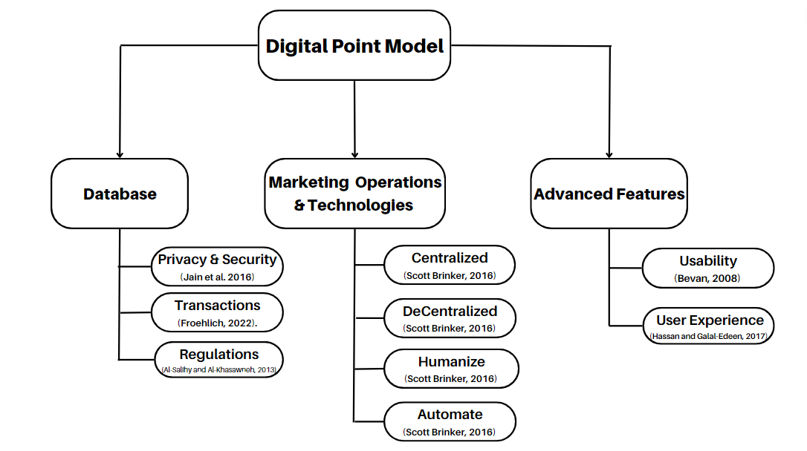
Proposed Model

Slide 13
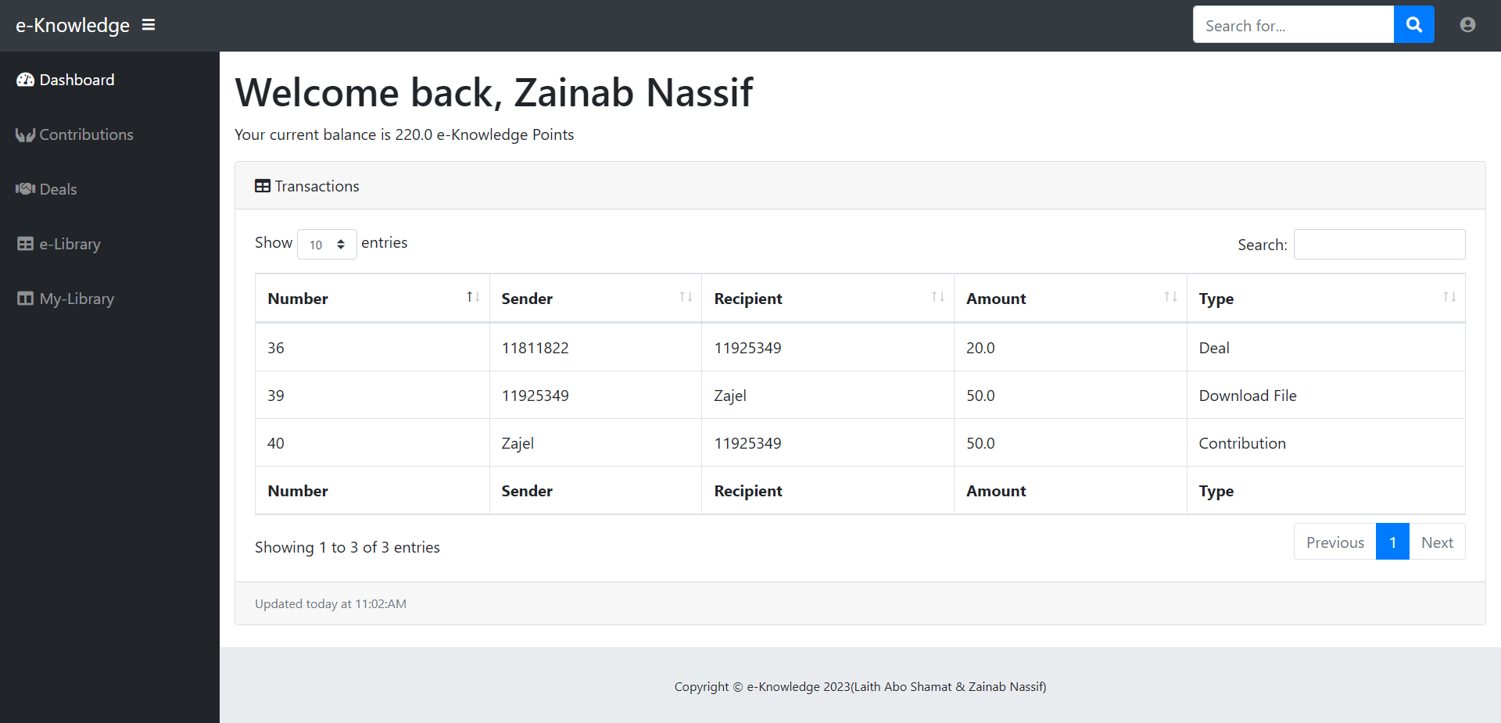

Slide 14

Methodology
Quantitative (Survey)
  Our targeted sample was An-Najah Students.
  The survey was launched on the 28th of April, 2023, till now.
  We have successfully collected a total of 30 responses (56% Females and 43% Males)
Analysis
Data was collected from a form filled out by students and analyzed by SPSS

Slide 15
Statistics
We analyzed the data by
  Descriptive Statistics
  Comparative Analysis by ANOVA Test
  Correlation Analysis
  Reliability Test

Slide 16
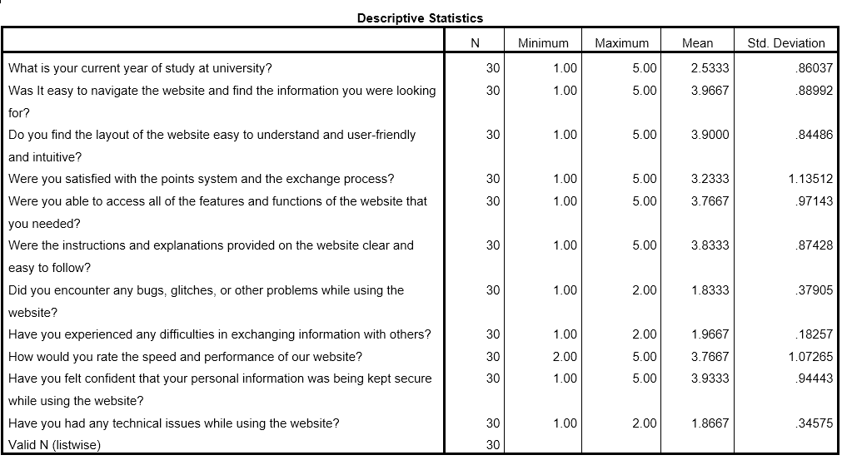

Slide 17
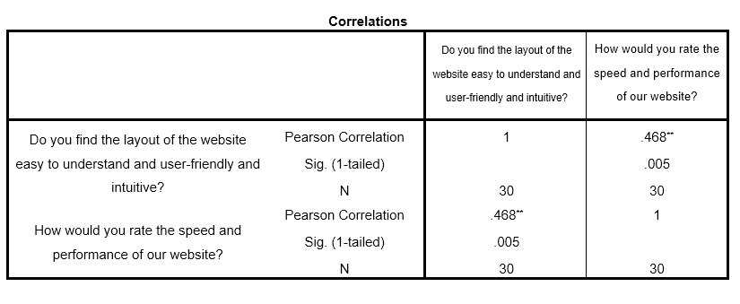

**.Correlation is significant at the 0.01 level (1-tailed).

Slide 18
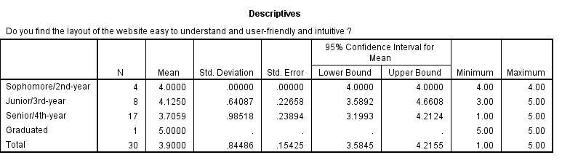

Slide 19

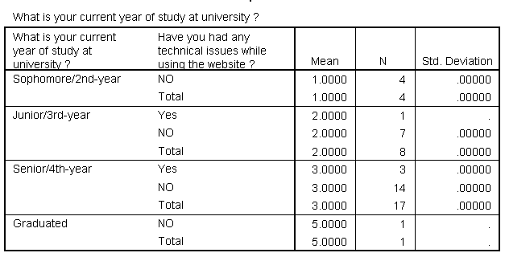
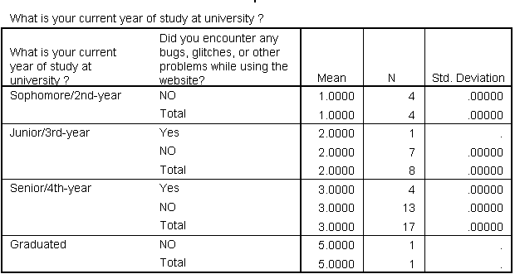

Slide 20
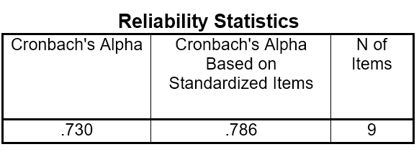
The acceptable value for the reliability analysis > 0.7
(StaticHero)

Slide 21


Marketing Plan
Define Objectives
Survey Design
Communication Channels
Follow-ups and Thank You
Content Marketing
Continuous Improvement

Slide 22

"Let's shift gears from theory to practice and embark on an exciting journey of hands-on exploration, where we'll unleash our potential, turn ideas into actions, and witness the transformative power of putting knowledge into motion."
Notes:
Here we shifted to the practical part

Slide 23

Added values
Encourages knowledge sharing and learning from each other
Builds a community of knowledgeable users
collaboration and problem-solving among users
Key milestones
Awards
Point system trading
Responsive design
Search functionality
Start and release
User-friendly
Features

Slide 24

Future work
  Profile page for each user
  Rating system (like & dislike method)
  Chat between users
  Email-verification
  Tables Categorization
  Tables Connectivity

Slide 25


Research and Development
Consider scalability and future-proofing
Address implementation challenges
Implement data-driven strategies

Slide 26


Morals
Collaboration
Transparency
Never stop learning
Communication

Slide 27
References
Al-Salihy, A., & Al-Khasawneh, M. (2013). Database Security Regulations and their Impact on Data Warehousing. International Journal of Computer Applications.
Billah, M. M., (2019). “Halal Cryptocurrency Management”. Journal of Islamic Finance: Palgrave Macmillan Cham.
Bevan, (2009), “What is The Difference between the Purpose of Usability and User Experience Evaluation Methods?”
Brinker, S. (2016). Hacking Marketing: Agile Practices to Make Marketing Smarter, Faster, and More Innovative. Wiley.
Cheah, E.T., and Fry, J. (2015). Speculative bubbles in Bitcoin markets? An empirical investigation into the fundamental value of Bitcoin. Economics Letters.
Farell, R. (2015). An analysis of the cryptocurrency industry.
Froehlich, M. (2022). Usable Cryptocurrency Systems. (Doctoral dissertation, University of Stuttgart).
Hassan, H. M., & Galal-Edeen, G. H. (2017). From usability to user experience.

Slide 28
References
(cont.)
Hileman, G., & Rauchs, M. (2017). 2017 global cryptocurrency benchmarking study. Available at SSRN 2965436.
Jain, P., Gyanchandani, M. & Khare, N. (2016). Big data privacy: a technological perspective and review. J Big Data.
Lee, J. Y., Kim, S., & Choi, J. (2019). A digital point system for peer-to-peer knowledge sharing using blockchain. International Journal of Information Management.
Li, X., Song, Z., & Wang, C. (2020). A blockchain-based cross-border payment system using cryptocurrency. Future Generation Computer Systems.
Tasca, P. (2018). The evolution of trust in cryptocurrency exchanges: Insights from empirical analysis. Journal of Risk Finance.
Ujan Mukhopadhyay; Anthony Skjellum; Oluwakemi Hambolu; Jon Oakley; Lu Yu; Richard Brooks,2016,A brief survey of Cryptocurrency systems,IEEE.
Yukun Liu, Aleh Tsyvinski 2021, “Risks and Returns of Cryptocurrency” “The Review of Financial Studies”.

Slide 29



OUR TEAM MEMBERS
Zainab Nassif
Laith AboShamat

Slide 30

"Thank you for your attention and participation" We welcome any questions or discussions you may have.

