Slide 1

An-Najah National University
Faculty of Engineering and Information Technology Chemical Engineering Department
Graduation Project-2 (10626594)
Presented By:
Noor Rehan.
Sabreen Quzmar.
Ruba Arafat.
Bara’a Bsharat.

Slide 2
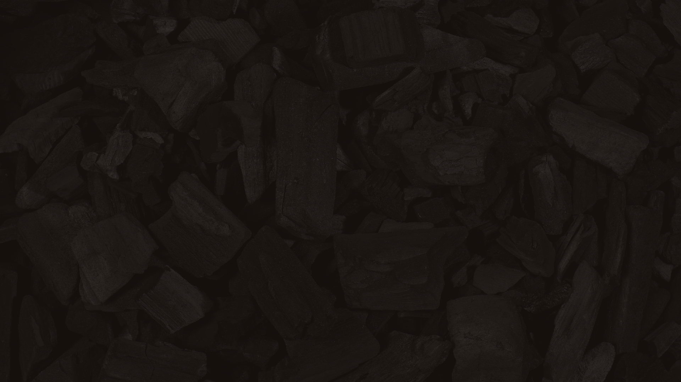
OLIVE SOLID WASTE AS ALTERNATIVE OF COCONUT CHARCOAL: TECHNICAL AND ECONOMICAL STUDY

Slide 3
summary of graduation project 1
collecting 10 different samples of coconut charcoal in the Palestinian markets
calculate fixed carbon of the samples via three test (Moisture content, Volatile matter content, and Ash content),
The results were compared with international standards.
According to the results, we found that the Panorama sample has the best quality according to all standards specification.

Slide 4

THE AIM OF THE RESEARCH
Find an alternative to coconut charcoal

Slide 5
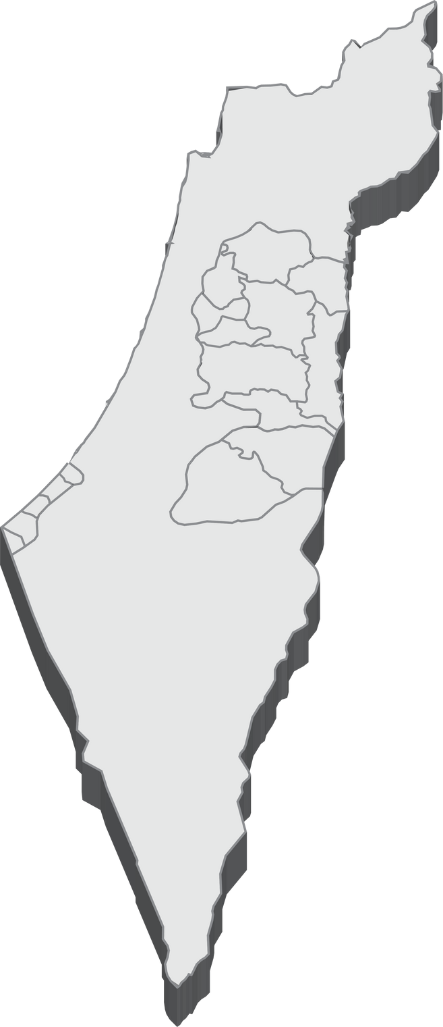
1
The Problem
The average production of peat in Palestine in the last 10 years is about
50 thousand tons annually,
2the number of establishments working in
the field of peat in Palestine is
only about 10 establishments.

Slide 6
OVERVIEW
The quantity of olive peat produced makes it the most important agricultural by- product in the country.
Charcoal made in Palestine is harmful to the environment
Making charcoal from olive peat
There is no Palestinian product that can compete with imported coconut charcoal
Olive waste (peat) is not sufficiently recycled

Slide 7
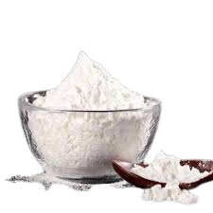
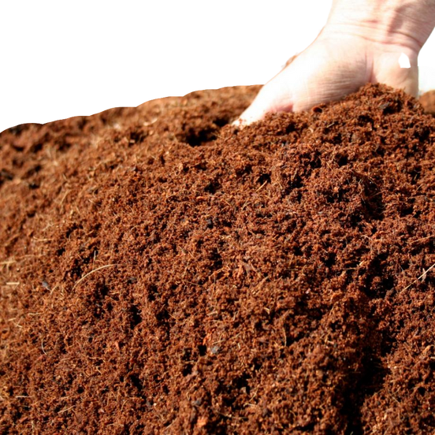




Materials
starch
Olive Solid wastes (peat)
starch
water

Slide 8
METHODS& Equipment

Slide 9
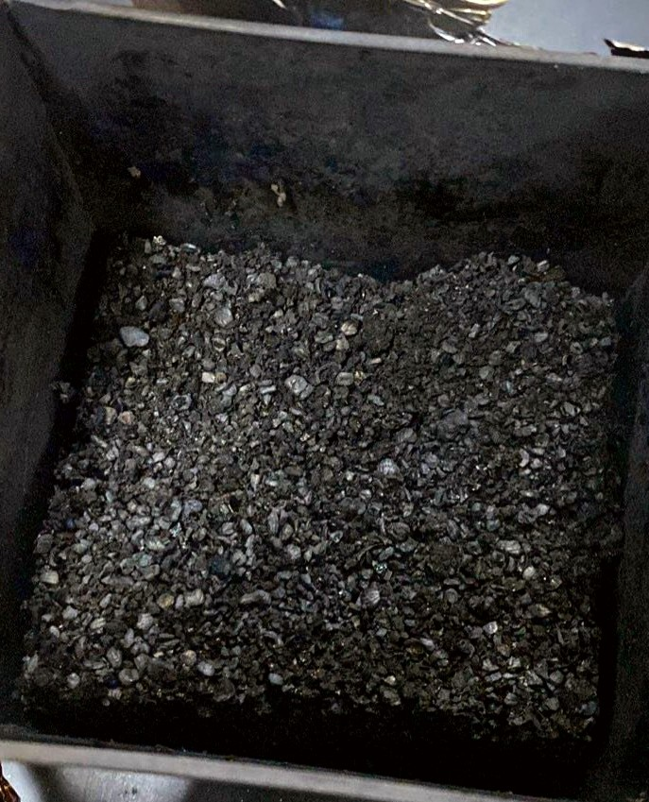

Methods
1Carbonization
Carbonization (pyrolysis) was performed by inserting a dried
weighed peat sample in a muffle furnace at 500C for 2 hrs.

Slide 10

Methods
2Cooling
After the completion of carbonization,
samples were cooled to room temperature inside a desiccator.

Slide 11
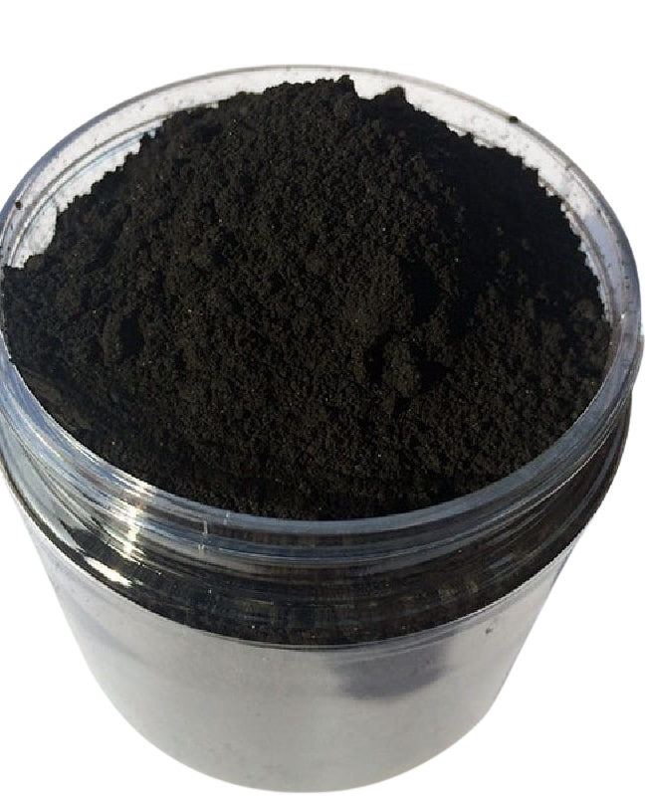
Methods
₃Milling
100 g of carbonized peat was
grounded manually using an Electrical Milling machine, to a fine powder

Slide 12
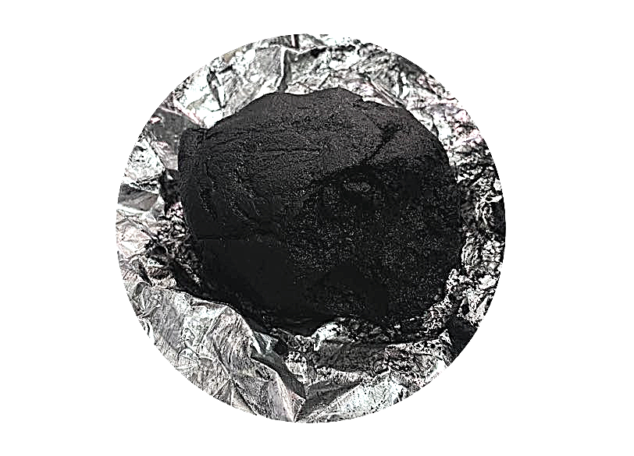
Methods
₄Mixing
mix the powder with 30
ml of water and different concentrations of starch (1%, 2%, and 5%)

Slide 13
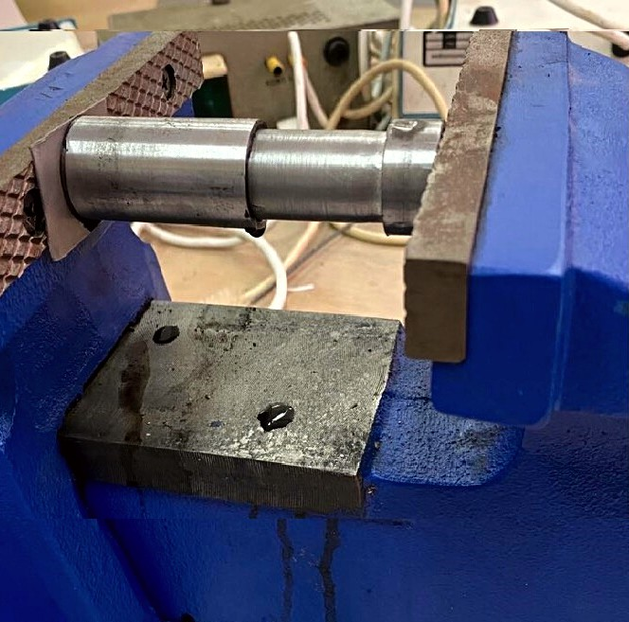
Methods
5Pressing
a mixture of charcoal powder with starch was compressed and extruded with molds of the same size and shape

Slide 14
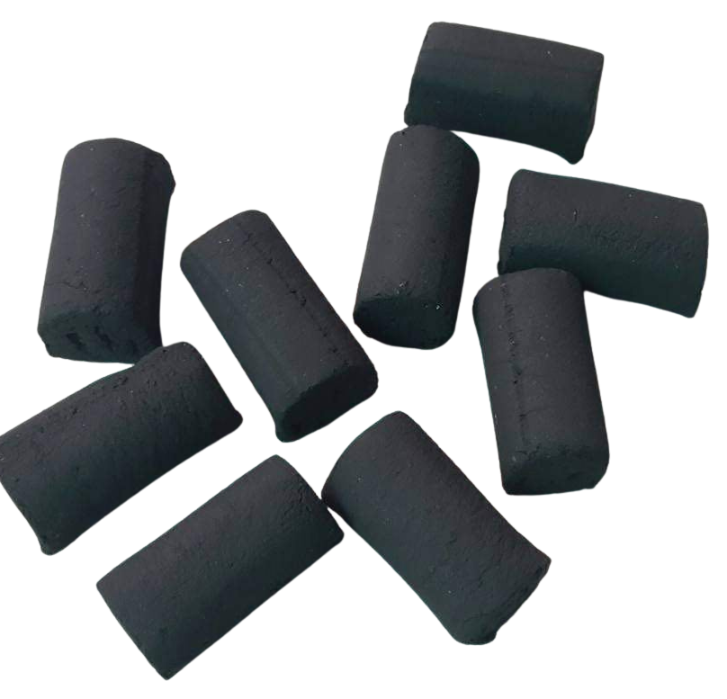
Methods
6drying
Charcoal briquettes produced were then dried in an oven at 50° C for 48hours

Slide 15
CALCULATIONS AND
RESULTS

Slide 16
Laboratory examinations
Moisture content
Volatile matter
Ash content
Fixed carbon
Heating Value

Slide 17
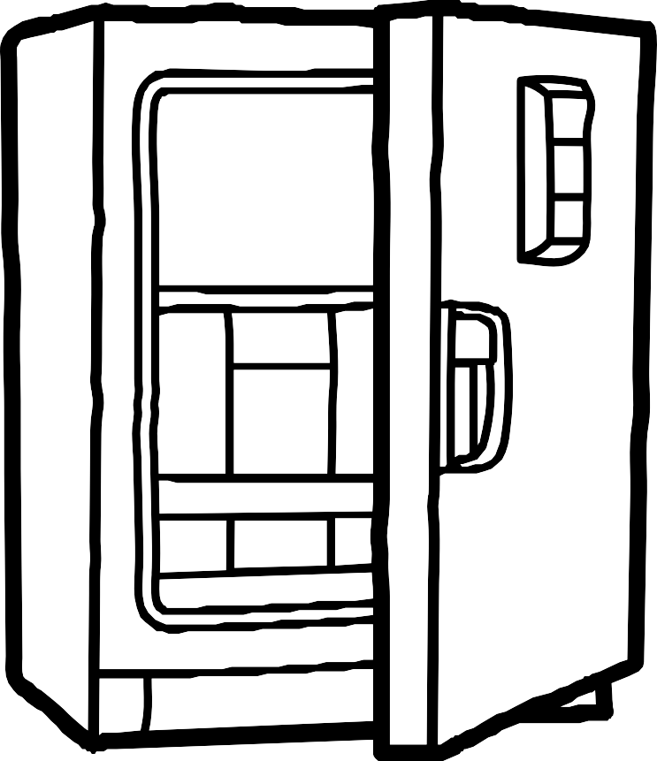


Moisture content
Laboratory examinations
1 g of sample 1 hour
(107) °C
Moistures=(Wt.of moisture)/(Wt.of coal) ×100 %

Slide 18



Volatile matter
Laboratory examinations
1 g of sample
7 minutes
(950) °C
Percentage of volatile matter =(Wt.of volatile matter)/(wt.of dry coal sample)×100%

Slide 19



Ash content
Laboratory examinations
1 g of sample
3 hours
(700–750) °C.
Percentage of ash=(Wt.of ash )/(wt.of coal sample)×100

Slide 20
Fixed carbon
Laboratory examinations
(% Moisture + % Ash + % Volatile matter)

Slide 21
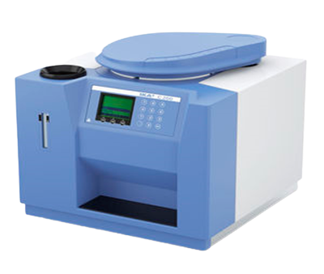
Heating Value
Laboratory examinations
0.5 g
Bomb Calorimeter
Calor Value =(( T2-T1) x W)/m

Slide 22
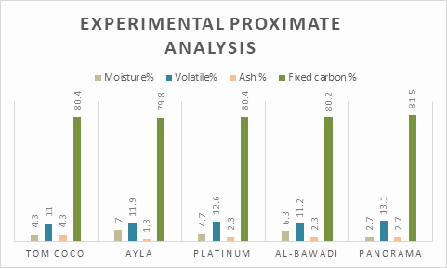
EXPERIMENTAL PROXIMATE ANALYSIS RESULTS OF COCONUT CHARCOAL.

Slide 23
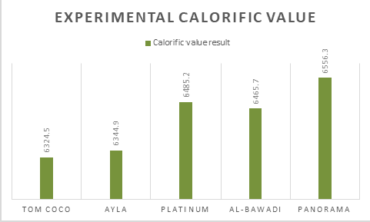
EXPERIMENTAL CALORIFIC VALUE RESULTS OF COCONUT CHARCOAL.

Slide 24
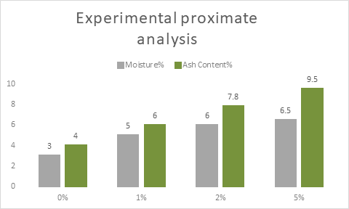
EXPERIMENTAL PROXIMATE ANALYSIS RESULTS OF PEAT CHARCOAL COMPARED WITH JAPAN, ENGLAND, USA, INDO. (SNI 1- 6235- 2000) STANDARDS

Slide 25
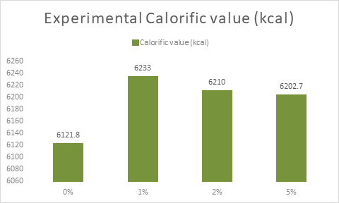
EXPERIMENTAL CALORIFIC VALUE RESULTS OF PEAT CHARCOAL COMPARED WITH JAPAN, ENGLAND, USA, INDO. (SNI 1-6235- 2000) STANDARDS

Slide 26
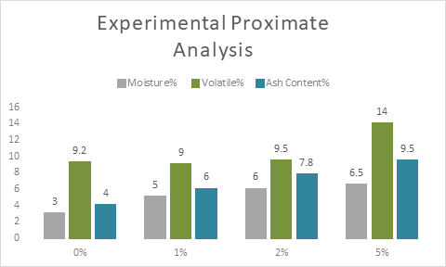
EXPERIMENTAL PROXIMATE ANALYSIS RESULTS OF PEAT CHARCOAL COMPARED WITH ENGLAN PHILIPPINES STANDARDS

Slide 27
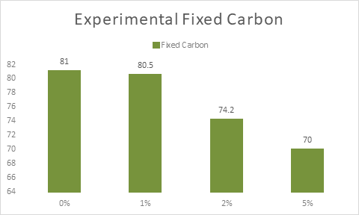
EXPERIMENTAL FIXED CARBON RESULTS OF PEAT CHARCOAL COMPARED WITH ENGLAND PHILIPPINES STANDARDS

Slide 28
FEASIBILITY STUDY
Analytical study
Financial study

Slide 29











Analytical study
very good
good
bad
1% of starch
2% of starch
5% of starch

Slide 30


Analytical study
The unique feature
Coconut charcoal
Peat charcoal

Slide 31

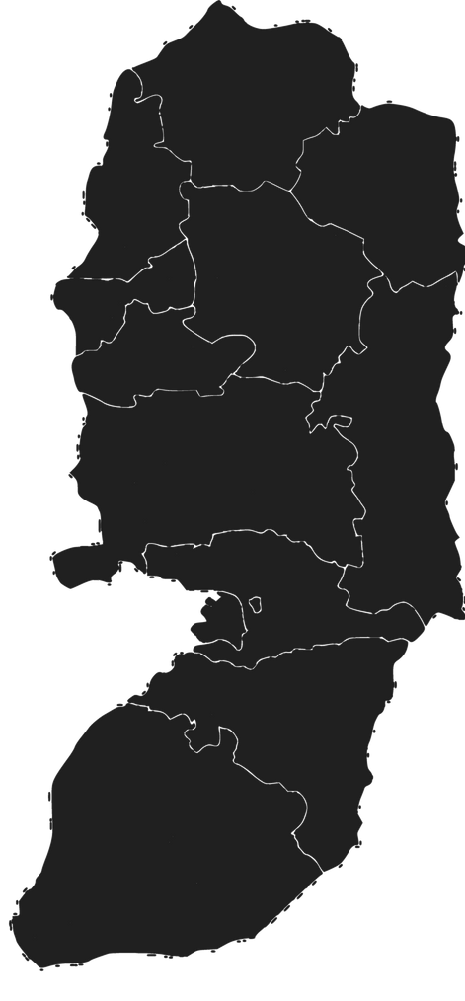
They use coconut charcoal
A QUESTIONNAIRE WAS CONDUCTED ON 100 PEOPLE FROM THE WEST BANK
95%
29%
They use platinum type
The amount consumed per week is 0.5 - 1 kilo
38%
They wanted to try olive dried charcoal
73%

Slide 32

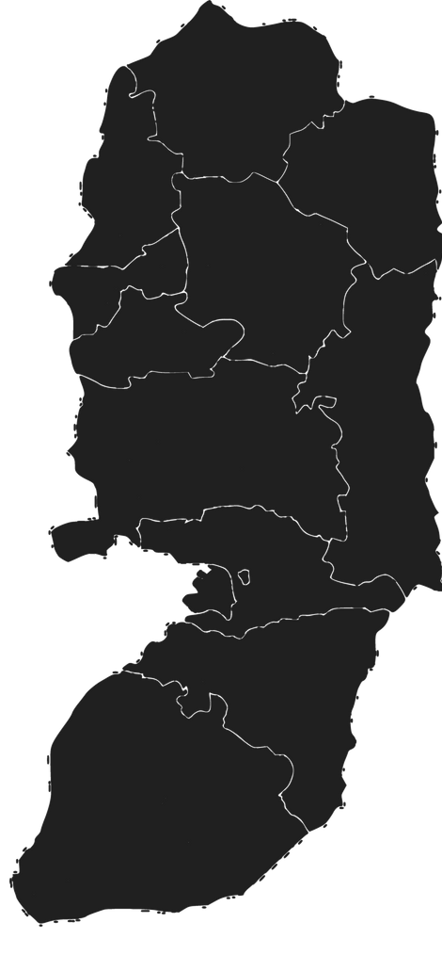
They will pay 7 shekels for half a kilo
A QUESTIONNAIRE WAS CONDUCTED ON 100 PEOPLE FROM THE WEST BANK
28%
Enabling local production is one of the most important reasons for buying this coal
45%
They don't know what peat is
29%
11

Slide 33

FEASIBILITY STUDY
Analytical study
Financial study

Slide 34

rate of hookah smoking
Good planning
Success factors
Quantities of olive peat
peat price

Slide 35






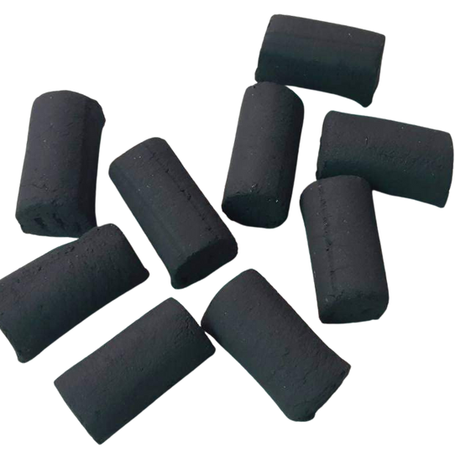


TARGET MARKET
COMPETITORS
Restaurants and cafes.
Wholesale and retail stores.
Foreign markets.
Coal importers
local coal manufacturers

Slide 36



CHARCOAL PROMOTION PROCESS
Creating brochures about the project.
Website
Advertisements
Marketing in retail stores

Slide 37
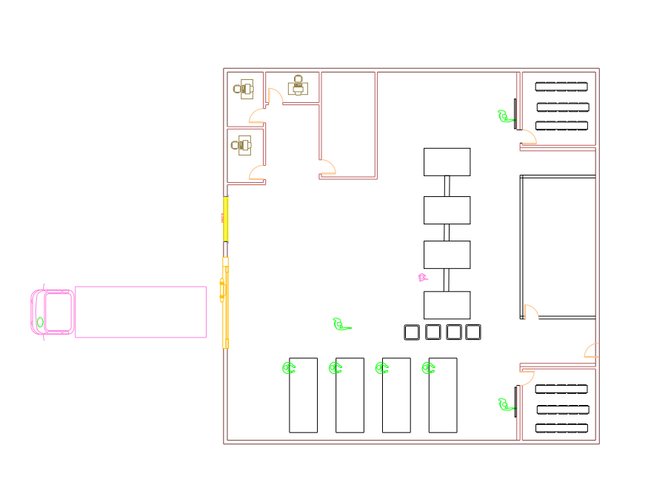
2D Factory design
Milling machine
oven 1
mixing machine
extruder
pressing machine
oven 2
packaging table

Slide 38
OUR INCOME STATISTIC
240 tons/year
$ 59,271
620,057 Units
$ 962,275
1 ton /day
800 kilo
0.5 kilograms
(1.28 $)
1 kilogram (2.57$)

Slide 39
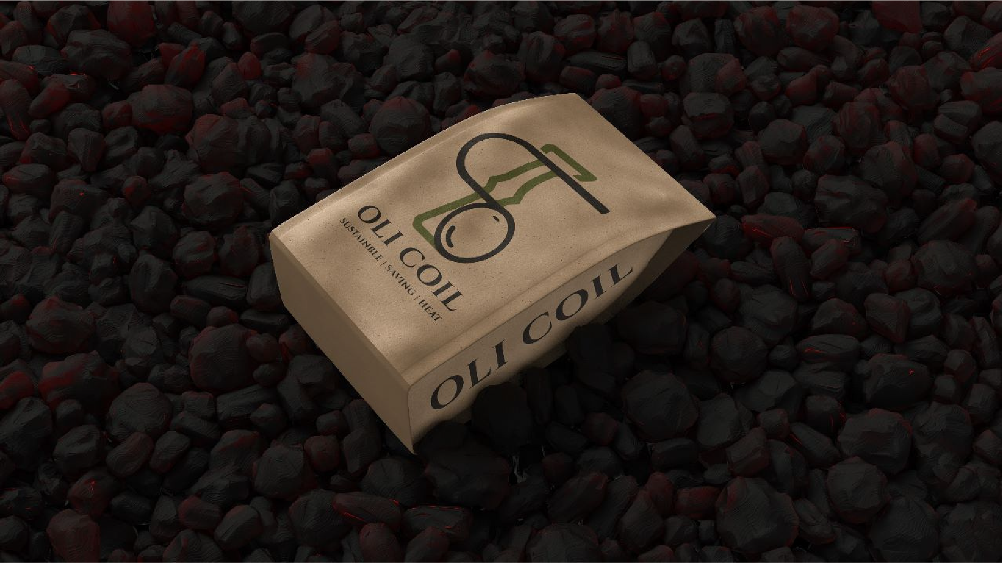
PACKAGING !
During the manufacture of this charcoal, no trees were cut down

Slide 40
THANK YOU

