Slide 1

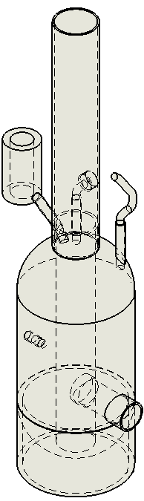
Steam Car Wash Machine
Supervisor:
Dr. Ramez Khaldi
Students:
Ahmad Taha
Bara’a Aghbar
Faris Eskander
Majdi Darwish

Slide 2
The acknowledgment
The project was not possible to complete without the continued support of a number of people. In the very beginning, we would like to thank our advisor Dr. Ramez Khaldi who at each and every step provided us with the proper guidance, advice, encouragement and taught us various important concepts. Then, we would also like to convey our sincere thanks to Dr. Mona Demaidi who contributed towards the accomplishment of our project work. Also, we can’t forget the help we got form Mr. Omar Toffaha, Dr. Ihab Surakje, and Mr. Ameed Amireh, Ms. Majd Shehadeh because without their efforts we wouldn’t be able to finish the project in its best way.

Slide 3
Table of contents
The problem.
Why important.
Through years.
Heat transfer.
What to do.
The designing process.
Some equations
Constraints.
Future work.

Slide 4
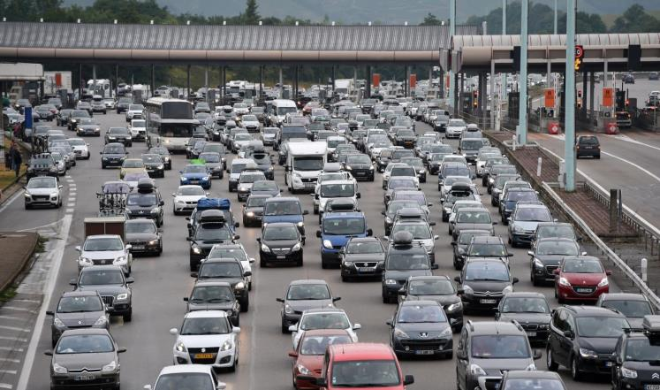
The problem

Slide 5

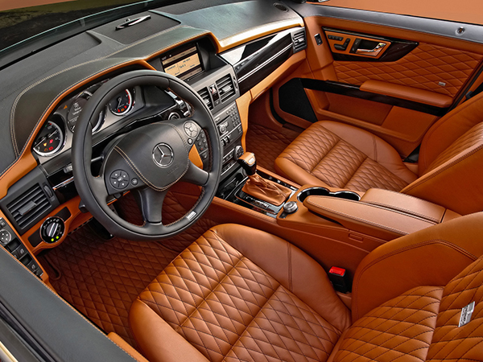
Why Important?

Slide 6


Why Important?

Slide 7

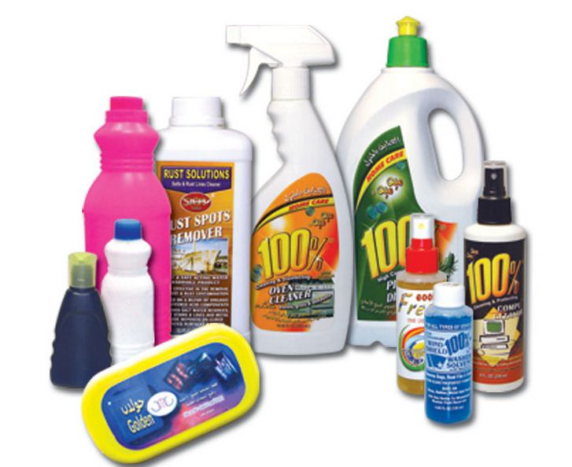
Why Important?

Slide 8

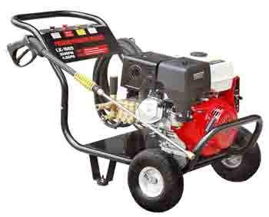
Through Years
Manual Method
Hydraulic Pump

Slide 9
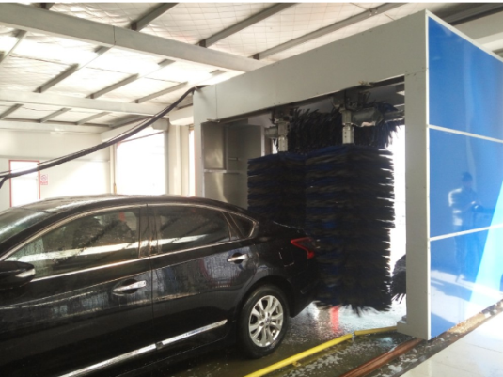
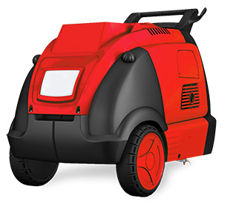
Through Years
Automatically Method
Steam Washing Machines

Slide 10
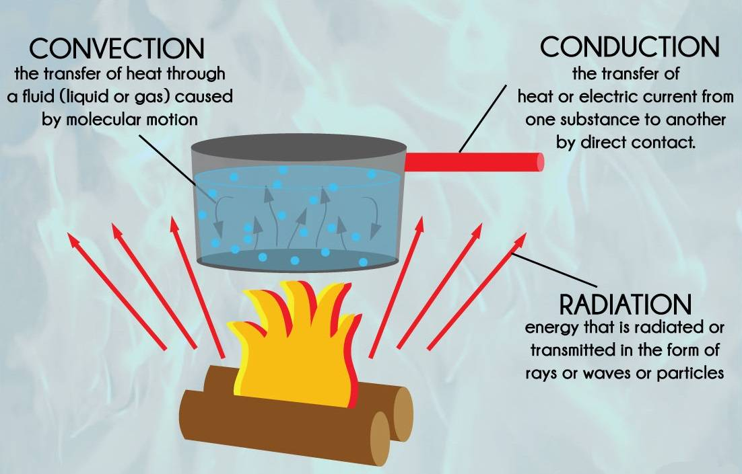
Heat Transfer

Slide 11
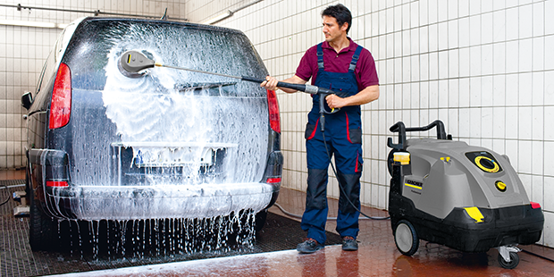
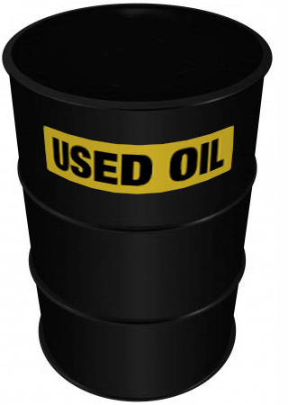
What to do?

Slide 12
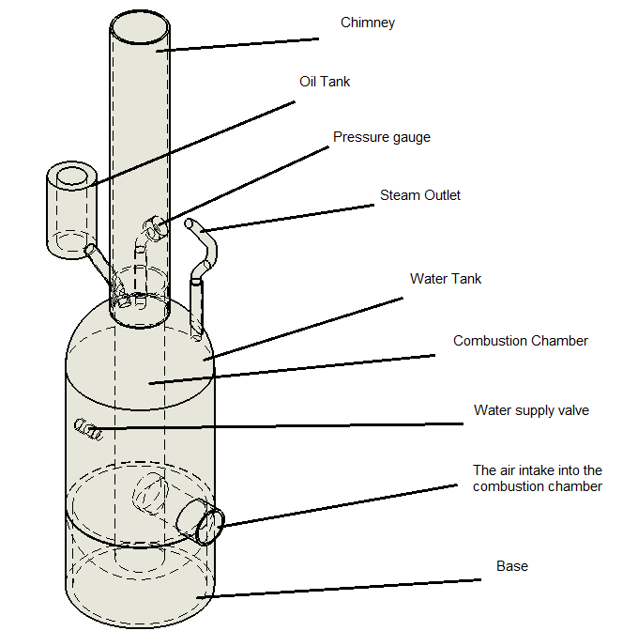
The Designing Process

Slide 13
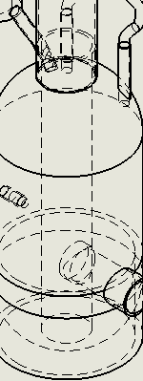
The Designing Process
The Combustion
Chamber

Slide 14
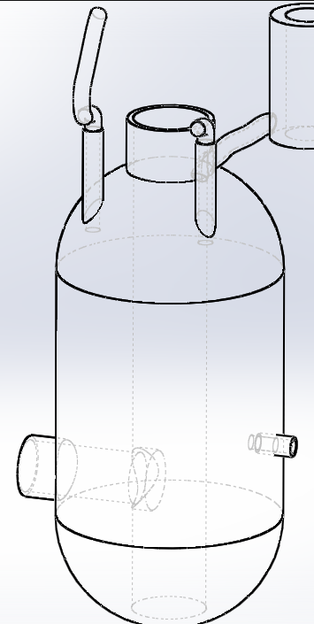
The Designing Process
The Water Tank

Slide 15
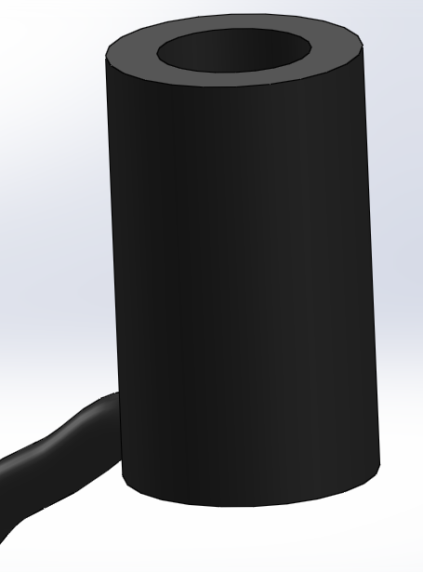
The Designing Process
The Oil Tank

Slide 16
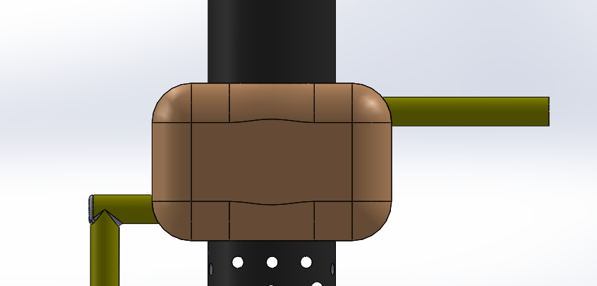
The Designing Process
The Heat Exchanger

Slide 17




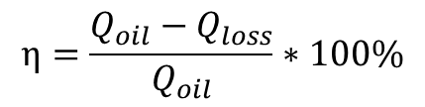
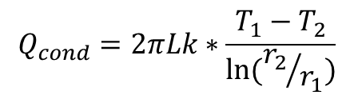
Some Equations
$$Q_{cond}=2πLk∗\frac{T_{1}−T_{2}}{\ln{({r_{2}}/{r_{1}})}}$$
$Q_{conv}=hA_{s}(T_{s}−T_{∞}$)
$Q_{rad}=Aεσ({T_{s}}^{4}−{T_{∞}}^{4}$)
$$Q_{sensible}=mC_{P}∆T$$
$$η=\frac{Q_{oil}−Q_{loss}}{Q_{oil}}∗100\%$$
$$Q_{latent}=mL$$

Slide 18
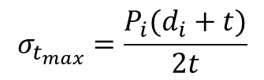
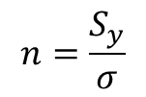
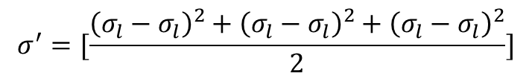
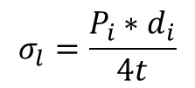
Some Equations
$$σ_{t_{max}}=\frac{P_{i}(d_{i}+t)}{2t}$$
$$σ_{l}=\frac{P_{i}∗d_{i}}{4t}$$
$$σ^{′}=[\frac{{\left(σ_{l}−σ_{l}\right)}^{2}+{\left(σ_{l}−σ_{l}\right)}^{2}+{\left(σ_{l}−σ_{l}\right)}^{2}}{2}]$$
$$n=\frac{S_{y}}{σ}$$

Slide 19



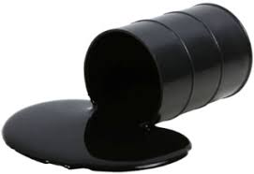
Constraints

Slide 20





Future Work

Slide 21
Thank You
Any Questions?

