Slide 1

Synthesis of Nitrogen-Doped Carbon Nanodots from Ethylene Amine
Graduation Project-1 (10626591)
Supervised by: Dr. Shadi Sawalha
Prepared by: Ansam Zedan
Anhar Azizeh

Slide 2
01
02
03
Problem statment
Scope of work
Carbon nanodots
TABLE OF CONTENTS
04
N-Doped
05
06
07
08
Methodology
Results and discussion
Conclosion
Prospective and Recommendations

Slide 3
Problem Statement
01

Slide 4
  Problem Statement
Different properties of CNDs are affected by the choice of precursor. Due to their differences, they can be used in a variety of applications, including biomedicine and advanced materials depending on the different properties that characterize each CND configuration depending on the source and its compatibility with the specific application.

Slide 5
Scope of work
02

Slide 6

Scope of work
To synthesize N-doped CNDs from Penta ethylene hexamine and triethylenetetramine by chemical oxidation method. Furthermore, To study the effect of the oxidizing agent (H₂O₂)on their properties.

Slide 7
Carbon nanodots
03
Synthesis, application, and property

Slide 8
02
Bottom-up
Synthesis and source
02
Bottom-up
01
Microwave pyrolysis
Hydrothermal
solvothermal treatment
Top-down
Microwave pyrolysis
Hydrothermal
solvothermal treatment
chemical oxidization
laser ablation
arc discharge

Slide 9
CNDs properties
Ease of functionalization
Good biocompatibility
01
02
03
04
05
Resistance to photobleaching
Low cost
Low cytotoxicity

Slide 10
04
N-Doped
Source and property

Slide 11
Element surface doping
Nitrogen
Phosphorus
sulfur
Good stability
Structure defects
Electrochemical activity
High conductivity
Specific surface area

Slide 12
Methodology
5
Materials and Synthesis of CNDs

Slide 13

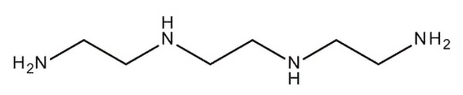
Chemical Materials
Penta ethylene hexamine (PEHA)
Triethylenetetramine (TETA)

Slide 14
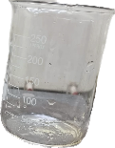
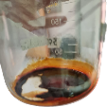
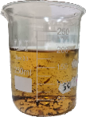

Synthesis of CNDs
0.5 ml PEHA with H₂O₂
(0-1.5 ml)
black Residue
CNDs
solution
cenrifuge and filter
heating at 220 C

Slide 15
6
Results
and Dissection

Slide 16
Synthesis mechanism

Slide 17
Compilation time
Catalyst Compilation time (min)
H₂O₂ PEHA TETA
0 25 10.5
0.25 22 9
0.5 22 8
1 16 7.5
1.5 11 7

Slide 18
product yield
catalyst product yield %
H₂O₂ TETA PEHA
0 3.5 14.8
0.25 4.7 23.7
0.5 5.2 40.6
1 5.6 46

Slide 19
Morphology and Surface functional group

Slide 20
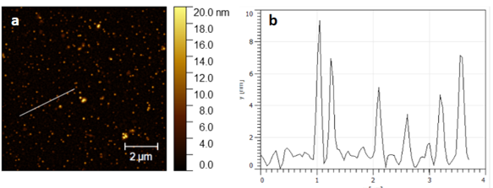
AFM for TETA
(a) AFM image of TETA. (b) height profile of TETA.

Slide 21
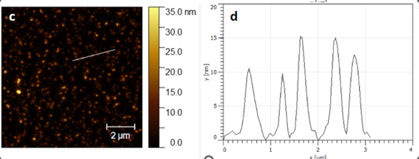
AFM for PEHA
((c) AFM image of PEHA. (d) height profile of PEHA.

Slide 22
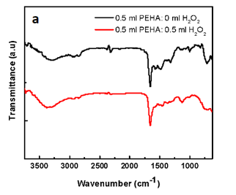
FTIR spectra of synthesized CNDs from PEHA
ζ-potential
10.83 to
0.59.

Slide 23
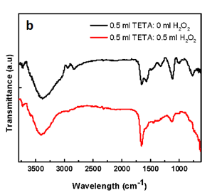
FTIR spectra of synthesized CNDs from TETA
ζ-potential
11
to
2.27

Slide 24
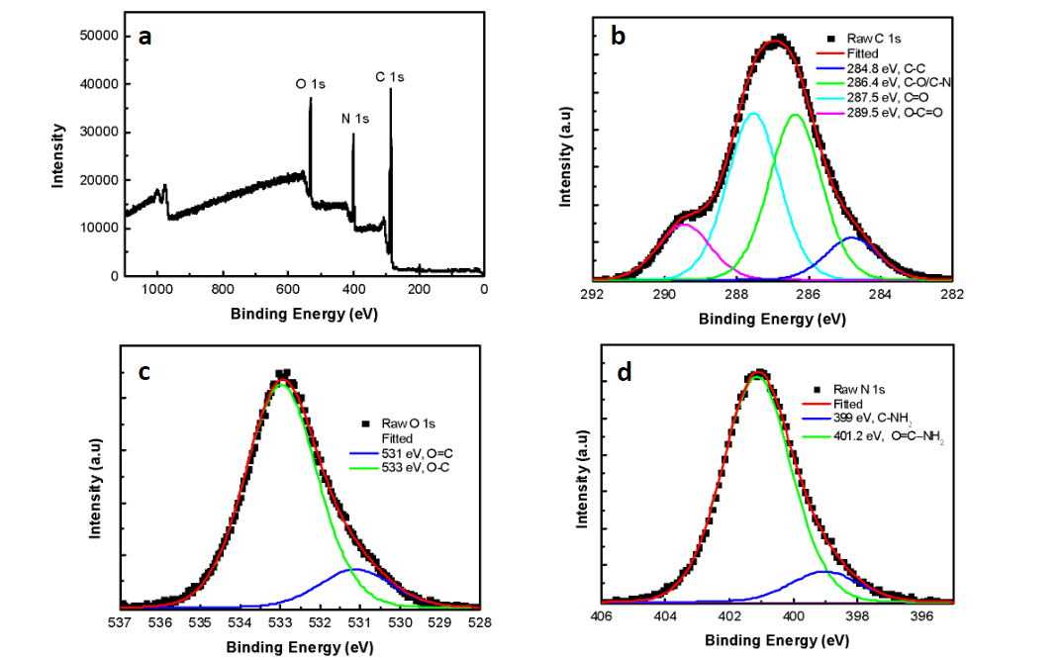
XPS for PEHA
(a) XPS survey of PEHA. (b) High resolution of C 1s core.
(c) High-resolution O 1s cores. (d) High-resolution N 1s cores.

Slide 25
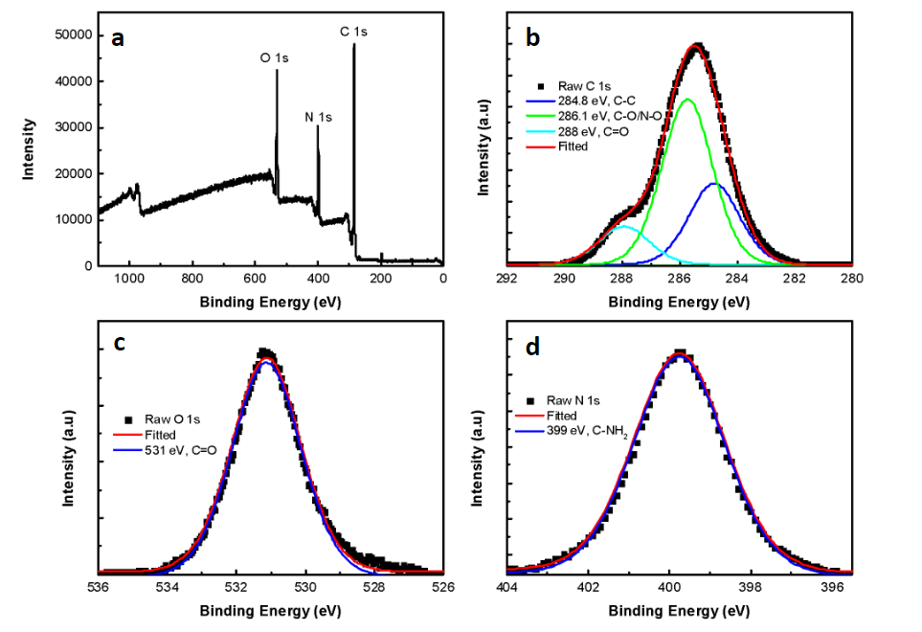
XPS for TETA
(a) XPS survey of TETA. (b) High resolution of C 1s core.
(c) High-resolution O 1s cores. (d) High-resolution N 1s cores.

Slide 26
Optical property

Slide 27
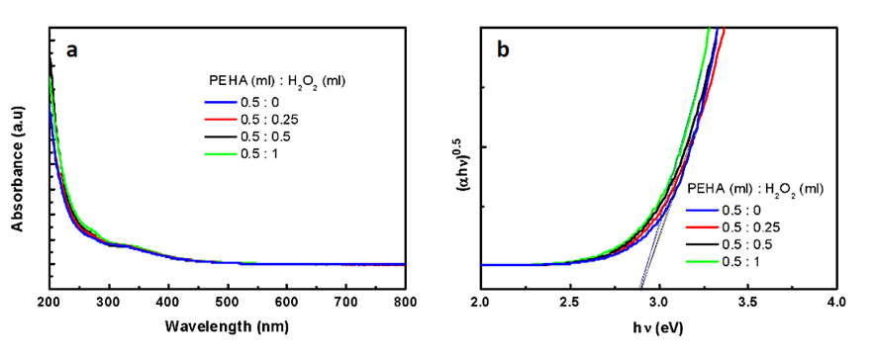
UV-Vis for PEHA
Bandgap
2.9 eV
(a)The absorption spectra of synthesized CNDs from PEHA
(b)Tauc plot of PEHA

Slide 28
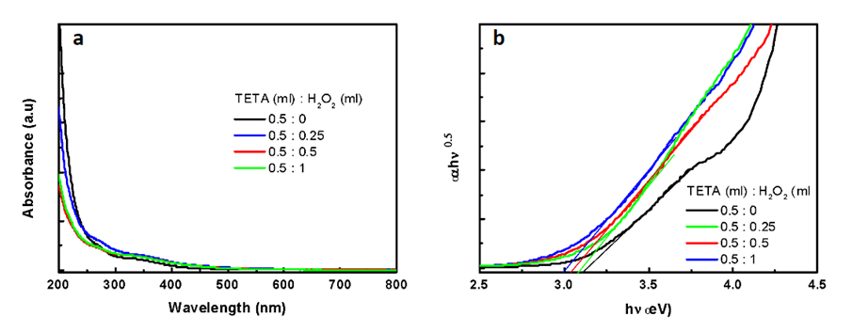
UV-Vis for TETA
3.12-3 eV
Bandgap
(a)The absorption spectra of synthesized CNDs from TETA
(b)Tauc plot of TETA

Slide 29
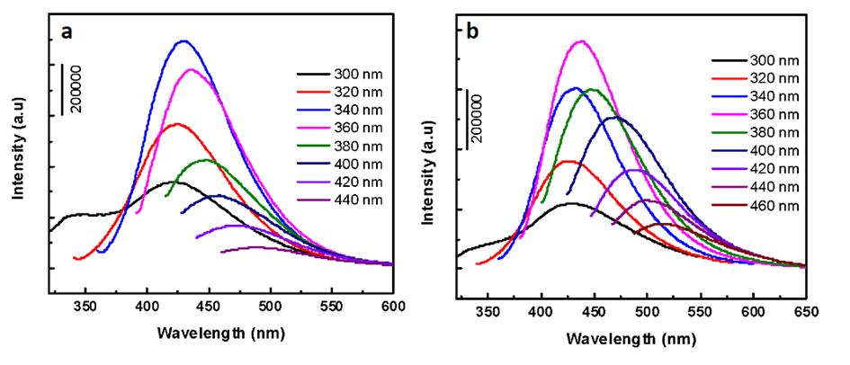
Fluorescence spectra
Maximum emission
436 nm
PEHA
Maximum emission
TETA
430 nm
(a) Fluorescence spectra at different excitation wavelengths for PEHA
(b) Fluorescence spectra at different excitation wavelengths for TETA

Slide 30
Quantum Yield
Catalyst | Quantum Yield
H₂O₂(ml) | PEHA(0.5ml) | TETA(0.5ml)
0 | 9.5 | 14.8
0.25 | 9.2 | 12.27
0.5 | 8.8 | 9.8
1 | 6.4 | 7.7

Slide 31
7
Prospective and Recommendations

Slide 32
Prospective and Recommendations
CNDs from N-doped CNDs can be used for several applications including LED for the reason CNDs that were produced from PEHA and TETA have a high fluorescence, especially for TETA so it’s suitable to produce LED from these CNDs. Furthermore, Other applications could be proposed as antibacterial, and anti-cancer and could be good candidates for bioimaging.

Slide 33
8
conclusion

Slide 34
conclusion
In this project, CNDs were synthesized from PEHA and TETA with the presence of various amounts of H₂O₂ from 0 to 1.5 by using the chemical oxidation method. The resulting high-efficiency N-doped CNDs gives a wide variety of different characteristics in particle size, but PEHA gave a larger size than TETA, and this in turn affects the band gap in the opposite way, as the band gap of TETA is relatively large compared to PEHA.
The N-doped CNDs possess distinct fluorescent properties that appeared when they were irradiated with a 360 nm UV lamp. In addition, they behave with excellent absorption in the UV region, and the tail extends into the visible region which is characteristic of most synthesized CNDs.
Moreover, a thorough analysis of the nitrogen, carbon, and oxygen contents in both materials revealed strikingly identical amounts. This consistency supports the claim that carbon nanodots with comparable compositions from TETA and PEHA sources were successfully synthesized by the synthesis technique.

Slide 35


Slide 36


Our team
Anhar Yousef Azizeh
Ansam Shdad Zedan

