Slide 1



CIRCUITAI: AN INTERACTIVE HARDWARE LEARNING PLATFORM
Ahmed Gharib
Maen Thaher
Supervised by
Eng. Haya Samana

Slide 2

TABLE OF CONTENTS
System Requirements & Design Goals
Methodology
Introduction
Results & Discussion
Strengths & Limitations
Conclusion &
Recommendations

Slide 3

INTRODUCTION
THE CORE
PROBLEM
1
context switching between many Platform
2
Ai Generate hallucinated answer
3
simulator license

Slide 4

INTRODUCTION
PROBLEM - FRAGMENTED LEARNING WORKFLOW
CURRENT REALITY
CONSEQUENCE
  Learning management systems deliver content and assessments.
  Specialized desktop simulators perform circuit analysis.
  Informal online platforms provide explanations and debugging support.
  Complex installation and licensing requirements.
  Lack of integration between educational, simulation, and support systems.
  Constant tool switching and broken learning continuity.

Slide 5

INTRODUCTION
PROBLEM - LIMITATIONS OF CURRENT AI SUPPORT
  LLMs generate plausible but sometimes incorrect circuit reasoning.
  Debugging suggestions lack formal validation.
  Responses are not aligned with course-specific conventions or material.
AI operates on global possibly inaccurate knowledge, not curriculum-grounded context.

Slide 6
INTRODUCTION
WHY INTEGRATION MATTERS
The Shift in Hardware Education
1. Learning is becoming digital and hybrid.
2. Practical training must scale beyond physical labs.
3. AI is increasingly used, but rarely integrated properly into learning workflows.
What This Project Enables
1. A single workflow linking theory, simulation, and assessment.
2. Support practical learning beyond physical lab settings
3. Curriculum-grounded AI embedded in the academic processes.

Slide 7
Objectives
INTRODUCTION
AIM AND OBJECTIVES
1
Integrate LMS, simulators, and AI into one system
Aim
Build a unified platform that connects learning, simulation, and AI support for hardware education.
2
Provide real-time circuit simulation and validation
3
Deliver curriculum-grounded AI tutoring and automation

Slide 8
SYSTEM REQUIREMENTS & DESIGN GOALS
SYSTEM CONTEXT
Hardware learning involves theory, simulation, and academic evaluation as interconnected processes.
At An-Najah University, these processes are distributed across disconnected tools and workflows.
The system is designed to restructure this fragmented context into a unified learning environment.

Slide 9
Inclusion Scope
Exclusion Scope
  Course workflows: modules, assignments, quizzes, and grading logic.
  Browser-based circuit design, simulation, and visualization features.
  AI pipelines: content retrieval, tutoring, quiz generation, and grading assistance.
  External curricula beyond An-Najah University.
  Advanced circuit domains (RF, power, etc.).
  Physical hardware and embedded execution.
  Commercial-scale deployment and guarantees.

Slide 10




STAKEHOLDERS
Students
Instructors
Administrators
Institution
Primary users who design circuits, run simulations, complete assessments, and use AI support.
Academic leaders who design courses, evaluate student work, and oversee AI-assisted processes.
System managers responsible for users, courses, and platform governance.
Defines curriculum constraints, evaluation standards, and system boundaries.

Slide 11
FUNCTIONAL REQUIREMENTS
1
2
Course & Content Management
User Roles and Workflows
Create, organize, and deliver courses, modules, slides, labs, assignments, and quizzes.
Support students, instructors, and administrators with role-specific permissions and actions.
3
4
Circuit Design and Simulation
Assessment and Grading Workflows
Enable digital and electrical circuit creation, execution, and visualization of simulation results.
Handle assignment submission, quiz execution, grading, feedback, and progress tracking.
5
6
AI-assisted Learning Workflows
System Integration and Persistence
Provide curriculum-grounded tutoring, quiz generation, and grading assistance using RAG-based AI.
Store user data, circuits, submissions, and AI knowledge across databases and services.

Slide 12
NON-FUNCTIONAL REQUIREMENTS
1
2
Correctness and Reliability
Security and Access Control
Ensure accurate simulation behavior and consistent system outputs in educational scenarios.
Protect user data through authentication, authorization, and secure data handling mechanisms.
3
4
Maintainability and Modularity
Cross-platform Compatibility
Enable digital and electrical circuit creation, execution, and visualization of simulation results.
Handle assignment submission, quiz execution, grading, feedback, and progress tracking.

Slide 13
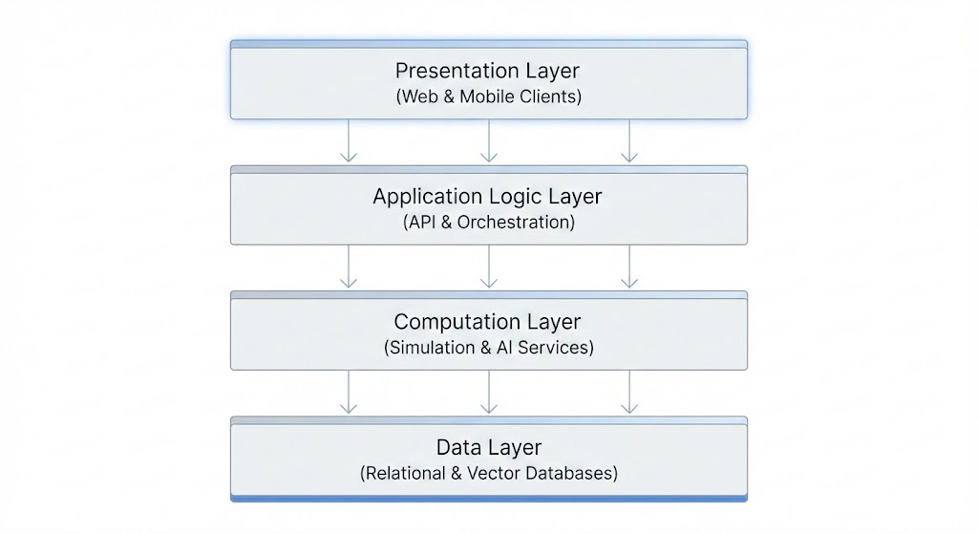
METHODOLOGY
SYSTEM ARCHITECTURE

Slide 14
METHODOLOGY
DESIGN PRINCIPLES
  Separation of Concerns: Each layer has a single, well-defined responsibility to reduce complexity and coupling.
  Modular Design: Simulation, AI assistance, learning management, and file handling are implemented as independent modules.
  Reusability: Shared components and services are reused across multiple features and user roles.
  Clear API Boundaries: Communication between layers occurs exclusively through documented REST interfaces.
  Incremental Development and Testing: Features were developed and validated independently to reduce integration risk.

Slide 15






METHODOLOGY
TECHNOLOGY STACK — FRONT-END
NextJS
React & React Native
CSS Modules
Fabric.js
EXPO
Typescript

Slide 16


METHODOLOGY
TECHNOLOGY STACK — BACK-END & SIMULATION
NextJS API Routes
Python Flask
PySpice

Slide 17






METHODOLOGY
AI & DATABASE SERVICES
PostgreSQL
Supabase Bucket
ChromaDB
GROQ API
Hugging Face
(Sentence Transformers)
PyMuPDF (PDF
Processing)

Slide 18
RESULTS
&
DISCUSSION

Slide 19
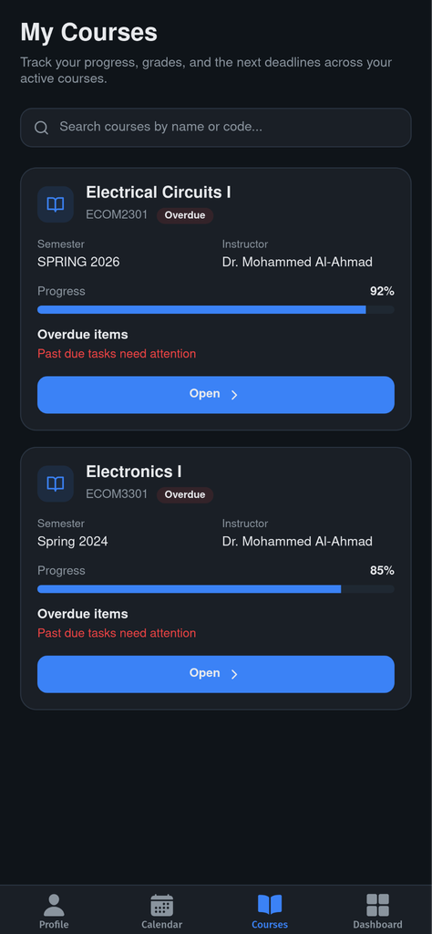
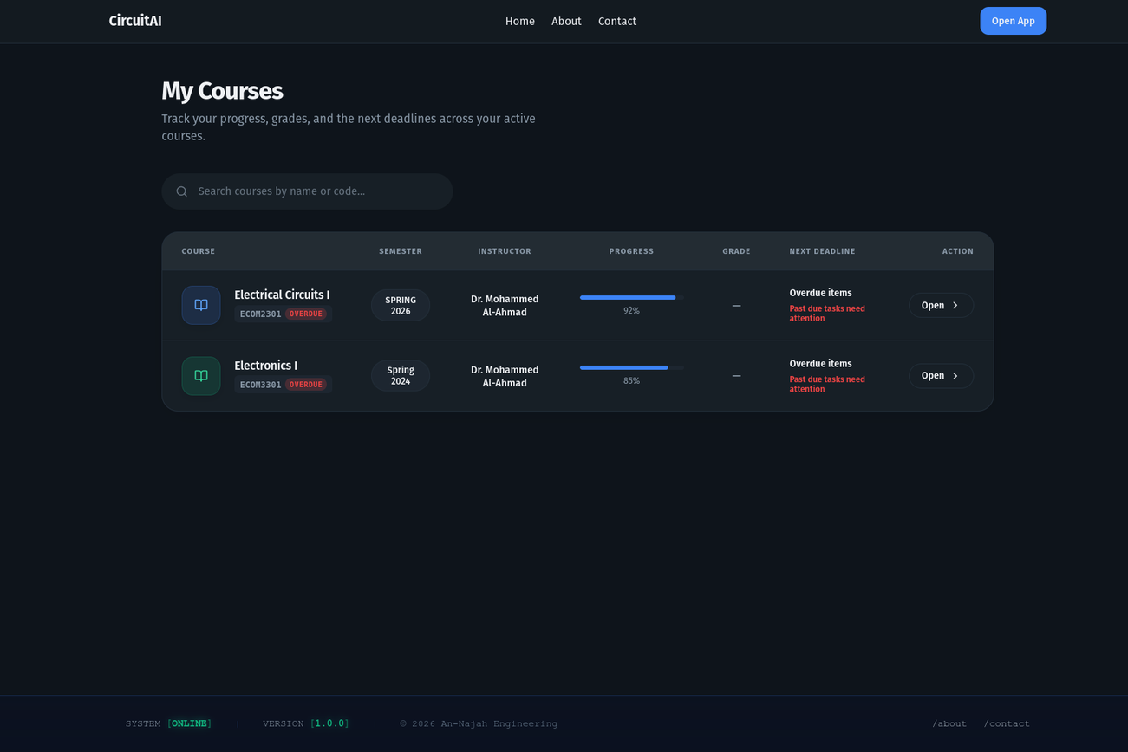
RESULTS & DISCUSSION
FEATURE 1: COURSE MANAGEMENT SYSTEM
→ Student Course List & Discovery

Slide 20
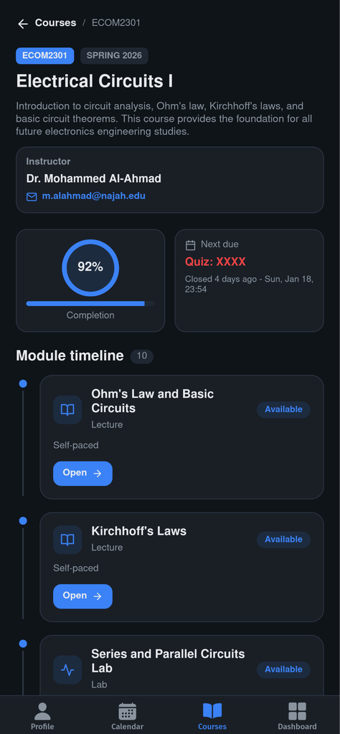
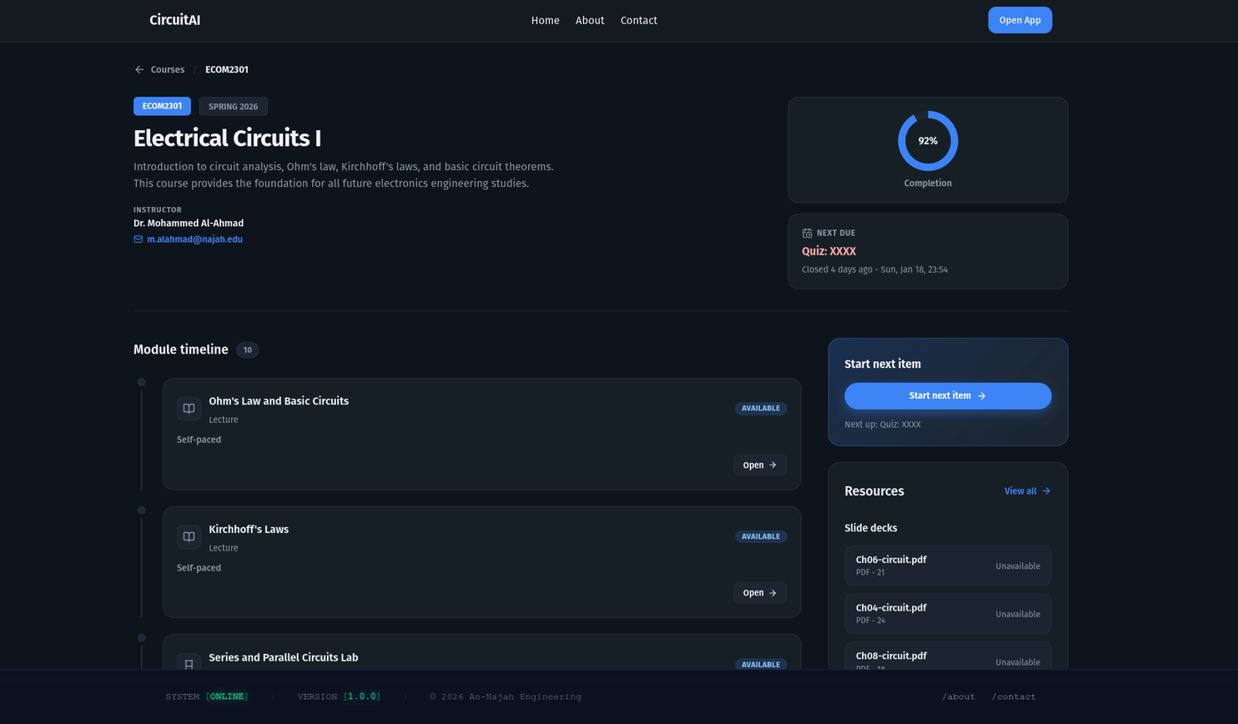
RESULTS & DISCUSSION
FEATURE 1: COURSE MANAGEMENT SYSTEM
→ Student Course Detail & Content Access

Slide 21
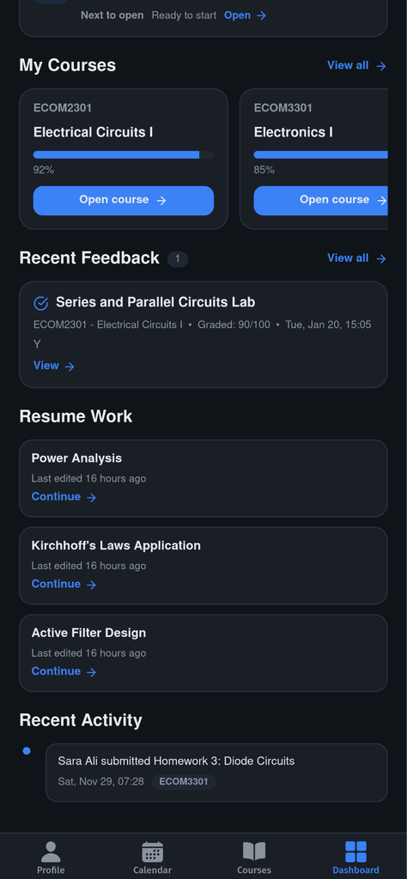
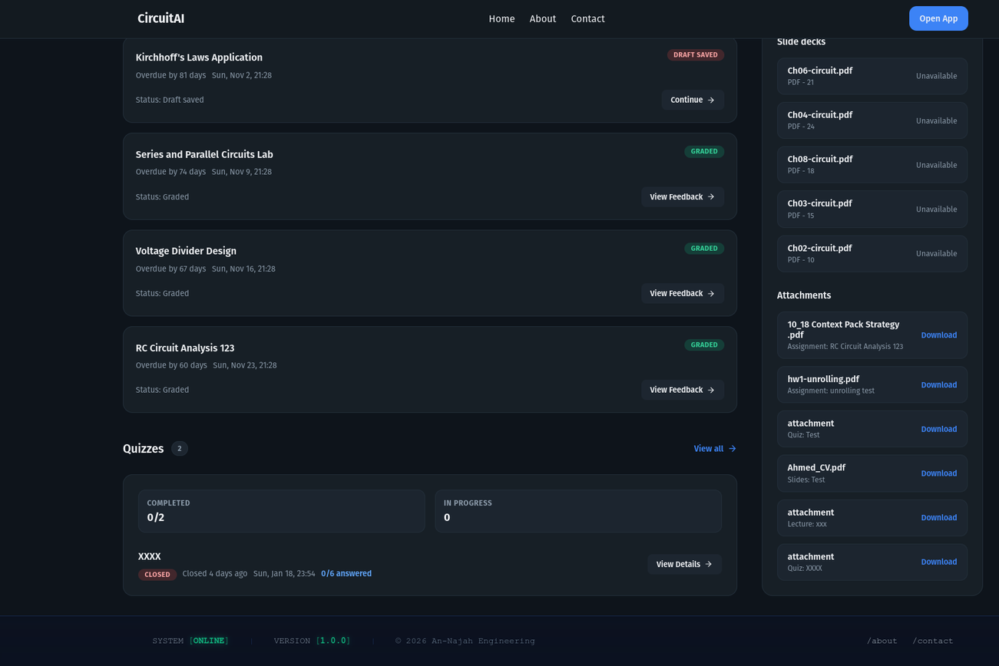
RESULTS & DISCUSSION
FEATURE 1: COURSE MANAGEMENT SYSTEM
→ Student Course Detail & Content Access - Cont.

Slide 22
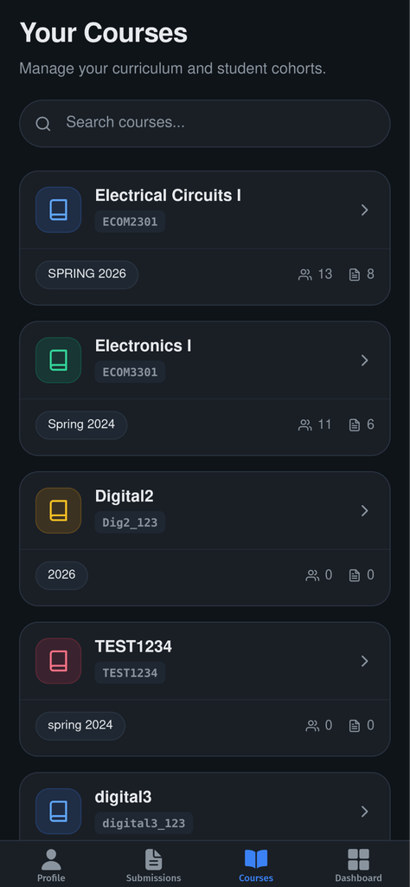
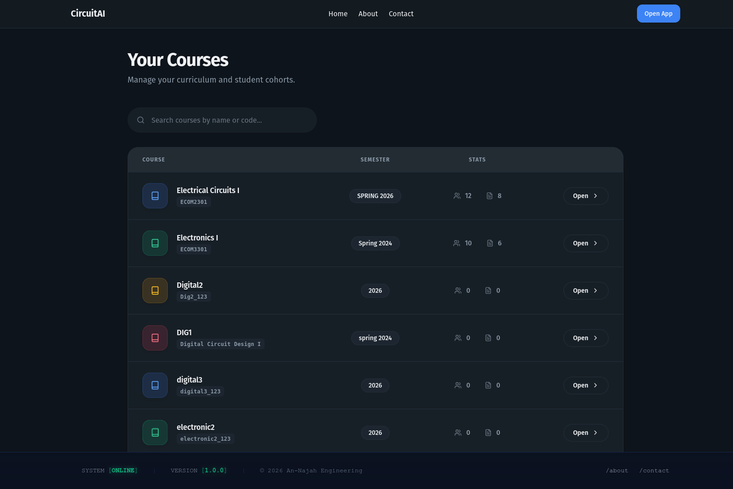
RESULTS & DISCUSSION
FEATURE 1: COURSE MANAGEMENT SYSTEM
→ Instructor Course List & Discovery

Slide 23
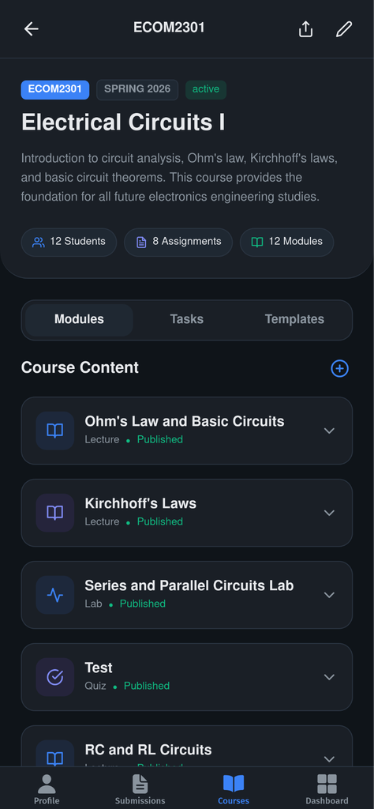
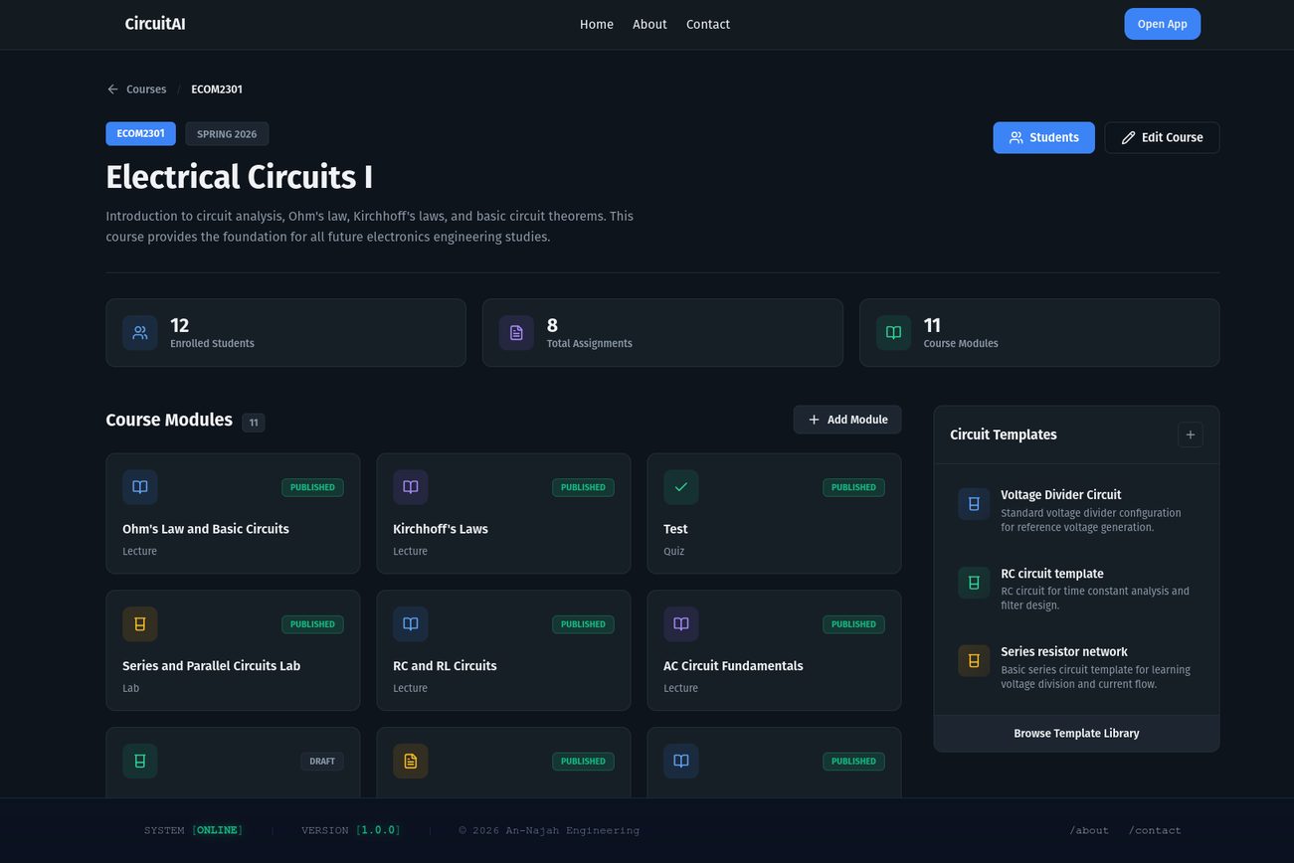
RESULTS & DISCUSSION
FEATURE 1: COURSE MANAGEMENT SYSTEM
→ Instructor Course Detail & Management

Slide 24
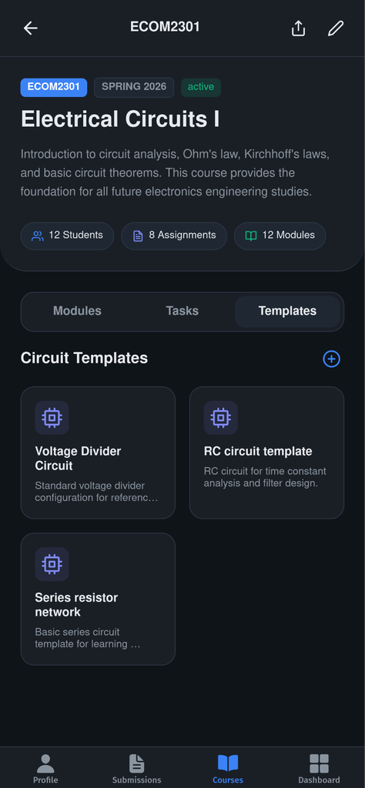
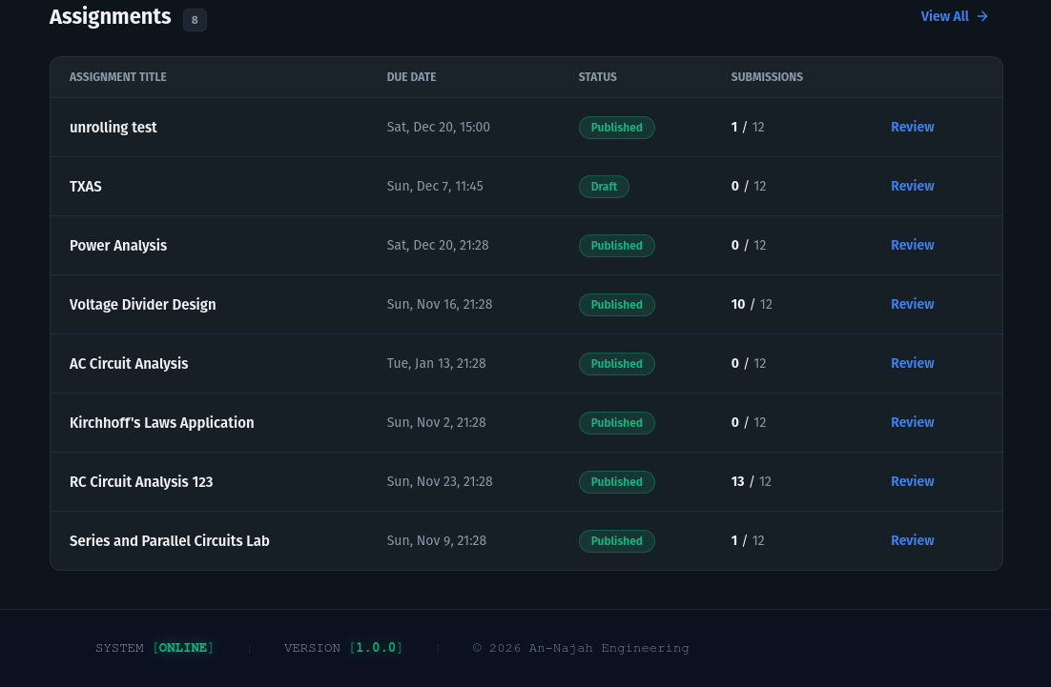
RESULTS & DISCUSSION
FEATURE 1: COURSE MANAGEMENT SYSTEM
→ Instructor Course Detail & Management - Cont.

Slide 25
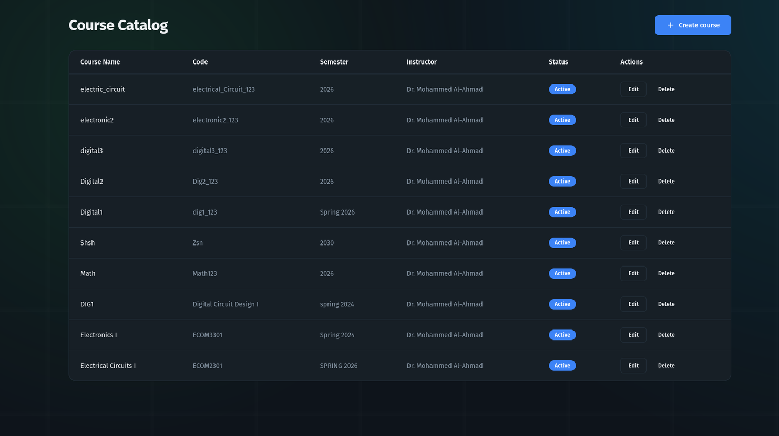
RESULTS & DISCUSSION
FEATURE 1: COURSE MANAGEMENT SYSTEM
→ Admin Course Oversight

Slide 26
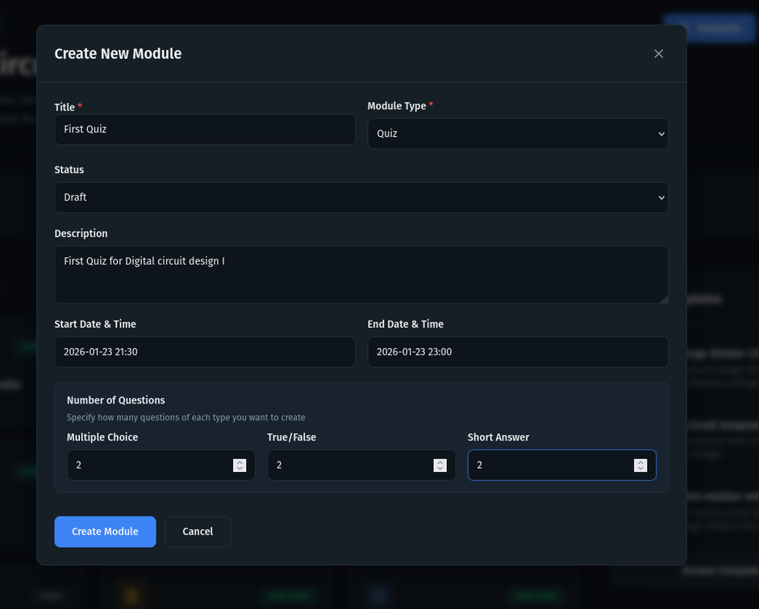
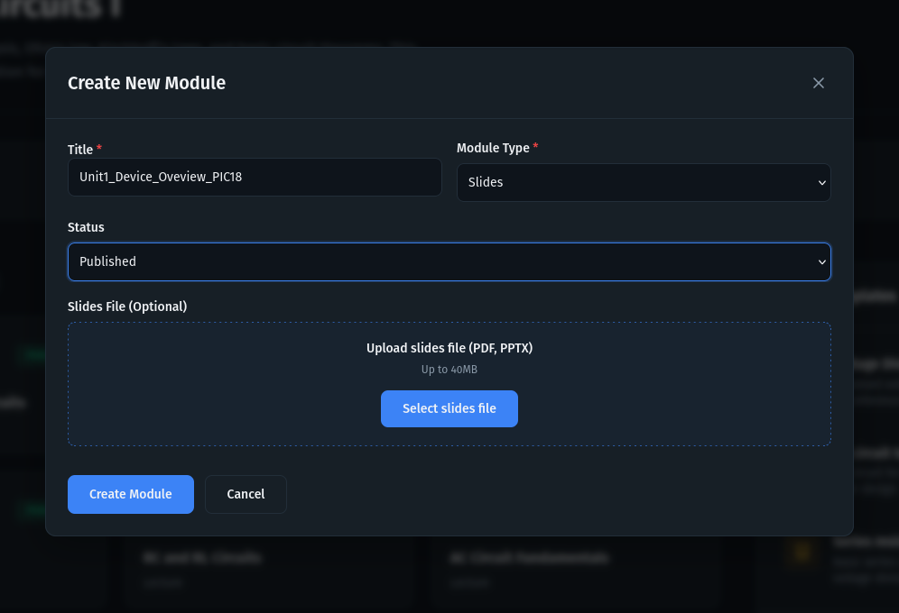
RESULTS & DISCUSSION
SUB-FEATURE: MODULES & MODALS
→ Module Types & Creation Modal

Slide 27
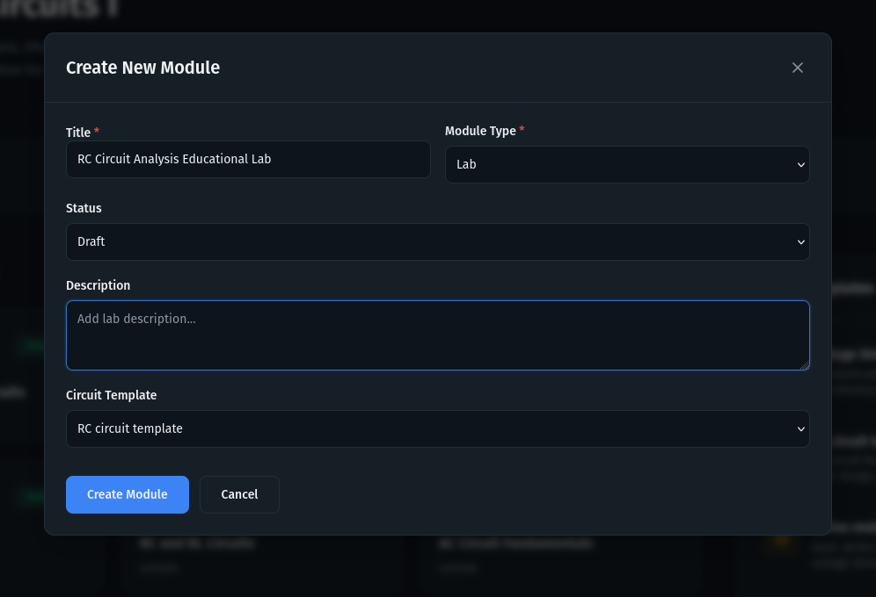
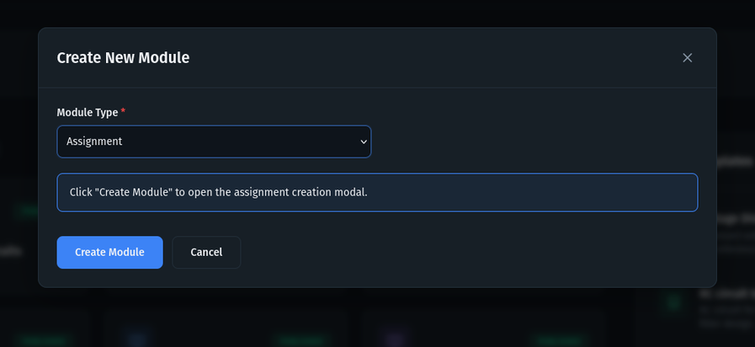
RESULTS & DISCUSSION
SUB-FEATURE: MODULES & MODALS
→ Module Types & Creation Modal

Slide 28
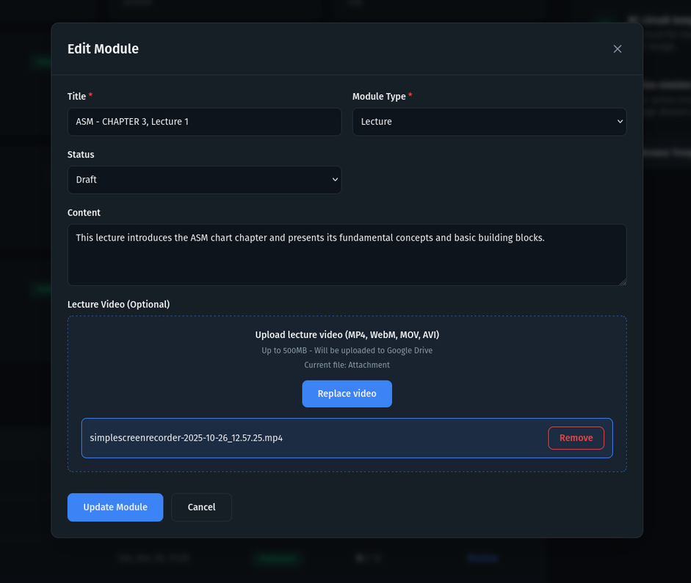
RESULTS & DISCUSSION
SUB-FEATURE: MODULES & MODALS
→ Modal Types

Slide 29
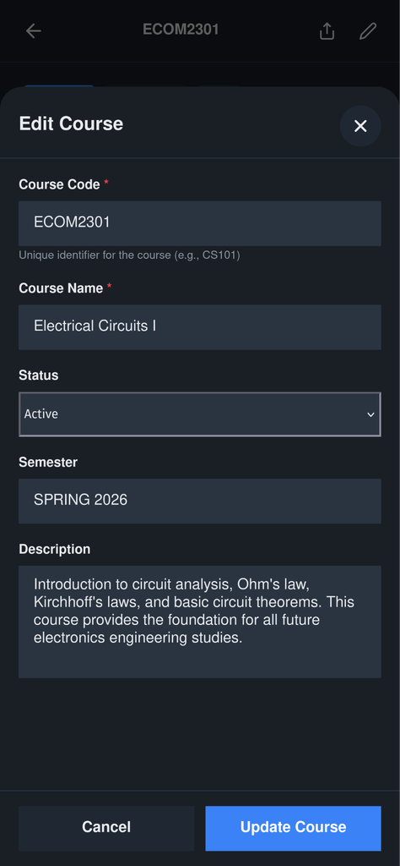
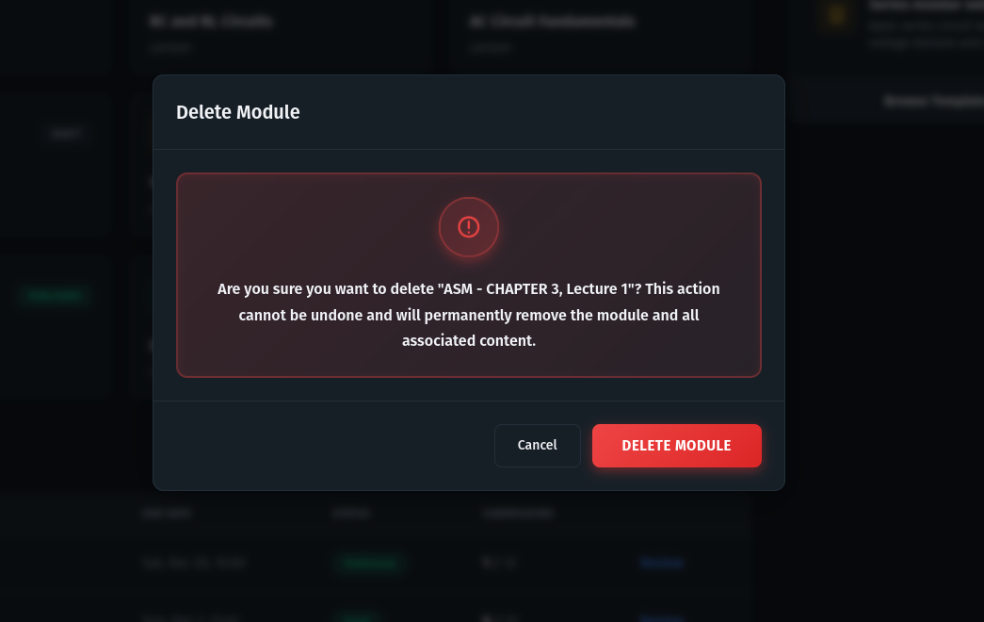
RESULTS & DISCUSSION
SUB-FEATURE: MODULES & MODALS
→ Modal Types

Slide 30
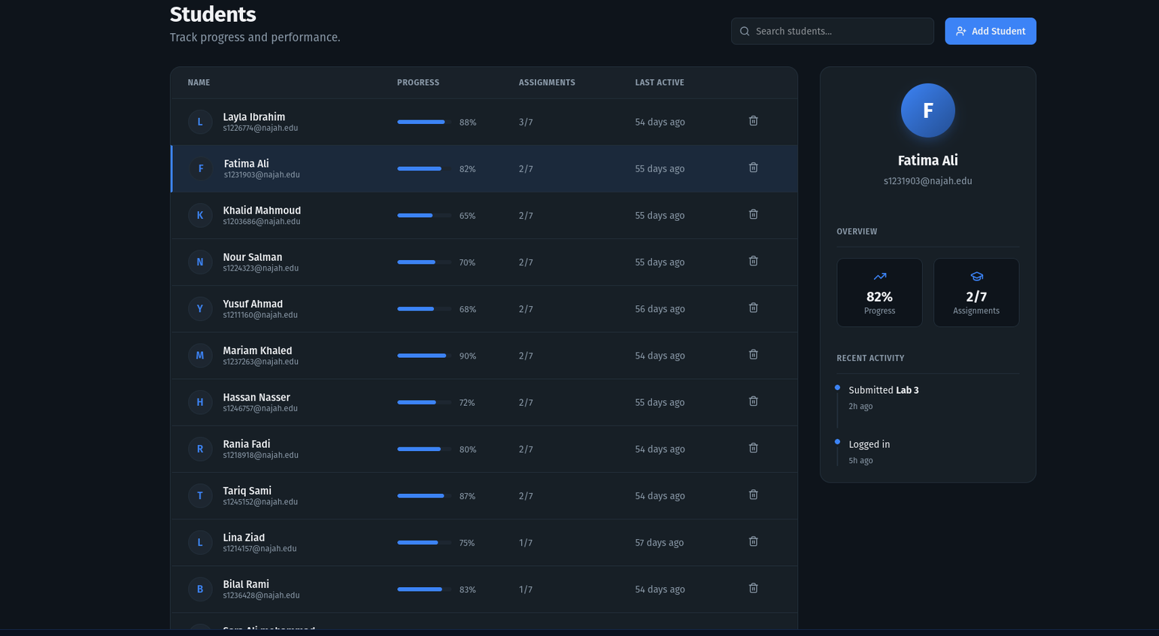
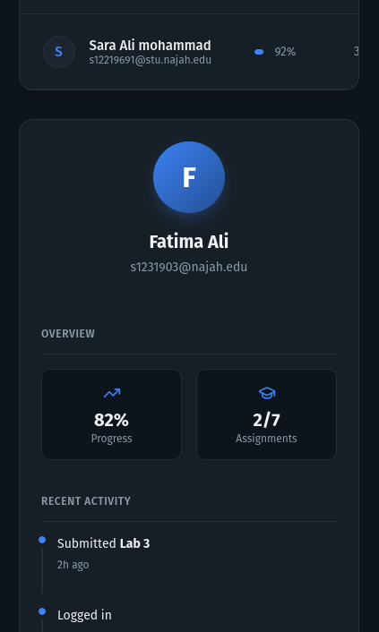
RESULTS & DISCUSSION
SUB-FEATURE: INSTRUCTOR STUDENT MANAGEMENT
→ Student Enrollment Management

Slide 31
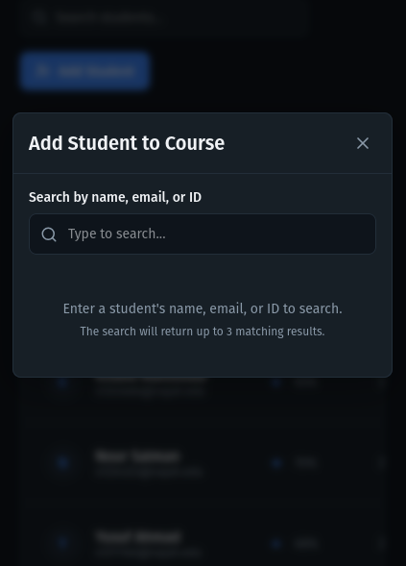
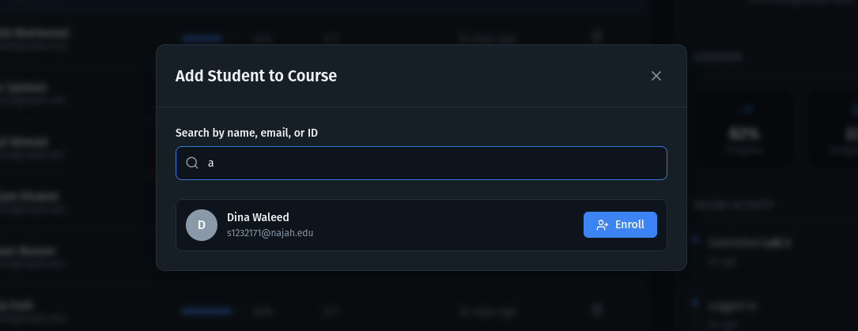
RESULTS & DISCUSSION
SUB-FEATURE: INSTRUCTOR STUDENT MANAGEMENT
→ Student Enrollment Management - Cont.

Slide 32
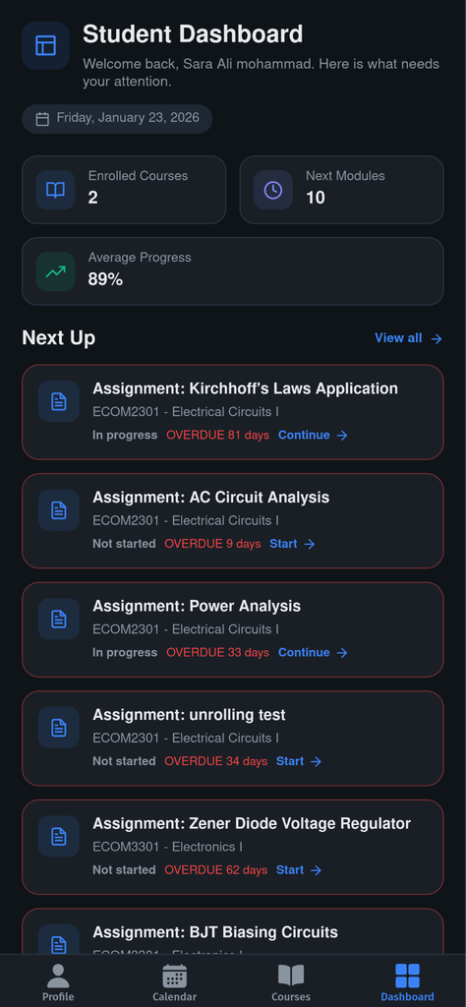
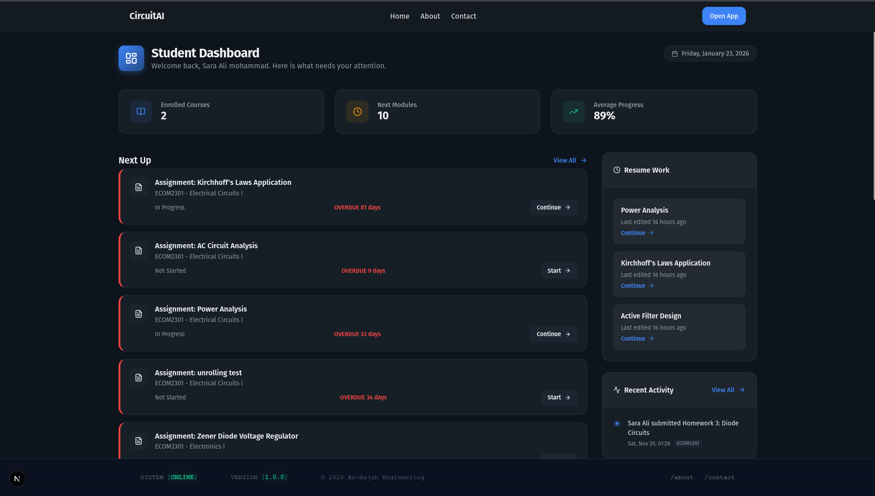
RESULTS & DISCUSSION
FEATURE 2: DASHBOARD & PROGRESS TRACKING
→ Student Dashboard

Slide 33
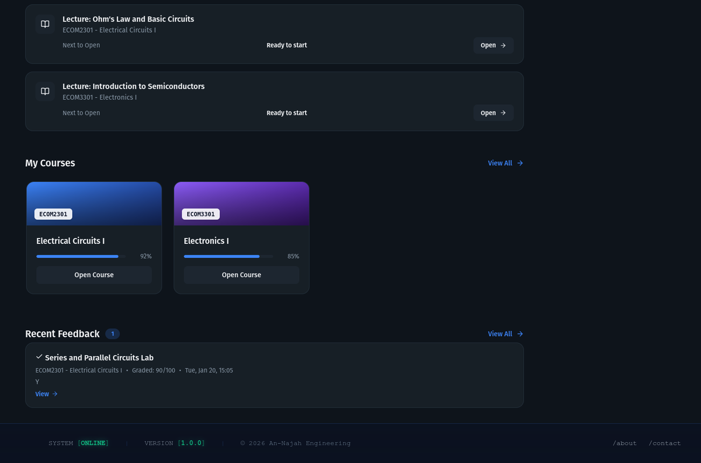
RESULTS & DISCUSSION
FEATURE 2: DASHBOARD & PROGRESS TRACKING
→ Student Dashboard - Cont.

Slide 34
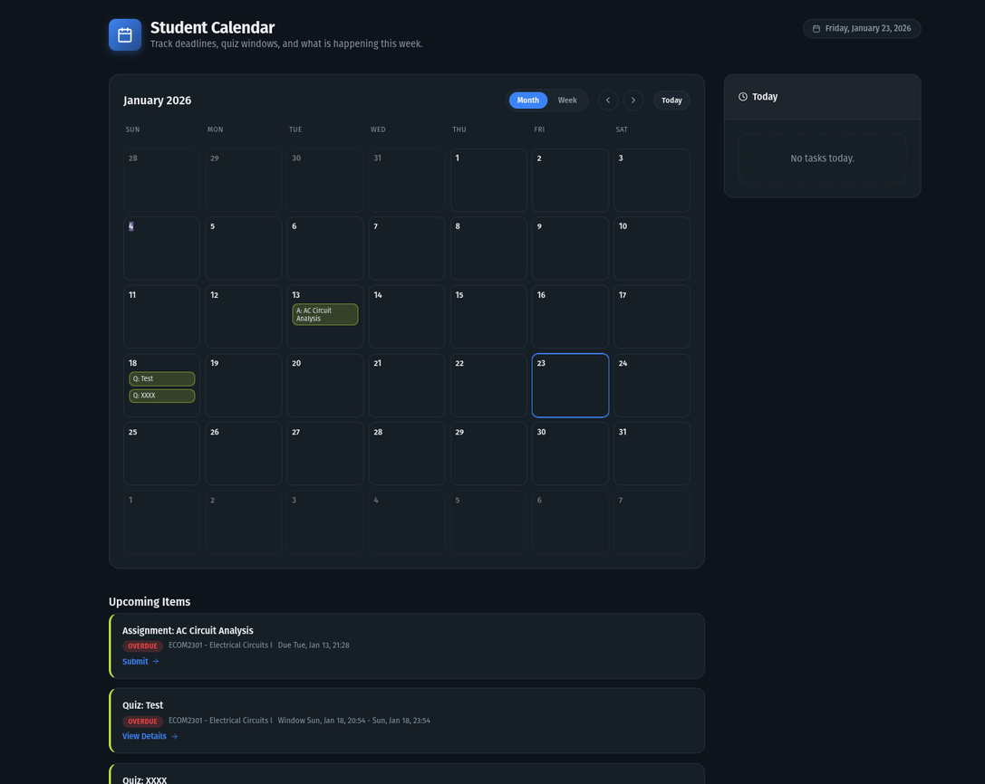
RESULTS & DISCUSSION
FEATURE 2: DASHBOARD & PROGRESS TRACKING
→ Student Calander.

Slide 35
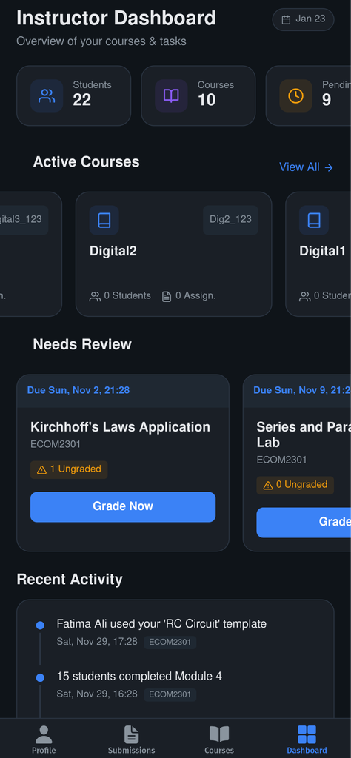
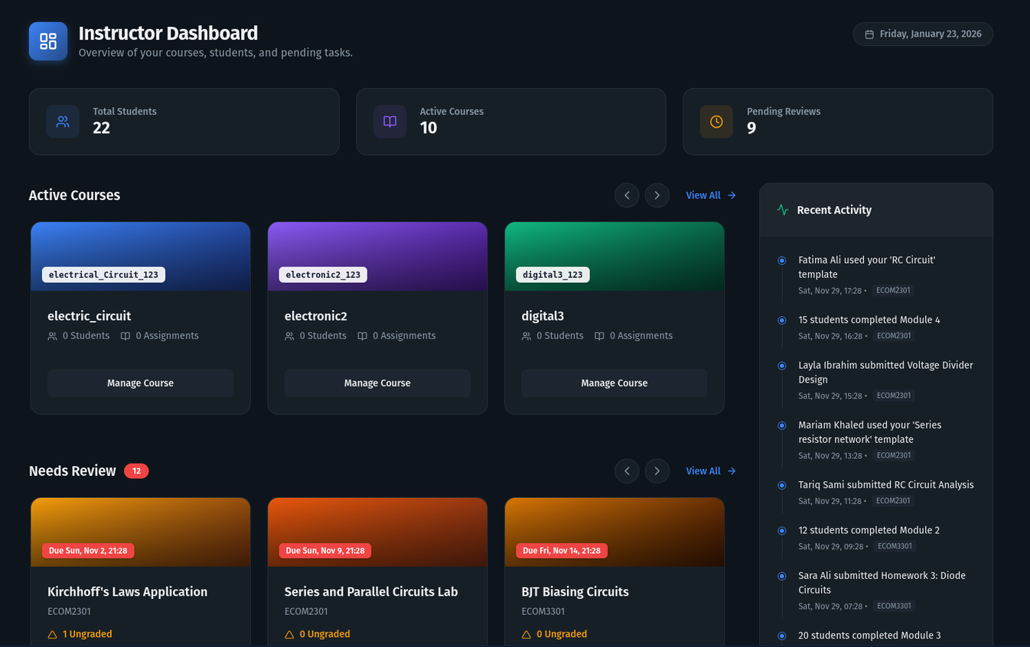
RESULTS & DISCUSSION
FEATURE 2: DASHBOARD & PROGRESS TRACKING
→ Instructor Dashboard

Slide 36
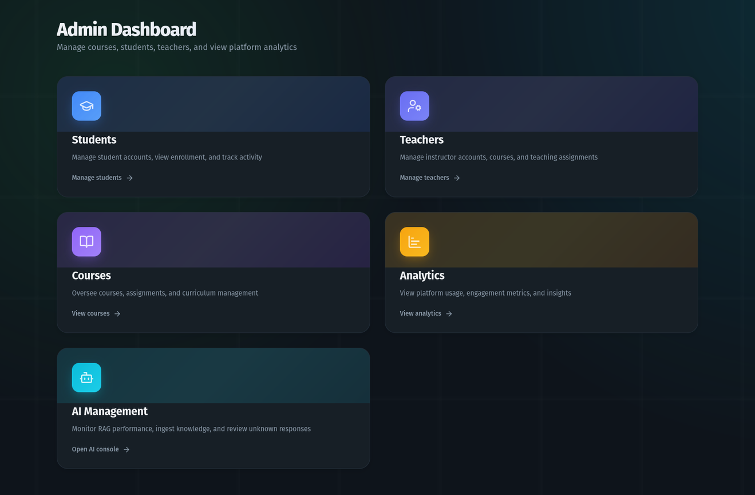
RESULTS & DISCUSSION
FEATURE 2: DASHBOARD & PROGRESS TRACKING
→ Admin Dashboard

Slide 37
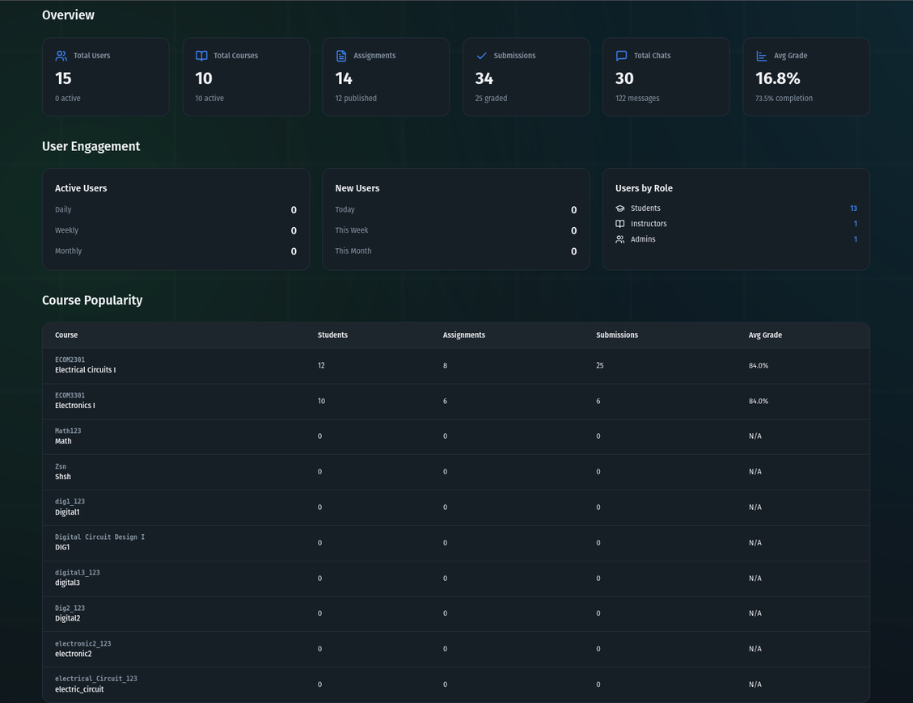
RESULTS & DISCUSSION
FEATURE 2: DASHBOARD & PROGRESS TRACKING
→ Admin Analytics

Slide 38
RESULTS & DISCUSSION
FEATURE 2: DASHBOARD & PROGRESS TRACKING
→ Admin Analytics

Slide 39
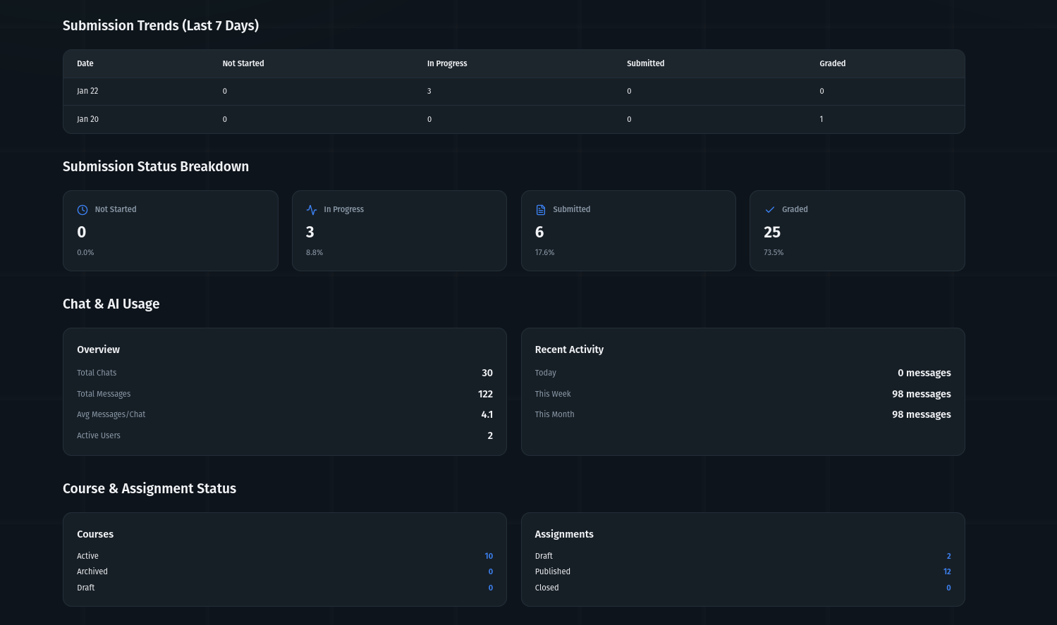
RESULTS & DISCUSSION
FEATURE 2: DASHBOARD & PROGRESS TRACKING
→ Admin Analytics - Cont.

Slide 40
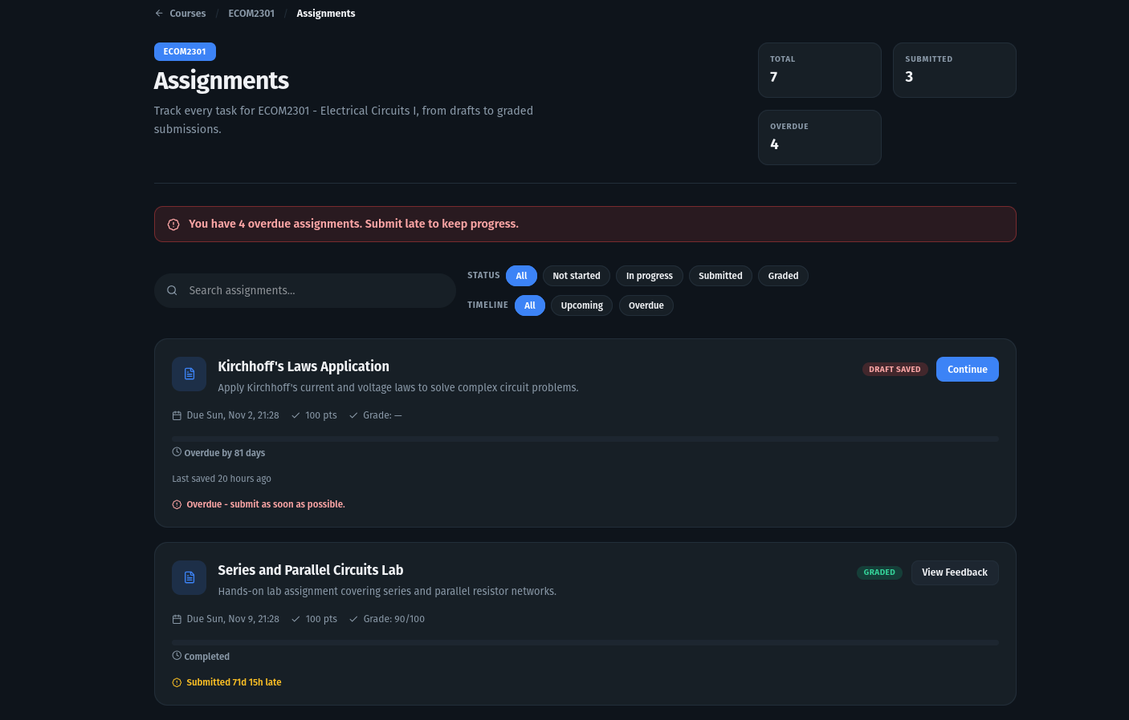
RESULTS & DISCUSSION
FEATURE 3: ASSIGNMENT SYSTEM
→ Student Assignment List

Slide 41
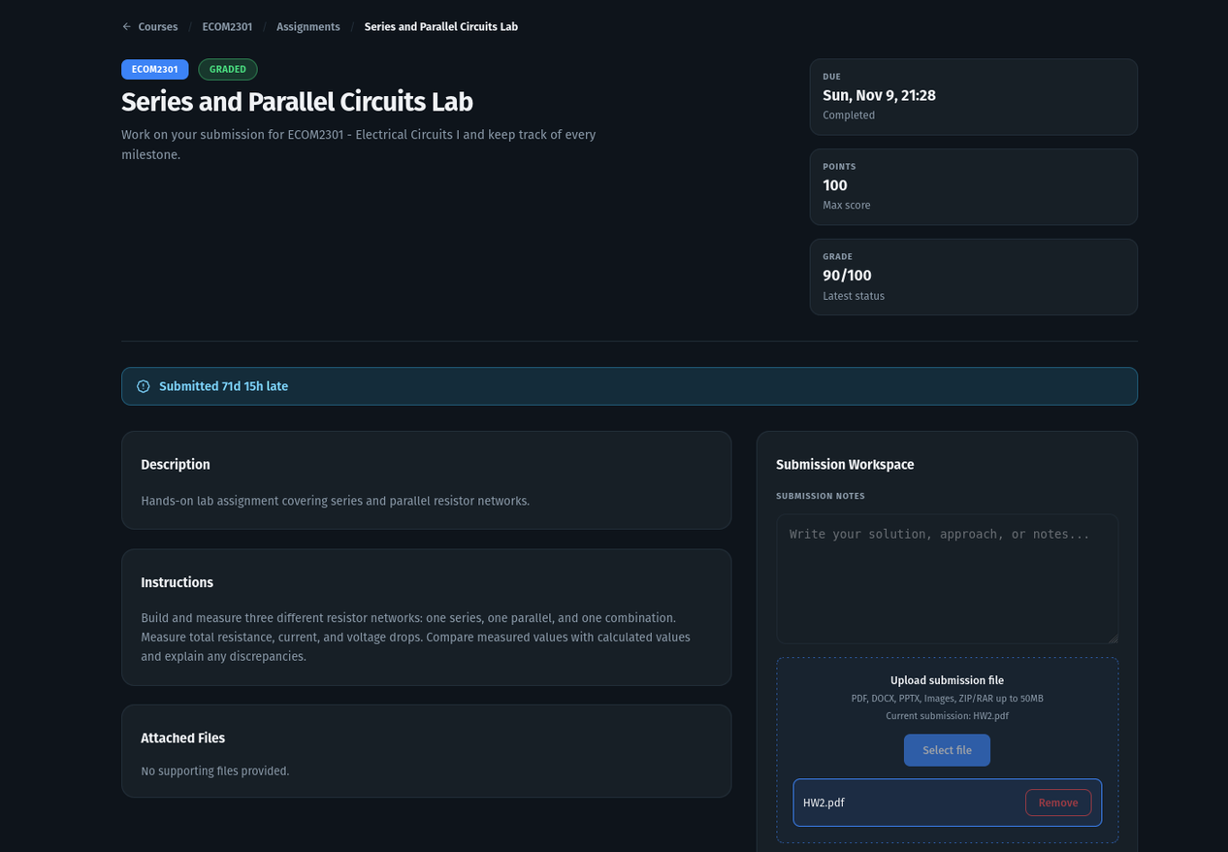
RESULTS & DISCUSSION
FEATURE 3: ASSIGNMENT SYSTEM
→ Student Assignment Detail & Submission

Slide 42
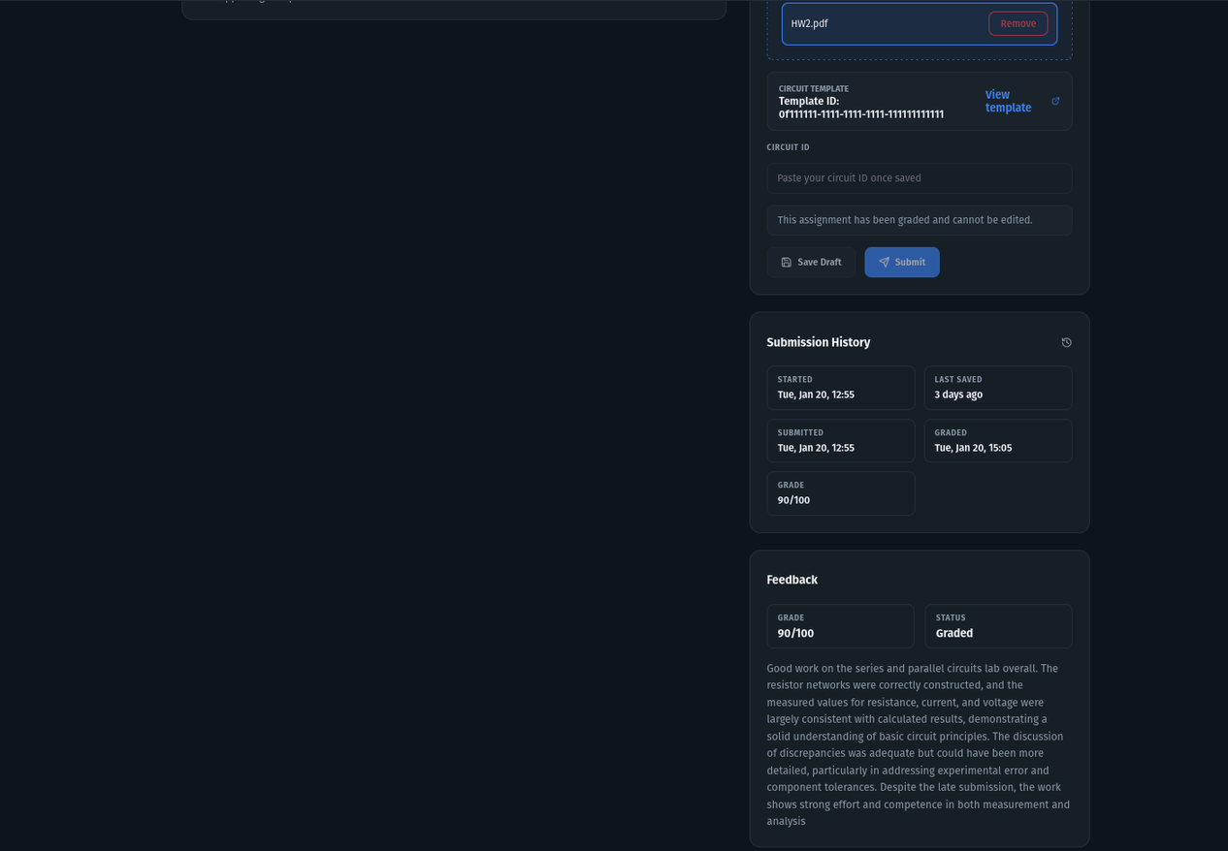
RESULTS & DISCUSSION
FEATURE 3: ASSIGNMENT SYSTEM
→ Student Assignment Detail & Submission

Slide 43
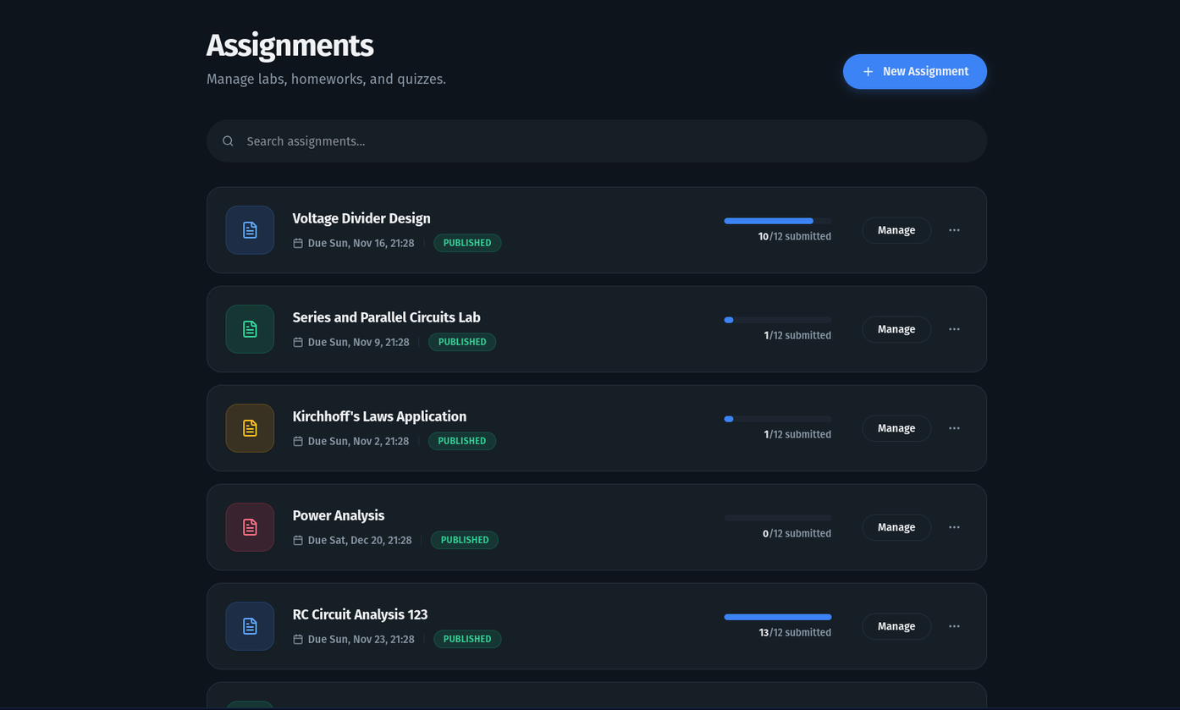
RESULTS & DISCUSSION
FEATURE 3: ASSIGNMENT SYSTEM
→ Instructor Assignment List

Slide 44
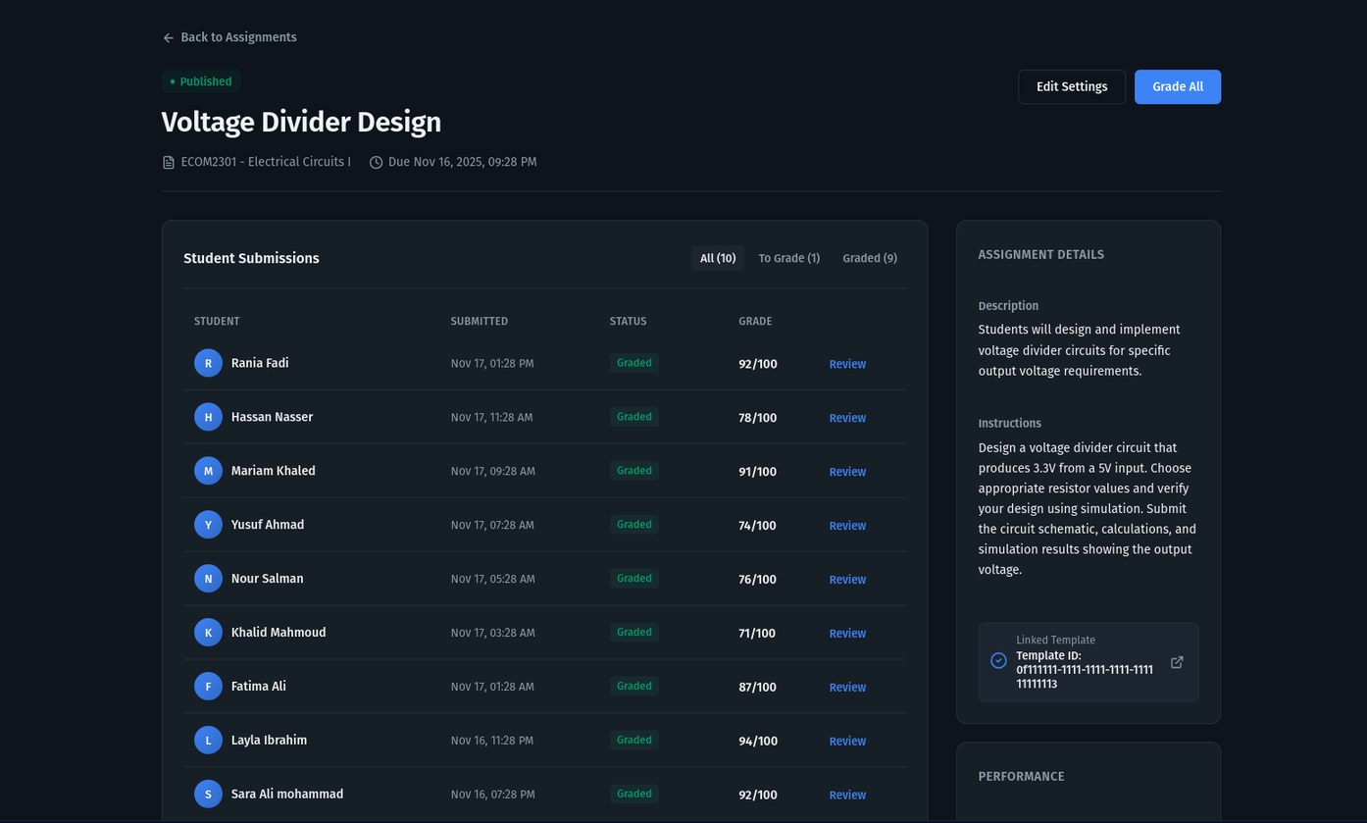
RESULTS & DISCUSSION
FEATURE 3: ASSIGNMENT SYSTEM
→ Instructor Assignment Submissions View

Slide 45
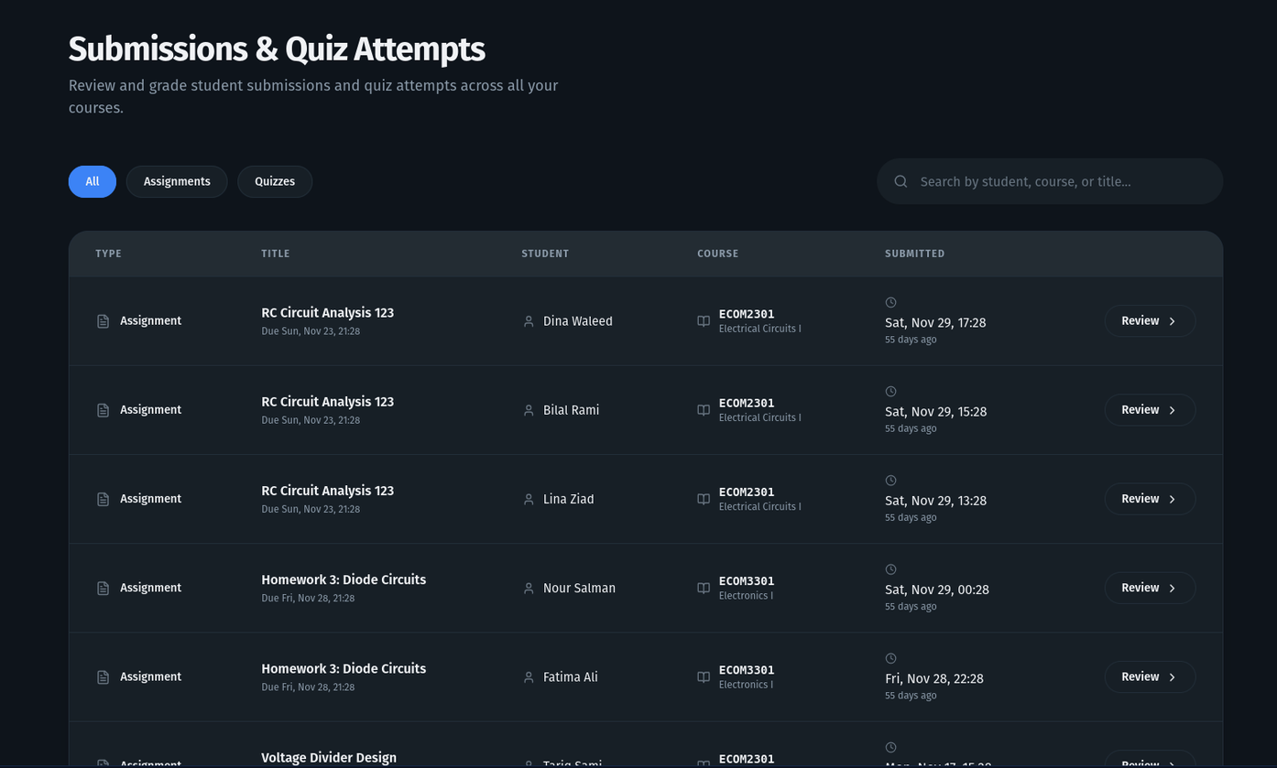
RESULTS & DISCUSSION
FEATURE 3: ASSIGNMENT SYSTEM
→ Instructor Cross-Course Submission

Slide 46
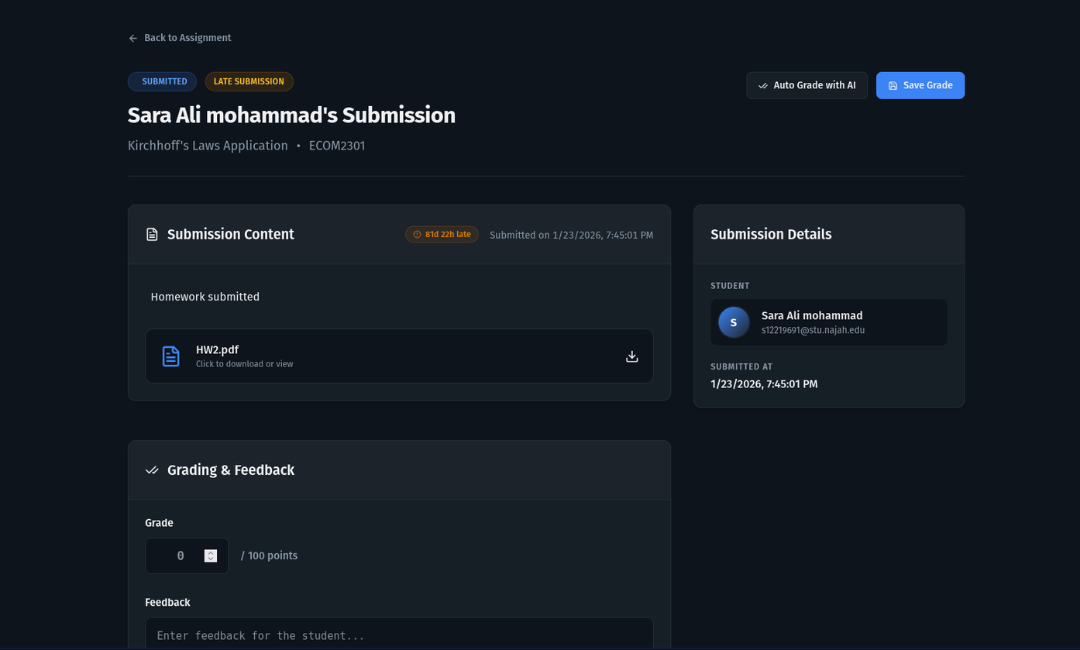
RESULTS & DISCUSSION
FEATURE 3: ASSIGNMENT SYSTEM
→ Instructor Submission Grading

Slide 47
RESULTS & DISCUSSION
FEATURE 3: ASSIGNMENT SYSTEM
→ Instructor Submission Grading

Slide 48
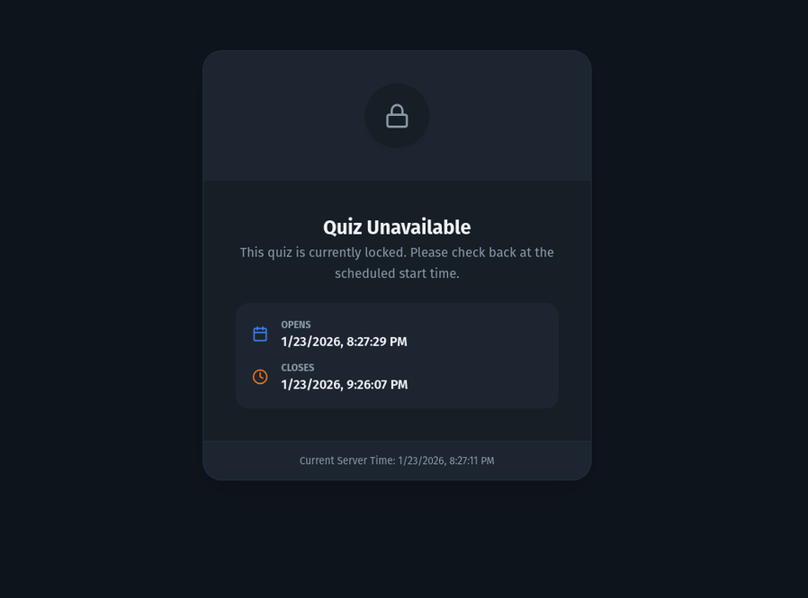
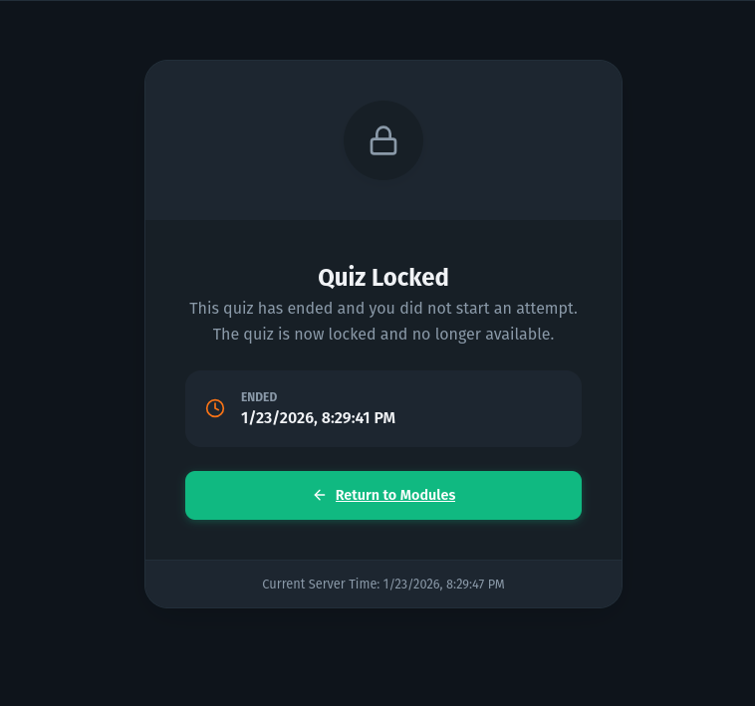
RESULTS & DISCUSSION
FEATURE 4: QUIZ SYSTEM
→ Student Quiz Locking

Slide 49
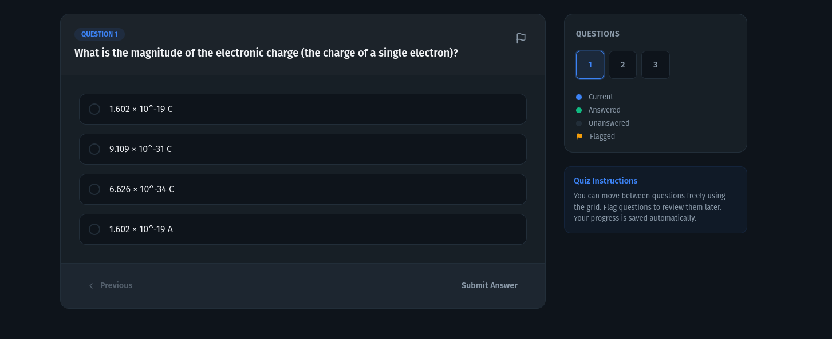
RESULTS & DISCUSSION
FEATURE 4: QUIZ SYSTEM
→ Student Quiz Question

Slide 50
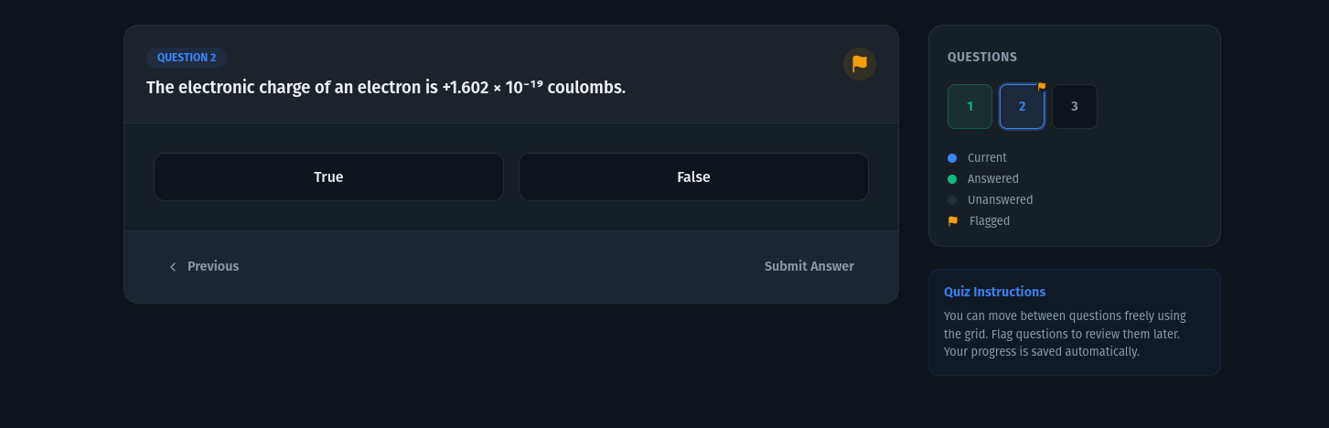
RESULTS & DISCUSSION
FEATURE 4: QUIZ SYSTEM
→ Student Quiz Question - Cont.

Slide 51
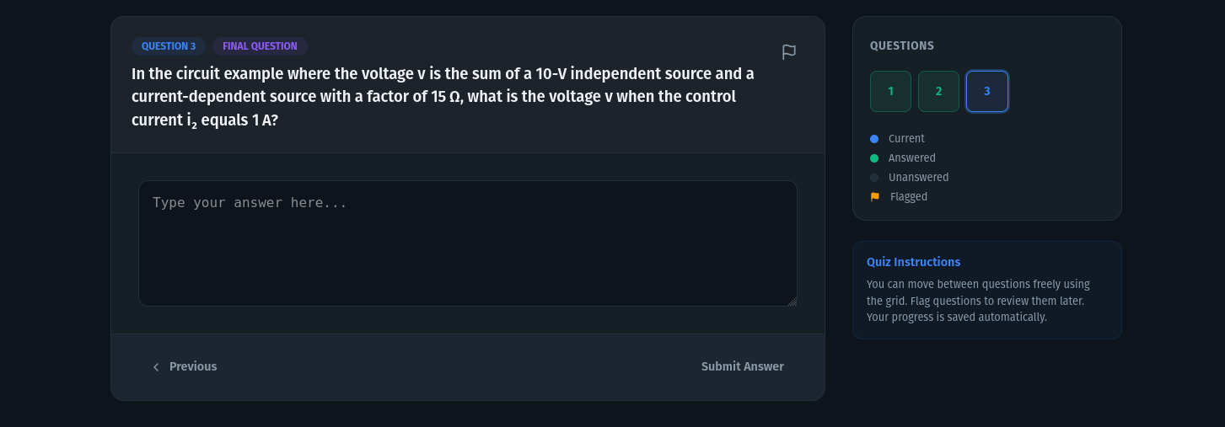
RESULTS & DISCUSSION
FEATURE 4: QUIZ SYSTEM
→ Student Quiz Question - Cont.

Slide 52
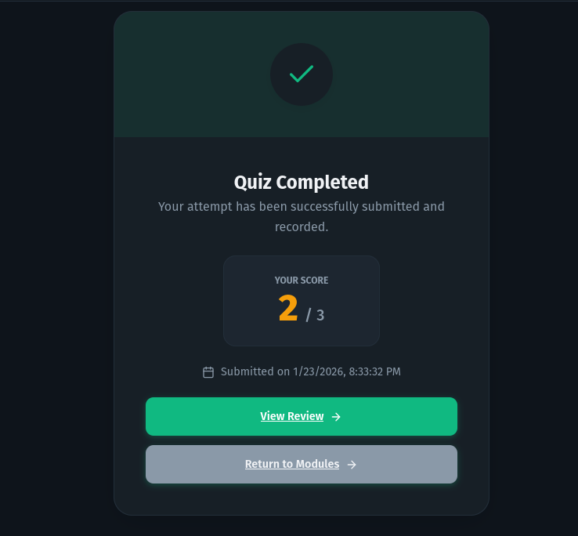
RESULTS & DISCUSSION
FEATURE 4: QUIZ SYSTEM
→ Student Quiz Review

Slide 53
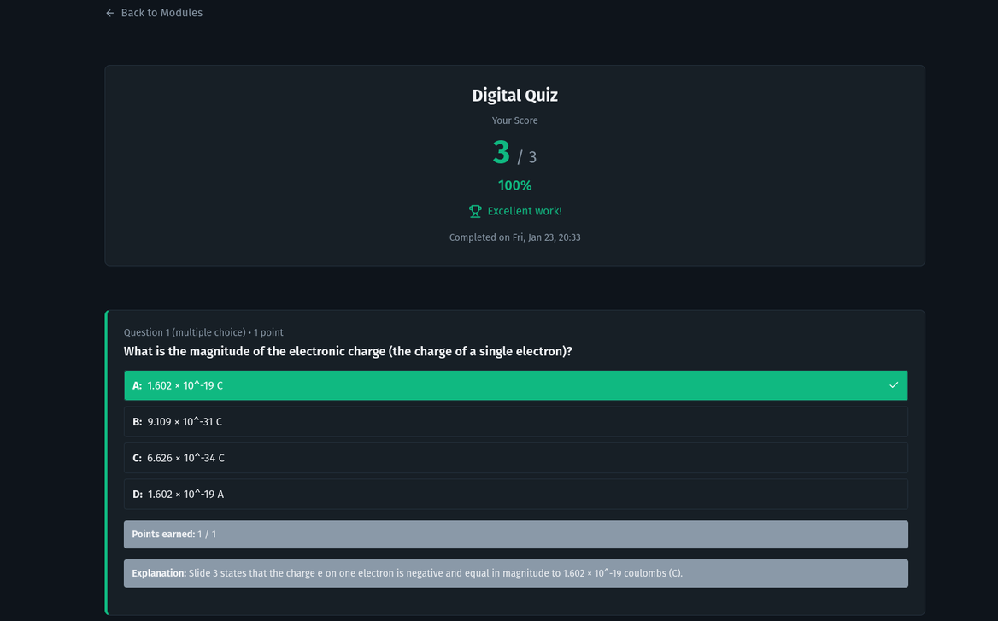
RESULTS & DISCUSSION
FEATURE 4: QUIZ SYSTEM
→ Student Quiz Review - Cont.

Slide 54
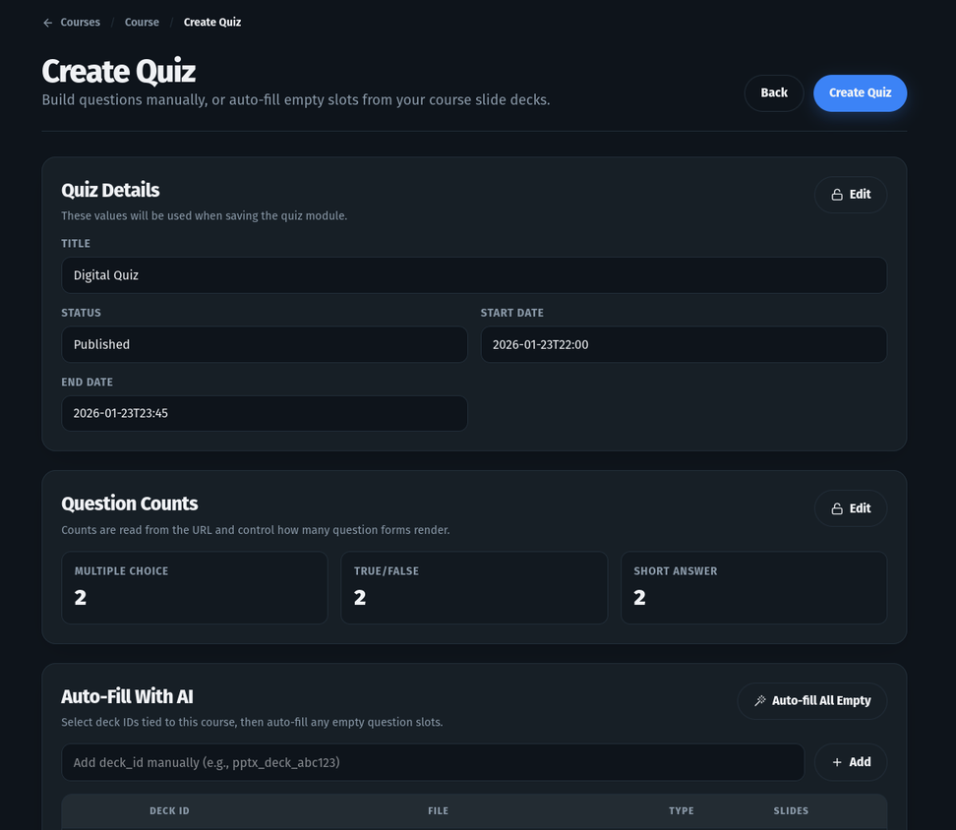
RESULTS & DISCUSSION
FEATURE 4: QUIZ SYSTEM
→ Instructor Quiz Creation

Slide 55
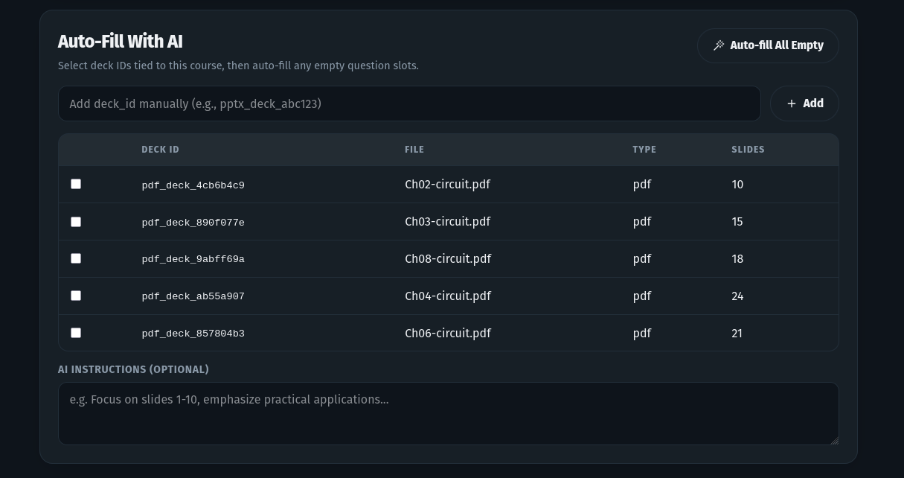
RESULTS & DISCUSSION
FEATURE 4: QUIZ SYSTEM
→ Instructor Quiz Creation - Cont.

Slide 56

RESULTS & DISCUSSION
FEATURE 4: QUIZ SYSTEM
→ Instructor Quiz Creation - Cont.

Slide 57

RESULTS & DISCUSSION
FEATURE 4: QUIZ SYSTEM
→ Instructor Quiz Creation - Cont.

Slide 58

RESULTS & DISCUSSION
FEATURE 4: QUIZ SYSTEM
→ Instructor Quiz Submissions

Slide 59

RESULTS & DISCUSSION
FEATURE 5: CIRCUIT SIMULATION SYSTEM
→ Simulator Landing Page

Slide 60

RESULTS & DISCUSSION
FEATURE 5: CIRCUIT SIMULATION SYSTEM
→ Digital Simulator Hub

Slide 61
RESULTS & DISCUSSION
FEATURE 5: CIRCUIT SIMULATION SYSTEM
→ Digital Simulator Hub

Slide 62

RESULTS & DISCUSSION
FEATURE 5: CIRCUIT SIMULATION SYSTEM
→ Electrical Simulator Hub

Slide 63
RESULTS & DISCUSSION
FEATURE 5: CIRCUIT SIMULATION SYSTEM
→ Simulator Tool Bars
Electrical Simulator
Digital Simulator

Slide 64

RESULTS & DISCUSSION
FEATURE 5: CIRCUIT SIMULATION SYSTEM
→ Digtial Simulator Component Library

Slide 65

RESULTS & DISCUSSION
FEATURE 5: CIRCUIT SIMULATION SYSTEM
→ Electrical Simulator Component Library

Slide 66

RESULTS & DISCUSSION
FEATURE 5: CIRCUIT SIMULATION SYSTEM
→ Digtial Simulator Example 1

Slide 67


RESULTS & DISCUSSION
FEATURE 5: CIRCUIT SIMULATION SYSTEM
→ Digtial Simulator Example 2

Slide 68

RESULTS & DISCUSSION
FEATURE 5: CIRCUIT SIMULATION SYSTEM
→ Electrical Simulator Example 1

Slide 69

RESULTS & DISCUSSION
FEATURE 5: CIRCUIT SIMULATION SYSTEM
→ Electrical Simulator Example 1 - Cont.

Slide 70

RESULTS & DISCUSSION
FEATURE 5: CIRCUIT SIMULATION SYSTEM
→ Electrical Simulator Example 1 - Cont.

Slide 71

RESULTS & DISCUSSION
FEATURE 5: CIRCUIT SIMULATION SYSTEM
→ Electrical Simulator Example 2

Slide 72

RESULTS & DISCUSSION
FEATURE 5: CIRCUIT SIMULATION SYSTEM
→ Electrical Simulator Example 2 - Cont.

Slide 73

RESULTS & DISCUSSION
FEATURE 5: CIRCUIT SIMULATION SYSTEM
→ Electrical Simulator Example 3

Slide 74

RESULTS & DISCUSSION
FEATURE 5: CIRCUIT SIMULATION SYSTEM
→ Electrical Simulator Example 3 - Cont.

Slide 75

RESULTS & DISCUSSION
FEATURE 5: CIRCUIT SIMULATION SYSTEM
→ Electrical Simulator Example 3 - Cont.

Slide 76

RESULTS & DISCUSSION
FEATURE 6: AI-POWERED EDUCATIONAL ASSISTANT
→ Chat Area

Slide 77


RESULTS & DISCUSSION
FEATURE 6: AI-POWERED EDUCATIONAL ASSISTANT
→ Slide Deck Modal

Slide 78


RESULTS & DISCUSSION
FEATURE 6: AI-POWERED EDUCATIONAL ASSISTANT
→ Chat Side Bar

Slide 79

RESULTS & DISCUSSION
FEATURE 7: AUTHENTICATION & USER MANAGEMENT
→ Authentication Page

Slide 80

RESULTS & DISCUSSION
FEATURE 7: AUTHENTICATION & USER MANAGEMENT
→ Reset Password

Slide 81
CONCLUSION
The developed system successfully provides a unified workflow where students can study theory, design circuits, run simulations, and complete assessments within one coherent environment.
While the grounded domain-specific AI gave better results in general compared to generic AI tools
This project demonstrates that integrating learning management, circuit simulation, and curriculum-grounded AI into a single platform can significantly reduce the gap between theoretical knowledge and practical circuit design.
Overall, the project validates the feasibility and educational value of integrated AI-driven hardware learning platforms as a foundation for future academic systems.

Slide 82
Strengths
Limitations
  Translation of fragmented academic workflows into a coherent system model.
  Design decisions prioritized system breadth over deep specialization in any single subsystem.
  Dual simulation approach enabling conceptual and realistic circuit analysis.
  AI performance is constrained by model capacity, dataset quality, and cost-efficient inference choices.
  Real-world experimentation with curriculum-grounded AI rather than generic LLM usage.
  Content ingestion and text extraction are affected by inconsistencies in academic materials and document formats.

Slide 83

RECOMMENDATIONS
1
Extend the circuit simulation engine to support a broader range of components and advanced analysis domains.
Improve AI grounding by expanding the dataset to include structured textbooks, lab manuals, and verified engineering references.
2
3
Introduce more flexible publishing, scheduling, and collaboration features for instructors and multi-course environments.

Slide 84
RECOMMENDATIONS
Conduct empirical studies to measure improvements in student understanding, performance, and engagement.
4
Adapt the platform for use beyond a single institution to explore its potential as a generalized engineering learning framework.
5
6
Explore the role of AI as a pedagogical assistant rather than a problem-solving tool, emphasizing guidance or load reducing over direct answers.

Slide 85

THANK YOU
VISIT US

