Slide 1

An-Najah National University
Engineering College
Civil Engineering Department
Graduation Project
Structural Analysis and Design of
Ya’bad Secondary School under Static and Dynamic Loads

Slide 2





Group Members
Hiba Hassoun
Mohammed Shtaya
Ala Al -husain
Hanan Ahmad
Ahmad Zahalqa
Supervised by : Dr. Mahmoud Dwaikat

Slide 3
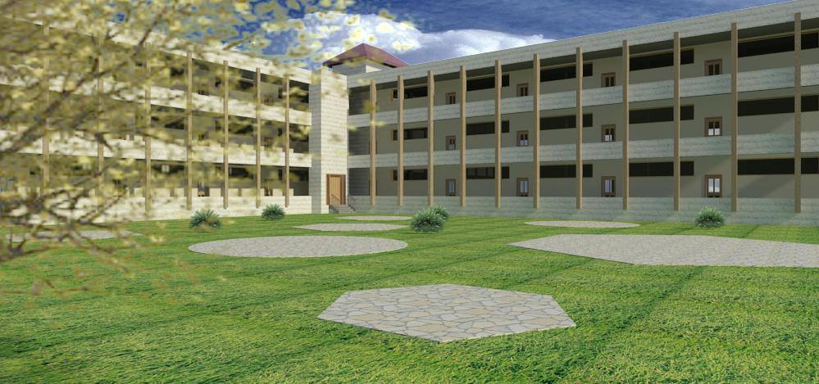

Slide 4

Outline :
General description of the school
Design criteria .
Materials .
Loads.
Methodology .
Conceptual design .
SAP analysis.
Envelop results for design.
Results and Discussion .
Conclusion and Recommendations.

Slide 5
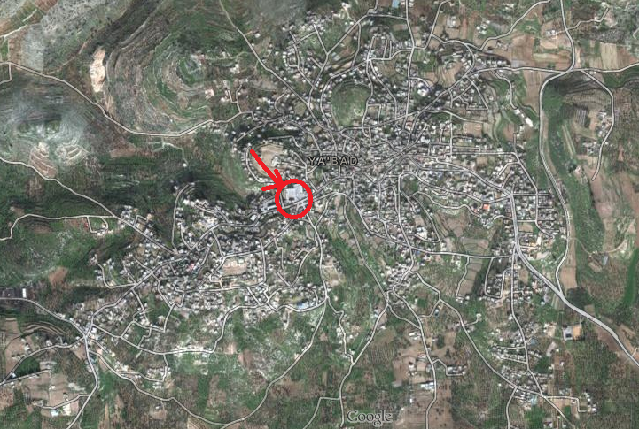
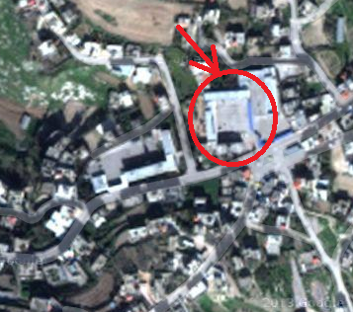
Introduction :
The project under study is Ya'bad secondary school for boys. The building is located in Jenin district in Ya'bad town at Schools Street next to Yasser Arafat School.

Slide 6
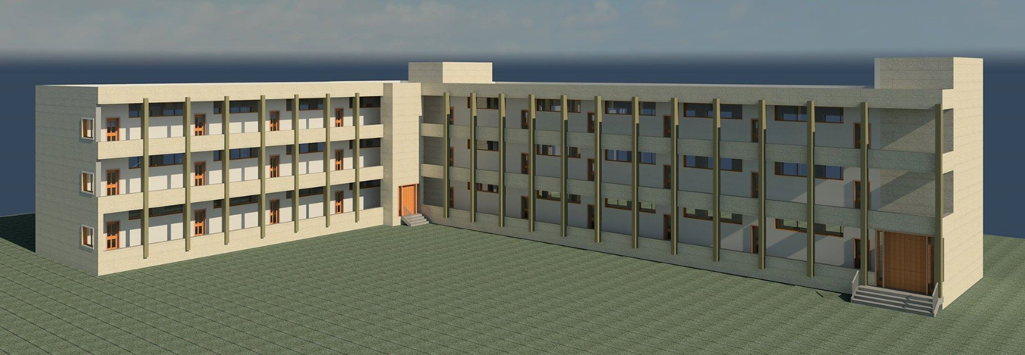
The building is considered as reinforced concrete frame structure with masonry walls all around it.

Slide 7
The project includes three blocks , two blocks consist of three floors for class and teachers’ rooms with a height of 3.15 meter and a third block with two floors used as a Gym and Cafeteria of 4 meter height , It has a total area of (1082.33 m2).
Project
School
(Block1& Block2)
Gym & Cafeteria
(Block 3)

Slide 8
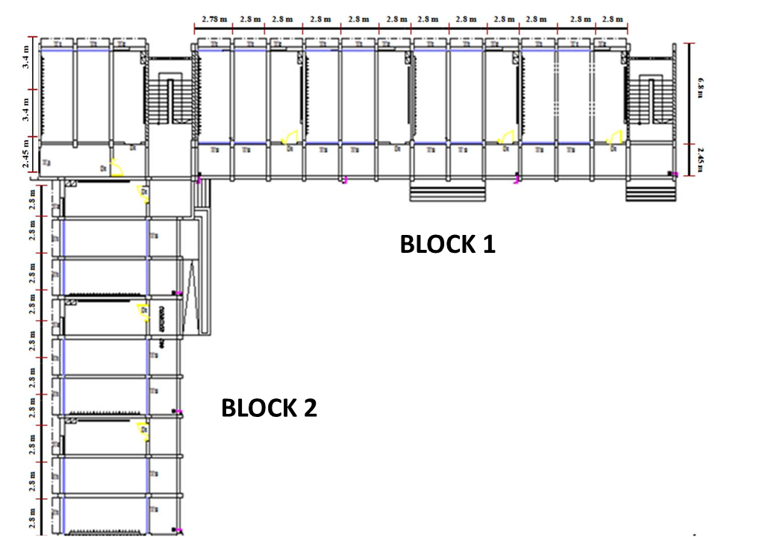
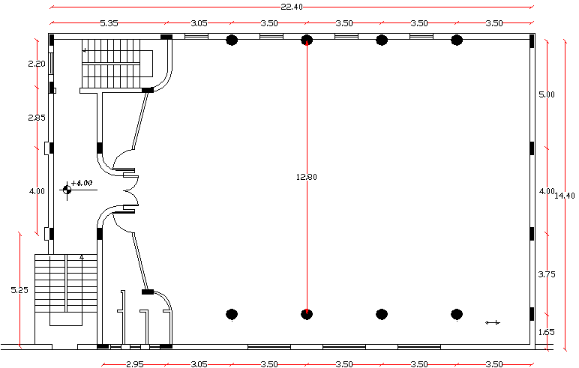
Block3
Architectural Plan of School (Block 1 & Block2)

Slide 10
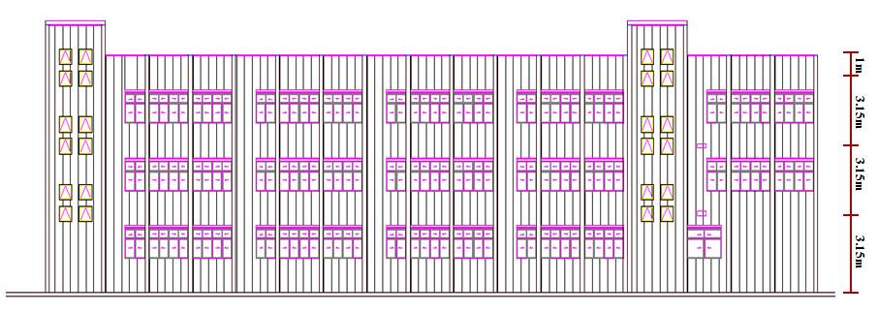
North Elevation View of School

Slide 11
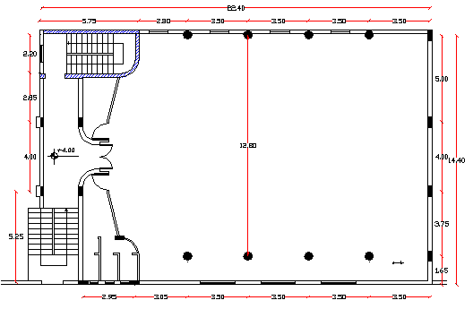
BLOCK 3

Slide 12
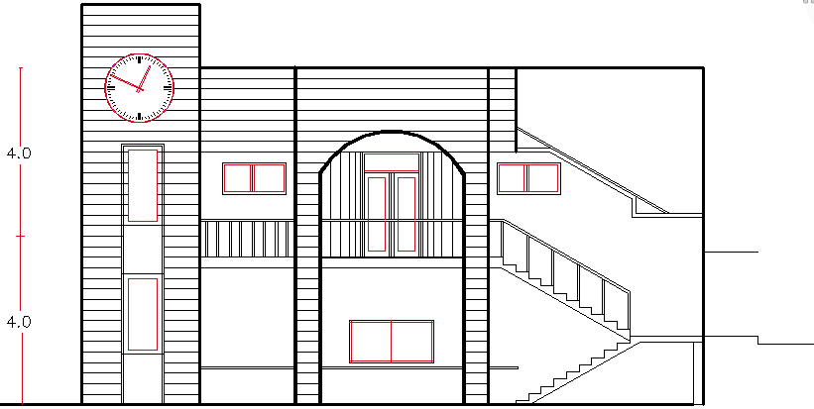
West View of Cafeteria and GYM

Slide 13
Different types of analysis and design are done in this project in order to choose the best one based on the following criteria:
Weight.
economy.
deflection.
The Structural Systems are :
One Way Solid slab system
One Way Ribbed slab system
Then :
Ribbed slab system was considered in the three blocks .

Slide 14

Design criteria :
Strength criterion.
Serviceability criterion.
Economic criterion.

Slide 15
Material :
1. Concrete :
density = 25 KN/ m³ for reinforced concrete and density = 23 KN/ m3 for plain concrete.

Slide 16
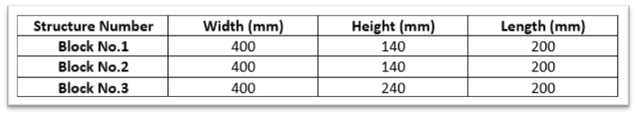
2.Concrete Blocks :
normal weight concrete block with unit weight = 12 KN/ m3
3. Reinforcing steel :
We use steel with stress yield strength = 420 Mpa and modulus of elasticity (Es) = 2×10⁵ (MPa).

Slide 17
Loads :
Loads
Gravity
Lateral
Dead
Live
Snow
Earthquake
Wind

Slide 18

Minimum design live loads in our structure according to ( ASCE 7 )
Super imposed load
Finishing
Partitions
Total superimosed load = wt of finishing + wt of partions

Slide 19
Loads combinations :
Wu = 1.4 D.L
Wu = 1.2 D.L+ 1.0 L.L ± 1.0 E
Wu = 1.2 D.L + 1.6 L.L
Wu = 1.2 D.L + 1.6 L.L

Slide 20
Methodology :
In our project ,the structural elements are modeled as 3D dimensional elements (Beams ,columns , slabs and footing ) using (SAP 2000 program and safe program ) , after using 3D model to represent the structure , we analyze it considering gravity and lateral loads , and compare the results with hand calculations to verify that 3D model results.

Slide 21
Dimensions of structural elements
Slabs
Beams
Columns

Slide 22
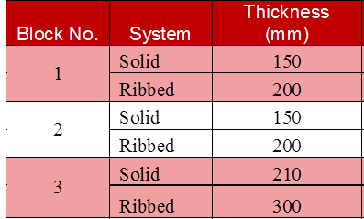
1. Slab Dimensions:

Slide 23
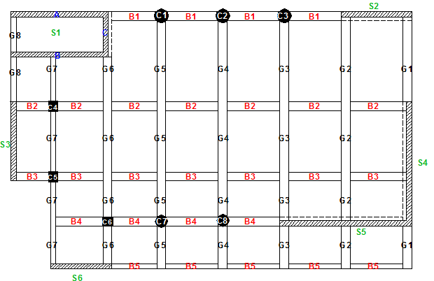
Beam and columns distribution of the third Block :

Slide 24
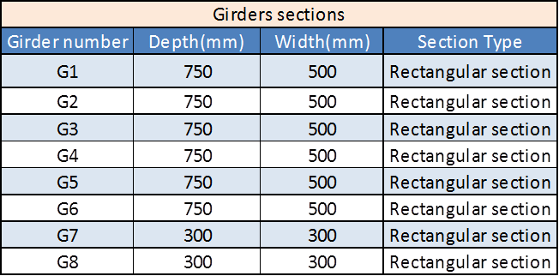
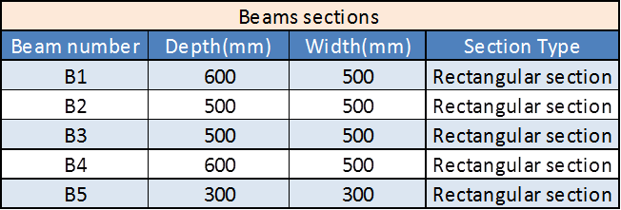
2. Beam Dimensions :

Slide 25

3. Column Dimensions :

Slide 26
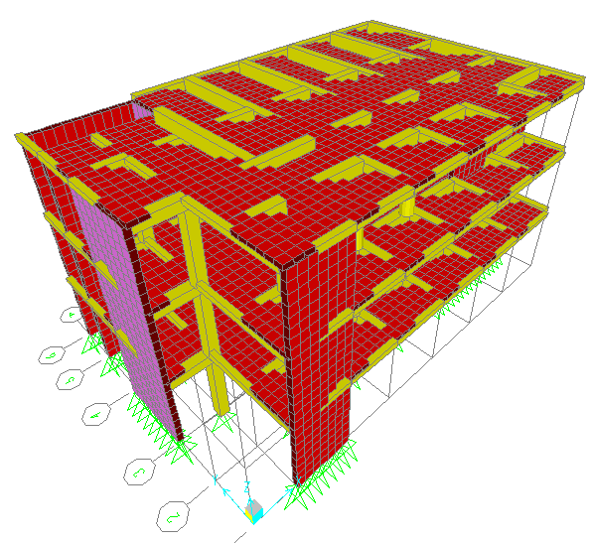
Sap Model :

Slide 27
Sap Checks
Compatibility Check
Counter Balance Equilibrium
Stress-strain relationship

Slide 28
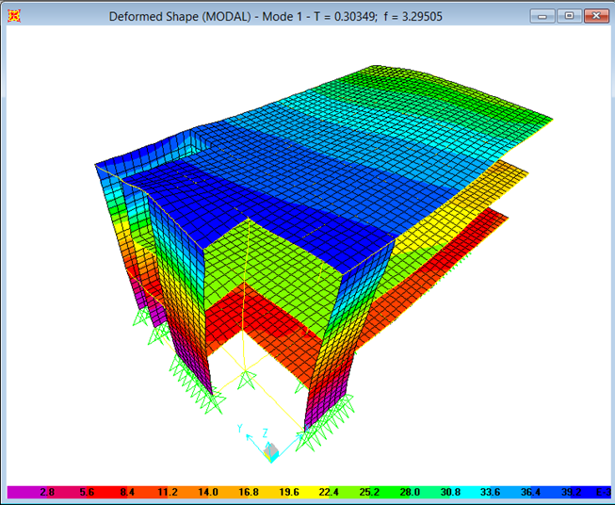
1.Compatability Check :

Slide 29
2.Counter Balance / equilibrium :
Live load = 295.5* 5 = 1477.5KN
Error = Zero

Slide 30
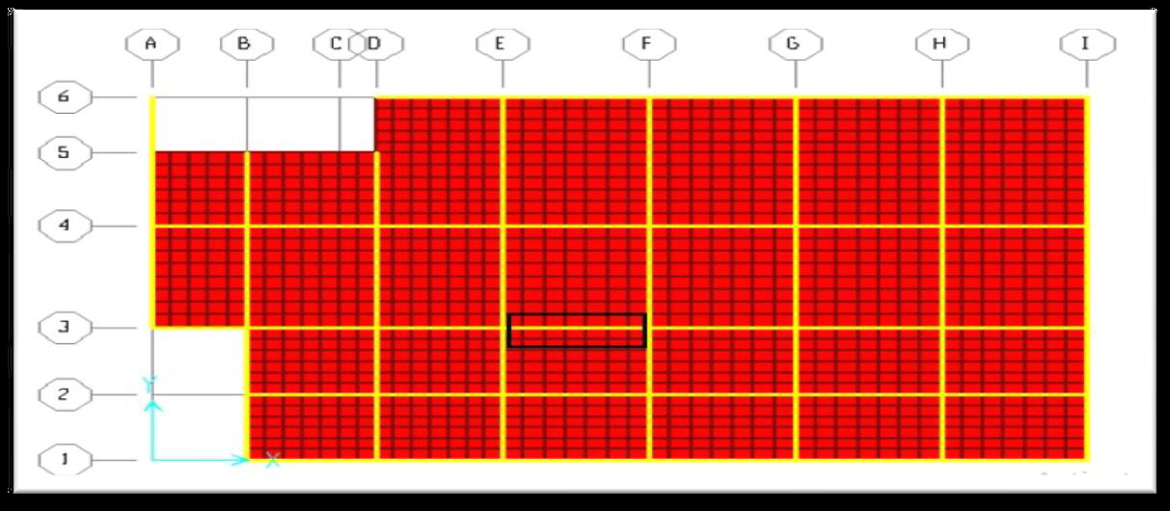
3. Stress / Strain Relationship :
Mu manual 32.07 KN.m
Mu SAP
Error 1.77 %
Less than 5%
Acceptable

Slide 31
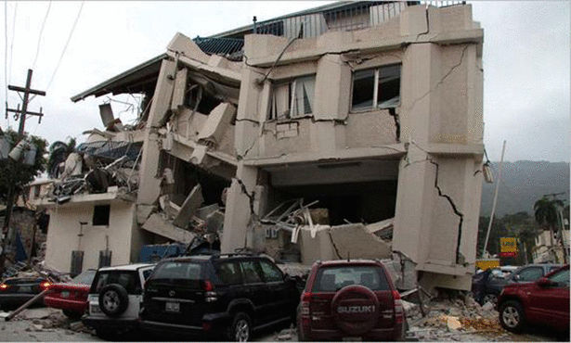
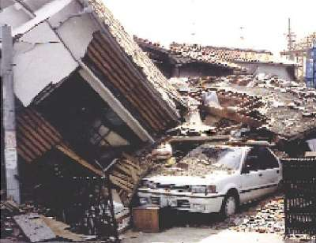
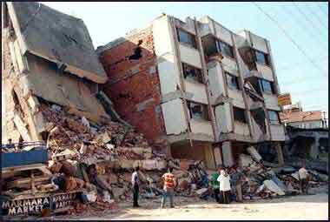
Dynamic Design:
Dynamic analysis is based on an appropriate ground motion representation and is performed using accepted principles of dynamics

Slide 32
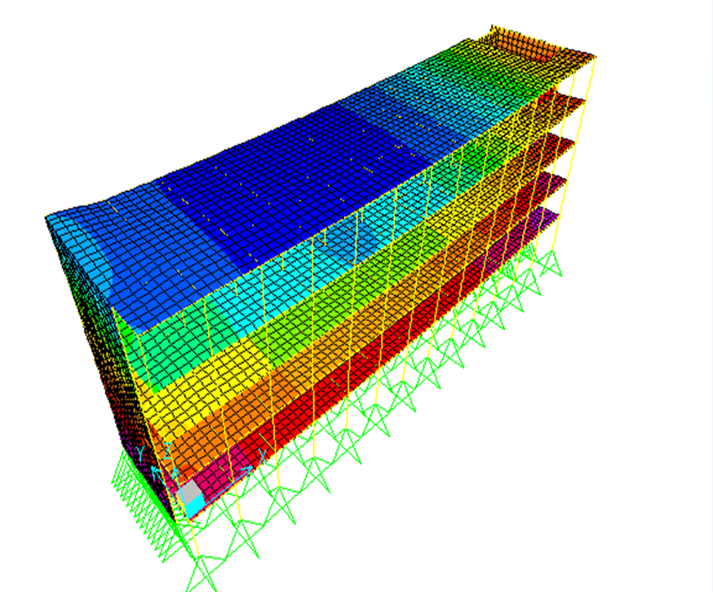
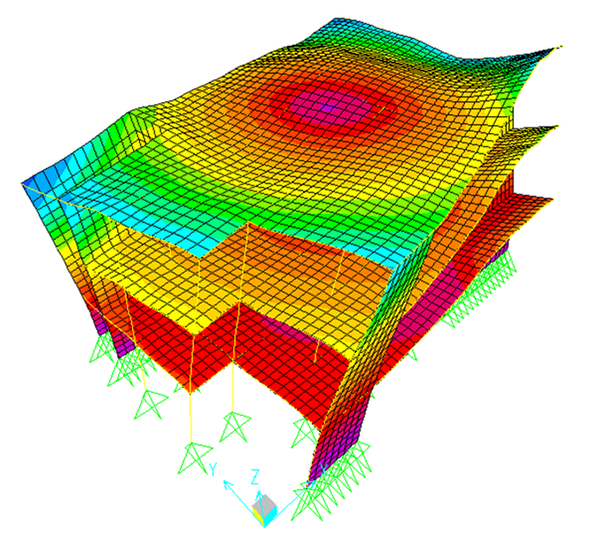
from our dynamic studies of the building we found that the three blocks are subjected to torsion .

Slide 33
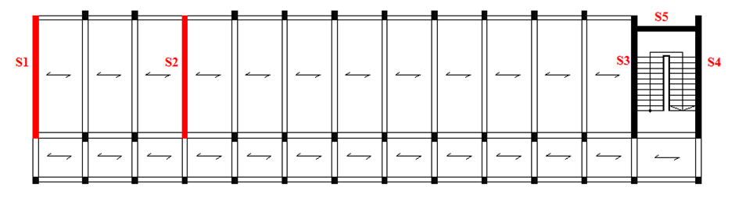
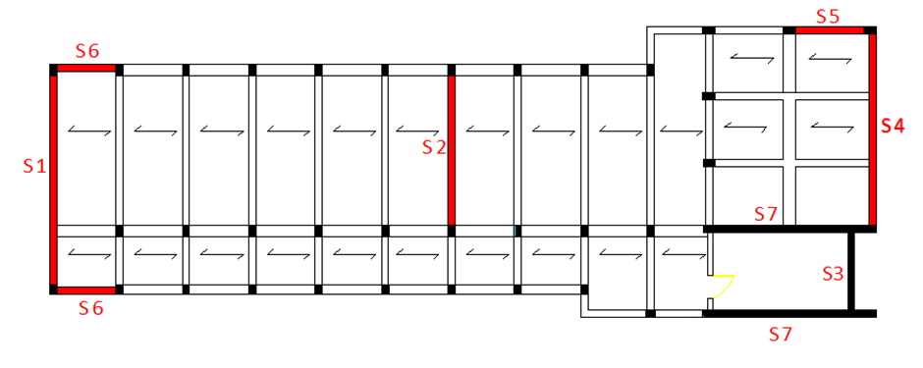
Block 1
Block 2

Slide 34
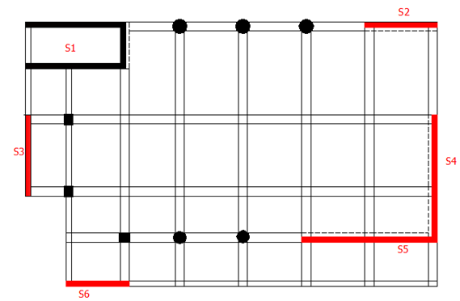
Block 3

Slide 35
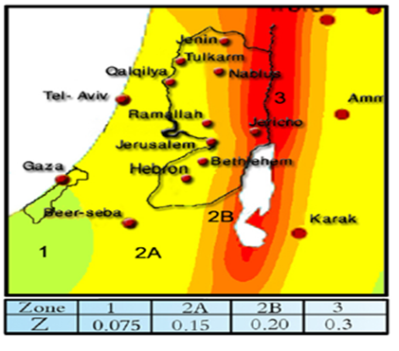
Seismic Loads :
1- Seismic zone factor (Z).(Zone 2B); Z= 0.2
Main factors according to UBC 97 code:

Slide 36
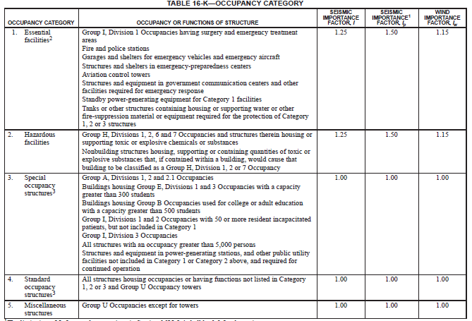
2- Importance factor
I=1.25.

Slide 37
3- Numerical coefficient representative of the inherent over strength and global ductility capacity of lateral- force- resisting systems.(R)

Slide 38
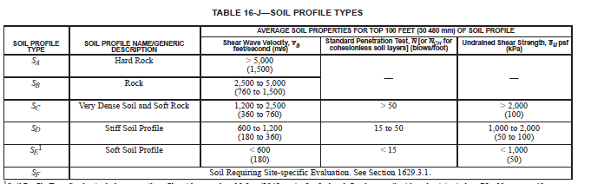
4- SoilType .
According to soil test soil is denes soil and soft rock which indicate that soil type is Sc .

Slide 39
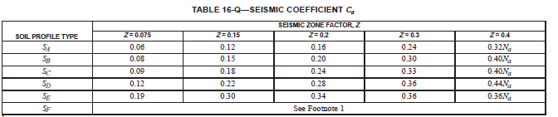
5- Acceleration seismic coefficient for soil
Ca = 0.24

Slide 40
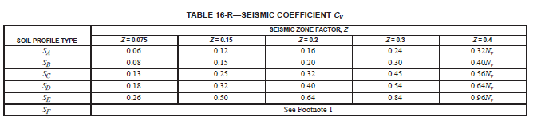
5- Velocity seismic coefficient for soil
Cv = 0.32

Slide 41
Definition of Earthquake function :
Total Base shear
Static
Dynamic
Equivalent Static
Response spectrum

Slide 42
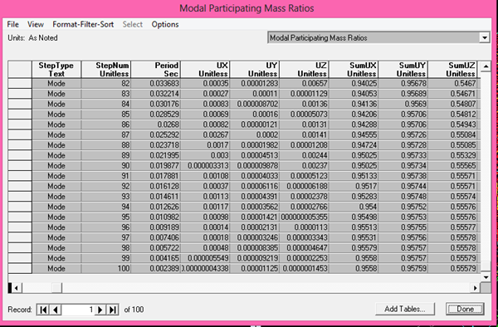
Mass participation ratio:

Slide 43
Equivalent Static:
V max
=2.5 W Ca I / R
V
Vmin
=0.11 Ca I W
= W Cv I / RT

Slide 44
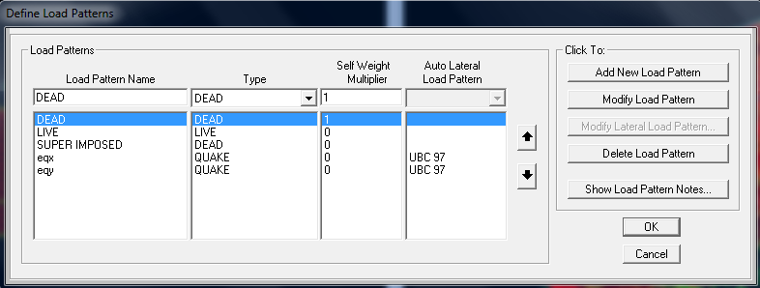
Definition of Equivalent Static

Slide 45
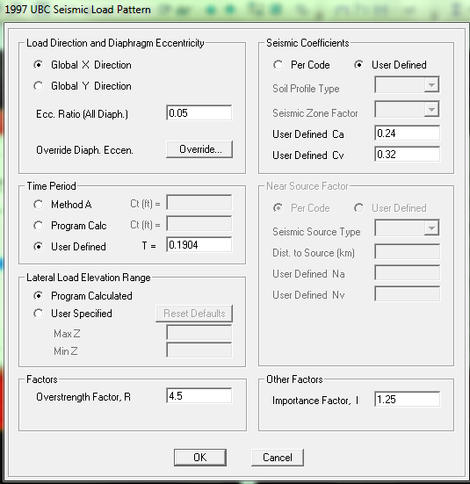
Load Pattern

Slide 46
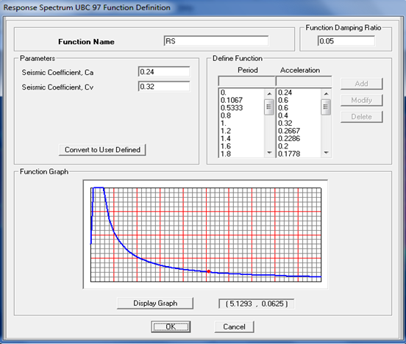
Definition of Response Spectrum
Notes:
صورة البيس شير

Slide 47
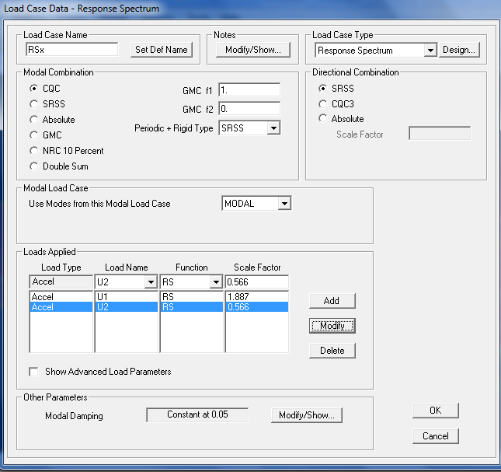
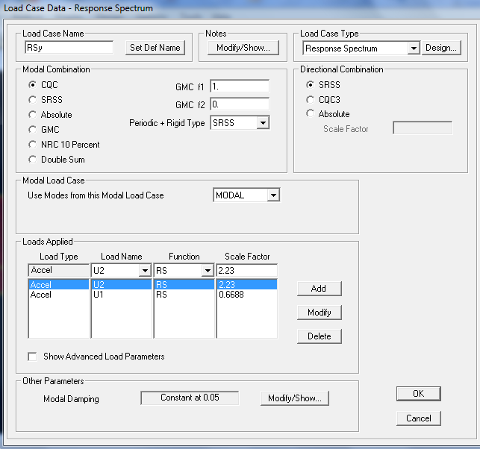
Load cases:
Earth quake –x(RSx)
Earth quake – y (RSy)
From UBC 97
Load Case Data for Earth Quake –X
Load Case Data for Earth Quake –Y

Slide 48
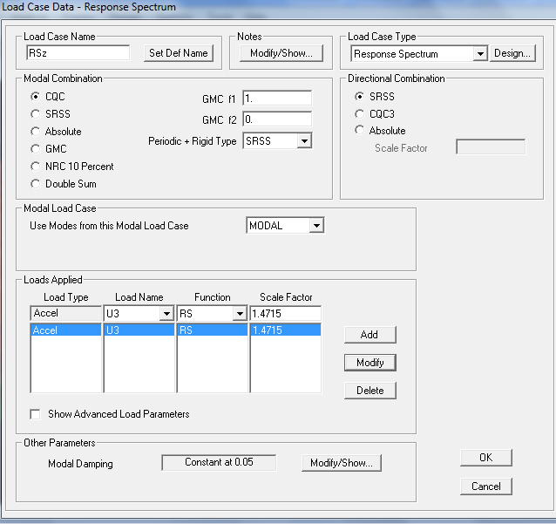
Earth quake – Z (RSz)
Scale factor =0.5CaIg
Load Case Data for Earth Quake –Z

Slide 49
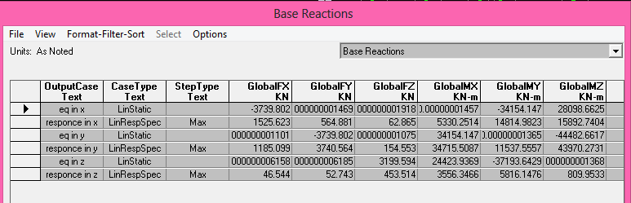
Before scaling

Slide 50
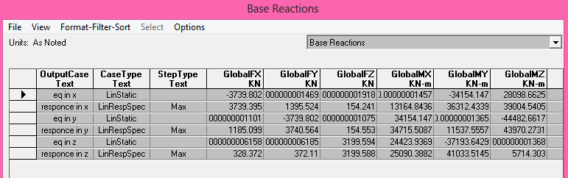
After scaling

Slide 51
Periodic check:
The structure has a period T =0.3035 seconds as shown:
The following equation is used to check T:
Then T= (0.0488)×(3story×4m)3/4 =0.3146 seconds.

Slide 52

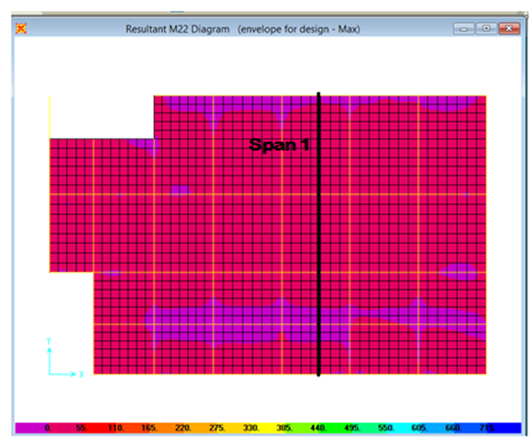
Envelope Results For Design :

Slide 53
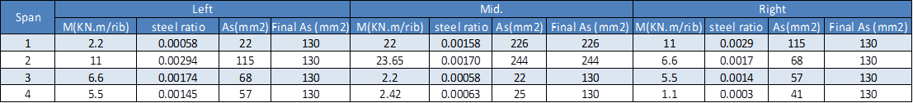
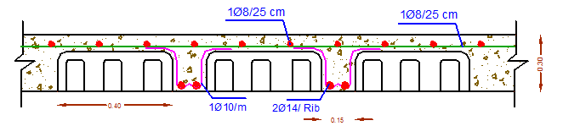

Slide 54
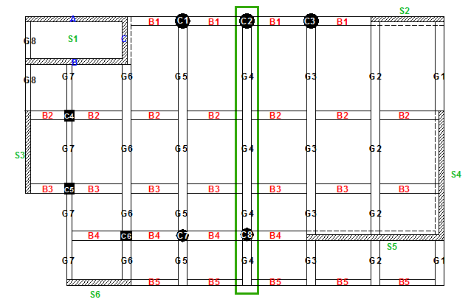
2. For Beams :

Slide 56
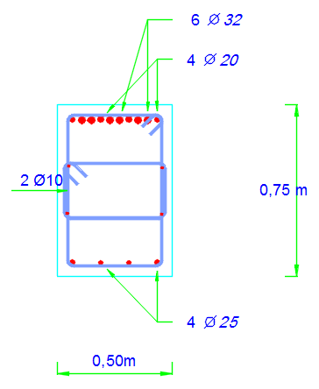
Cross Section For G4

Slide 57
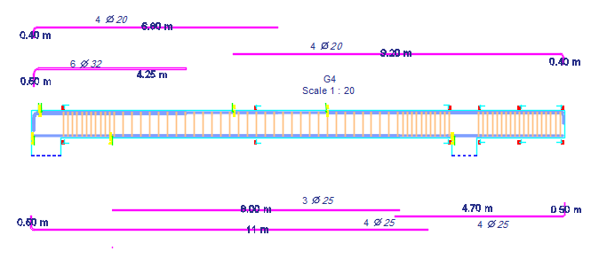
Longitudinal Section For G4

Slide 58
3. For Columns :

Slide 59
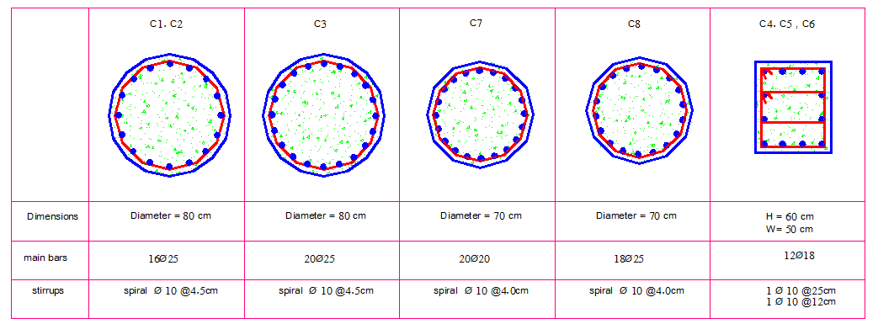

Slide 60
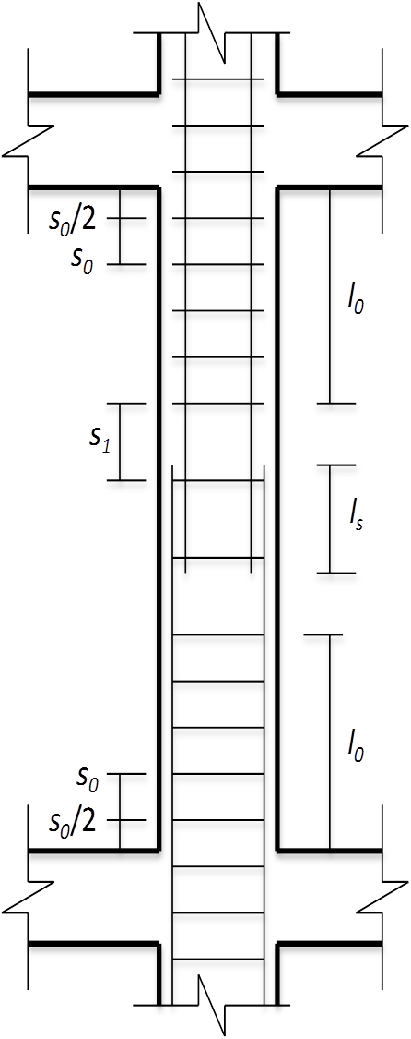

Slide 61
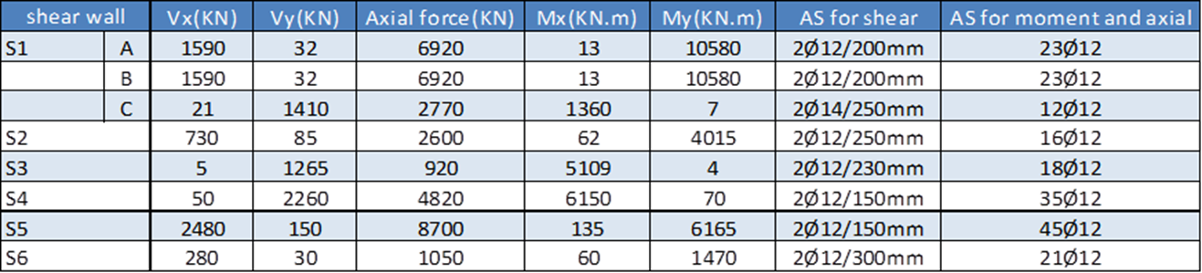
3. For Shear walls :

Slide 62
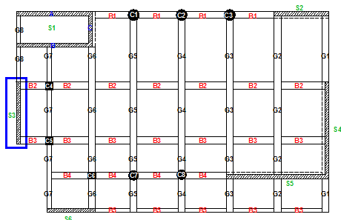
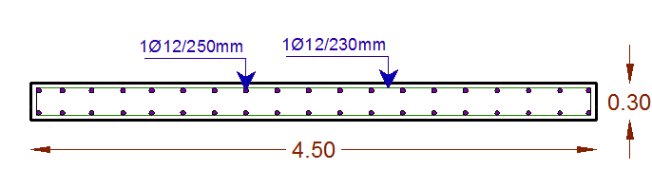

Slide 63

3. For Footings:

Slide 64


→ Footing of (C5)

Slide 65
Results and Discussion:
The following table shows the area of steel needed for slabs , beams and columns in the three blocks for ribbed system :

Slide 66


Conclusion and Recommendations :
from our dynamic studies of the building we found that the three blocks are subjected to torsion .

Slide 67


Seismic joint

Slide 68

Thank You

