Slide 1
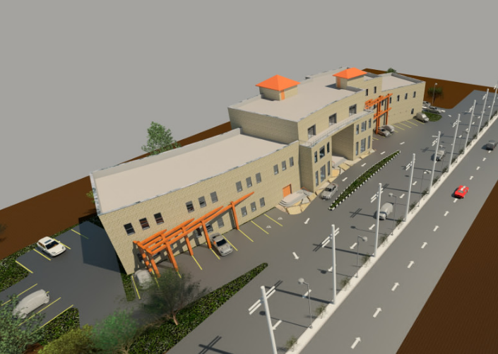
Jenin Cultural Center
Prepared by :
Hani Shahateet
Mo’men “ Qasim Suliman “
Qutaiba Ghaneem
Mohammed Daghlas
Supervisor : Eng . Nermeen Albarq

Slide 2
Outline:
Introduction
Architectural Design
Structural Design
Mechanical Design
Safety Design
Environmental Design
Electrical Design
Quantity surveying and cost estimation

Slide 3
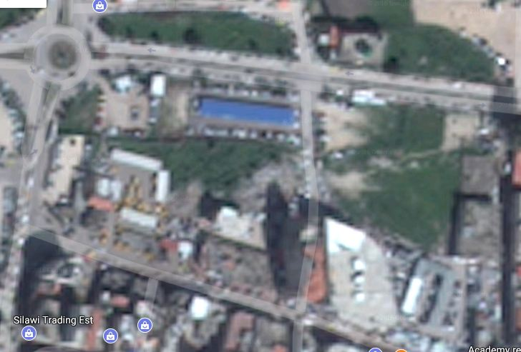
Introduction :
Location:
  - In Jenin City, near ‘Yahya Ayash’ Traffic circle.
At ‘Al-madares‘ street.
The area of the site (3434 m² ) .

Slide 4
Architectural Design:
Site plan and Accessibility
The plans
Sections
Elevations

Slide 5
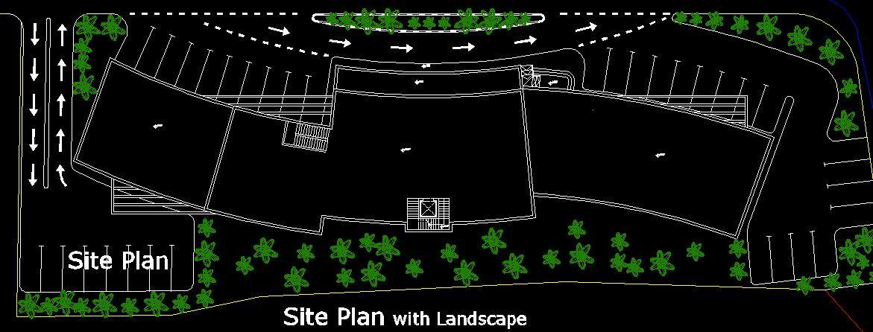
Site plan:

Slide 6
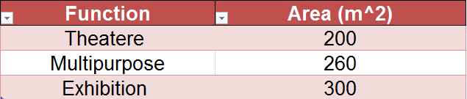
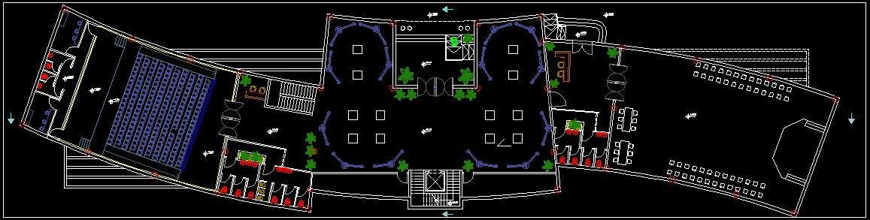
Ground floor plan
Area : 1185 m2.

Slide 7
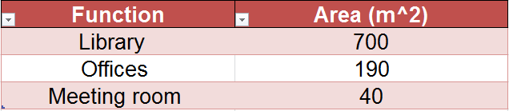
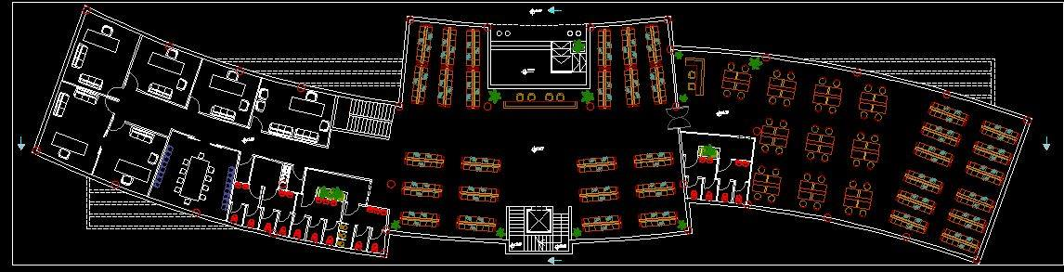
First floor plan
Area : 1185 m2.

Slide 8
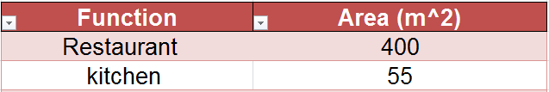
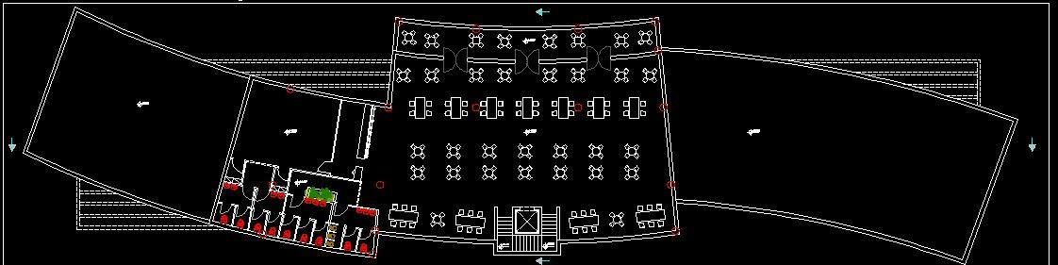
Second floor plan
Area : 612 m2.

Slide 9
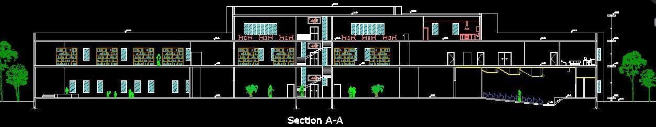
Sections
Section A-A

Slide 10
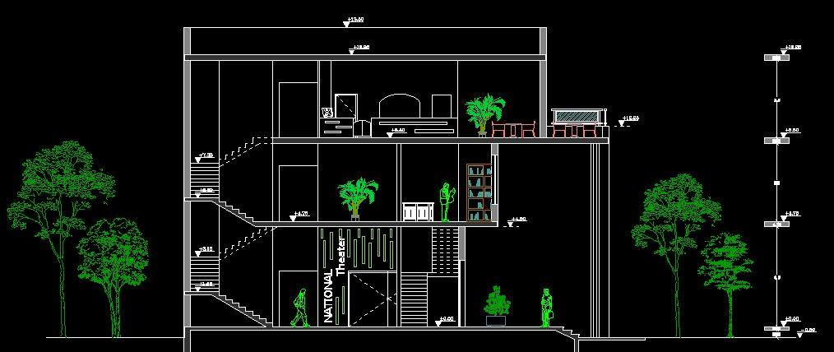
Sections
Section B-B

Slide 11
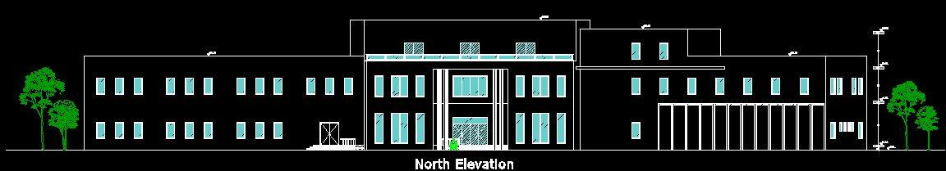
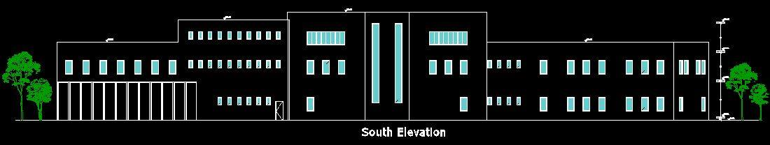
Elevations:

Slide 12
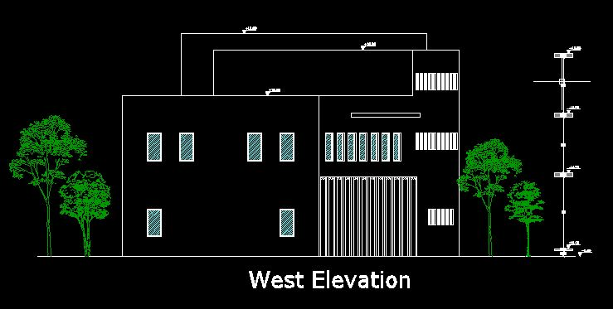
Elevations:

Slide 13
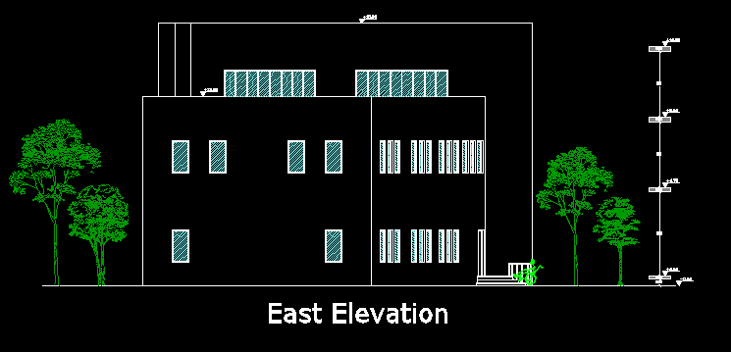
Elevations:

Slide 14
Structural Design
Structural Design:
1- Design codes
2- Loads
3- Sap model and checks
4- Structural elements and detailing

Slide 15
Design Codes:
ACI-318-08 for reinforced concrete design .
UBC-97 for earthquake load computations .
ASCE for load computations

Slide 16
Loads:
Type of loads | Load
Live load | 5KN/m2
Super imposed | 4KN/m2
Exterior walls | 21KN/m

Slide 17
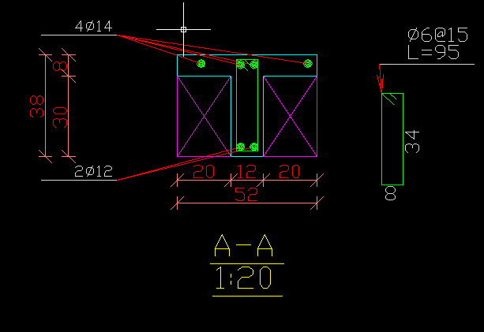
Slab system :
- one way ribbed slab (38 cm thickness )

Slide 18
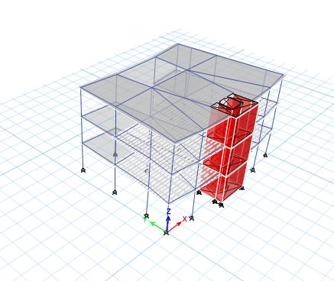
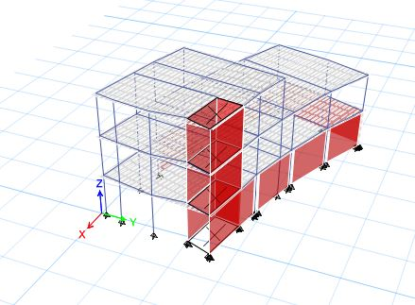
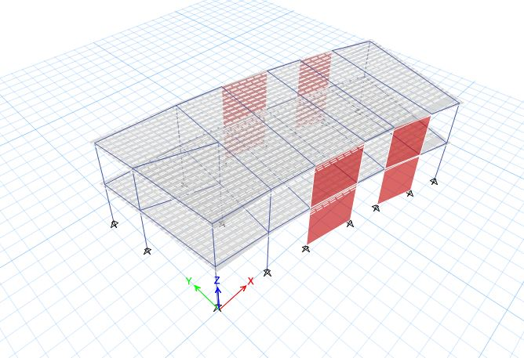
Sap model:

Slide 19
Cheeks
1-Compatiblity check
2-deflection cheek .
3-Equlibrume check
4-Stres strain check

Slide 20
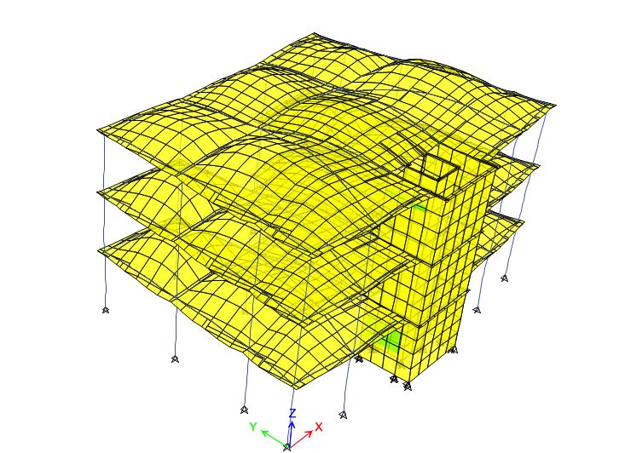
Checks for model : model 1
1. Compatibility check:

Slide 21
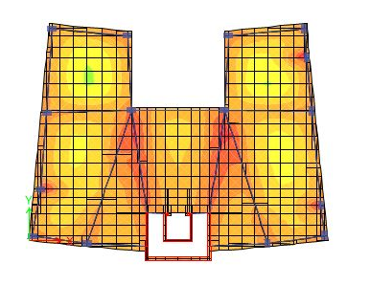
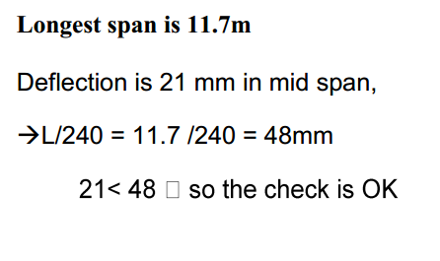
Deflection check:

Slide 22
2. Equilibrium check:
load | Manual | E-Tab | %Error
dead | 16450 | 17051 | 3.6%
live | 5700 | 5757 | 1%
S.D | 7182 | 7254 | 1%
Error < 5%
So ok

Slide 23
3. Internal Forces Check:
 | Manual | E-Tab | Error%
For beam | 53711444 | 1325 | 8.2%
Slab | 96 | 88 | 8%
column | 5371 | 5370 | 0%

Slide 24
Seismic Design
Response Spectrum
UBC-97
I = 1
Z= 0.2
R= 5.5
Ca= 0.24
Cv= 0.32
T = 0.36 sec
W=23894KN,
Include D.L+S.D+0.25LL

Slide 25
• Period check
T= 1.4 * 0.36 = 0.51 sec.
The maximum modal period from ETABS is 0.61
therefore the period check is suitable
So ok

Slide 26
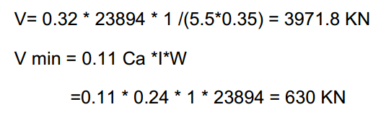
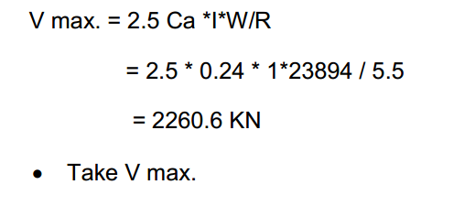
Base Shear check:

Slide 27

Base Shear check:
the percentage of error was 0 % for X-Direction
the percentage of error was 0 % for X-Direction
less than 5% . So it is OK

Slide 28
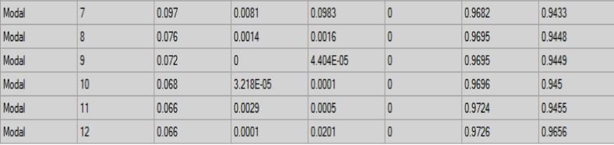
Modal Participating mass ratio check
The 6th mode will satisfy the needed value of 0.9

Slide 29
Drift Check:
According to UBC 97 Code:
Δ story (elastic) ≤ L story/40 for T≤0.7
Δ story (elastic) ≤ L story/50 for T > 0.7
T=0.25 <0.7
Take the average of the two values
Δelastic = ( 0.001 + 0.4 ) /2 =0.2 mm
Δinelastic =0.7*R*Δelastic = 0.77mm < L/40 =4500/40=112.5 mm OK

Slide 30
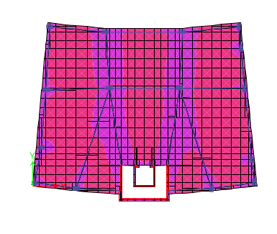
Slab Design :
As shrinkage
As, sh = ρmin * b * h
= 0.0018 * 1000 * 380 =684 mm2/m Use 9 Ø 10/1m in both directions
Moment in slab from E-Tab

Slide 31
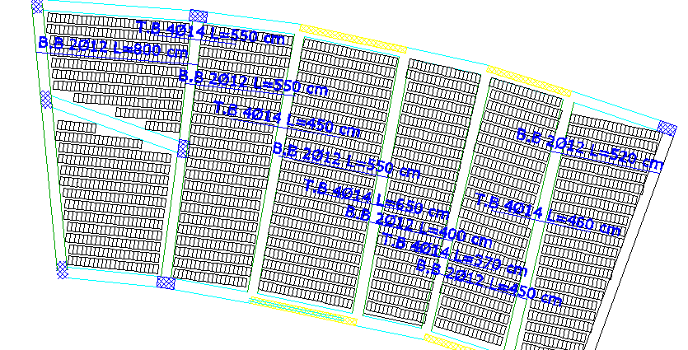
Slab design :

Slide 32
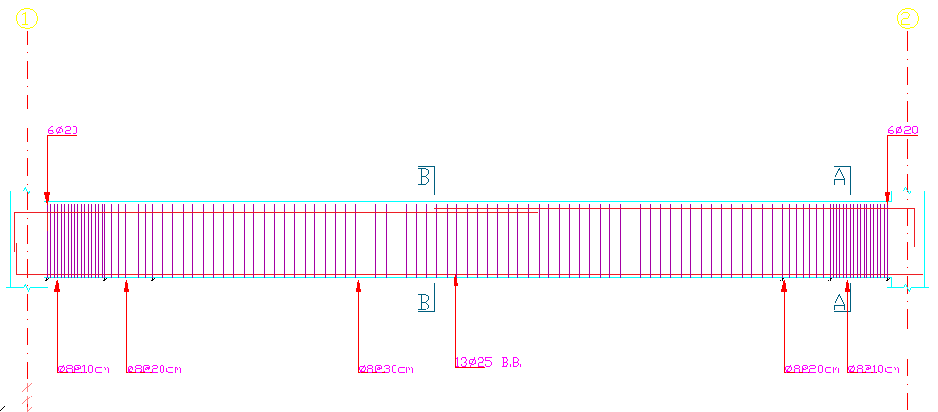
Beams Reinforcement
Main Beam

Slide 33
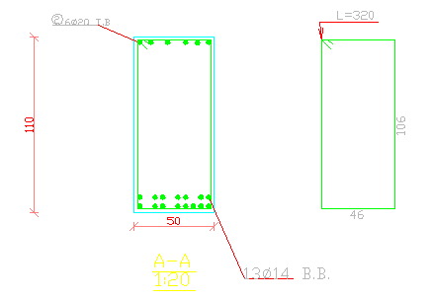
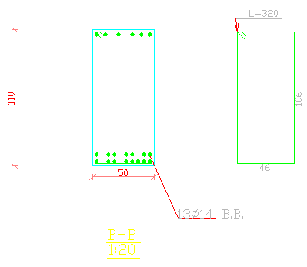
Beam Reinforcement

Slide 34
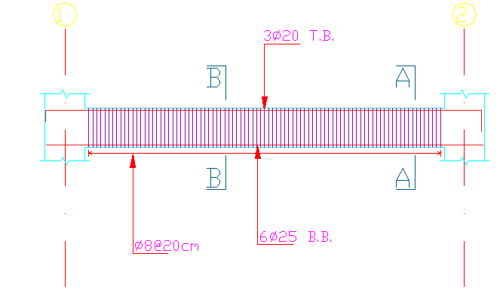
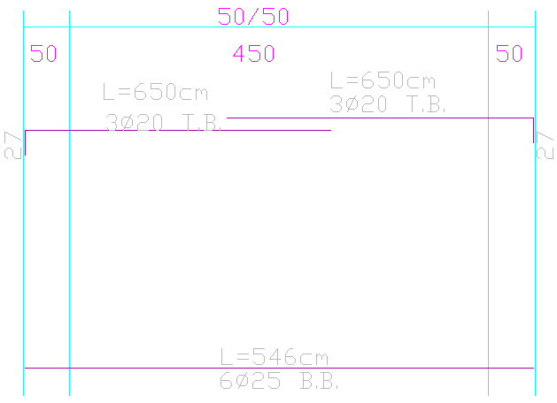
Beam Reinforcement :
Sec. Beam

Slide 35
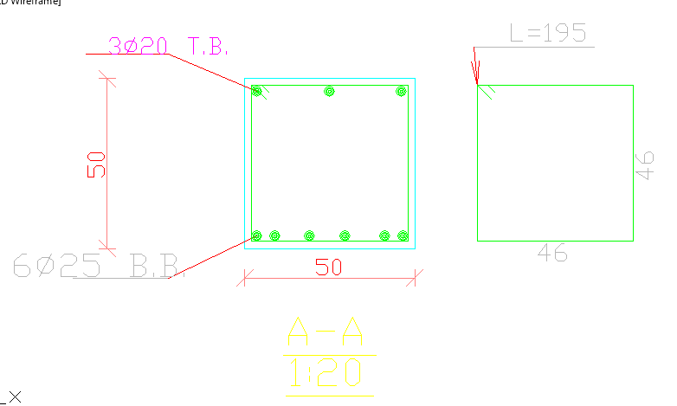
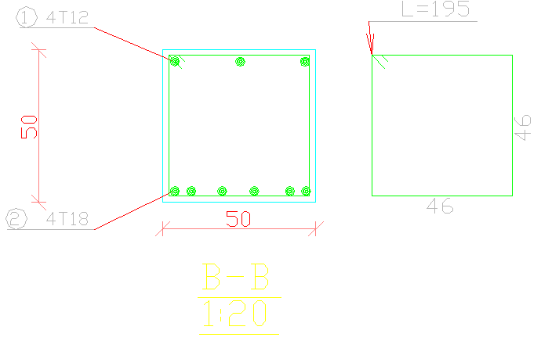
Beam Reinforcement :

Slide 36
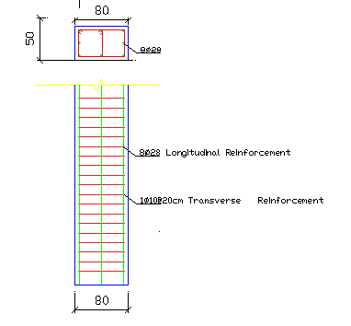
Column Reinforcement

Slide 37
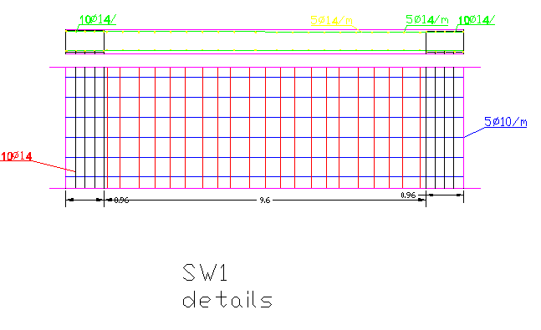
Wall Reinforcement

Slide 38
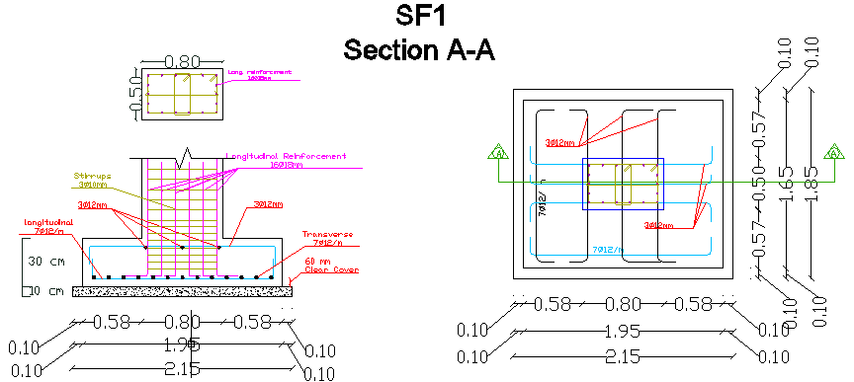
Footing Reinforcement
Single footing

Slide 39
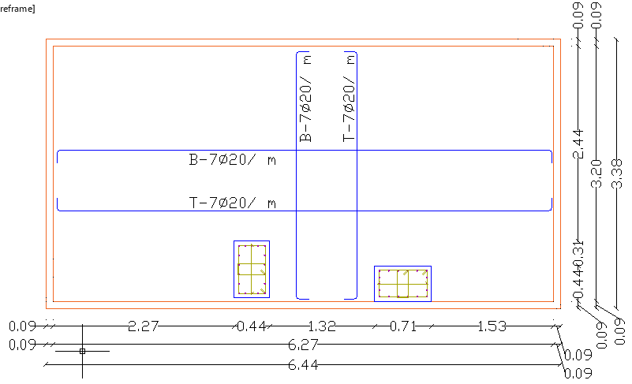
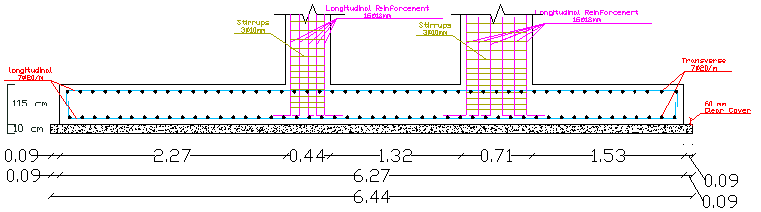
Footing Reinforcement
Combined footing

Slide 40
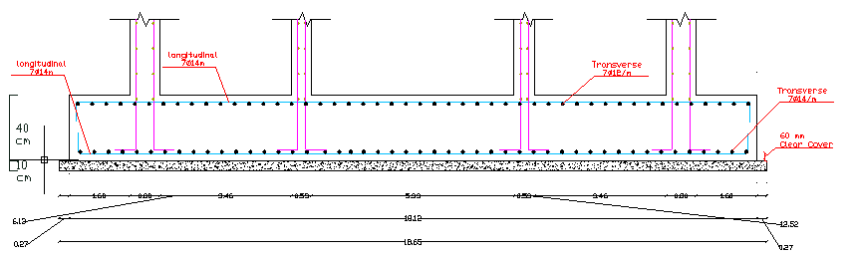
Footing Reinforcement
Wall footing

Slide 41
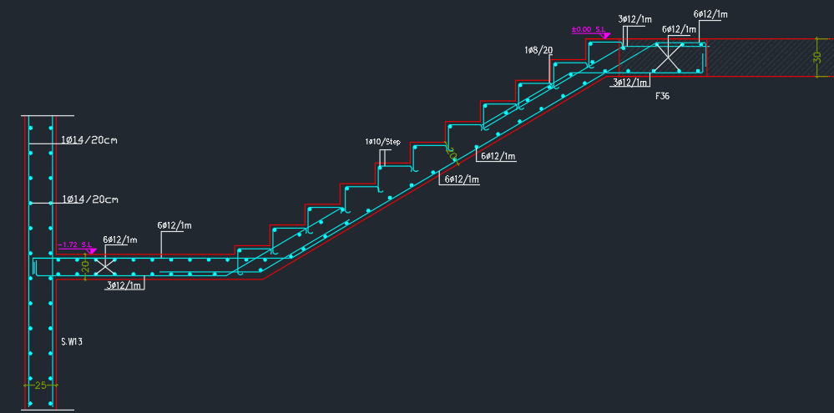
Stair

Slide 42
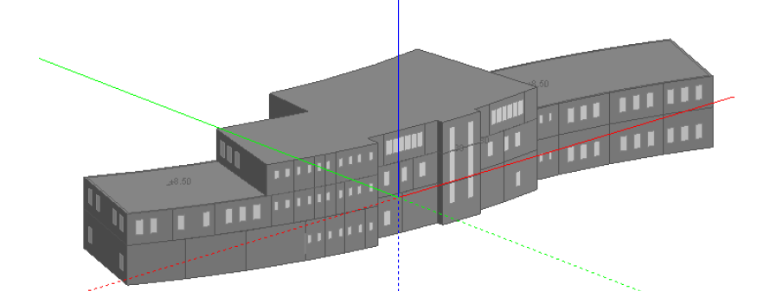
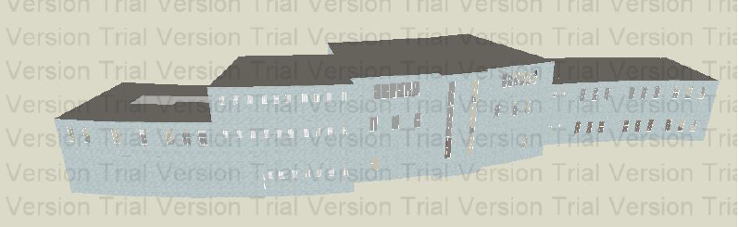
Building in Design Builder

Slide 43
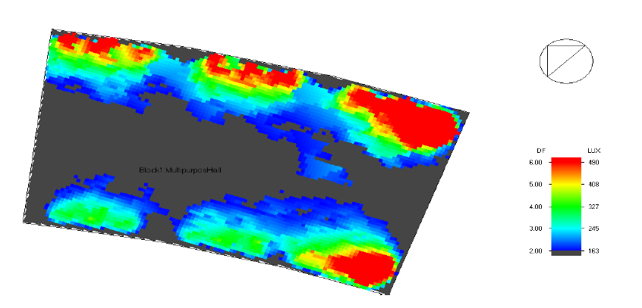
Daylight factor in Multipurpose Hall:

Slide 44
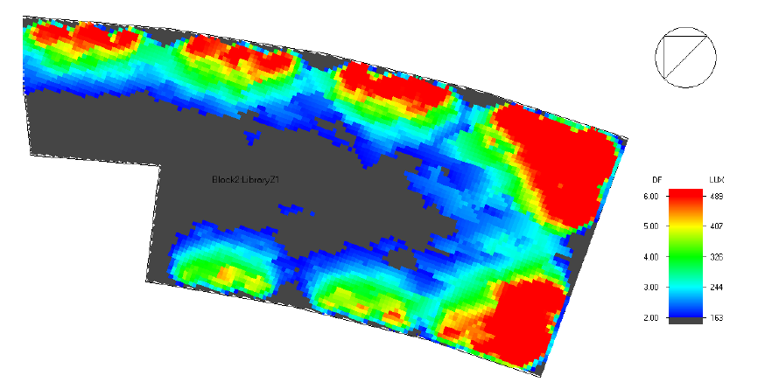
Daylight factor in Library:

Slide 45
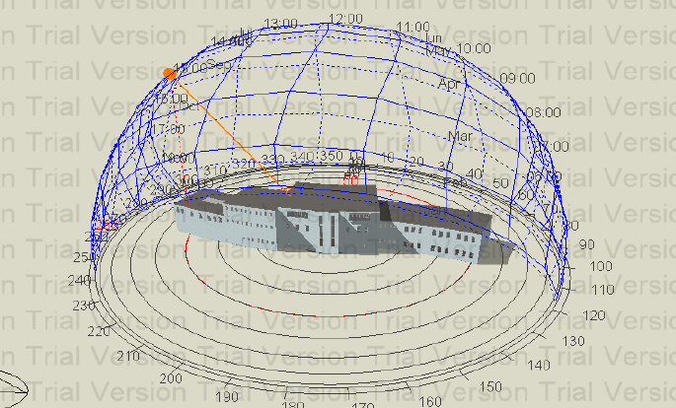
Sun path and shadow on building at 15:00pm

Slide 46
Thermal Analysis
Total cooling load (KW) = 145 KW In 21/7
Total Heating load (KW) = 130 KW In 21/12

Slide 47
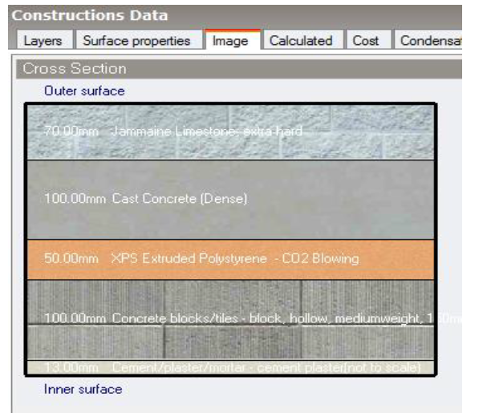
Materials :
External wall of U = 0.521 W/m2.K

Slide 48
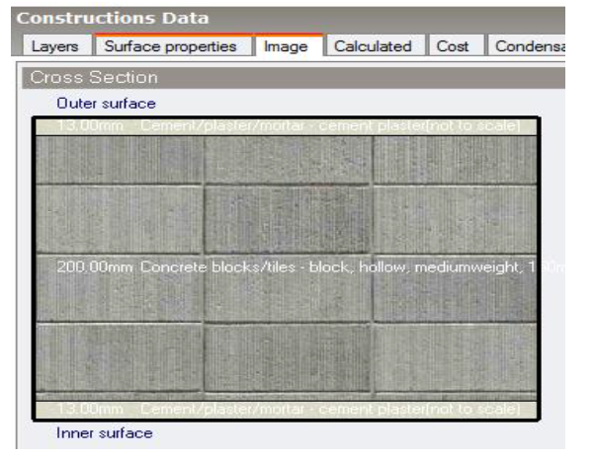
Internal wall of U = 1.61 W/m2.K

Slide 49
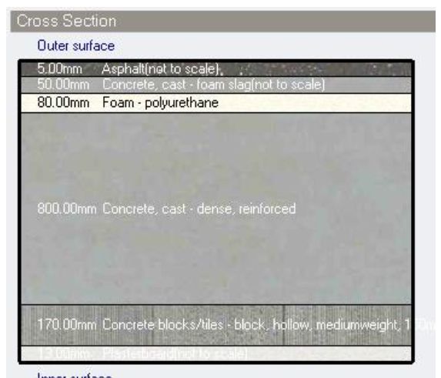
Roof of U = 0.26 W/m2.K

Slide 50
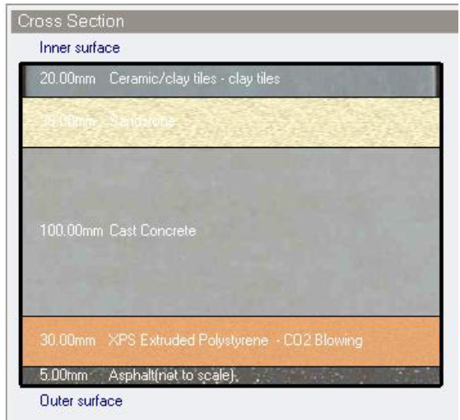
Ground Floor of U = 0.814 W/m2.K

Slide 51

Glass material :
The windows consist of two layers (double glazing) with air gap =6mm
U = 3.159 W/m2.K

Slide 52

Acoustical Design for Theater
Model in ecotect

Slide 53

Reverberation Time RT60
The reverberation time for Music room and small theater is 0.8-1.5

Slide 54



Slide 55



Slide 56


HVAC System(VRF):

Slide 57

HVAC System(VRF):

Slide 58

HVAC System(VRF):

Slide 59

HVAC System(VRF):
Required pipe diameter for library

Slide 60

HVAC System(VRF):
Required pipe diameter for restaurant

Slide 61

HVAC System(VRF):
In door unit distribution in restaurant

Slide 62

HVAC System(VRF):
In door unit distribution in library

Slide 63


Lighting for theater:

Slide 64


Lighting for hall:

Slide 65


Water supply:

Slide 66
Electrical boilers:

Slide 67

Drainage design:

Slide 68
Quantity surveying:
The total cost of the project is : 6483194 NIS
The unit cost of the project is : 2175 NIS

