Slide 1

Prepared by:
Ashraf Ghanem
Futna Shoqo
Supervisor: Dr. Samer Arandi

Slide 2
Outline
Introduction
Methods and Techniques
Constraints
Demo
Future Work

Slide 3
Introduction
1

Slide 4
Problem
Shopping
Travel abroad
Illiterate People
Emergency Situations

Slide 5
Objectives
Barcode Scanning
Predicting
Crowdsourcing

Slide 6
Methods and Techniques
2

Slide 7
Mobile
React Native
Clarifai API
Push Notifications (FCM)
Web
React (Client Side)
Node.js (Server Side)
Database (Firebase)
Authentication
Realtime Database
Cloud Storage
Cloud Messaging

Slide 8
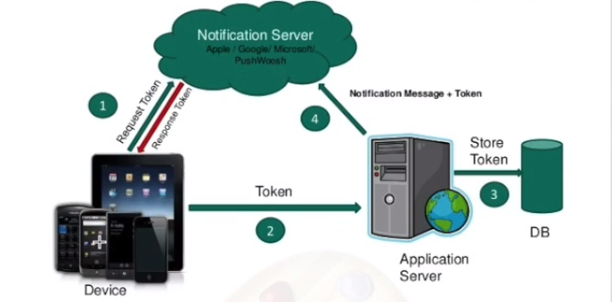

Slide 9
Authentication

Slide 10
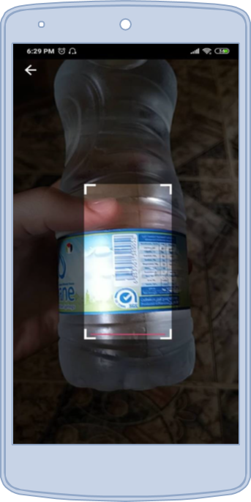
Barcode Scanner

Slide 11
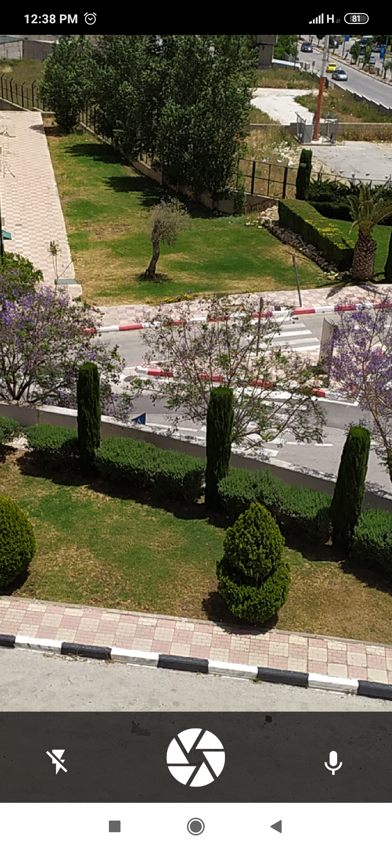
Voice Recognition

Slide 12
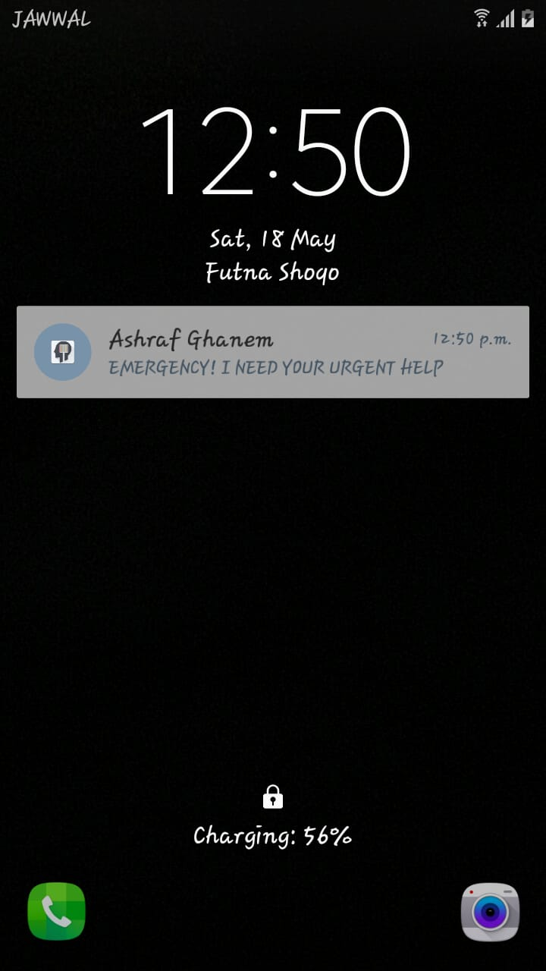
Push Notifications

Slide 13
Constraints
3

Slide 14
Problems with used framework
Lack of knowledge in iOS development
Internet Connection [Limitation]

Slide 15
Demo
4

Slide 16
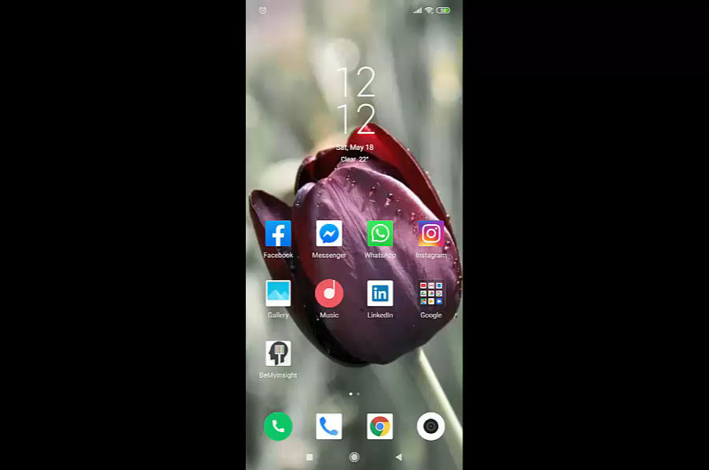

Slide 17
Future Work
5

Slide 18
Support multi-language application
Make the app suitable for visually impaired people use
Enable users to use photos in device gallery to be recognized
Support geographical information in crowdsourcing

Slide 19
THANKS!
Any questions?

