Slide 1
Outline:
Reason behind Furia
What’s Furia?
Furia’s Dimensions

Slide 2
Problem:
New technology trends imposes new rules in gaming
Player can’t feel the interaction from the game
Current technology available for body tracking is platform-dependent
Game developers needn’t to work with hardware components

Slide 3
Solution:
Need for Interactive Universal Controller works on every platform

Slide 4

Reveling Magic:
Furia
  Universal controller
  Feedback interaction from the game
  Non-optical Motion tracking

Slide 5
Furia
Suit-up & let the magic begin

Slide 6
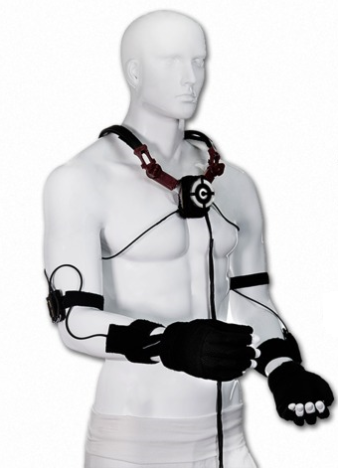



Furia:
Furia Suit
Development kit
Communication

Slide 7
Right Leg:
Motion Track Unit
Haptic Feedback Unit
Radio-Module
Processor Unit

Slide 8
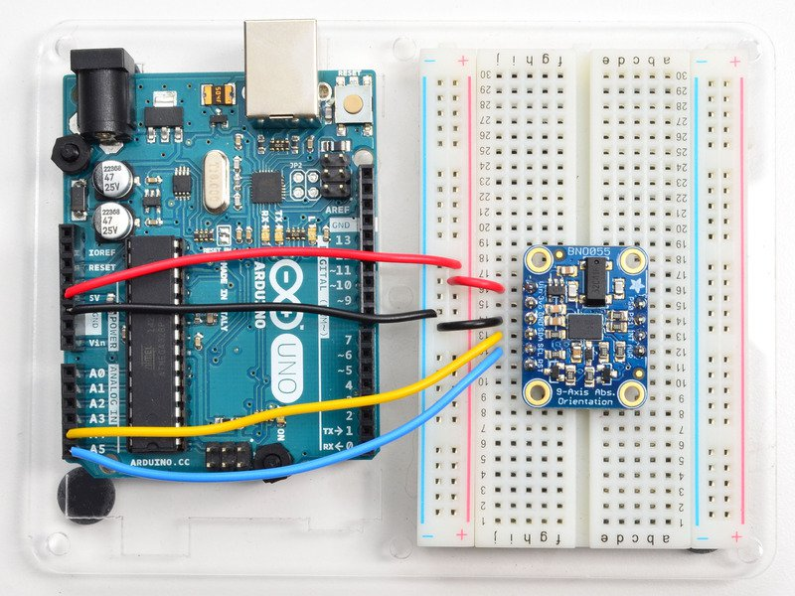
Motion Track Unit:
This main feature of Furia
BNO055 Sensor
Absolute Orientation
Returns Quaternion

Slide 9
Processor Unit:
The processor is an Arduino-Nano that gets
the signal out of the two limbs sensors
and transfer it into packet to send it to central heart
Note: Insert a pic of the project

Slide 10
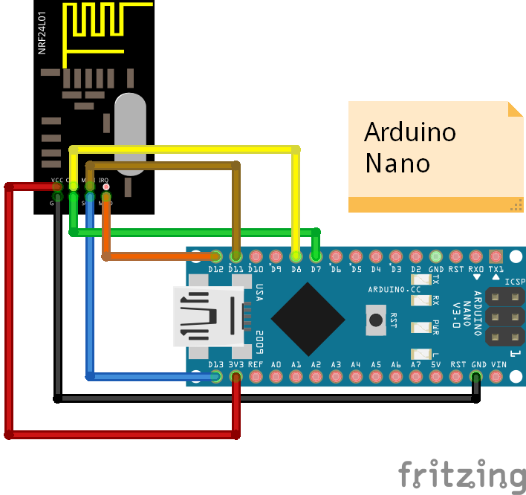
Radio Module:
Inner Communication between the different limbs
and the heart is established by the NRF21014

Slide 11
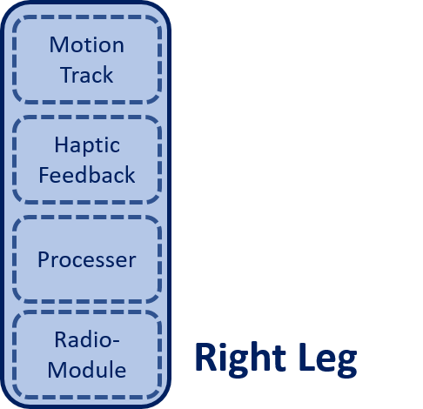
Furia Suit Structure:

Slide 12
Right Arm:
Motion Track Unit
Haptic Feedback Unit
Radio-Module
Processor Unit
BTN Reader Unit & RF BTN

Slide 13
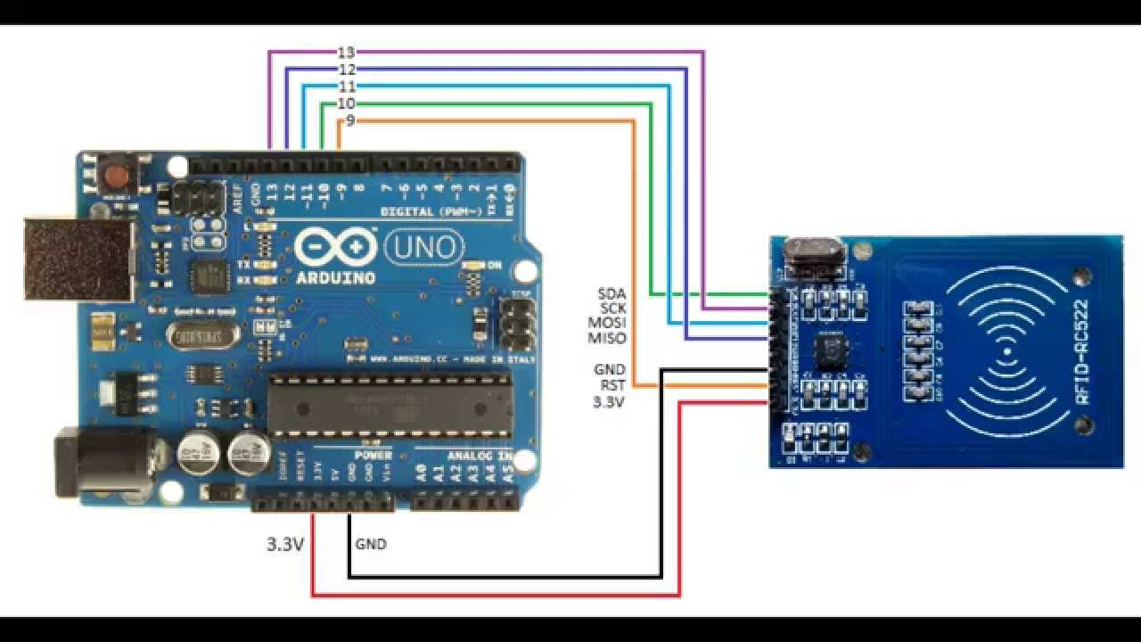
BTN Reader Unit:
This feature is established using RF reader connected to
The right hand and it can be used to push different RF Buttons
scattered around the body

Slide 14
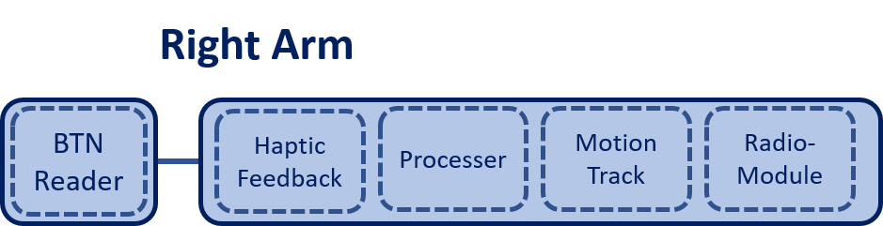
Furia Suit Structure:

Slide 15
Central Heart:
Motion Track Unit
Haptic Feedback Unit
Radio-Module
Processor Unit
Wi-Fi Module

Slide 16
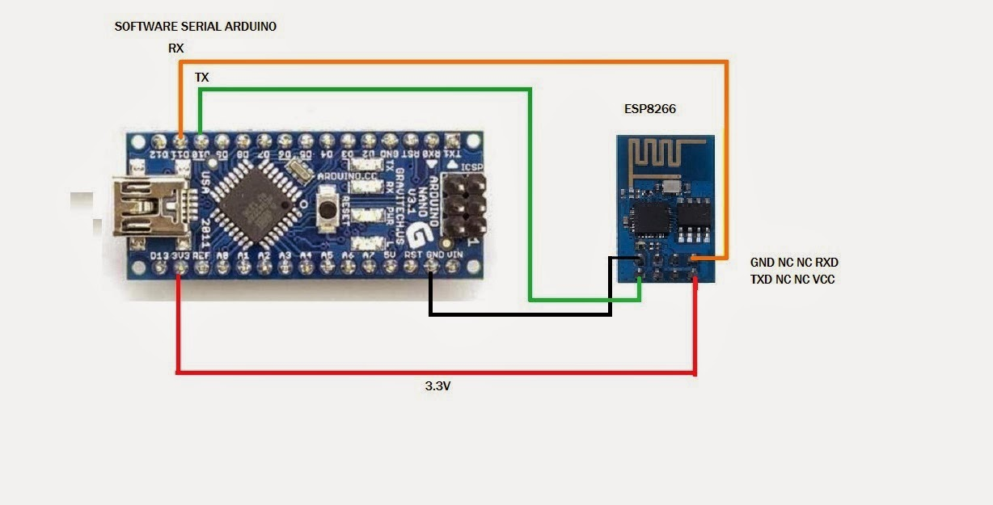
Wi-Fi Module:
The Wi-Fi module responsible for the outer communication
between central heart and the game

Slide 17
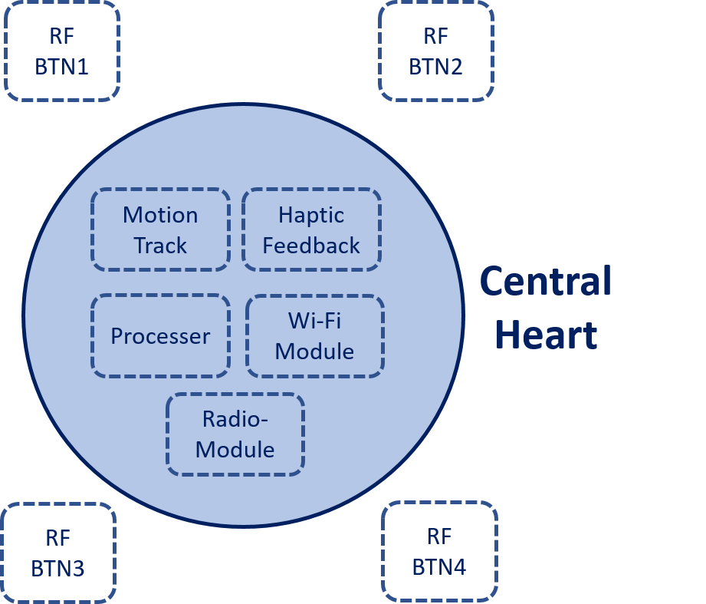
Furia Suit Structure:

Slide 18
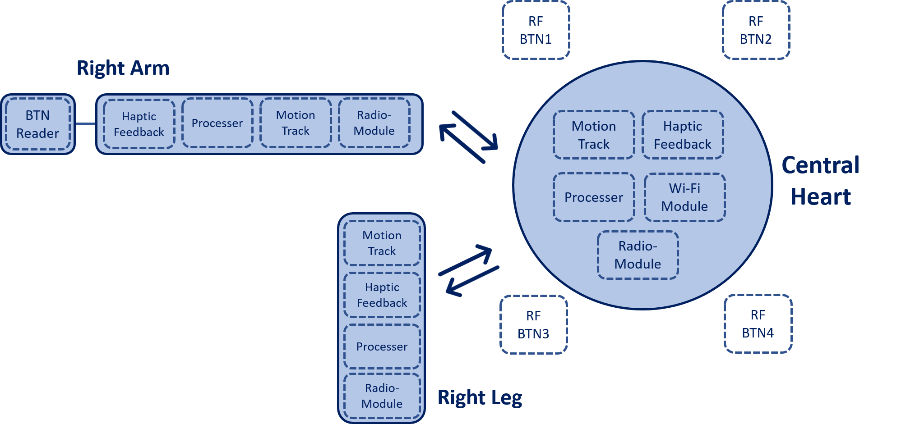
Furia Suit Structure

Slide 19

Furia Suit Structure
RF BTN1
RF BTN2
Right Arm
BTN Reader
Haptic Feedback
Processer
Motion Track
Radio-Module
Motion Track
Haptic Feedback
Central
Heart
Processer
Wi-Fi Module
Motion Track
Radio- Module
Note: this is editable unlike the
previous slide is an image
Haptic Feedback
RF BTN3
RF BTN4
Processer
Radio-Module
Right Leg

Slide 20
Furia Constraints:

Slide 21
Furia Dimensions:
Virtual reality now imposed new rules of interaction where
players are an actual part of the game
Non-Optical Movement tracking
Hands Tracking

Slide 22
Thanks For Listening

