Slide 1


Authorship Attribution in Arabic Poetry
Students : Supervisor :
Razan Balatiah Dr.Samer Arandi
Sara Mahmoud

Slide 2
This project represents an authorship attribution in Arabic poetry using Arabic Natural Language Processing (ANLP) and machine learning techniques.

Slide 3
Authorship Identiﬁcation Process
Collect Data (Poems)
Classific-ation
Extract Features
Prepare Corpus
Select Features

Slide 4
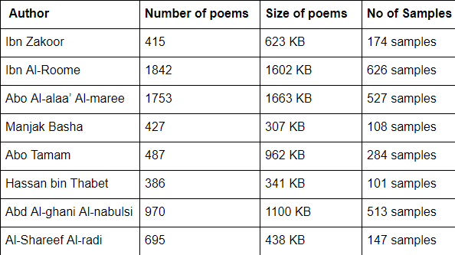
Collect Data
The Poems are collected
from the websites for
a group of poets from
three diﬀerent eras.

Slide 5
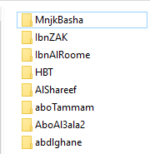
Prepare Corpus
Scrap the poems from the website .
Gathered and stored poems
at a text ﬁles as samples
with same size.
Renamed this ﬁles with
a unique serial number.
Finally stored in a separate
directory named by the author name .

Slide 6
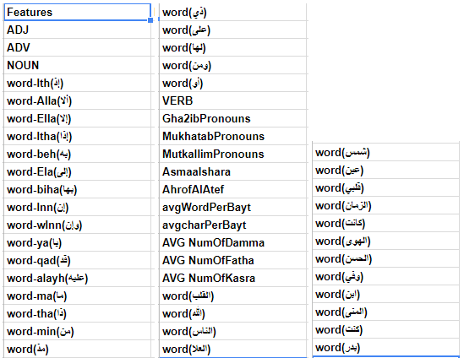
Extract Features

Slide 7
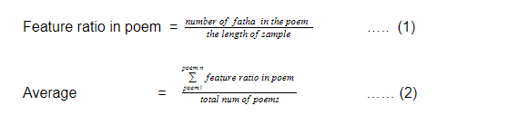
Select Features
The method used is Chi-Squared.
Equations used in calculations for the features .

Slide 8
Results and Discussion

Slide 9
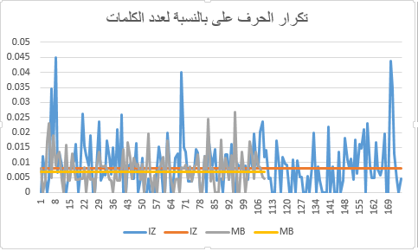
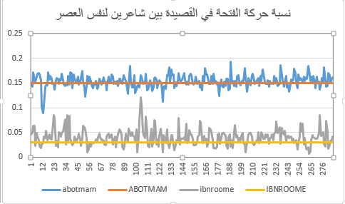
Results in Excel sheet
\\\\\
تكرار الحرف «على» في القصيدة
نسبة حركة الفتحة في القصيدة

Slide 10
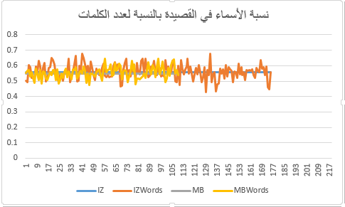
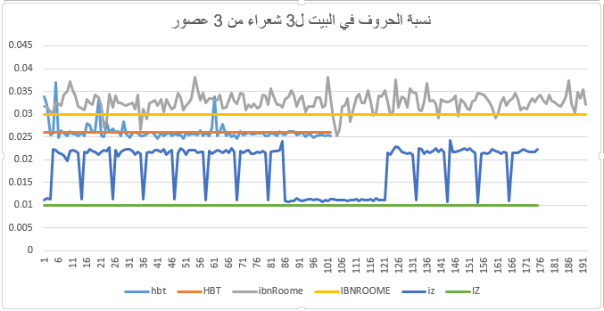
Results in Excel sheet
نسبة الأسماء في القصيدة
نسبة الحروف في القصيدة

Slide 11
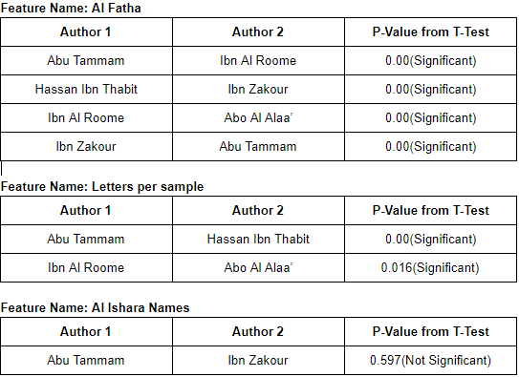
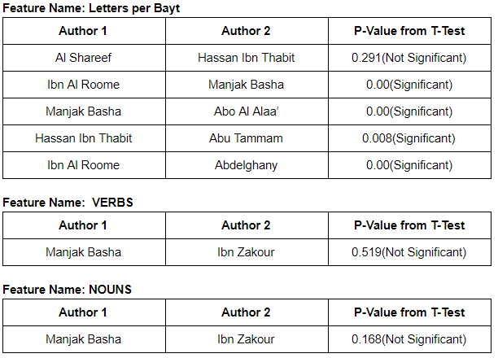
Results in Minitab

Slide 12
Classification Model Building
Random Forest Classiﬁer .
KNN (K Nearest Neighbor Classiﬁer) .
Gaussian Naive Bayes .

Slide 13
Future Work
Increase the number of poets to be more than 8 poets .
Tend to try many algorithms and classiﬁers .
More features will also be implemented (meter and rhyme of poems).

Slide 14


Slide 15
Thanks!
Any questions?

