Slide 1
Archery Game

Slide 2
1
What is
2
Problems and objectives
CONTENTS
3
Implementation
4
Constraints
5
Future work

Slide 3
What is our Game?
Our project, the 'Archery Game,' is an immersive and interactive gaming experience that offers two exciting modes: Attack and Defense. Inspired by the timeless sport of archery, our game combines elements of precision shooting, strategic decision-making, and fast -paced action.

Slide 4
Problems and objectives

Slide 5
Problems and Objectives
1
Design and construct an Archery game with rotational capabilities.
2
Implement attack mode for target detection and shooting.
3
Implement defense mode with motion sensor-based threat detection.
4
Integration of ESP8266 controller and the Blynk mobile app.

Slide 6
Implementation

Slide 7

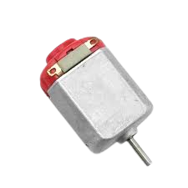
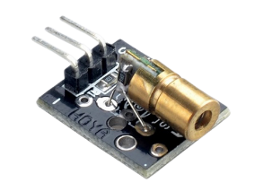
1. Hardware Components:
Servo Motors
DC Motors
Laser Module
We integrated servo motors to control the rotational movement of the game apparatus along the X and Y axes. These motors enable precise aiming and tracking of targets.
Two DC motors were incorporated to provide the power needed to shoot rubber darts with force. The motors are synchronized to work in opposite directions, resulting in a vigorous shooting mechanism.
We utilized a KY-008 laser module to indicate the location of the target, enhancing the gameplay experience and aiming accuracy.

Slide 8
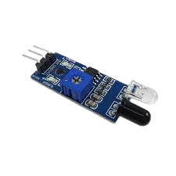
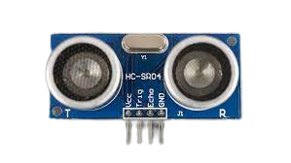
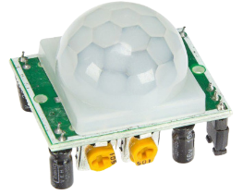
1. Hardware Components:
Ultrasonic Sensor
PIR Sensor
IR Sensor
The game utilizes a Sharp ultrasonic sensor for target detection in Defense mode, where It measures the distance to the target .
A PIR (Passive Infrared) sensor was employed to detect any motion . It plays a crucial role in identifying potential threats and triggering the appropriate defensive actions.
An IR sensor detects and measures infrared radiation. It uses an IR source to emit infrared waves and an IR detector to convert the received radiation into an electrical signal. The sensor can detect objects, measure temperature, and monitor motion.

Slide 9
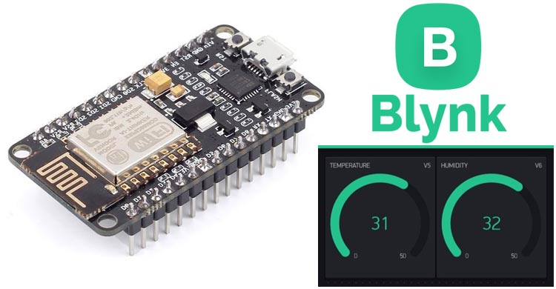
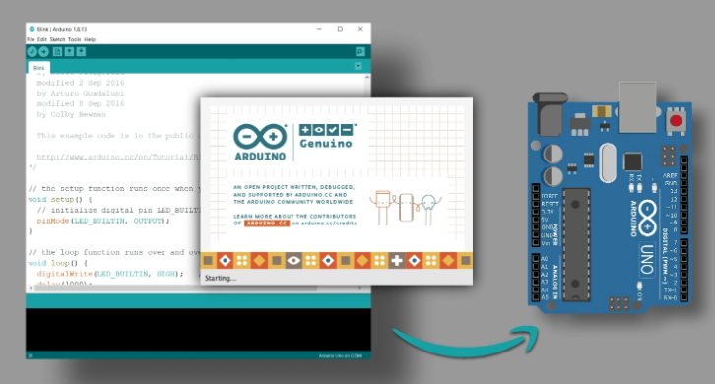

2. Software and Control:
Arduino IDE
Blynk Mobile App with ESP8266
We programmed the Arduino Uno board using the Arduino IDE to control the various hardware components and coordinate their actions.
To provide remote control and monitoring capabilities, we integrated the Blynk mobile app with an ESP8266 controller. This allowed users to control the game apparatus wirelessly and monitor its status and performance.

Slide 10
Constraints

Slide 11



Constraints
3D Printing Design
Loading the Rubber Darts Shots
DC Motor
Lack of Experience: We faced a constraint regarding our limited experience in 3D printing designs. To overcome this challenge, we conducted thorough research and immersed ourselves in the subject matter. By exploring various design possibilities and seeking input from a friend who was familiar with 3D printing, we were able to develop a unique and innovative design for the project's structure.
The loading mechanism for the rubber darts shots employed a servo motor with limited range of motion. The design allowed the servo motor to move approximately 60 degrees, with 10 degrees in the forward direction and 70 degrees in the backward direction. This constraint influenced the design of the loading mechanism and the range of motion available for loading the rubber darts.
The use of a 12V DC motor in the game imposed a constraint on the power supply. It required a stable and sufficient 12V power source to ensure optimal motor performance and torque. Deviating from the recommended voltage range may result in decreased motor speed or inadequate rotational force, affecting the game's aiming capabilities.

Slide 12

Future Work

Slide 13






Future Work
Full 360-Degree Coverage
Improved Defense Mode
Enhancing the game experience by enabling a full 360-degree coverage instead of the current 180-degree range. This modification would provide players with a more immersive and dynamic gameplay environment, allowing them to engage targets from all directions.
Introducing a Raspberry Pi into the system to enhance the defense mode. This addition would enable a higher level of accuracy by allowing the Raspberry Pi to selectively target specific objects rather than responding to any detected movement. This enhancement would enhance the precision and efficiency of the defense mode, making it more effective and reliable.
Multi-Directional Movement
Increasing the level of enjoyment in the game by incorporating movement capabilities similar to that of a car. By implementing this feature, users would have the ability to control the game apparatus in all directions, adding a new dimension of interactivity and excitement to the gameplay.

Slide 14
THANK YOU

