Slide 1
Fake News Detection For Arabic Tweets
Momen Buzz - Ghaith Jardaneh
Supervised by: Dr. Hamed Abdelhaq
An-Najah National University
Department of Computer Science

Slide 2
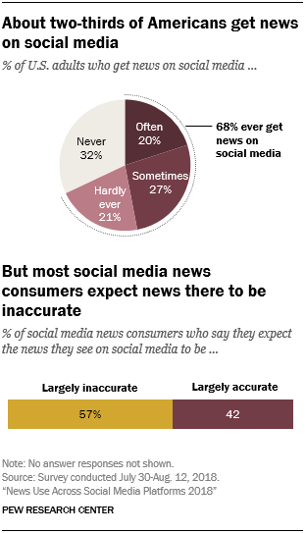
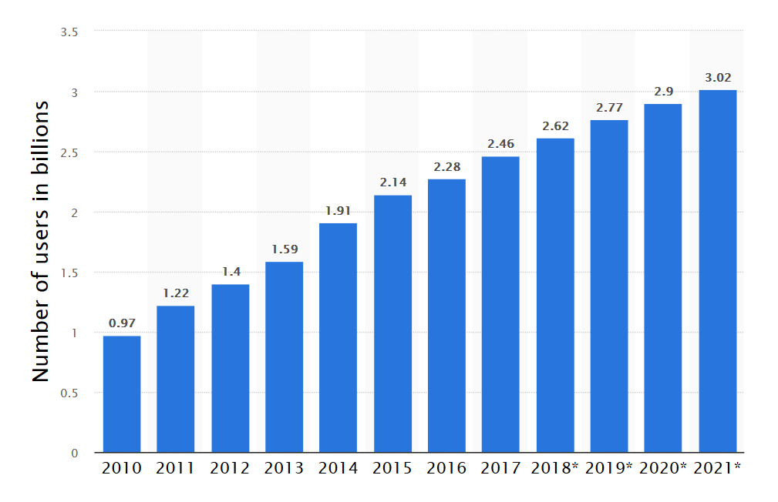
Motivation
Social network penetration is ever increasing
About two-thirds of americans say they get their news from social media
~ 57% of these news posts are inaccurate
Taken From [https://www.statista.com/statistics/278414/number-of-worldwide-social-network-users/]
Taken From [http://www.journalism.org/2018/09/10/news-use-across-social-media-platforms-2018/]

Slide 3
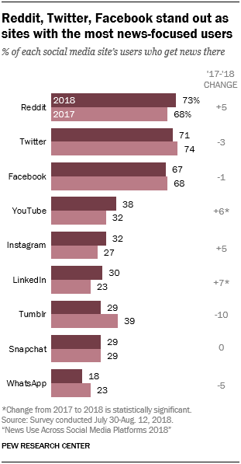
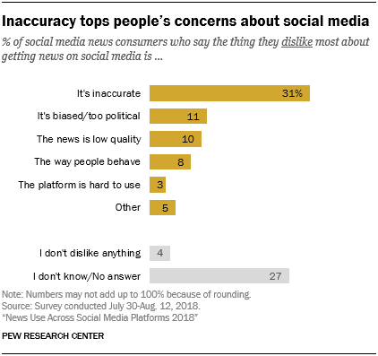
Motivation
Why Twitter?
How fake news affects the world
Twitter is the largest source of breaking news on U.S presidential election day (2016)
40 million tweets sent by 10:00 pm that day
Taken From [http://www.journalism.org/2018/09/10/news-use-across-social-media-platforms-2018/]

Slide 4
Outline
Related Work
Framework
Dataset
Feature Extraction
Feature pre-processing
Applied Machine Learning Algorithms
Future Work

Slide 5
Related Work
Most related work found was for english tweets
“Arabic news credibility on twitter: An enhanced model using hybrid features” by Sara sabbah.
Topic-related and user related-features
Included user replies features
“An experimental system for measuring the credibility of news content in Twitter” by Hend Al-khalifa
Three levels of credibility: low, average and high
Utilizing authentic news sources for validating suspicious tweets

Slide 6
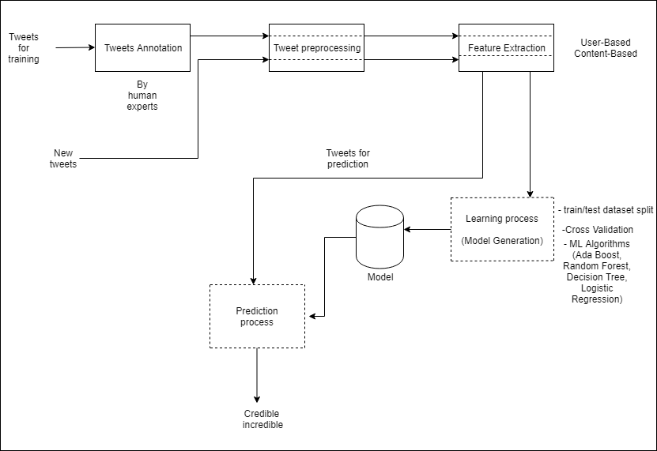
Framework

Slide 7
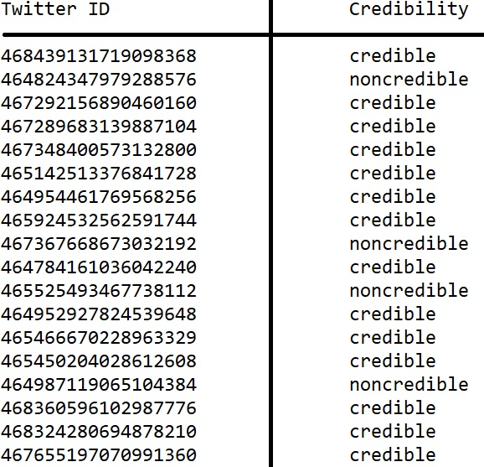
Dataset
Contains 2708 records
Some users are suspended due to the violation of twitter policy
Our definition of credibility

Slide 8
Feature Extraction
Using Twitter API
Some features had to be derived (e.g. retweet fraction)
44 extracted features
  Content-based features
  User-based features

Slide 9
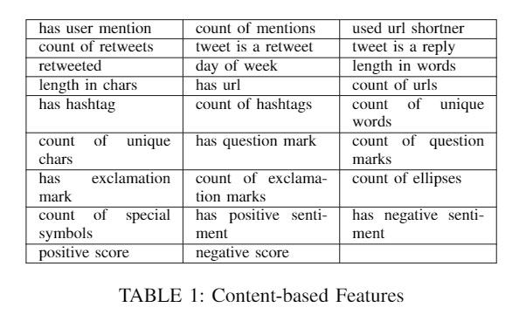
Content Features
26 Content-based features
including sentiment features:
  Has positive sentiment
  Has negative sentiment
  Positive score
  Negative score

Slide 10
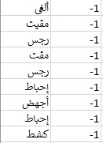
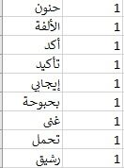
Sentiment Analysis
Using NLTK (Natural Language Toolkit) that supports Arabic
  employ a lexicon of positive and negative words:
  5200 words total
Negative words
Positive words

Slide 11
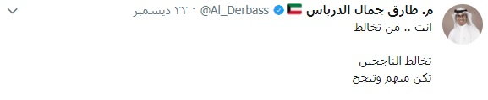


Sentiment Analysis
Tokenize the tweet
Remove stopwords
Get the stem of each word
Stems:
Comparing
Positive words:

Slide 12
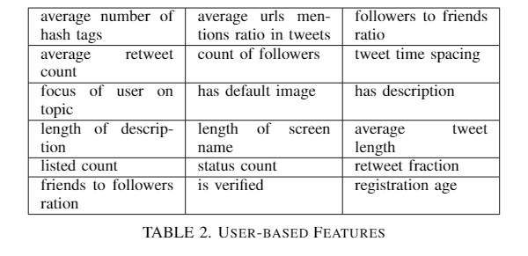
User Features
18 User-based Features
Tweet time spacing
Focus of user on topic
Retweet fraction

Slide 13
Machine Learning Algorithms
We tested many Machine Learning algorithms
Some algorithms were more effective:
Ada Boost
Random Forest
Decision Tree
Logistic Regression

Slide 14
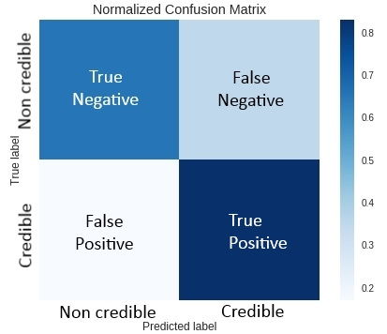


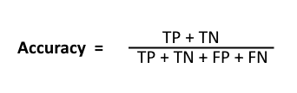

Terminology

Slide 15
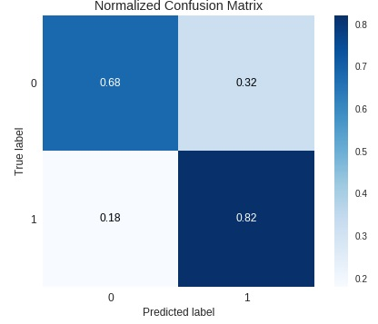
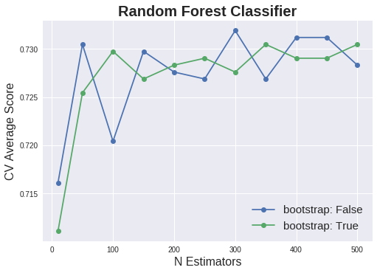
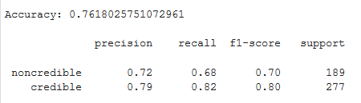
Random Forest Classifier

Slide 16
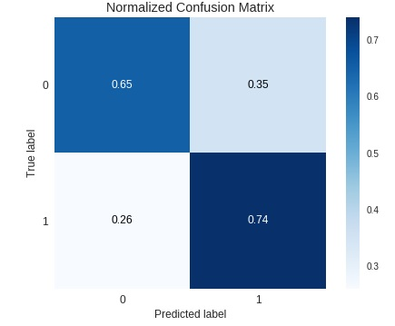
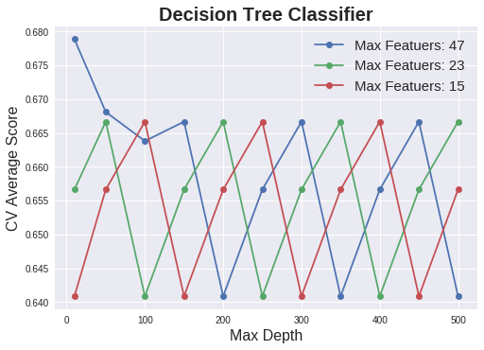
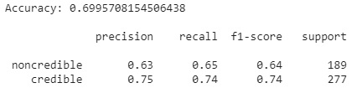
Decision Tree Classifier

Slide 17
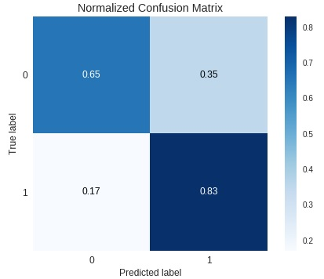
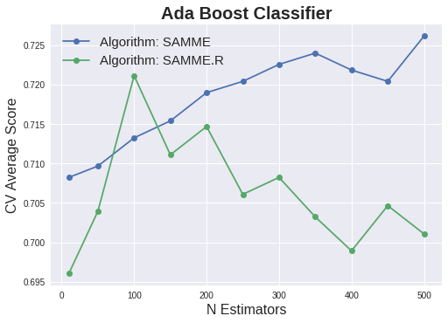
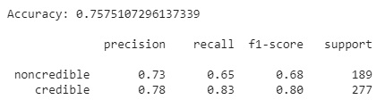
Ada Boost Classifier

Slide 18
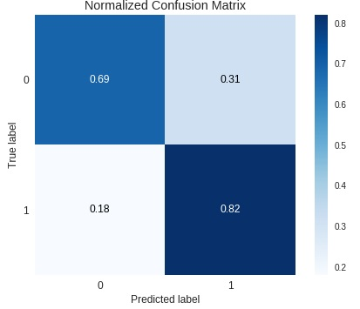
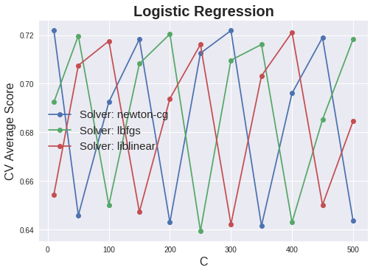
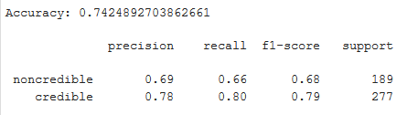
Logistic Regression Classifier

Slide 19
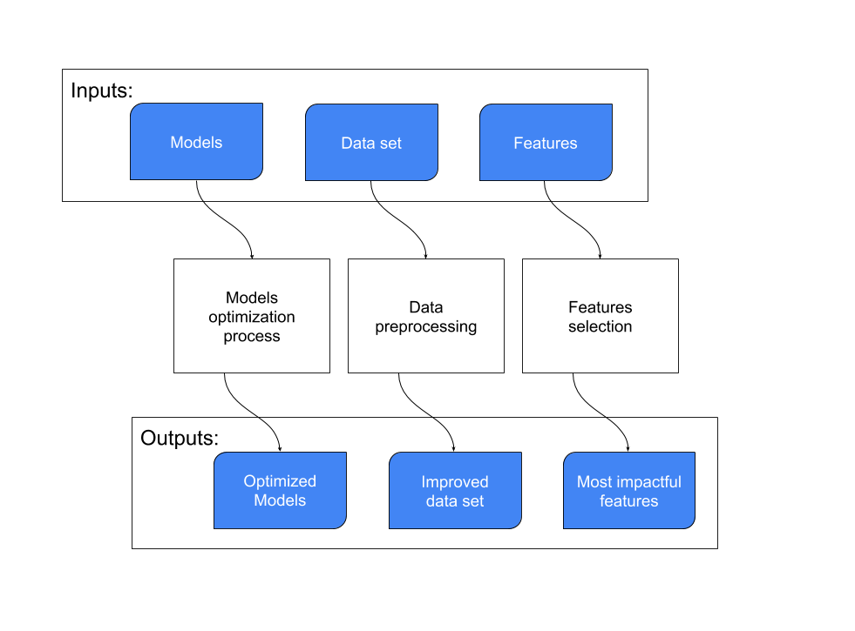
Experimentals

Slide 20
Model Optimization
Achieved using GridSearchCV module.
Optimizes a model by the means of exhaustive search over specified hyperparameters values.
Cross-Validation is used to accurately validate our results.

Slide 21
Model Optimization Output

Slide 22
Experimentals

Slide 23


Data set Transformations
Standardization transforms each feature so it have zero-mean and unit-variance.
Standardization can be achieved by applying the Equation 1.
Where ́x is the resulted standardized feature vector.
X is the original feature vector.
̄x is the mean of the feature vector.
And σ is the standard deviation.
Min-max Rescaling is the process of transforming each feature
so that each of its values is in the range of [0,1].
Min-max Rescaling can be achieved by applying the Equation 2.
Where ́x is the new normalized feature vector.

Slide 24
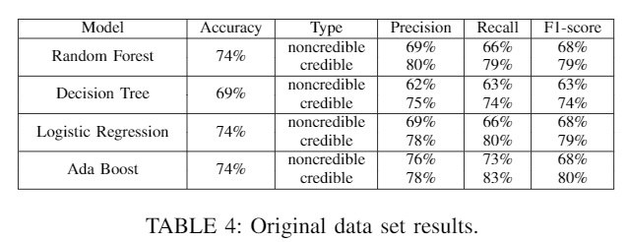
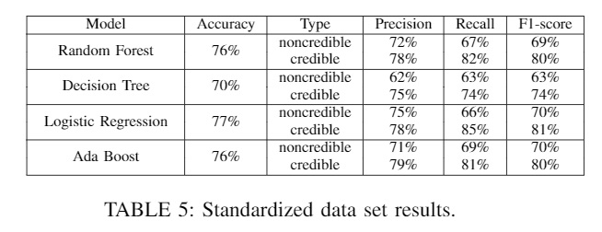
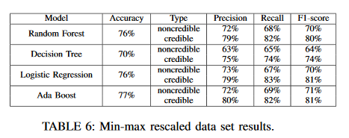
Results of data preprocessing

Slide 25
Experimentals

Slide 26
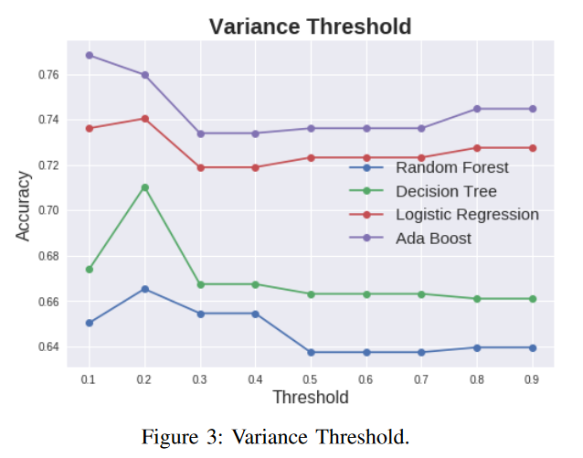
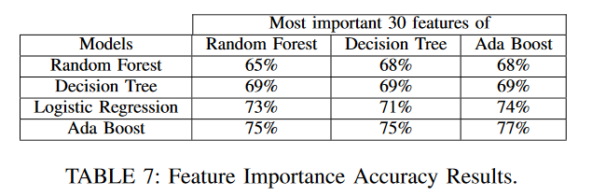
Features Selection
VarianceThreshold module.
Feature importance of each Model.

Slide 27
Future Work
larger datasets
Replies-Centric Features
Use more sophisticated NLP algorithms
Include other languages

Slide 28
Thanks For Listening

