Slide 1

Telecommunication Engineering Department
An Najah National University
Simulation of Acoustic Camera
Supervisor: Dr Falah Hasan
Prepared by:
Ange Mustafa
Dania Abu Yasin
Shahd Najjar

Slide 2
Outline:
Acoustic camera definition.
Theoretical aspects of microphone array design.
Beamforming technology.
Software part.
Conclusion.
Future work.

Slide 3
What is an “Acoustic Camera”?
it is an imaging device and a measurement tool. This technology analyses the actual sound scene and used to locate sound sources and to characterize them. Acoustic camera consists of a superposition of different sound sources, into a visual sound map.
It consists of optionally an optical camera and a group of microphones—also called microphone array—that are simultaneously acquired to form a representation of the location of the sound sources.

Slide 4
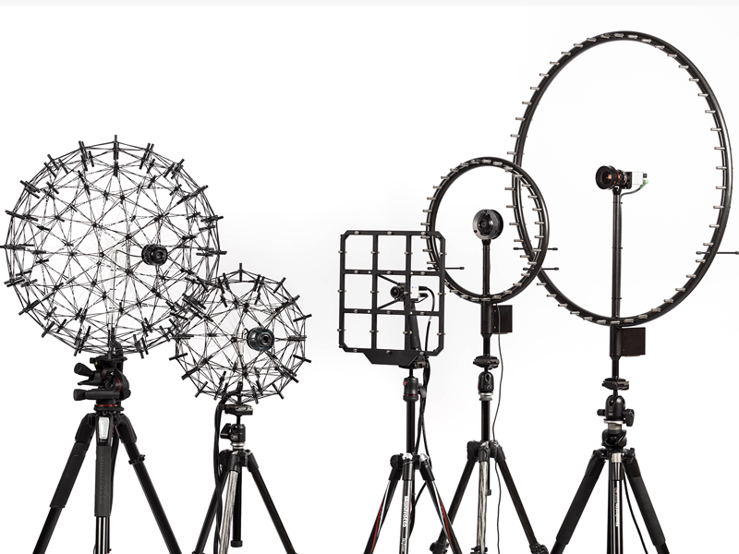
This figure shows different Acoustic Cameras with different microphone arrays shapes:
Figure (1): Different Acoustic Cameras.

Slide 5
Microphone Array design:
Microphones are passive sensors which convert the change of pressure into an electric signal. Microphones can be also seen as ‘acoustic antennas’.
Ideally array design will be infinite number of microphones randomly distributed. But practically that would be expensive as you can imagine !!!
Array should be compromise to provide the best result for the cost, application and the results of beam pattern and directivity.
The main goal of our design is to have a sharp main lobes and small side lobes .The last one will always exist ,but they also should help you to locate the sound source.
The array beam width decreases as the spacing d increases, main lobe become narrower. So, if we want a sharper beam, we can simply increase the spacing d, which leads to a larger array aperture.

Slide 6
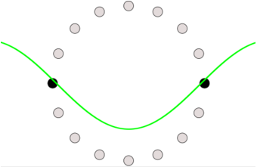
Limiting frequencies of Microphone Array:
Another aspect affected by array geometry, is the quality of sound signal level (SSL) depending on the source frequency.
1. Lower limit frequency:
Assuming that the microphone density is reasonable, the lower limit frequency depends on the largest distance between two microphones within the array.
Figure (2): Lower limit frequency.

Slide 7
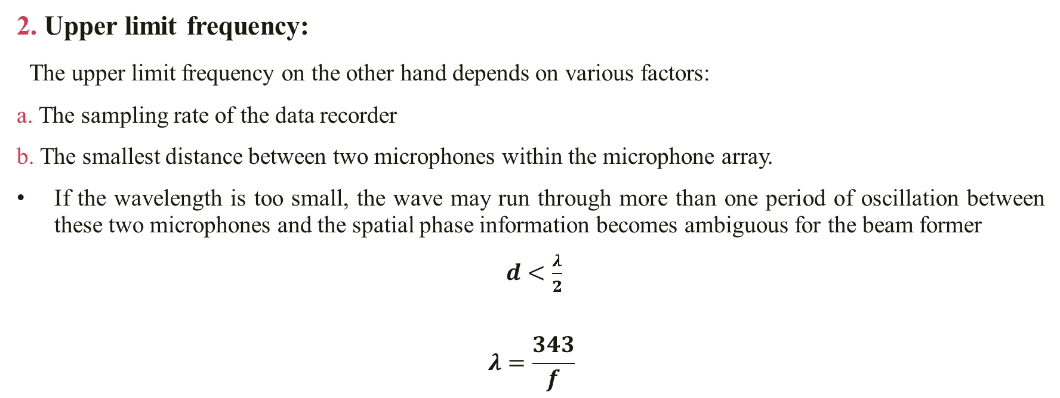
Limiting frequencies of Microphone Array:
2. Upper limit frequency:
The upper limit frequency on the other hand depends on various factors:
a. The sampling rate of the data recorder
b. The smallest distance between two microphones within the microphone array.
If the wavelength is too small, the wave may run through more than one period of oscillation between these two microphones and the spatial phase information becomes ambiguous for the beam former
$d<\frac{λ}{2}$
$$λ=\frac{343}{f}$$

Slide 8
Theory behind this technology:
Beamforming:
Beamforming or spatial filtering is a signal processing technique which means filter the entire space, giving the highest possible gain to the desired direction and nullifying the other directions.
The simplest form of beamforming algorithm is the delay-and-sum beam former which can be used to generate an acoustic map from microphone data.

Slide 9
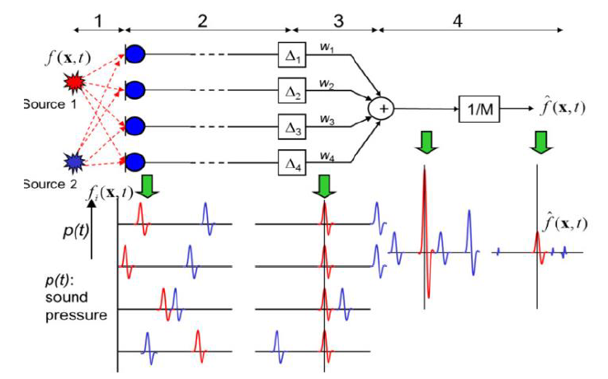
The functionality of the Delay-And-Sum-Beamformer can be described by decomposing the signal processing into four main steps. The block diagram illustrates the case of two-point sources situated in front of the microphone array.
Step 1:The sound of each source reaches the microphones on different paths.
Step 2:The signals captured by the microphones are similar in wave form, but show different delays and phases. Both are proportional to the covered distances. The delays can be determined from the speed of sound, the distance between the microphones, and the sound sources. The Beamformer targets the point where source 1 is situated.
Figure (3): Two-point sources situated in front of the microphone array.

Slide 10
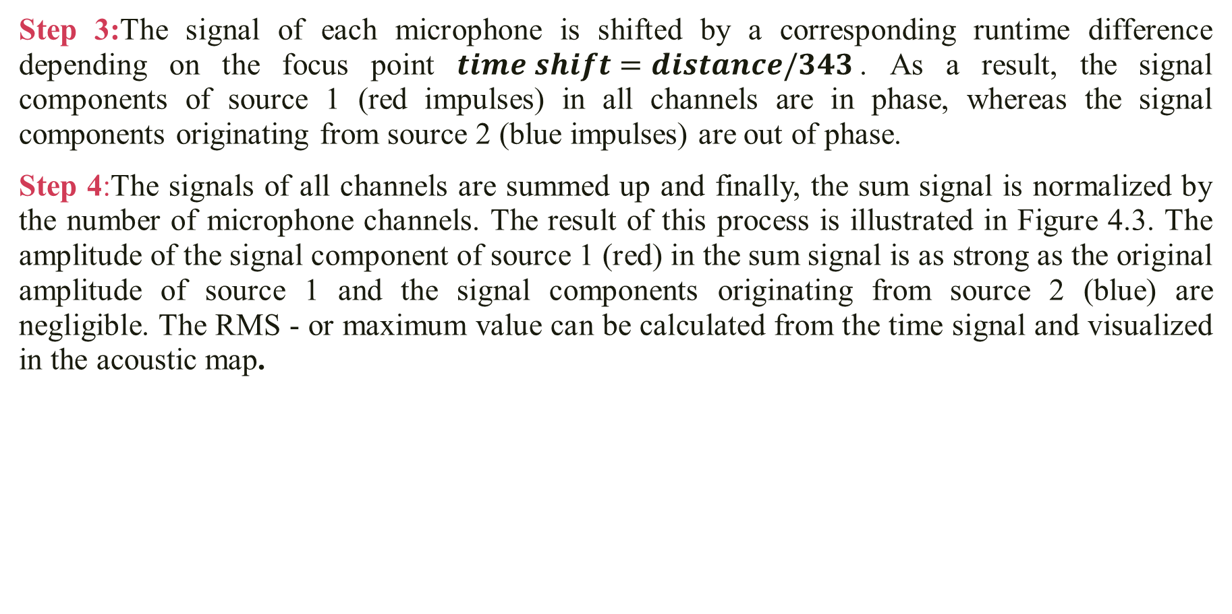
Step 3:The signal of each microphone is shifted by a corresponding runtime difference depending on the focus point $time shift=distance/343$. As a result, the signal components of source 1 (red impulses) in all channels are in phase, whereas the signal components originating from source 2 (blue impulses) are out of phase.
Step 4:The signals of all channels are summed up and finally, the sum signal is normalized by the number of microphone channels. The result of this process is illustrated in Figure 4.3. The amplitude of the signal component of source 1 (red) in the sum signal is as strong as the original amplitude of source 1 and the signal components originating from source 2 (blue) are negligible. The RMS - or maximum value can be calculated from the time signal and visualized in the acoustic map.
Figure (3): Two-point sources situated in front of the microphone array.

Slide 11
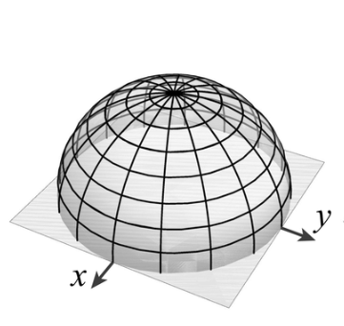
Steering Vector:
We don’t know from which point the source is coming .
So the steering vector rotates over a group of points and executes the beamforming algorithm at each focus point or spatial angle.
Step = 6 degrees.
Theta= 0-360 degrees.
Phi=0-90 degrees.
Figure (4): Group of focus points as a half sphere

Slide 12
Tracking:
We have what we do with that information which is basically divide our image from our camera into different pixels and at each pixel we calculate the run time delay for each of the pixels that are in the camera image and then do projection of each sound signal level at each pixel .

Slide 13
Software Part
Part one: MATLAB Code (m file)
We have made a simulation for “Acoustic Camera” using MATLAB ,where we implemented a microphone array with 33 microphones and we used two sound sources as follow:
1. Microphones position in Euclidean Space:
We implemented a circular microphone array which consists of 33 microphones distributed over different radiuses as follow:
Circle 1 has a radius of 0.7 meter and consists of 3 microphones.
Circle 2 has a radius of 0.55 meter and consists of 3 microphones.
Circle 3 has a radius of 0.4 meter and consists of 24 microphones.
Circle 4 has a radius of 0.25 meter and consists of 3 microphones.

Slide 14
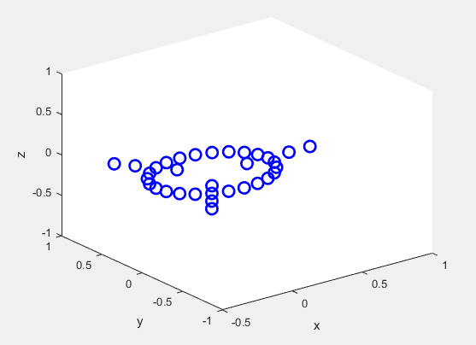
This figure shows the microphones distribution in Euclidean Space:
Figure (5): 33 microphones position in Euclidean Space.

Slide 15
Largest distance between microphones = 1.4 m
Smallest distance between microphones= 0.1 m
d= λ/2
0.1 < d < 1.4 → 0.2 < λ < 2.8
Where λ = speed of sound/ f = 343/ λ
Which gives that the operating frequency is:
123 Hz < f < 1.715 KHz

Slide 16
2. Sources Position:
We placed the two sound sources as follow:
Source 1 spherical coordinates are:
R = 30m
theta = 45ᵒ
phi = 45ᵒ
Source 2 spherical coordinates are:
R_source2 = 10m
theta_source2 = 165ᵒ
phi_source2 = 30ᵒ

Slide 17
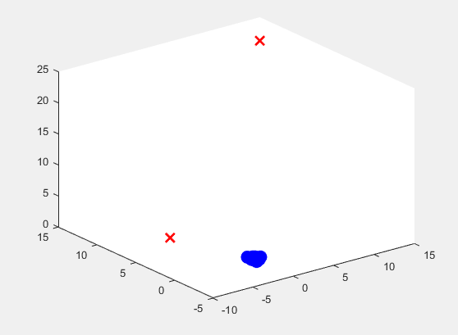
This figure shows the location of sources, where they are indicated by two cross signs:
Figure (6): Location of the two sources.

Slide 18
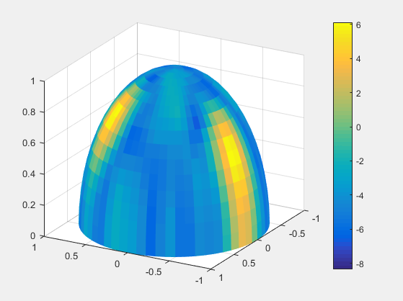
3. Obtained result on a half sphere:
We can notice that we have a relatively high directivity where the two sources are existing.
Figure (7): Directivity presented as a half sphere.

Slide 19
Part two: Graphical User Interface (GUI) results:
We used GUI in order to easily visualize the scenario of Acoustic Camera and to facilitate our study in order to change the parameters of sources and array easily. Where we can modify or change these parameters:
Number of circles where the microphones are located is from 1 up to 4 circles.
Number of steps in degrees between spatial angle.
Viewing angle of camera.
Open an audio file that you want.
Changing the properties of each circle in the array by changing these parameters:
Radius.
Number of microphones.
Orientation.
Height.
6. Number of sources.

Slide 20
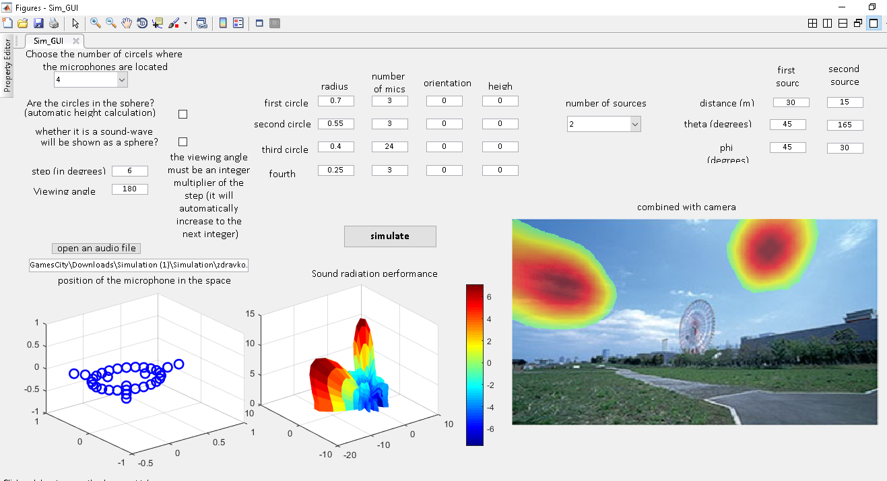
7. Changing position properties of each source as spherical coordinates:
Theta (azimuth angle).
Phi (elevation angle).
Distance from the origin in meter.
Figure (8): GUI representation for Acoustic Camera.

Slide 21
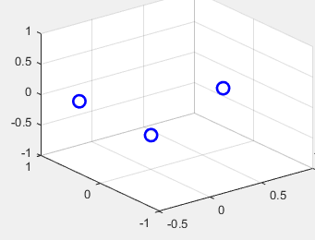
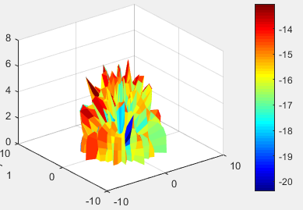
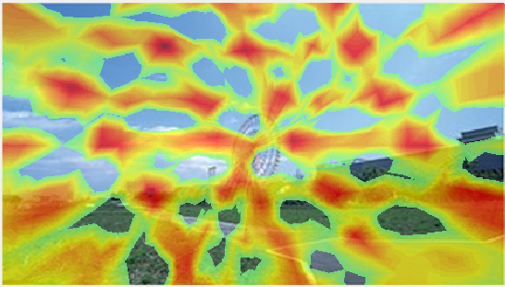
We have studied the following cases using GUI:
First case: Changing the array size.
Array with one circle (0.25 m) of microphones:
Figure (9): Position of 1 circle array with 3 microphones.
Figure (10): Sound radiation performance.
Figure (11): Sound localization for one circle.

Slide 22
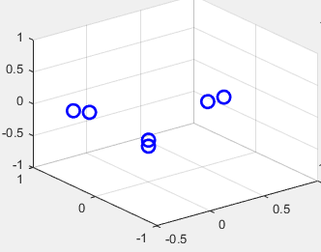
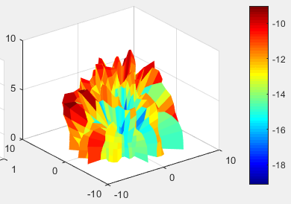
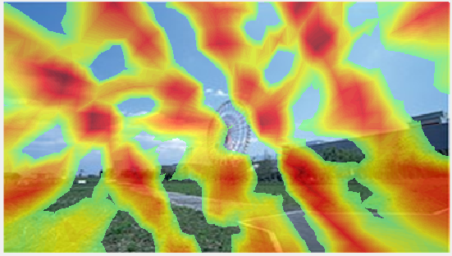
2. Array with two circles (0.4 and 0.25 m) of microphones:
Figure (12): Position of 2 circles array with 6 microphones.
Figure (13): Sound radiation performance.
Figure (14): Sound localization for two circles.

Slide 23
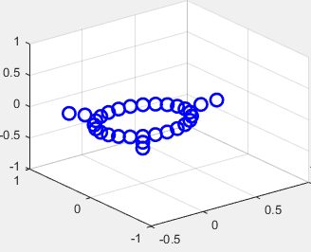
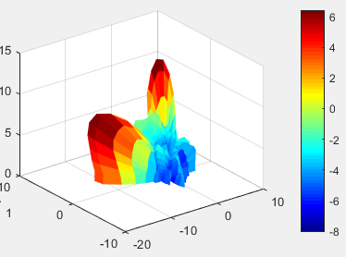
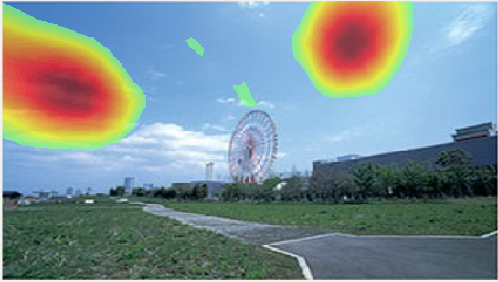
3. Array with three circles of microphones:
Figure (15): Position of 3 circles array with 30 microphones.
Figure (16): Sound radiation performance.
Figure (17): Sound localization for three circles.

Slide 24
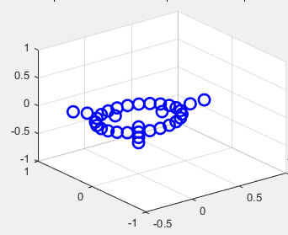
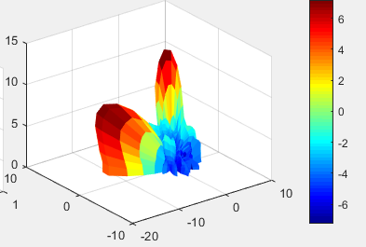
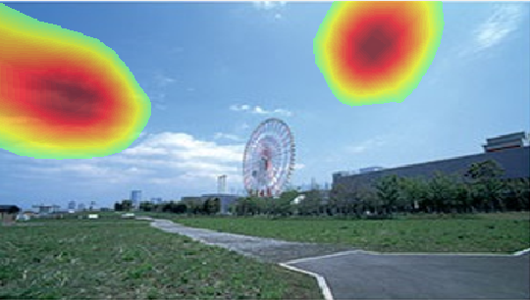
4. Array with four circles of microphones:
Figure (18): Position of 4 circles array with 33 microphones.
Figure (19): Sound radiation performance.
Figure (20): Sound localization for four circles.

Slide 25
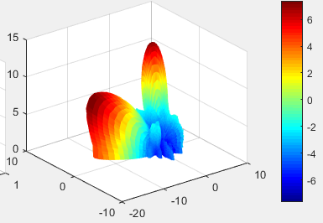
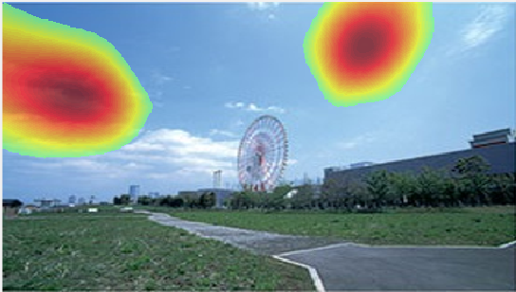
Second case: Changing the spatial resolution
The step size in all of the previous cases was 6 degrees. We changed this step size by decreasing it by 2 degrees which means it becomes 4 degrees and we got the following results:
Figure (21): Sound radiation performance.
Figure (22): Sound localization with 4 steps.
When we decrease the step size between the spatial angle, we obtain a high resolution.

Slide 26
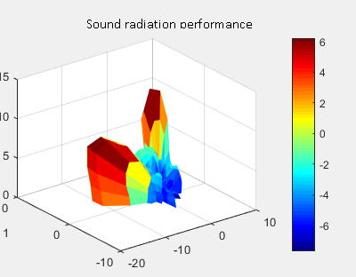
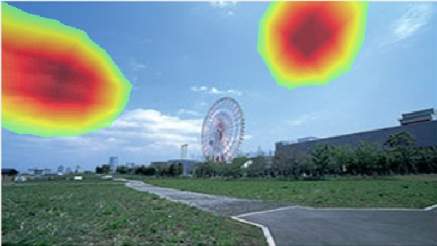
We changed this step size by increasing it by 4 degrees which means it becomes 10 degrees and we got the following results
Figure (23): Sound radiation performance.
Figure (24): Sound localization with 10 steps.
When we increase the step size between the spatial angle, we obtain a weak resolution .So in order to increase the resolution and accuracy of pattern, we decrease the step size between spatial angles.

Slide 27
Conclusion:
This project is mainly designed for applications working on frequency range from 120 Hz up to 1.7 KHz.
We designed this project to be applied for catching honking drivers where the acoustic camera will work by capturing a picture of a honking car, then the police will analyze the footage to determine whether drivers who honked had a fair reason to do so, if not they could receive a fine. This may be the first step to link car honking with further penalties for drivers.

Slide 28
Future Work:
The next step in our project is to:
Enhancing this simulation in order to cover a higher range of frequencies, so that the acoustic camera can be used for noise detection purposes.
Another aim is to build a prototype for acoustic camera with a low cost and an accepted volume so that it can be a flexible tool for taking sound images.
One more aim is to make an acoustic mapping of 3D- objects.

Slide 29
Thank you.

