Slide 1
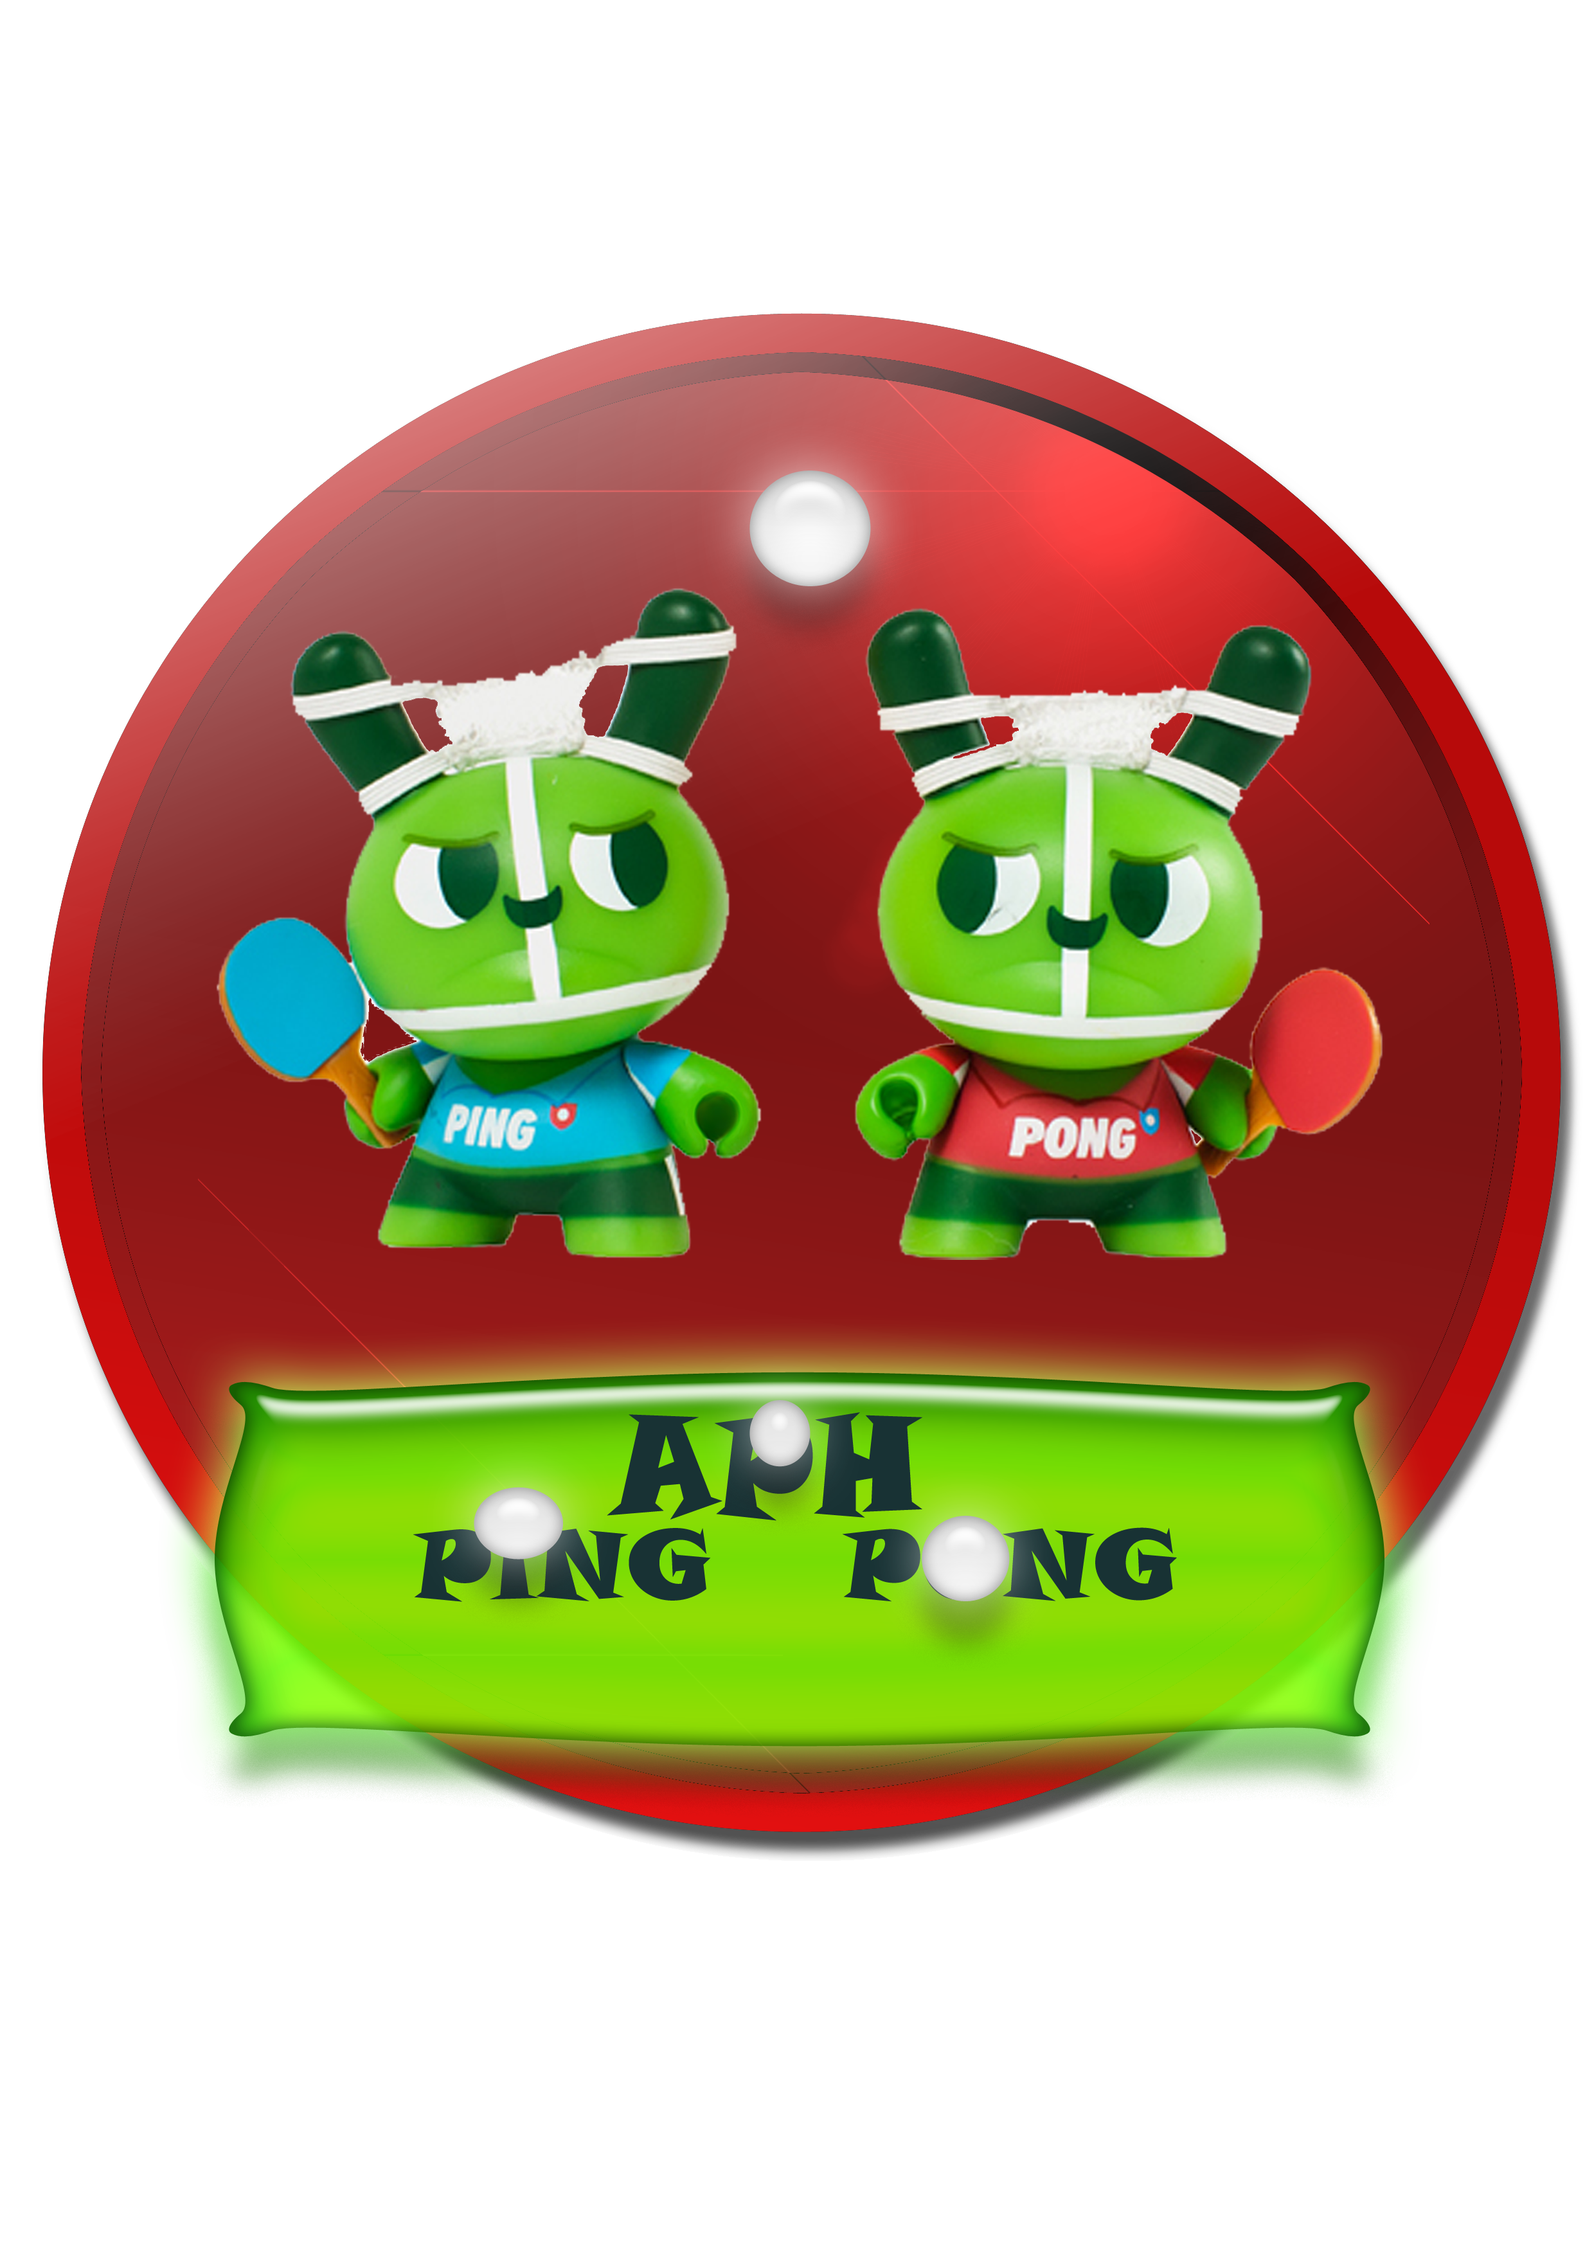
APH Ping Pong

Slide 2
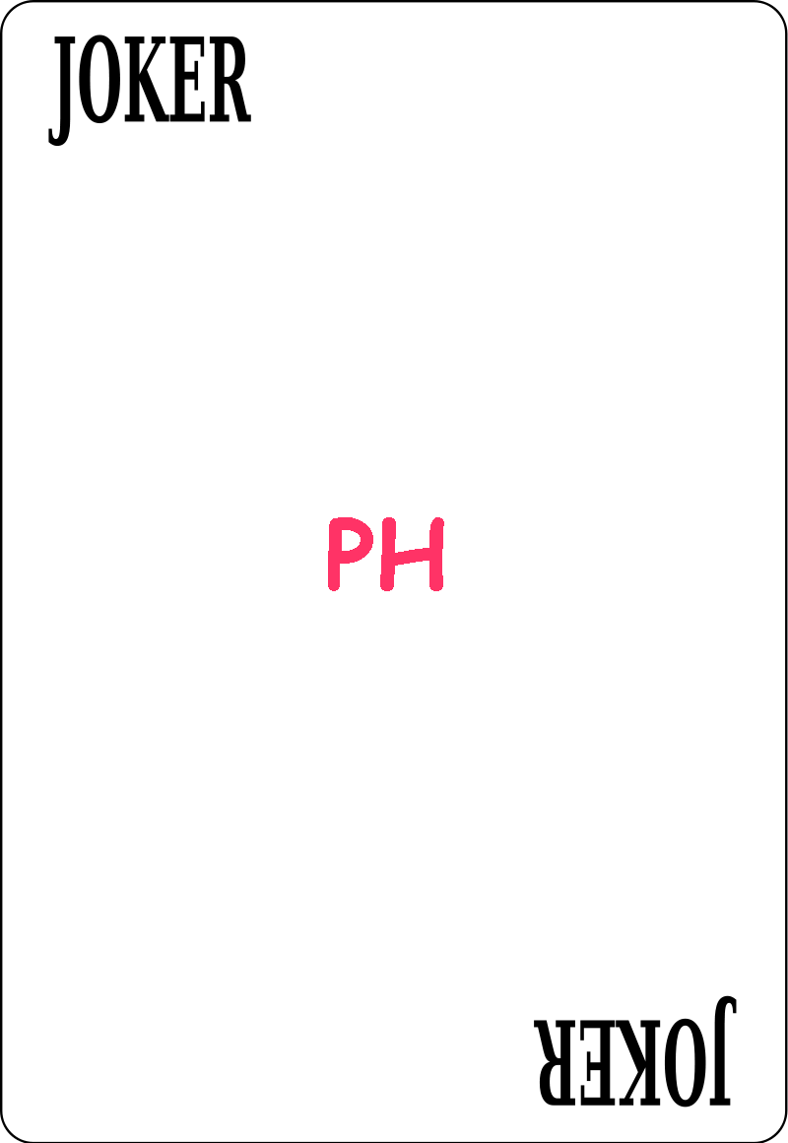


The Team
Mohammad Ihmouda
Ala'eddeen Awwad
Dr. Ashraf Armosh

Slide 3
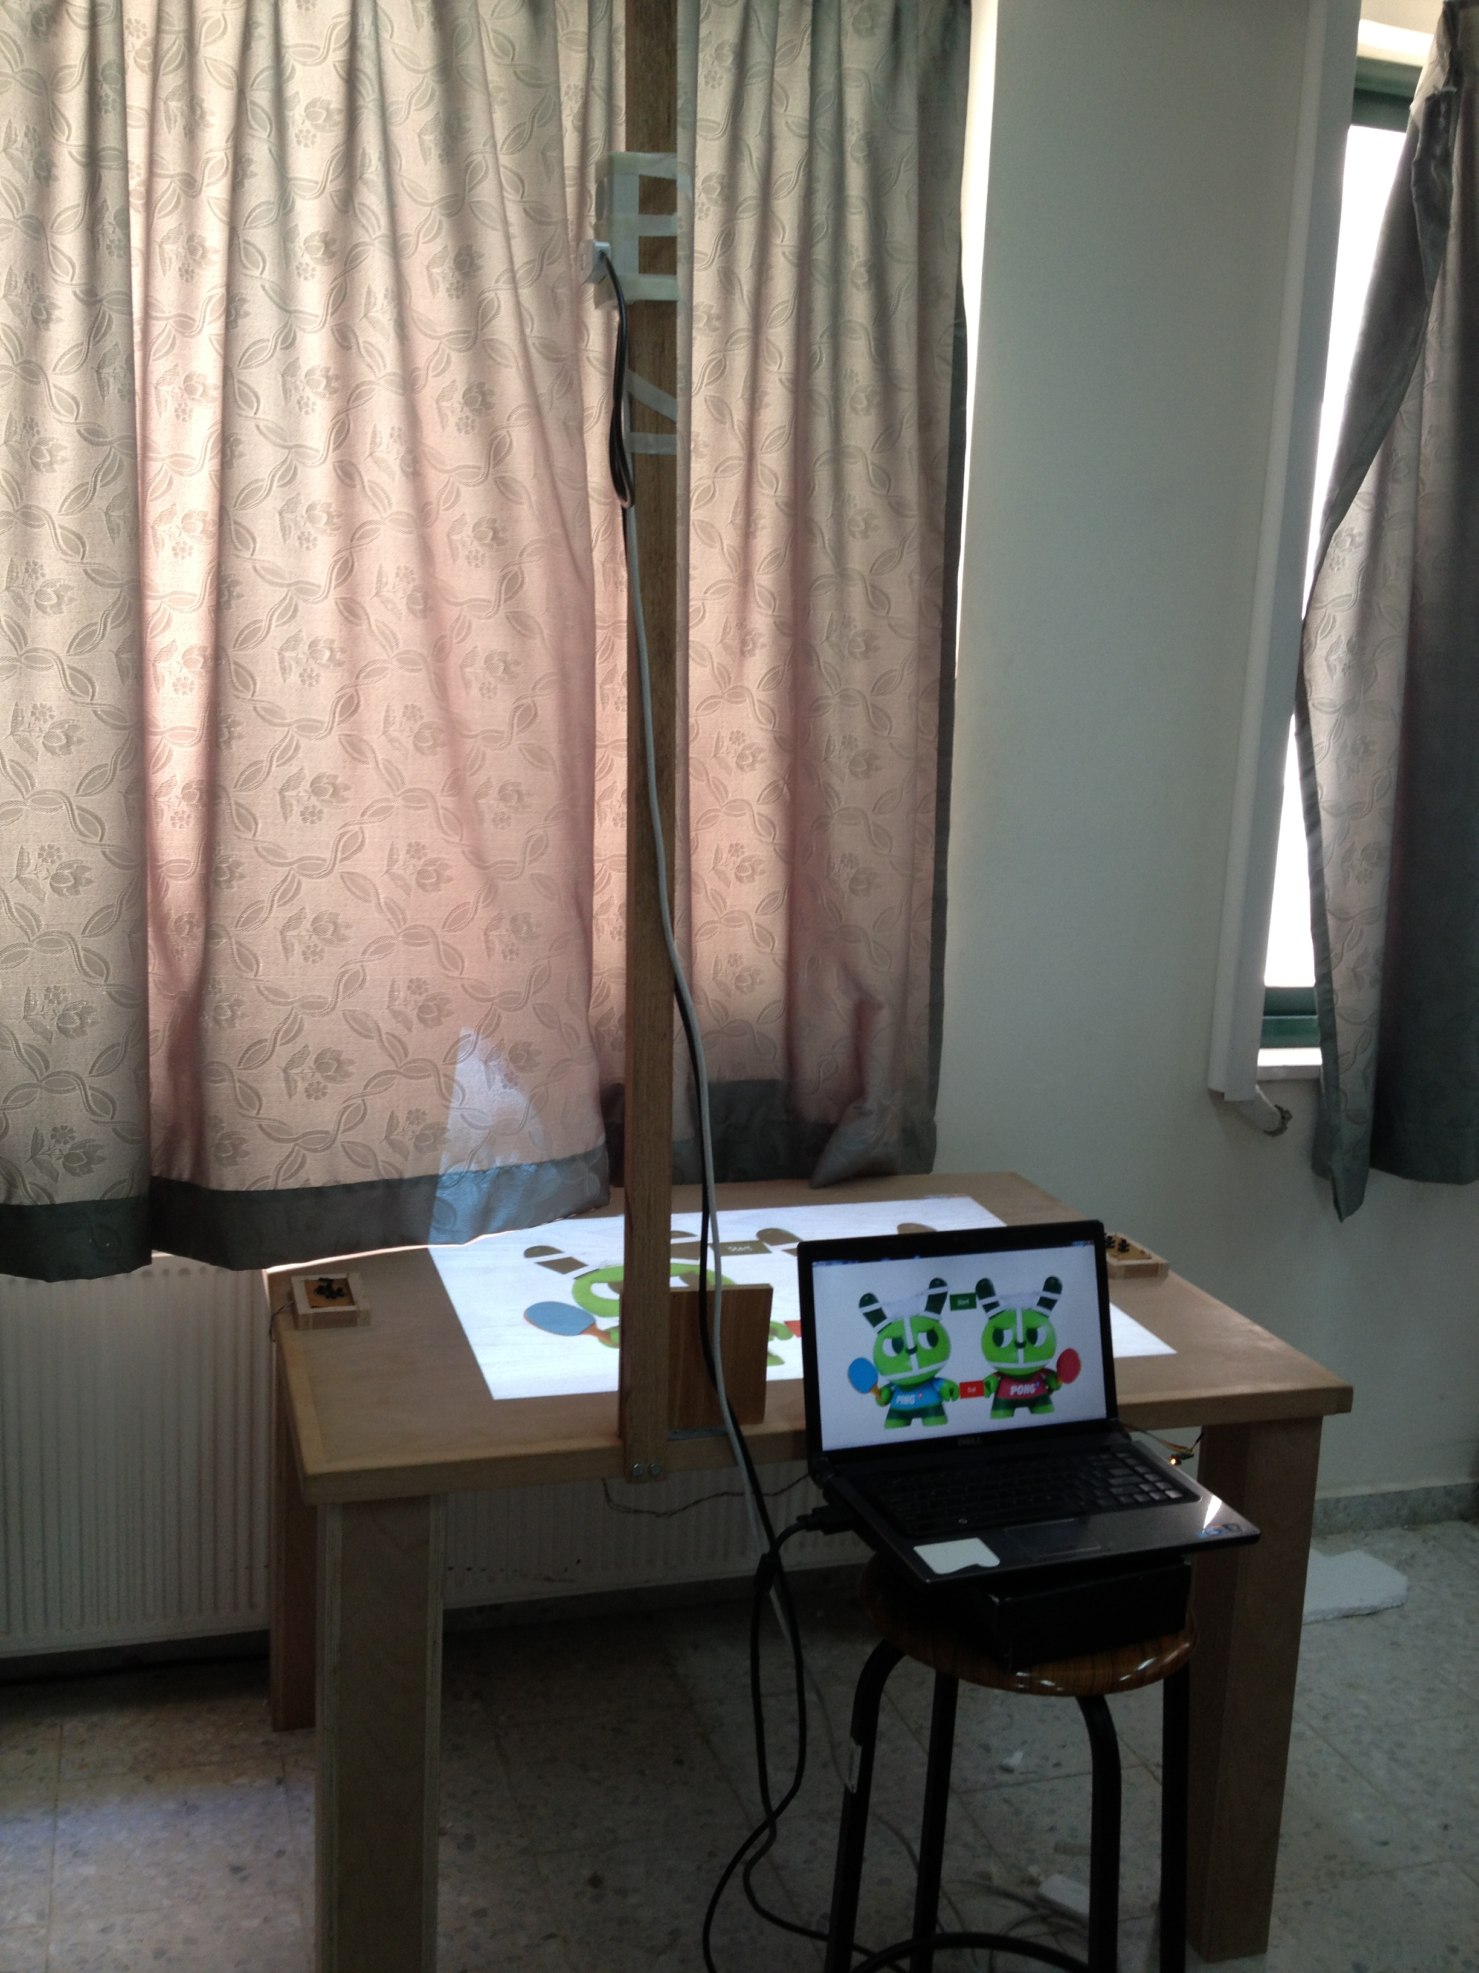
APH Ping Pong
APH Ping Pong is a funny interactive projected game played between two players on hardware table.

Slide 4
Game Strategy
Interactive game played between two players each one keeps track of the ball direction and try to hit the ball toward his opponent before entering his goal.
Notes:
Points are scored when a player fails to return the ball before entering his goal.

Slide 5
Game Strategy…. Cont.
APH Ping Pong Players choose which type of control is:
Notes:
1. Normal one by using keypad 4-directions
2. IPhone mobile application .

Slide 6
Game Strategy…. Cont.
The game start by deciding who is the first service (Player) which is defined by Randomly Coin flipping for the first player. The correct or incorrect guess gives the "winner" the option to have the ball.
Notes:
control strike movement on the game.

Slide 7
Game Strategy…. Cont.
The two players take their positions and the game start .
Notes:
such that The first player strike the ball to his opponent direction and the second keeps track of the ball before entering his goal.

Slide 8
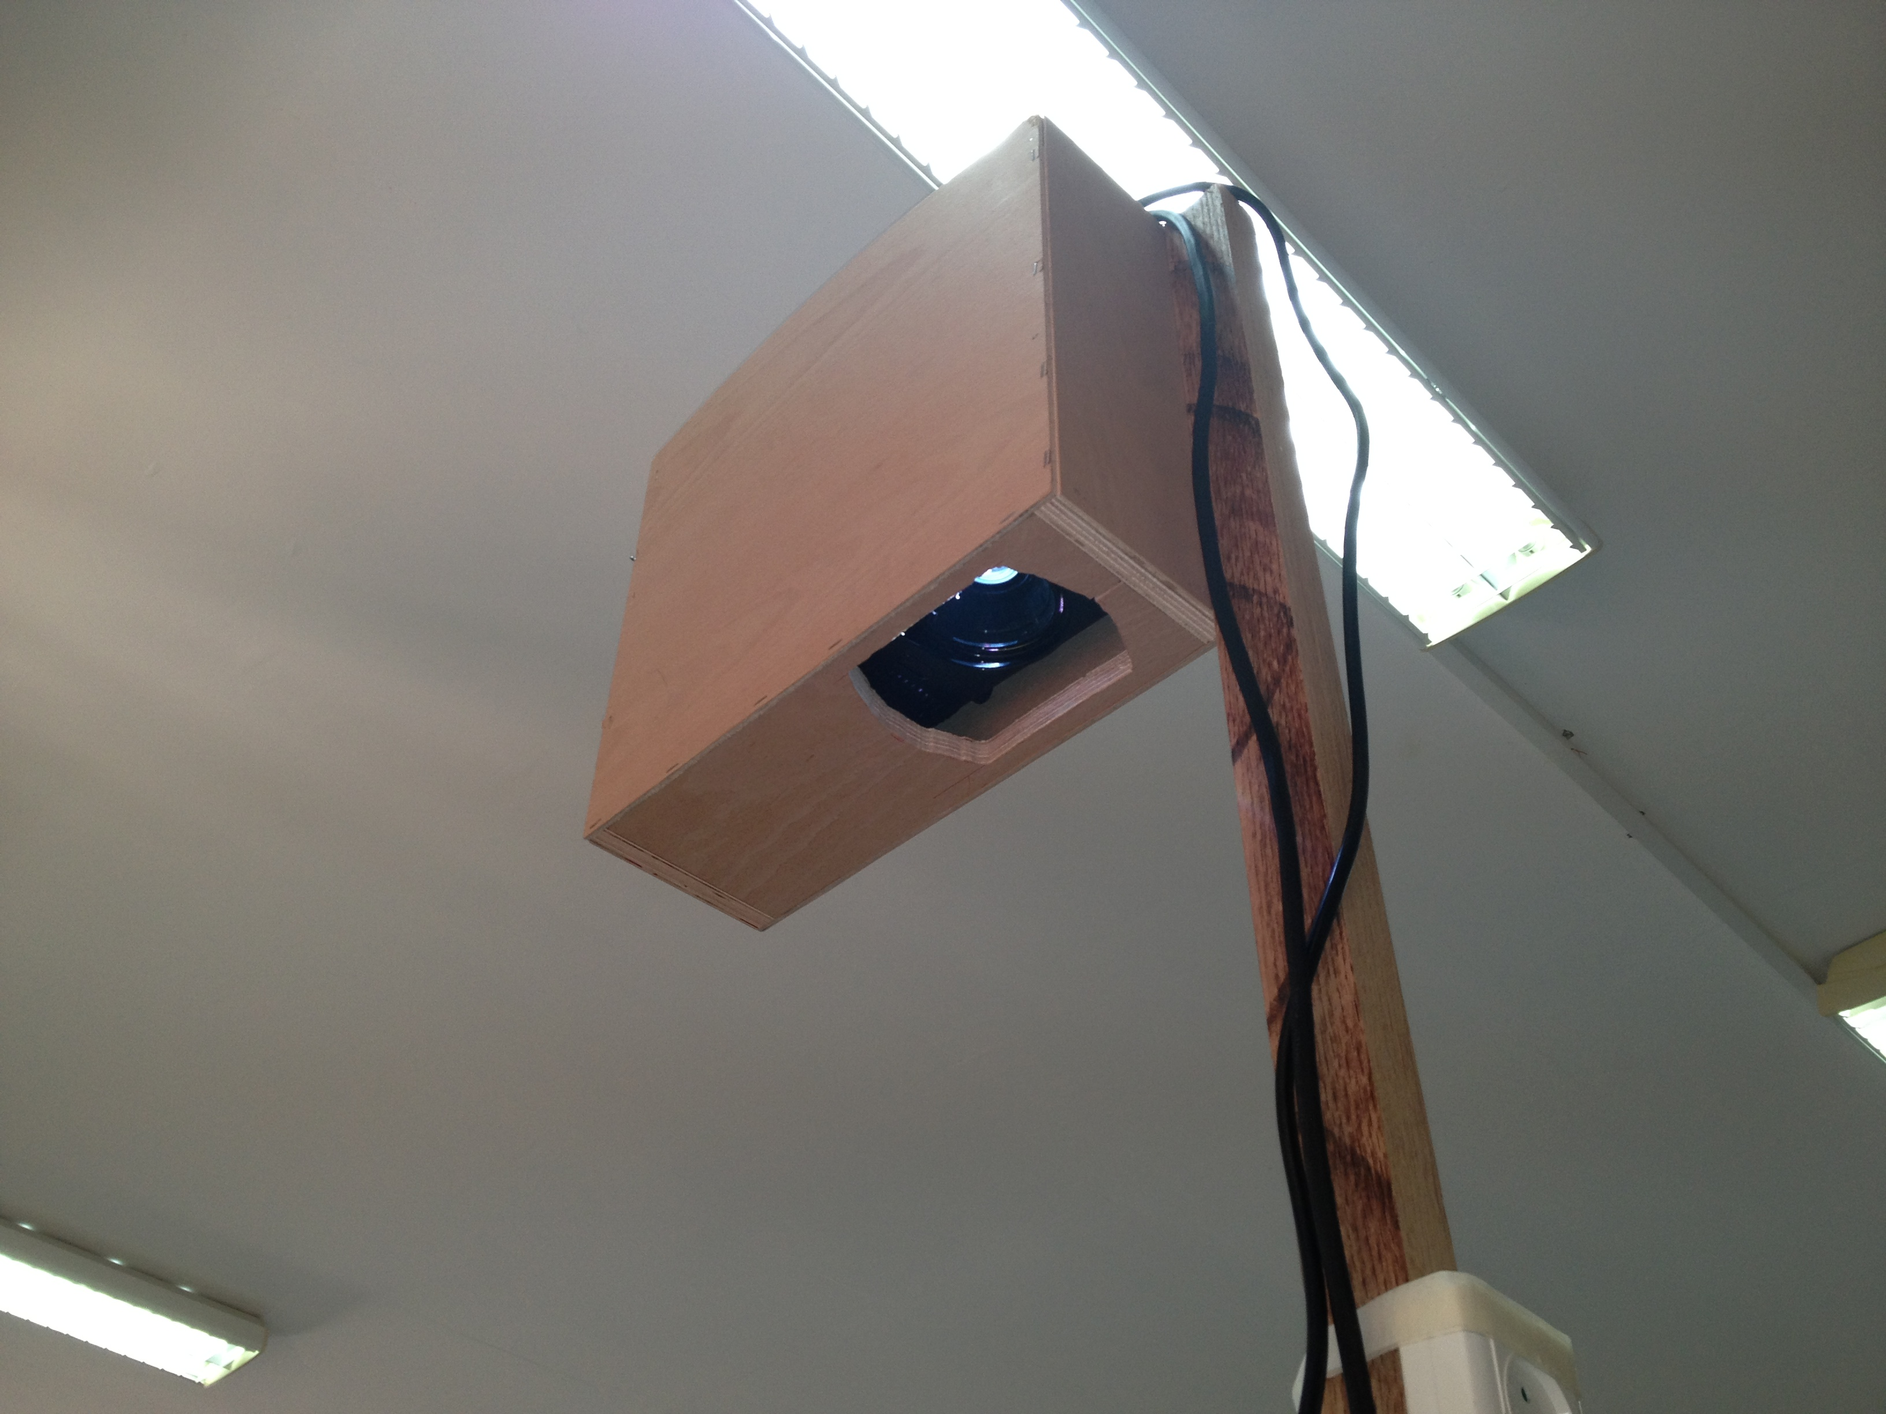
Playing Field Details
Ping Pong game projected on a hardware table using a projector .
Notes:
Our playing field is smooth, low fraction wood table
120cm long, 90 cm wide and 70 cm height
The game projected by a projector inside a projector box connected with the table by a pole
with 160 cm tall from the edge of the table.

Slide 9
Hardware Sensors
1. LDR (Led Dependent Resistor ) .

Slide 10
Why APH Ping Pong
Is an interactive funny game has two types of control :
1. Using 4- buttons keypad.
2. Using smartphone IPhone Application.
Notes:
➔ APH Ping Pong is simulation of traditional Ping Pong by adding many features as a result more wonderful game :
to control movement and power of striker.
Such that it’s a circuit for 4 push buttons (up/down and left/right).
Iphone app using accelerometer and gyroscope hardware build in sensors in iphone to control movement.

Slide 11
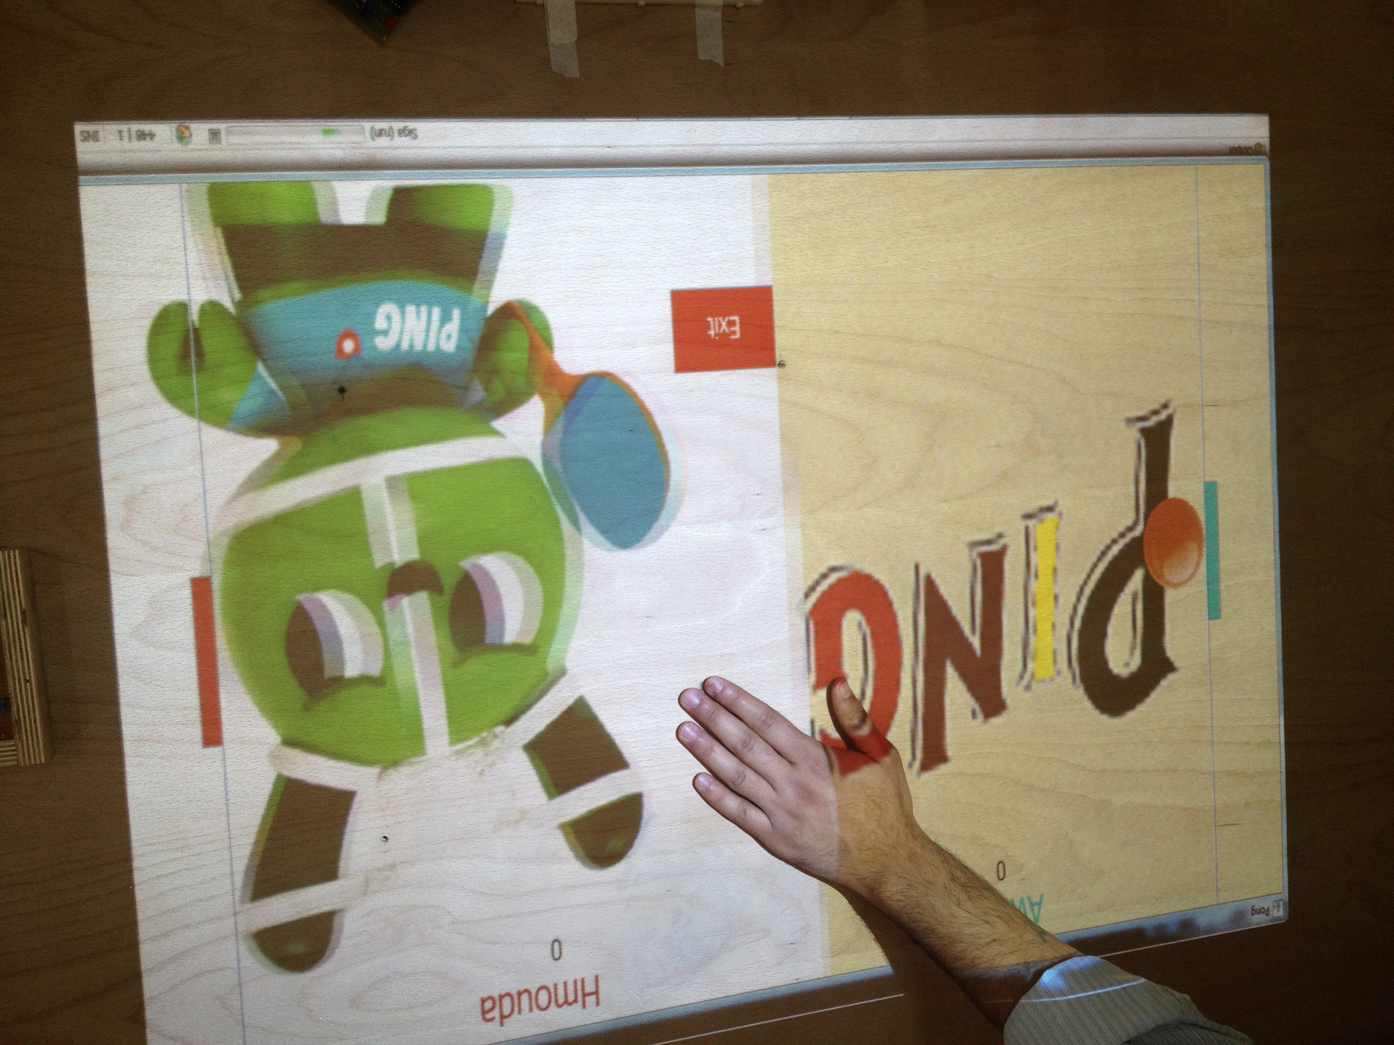
Why APH Ping Pong
APH supports table touch or interactivity feature for well-known positions on table to control flow user options at the start and with the end of the game.
Notes:
We have used 4 special type of LDR sensors. Such that when the user try to choose any projected button option on these sensor the game respond and interactive by present his choice .

Slide 12
Why APH Ping Pong
Contains many features and customizable user options
Setting the ball speed.
Setting number of rounds.
Randomly Coin flipping for the first player.
Notes:
Such that with the start of the game it gives you many features like

Slide 13
Why APH Ping Pong
  Contain interaction animations and accessory in harmony with the processing of the game.
Notes:
Like scoring new point.
Winner during 5 rounds.
And other projected graphics and animations.

Slide 14
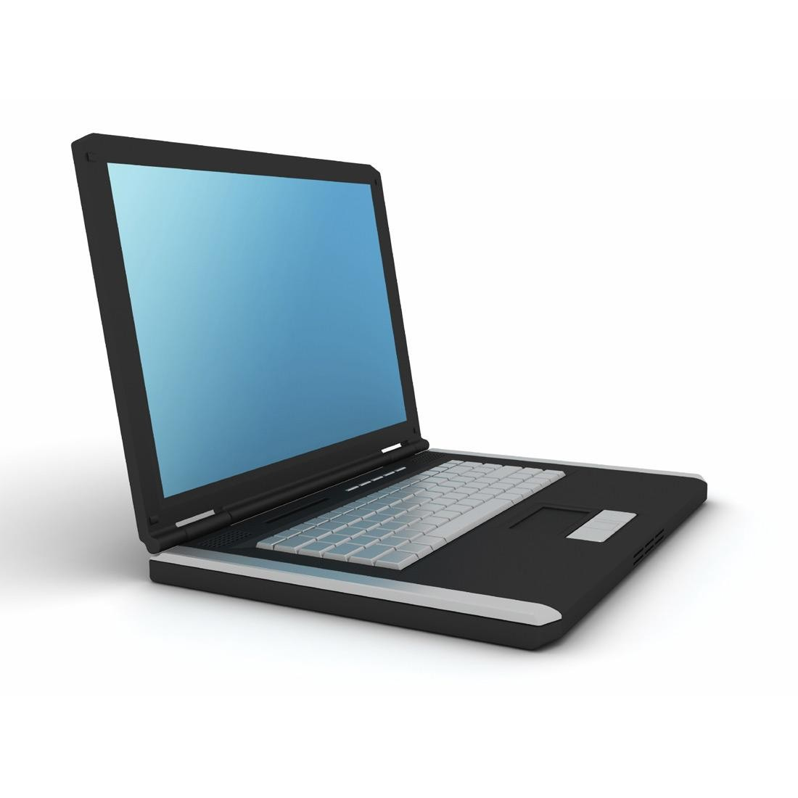
Sending Data
Data transferred Inputs to the PIC.
PIC send the right command.
Java App algorithm handle the command.
Inputs
PIC 18F4620
Notes:
Data transferred from the keypads and LDR sensors to the pic18f4620 40 pins which translate these inputs and send the right command to the java application on pc using serial-usb port.

Slide 15
Software Tools
Java Programming Language
IOS mobile programming language
NetBeans IDE

Slide 16
Game Stages
New Game
Game Mode(paddles, Mobile)
Number Of Rounds
Select the Starter Player
Game is Running
Winner Stage

Slide 17
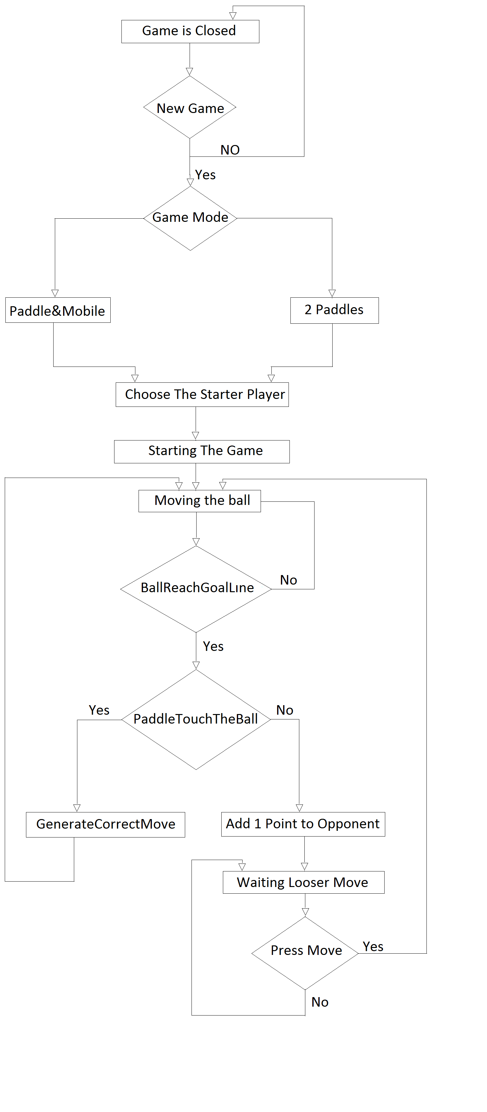

Slide 18
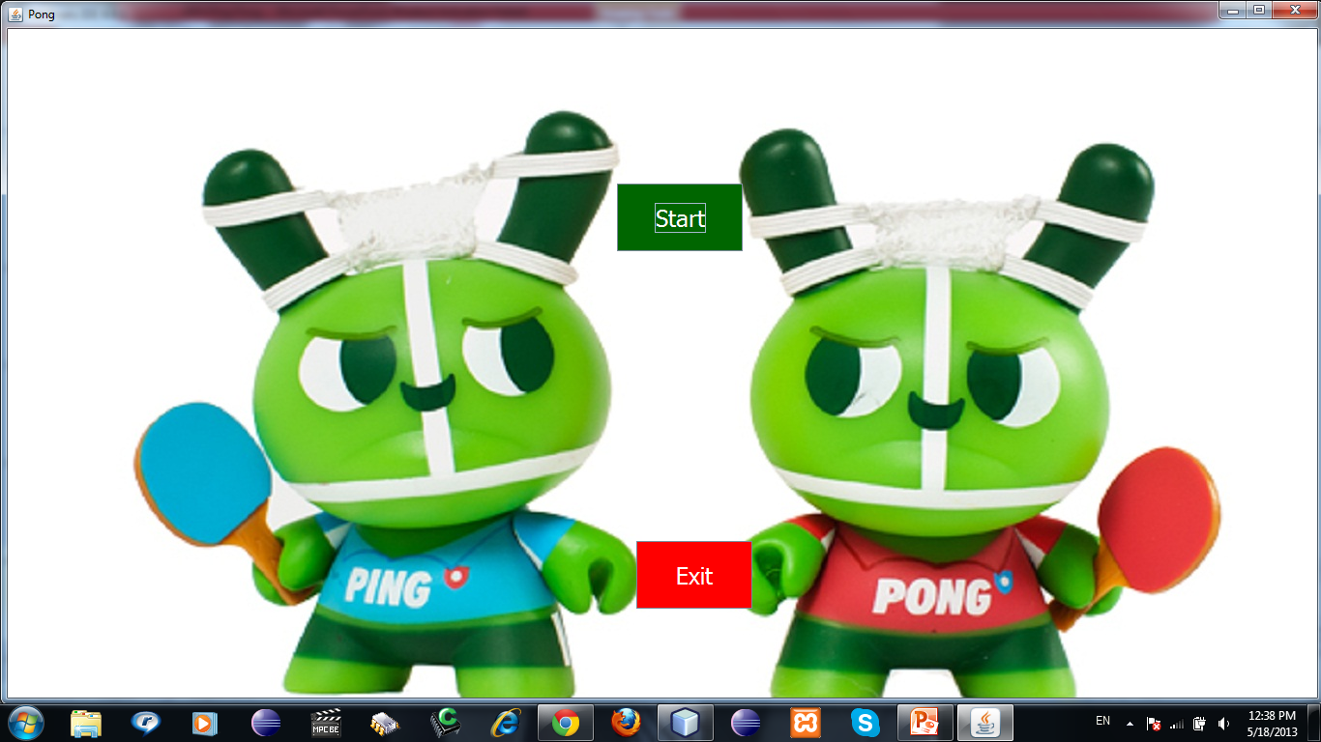
1- New Game

Slide 19
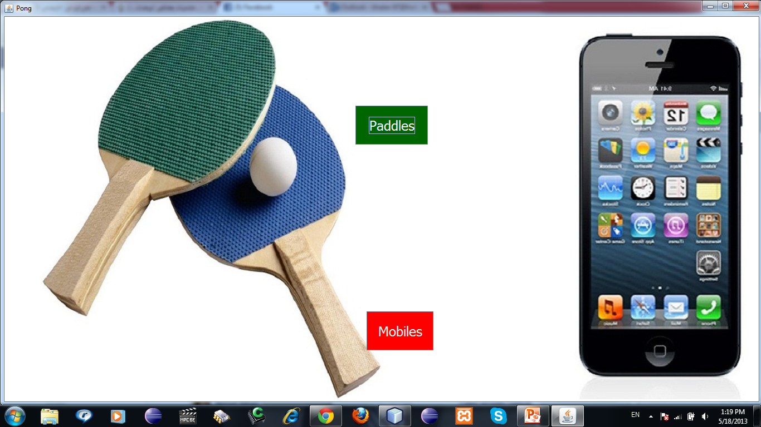
2- Game Mode

Slide 20
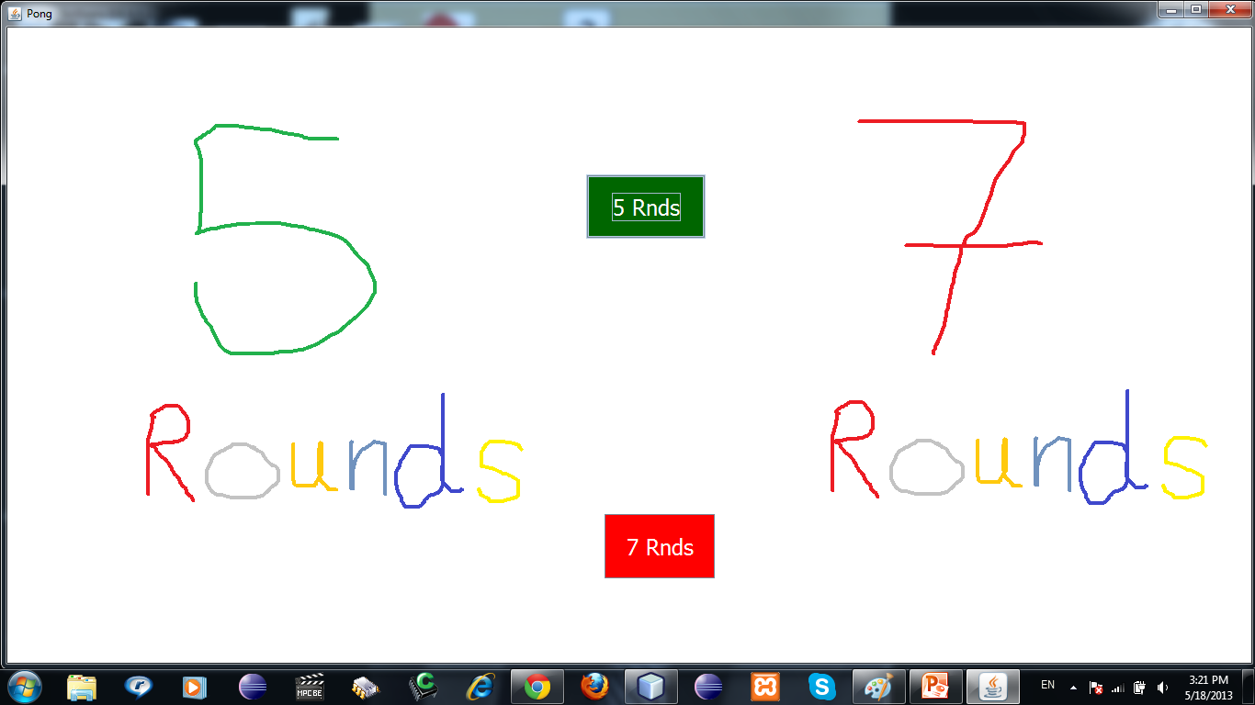
3-Number Of Rounds

Slide 21
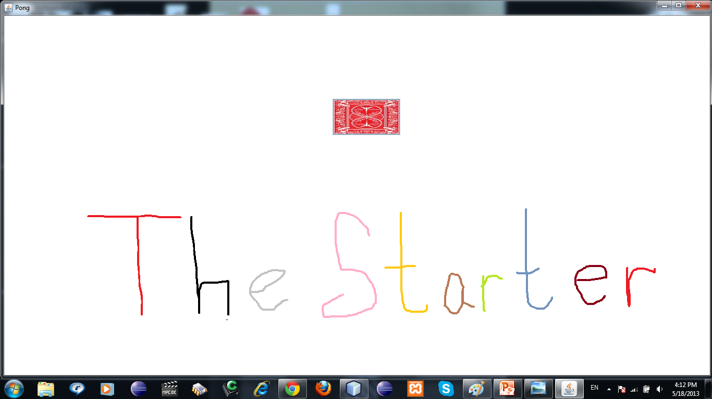
4- The Starter Player

Slide 22
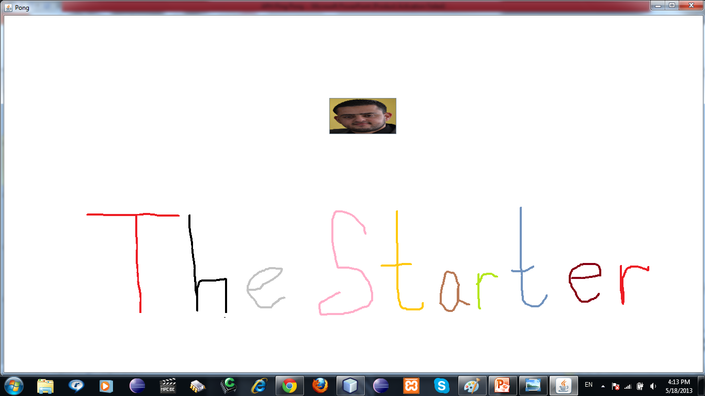
5- The Starter Player (2)

Slide 23
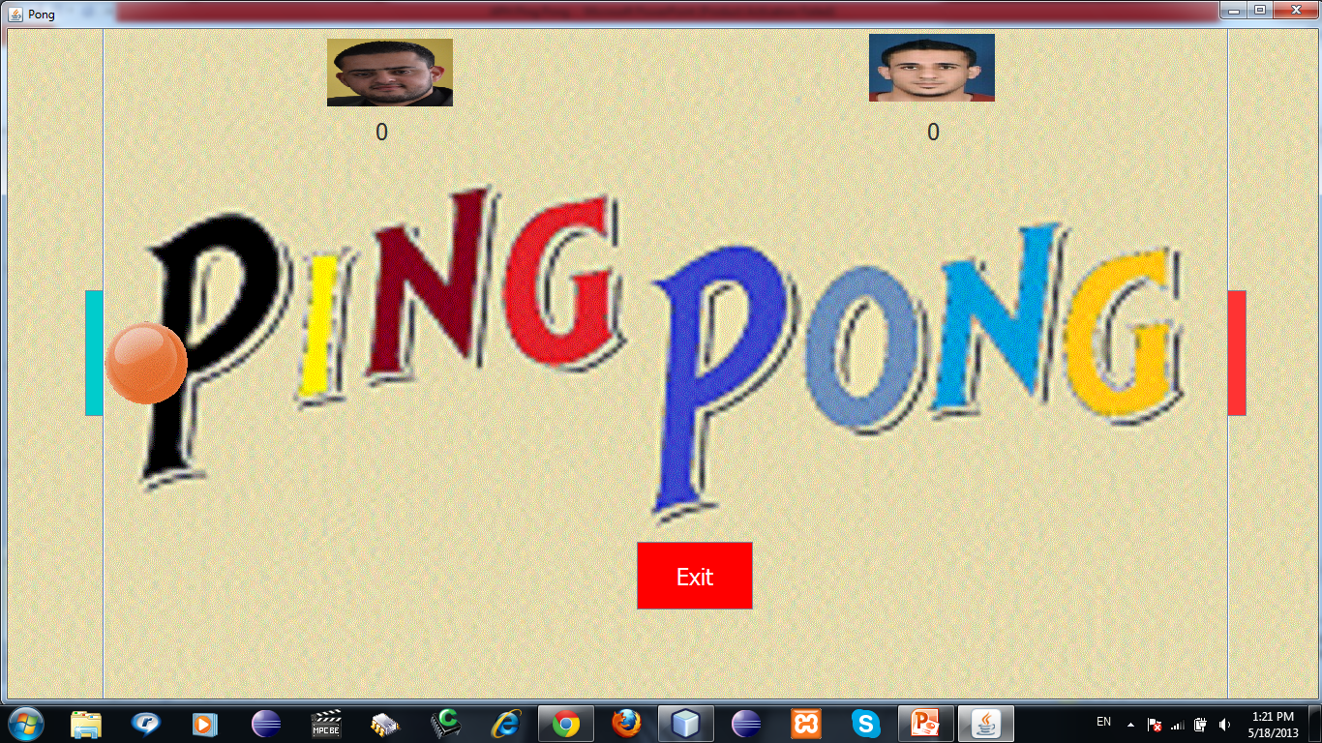
6- Running Stage

Slide 24
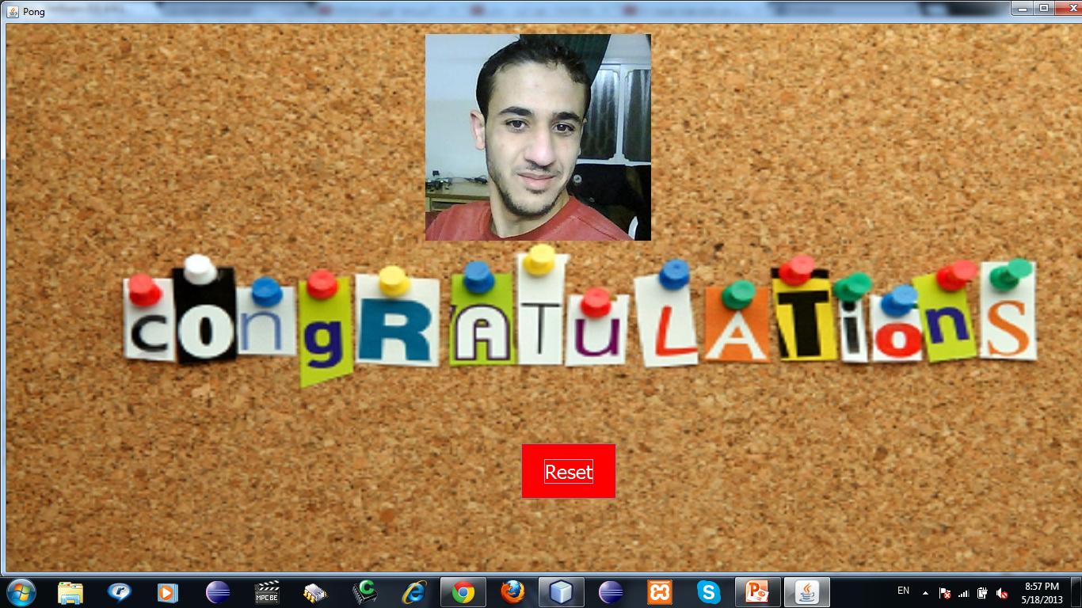
7- Winner Stage

Slide 25


