Slide 1


Graduation Project report- II
Faculty of Engineering & Information Technology
Department of Building Engineering
Desgin of Deir Al-hatab Secondary School
By: Mohammed Abu Hneish
Khaleel Sabbah
Maan Halees
Supervisor: Dr: Nirmeen Al-barq

Slide 2
Introduction
During the previous century, we've witnessed progress and development in all fields of life, and the viewer of this development marked increase in the numbers of the population and therefore an increase in their needs for housing and services, huge economic and social needs have issued such as the need for constructing schools.

Slide 3
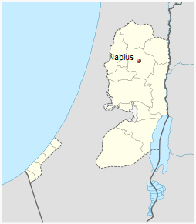
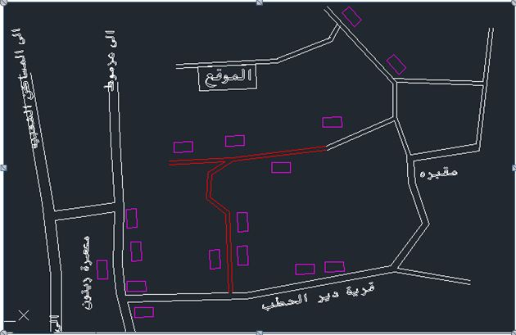
Site Discription
Location:
Nablus is a city in the northern west bank, with a population of 126,132. located in the west of Deir AL-Hatab village .with seismic zone 2B .

Slide 4
Site Discription
.The site of the project is located in the west of Deir AL-Hatab village near Nablus city.
.The area of the site is 4838 m2.
. The topography of site is flat.
. The site is a far away from noise sources.
. in this figure show the location of the site.

Slide 5
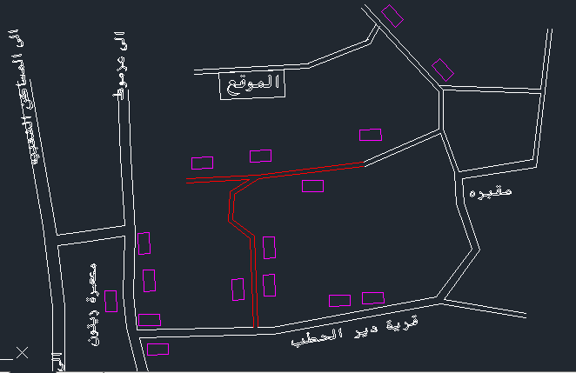
Site Discription
Fig.3.6: The site Location due to the village

Slide 6
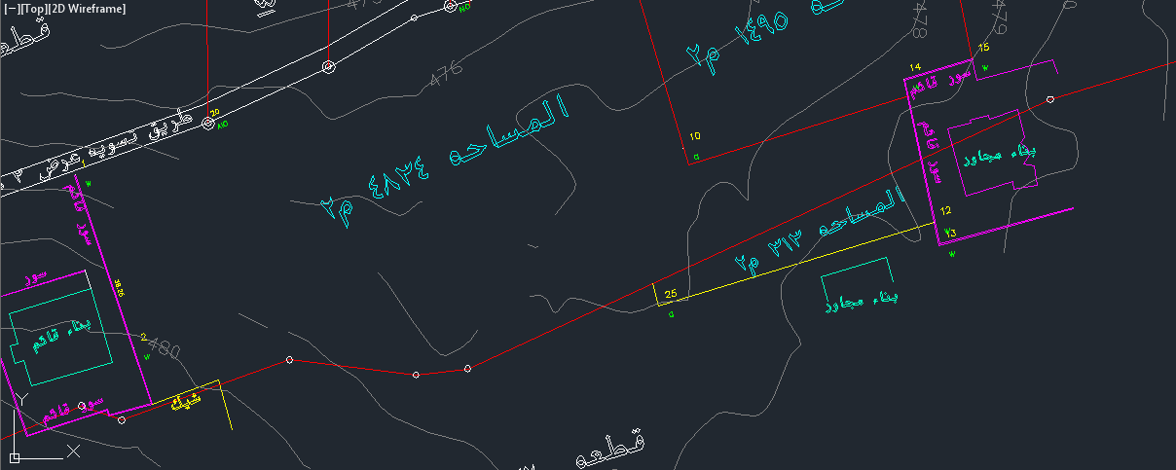
Site Analysis
Site Surroundings:
As shown in the figure, The site is surrounded by 12 -m main Street on the north, exist Fence in the west of the land and exist building in the south and east of the site.

Slide 7
Site Analysis
• Wind
Northwest winds are considered the prevailing wind directions in Nablus, and an annual overall average wind speed 10 km / h.
• Humidity
As for the relative humidity in Nablus, the annual overall rate of up to (61%).
• Noise
The site can be considered as low noise region .and the site is far away from the center of a village, and using an audio meter program that shows us the noise at the site approximate 52 dB.

Slide 8
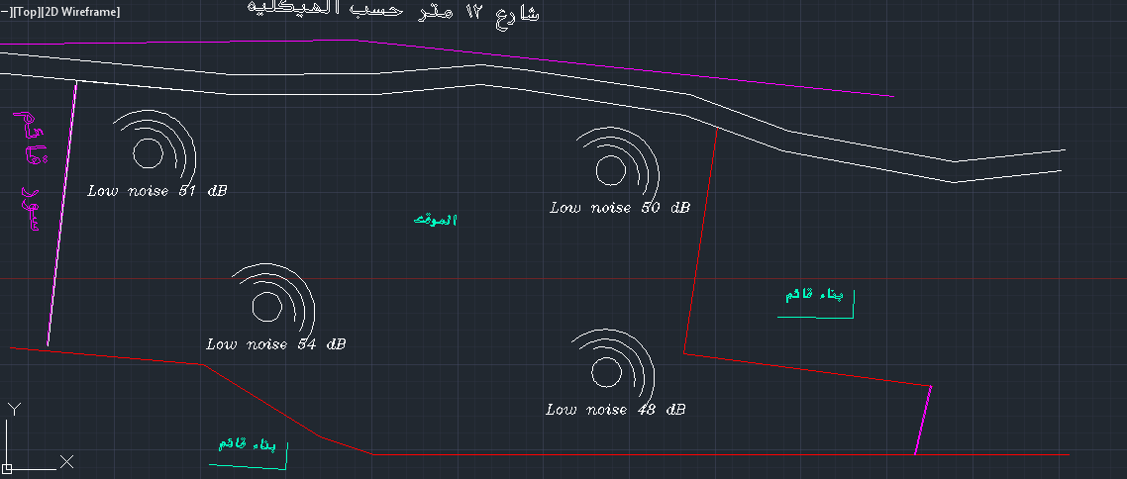
Site Analysis

Slide 9
Project design
Design School Concept
The site will be used to design secondary school for boys, the number of students about 400 students with 30-35 students per class .Thus; we will need 12 class room, three floors. The spaces in the school can be classified into two categories:
Teaching Spaces:
This space is used for teaching only , may be in some schools also include some class for computer laboratory, biology and chemistry laboratory and arts.

Slide 10
Project design

Slide 11
Project design
Non-teaching spaces:
this space will include library, head master room, administration unit, teacher room, social worker room.

Slide 12
Project design

Slide 13
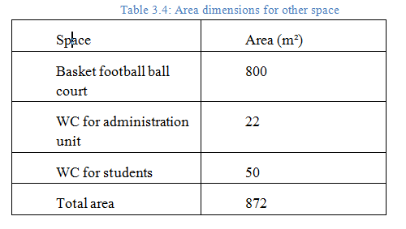
Project design
Other Spaces:
Include; play courts, corridors, and parking.

Slide 14
Architectural Design

Slide 15
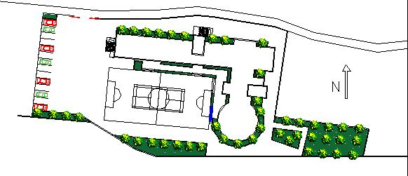
Site plan

Slide 16
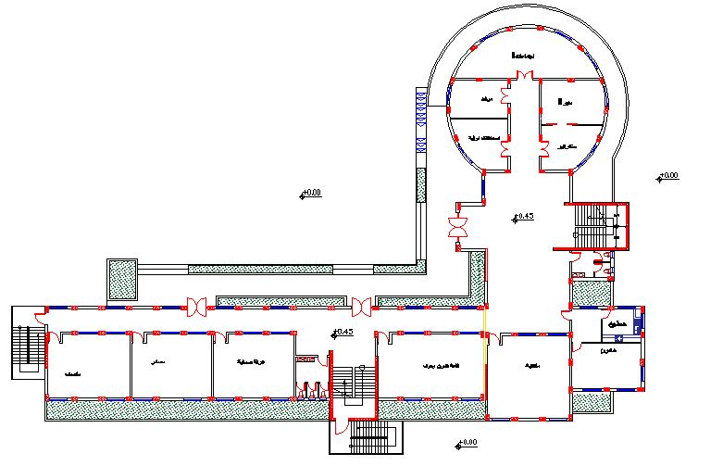
Ground Floor

Slide 17
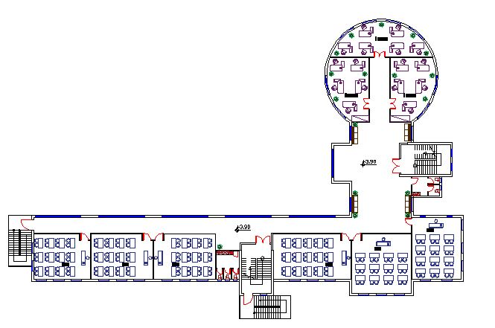
First Floor

Slide 18
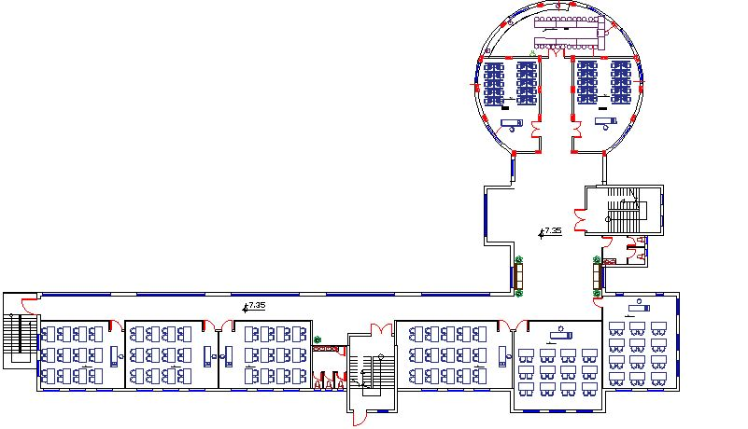
Second Floor

Slide 19
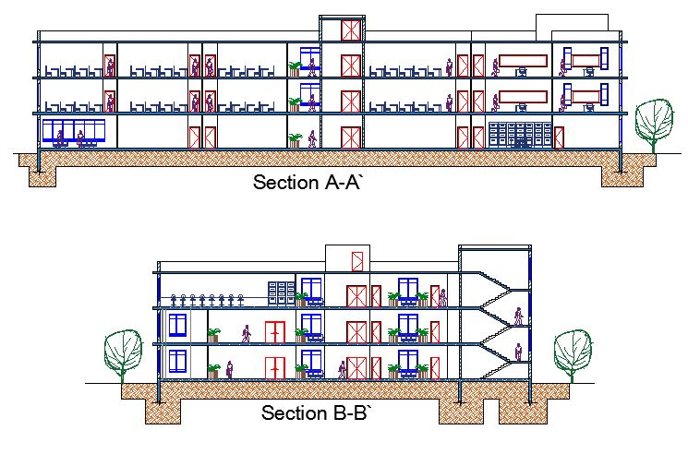
Sections

Slide 20
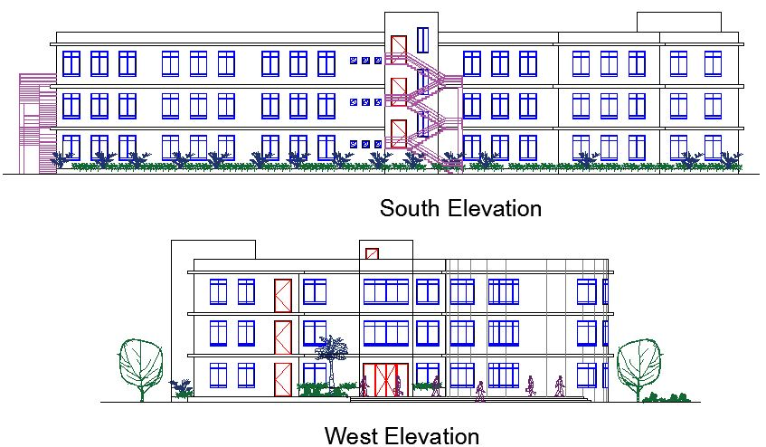
Elevations

Slide 21
Structural Design

Slide 22
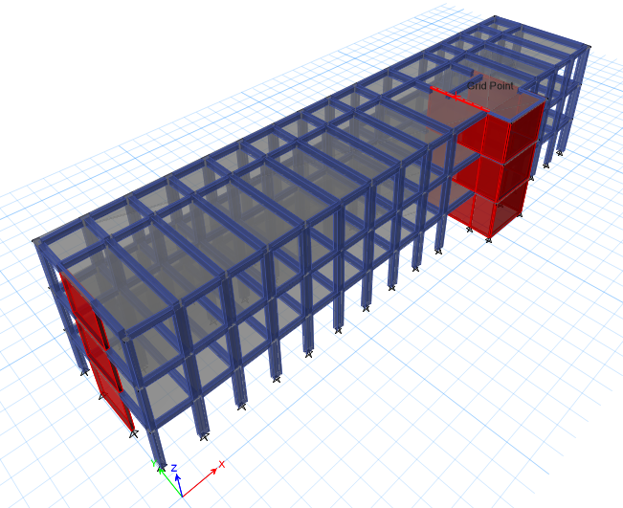
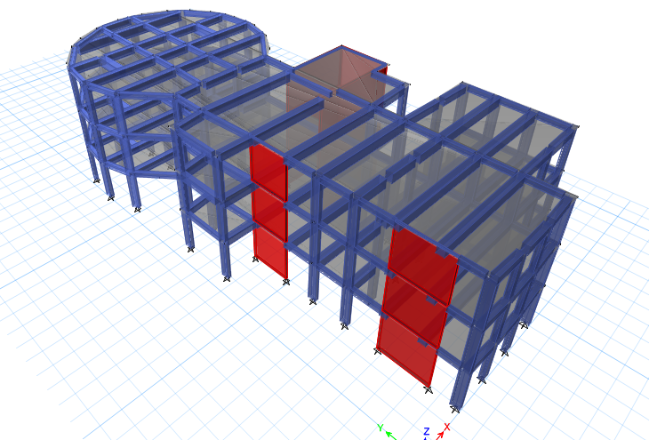
3D Structural Modeling
For tow module

Slide 23
Structural Design
The software's used for analysis and design is:
ETABs2016 and sap2000 for structural analysis & design.
AutoCAD for all drawings.

Slide 24
Structural Design
The design of the building was done according to the following codes and standards:
ACI -318-2011 for reinforced concrete structural design.
UBC -97 for earthquake load computations and seismic design .

Slide 25
Material Property
The materials used in the construction have the
following characteristics :
Compressive strength of Concrete (f'c`)
Compressive strength of Concrete “f′c”. | Type of frame or shells
24 | Slabs
28 | Beams
28 | Column
28 | Wall
28 | Footing
28 | Stair case

Slide 26
Loads on the floors
Load on slab and frames | Type of load
4 KN/m2 | Super imposed on slab
5 KN/m2 | Live load on slab
18 KN/m | Load on beams from stone

Slide 27
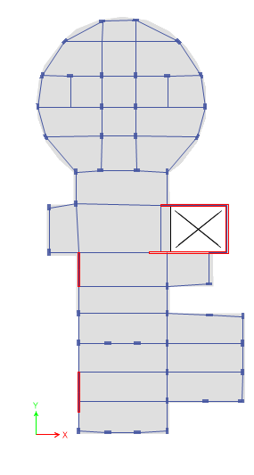
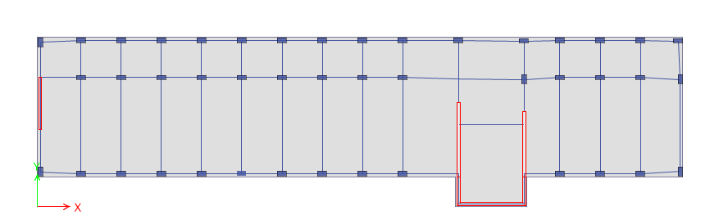
Beam and column distribution:

Slide 28
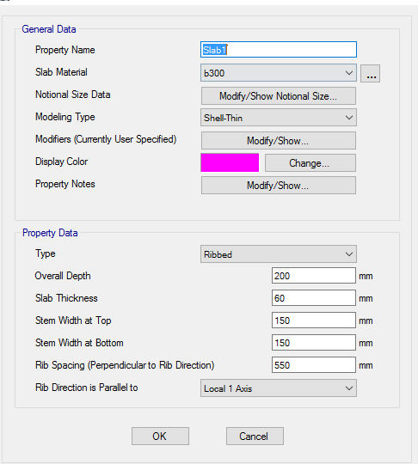
Structural elements information
One way ribbed slab with thickness h = 20cm.

Slide 29
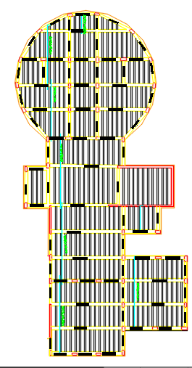
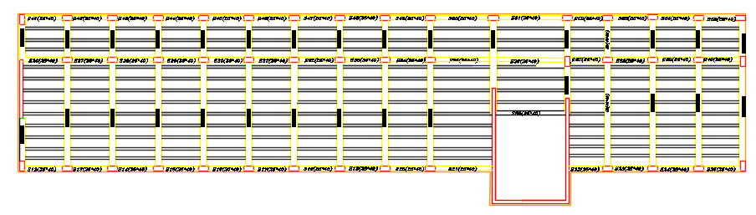
Direction of ribs

Slide 30
Dimensions Beams, Column and shear wall
Main beams (400*600)mm.
Secondary beams (250*400) mm.
Column (600*300) mm.
Shear wall with thickness of 200mm

Slide 31
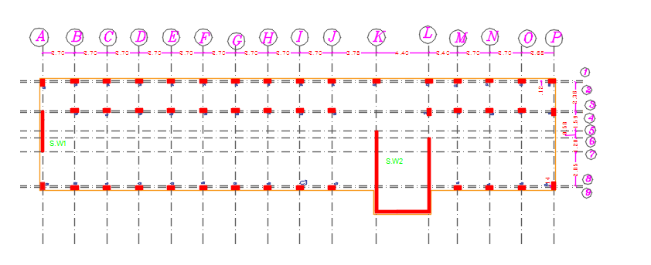
Center Of columns

Slide 32
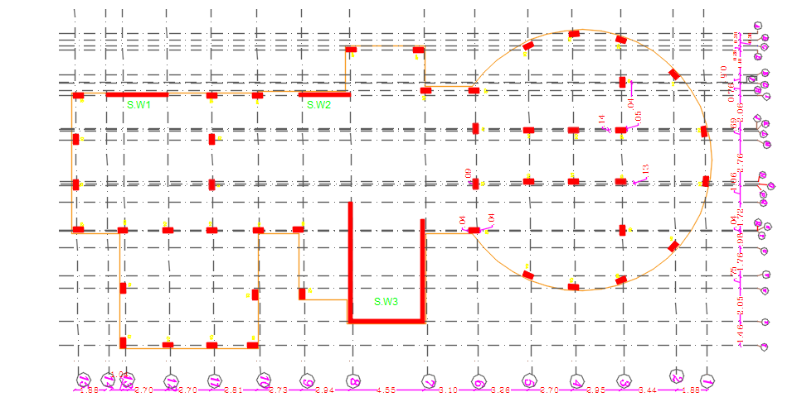
Center Of columns

Slide 33
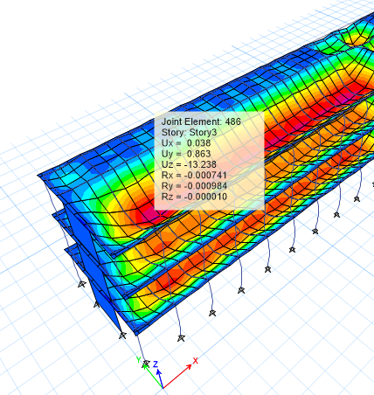
Analysis the model and checks
Compatibility and deformation check.
Modal is combatable .
Deformation:
For module 1
Deflection on slab = L/240
= 6.17/240 =25.7mm
Etabs result due to live load is
Uz= 13.238 mm
Thus , ok .

Slide 34
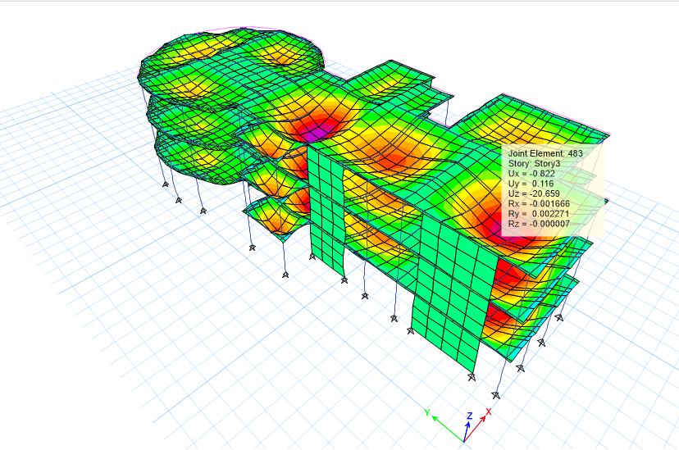
Analysis the model and checks
For module 2
Deflection on slab = L/240
= 7.95/240 =33.12mm
Etabs result due to live load is
Uz= 20.656 mm
Thus , ok .

Slide 35
Equilibrium checks For module 1
Percentage of Error (%) | Base reaction from manual calculation | Base reaction from ETABs | Load type
4.43% | 8787.2 | 8748.2 | Dead
3.5% | 6034.12 | 6255 | Live
3.53% | 13923 | 14430 | SID
The percentages of error <5% , the checks are acceptable.

Slide 36
Equilibrium checks For module 2
Percentage of Error (%) | Base reaction from manual calculation | Base reaction from ETABs | Load type
2.10% | 11791.2 | 11772 | Dead
2.13% | 7516 | 7500 | Live
3.53% | 13923 | 14430 | SID
The percentages of error <5% thus, the checks are acceptable.

Slide 37
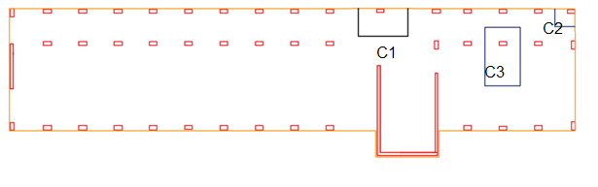
Stress –strain relation checks module 1
Percentage of error (%) | ETABs result | Axial Force result (KN) | column
2.5% | 441 | 452.4 | C1
8.1% | 469 | 430.5 | C2
4.5% | 955.6 | 891.5 | C3

Slide 38
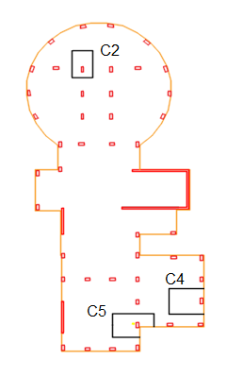
Stress –strain relation checks module 2
Percentage of error (%) | ETABs result | Axial Force result (KN) | column
3.6% | 868 | 900 | C2
2.5% | 441 | 452.4 | C4
4.7% | 1377 | 1340 | C5

Slide 39
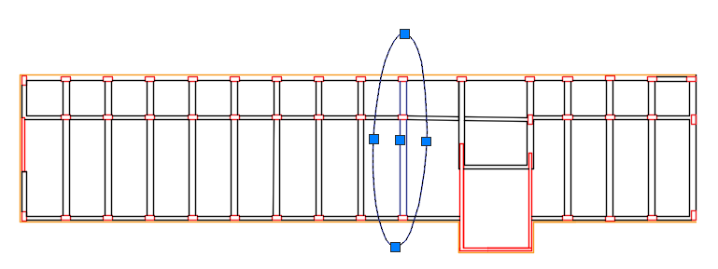
Manual calculation For beam shown above:
Length = 6.47m
Live load = 5kN/m
SID load = 4 kN/m
Slab own weight = 3.67 Kn
Wu= 1.2(3.67+4) +1.6*5 = 17.2 KN/m^
Mu hand calculated = W L²/8 = 208.65 kNm
Mu from ETABS = M1+M2/2 + M3 = 83 + 117.28)/2 + 102= 202.14 kNm
%Error = 208.65-202.14 /208.65 =3.1 % <10% OK

Slide 40
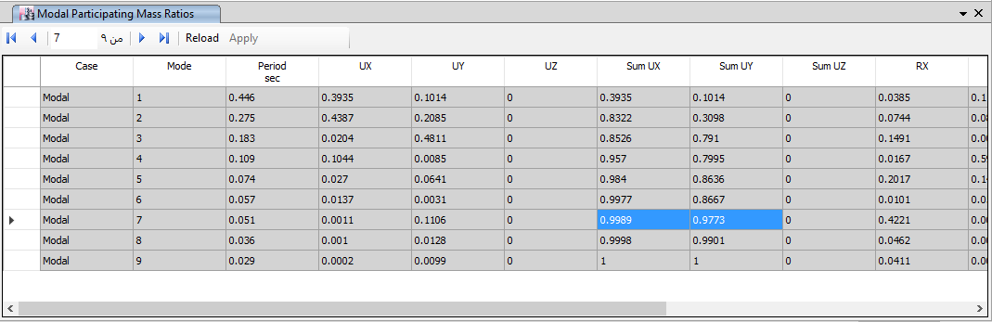
Making sure modal participation mass ratio > 90% in both x and y For moule 1

Slide 41
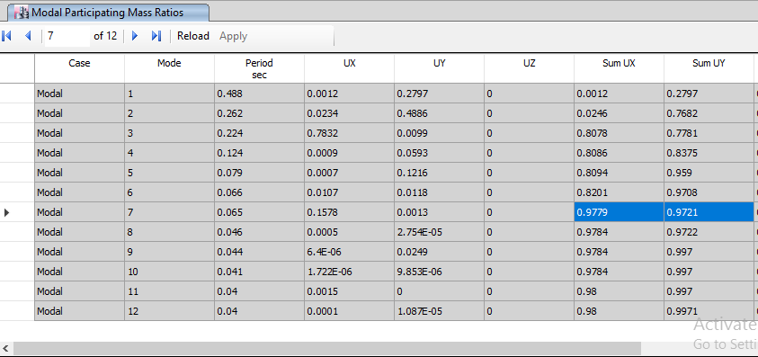
Making sure modal participation mass ratio > 90% in both x and y For moule 2

Slide 42
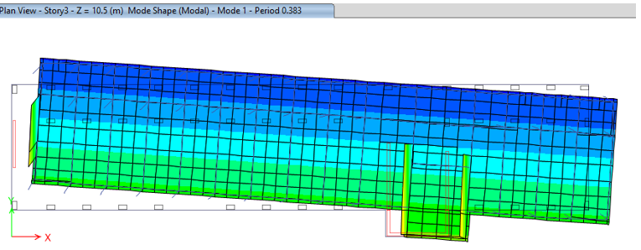
Check period of mode of maximum Modal (1) participation mass ratio.
for the first mode =T etabs
=0.388 sec.
T=1.4Ct * (hn) ^3/4
h_{n} =10.5 m
Ct =0.0488
T= 0.29 sec ➔T = 0.29*1.4 = 0.4
T _{etabs} should be <Tcode
Thus, ok.

Slide 43
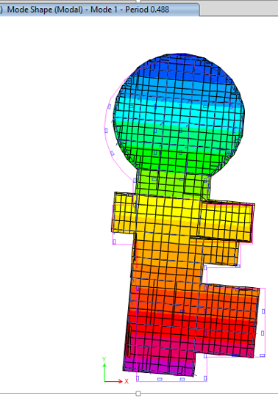
Check period of mode of maximum Modal (2) participation mass ratio.
for the first mode =T etabs
=0.488 sec.
T=1.4Ct * (hn) ^3/4
h_{n} =10.5 m
Ct =0.0488
T= 0.29 sec ➔ T = 0.29*1.4 = 0.4
T _{etabs} should be <Tcode
Thus, ok.

Slide 44
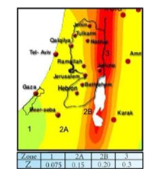
Seismic-Design
seismic zone factor of Nablus Z = 0.20
bearing capacity = 400 kN/m^2
soil profile type Sc
Seismic coefficient Ca = 0.24
Seismic coefficient Cv = 0.32

Slide 45
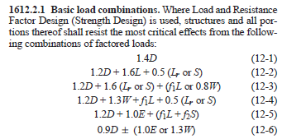
Load combinations
Ultimate Combinations

Slide 46
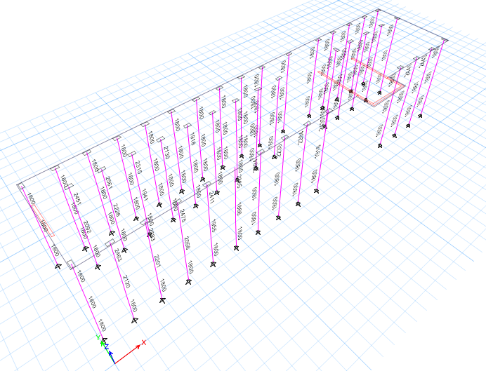
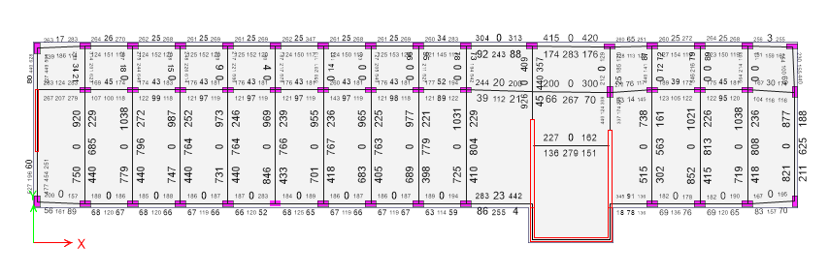
Check The Designed Member For Model 1

Slide 47
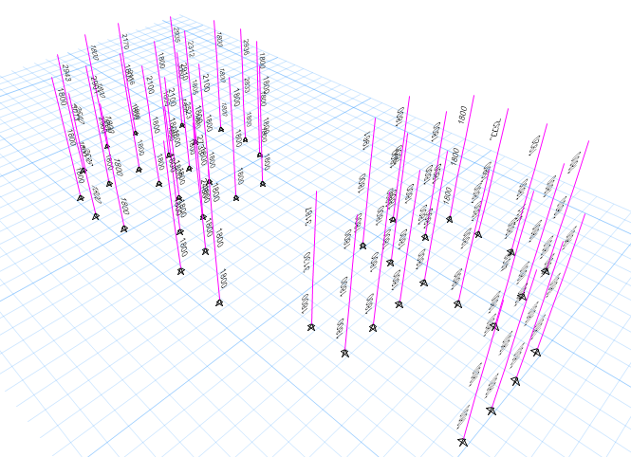
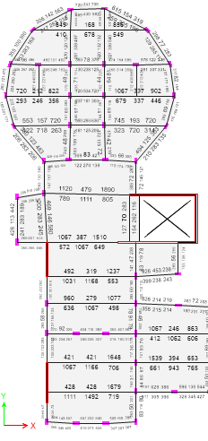
Check The Designed Member For Model 2

Slide 48
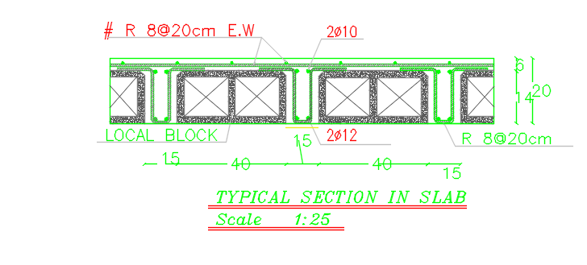
Section In Slab:

Slide 49
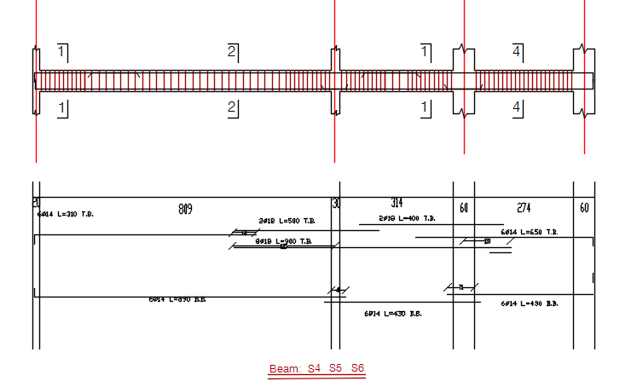
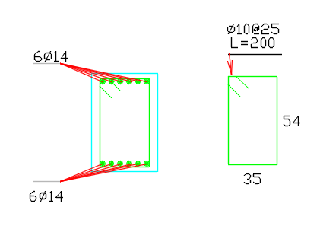
beams design

Slide 50
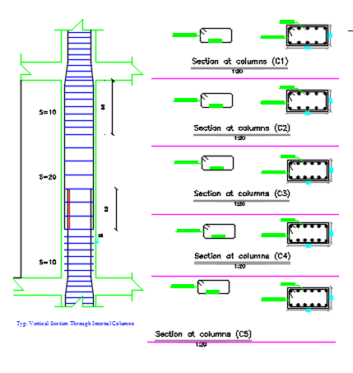
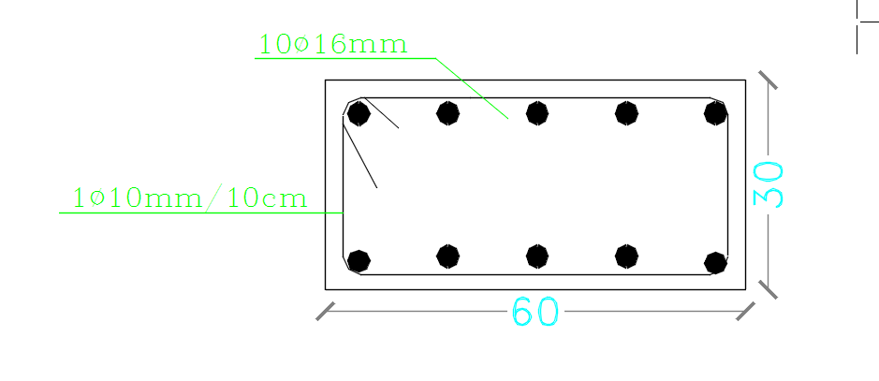
Column design

Slide 51
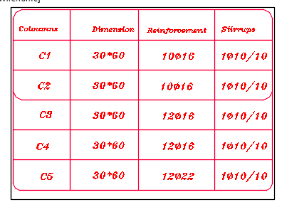
Column design

Slide 52
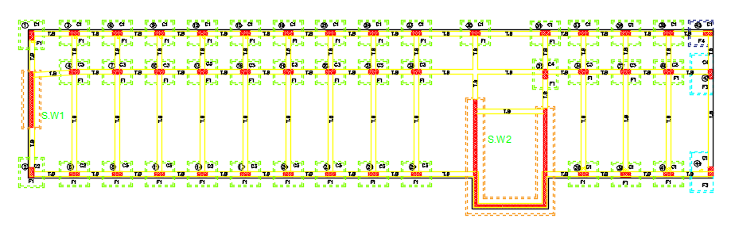
Footing Plan:-

Slide 53
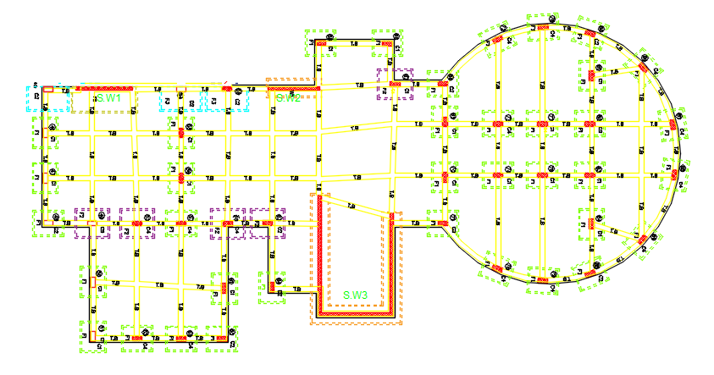
Footing Plan:-

Slide 54
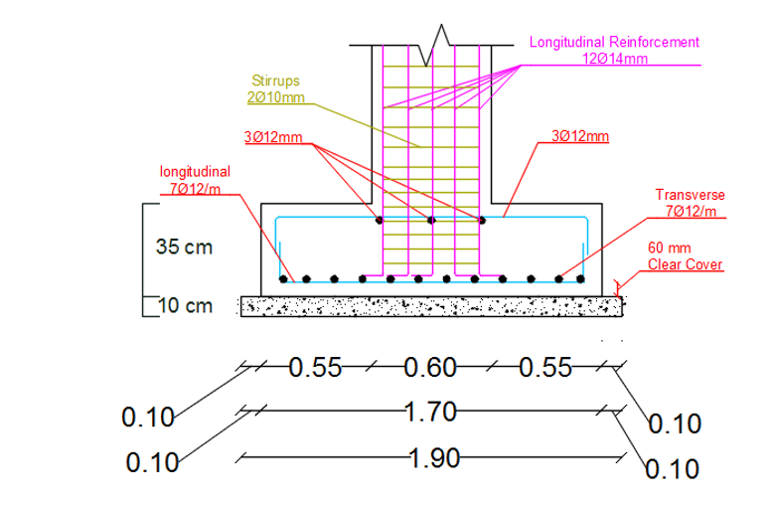
Footing Details:-

Slide 55
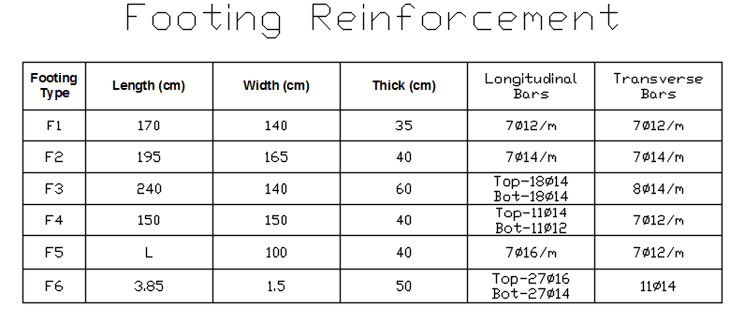
Footing table:-

Slide 56
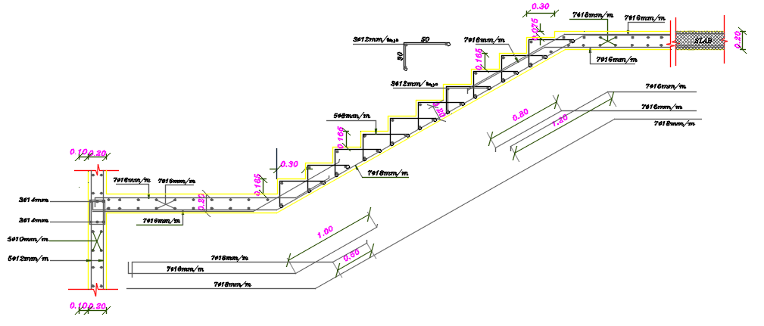
Detail of stair

Slide 57
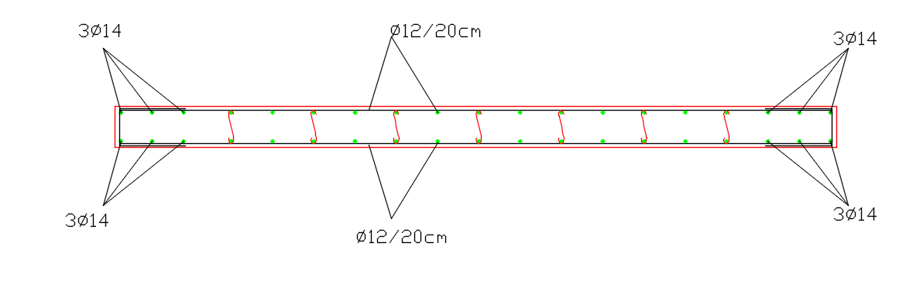
Detail of Shear Wall

Slide 58
Expantion joint
to determine the expantion joint from Etabs
Dm1 = 0.7*R*∆S1
Dm2 = 0.7*R*∆S2
Dmt=( Dm₁²+ Dm₂²)^{0.5}
From Etabs
Ux₁ = 8.736 mm
Ux₂ = 5.956 mm
Ux₃ =6.636 mm
Ux₄ =11.053 mm

Slide 59
Expantion joint
∆S1= 0.7*5.5*8.736 = 33.63
∆S2= 0.7*5.5*5.956 = 22.9
∆S3= 0.7*5.5*6.686 = 25.74
∆S4= 0.7*5.5*11.053 = 42.55
Dmt=( Dm₁²+ Dm₃²)^{0.5}
= (33.63²+25.74²)^{0.5 =} 42.35 mm
Dmt=( Dm₂²+ Dm₄²)^{0.5}
= (22.9 ²+42.55²)^{0.5 =} 48.32 mm
So Use 5+2 = 7 cm

Slide 60
Environmental Design

Slide 61
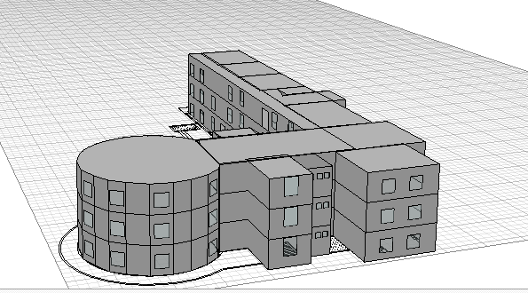
Environmental design:
Simulation analysis via Ecotect
Ecotect its environmental analysis program to evaluate daylight, thermal , solar analysis , and sun path . To get illustration about energy efficient and sustainable future .
The input data inserted in Ecotect:
Insert the school into the program , oriented to north . As shown in the figure below.

Slide 62
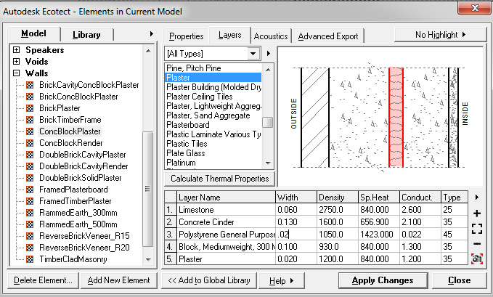

U-Value

Slide 63

U-Value

Slide 64

Natural Day Light Analysis:

Slide 65
Natural Day light analysis:
Since models have a good lighting values within the range 300- 500, as recommended , and that will work as a solarium which enhance the heating in winter and ventilation in summer.

Slide 66

Annual temperature distribution

Slide 67
Comfort in Classroom
.
 | HOURS | PERCENT
0.0 | 0 | 0.0%
2.0 | 0 | 0.0%
4.0 | 8 | 0.8%
6.0 | 29 | 2.7%
8.0 | 31 | 2.9%
10.0 | 60 | 5.7%
12.0 | 10 | 0.9%
14.0 | 38 | 3.6%
16.0 | 55 | 5.2%
18.0 | 127 | 12.0%
20.0 | 250 | 23.7%
22.0 | 210 | 19.9%
24.0 | 129 | 12.2%
26.0 | 54 | 5.1%
28.0 | 41 | 3.9%
30.0 | 14 | 1.3%
32.0 | 0 | 0.0%
34.0 | 0 | 0.0%
36.0 | 0 | 0.0%
38.0 | 0 | 0.0%
40.0 | 0 | 0.0%
42.0 | 0 | 0.0%
44.0 | 0 | 0.0%
46.0 | 0 | 0.0%
COMFORT | 825 | 78.1%

Slide 68

Heating and cooling results
We use the full air conditioning settings to obtain the cooling and heating values just to compare it with the energy efficient buildings and the results are as following.
All Visible Thermal Zones
Comfort: Zonal Bands
Max Heating: 60467 W at 09:00 on 19th January
Max Cooling: 97920 W at 12:00 on 4th September

Slide 69

Sun path and shadow on the building :
In our project theirs no surrounding buildings exist as shown in figure and this figure show the building.

Slide 70

Acoustical analysis:
Good acoustics in teaching spaces make for quality learning environments. It is essential to ensure good acoustics are achieved when building new facilities or upgrading older buildings .Knowing that the optimum reverberation time for classrooms is 0.6- 0.8 Sabine. to achieve this value we use false ceiling with perforated panel.

Slide 71

RT-60
From previous tables for RT60 = 0.67 , we conclude that classroom are within range(0.6-0.8) .

Slide 72

Sound Transmission Class

Slide 73

Sound Transmission Class
✓ Classroom to Classroom :
The value of sound transmission class (STC) between classroom and others class shall be 40 or more ,.
✓ Partition type : plaster , block 20 cm , plaster.

Slide 74

Sound Transmission Class
This type of partition achieve
the value of airborne sound insulation
between
classroom equal 61 which is very
good for building acoustics.

Slide 75
Electrical Design

Slide 76

$$\text{introduction}$$
$$\text{. }\text{in} \text{this} \text{chapter} \text{the} \text{electrical} \text{design} \text{will} \text{deal} \text{with} \text{three} \text{main} \text{aspects} \text{the} \text{first} \text{one} \text{is} \text{the} \text{socket} \text{arrangement}\text{, }\text{the} \text{second} \text{one} \text{is} \text{the} \text{artificial} \text{lighting} \text{arrangement} \text{and} \text{the} \text{last} \text{one} \text{is} \text{the} \text{circuit} \text{breakers}\text{’ }\text{arrangement} \text{and} \text{calculations}\text{.}$$

Slide 77
Distribution of socket in the loops such as each loop contains 6 socket, such as each socket given 250W.
Distribution of socket in the loops such as each loop contains 4 socket, such as each socket given350W.

Slide 78

Socket

Slide 79

Main distributed board

Slide 80
Dialux For Classroom
Type of luminaire used:
disano
U = 0.62
UGR<19

Slide 81

Table : luminance and other
recommendations related
to different spaces

Slide 82

Dialux For Classroom

Slide 83

Dialux For Classroom

Slide 84

Dialux For Classroom

Slide 85

Dialux For Classroom

Slide 86
Resluts
Function | Uo | Targeted Eavg. Lux | No. of Lamp | Glare
Classroom | 0.62 | 300 | 6 | 17.9
Science Lab | 0.6 | 500 | 7 | 13.6
Manager Office | 0.64 | 300 | 4 | 13
Table 3.20: Spaces’ Result by Dialux

Slide 87
Mechanical Design

Slide 88
Mechanical Design
1- Water Supply .
2- Drainage System
3- Protection System.

Slide 89
Water supply system
Tanks:
Through several research projects in many schools in the Directorate of Education in Nablus, it was found that The daily consumption of water by students in secondary schools ranges between ( 6-7) liters per day. Given that the number of students in the school is almost 400 students, the school's consumption of water between (2400-2800) liters per day.
The water cycle in the school runs every 3 days . Thus, the water consumption in the school every 3 days between (7200 - 8400) liters. So we need 9 water tanks of 1 cubic meter.

Slide 90

Water Tanks

Slide 91

Water Consumption

Slide 92

Water Supply System

Slide 93


Water Supply System

Slide 94

Drainage System
Number of DFU’s
for each fixture

Slide 95

Drainage System

Slide 96

Drainage System

Slide 97

Drainage System

Slide 98
Drainage System
Stack is 4’’ diameter .
The horizontal Line for lavatory which reach to the main drainage = 2".
The horizontal Line for W.C which reach to the main drainage = 4"

Slide 99

Drainage System

Slide 100

Safety System
Fire Extinguishers

Slide 101

Safety System
Emergency egress system

Slide 102

Safety System
First Aid

Slide 103
Quantity surveying and cost estimation

Slide 104

Material Quantity

Slide 106
Thank You

