Slide 1
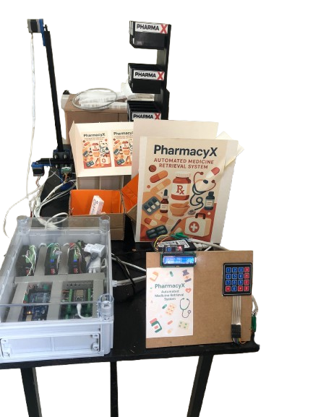
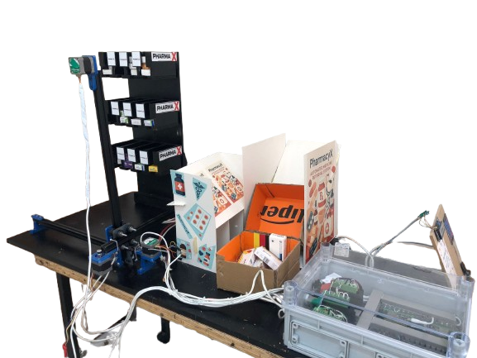
Pharma X
Presented by: Saif Shayeb & Osama Ishtaiwi
Supervisor: Dr Abdullah Rashed

Slide 2
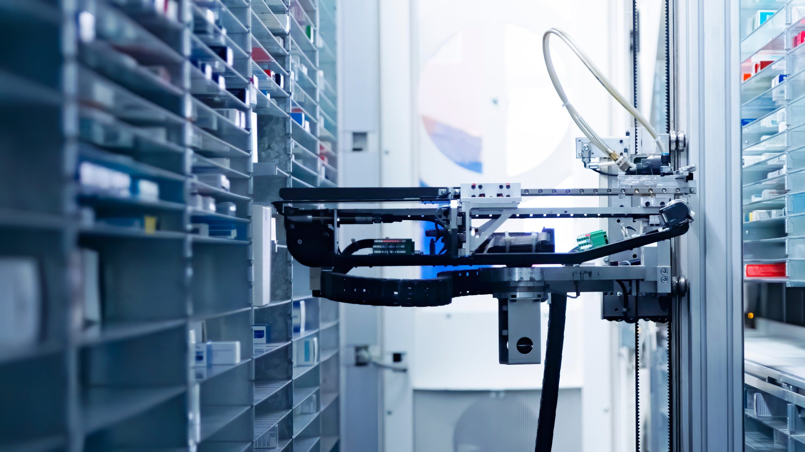
TABLE OF CONTENTS
FEATURES
2
3
CONTROL MECHANISMS OF A ROBOT
1
1
Introduction
4
2025
2025
External Robot Structure
5
7
6
Hardware Modules
Constraints
Future Work

Slide 3
Introduction
Pharma X was developed to address rising prescription volumes and the errors of manual systems. It provides a reliable, fast, and cost-effective solution that reduces mistakes, improves efficiency, and represents a step toward smart pharmacy automation.

Slide 4
F
D
C
Event-Driven Status & Logging
System reports real progress (ACK, ERR, SUCCESS) for easy tracking and debugging.
Clean Power & EMC
Separate 12 V and 5 V rails with shielding ensure stable, noise-free operation.
Autonomous 3-axis pick & drop
The gantry moves on X, Y, Z axes to pick a box and drop it into the pickup bin automatically.
Features:
Two user interfaces
ESP32 web app for ordering + LCD/Keypad for local/offline control.
B
Dual Ultrasonic Verification with Retries
Front sensor checks the shelf, platform sensor confirms the box; retries up to 3 times if needed.
A
Autonomous 3-Axis Pick & Drop
Dual Ultrasonic Verification with Retries
Two user interfaces
Event-Driven Status & Logging
Clean Power & EMC

Slide 5
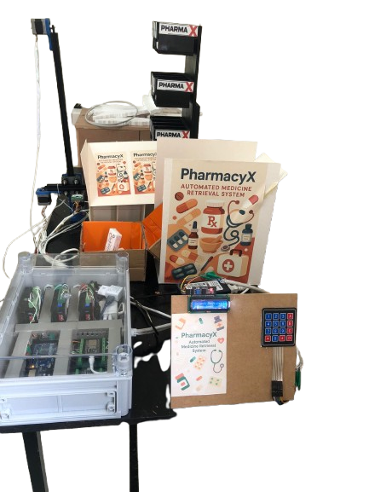
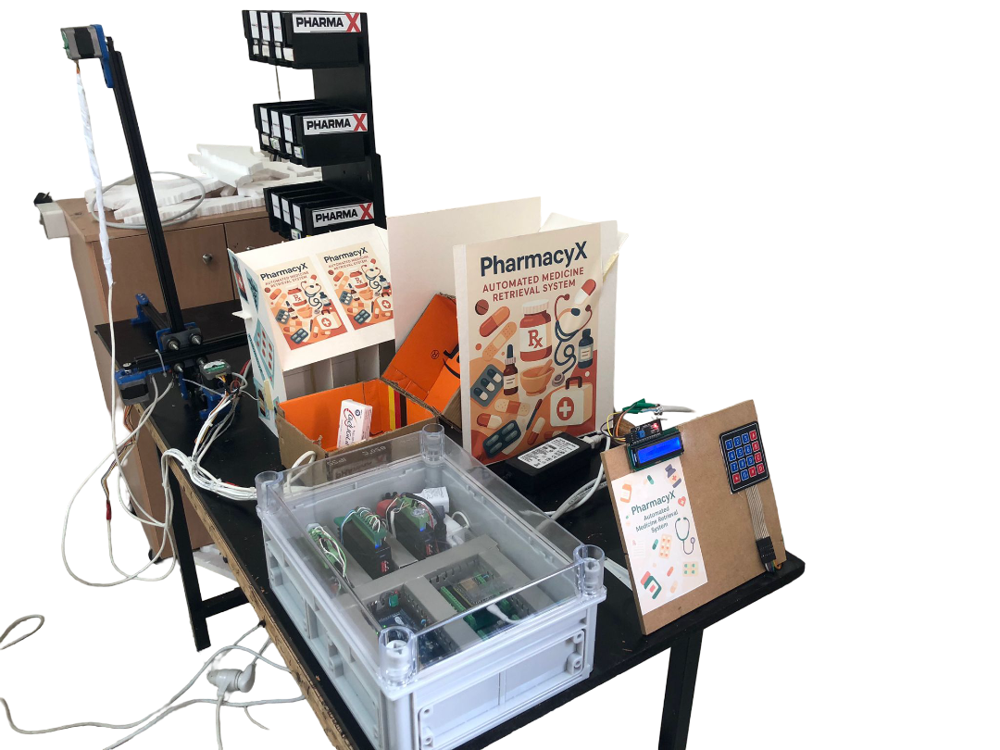
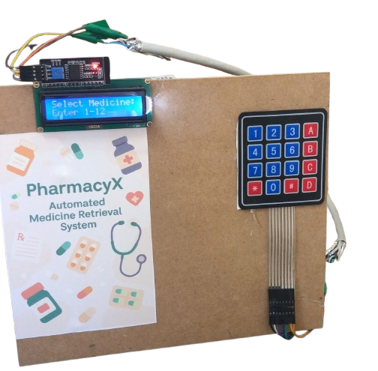
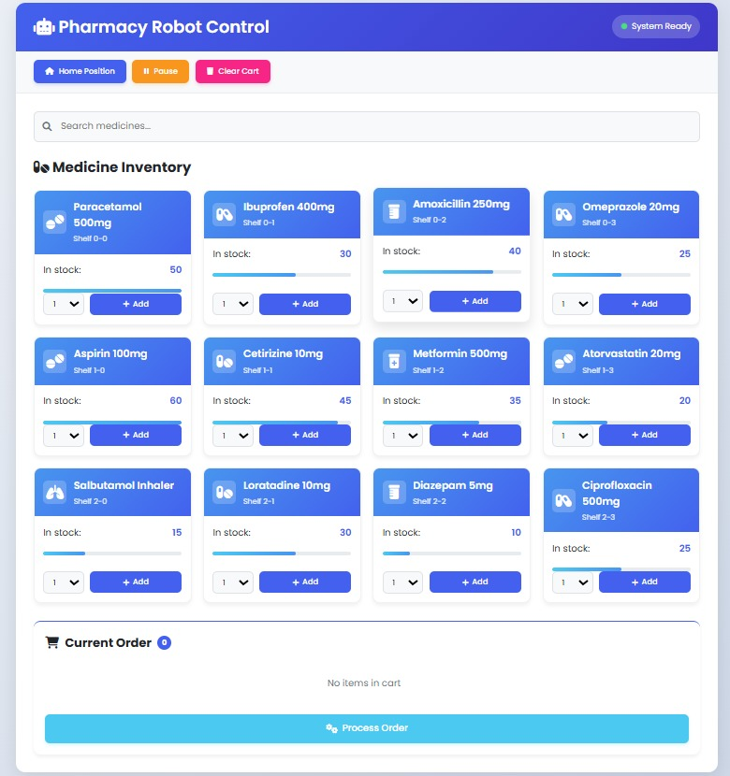
CONTROL MECHANISMS OF A ROBOT:

Slide 6
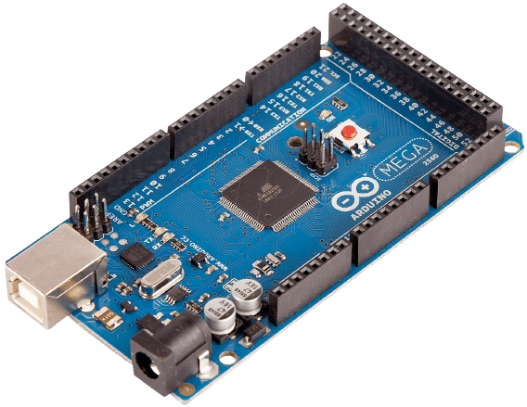
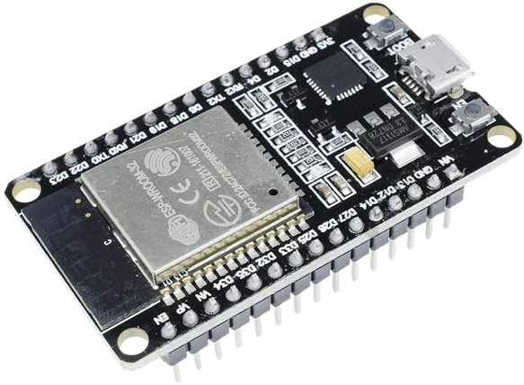
EXTERNAL ROBOT STRUCTURE :

Slide 7
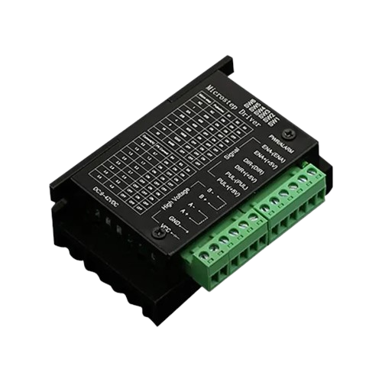
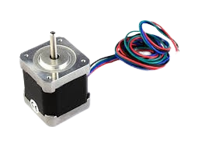
HARDWARE MODULES :

Slide 8
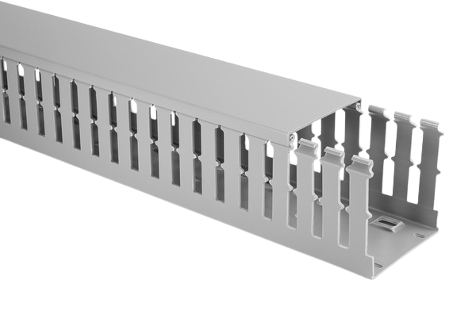
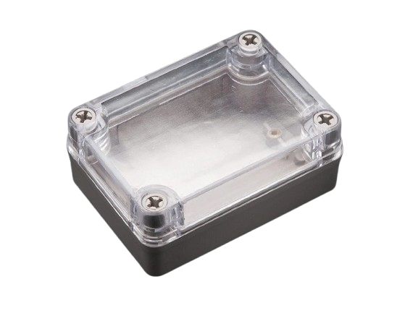
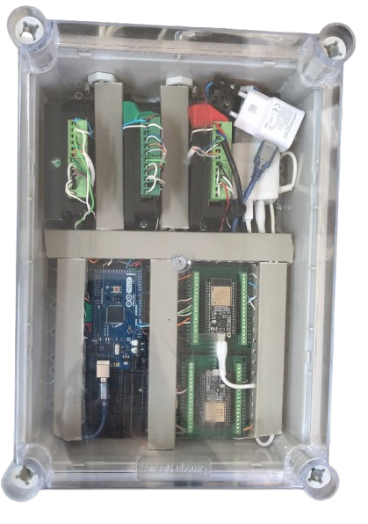
HARDWARE MODULES :

Slide 9
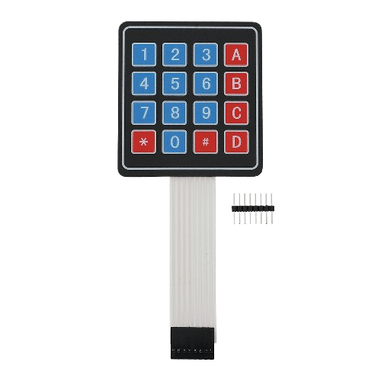
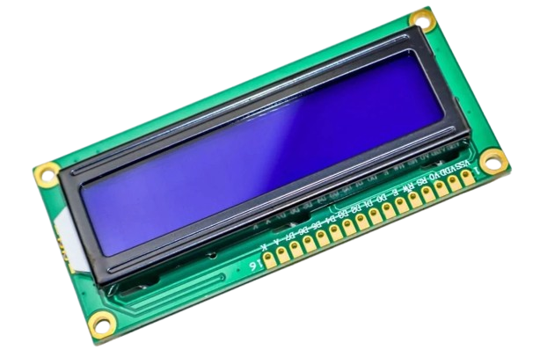
HARDWARE MODULES :

Slide 10
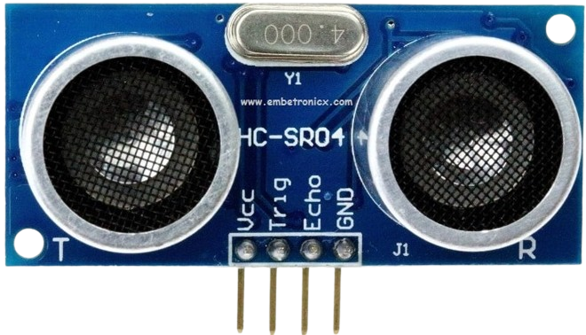
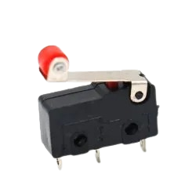
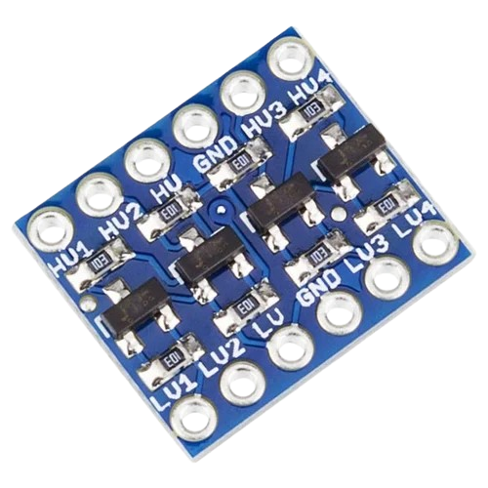
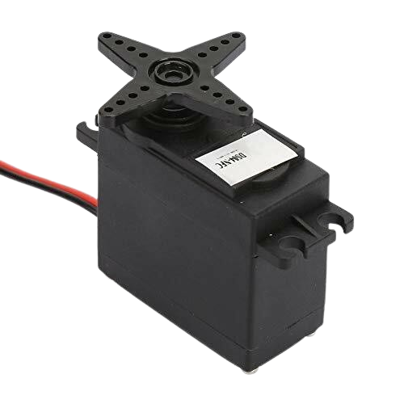
HARDWARE MODULES :

Slide 11
HARDWARE MODULES :

Slide 12

Constraints
Schedule pressure
Shelf geometry & capacity
Sensing
Mechanical
Budget

Slide 13
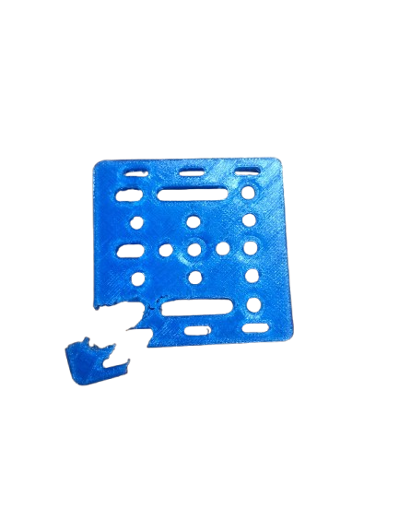
Mechanical robustness & sourcing
Schedule pressure
Budget
Shelf geometry & capacity
Sensing
Mechanical
We relied on 3D-printed parts to build the robot, which made prototyping fast and low-cost. However, these parts are weaker than metal and may wear out with repeated use. Finding drop-in metal replacements is also difficult, so a production version would need stronger materials.

Slide 14
Shelf geometry & capacity
Schedule pressure
The shelves were not perfectly uniform in size, which caused alignment issues when the robot retrieved medicines. Limited space also restricts how many boxes can be stored. To manage this, we often recalibrated and standardized the package sizes.
Budget
Shelf geometry & capacity
Sensing
Mechanical

Slide 15
Sensing reliability
Schedule pressure
Ultrasonic sensors offered a simple way to detect medicines but are not always reliable. Glossy packages or shelf angles sometimes caused false readings. We improved accuracy with filtering, retries, and delays, but better backup sensors would help in the future.
Budget
Shelf geometry & capacity
Sensing
Mechanical

Slide 16
Budget ceiling
Our budget was limited, which forced us to choose simpler, low-cost components instead of industrial ones. This worked well for the prototype, but it restricted the types of sensors and mechanical parts we could use. Scaling up would require more investment.
Schedule pressure
Budget
Shelf geometry & capacity
Sensing
Mechanical

Slide 17
Schedule pressure
The project was developed under a tight timeline, leaving little room for multiple design revisions or endurance testing. We focused on making the core system functional rather than perfecting every detail. This means there is still room for refinement.
Schedule pressure
Shelf geometry & capacity
Budget
Sensing
Mechanical

Slide 18
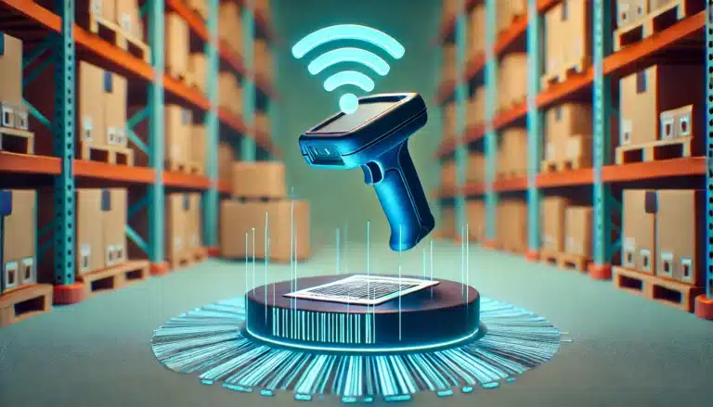
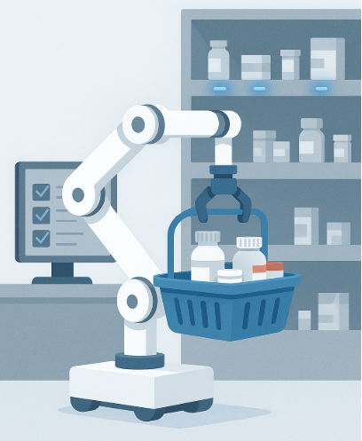
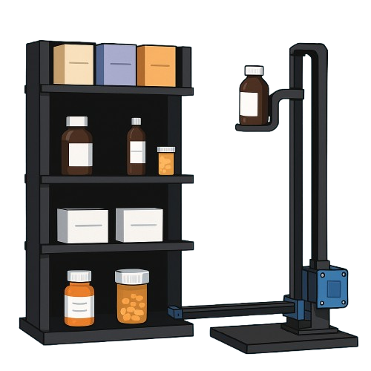
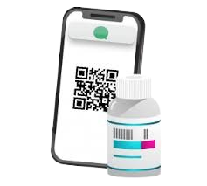
FUTURE WORK
Automated Shelf Restocking
Multi-Item Retrieval in One Trip
Support for Bottles & Non-Box Medicines
E-Prescription with Unique Barcode/QR

Slide 19
Automated Shelf Restocking
Use LEDs and barcode/RFID scans to guide restocking; “low/empty” slots trigger refill tasks and auto-update the web inventory.

Slide 20
Multi-Item Retrieval in One Trip
Plan efficient routes so the robot collects several items in a single tour, cutting down on travel time and repeated homing.

Slide 21
Support for Bottles & Non-Box Medicines
Add modular grippers and ramp inserts to handle bottles or irregular packages, with extra checks like weight or IR sensors.

Slide 22
E-Prescription with Unique Barcode/QR
Each order gets a unique code linking patient, medicine, dose, and expiry; scanning at pickup ensures accurate and secure delivery.

Slide 23
