Slide 1
Caffeine Shot
Prepared by:
Nabeel Kayed
Sondos Hijab
Supervised by:
Dr.Samer Arandi

Slide 2
Table of contents
01
02
03
Main idea
Features
Motivation
04
05
06
Hardware modules & how it works
Constrains
Future work

Slide 3
Main Idea:
Caffeine Shot is a coffee machine that serves drinks such as Nescafe, coffee, and customized drinks.
Smart and Automated
Remote Control
The machine will take your order and notify you when it’s ready to take.
An administrator can manage the machine using the Web Server, while an employee can order.

Slide 4
Features:
2 ways of ordering drinks
Drink Customization
Small and Large Quantities
either using the mobile application or by using the input components of the machine itself
Users can customize his/her own drink depending on their own preferences.
The machine supports different quantities of drinks (large, and small).

Slide 5
Features:
Automatic water temperature control
Special Cup dispensing mechanism
Payment and balance implementation
Using the water temperature sensor
Using the cup dispensing Mechanism
An electronic wallet payment mechanism was added if the machine was used by employees.

Slide 6
Motivation:
Many coffee machines serve just one type of drink, Lack of customization.
Organize the employees usage of the coffee machine
Most coffee machines found in shops can't be controlled remotely

Slide 7
Hardware Modules

Slide 8
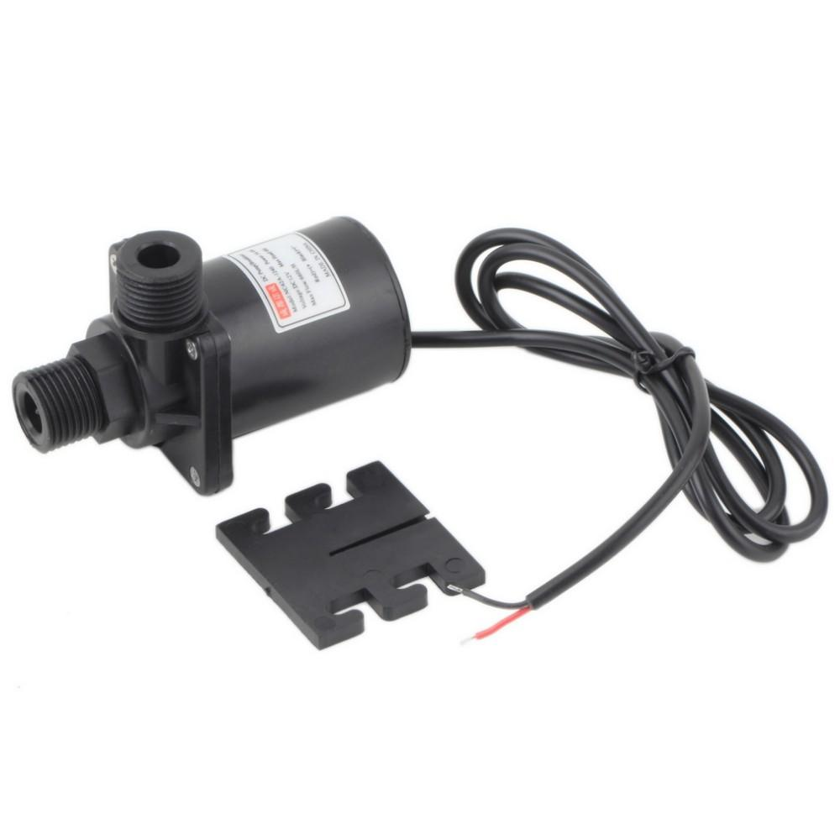
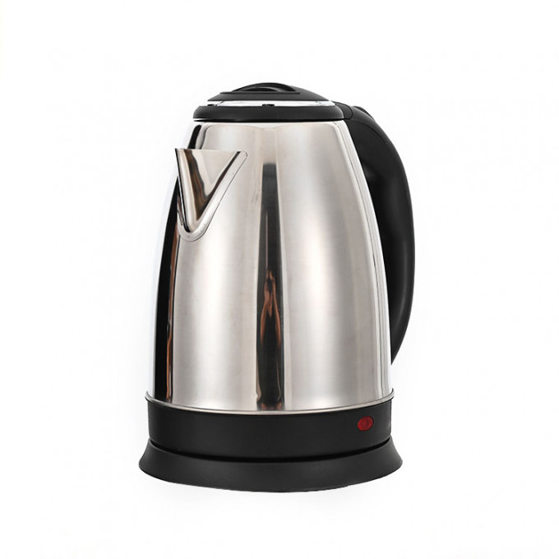
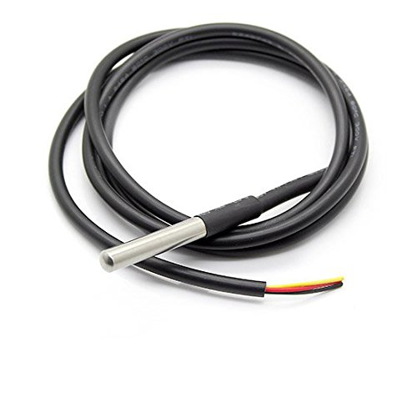
Heating Unit
Heater
Temperature sensor
Pump

Slide 9
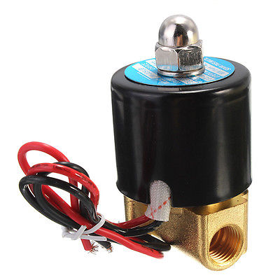
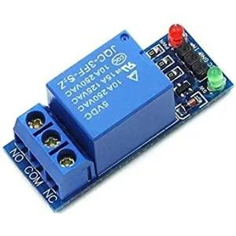
Heating Unit
Solenoid Valve
Relay

Slide 10
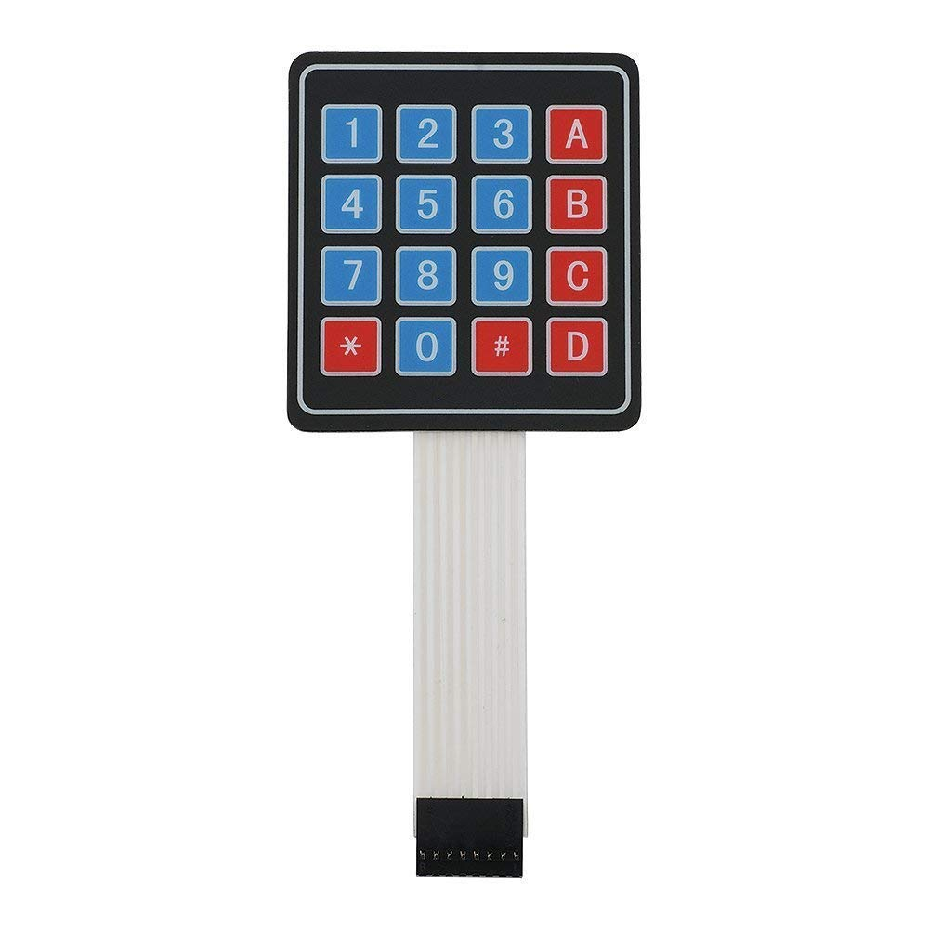
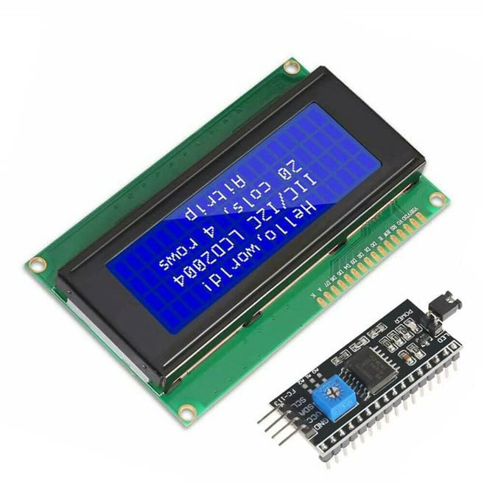
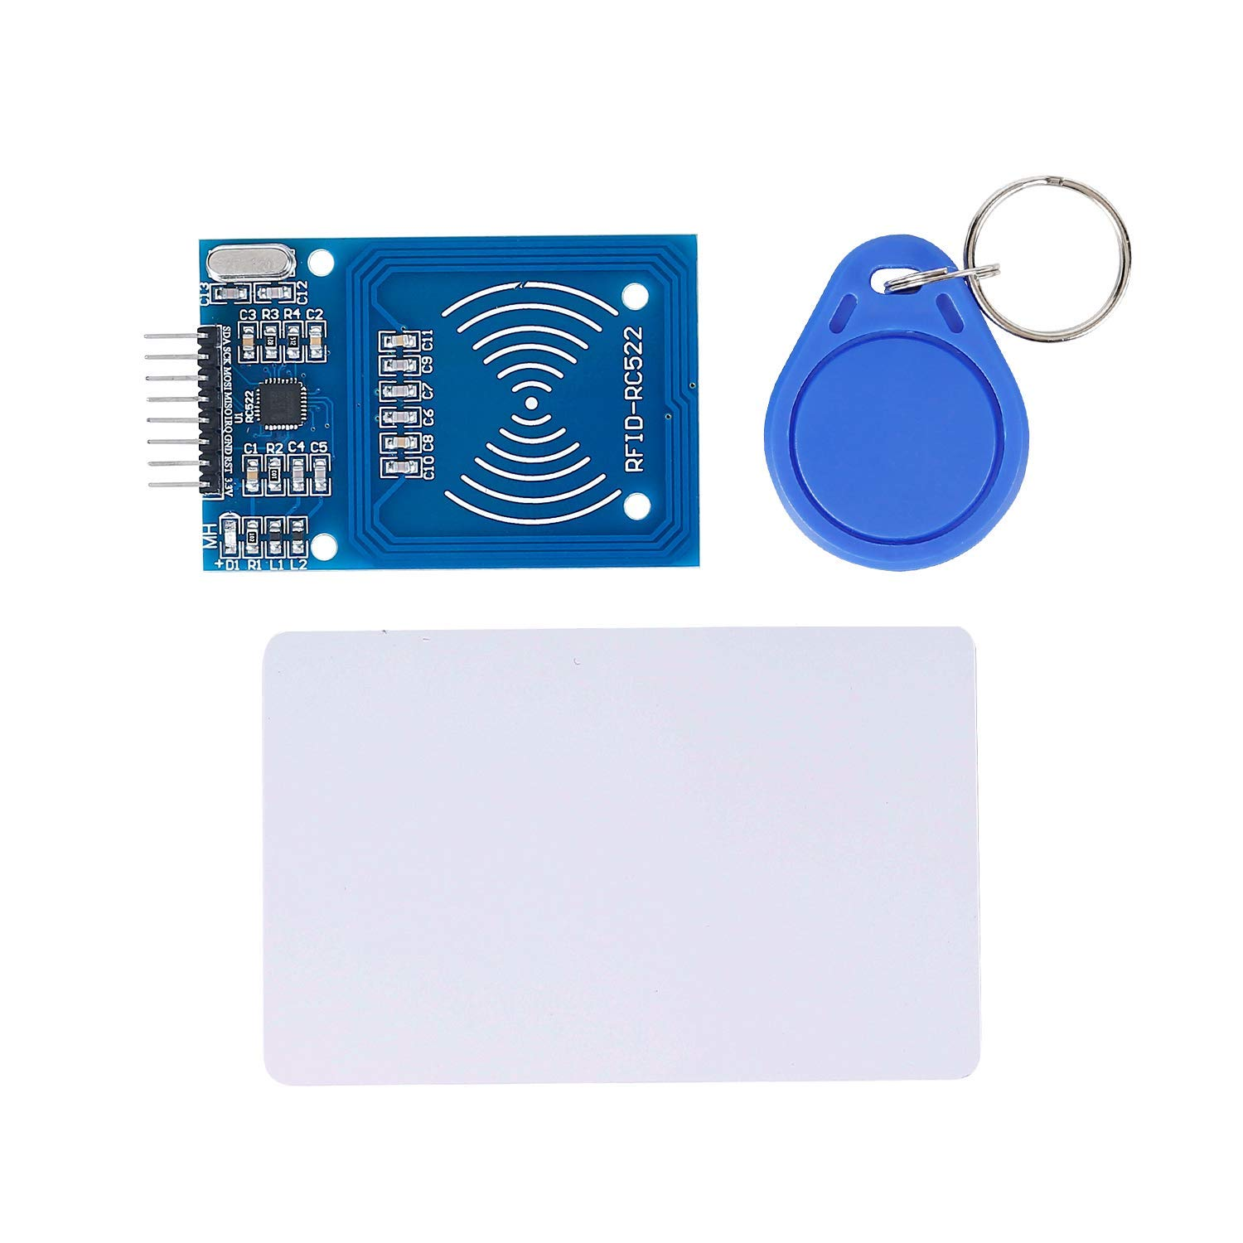
Input/Output Unit
LCD 20x4 I2C
Keypad 4*4
RFID

Slide 11
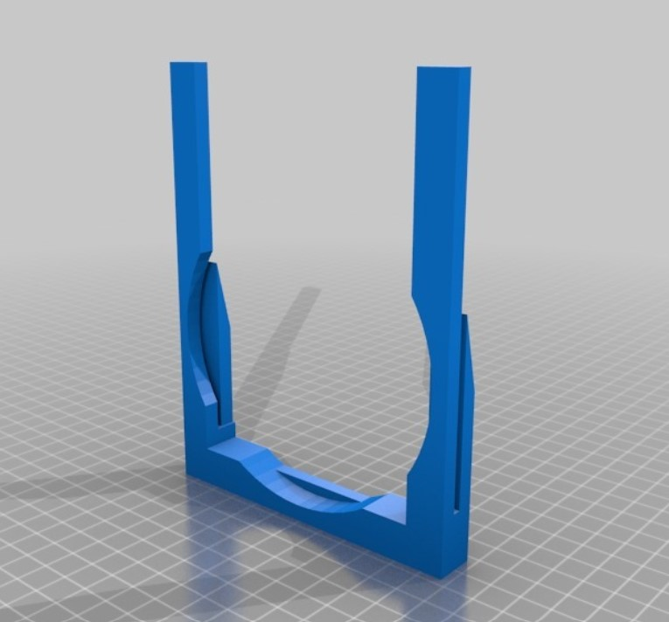
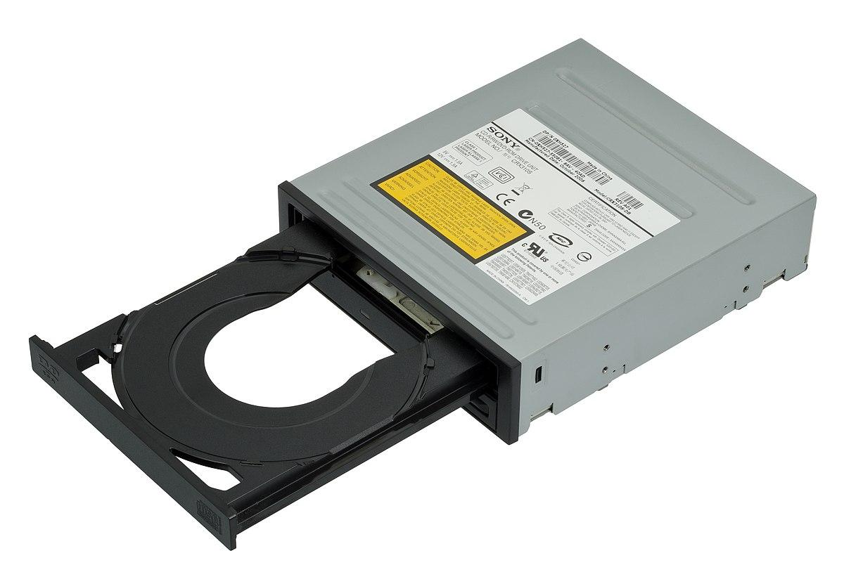
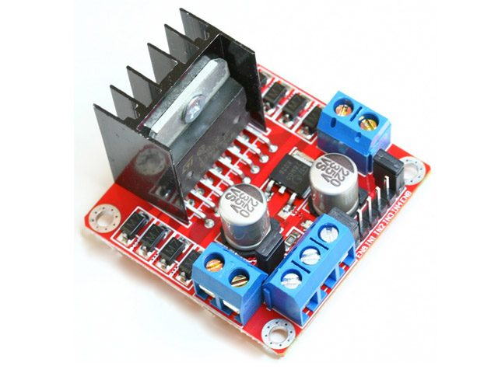
Input/Output Unit
Cup Dispensing
DC motor - Optical Disk Drive
H-bridge

Slide 12
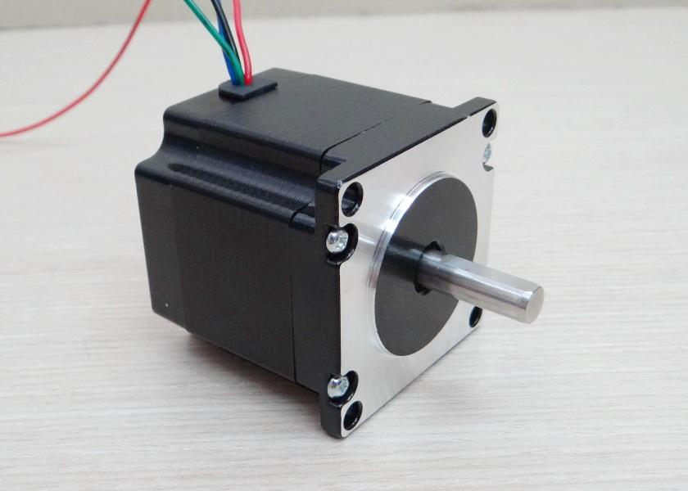
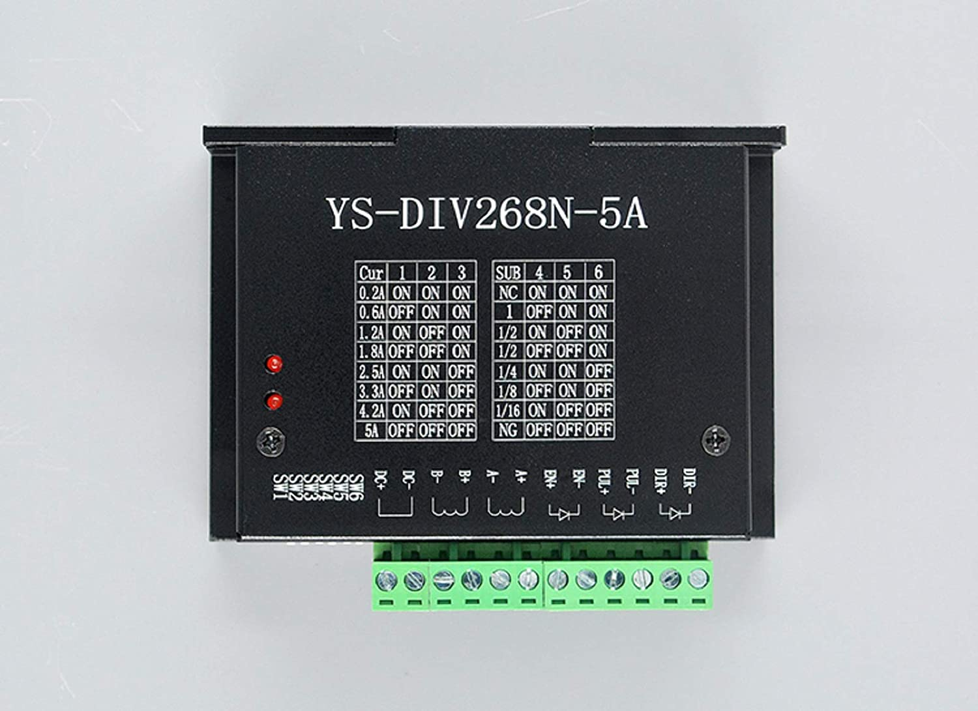
Input/Output Unit
Stepper Motor
Stepper Motor Driver

Slide 13
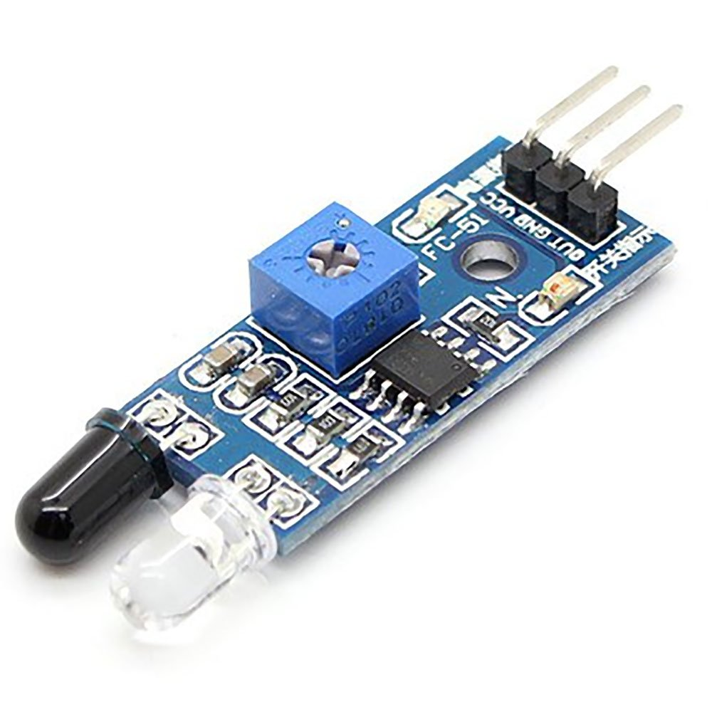
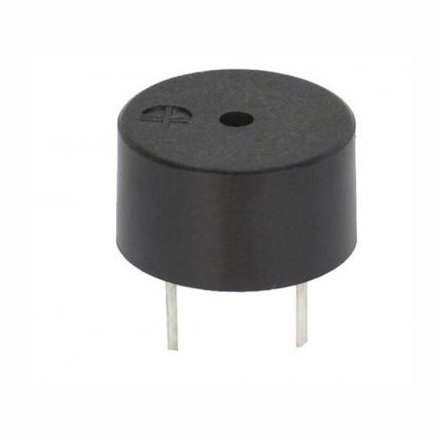
Input/Output Unit
IR sensor
Buzzer

Slide 14
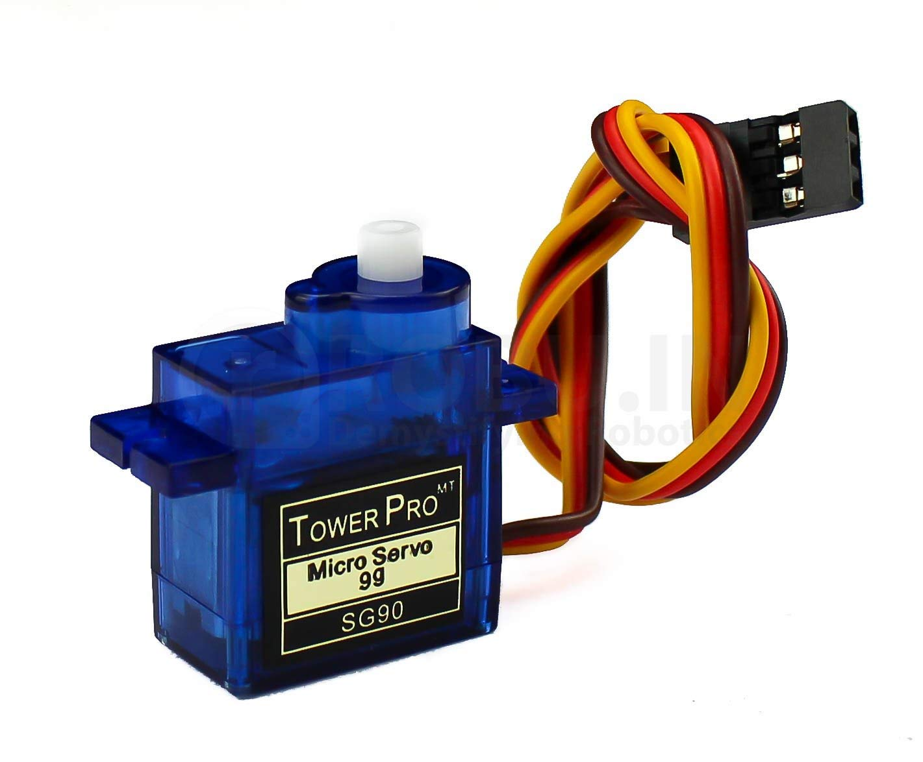
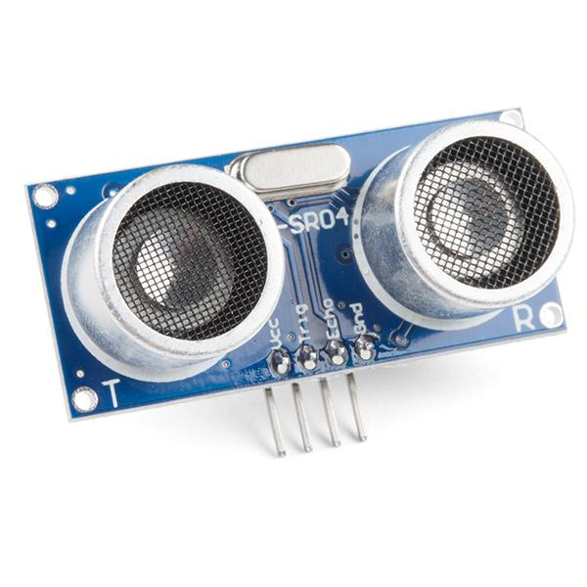
Making Coffee Unit
Servo Motor
Stepper Motor
Ultrasonic Sensor

Slide 15
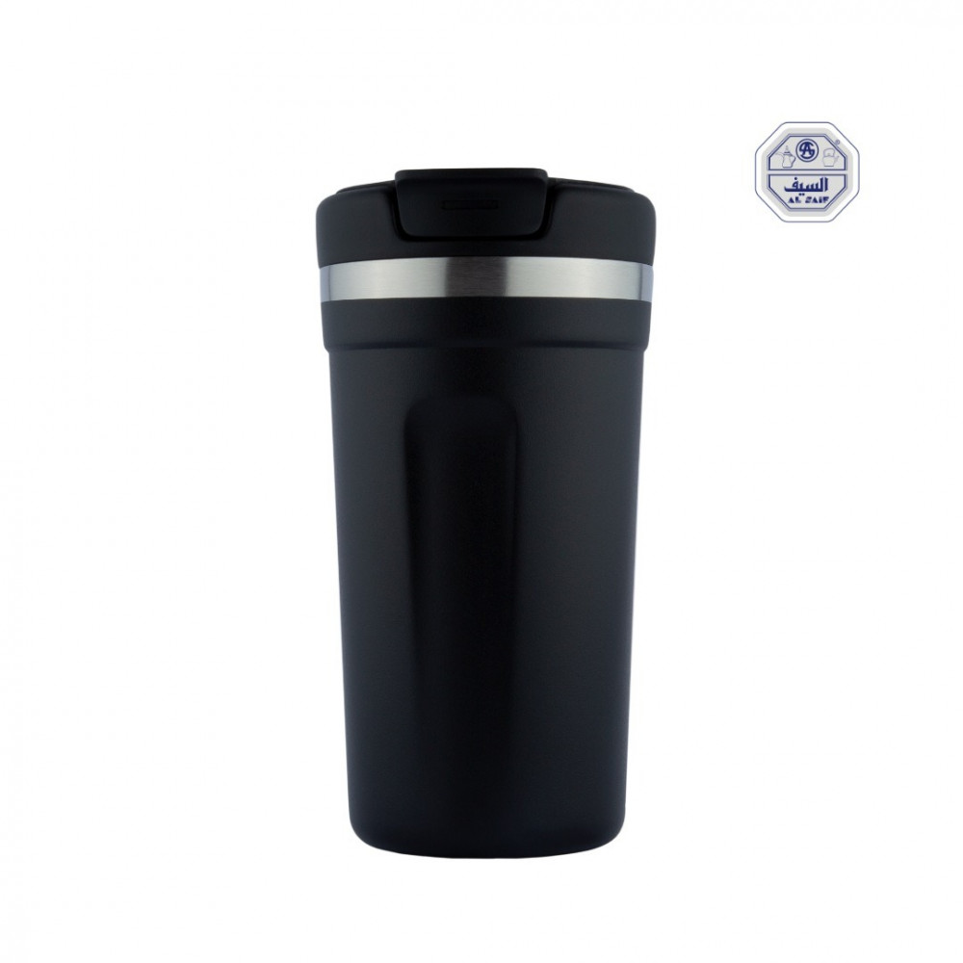
Making Coffee Unit
Group Head
Pump
Relay

Slide 16
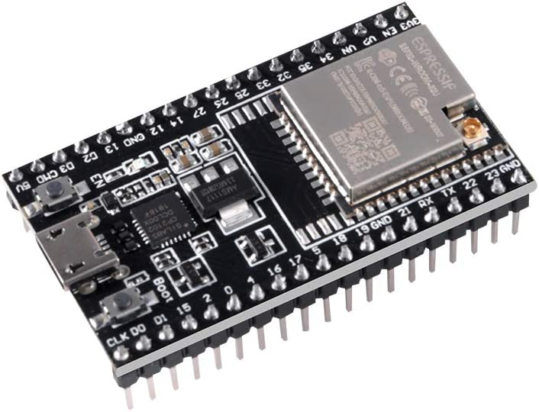
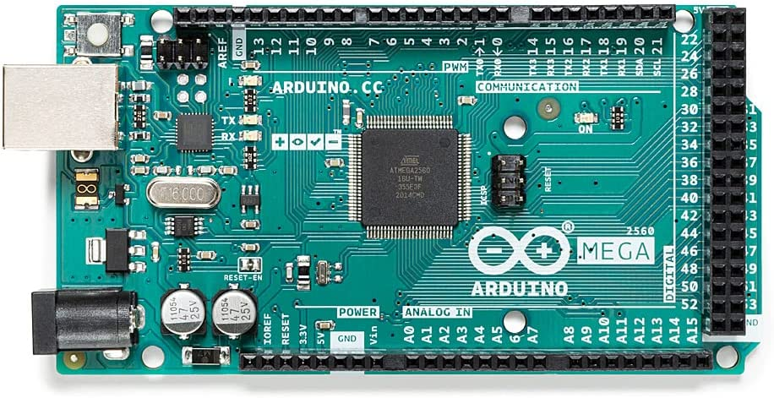
Control Unit
Arduino Mega
ESP32

Slide 17
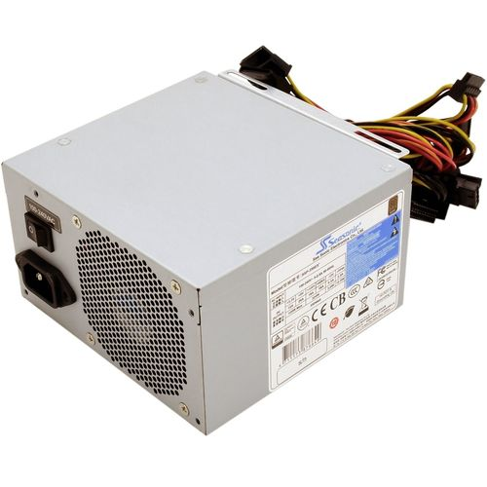
Control Unit
Power Supply

Slide 18
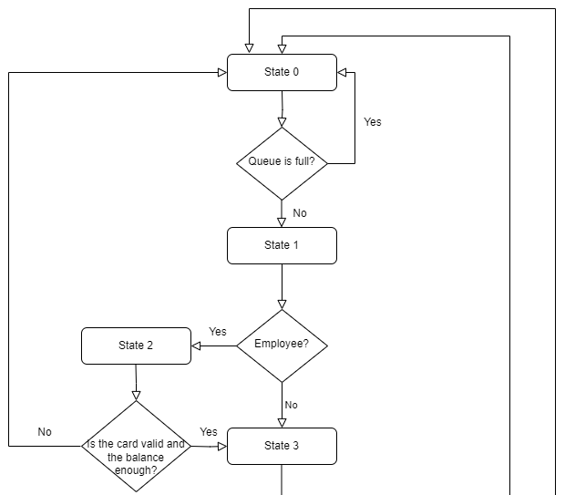
How it works:

Slide 19
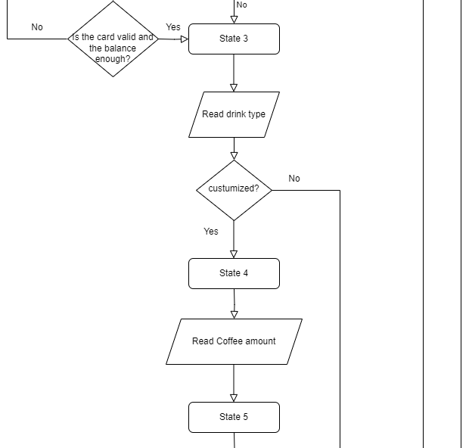
How it works:

Slide 20
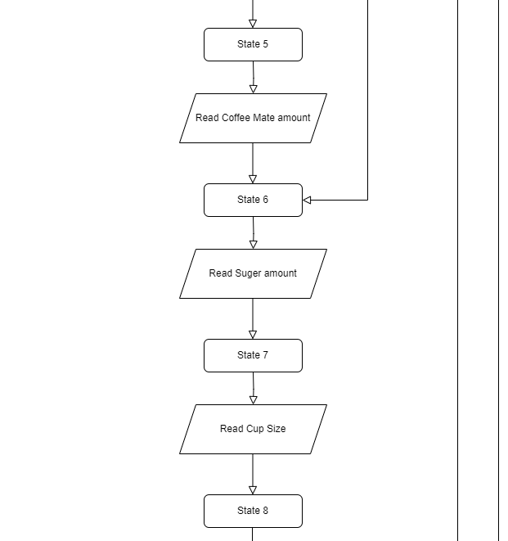
How it works:

Slide 21
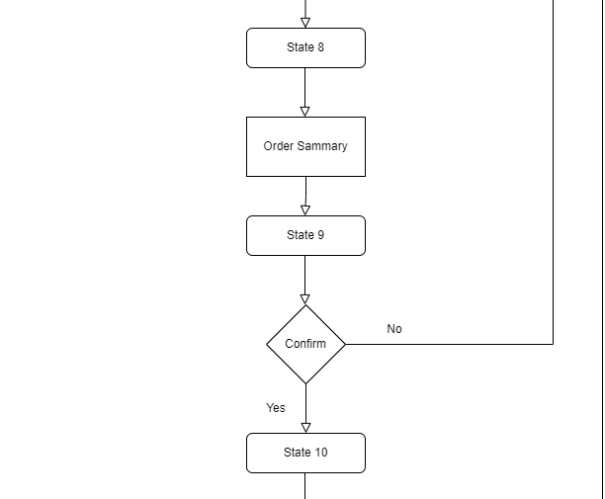
How it works:

Slide 22
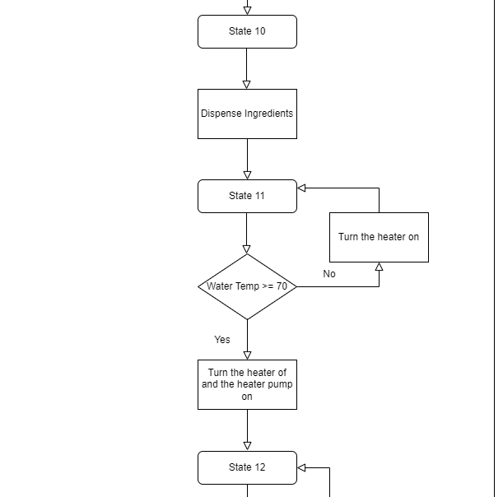
How it works:

Slide 23
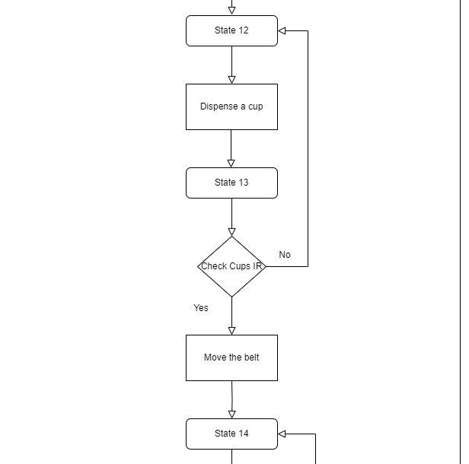
How it works:

Slide 24
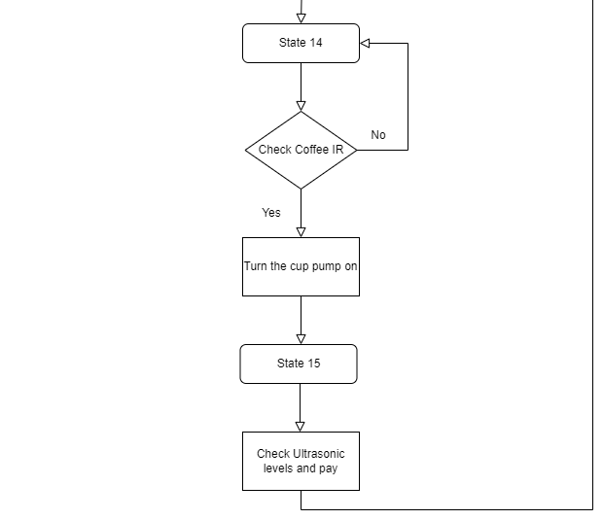
How it works:

Slide 25
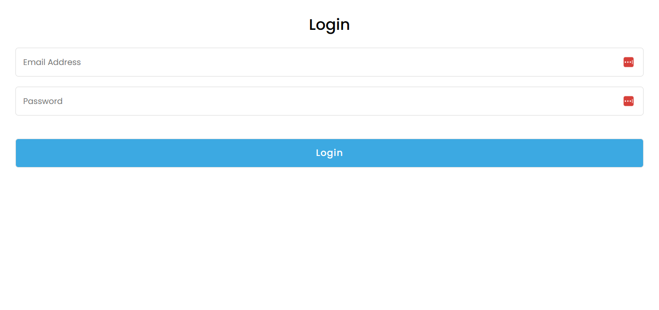
ESP32 Web Server

Slide 26
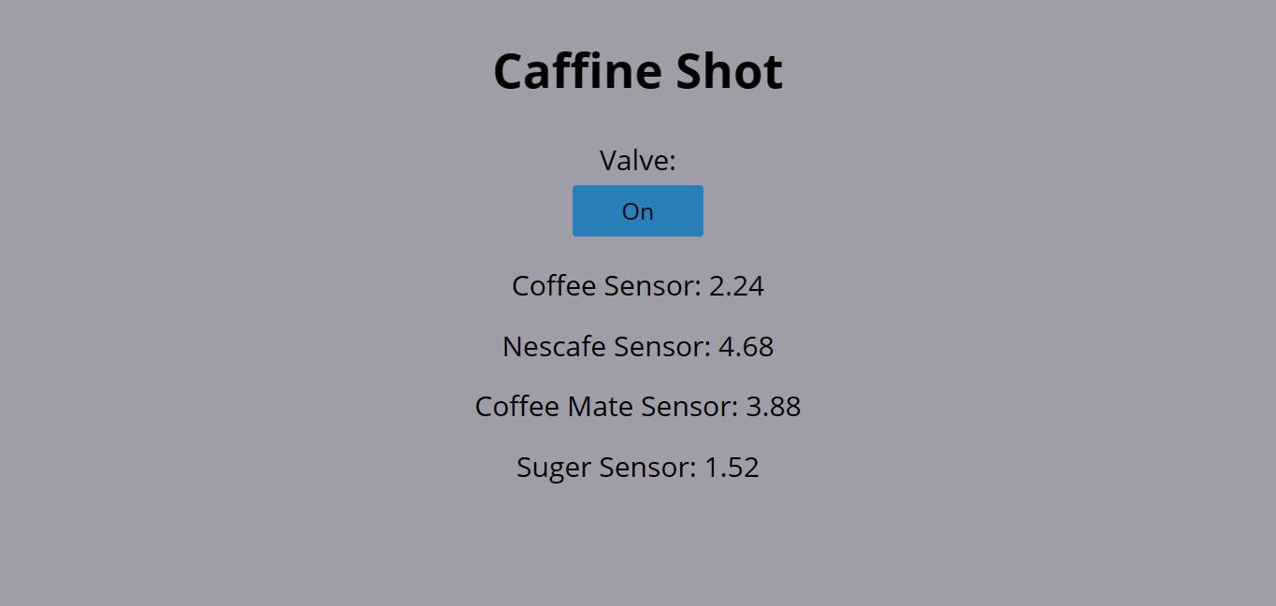
ESP32 Web Server

Slide 27
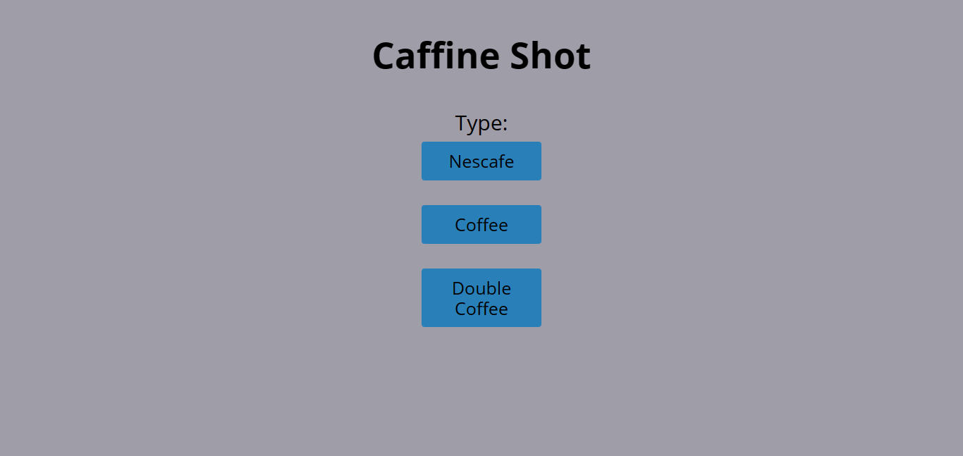
ESP32 Web Server

Slide 28
constrains:
Valve pressure problem.
Cup dispensing 3d printed part.
Interfacing the arduino with other components (relays and stepper motors).
Stepper motor problem
Connect the Esp32 to the (internet).

Slide 29
Future work:
Add GSM to allow the machine to give notifications to the manager.
Make the machine programmable so employees can create custom drinks and add them to the list of available drinks.
Clean the group head after every use to ensure the quality of the next drink.
Add a second cup dispenser for larger cup sizes.
Make the valve automatic with a water level sensor.

Slide 30
THANK YOU!
Any questions?

