Slide 1

Tourism Management System
by:
Aya M. Obead
Azza Z. Arar
Supervisor:
D.Emmad Saadeh

Slide 2
Introduction
Goals and Objective
System Features
AGENDA
Development Process
Future Work
Conclusion

Slide 3
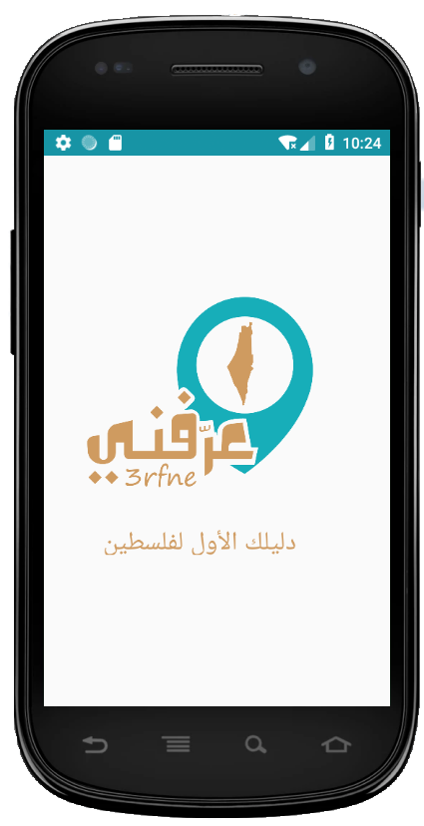




Introduction

Slide 4


Slide 5





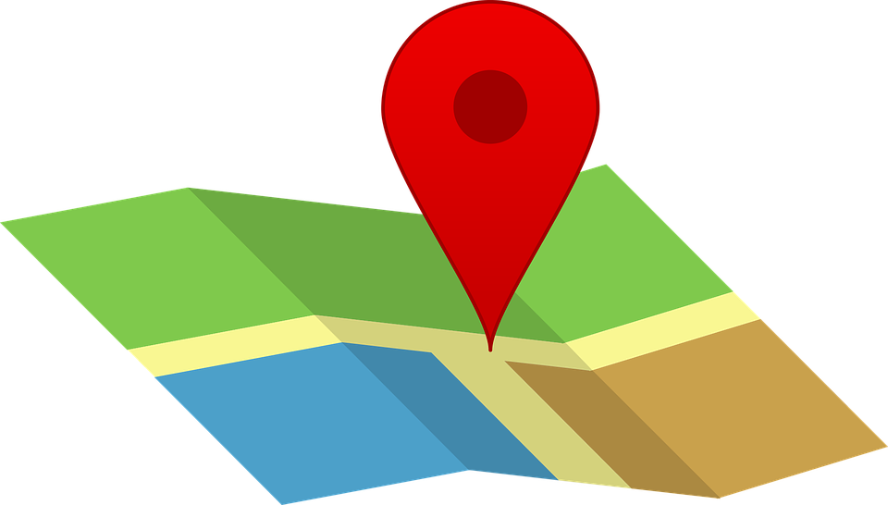
Current System
Proposal System
-Palestine has many tourist places, but it is unknown for all.
-All tourist places are in one place.
- provide information, photos ,and the possibility of tracking the place on the map.

Slide 6







Current System
Proposal System
-Current ways to search for a trip:
1.Social Media
2.friends
3.Posters
for users: The results are unsatisfactory.
for tourism office: Lots of time and
effort
-Payment by office directly
-Provide a communication way
between the tourist office and
the user.
-Provide search engine for trips
user search by :
Price, trip direction,Name of tourist
office.
-Payment by bank

Slide 7





Goals and Objectives
Tourist offices can publicate tours and offers in easy way.
Connect the user and the offices directly.
gathers all available tours and places in the same place.
Make the process paperless.

Slide 8

Stakeholder

Slide 9
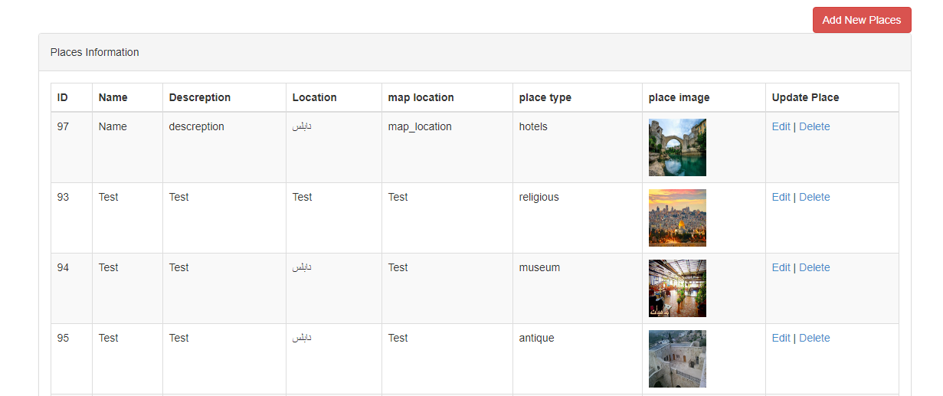
Admin
Add,edit ,delete places.

Slide 10
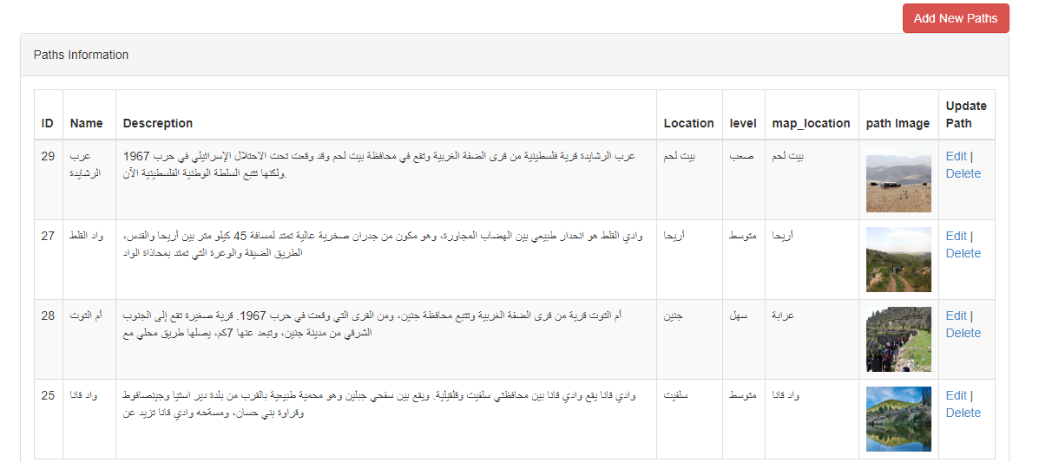
Add,edit ,delete paths.

Slide 11
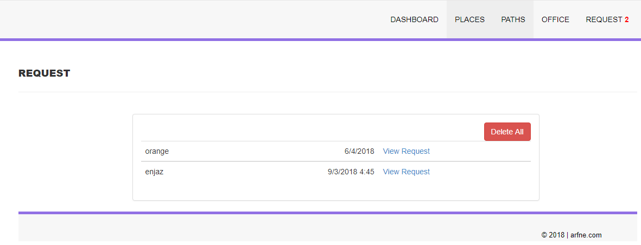
Show Office request.

Slide 12
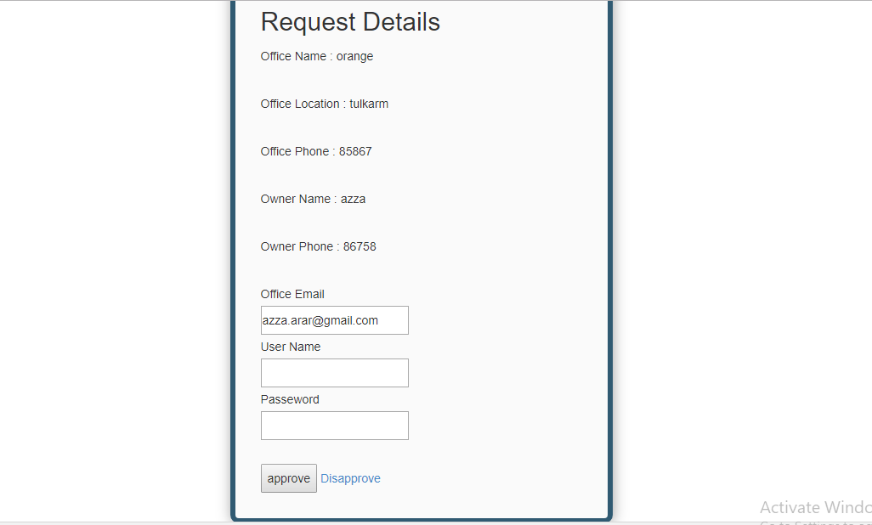
Show Office request.

Slide 13
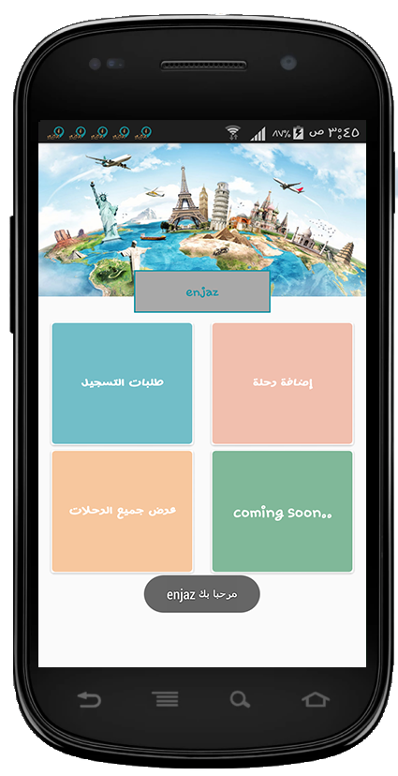
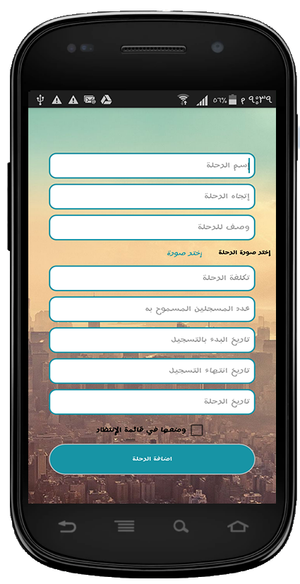
Tourism Office
Add trip

Slide 14
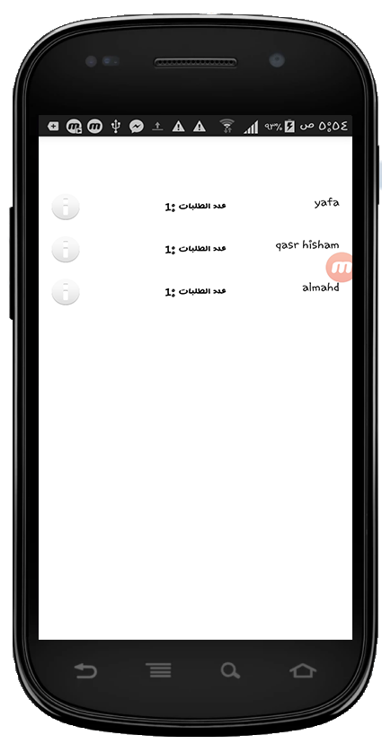
show trips orders

Slide 15
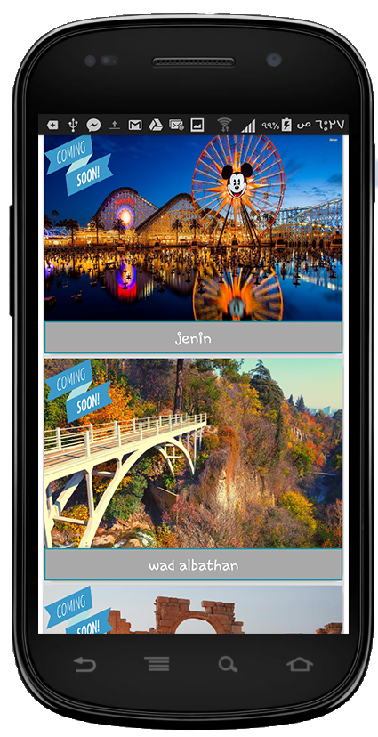
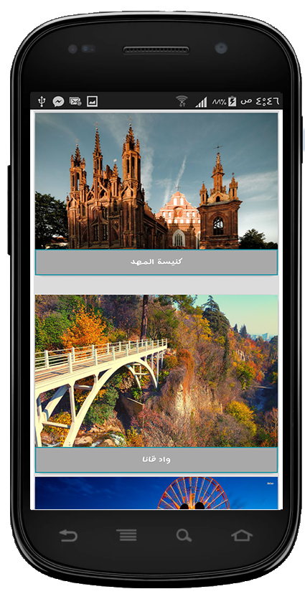
Show all trips ,coming soon trips.

Slide 16
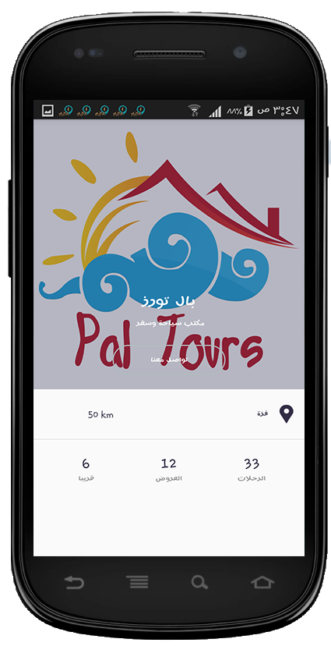
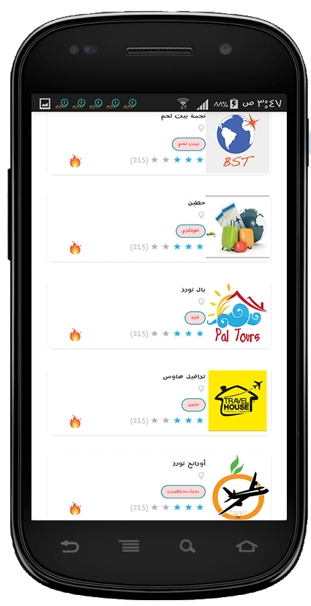
Users
Show tourism offices and its details.

Slide 17
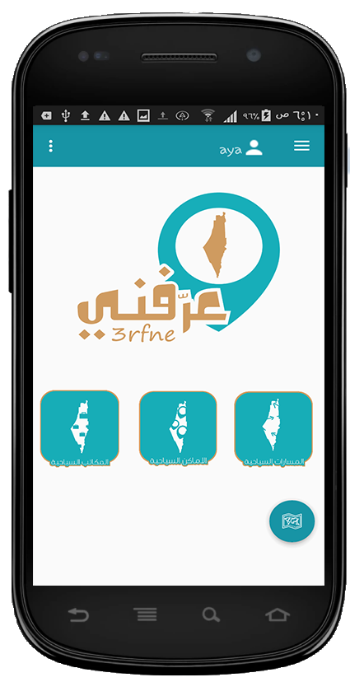
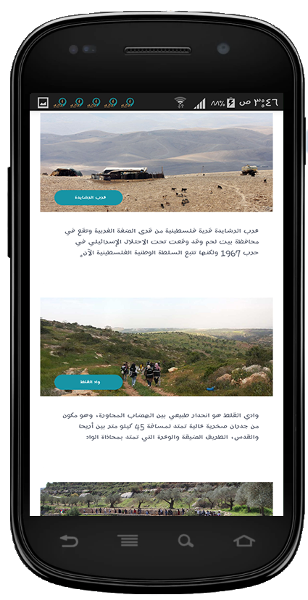
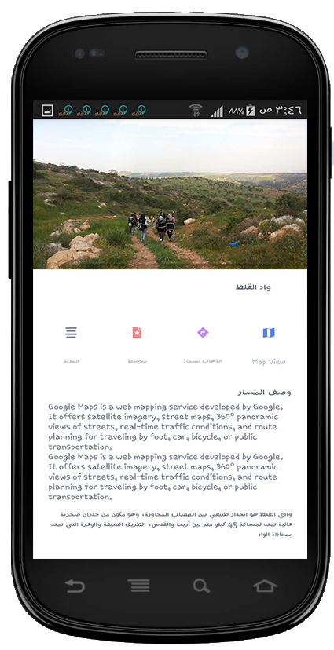
Show tourism paths and its details.

Slide 18
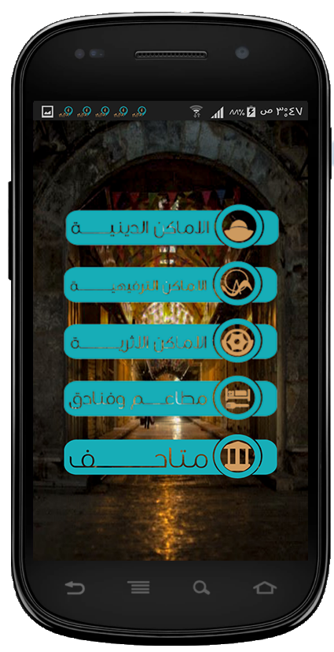
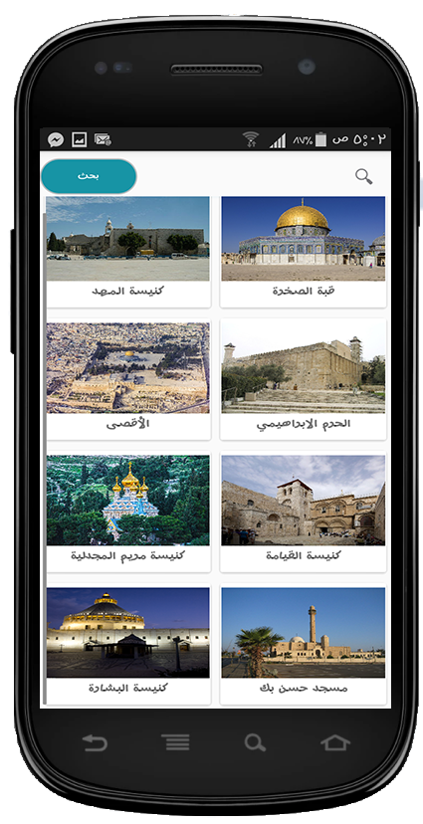
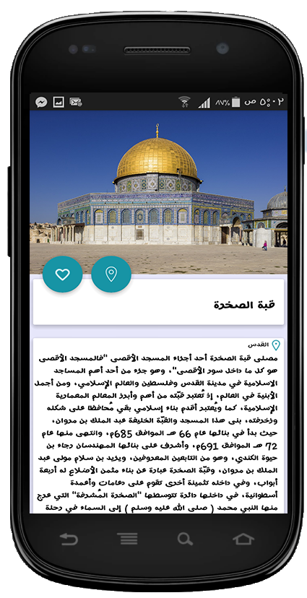
Show tourism places and its details.

Slide 19
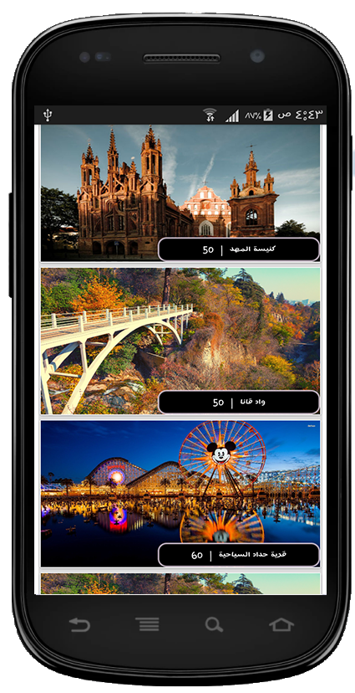
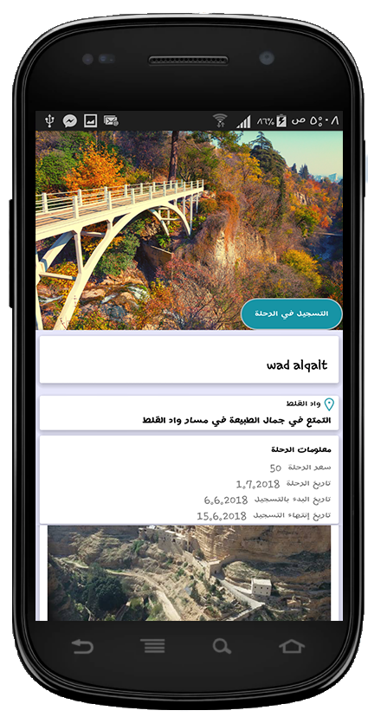
Show all trips and its details.

Slide 20
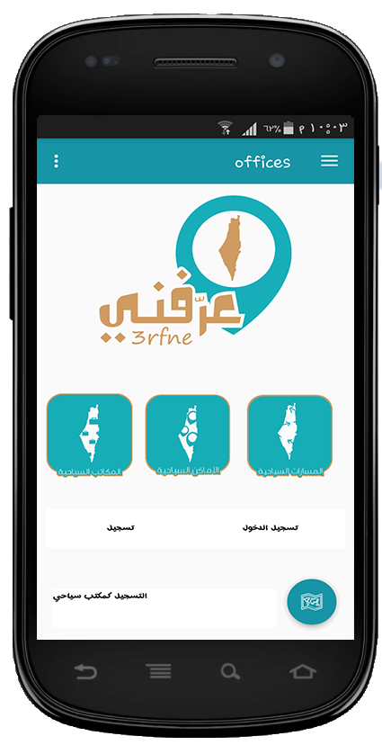
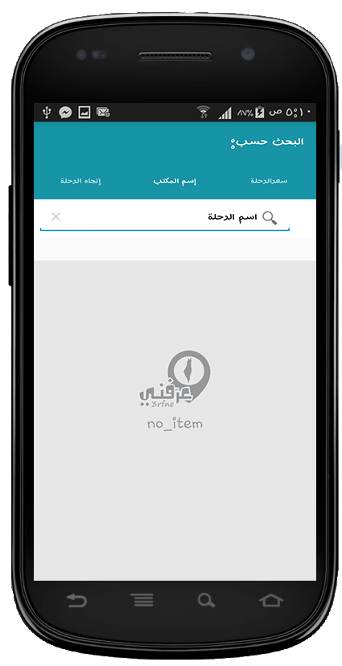
Search in trips.

Slide 21
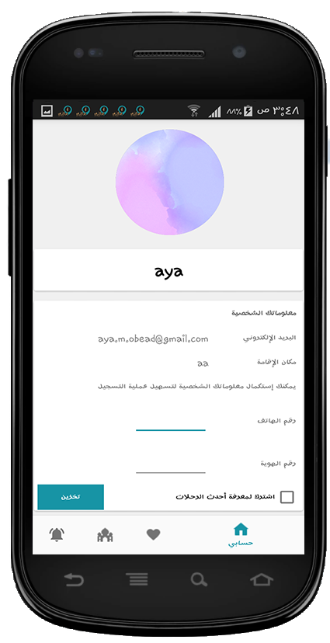
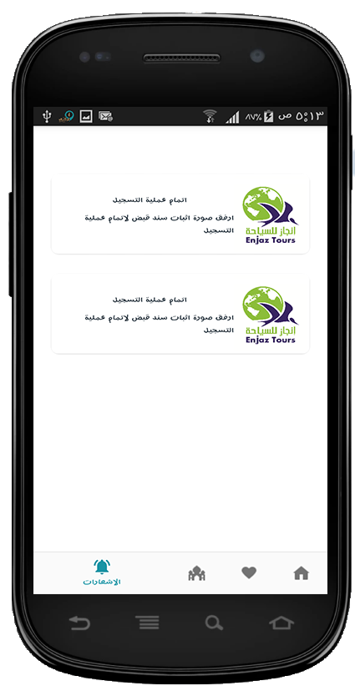
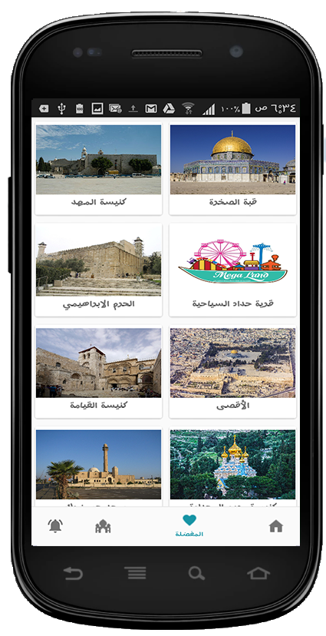
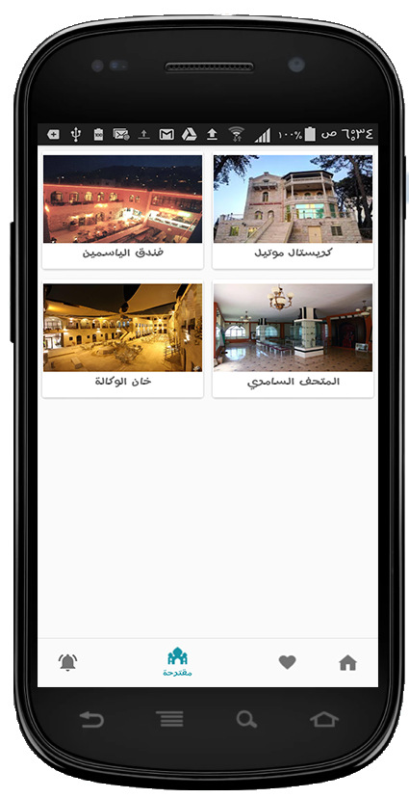
Show ,edit user profile.

Slide 22

Development Process

Slide 23



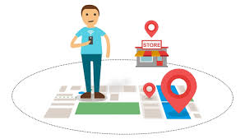


Slide 24

System features

Slide 25




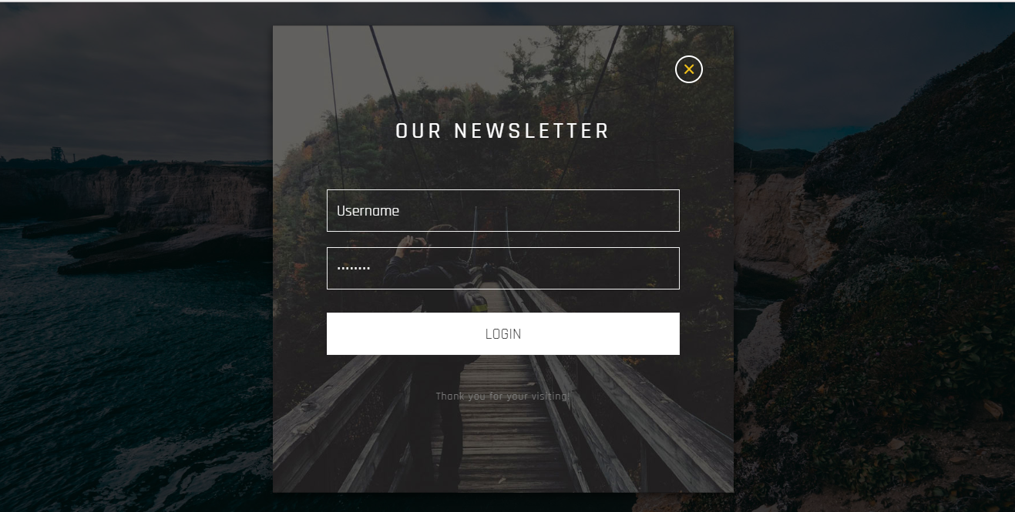
Website admin panel
1
Using bootstrap , CSS ,PHP.
2
Using web services(API’S) to make
integration between website and android.

Slide 26
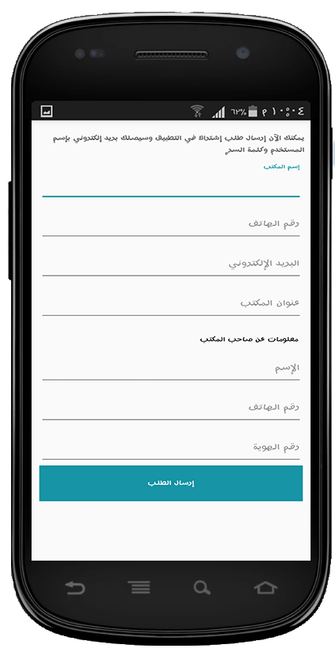

Slide 27
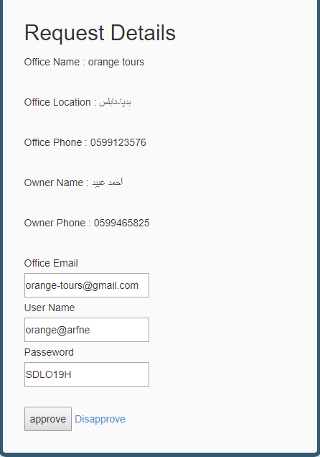
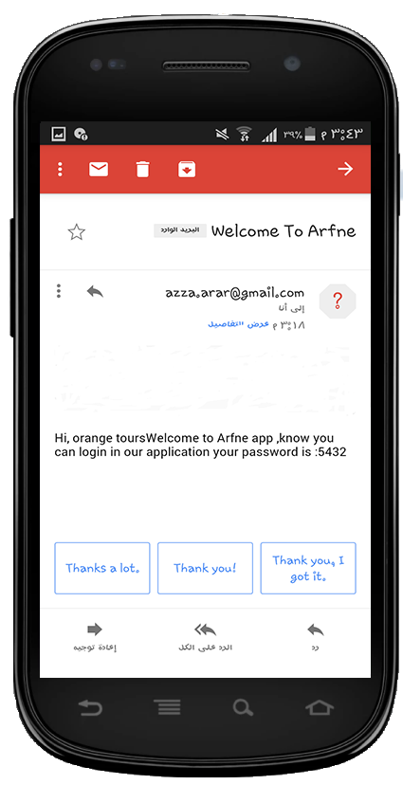

Slide 28

Search Engines
Customize search engine in places with (name place) filter.
Customize search engine in Trips with (price , office name and trip destination).

Slide 29
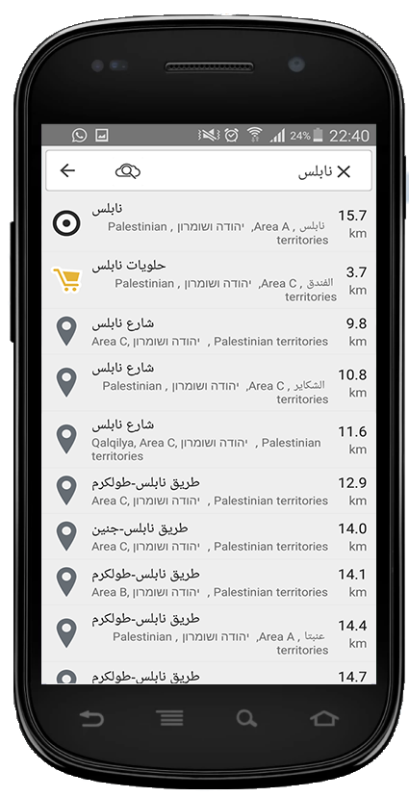
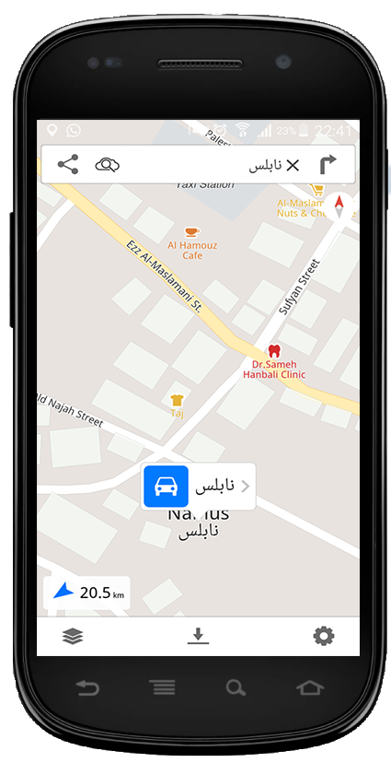
Continu..
Customize search engine in map.

Slide 30









Booking and notification

Slide 31
Informative content
Places
Trips
Path
Office

Slide 32
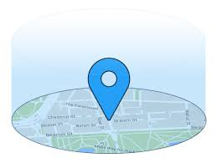


Recommendation System
Recommendation System based on nearest places and userprofile.
-We have database with some categories.
-Used geofence to draw circle,which represent the range to provide suggestions.
-Then used userprofile to provide suggestions based on it.

Slide 33
Map
1.Use GPS to determine user location.
2.Determine the location of the destination.
3.Mapbox receive the previous data then:
-Calculate distance between current location and destination .
-Draw path.
.
-Provide turn by turn navigation through GPS.
-Provide voice guide.

Slide 34
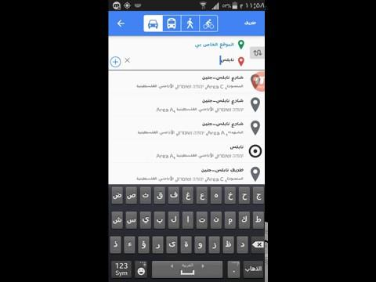

Slide 35


Slide 36

conclusion

Slide 37
Arfne is a mobile application that seeks to provide all the details that customer need primarily to take right decision to book the tour .In addition to facilitating the process of booking by sending request to tourist office. Customer can show the path of tour in map and facilitating search about tour according to price or location. In other hand, the system facilitate for offices to publicate tours.

Slide 38



Future Works
Recommendation according to other users feedback.
Rating System
Feedback

Slide 39
THANK YOU.

