Slide 1


Prepared by :
Zain Al Ardah.
Renan Atrash.
Supervisor :
Haya Sammaneh.

Slide 2
Outline
Election.
Traditional voting.
Disadvantages of traditional voting.
Electronic voting(e-voting).
Advantages of e-voting.

Slide 3
Outline
The whole sequence of our project:
Registration(Administrator, Candidate, Voter).
Administration.
Voting.
Calculating the Result.
St. Logie Algorithm.
System Properties.
Future Work.

Slide 4
Election
Election is a legitimate right of every citizen to choose his representative and to express their preferences and how they are governed.
Notes:
Because of the importance of the elections and a major impact on our future must be taken care of. So there is a set of standards that must be taken into consideration when doing any election process, whether electronic or traditional.

Slide 5
Traditional Voting
Register for the elections in the polling stations in time before the elections process start.
When election process start voters go to polling station to vote for their representative.

Slide 6
Traditional Voting
Every elector come with election card, which has information prove that this person has right to vote when verify the information with information in election roll placed at polling station.
Assistant puts the mark of the indelible ink near the nail of the ring-finger of every voter left hand.

Slide 7
Traditional Voting
Use ballot paper, and pass it through into the polling box.
The ballot-box is carefully sealed and moved to the pre-appointed office to be properly preserved until counting process.
Finally, counting process begin and it take period of time to get the election result. Then the result officially announced to the public.
Notes:
A ballot is a sheet of paper on which there is the name of the candidate and his picture assigned to him.

Slide 8
Disadvantages of traditional voting
Most important of these problems:
Some times voter cannot reach the hall of the election .
Cost a lot of time and money.
Lots of paper waste during election times.
Voter usually doesn’t know too much detail about the candidates.
Notes:
Sometimes people may not be in the village or country at which the election will be because of their work or other circumstances. And at other times they cannot reach the hall of the election and especially because of the occupation in Palestine.
Traditional election process needs a lot of time and money in the papers, ballot boxes and transport for the counting centers, statistics and this can cause many problems.

Slide 9
now..
Are you ready for ..

Slide 10
less cost
Easy
Online
Secure
Confidence

Slide 11
E-Voting
Electronic voting: Computers and software capture and record votes in digital memory without paper.
Also called DRE(Direct Recording Electronic).
In some cases it have touch screen interface.
Notes:
When we talk about these requirement and more and more we talk about e-voting.
1. The main objective of this project is to allow user to vote from anywhere electronically at any time within the limited period of vote with maximum security.
2. Get rid of the time cost.

Slide 12
E-Voting Project Overview
This project contains all the conditions in traditional elections, but through the Internet.
Do not worry, our responsibility towards you to make the right to vote is wherever you are, whether you are sick, traveler … etc with secure confident conditions.

Slide 13
How our project work

Slide 14
Registration
Voter, Candidate, Administrator.
All are users. They have to register before a period of starting election.

Slide 15
Registration
Users take their secure information login from registration center.

Slide 16


Registration Center
Card ID
Password
User Information
Notes:
Take Card Contains unique Password, Card ID written on a card.

Slide 17
Administrator
Administrator can enter his webpage using his information on the card.
After that he can do many tasks.

Slide 18
Administrator
Administrator can create, update election.
Administrator specify all the information related to the election:
Name of the election.
Style(Individuals, Lists).
Type(Municipality, Student Council, Local elections ..)
Seat Number.

Slide 19
Administrator
Minimum and maximum number of candidates in the lists if the election style Lists.
Start and end date of the election.
Minimum age of candidate.
Administrator can also update all the information of the election.

Slide 20
Administrator
Administrator can add, delete, update lists and candidates of a specific elections.

Slide 21
Candidates and Voter
Candidate lists will appear on the election page without candidate name in each list(if it is Lists Election) or candidate name appear on the election page (if it is Individuals Election).
Feedback message will appear for the user directly after voting.
Notes:
1. After secure login with their information from any where in any time (within election period) , candidate lists will appear on the election page without candidate name in each list(if it is Lists Election) or candidate name appear on the election page (if it is Individuals Election).
2. Feedback message will appear for the user directly after voting to ensure him that he vote and his vote taken correctly and told him the time of his voting.

Slide 22
User page
User voted
else
Election time end
Show result
Show information
Election process
Help about process
Election information
Select candidates

Slide 23
Computing Result
After the end of the period allowed to vote the system will compute the result directly.
System will appear it to the administrator on his page and appear it on the main page of the website.

Slide 24
Computing Result
If the election is Individual Election:
winner will be the person with the most votes.

Slide 25
Computing Result
If the election is Lists Election:
In accordance with the law, the process of distribution of seats according to the St. Logie method.

Slide 26
St. Logie Method Example
If we have 9 seats.
Lists of candidates :
Notes:
Determine the electoral lists that have crossed the threshold.
Exclude each electoral list did not exceed the threshold of the process of calculation and allocation of seats.
The apportionment of votes each list crossed the threshold on individual numbers (1,3,5,7,9 ...) and so on as necessary for the allocation of seats.
Order products division in descending order (from largest to smallest).
Distribution of seats on the menus in the previous item, to be given the first seat of the list obtained by the first output, then given a second seat for the resulting list of winning the second and so on until the completion of the distribution of all seats.
In the event of a tie products division:
1. Whether equality during the process of distribution of seats given the seat to the list of winning fewer seats equals the moment.
2. Whether equal to the distribution of the last seat given the seat to the list that received the highest number of votes.
7. Distribution of seats on the list candidates according to their ranking in the detection of CSS, the first one who followed.

Slide 27
D | C | B | A | Number
Candidate Name | Candidate Name | Candidate Name | Candidate Name
Huda | Jameel | Raja | Mohammad | .1
Hassan | Ramzi | Shahd | Ahmad | .2
Mahmoud | Zahir | Othman | Ali | .3
Rana | Imad | Saleem | Leena | .4
 | Rami |  | Maha | .5

Slide 28
St. Logie Method Example
List A have : 1500 Vote.
List B have : 1300 Vote.
List C have : 600 Vote.
List D have : 200 Vote.

Slide 29
St. Logie Method Example
Compute threshold :
= 10 % *(1500+1300+600+200)
=10 % *(3600)
=360 Vote .
Note that list D did not pass the threshold and therefore excluded from the computation process and the distribution of seats

Slide 30
St. Logie Method.
Then divided valid votes for each list on the odd numbers.
Votes/9 | Votes/7 | Votes/5 | Votes/3 | Votes/1 | Total Votes | Lists
166.7 | 214.3 | 300 | 500 | 1500 | 1500 | A
144.4 | 185.7 | 260 | 433.3 | 1300 | 1300 | B
66.7 | 85.7 | 120 | 200 | 600 | 600 | C

Slide 31
St. Logie Method.
Distribute seats based on the outputs of the division from the highest to the lowest.
Votes/9 | Votes/7 | Votes/5 | Votes/3 | Votes/1 | Total Votes | Lists
166.7 | 214.3 | 300 | 500 | 1500 | 1500 | A
144.4 | 185.7 | 260 | 433.3 | 1300 | 1300 | B
66.7 | 85.7 | 120 | 200 | 600 | 600 | C
8
6
4
1
7
5
2
9
3
Notes:
After that each list distribute it seats on its candidate dependent on order which it put previously.

Slide 32
St. Logie Method.
If Output of division equals during the process of distribution of seats, list with the least number of seats will take this seat.
If Output of division equals when the distribution of the last seat, list that has the largest number of votes will take it.

Slide 33
St. Logie Method.
Distribution of seats on the list candidates according to their ranking between themselves, the first one takes the first seat then the second takes the next one ... and so on.

Slide 34
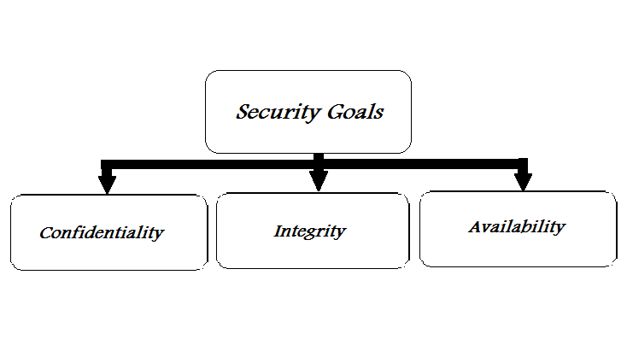
System Properties
Achieve security goals
Notes:
Confidentiality:
Ensure only authorized entities obtain information.
Applies to storage and transmission of information.
Integrity:
Changes to data on storage or during transmission only by authorized persons or processes.
Availability:
Information stored by an organization needs to be available to authorized entities.
Digital Signature achieve all of these security goals.
Now what is digital signature …

Slide 35
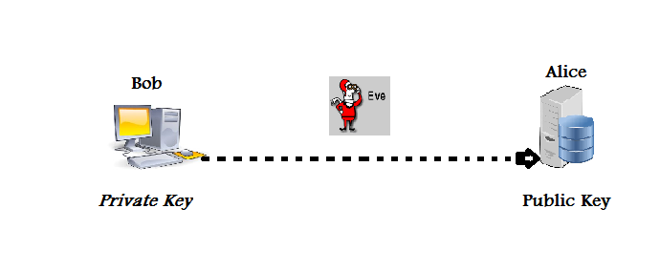
Digital Signature
Using Asymmetric key
Notes:
Digital signature protect user from third party.
Digital signature using asymmetric key (private key, public key).
1.Everyone knows Bob’s public key.
2.Only Bob knows the corresponding private key.
Bob can digitally sign a message such that anyone can verify his signature.
1.To compute signature, one must know the private key.
2.To verify a signature it is enough to know the public key.

Slide 36
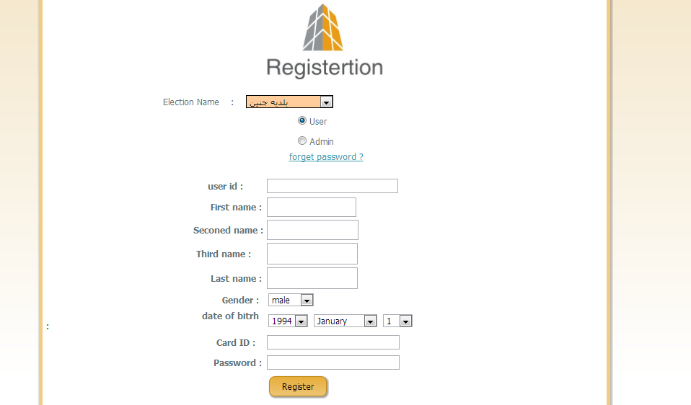

Slide 37
Digital Signature in Registration
Generated Public Key
Generated Private Key
Hash[Card ID + User ID]
Generate Signature
Database
Notes:
Stored in Database

Slide 38
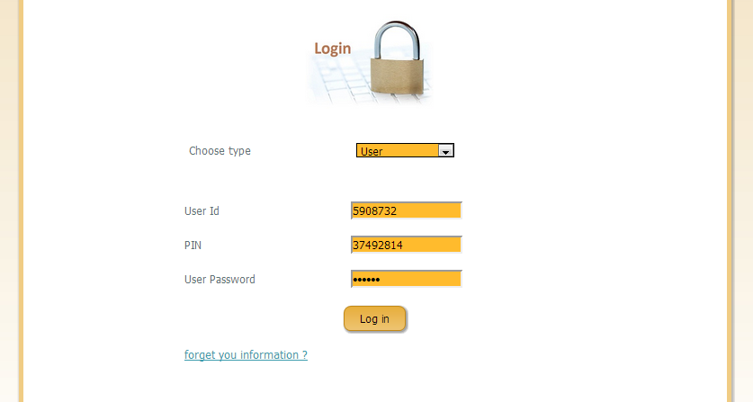

Slide 39
Verify Digital Signature in Login
Database
Hash[Card ID + User ID]
Public Key
Signature
Verify
Notes:
Verify Digital Signature in login

Slide 40
System Properties
Achieve all Security Requirements
Generality: this system allows all people who are eligible for election to participate in the voting process.
Freedom: Free voting.
Notes:
The security requirements for this system include generality, freedom, equality, secrecy, directness.
Generality: this system allows all people who are eligible for election to participate in the voting process, provided pre-registration for the elections.
Freedom: Free voting.

Slide 41
Equality: Only people registered before they are allowed to vote and allowed to vote only once (reusability).
Secrecy: Sure that this is the same person (authentication).
Notes:
Secrecy : using the digital signature.
Equality: Only people registered before they are allowed to vote and allowed to vote only once (reusability). After that the person voting allows him to make sure that he vote and then his vote will sent to the Server and cannot later change his vote and return feedback message to the voters to assure him that he had participated in the voting process and at any time was it and what is his vote.
Secrecy: Sure that this is the same person (authentication).
Directness: no one can vote instead of another and every vote calculated correctly.

Slide 42
System Properties
Store hash values (not plain text) like password, card ID concatenated with user ID.
Every login, server store time stamp for each user, show this time when user login.
When user vote, store time of voting, and show it as feedback message for user.
Each user has right to vote one time only.
Registration process at registration centre, to ensure that no one register/vote instead of other.

Slide 43
2. Performance
Deal with speed of voting and calculating the result, efficiency, availability, accuracy, throughput, response time, recovery time, resource usage.

Slide 44
Technical requirement
Voter Authentication: all registered , eligible voter votes. Unregistered and ineligible voter disallowed.
Multiple Vote prevention: No one votes more than once.
Availability: System must be up to at least accept ballots for the entire period prescribed by low.

Slide 45
This System provides many properties:
Provide direct, reliably result of the election after closing the election.
Increase number of voters related to the availability.
Decrease the cost of the election (papers, ballot boxes, transportation and places).
Avoid invalid ballot directly.
Provide report about the winner direct after the election end.
Allows voter to correct their mistake before final submission.
Reduce the time needed to vote for voters (by reducing the time needed to reach the polling center and the time needed to get in queues to get ballots stamped and then to vote in another queue.
Allow voters to vote from any site in global no needs to be in their country.
Prevent vote from modify from any third party using digital signature.
Increase voter confidence and improve the voting experience.
All previous election’s results can be archived without the needs to dig through records.

Slide 46
Future Work
most important criteria that country tried to achieve in their election systems is the secrecy of the ballot to ensure the integrity of the voter and ensure that change the sounds by another element and not to buy votes and the right sort of sounds using this electronic election process.

