Slide 1


Formula Student Aerodynamics
Design, Analysis and Tests

Slide 2
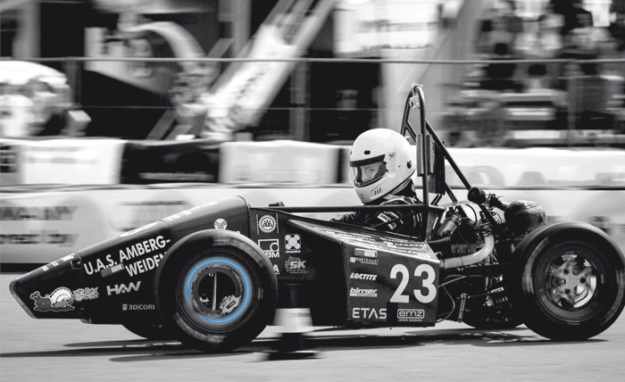
Outline
01
Design of the parts
Chassis, Surface chassis, Front wing, Rear wing
02
Flow Simulations
Front wing, Rear wing
03
Attenuator
Stress and strain tests and pressure distribution
04
Chassis
Stress and Strain tests
05
Foils Design
Using JavaFoil software

Slide 3

Design of the parts

Slide 4
SolidWorks
Why use SolidWorks?
It is an easy-to-use program that provides many of the tests project need for a vehicle such as the Impact Test and Power Test.
A
B
Run different types of simulations and the car movement gives results realistic saves a lot of time and effort.
C
This program uses the system of equations , that is, when anything changed in the design, each design will be adjusted to suit this change.
D
This system can identify areas of strength and weakness in a car and identify areas that are more stressed and the possibility of failure.

Slide 5
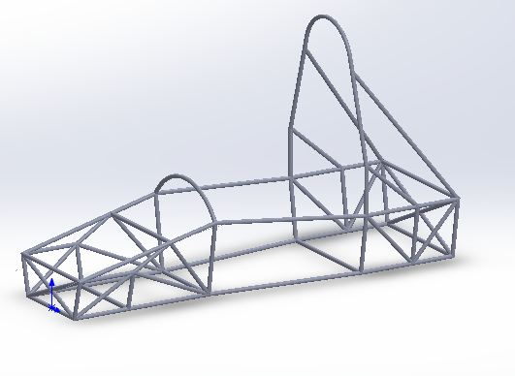
Chassis:
Frame is the first part that was designed, it is considered the main part of a car, it determines the shape of the exterior of a car and is the first part is built to accommodate the rest of the car parts.

Slide 6
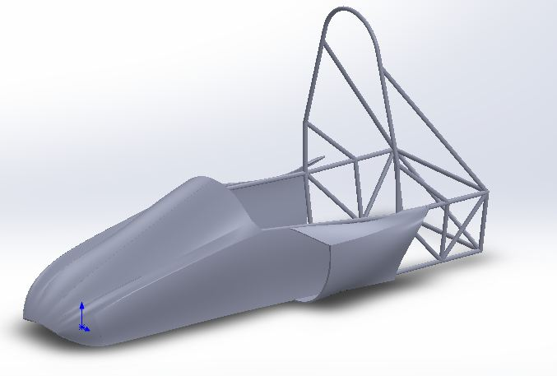
Surface chassis:
The external shape of the car also plays a role in the flow of air around the car ,it plays an important role in the distribution of power and increases its effect , improve the overall design and develop performance.

Slide 7
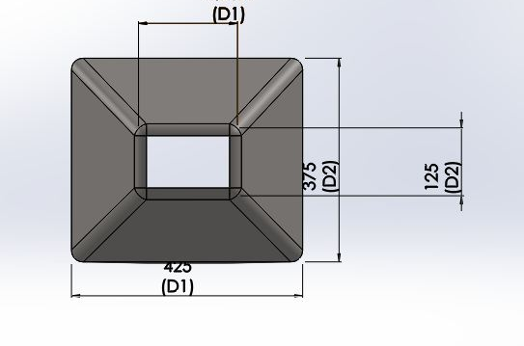
Impact attenuator:
Is a front of the structure of a car and is considered with front wings front and also designed to be in a streamlined with the structure and fit with the front wings and is an important part of the structure because it is a lot of tests as the area of ​​the forward car and which are directly exposed to shocks during the tests

Slide 8
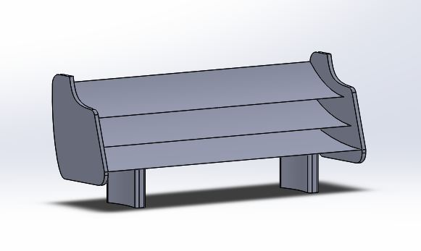
Rear wing:
The last parts of the system of aerodynamics of the car installed rear wings on the top surface of a car unlike the front wings placed in the front of the car and the rear wings are the last parts of a car exposed to air and is characterized as unstable to fit more with the conditions of a car when the need to change the angle of wings to increase or reduce Down Force.

Slide 9
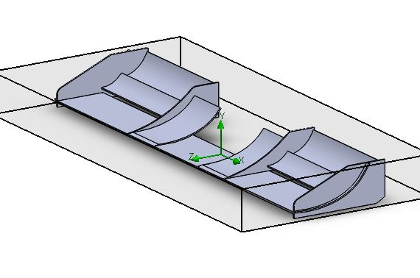
Front wing:
The air was studied on the front wings under the following conditions. The temperature of 293 k and the pressure of 101000 Pascal and the horizontal wind speed of 10 m /s.

Slide 10
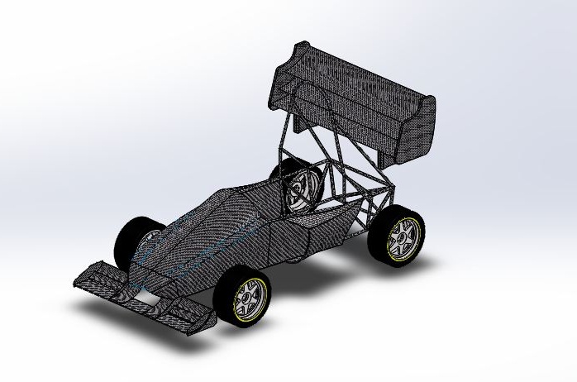
Final Assembly:
The last parts of the system of aerodynamics of the car installed rear wings on the top surface of a car unlike the front wings placed in the front of the car and the rear wings are the last parts of a car exposed to air and is characterized as unstable to fit more with the conditions of a car when the need to change the angle of wings to increase or reduce Down Force.

Slide 11
Chassis Tests

Slide 12
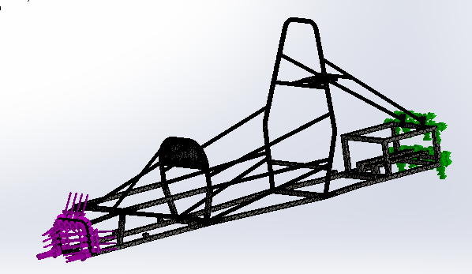
Chassis
Stress test
creating a mesh for a chassis befoere force

Slide 13
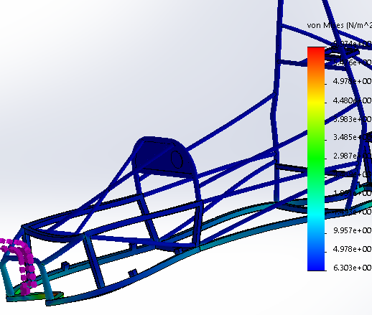
Chassis
Stress test
Stress in frame during the force equal 3000N

Slide 14
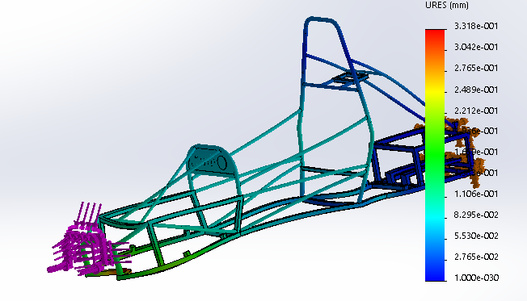
Chassis
Stress test
Displacement in frame after force equal 3000 N

Slide 15
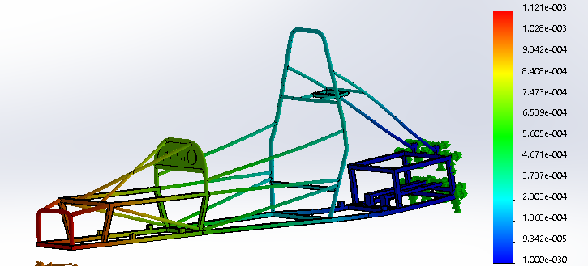
Chassis
Stress test
Strain in frame effect the force

Slide 16
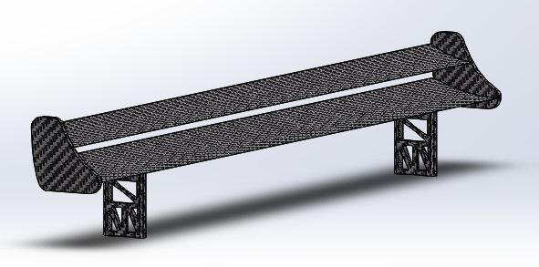
Flow Simulations

Slide 17
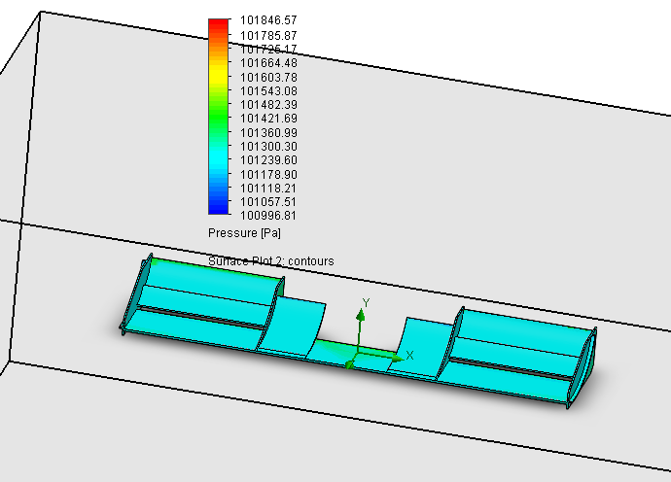
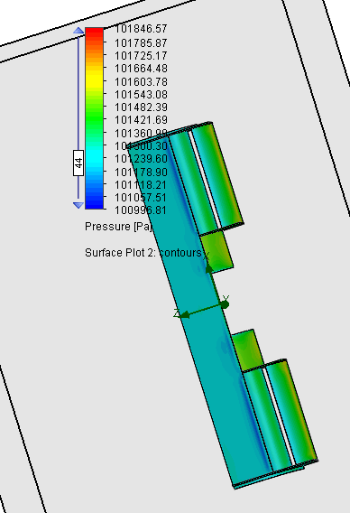
Front Wing
Pressure distribution
The effect of pressure at front wing at velocity of air 10 m/s at 101000 Pascal

Slide 18
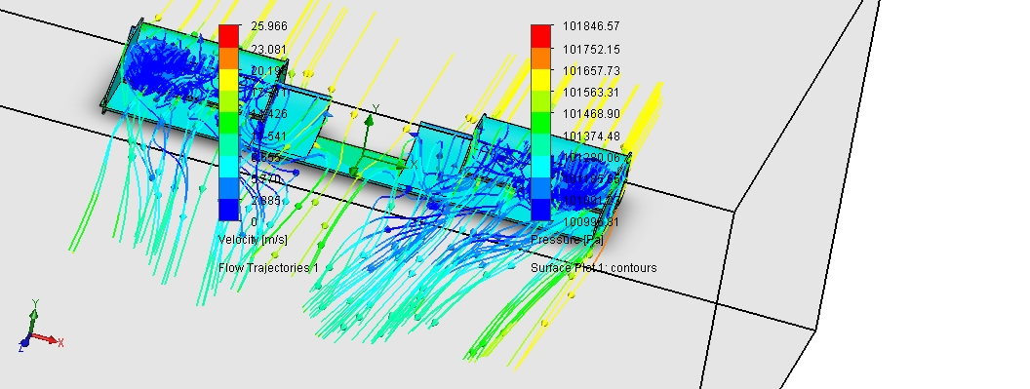
Front Wing
Effect of pressure and velocity

Slide 19
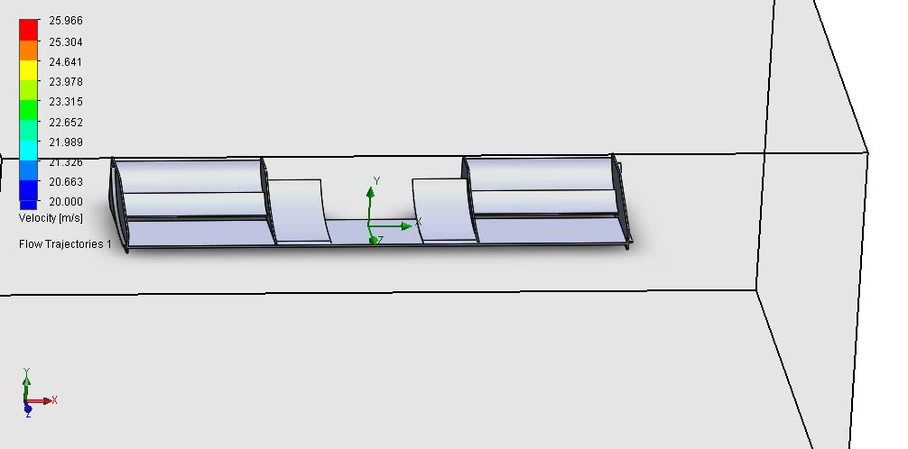
Front Wing
Effect of pressure and velocity

Slide 20
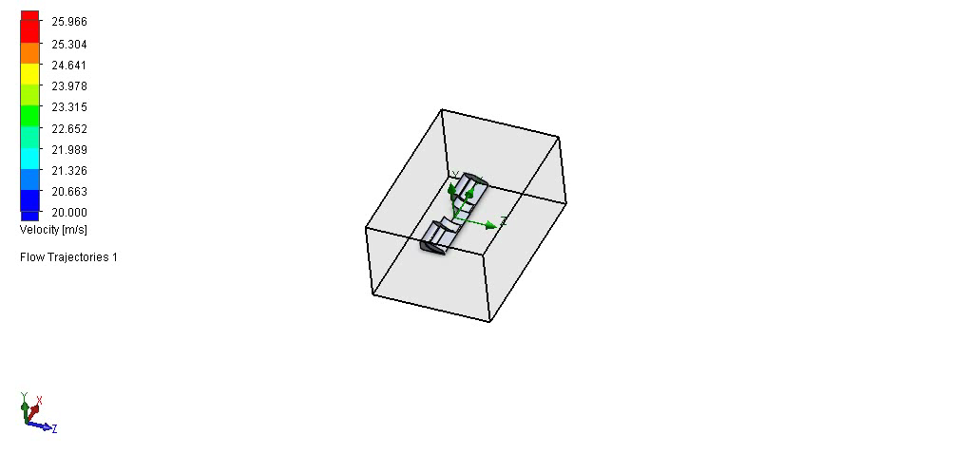
Front Wing
Effect of pressure and velocity

Slide 21
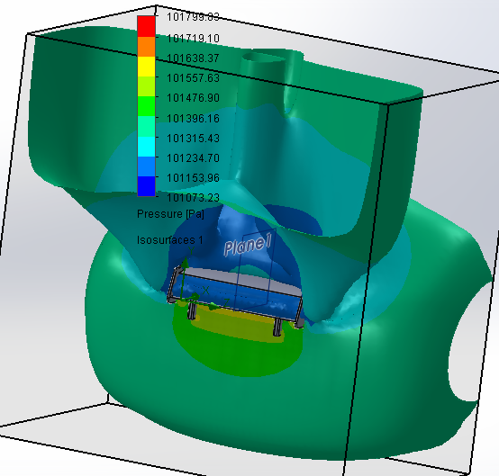
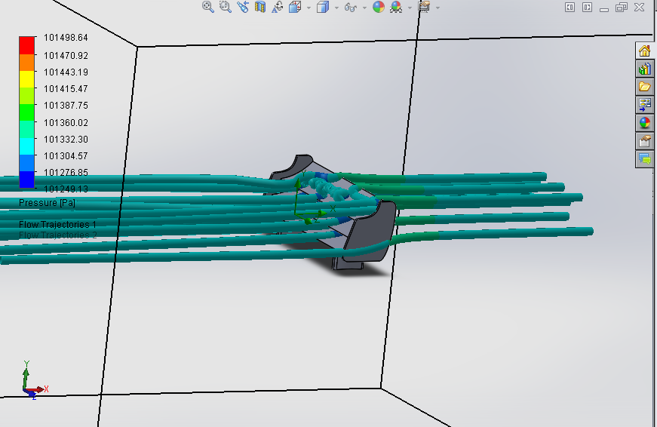
Rear Wing
Pressure distribution

Slide 22
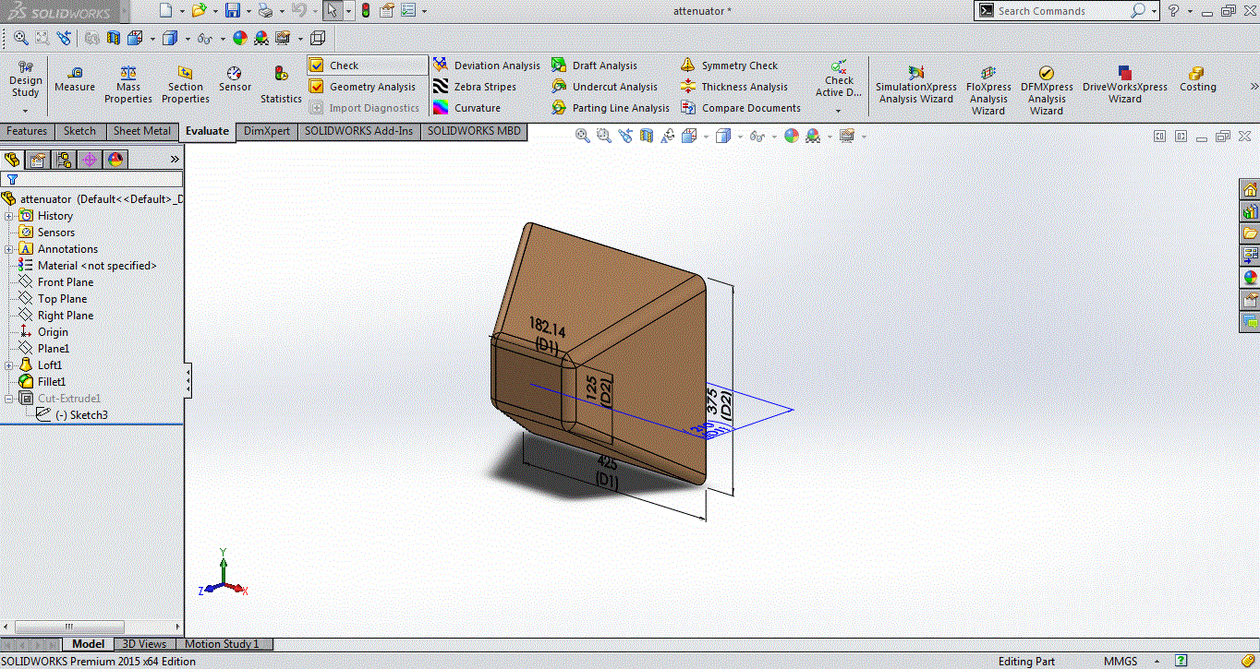
Attenuator tests

Slide 23
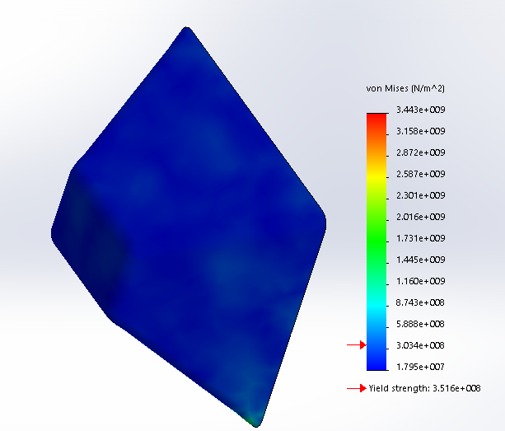
Attenuator
Impact and stress tests
Stress in attenuator show no effect in attenuator because its rigid stress after impact test at velocity 50m/s

Slide 24
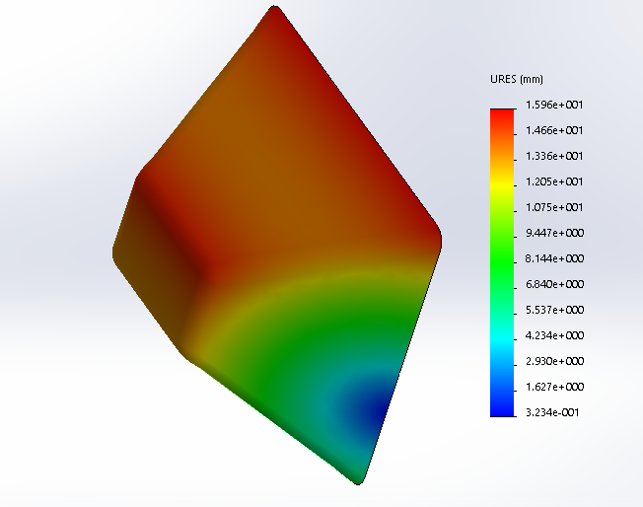
Attenuator
Impact and stress tests
Displacement attenuator shown in below figure(at velocity 50 m/s)

Slide 25
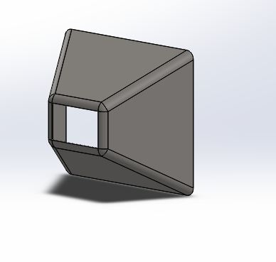
Attenuator
Impact and stress tests
After modified the attenuator it’s become weighing 5kg and that’s possible to use in design

Slide 26
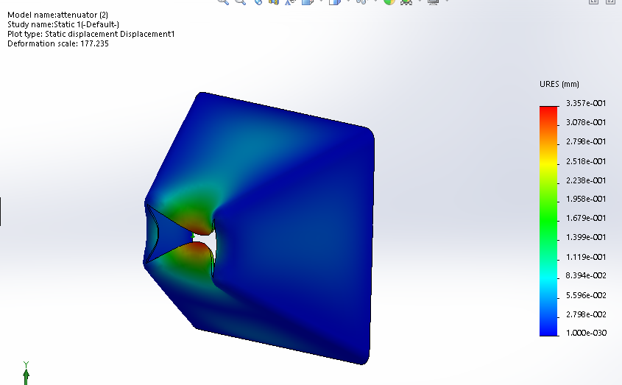
Attenuator
Impact and stress tests
Deflection in the modified attenuator shown in the figure (at velocity 15 m/s)

Slide 27
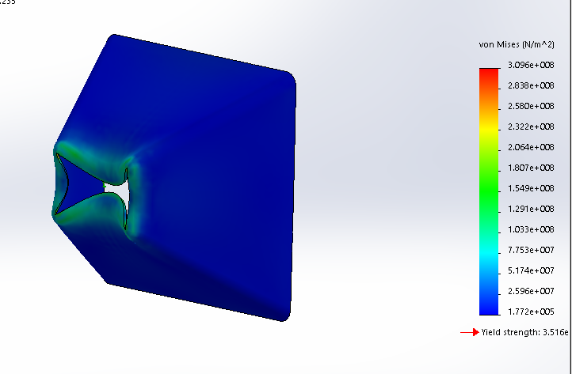
Attenuator
Impact and stress tests
Stress in attenuator after modified this stress after impact test at velocity 15m/s

Slide 28
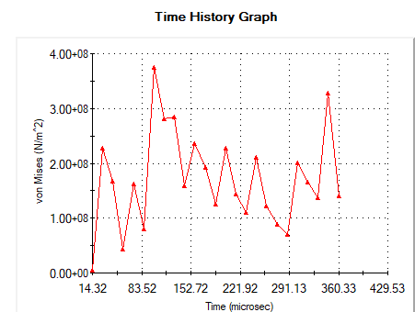
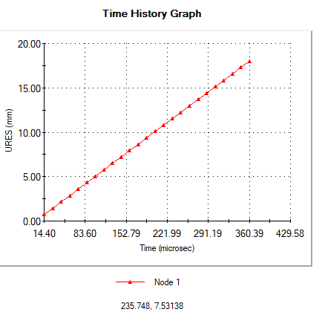
Attenuator
Impact and stress tests
Stress spread in attenuator with time.

Slide 29
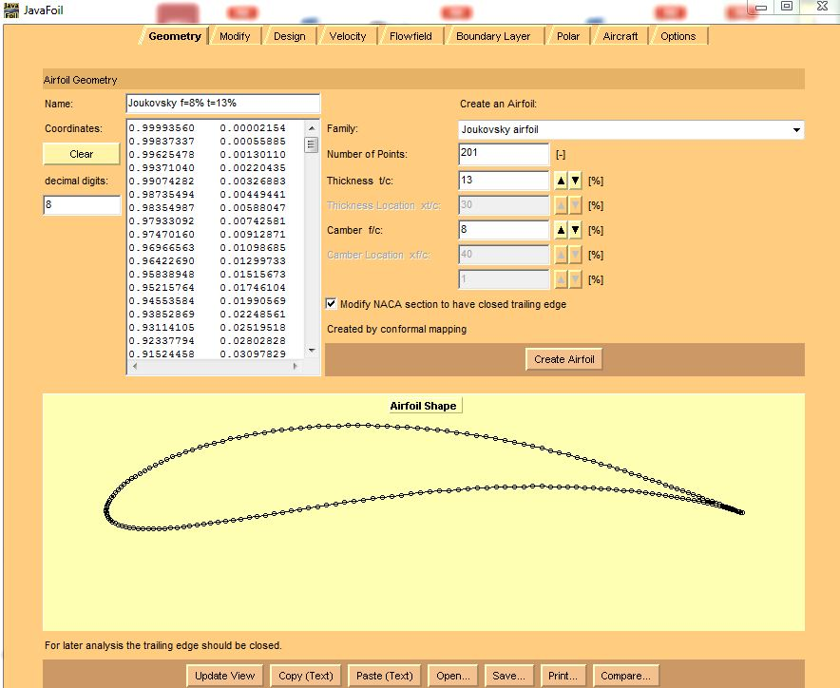
Foils Design

Slide 30
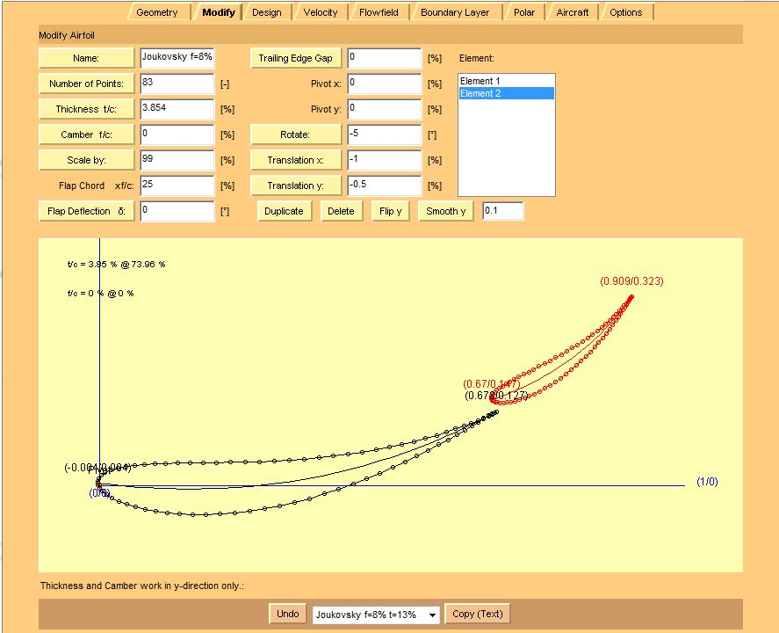
Foils Design
Rear and Front wings

Slide 31
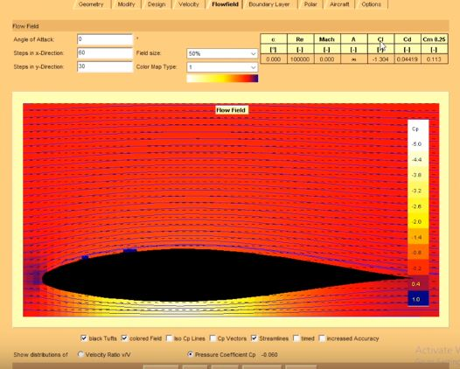
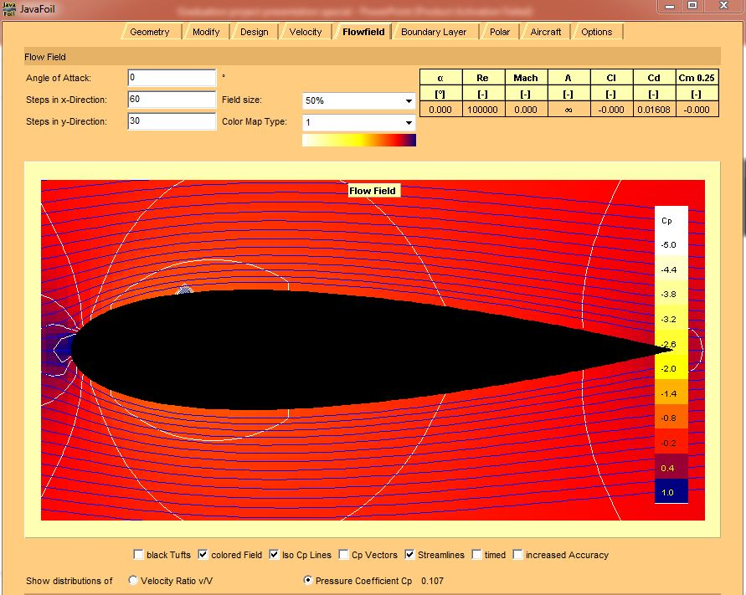
Foils Design
Rear and Front wings

Slide 32
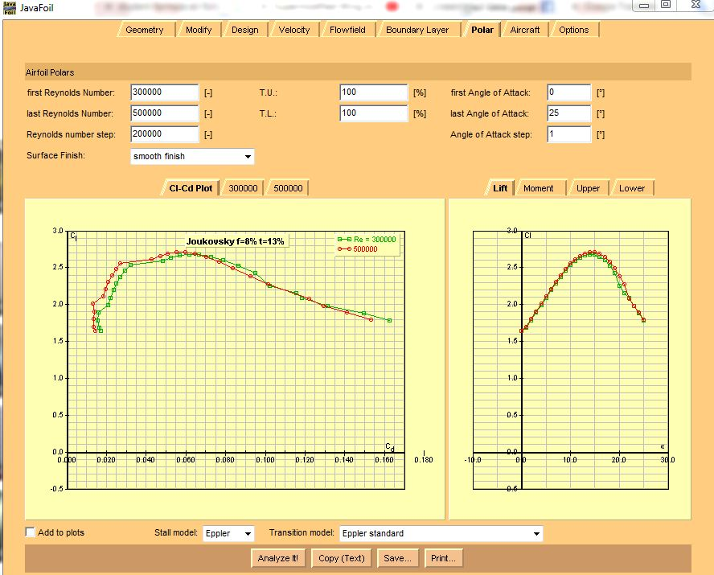
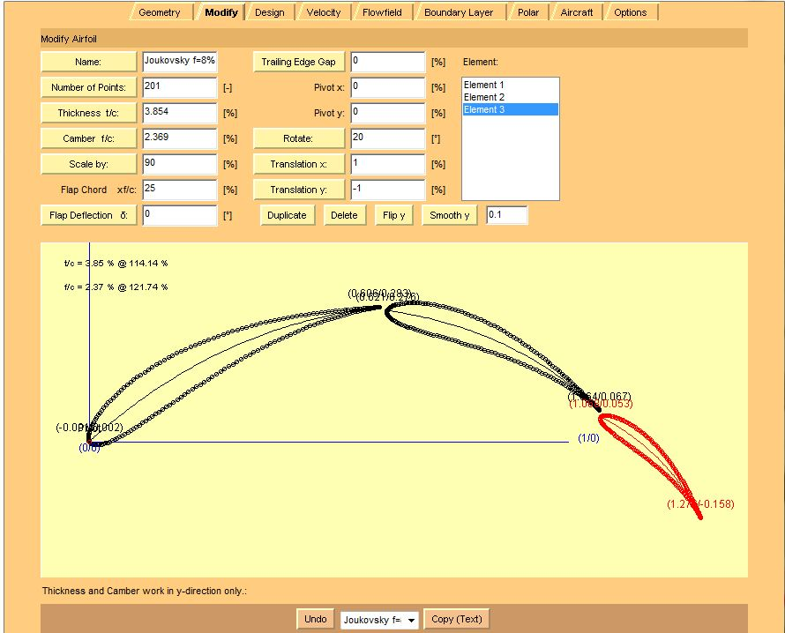
Foils Design
Rear and Front wings

Slide 33
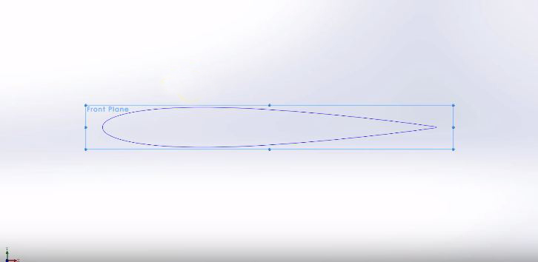
Foils Design
Rear and Front wings

Slide 34
Thank you
For Listening

