Slide 1

Home Automation using Arduino
Prepared by:
Deena Shabaro
Jenan Zaid
Shahd Okeh
Supervised by :
Dr. Falah Hasan

Slide 2


Slide 3

Home Automation Definition
The home automation is control of home devices from a central control point , its include
control of lighting , security locks of gates doors and other system .

Slide 4
Advantages of home automation :
Home automation keeps your home secure by being able to look your front door from your smart phone or tablet and do not be worry because you misplaced your keys inside home.
Home automation keeps your family comfortable .
With home automation you can turn your air conditioning on before you head home so when you arrive the house is nice and cool.

Slide 5
Advantages of home automation :
Home automation saves your money.
With home automation you never have to worry about appliances or lights being lefts on when out of use or when no one is home yeild to saving money and energy at the same time .
Home automation gives you control over your home from any location .
So control over your property and belongings even when you are on vacation far from home.

Slide 6
Advantages of home automation :
Home automation means you have less to worry about.
The greatest benefits of home automation system are added of sense of security and peace of mind .

Slide 7
Disadvantages of home automation :
Equipment and installation costs.
System crashes due to any damage in the inter connection .
Huaman errors .
Reliability .

Slide 8
What is Arduino?
Arduino is an open source prototyping platform based on easy to use hardware and software .
Arduino boards are able to read inputs ( light on sensor , or twitter message ) and turn it in to output ( activating motor , turn LED , publishing something on line ) .
You can tell the board what to do by sending set of instruction to the microcontroller on the board to do that use the arduino programming language and arduino software based on processing .

Slide 9
Advantages of using arduino
Ready to use .
Effortless function .
Large community .

Slide 10
Disadvantages of using arduino
Structure .
Costs .

Slide 11
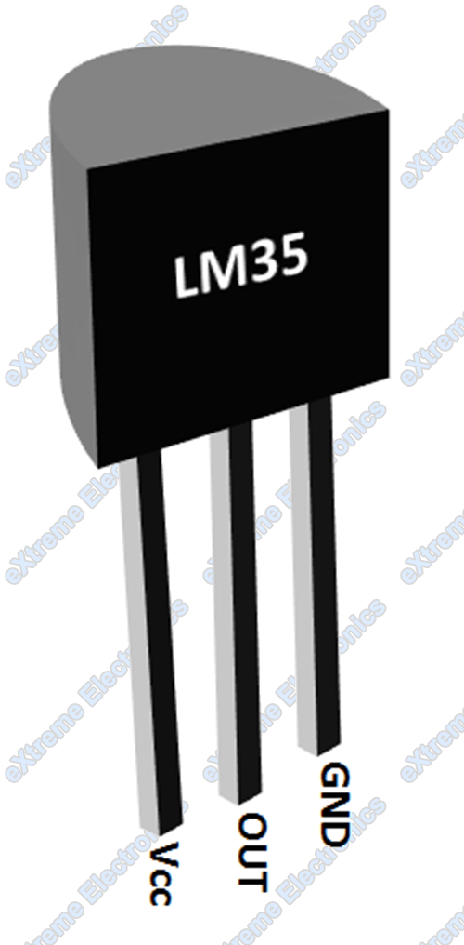
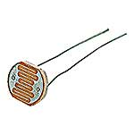
The environmental sensors and devices
LM 35.
LDR.
PIR sensor.
Smock detector.
Relay .
Reed switch door.
Small Fan.

Slide 12
LM35
Calibrated directly in º Celsius (Centigrade)
Linear + 10.0 mV/ºC scale factor
0.5ºC accuracy guaranteeable (at +25ºC)
Rated for full −55º to +150ºC range
Suitable for remote applications
Low cost due to wafer-level trimming
Operates from 4 to 30 volts
Less than 60 µA current drain

Slide 13
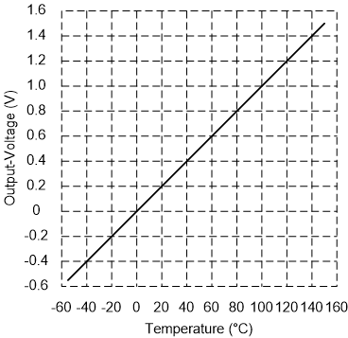
Relation between the temeprature and LM35 sensor

Slide 14
Relation between the temprature and LM35 sensor

Slide 15
LDR
A photoresistor (or light-dependent resistor, LDR, or photocell) is a light-controlled variable resistor. The resistance of a photoresistor decreases with increasing incident light intensity; in other words, it exhibits photoconductivity. A photoresistor can be applied in light-sensitive detector circuits, and light- and dark-activated switching circuits.

Slide 16
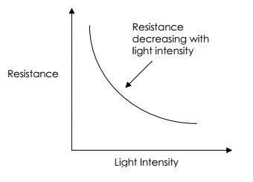
Variation in resistance with changing light intensity LDR sensor

Slide 17
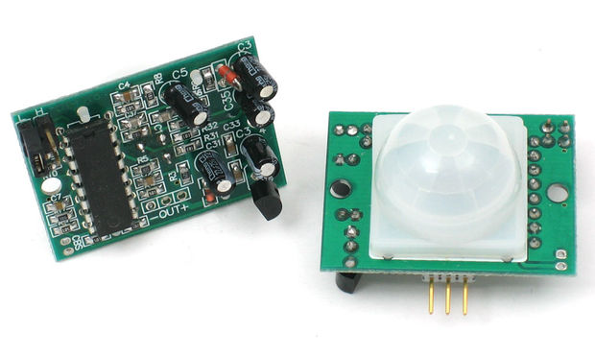
PIR
PIR sensors allow you to sense motion, almost always used to detect whether a human has moved in or out of the sensors range. They are small, inexpensive, low-power, easy to use and don't wear out. For that reason they are commonly found in appliances and gadgets used in homes or businesses. They are often referred to as PIR, "Passive Infrared", "Pyroelectric", or "IR motion" sensors.

Slide 18
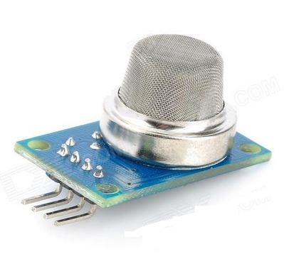
Smock detector
This flammable gas and smoke sensor detects the concentrations of combustible gas in the air and outputs its reading as an analog voltage. The sensor can measure concentrations of flammable gas of 300 to 10,000 ppm. The sensor can operate at temperatures from -20 to 50°C and consumes less than 150 mA at 5 V.

Slide 19
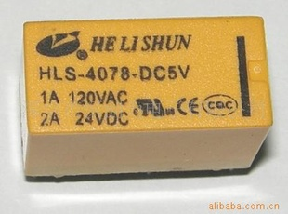
Relay
We used HLS 4078 5VDC relay, This relay is used to close the reset switch on a node and to keep the node's power and ground isolated from the other nodes and the Arduino.

Slide 20
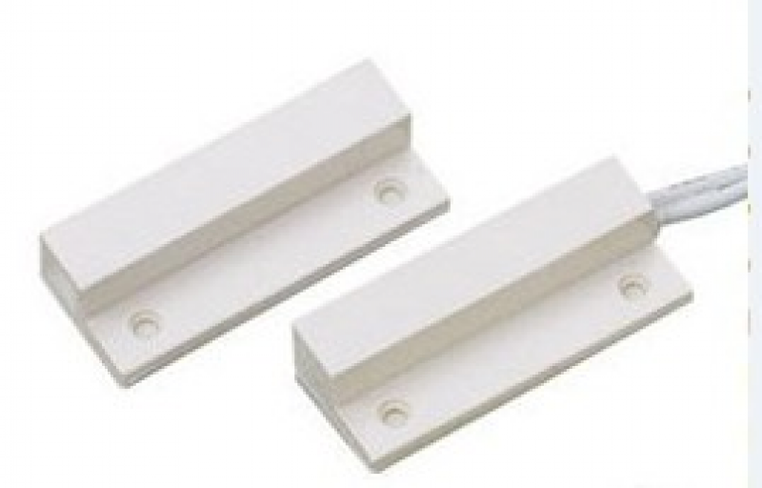
Reed switch door
Is an electrical switch operated by an applied magnetic field, It consists of a pair of contacts on ferrous metal reeds in a hermetically sealed glass envelope. The contacts may be normally open, closing when a magnetic field is present, or normally closed and opening when a magnetic field is applied. The switch may be actuated by a coil, making a reed relay, or by bringing a magnet near to the switch. Once the magnet is pulled away from the switch, the reed switch will go back to its original position.

Slide 21
Results and Discussion
When the LDR sensor analog value is less than a constant value equal to 20, and the PIR sensor notice a motion around the home, then the relay and the bulb outdoor will be ON.
If there is a fire in the home, the smock detector will be detect the smock, and the LEDs will be ON and OFF for 20 times as a warning.

Slide 22
Conclusion
We have designed a system that contains of many sensors using Arduino such as smock detector, temperature sensor, and photoresistor sensor.
This control reinterpreted many features to the home make it the ideal home that most companies aspics to design, which is more secure and energy efficient to be the home of future.

Slide 23


