Slide 1

FORKED SPIDER WEB COMPANY
Forked Spider Web Company Exists to Help Organizations Succeed in B2B Digital Commerce.
Anas Habash , Yasmeen Ghazi.
Supervisor :Dr.Adnan Salman

Slide 2
What is B2B ecommerce?
is the online exchange of goods or services between businesses rather than between a business and individual consumers.

Slide 3
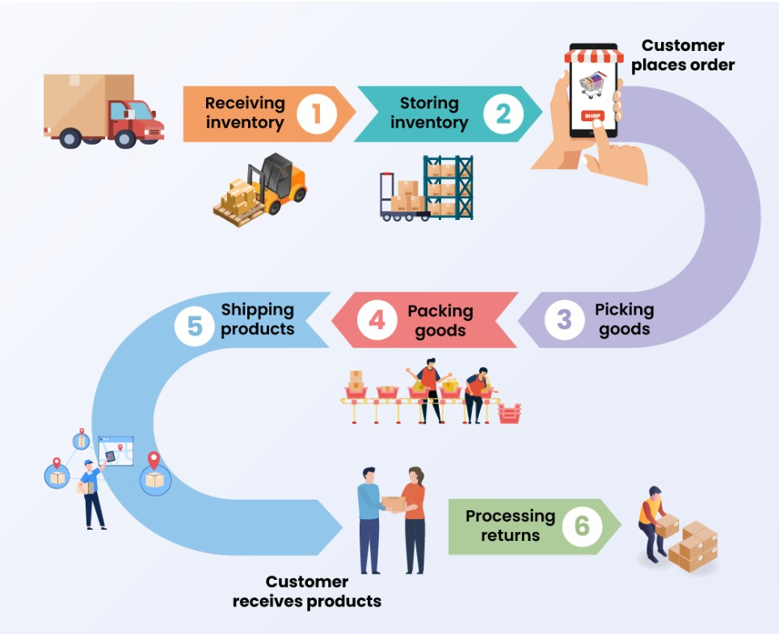
Streamlined e-commerce process in our project

Slide 4
Table of contents
01
06
02
03
04
05
Algorithms
Introduction
System Technologies
07
Prediction
08
Demo
System Architecture
Use Case diagram
09
Plans of future
Machine learning
10
Sources&References

Slide 5


01 Introduction :
Machine learning prediction
EOQ, ERP
Time
Quantity

Slide 6



02 System Technologies :
FRONT-END TECHNOLOGIES :

Slide 7


02 System Technologies :
BACK-END TECHNOLOGIES :

Slide 8

02 System Technologies :
DATABASE :

Slide 9


02 System Technologies :
External Resources :

Slide 10





02 System Technologies :
Tools:

Slide 11
02 System Technologies :
Tools, Libraries, Protocols, Design Patterns, and Concepts:
1- WkHtmlToPdf 2- SignalR
3- MailKit 4- Email SMTP
5- AutoMapper 6- Repository Pattern
7- Globalization 8- Configurations

Slide 12
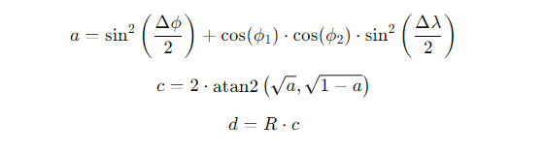
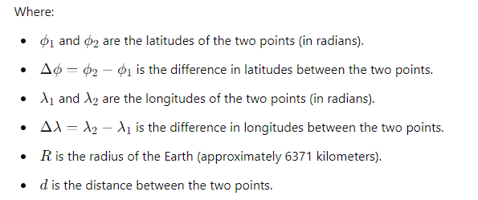
The Haversine Formula

Slide 13
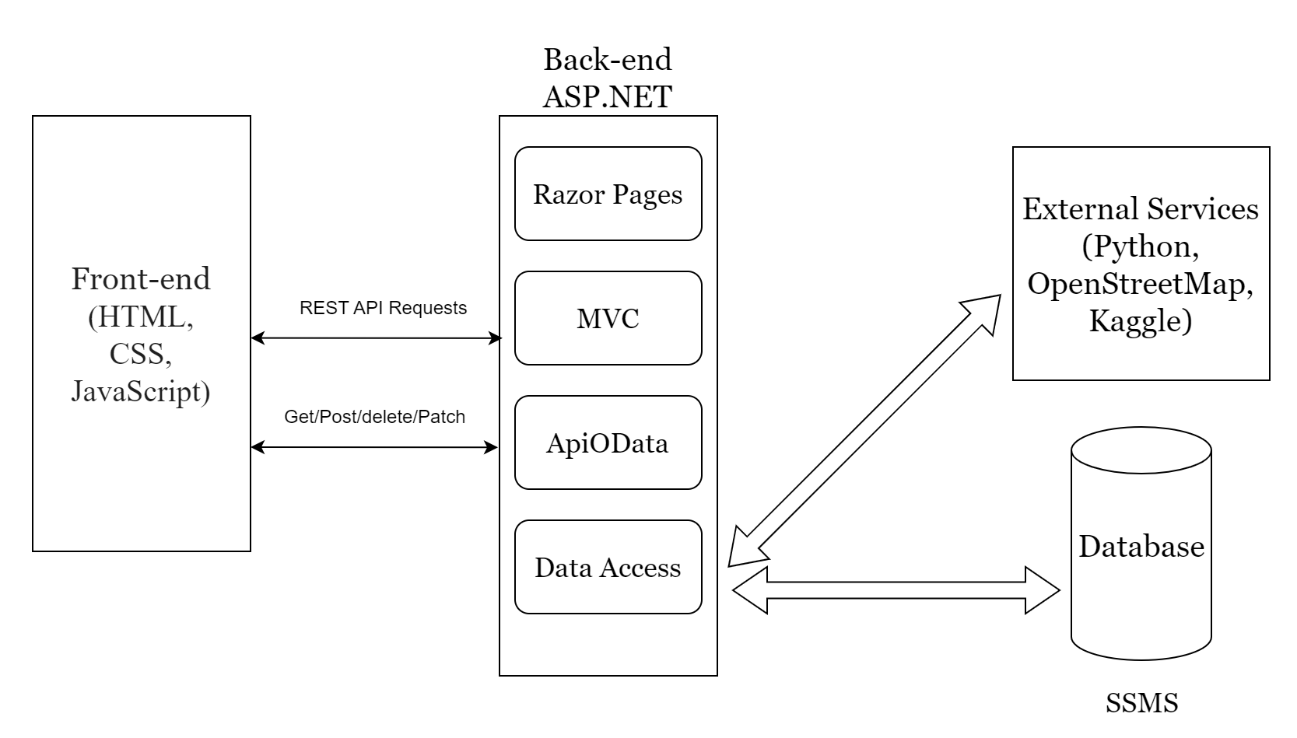
03 System Architecture :

Slide 14
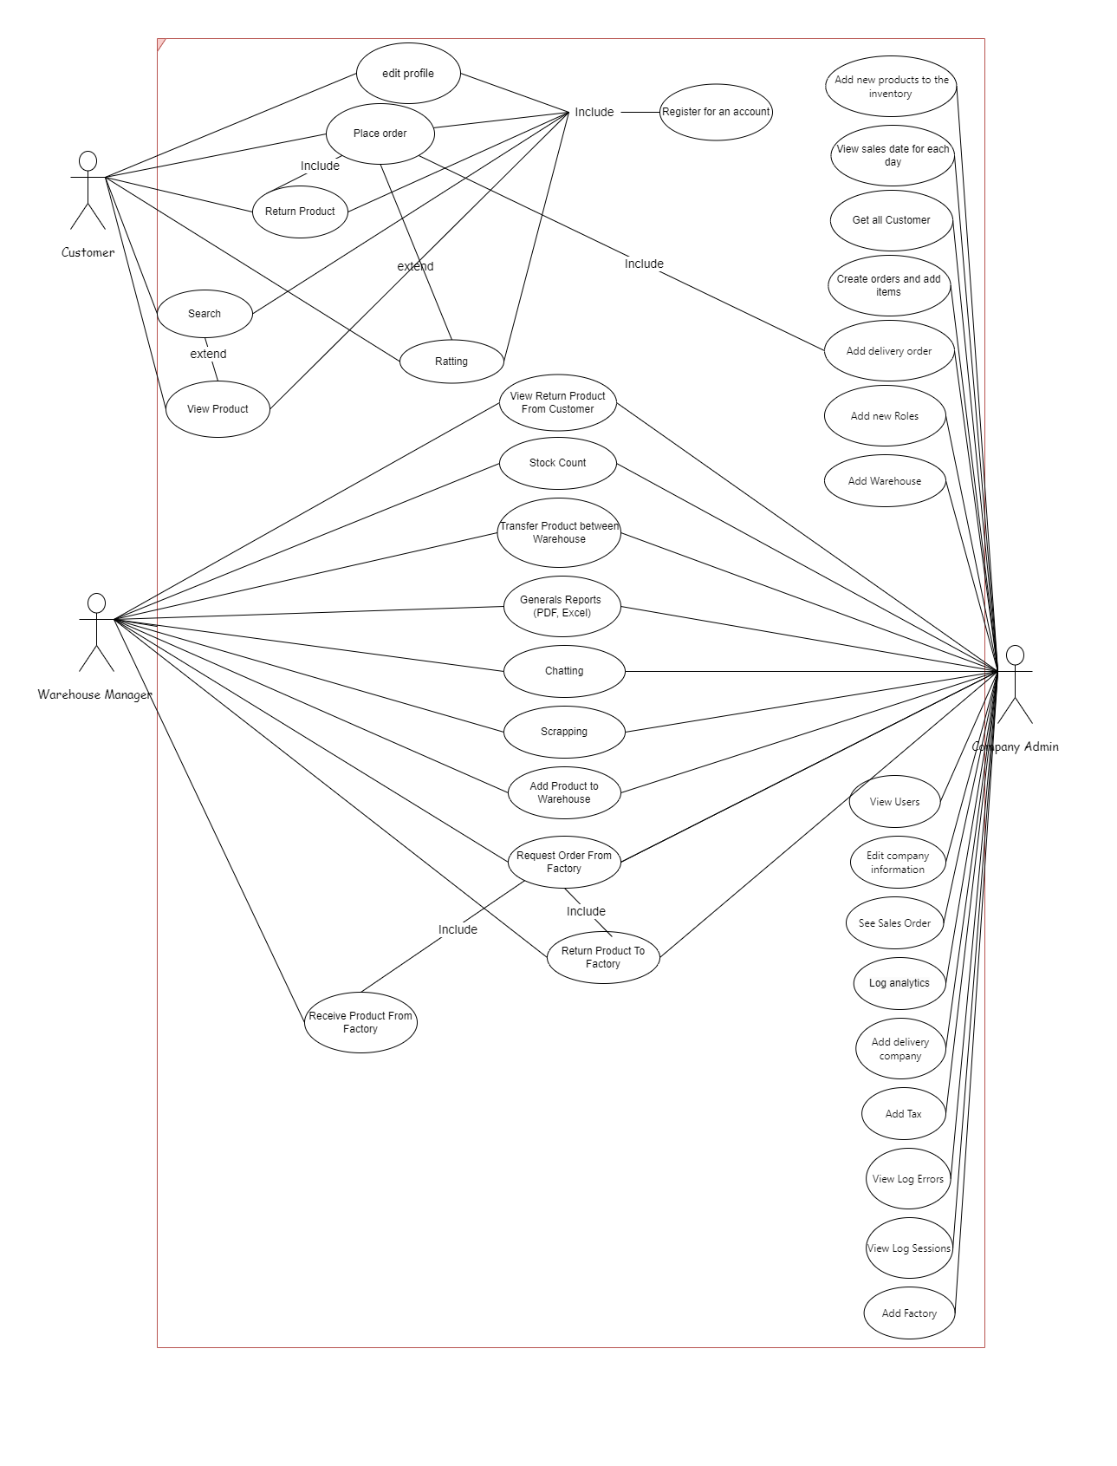
04 UseCase Diagram :

Slide 15

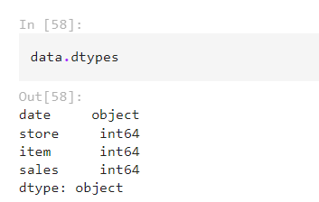
05 Machine Learning:
Getting some info about the data:
- Getting types for each feature :

Slide 16
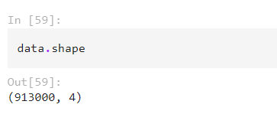
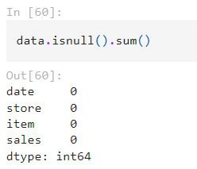
05 Machine Learning:
-Number of rows and columns in the dataset :
-Checking for missing values :

Slide 17
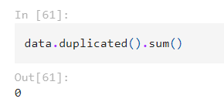
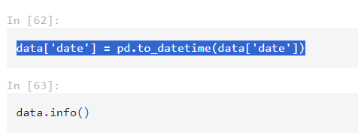
05 Machine Learning:
-Number of duplicated rows :
-Convert data from object datatype to dateTime dataType :

Slide 18

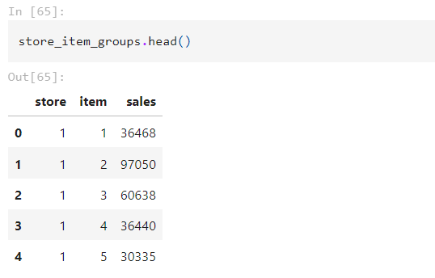
05 Machine Learning:
-Grouping data by store and item:

Slide 19
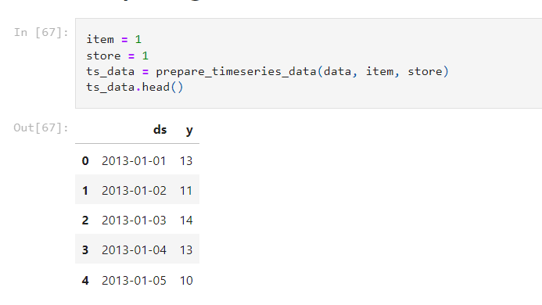
06 Machine Learning :
Preparing data for item 1 in store 1:

Slide 20
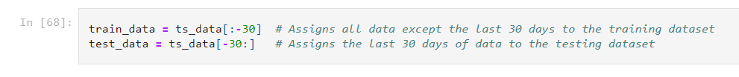

06 Algorithm :
Splitting the data into training and testing sets :
Creating and training a Prophet model :

Slide 21
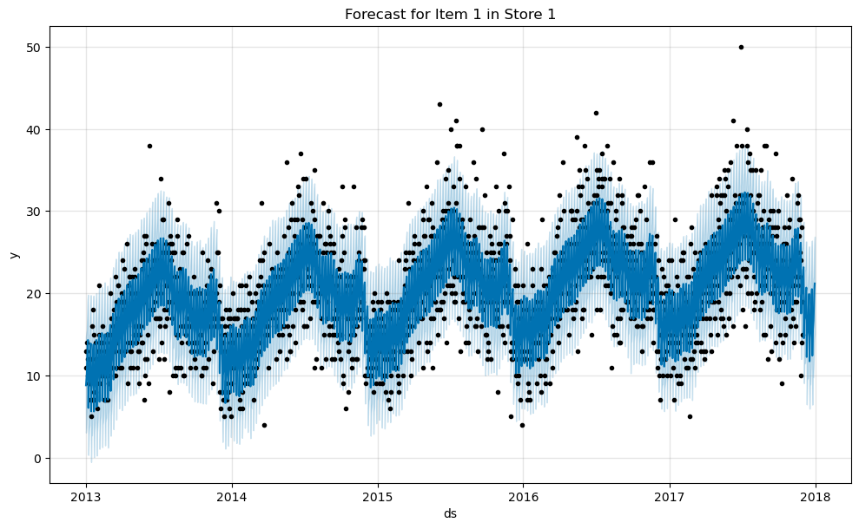
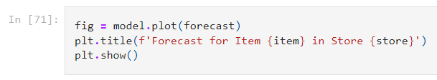
06 Algorithm :
Train dataset for item 1

Slide 22
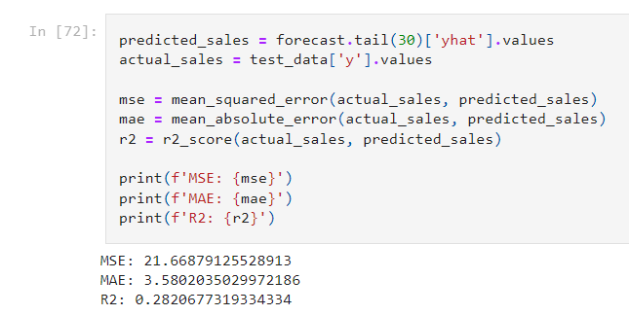
06 Algorithm :
Calculating errors :

Slide 23
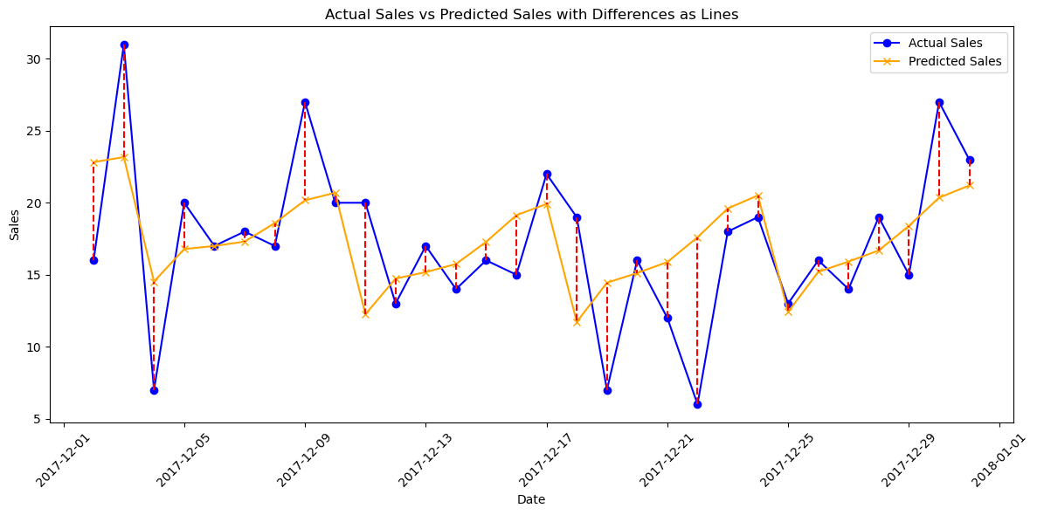
06 Algorithm :
Plot actual sales vs predicted sales :

Slide 24
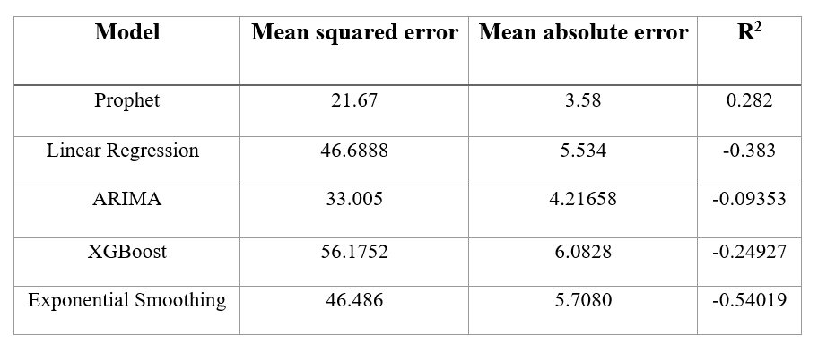
06 Algorithm :

Slide 25
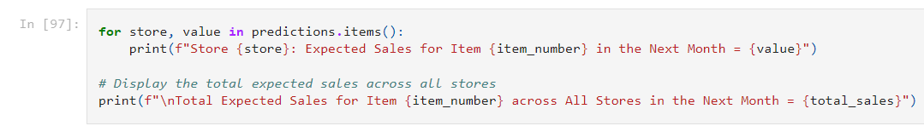
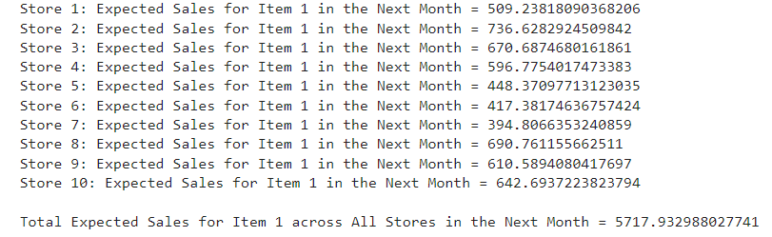
07 Prediction :
Display predictions for item 1 in the next month:

Slide 26
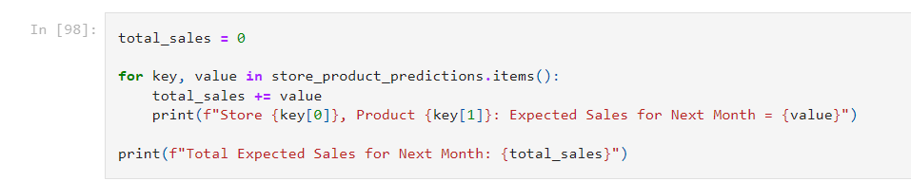
07 Prediction :
Display Expected Sales for Next Month :

Slide 27
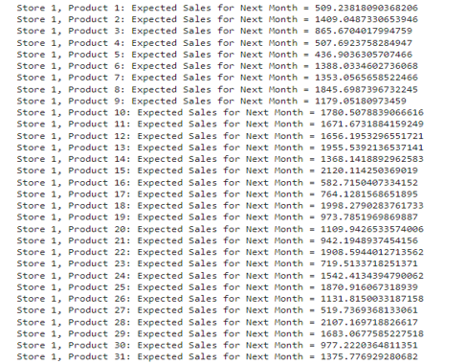
07 Prediction :
Display Expected Sales for Next Month :

Slide 28
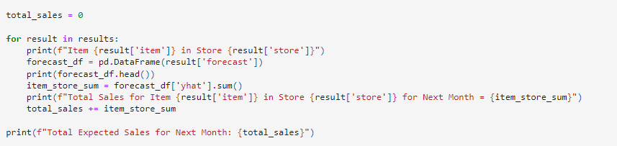
07 Prediction :
Display Expected Sales for Next Month by a day :

Slide 29
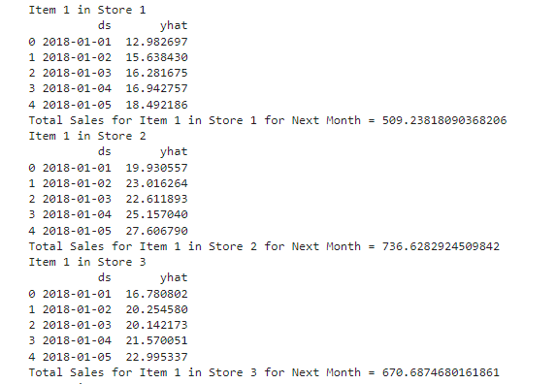
07 Prediction :
Display Expected Sales for Next Month by a day :

Slide 30
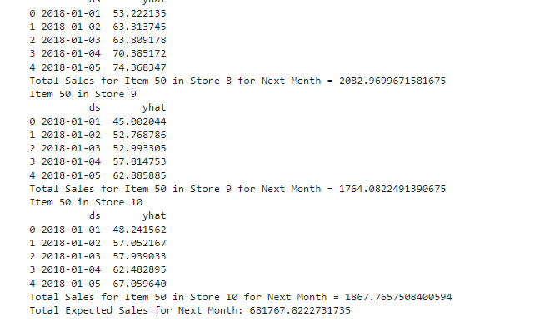
07 Prediction :
Display Expected Sales for Next Month by a day :

Slide 31
08 Demo :
click here

Slide 32
09 Plans of future :
Mobile Application Development
Extended language support
Enhanced Order Processing

Slide 33
Thanks
Do you have any questions?

Slide 34
10 Sources and References:
1- https://www.advancinganalytics.co.uk/blog/2021/06/22/10-incredibly-useful-time-series-forecasting-algorithms#components_of_time_series_forecasting_models
2- Currys Company

