Slide 1
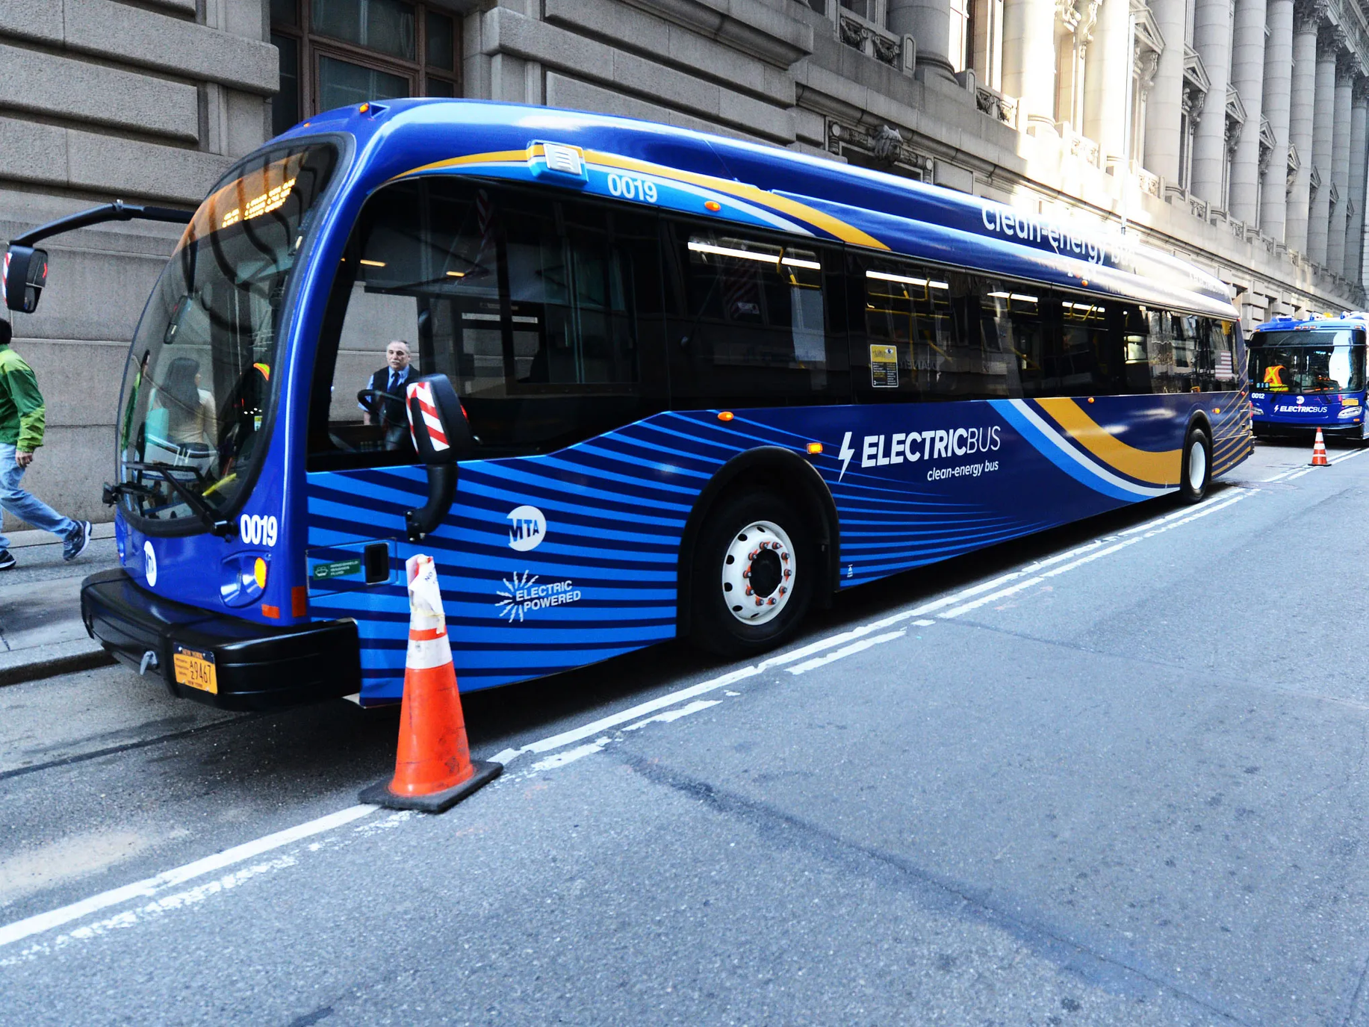

BUS
MONITORING
SYSTEM
BY:
OTHMAN OTHMAN
OSAMA DIAB
SUPERVISING:
DR.LUAI MALHIS

Slide 2
MAIN CONCERNS
BETTER SERVICE
MANAGEMENT
BETTER SERVICE FOR CUSTOMERS
TIMING
EASIER MANAGMENT SYSTEM
SAFETY
IMMUNITY AGAINST FIRE OXYGEN LEVELS
SECURITY
INDEPENDENCY
EASE THE CALL FOR HELP IN EMERGENCIES
INDEPENDENT PAYMENT SYSTEM

Slide 3
FEATURES
SAFETY
STREAMING
A CAMERA STREAMING ALL THE TIME
CO2 DETECTOR THAT REFRESHES THE AIR WHEN CO2 IS TOO HIGH
SECURITY
EMERGENCY BUTTON TO CALL POLICE

Slide 4
FEATURES
STATIONS
PAYMENT SYSTEM
THE STATION SHOWS THE NUMBER OF THE BUS AND SHOWS WHEN IT IS ABOUT TO LEAVE
INDEPENDENT PAYMENT SYSTEM WORKING ON RFID
TRACKING SYSTEM
GPS TRACKING THE BUS ALL THE TIME

Slide 5
DEMO

Slide 6
IS IT COMPLETE?
NOT EVEN CLOSE!

Slide 7
WHAT ARE WE MISSING?
USER EXPERIENCE
DISTRIBUTED
PROVIDING APPS,
MORE COMFORT TRIPS ...
SERVERS MAY GO DOWN BUT NOT TRAVELLING
ML
STUDYING THE PEOPLE BEHAVIOUR HELPS ADJUSTING ROUTS, SERVICE AND OTHER THINGS

Slide 8
WHAT ARE WE MISSING?
SAFETY
LOYALTY GIFTS
CO2 DETECTOR IS ONE OF MANY THINGS CAN BE DONE
FREE TRIPS AND SOME GIFTS CAN BRING MONEY
SECURITY
CO-OPERATING WITH THE POLICE TO PROVIDE BETTER COMMUNICATION SYSTEM TO PROVIDE CAMERA AND LOCATION

Slide 9
SUGGESTIONS!
HC05 IS BAD
Serial is good but there is a limit
It works now does not it is going to work later!

Slide 10
THANKS

