Slide 1
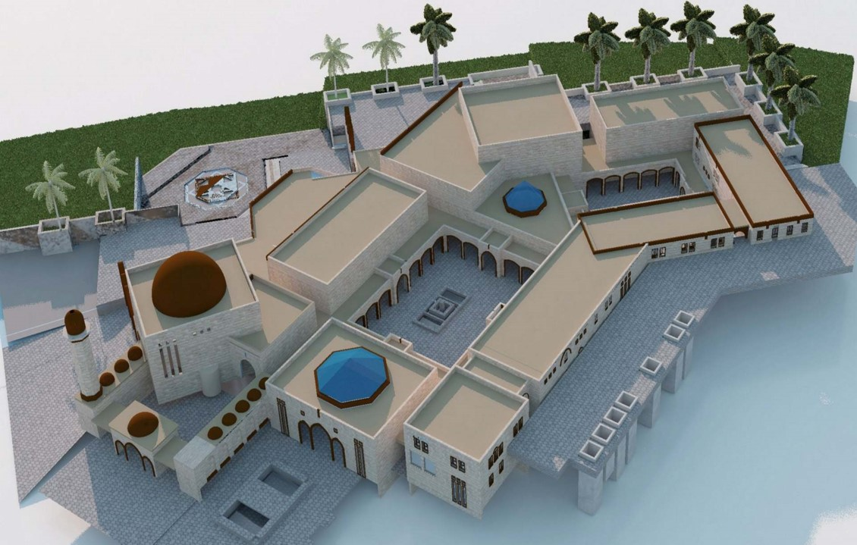

Structural Analysis and Design of
Educational-Cultural Building in Nablus city
An-Najah National University Faculty of Engineering and Information Technology |  | Department of Civil Engineering 2018
Submitted By
Heba Sameer Sabrin Suwan Tala Dwaikat
Supervisor
Dr. Munther Diab

Slide 2
Outline
Project Description.
Materials.
Loads.
Preliminary dimensions of slab, beams and columns.
ETABS modeling and checks.
Dynamic design.
Design of steel Truss.
Design of footing.

Slide 3
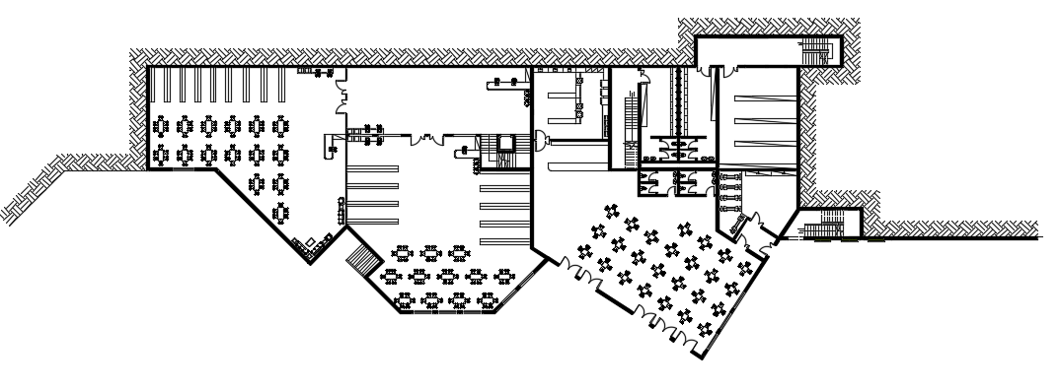
Basement plan

Slide 4
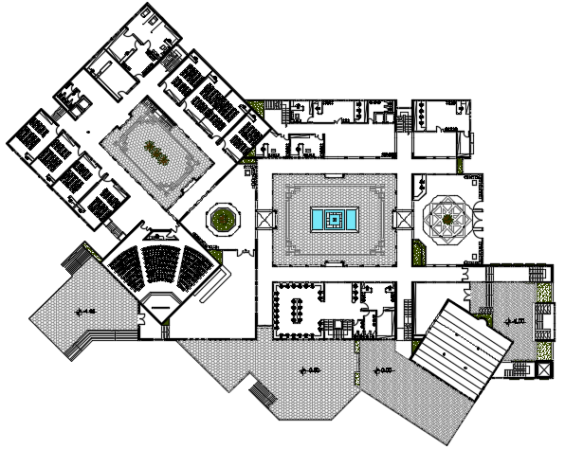
Ground floor:

Slide 5
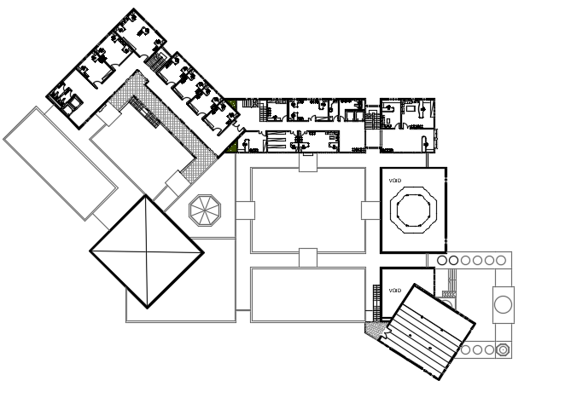
First floor

Slide 6
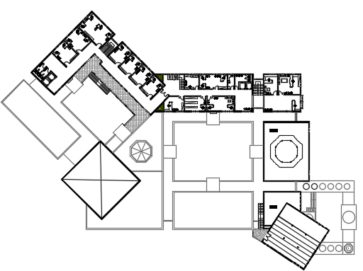
Second floor

Slide 7
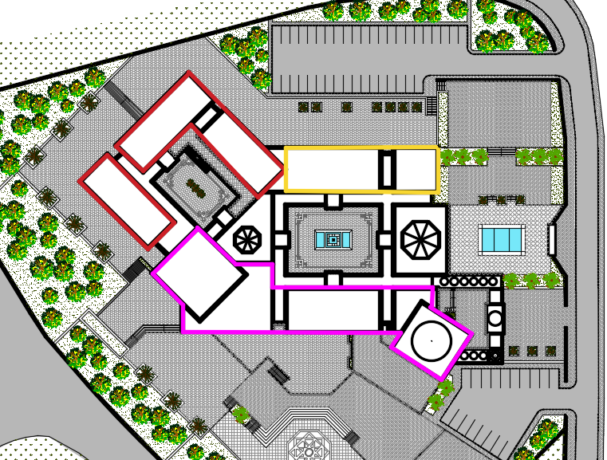
Site Plane
Separate blocks to Avoid differential settlement

Slide 8
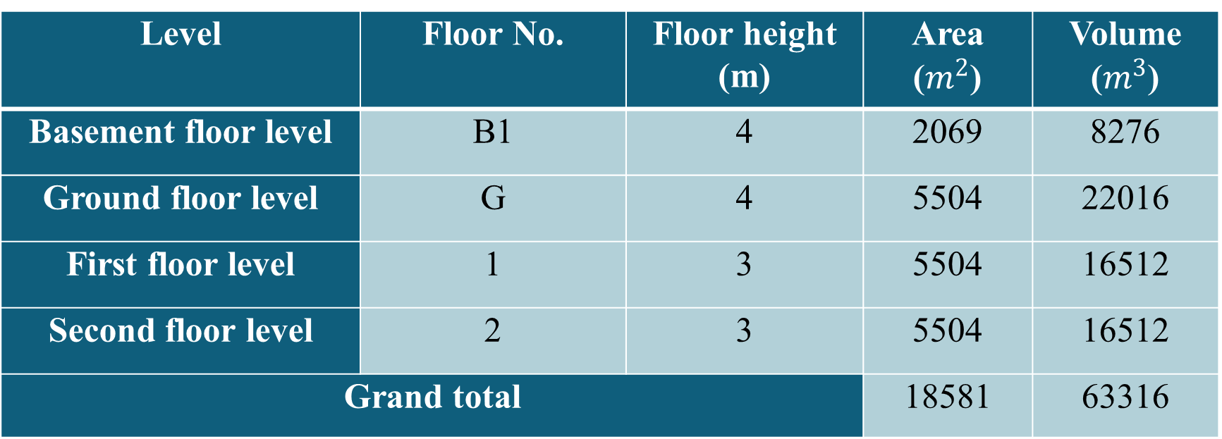
Description of the project
Level | Floor No. | Floor height (m) | Area ($m^{2}$) | Volume ($m^{3}$)
Basement floor level | B1 | 4 | 2069 | 8276
Ground floor level | G | 4 | 5504 | 22016
First floor level | 1 | 3 | 5504 | 16512
Second floor level | 2 | 3 | 5504 | 16512
Grand total |  |  | 18581 | 63316

Slide 9
Materials
*Concrete
Structural Element | Fc’ (MPs) | Concrete Type | Modulus of Elasticity (MPs)
Slab, Beams, columns, Shear walls | 28 | B350 | 24870
*Steel
Yielding strength (Fy) = 420MPa.

Slide 10
*Soil Properties
The bearing capacity of the soil in the region is estimated to be 2.5 Kg/cm²
*Loads
Gravity loads:
Dead Load
Slab own weight = 5 KN/m²
Superimposed load= 3.825 KN/m²
Wall load=24 KN/m.
Live Load
According to ACI 318-14 the value of live load = 5 kN/m²
Lateral loads:
Seismic load

Slide 11
*Codes and standards:
ACI 318-12
UBC-97
ASCE7-10 code
IBC 2012

Slide 12
Computer Programs
ETAPS 2016 is used to analyze and design the structural elements (3D).
AutoCAD is used for plans and some detailing.
Sap2019 is used to design 2D truss and footing

Slide 13
Slab Selection
There are many reasons to use solid slab instead of ribbed slab
1. Ribbed slab is bad in seismic design
2. Ribbed slab is difficult in solving problem of celling after removing formwork
Two way solid slab with drop beam was chosen (t=0.2m)

Slide 14
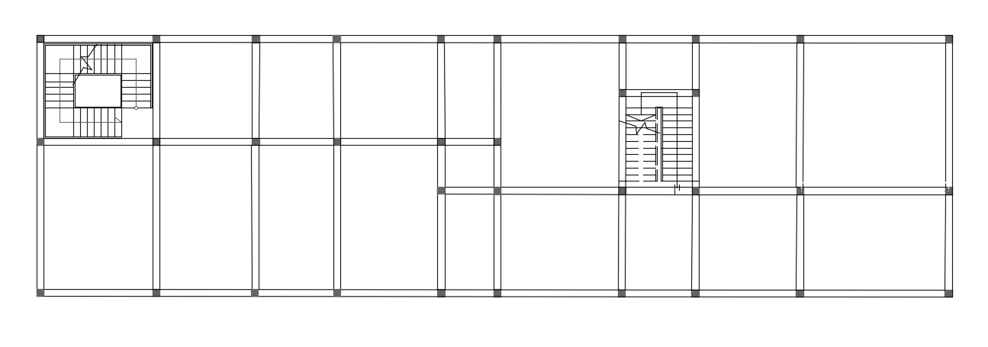
Block1 (with slab, beams and columns)

Slide 15
Slab Thickness
*Critical panel

Slide 16

Slab Thickness
L/B=1.1<2…… Two way solid slab
Thickness of slab=0.2m
I for interior beams = 12.57*10⁻³ $m^{4}$
I for exterior beams = 9.87 *10⁻³ $m^{4}$
$α_{f}=\frac{I_{b}}{I_{s}}$
${ α}_{f1}$, $α_{f2},$ $α_{f3}$, $α_{f4}$
check for αfm = 3.8>2

Slide 17
Preliminary Dimensions
*Beam
 | Depth(m) | Width(m) bw | Width(m) bf | Description for beam
Beam*1 | 0.7 | 0.6 | 1.7 | L-Section
Beam*2 | 0.6 | 0.55 | 2.7 | T-Section
Beam*3 | 0.6 | 0.5 | - | Rectangular

Slide 18
Preliminary Dimensions
*Column
Name of column | Depth(mm) | Width(mm)
Interior | 650 | 400
Edge | 600 | 400
Corner | 400 | 400

Slide 19
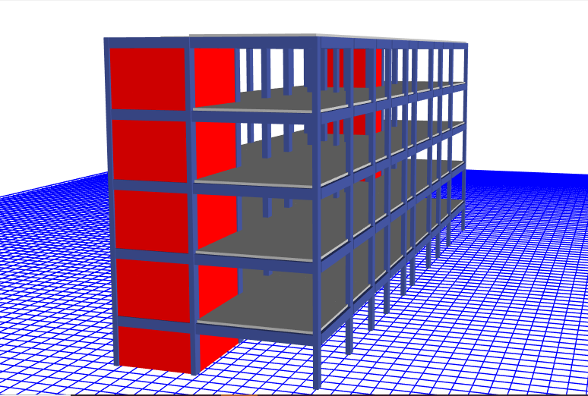
Block 1
*Checks

Slide 20
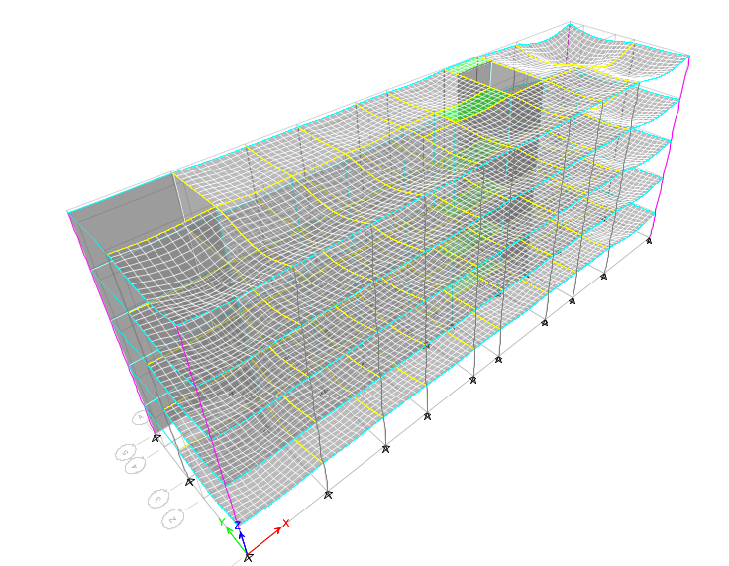
Compatibility Check
Period=0.53<1

Slide 21
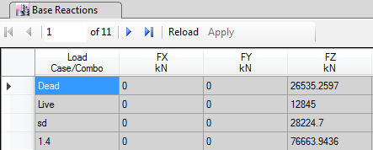
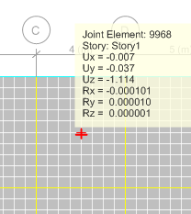
*Equilibrium check
Live load by hand=12840
For live load % of error=0.03%
Deflection from sap <allowable deflection
(Acceptable)
*Deflection check

Slide 22
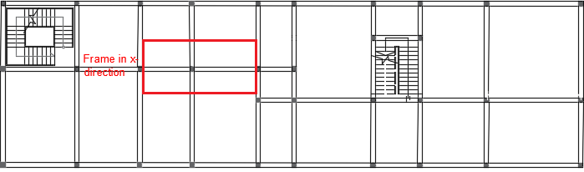
Stress Strain Check
*Frame in x-Direction
** % of Error =11% >>>> Acceptable

Slide 23
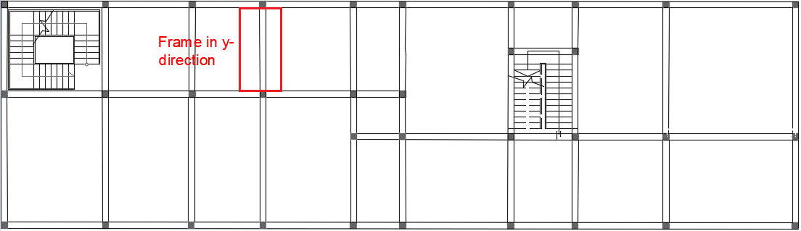
*Frame in Y-Direction
** % of Error =1.03% >>>> Acceptable

Slide 24
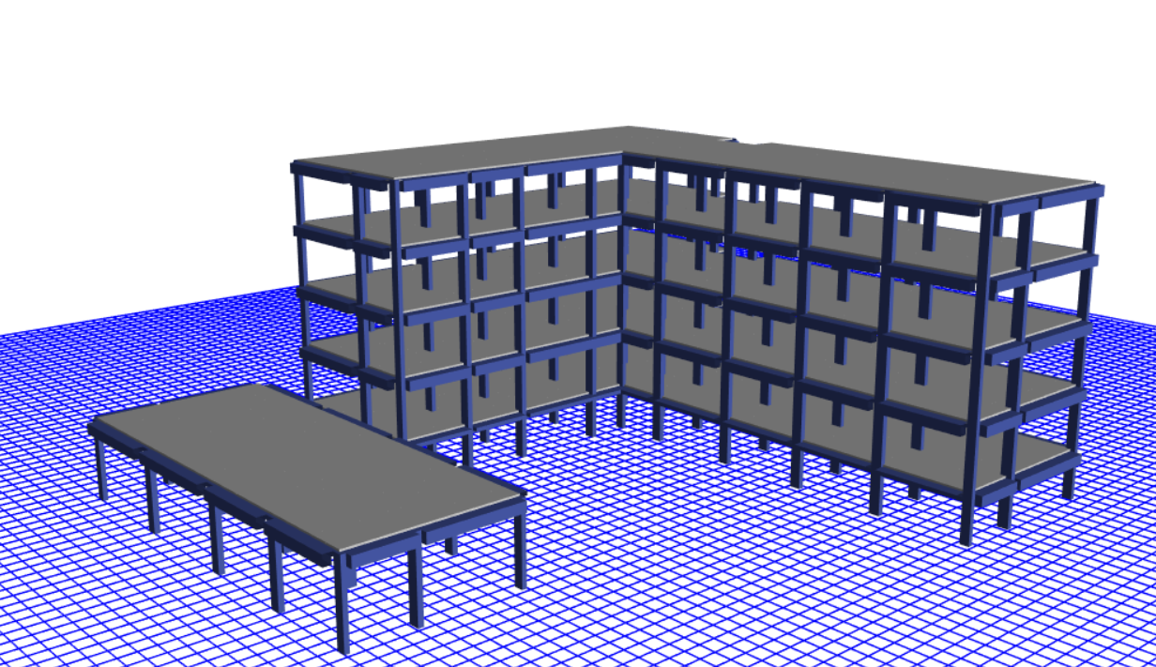
Block 2
All check are done and acceptable

Slide 25
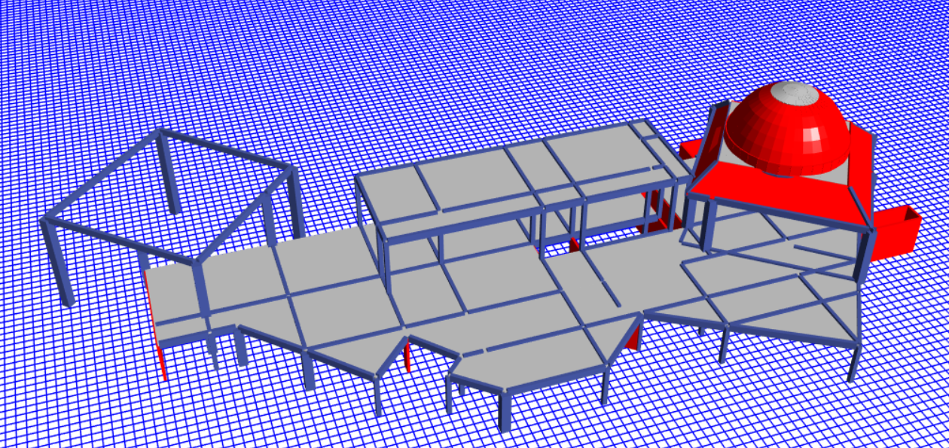
Block 3
All check are done and acceptable

Slide 26
Dynamic analysis for block 1:
Equivalent static method
UBC-97

Slide 27
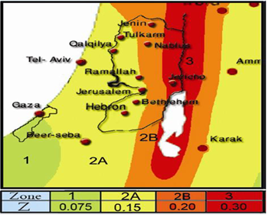
Seismic Zone Factor Z
Nablus city……2B
Z=0.2

Slide 28
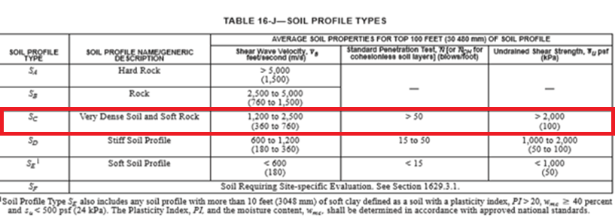
Site class

Slide 29
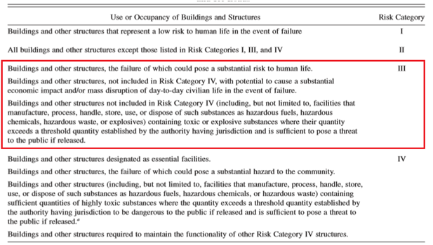
Risk category

Slide 30
Seismic Importance Factor I:

Slide 31
Response Modification Coefficient R

Slide 32
Seismic coefficient
Ca=0.24
Cv=0.32

Slide 33
Seismic Load combinations:
a) 1.34D+1.0L+1.0EQx + 0.3EQy
b) 1.34D+ 1.0L -1.0EQx – 0.3EQy
c) 1.34D+1.0L+1.0EQy + 0.3EQx
d) 1.34D+ 1.0L -1.0EQy - 0.3EQx
e) 0.9D+ 0.71 EQx +0.231 EQy
f) 0.9D- 0.71 EQx -0.231EQy
g) 0.9D+ 0.71 EQy +0.231 EQx
h) 0.9D- 0.71EQy -0.231EQx

Slide 34
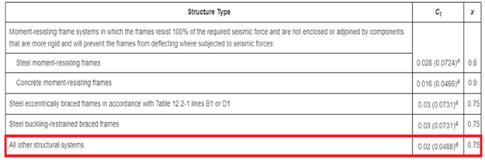
Structural Period for block1:
Ta=Ct * h_{n}^{x}
Ta=0.0488 * 19 ^{0.75} =0.45 Sec

Slide 35
Check for period:
Period from ETABS < Cu × Ta
The period in X direction from SAP ( Tx) =
0.425 second < 1.4× 0.45 =0.63
The period in y direction from SAP ( Ty)=
0.375 second< 1.4× 0.45 =0.63
Check for period …….. Ok

Slide 36
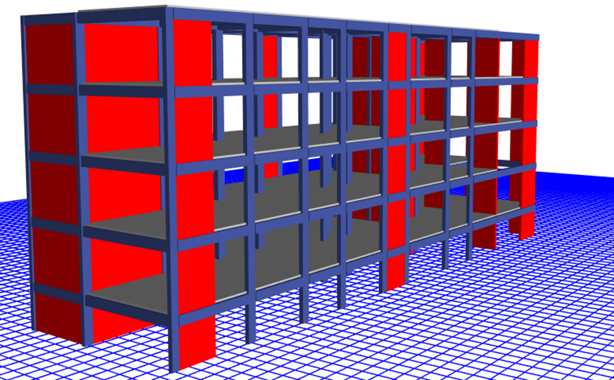
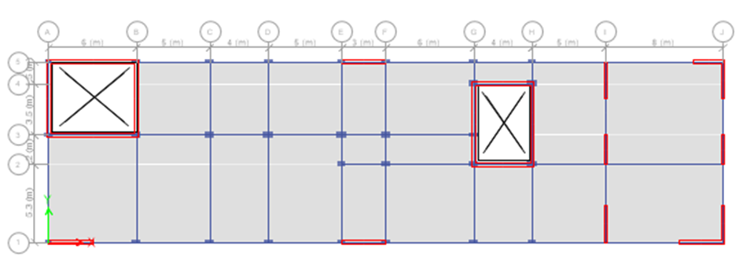
Drift check:
To eliminate drift and torsion we add shear wall.

Slide 37
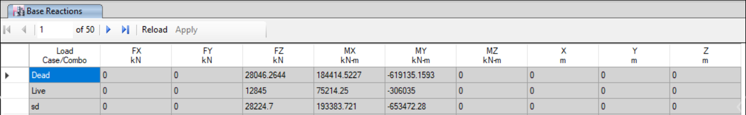
Check for Base Shear reaction:
Wight of structure= D + SD +0.25L
W = 59482.22 KN
V Max. = {(2.5 * Ca * I)/R.} * W.
={(2.5 * 0.24 * 1.25)/5.5.} * 59482.22=8111.2KN
V Min. = (0.11 * Ca * I} * W.
= (0.11 * 0.24 * 1.25} * 59482.22. =1963KN

Slide 38
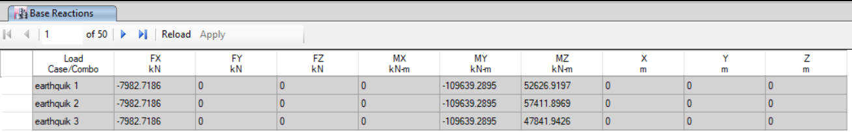
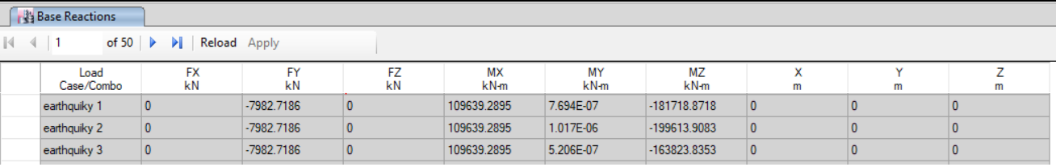
Base Shear from ETABS:
Vx=7982.7KN
Vy=7982.7KN
Check for Base shear …OK

Slide 39
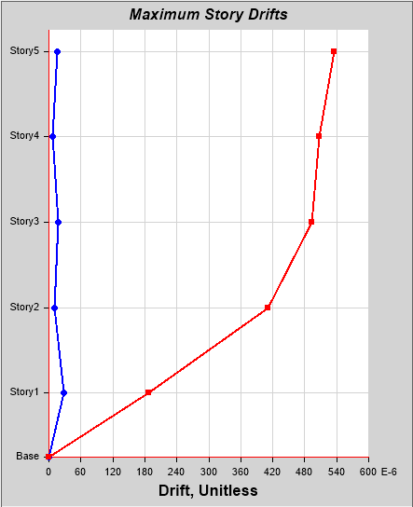
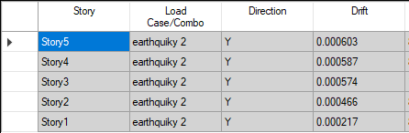
Drift check:
Allowable drift=0.02h
From story 5 the value of drift is
=0.000603<0.02*19=0.38
To eliminate drift and torsion we add shear wall.

Slide 40

Dynamic analysis for block 2:
Equivalent static method
IBC-2012

Slide 41

Seismic Zone Factor Z
Z= 0.2
S1 = 1.25*Z= 0.25
Ss= 2.5*Z =0.5

Slide 42
Site coefficient:
Fa=1.2
Fv =1.55
SDS = Ss *Fa = 0.5*1.2 = 0.6
SD1 = S1 * Fv = 0.25 *1.55 =0.39

Slide 43
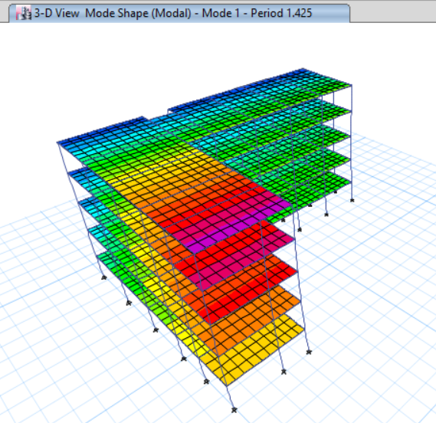
Check for period:
Period from SAP > Cu × Ta
Ta = 0.0466*(19)^{0.9} =0.66
Ta *Cu=0.66*1.4=
Period from ETABS=1.425
Take 0.66 for calculate base shear

Slide 44
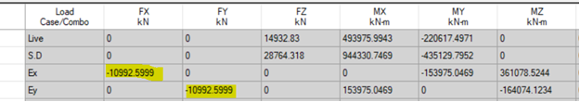
Check for Base shear:
W = 74601KN
CS minimum of 0.147, 0.15
V = 74601x 0.147= 10966 KN
Base shear from ETABS=10992.5KN

Slide 45
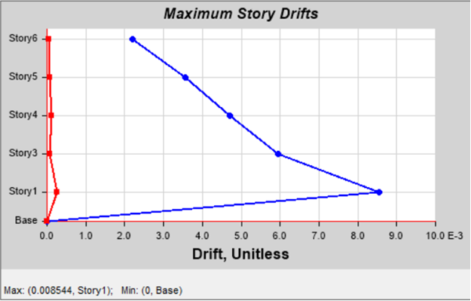
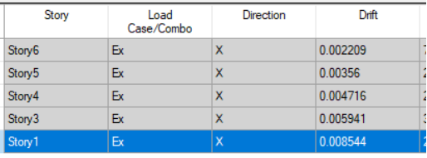
Drift in X direction:
story Drift in X direction

Slide 46
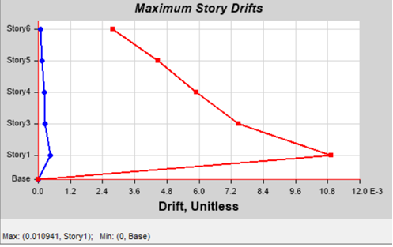
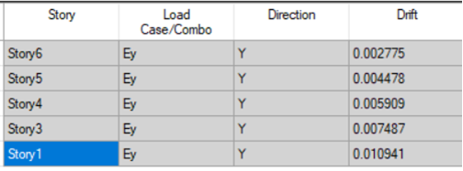
Drift in Y direction:
story Drift in Y-direction

Slide 47
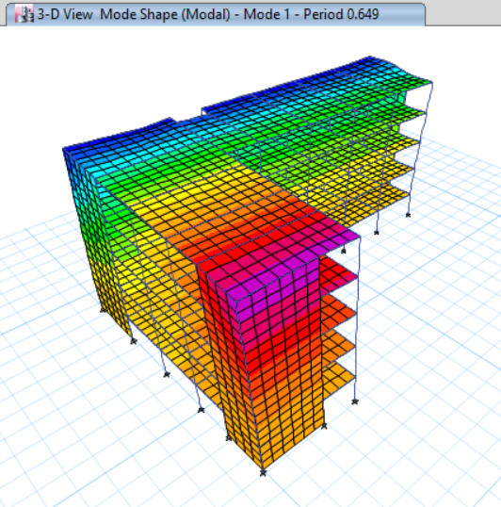
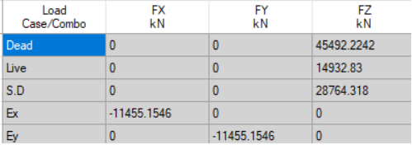
After modification on block 2:
TETABS<Ta*Cu
Period from ETABS=0.649Sec
Base shear by hand=11119KN
Error3% …..OK

Slide 48
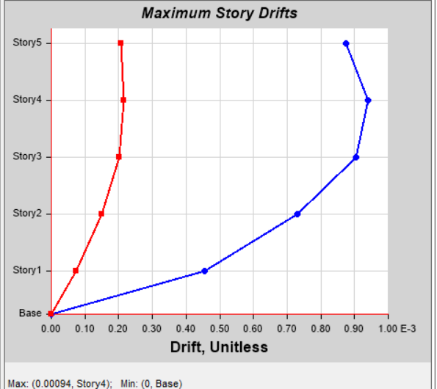
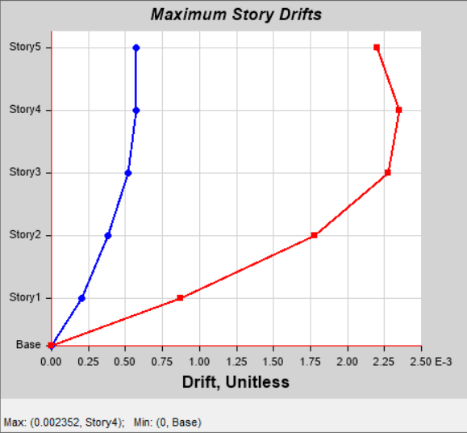
Drift for Block 2 after adding shear wall:
Drift in x-direction Drift in Y-direction
All values of drift less than 0.02h_{x}.............OK

Slide 49

Dome design:
Dead load (g) = 0.12*25 = 3 kN\m² , Radius (R) =8.7m , Thickness (T) = 0.12m
Live load (q) =1.5 kN\m² Φ=75 ͦ ,
For dead load:
N⦶ $=\frac{gR}{1+\cos{∅}}$
N_{ϴ=}$gR(\cos{∅}− \frac{1}{1+\cos{∅}})$
For live load:
N_{⦶ =}$\frac{qR}{2}$
N_{ϴ} =₌$\frac{qR}{2} \cos{2∅}$

Slide 50
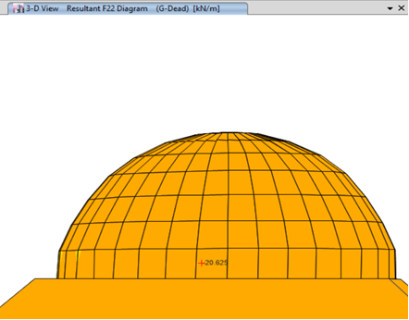
Force from ETABS:
Hand calculationNΦ@75 ͦ =-20.9KN/m

Slide 51
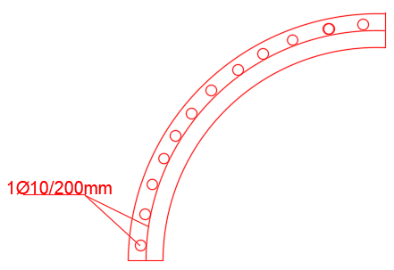
Dome design:
Ultimate load:
NΦmax =1.2*20.9+1.6*10.44=41.8 KN/m
Nθmax=1.2*14+1.6*7=28 KN/m
φPu=φλ(0.85f’c (Ag-As)+FyAs)
=0.65*0.8*0.85*28*1000*120/1000=1485 KN > NΦmax, Nθmax
So, use Asmin=0.003*1000*120=360 mm2/m ……….. 1φ10/200mm

Slide 52
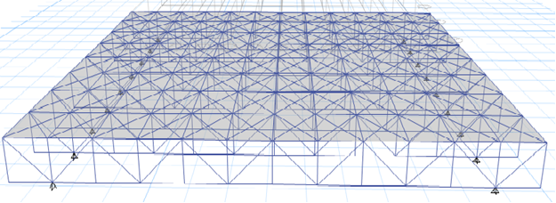
Truss Design:
In our project we have designed a steel truss 2D(roof) for Theater with dimension(20*20m) tube section for welding connection only
All check are done and acceptable

Slide 53
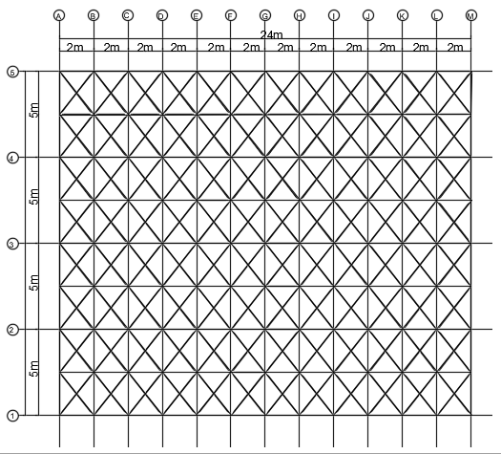
Dimension for Bracing:
Tubo 10*10*0.5

Slide 54
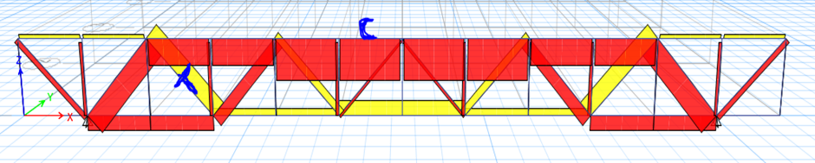
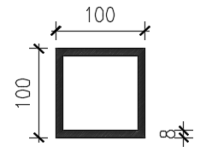
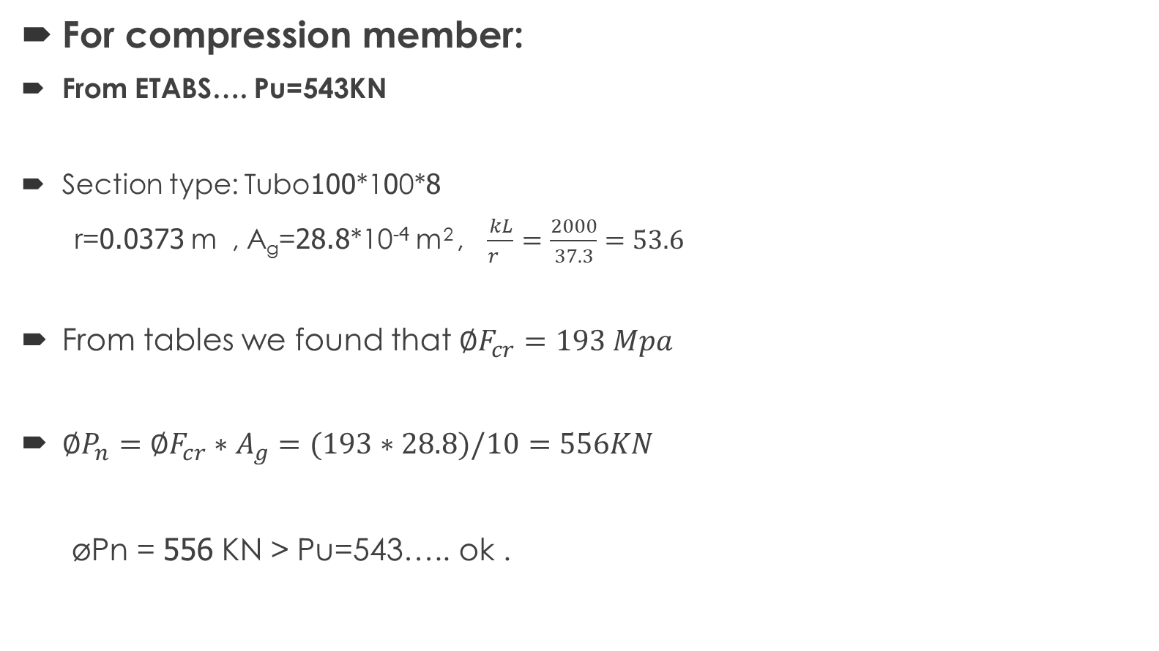
Design of comp. and tension member:
For compression member:
From ETABS…. Pu=543KN
Section type: Tubo100*100*8
r=0.0373 m , A_{g}=28.8*10⁻⁴ m² , $\frac{kL}{r_{}}=\frac{2000}{37.3}=53.6$
From tables we found that $∅F_{cr}=193 Mpa$
$∅P_{n}=∅F_{cr}∗A_{g}=(193∗28.8)/10=556KN$
øPn = 556 KN > Pu=543….. ok .

Slide 55
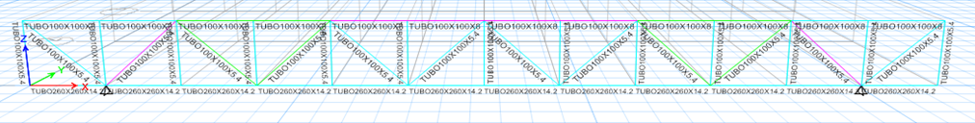
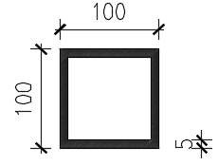

For tension member:
From ETABS $……Pu =243.7KN$
Section type: Tubo 100*100*5
Design of Ten. Member:
By fraction:-
øF_{frac}. = øFu (A _{gross} -A _{hole} )*t
$øF_{frac}=0.75∗400∗\left(1870\right)∗5=2805=2805KN$
øF_{frac}> $Pu$ so the member is safe for fracture.

Slide 56
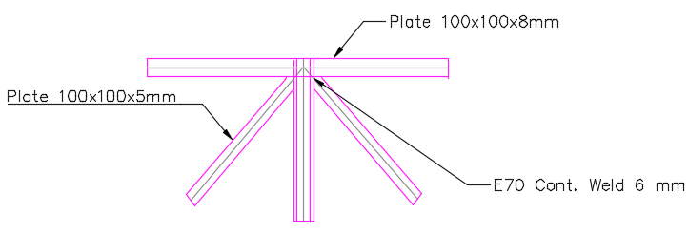


Design of Weld connection:
$∅Rn=∅∗t∗0.6∗Fy≥\frac{Tu}{\sum{lw}}$
0.9*8*0.6*248$≥\frac{543∗10^3}{4∗lw}$
Lw=126.7mm….use Lw=130mm
$(∅{R_{n})}_{weld}=∅_{w}∗0.6∗F_{Exx}∗a∗cos45≥\frac{T_{u}}{\sum{L_{w}}}$
$0.75∗0.6∗70∗8∗a∗0.707≥\frac{543∗{10}^{3}}{4∗130}$
$a≥5.86mm taBke a=6mm$
Check for size and length of weld……OK

Slide 57

Design for circular column:
Live load=130KN
Dead load=82KN
Pu=306.5kn
Ag=20211mm2…...D=165mm
Use ρs = 0.018
Use 1 ∅10/70mm

Slide 58


Designed Beam:
        For Block 1

Slide 59

Designed column:
        For Block 1

Slide 60

Design for stairs:
Thickness of flight = 19cm
Load on stair:
*Live = 5 𝑘𝑁/𝑚2
*Superimposed = 2.5𝑘𝑁/𝑚2

Slide 61
Design for Flight , Landing:
Design for Longitudinal steel
Max M33(Negative) = 3.6 KN.m
→ ρ = 0.0003 <0.0018
Use ρ = 0.0018
→ use 5φ14/m
Design for Transverse steel
𝐴𝑠 𝑠ℎ𝑟𝑖𝑛𝑘𝑎𝑔𝑒 =0.0018×190×1000
=324𝑚𝑚2.
→ Use 1 ∅12/250mm

Slide 62

Design for footing:
single footing
Area of footing= (PD+PL)/qall
B=3m,l=3.9m
Check punching : d=0.78m…OK

Slide 63

Design for footing:
Combined Footing
*Col (C5) =C1 (0.6*0.3) *Col (D5) =C2 (0.6*0.3)
PD1=580KN , PD2=670KN
PL1=312KN , PL2=423KN
B=2m, L=5m
d=0.7m, h=0.85m

Slide 64

Design for footing:
Shear wall footing:

Slide 65
Footing plan:

Slide 66
Thank you

