Slide 1

An-Najah National University
Faculty of Engineering & Information Technology
Department of Building Engineering
Graduation Project II Presentation
AL-Qassas Mosque Redesign
Prepared by : Tayseer Katot
Mohammed Khayat
Alaa Saleem
Yousef Kan’an
Supervised by : Dr.Luay Dweikat

Slide 2

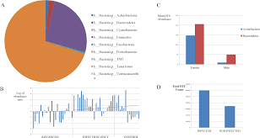






Presentation outline :
1.Introduction
2.Earlier Studies
3.Architectural Design
4.Structural Design
5.Environmental Design
6. mechanical Design
7.Electrical Design
8.Quantity & Cost Estimation

Slide 3
1.Introduction

Slide 4
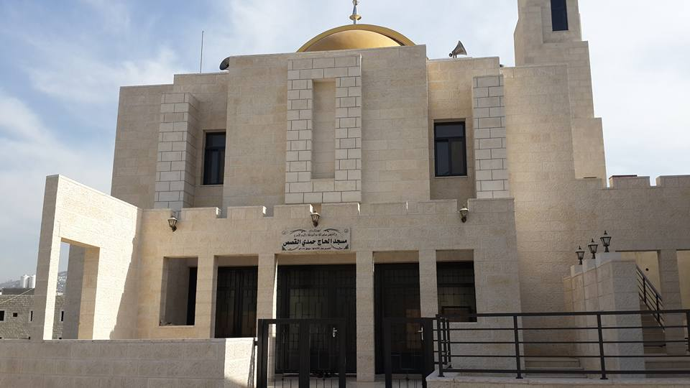
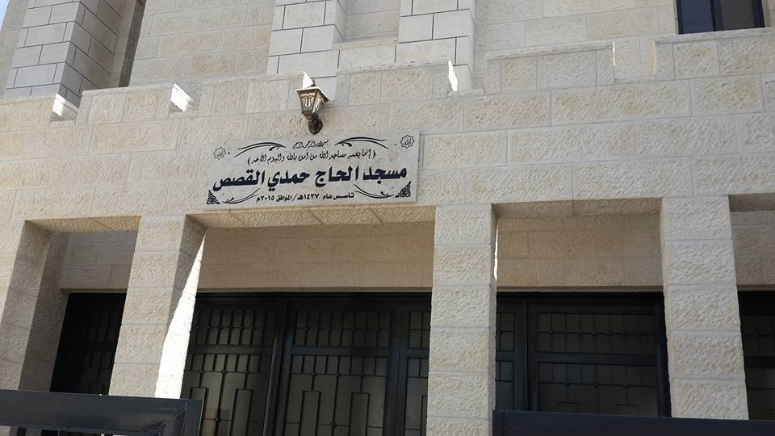
Photos of the existing mosque:

Slide 5
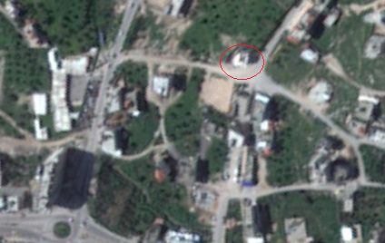
1.1 Site And Location:
The site is located in (Bit wazan), west of Nablus near To (dawar zawata) ,( tulkarem street) , about 496 m Above sea level, The Site has a total area of 954 m2.

Slide 6
1.2 Site advantage and disadvantage:
Pros:
-Away from traffic rush.
-Has a quiet surrounding environment.
-Close to the neighborhood residents.
-There is no buildings impedes the building from sun and wind at an exact elevation.
Cons:
-The total area were challenging to redesign the mosque with full specifications required.
- The slop of the land.

Slide 7
2. Earlier Studies:

Slide 8
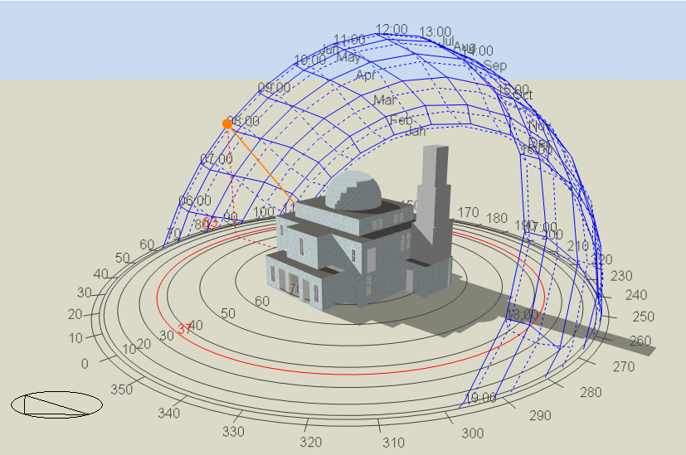
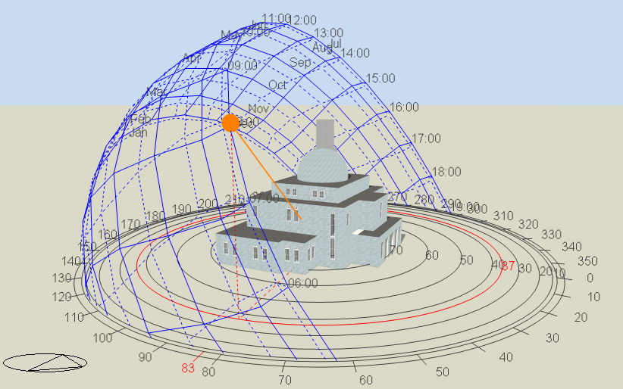
2.1 Solar Analysis:
In a Summer Day:
In a Winter Day:
The Site is fully exposed to sun.
In the midday, it is fully exposed to sun.

Slide 9
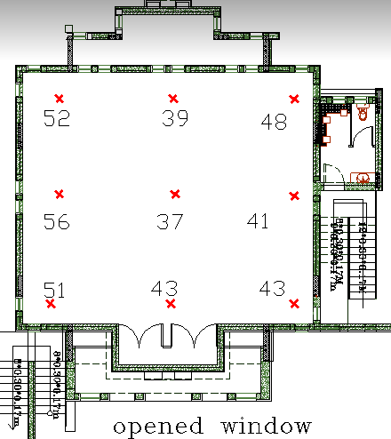
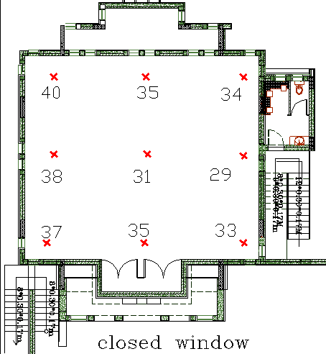
2.2 Noise Analysis:
Manual measured For Back Ground Noise:
Highest value doesn’t exceed 52db.

Slide 10
2.3 Earlier Conclusions:
Architectural Aspect:
-Mosque Area = 130 m² for 118-130 Worshipers.
-Important facilities are missed.
- The Material & Design doesn’t provide thermal comfort.
Safety Considerations:
- Emergency Fire Protection System

Slide 11
2.3 Earlier Conclusions:
Environmental Aspect:
-Low rated thermal comfort in the building.
Structural Aspect:
-Bad Acoustic performance for Pray hall.
- Seismic design considerations.
-The design does not offer optimal environmental solutions
Mechanical Aspect:
- Suitable HVAC system doesn’t exist.

Slide 12
3. Architectural
Re-design:

Slide 13
3.1 Building Function:
The building is a mosque.
Normal Working hours from 3:30 am to 10:30 pm.
Used by 140-170 worshipers .

Slide 14
3.2 Design Modifications:
Table of Areas
 | Old Design | New Design
Floor | Total Area(m2) | Total Area(m2)
Basement | Doesn't exist | 785
Ground Floor | 130 | 141
Mizanin Floor | 42 | 47
Laibrary | Doesn't exist | 45
Ablution For men | 13 | 30
Ablution For women | Doesn't exist | 20
WC For Men | 24 | 30
WC For woMen | Doesn't exist | 25

Slide 15
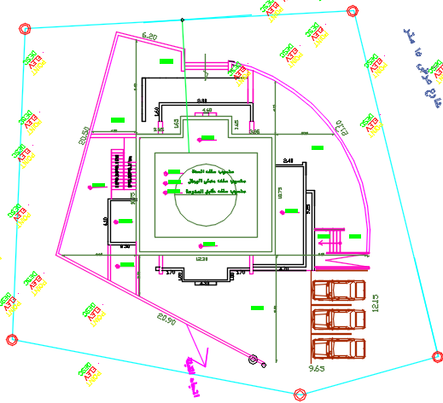
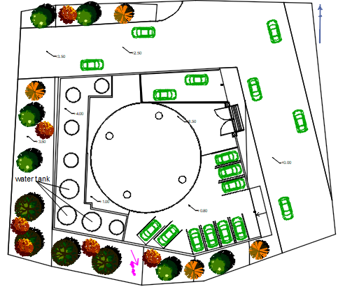
Old Site Plan
New Site Plan

Slide 16
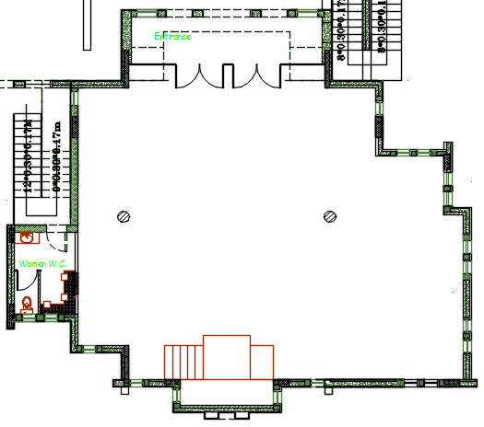
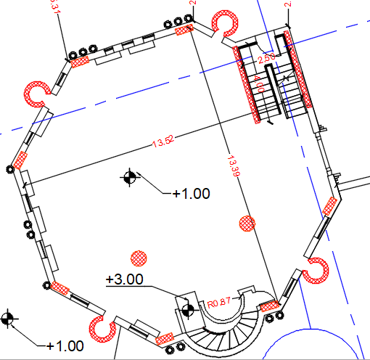
Old Ground Floor
New Ground Floor

Slide 17
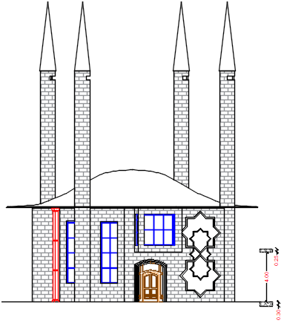
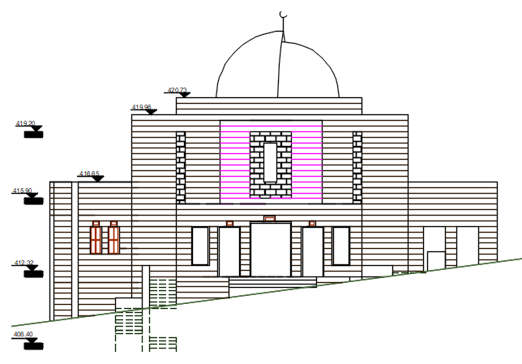
Old Main Elevation
New Main Elevation

Slide 18
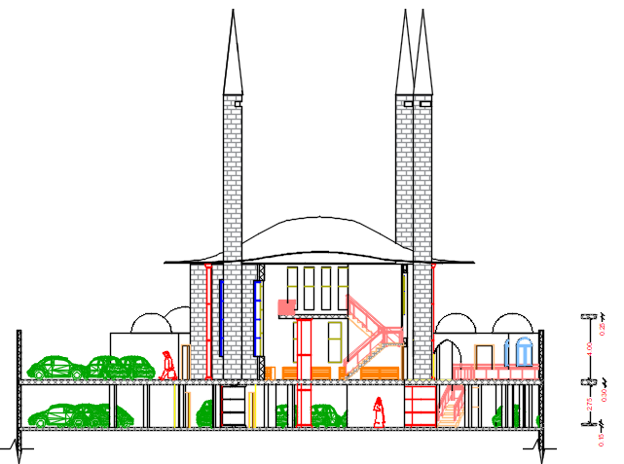
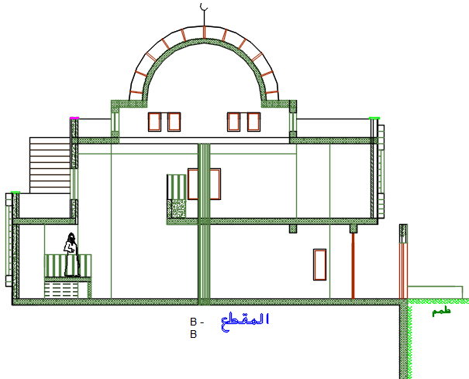
Old Main Section
New Main Section

Slide 19
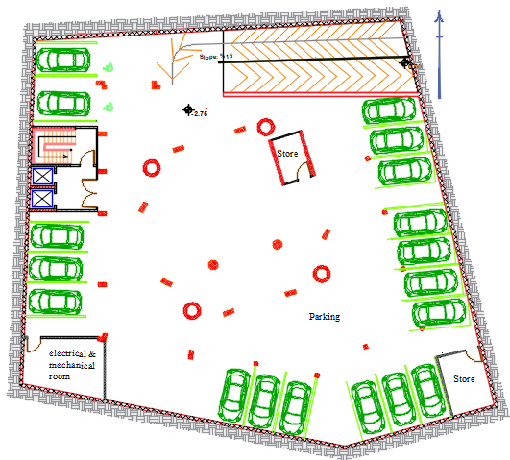
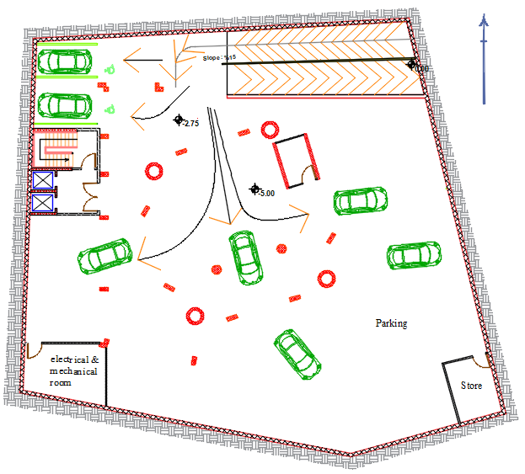
3.3 Improvements:
The Car parking is designed in a new Building while in the old one there was no car parking.

Slide 20
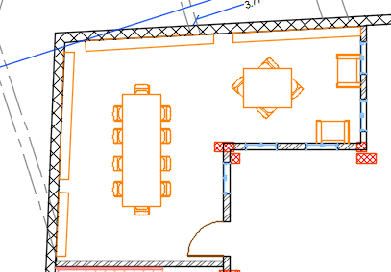
3.3 Improvements:
The Library is designed in a new Building while in the old one there was no Library.

Slide 21
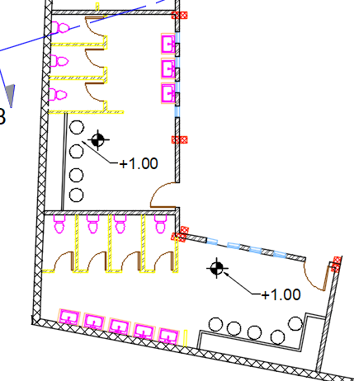
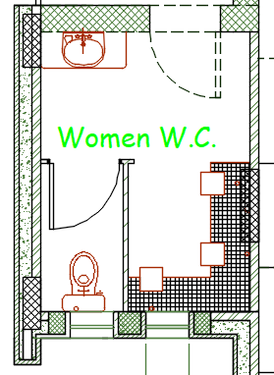
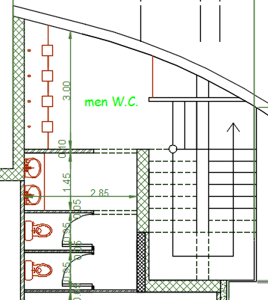
3.3 Improvements:
Old Ablution & WC
New Ablution & WC

Slide 22
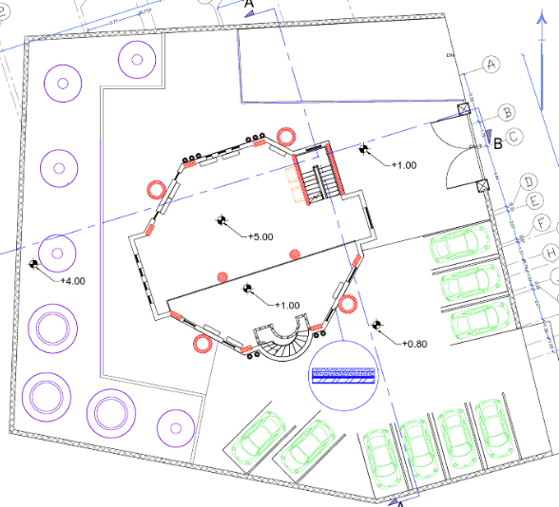
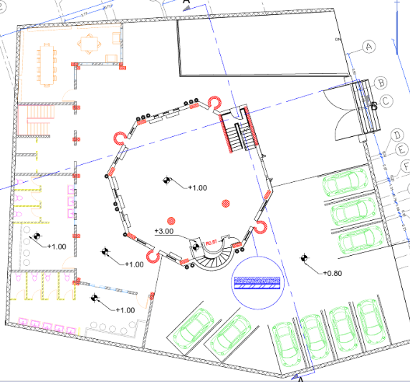
3.4 Final architectural plans :
Ground Floor Plan
Mezzanine Floor Plan

Slide 23
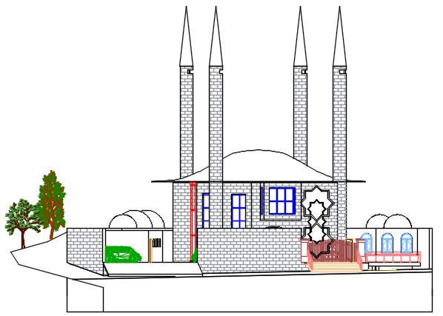
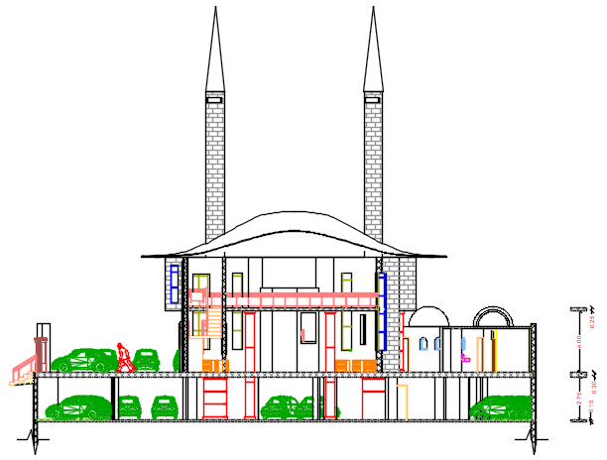
3.4 Final architectural plans :
East Elevation
Section B-B

Slide 24
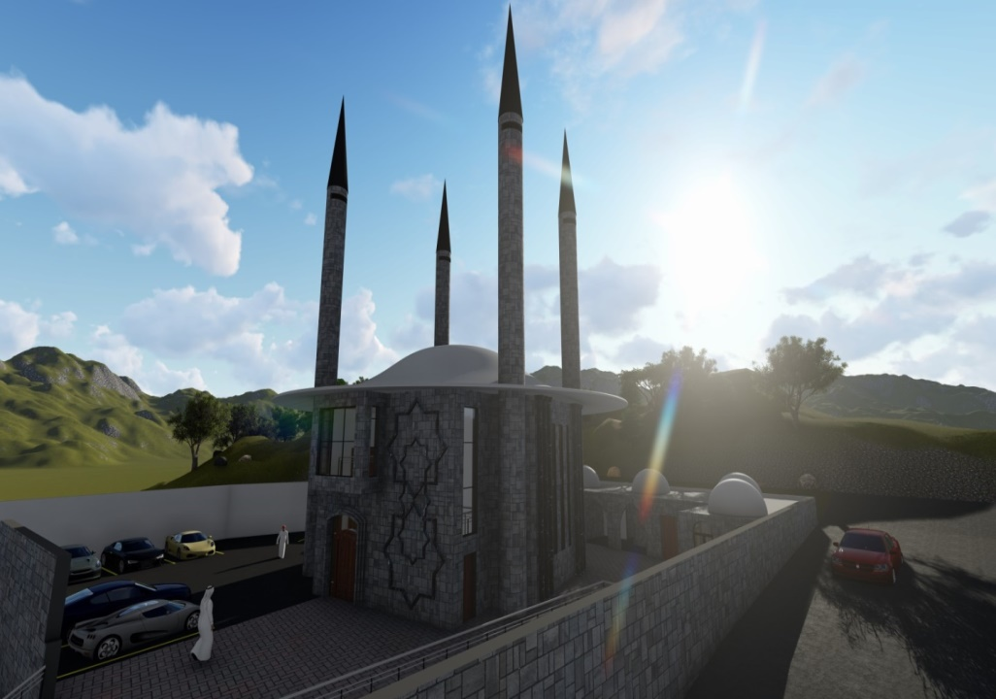
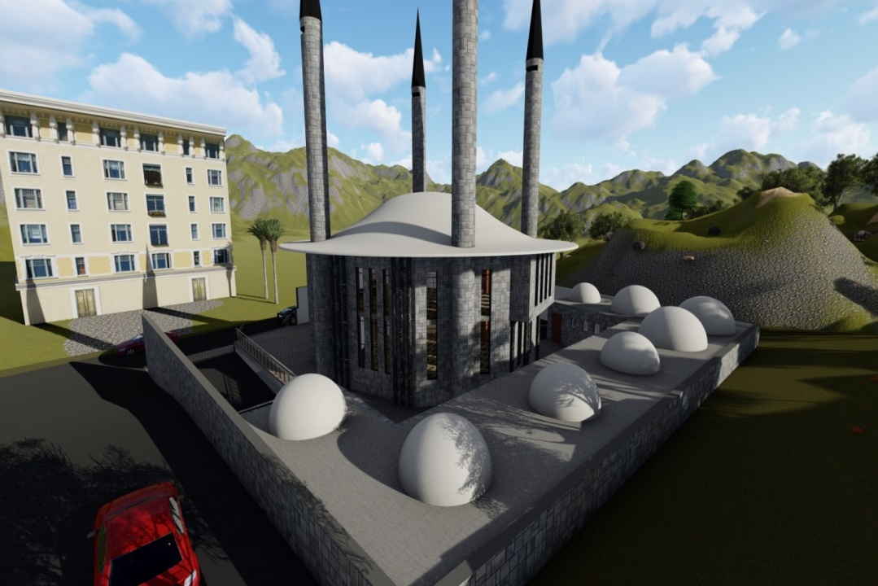
3.5 Final Design Photos:
External Render

Slide 25
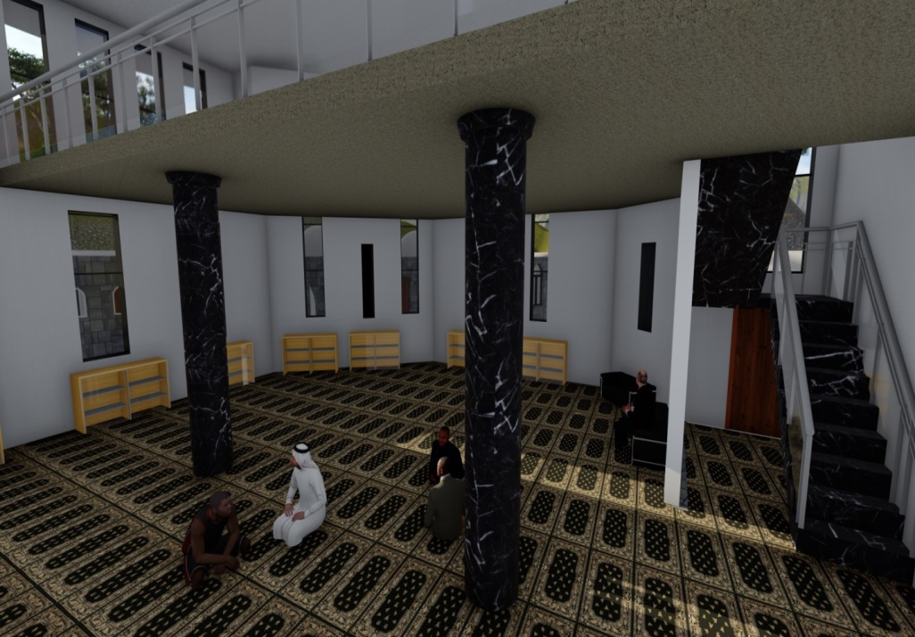
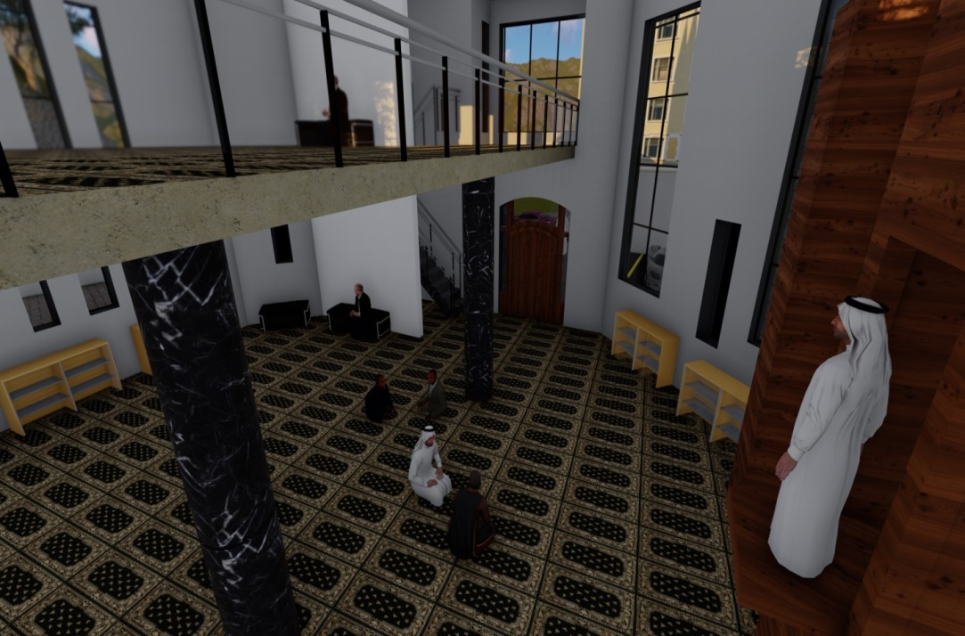
3.5 Final Design Photos:
Internal Render

Slide 26
4. Structural
Design:

Slide 27
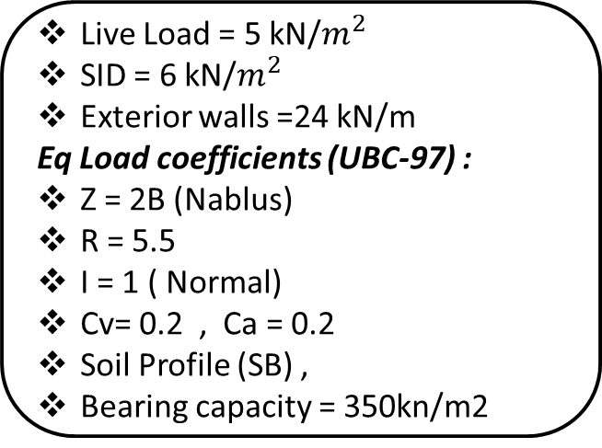
4.1 Codes & Loads & Modifiers :
ACI -318-08 (American Concrete Institution) for reinforced concrete structural design.
UBC-97 (Uniform Building Code) for earthquake load computations.
ASCE (American Society Of Civil Engineers) for design loads.
Live Load = 5 kN/$m^{2}$
SID = 6 kN/$m^{2}$
Exterior walls =24 kN/m
Eq Load coefficients (UBC-97) :
Z = 2B (Nablus)
R = 5.5
I = 1 ( Normal)
Cv= 0.2 , Ca = 0.2
Soil Profile (SB) ,
Bearing capacity = 350kn/m2
Structural Item | Modifier
Beams | 0.35
Slabs | 0.30
Walls | 0.70

Slide 28
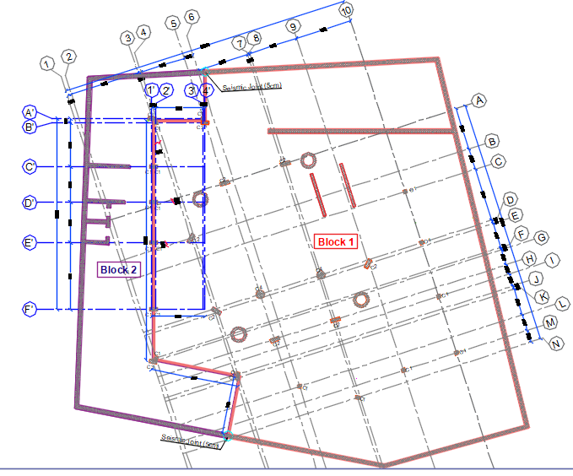
4.2 Building Description:
Structural Item | Compressive Strength
Slab, Beams & cantilever walls | (B350)
Columns, walls & Foundations | (B350)
Blinding | (B200)
Reinforced Concrete Compressive Strength (fc’)

Slide 29
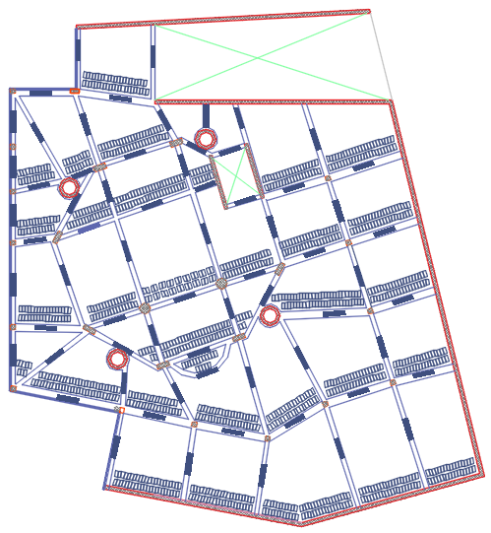
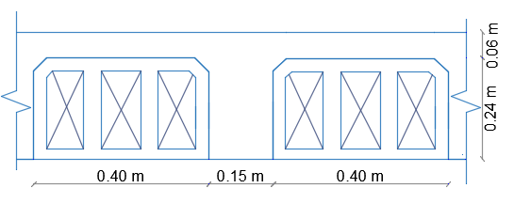
4.3 Structural System:
The system of the slab is one way slab(30 cm thickness) with Drop beams

Slide 30
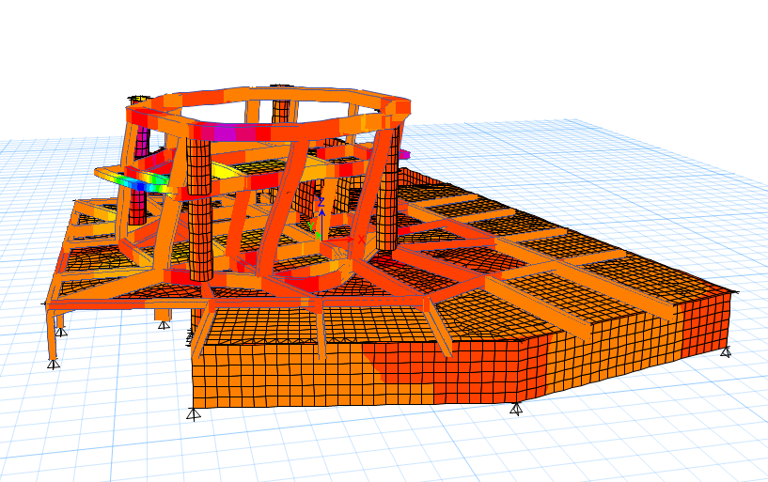
4.4 Model Checks :
Compatibility Check :
Block one

Slide 31
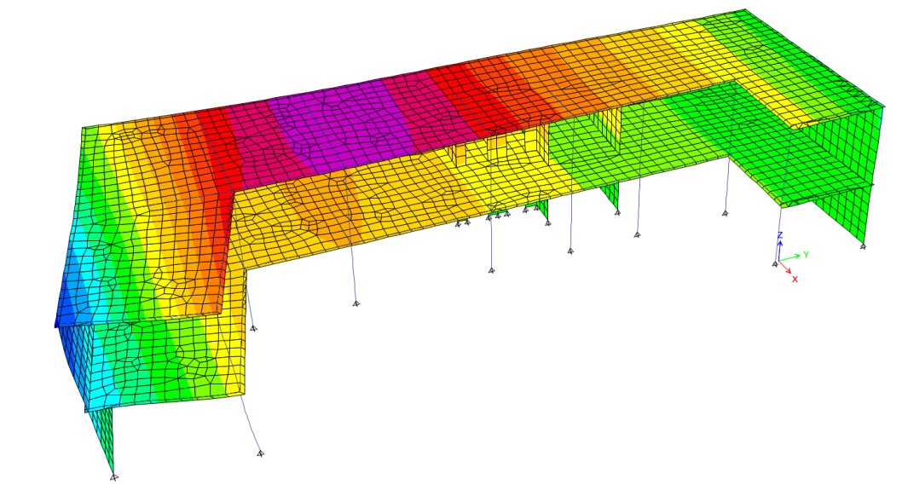
4.4 Model Checks :
Compatibility Check :
Block two

Slide 32
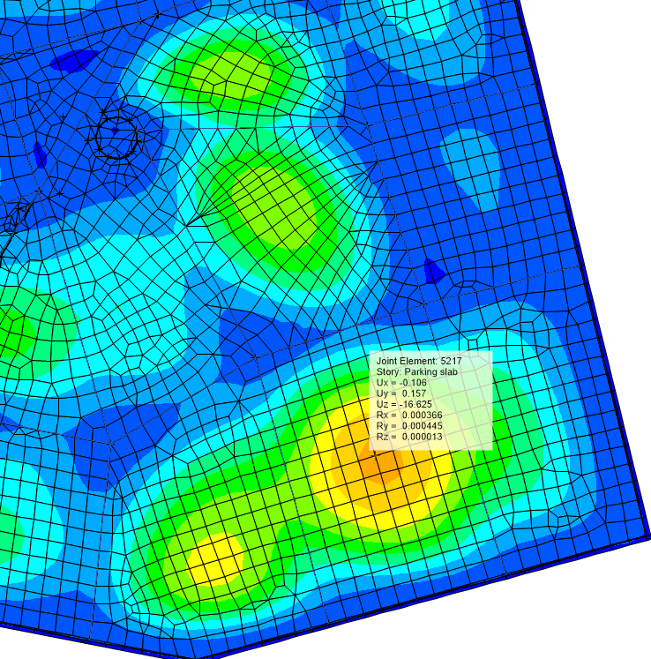
4.4 Model Checks :
Deflection Check:
Deflection Doesn’t exceed the limitation.
Block one

Slide 33
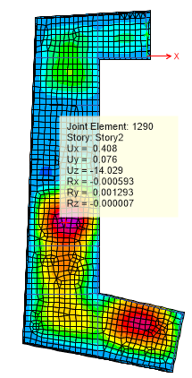
4.4 Model Checks :
Deflection Check:
Deflection Doesn’t exceed the limitation.
Block two

Slide 34
4.4 Model Checks :
Base Reaction Checks :
Load | Manual(Kn) | ETABS(Kn) | Error
Dead load | 7647 | 7514 | 1.7%
Live load | 4540 | 4555.3 | 0.34%
Super imposed | 7324.6 | 7152 | 2.35%
Load | Manual(Kn) | ETABS(Kn) | Error
Dead load | 4427 | 4437 | 0.2%
Live load | 2195 | 2204 | 0. 4%
Super imposed | 2634 | 2645 | 0.4%
Block one
Block two

Slide 35
4.4 Model Checks :
Internal Forces Check:
Done for 3 samples of slab strip, beams and columns within difference less than 10%
Element | Manual | ETABS | Difference
Column 1 | 494.3 KN | 441.13 KN | 3%
Column 2 | 624 KN | 661.19 KN | 5.9 %
Column 3 | 950.7 KN | 960.4 KN | 5.4%
Element | Manual | ETABS | Difference
Beam 1 | 257 KN.m | 243.5 KN.m | 5.2 %
Beam 2 | 120 KN.m | 110 KN.m | 8.3 %
Beam 3 | 195 KN.m | 196 KN.m | 1 %
Element | Manual | ETABS | Difference
Panel 1 | 40 KN.m | 39.5 KN.m | 1.3 %
Panel 2 | 51 KN.m | 48.3 KN.m | 5.3 %
Panel 3 | 47 KN.m | 46 KN.m | 2.12 %

Slide 36
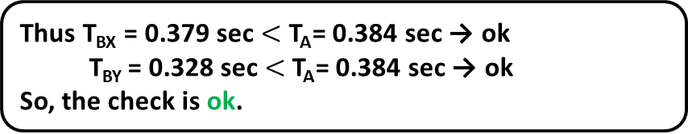
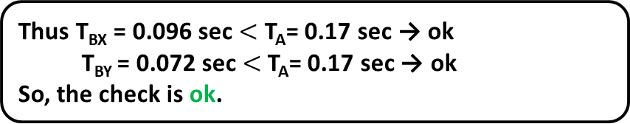
4.5 Seismic Design:
Period Check:
Thus T_{BX} = 0.379 sec $<$ T_{A}= 0.384 sec → ok T_{BY} = 0.328 sec $<$T_{A}= 0.384 sec → ok
So, the check is ok.
Block one
Thus T_{BX} = 0.096 sec $<$ T_{A}= 0.17 sec → ok T_{BY} = 0.072 sec $<$T_{A}= 0.17 sec → ok
So, the check is ok.
Block two

Slide 37
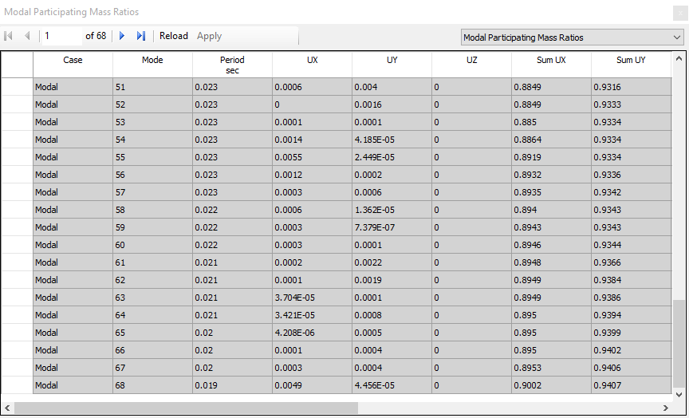
4.5 Seismic Design:
Modal Mass participating ratios check:
68 modes satisfy percentages higher than 90%.
Block one

Slide 38
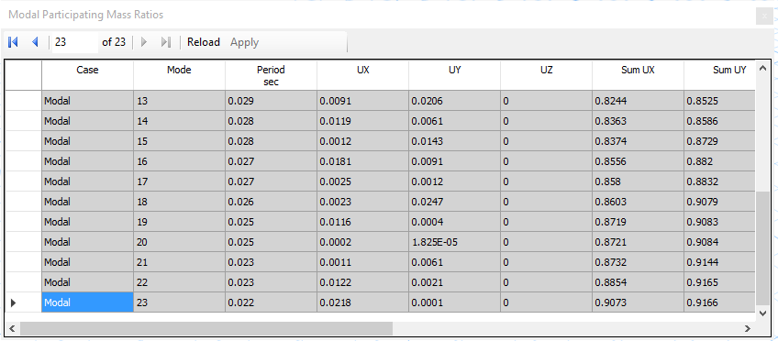
4.5 Seismic Design:
Modal Mass participating ratios check:
23 modes satisfy percentages higher than 90%.
Block two

Slide 39
4.5 Seismic Design:
Base Shear Check:
Manual Base Shear Values :
Base shear (Vx) = 1425KN.
Base shear (Vy) = 1414.3KN.
Load Case / Combo | Fx (kN) | Fy (kN)
EQx | 1425 | 0
EQy | 0 | 1414.3
Block one

Slide 40
4.5 Seismic Design:
Base Shear Check:
Manual Base Shear Values :
Base shear (Vx) = 694.7KN.
Base shear (Vy) = 695KN.
Load Case / Combo | Fx (kN) | Fy (kN)
EQx | 694.7 | 0
EQy | 0 | 695
Block two

Slide 41
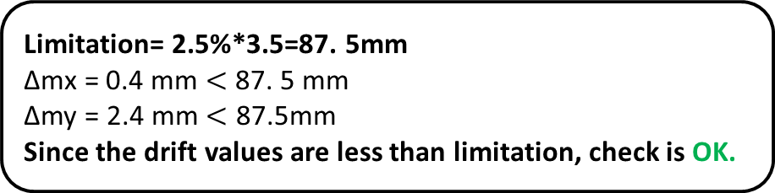
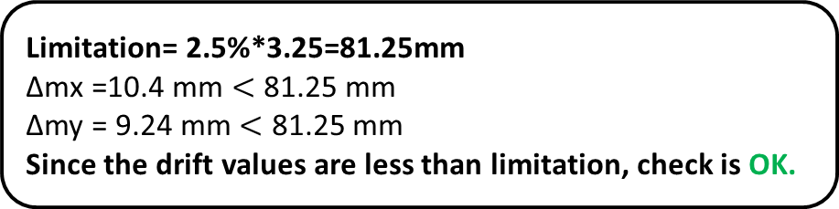
4.5 Seismic Design:
Drift Check:
Limitation= 2.5%*3.25=81.25mm
Δmx =10.4 mm $<$ 81.25 mm
Δmy = 9.24 mm $<$ 81.25 mm
Since the drift values are less than limitation, check is OK.
Block one
Limitation= 2.5%*3.5=87. 5mm
Δmx = 0.4 mm $<$ 87. 5 mm
Δmy = 2.4 mm $<$ 87.5mm
Since the drift values are less than limitation, check is OK.
Block two

Slide 42
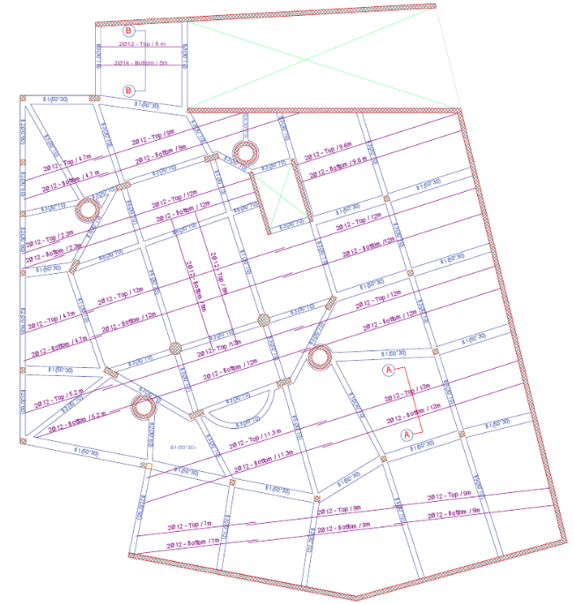
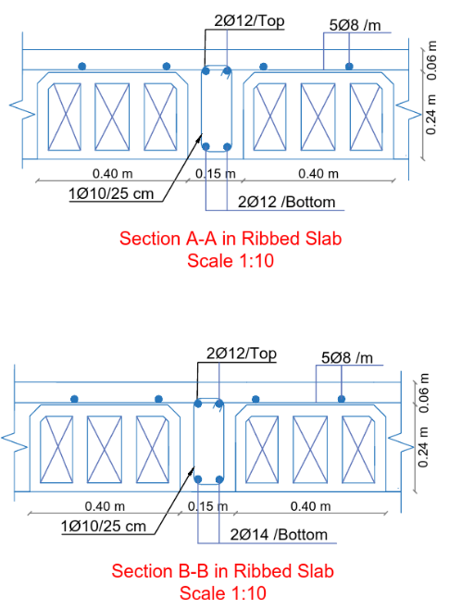
4.6 Reinforcement (Slab):
Block one

Slide 43
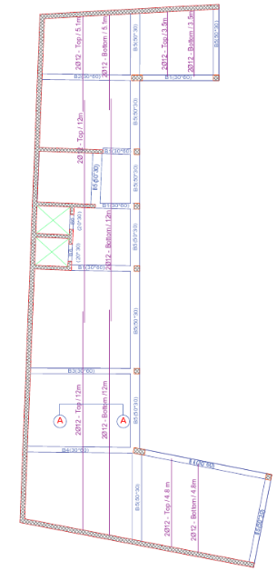
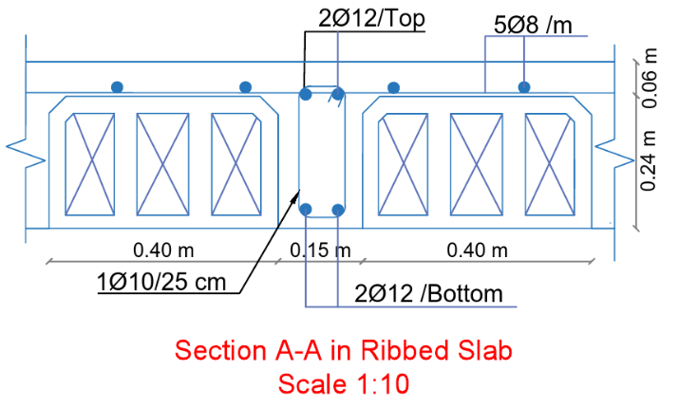
4.6 Reinforcement(Slab):
Block two

Slide 44
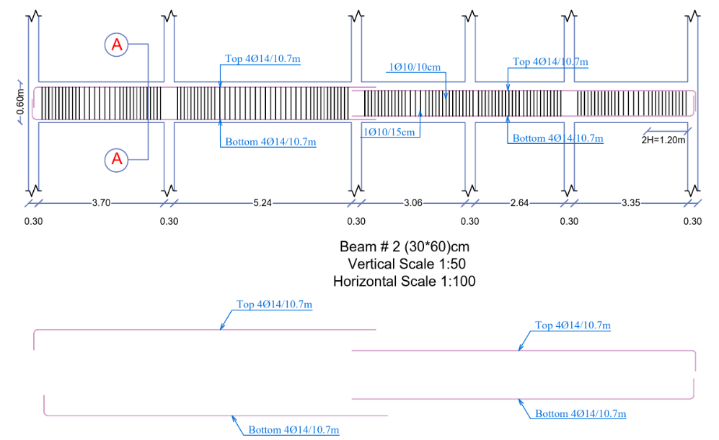
4.6 Reinforcement (Beam):

Slide 45
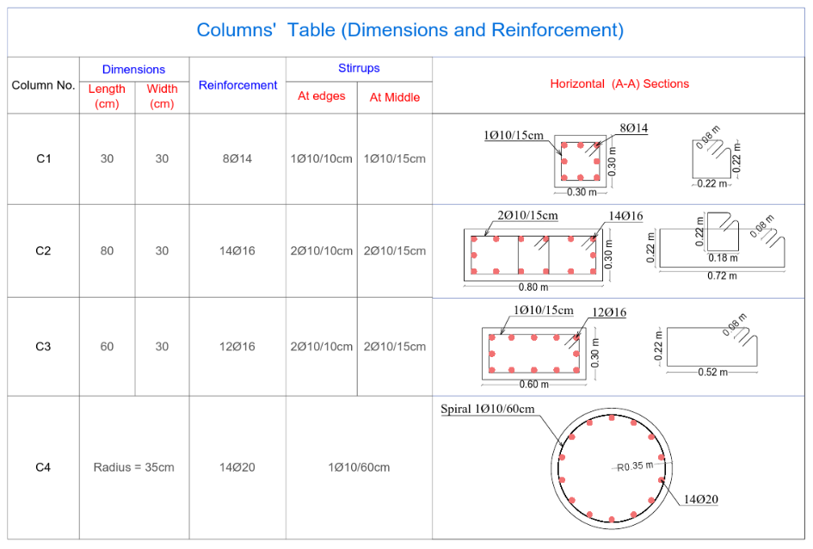
4.6 Reinforcement(Columns):

Slide 46

4.6 Reinforcement(Columns):

Slide 47


4.6 Reinforcement(Footing):

Slide 48


4.6 Reinforcement(Footing):

Slide 49

4.6 Reinforcement(Retaining Wall):

Slide 50


4.6 Reinforcement(Shear walls & Minaret):

Slide 51


4.6 Reinforcement(Stairs):

Slide 52
5. Environmental
Design:

Slide 53


5.1 Solar Analysis:
In a Summer Day:
Building Shadow at 8:00 am on 21/6
Building Shadow at 2:00 pm on 21/6

Slide 54


5.1 Solar Analysis:
In a Winter Day:
Building Shadow at 8:00 am on 21/1
Building Shadow at 2:00 pm on 21/1

Slide 55

5.1 Solar Analysis:
Solar Chimney in minaret :

Slide 56

5.2 Daylight factor:

Slide 57

5.3 Heating and cooling calculations:
Part | U value before (W/m².K) | U value after (W/m².K)
External walls | 2.435 | 0.445
Floor | 1.042 | 0.452
Roof | 2.970 | 0.472
Window | 5.879 | 1.493
U-value Improvements:
External wall Section (Not to scale)

Slide 58
5.4 Heating and Cooling Load:
The prayer hall and mezzanine and Library have a Cooling capacity = 22.7 kw
The prayer hall and mezzanine and Library have a Heating capacity = 21.1 kw

Slide 59

5.5 Thermal Comfort:

Slide 60


5.6 Energy Consumption(Site Energy/ m2):
Energy per Total Building Area in in old one was 136 while in new design is 110.72 which is good for worship building.
New Design
Old Design

Slide 61


5.7 Total discomfort hours:
The comfort in new design is Better than comfort in old one
New Design
Old Design

Slide 62

5.8 Acoustical analysis (RT60):
Pray Hall:
- Old design (empty space) :
The recommended reverberation time (RT60) shall be from 1.2 to 2 seconds.
RT60 at 125 Hz=0.95 s
RT60 at 250 Hz=0.85 s
RT60 at 500 Hz=0.61 s
RT60 at 1000 Hz=0.54 s
- New design (empty space):
RT60 at 125 Hz=2.10 s
RT60 at 250 Hz=1.97 s
RT60 at 500 Hz=1.65 s
RT60 at 1000 Hz=1.20 s

Slide 63
5.8 Acoustical analysis (RT60):
Pray Hall:
- Old design (Full space) :
The recommended reverberation time (RT60) shall be from 1.2 to 2 seconds.
RT60 at 125 Hz=1.14 s
RT60 at 250 Hz=0.85 s
RT60 at 500 Hz=0.74 s
RT60 at 1000 Hz=0.69 s
- New design (Full space):
RT60 at 125 Hz=2.17 s
RT60 at 250 Hz=1.52 s
RT60 at 500 Hz=1.35 s
RT60 at 1000 Hz=1.38 s

Slide 64


5.9 Acoustical analysis (STC):
Pray Hall:
STC shall be from45-55 dB to avoid unwanted noise in space
STC = 51 db

Slide 65


5.9 Acoustical analysis (IIC):
Pray Hall:
STC shall be from50-52 dB
IIC = 50

Slide 66



Loudspeakers :
10 Loudspeaker in pray hall needed

Slide 67
5. Mechanical
Design:

Slide 68

6.1 Water Supply System:

Slide 69

6.2 Water Tanks:
Vertical = steel pipe
Horizontal = UPVC pipe
Branch = UPVC pipe

Slide 70

6.3 Drainage Systems design:

Slide 71

6.4 HVAC System Design:
In the new design there is a split air unit for HVAC system while in old design there was no HVAC system
The prayer hall and mezzanine and Library have a cooling capacity 22.7 kw/hr , Which equal 6 ton
Design capacity Cooling (Kw) | Design capacity Heating (Kw)
22.7 | 21.1
Use 4 split unit each unit 2 ton in pray hall and 2 ton in the library .

Slide 72

6.5 HVAC System Design :

Slide 73
7. Electrical
Design:

Slide 74

Basement floor socket:

Slide 75

Basement floor lighting Plan:

Slide 76

Pray Hall socket :

Slide 77

Pray Hall lighting Plan :

Slide 78

Luminaires:
New main luminaire in parking

Slide 79


Luminaires:
New main luminaire in pray hall

Slide 80

3D Rendering View:

Slide 81


Pray Hall calculation :
UGR = 16.3<19 OK
Required illuminance
400 lux
Required uniformity
(>0.60)
Average Illuminance 582 Lux

Slide 82
Power Consumption Estimation:
Type | consumption (Kw/day ) | cost (Nis/day ) | Cost (Nis/month)
lighting | 47.60 | 34.27 | 1030
appliance | 12 | 8.64 | 259.2
AC | 0 | 0 | 0
total | 59.60 | 42.91 | 1289.2
Type | consumption (Kw/day ) | cost (Nis/day ) | Cost (Nis/month)
lighting | 46.12 | 33.21 | 996.3
appliance | 13.54 | 9.748 | 292.46
AC | 32 | 23.04 | 691.2
total | 91.665 | 65.9988 | 1979.964
Old Electricity Consumption Estimation
New Electricity Consumption Estimation

Slide 83


Emergency Fire Protection System:

Slide 84
8.Quantity & Cost
Estimation:

Slide 85
Cost Estimation:
Al-Qassas Mosque | Total Cost
Total project cost | ILS1,691,141
Structure work | ILS1,346,833
Mechanical Work | ILS 78,821
Finishing Work | ILS150,868
Electrical Work | ILS114,620
The total cost of the project is 331,597 JD, And the unit cost is 390 JD/M2

Slide 86
Thank You

