Slide 1
The Analysis And Design Of Beit Furik Water Supply Network
Graduation project II
Prepared by: Miriam Tamim
Yamama Mlitat
Under supervision of: Dr. Anan Jayyousi

Slide 2
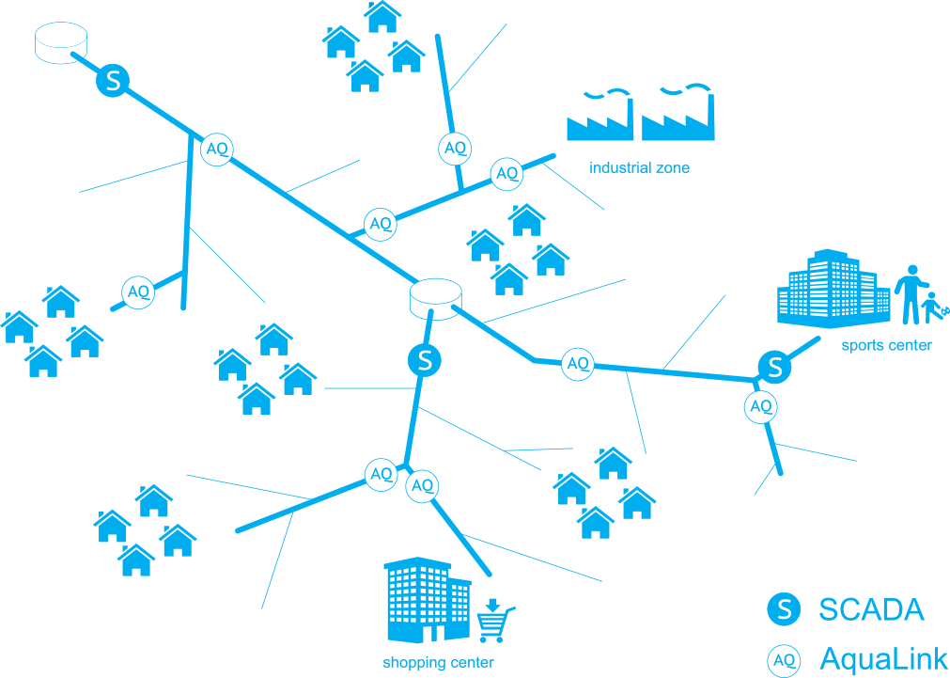
Introduction

Slide 3
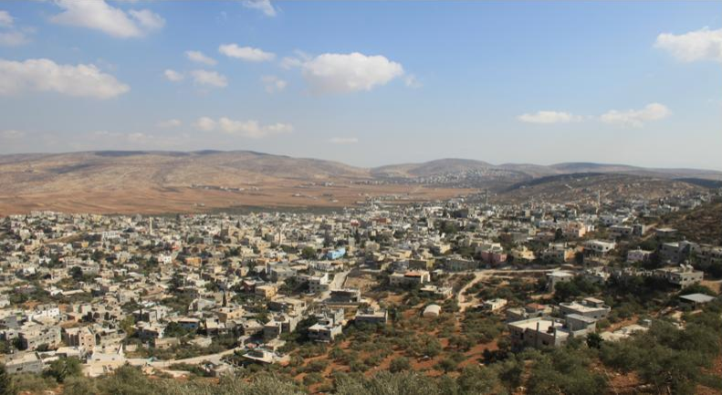
Study Area: Beit Furik

Slide 4
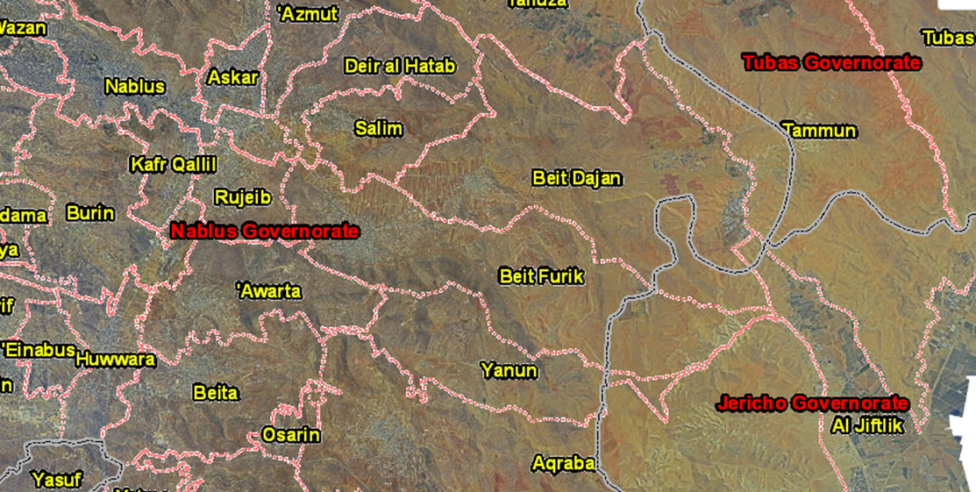
Location: Beit Furik is a Palestinian town in Nablus Governorate, located approximately 7 km south east of Nablus City.

Slide 5
Area: The total area is 36663 dunums, while the area of ​​the approved master plan is 4658.36 dunums.
Population: According to PCBS-2017, it had a population of 13,477 inhabitants.

Slide 6
Water service provider: Joint Services Council with Beit Dajan as well as private sources.
Main water source: One permanent source of water (Beit Furik artesian well). Provided to citizens through the public water network established in 2009.

Slide 7
Questionnaire Results
The average daily per capita water consumption is 62.28 liters.
Beit Furik is divided into eight regions, where the municipality provides each region (on average) with water every 5-10 days for approximately 3 hours.
Approximately 87% of our sample stated that they order water tankers.

Slide 8
Questionnaire Results

Slide 9
Preparation of the input file for waterCAD
AutoCad file of existing network
To
DXF files
Inserted to
WaterCad
Draw
Pipes
Nodes
Reservoir
-Diameter
-Material (C_{HW} )
-Length
-Elevation
-Demand
-Total Head

Slide 10
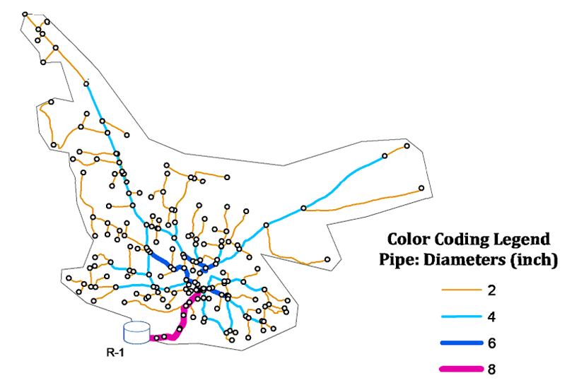
Existing Water Network

Slide 11
Problems of existing water network:
Intermittent Supply
Lack of water resources & inadequacy of water supply
Difficulty of water access to some citizens

Slide 12
Network Analysis Results

Slide 13
For future considerations, the following assumptions were made:
Design period = 20 years
Domestic consumption for Beit Furik citizens = 100 L/c-d
Physical losses =15%
Domestic consumption = 90% of total municipal consumption
The future designed network will provide continuous supply of water
The Palestinian hourly pattern was used in the design
The recommended values of velocity are (0.3 -3) m/s and the recommended pressure values are (15-100) mH2O

Slide 14
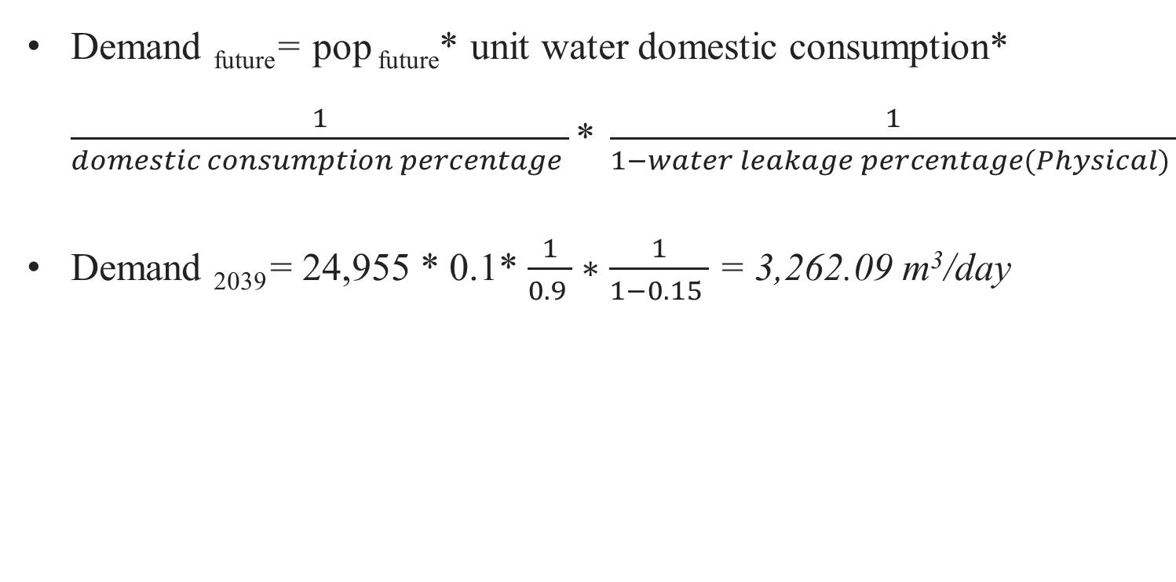
Demand _{future}= pop _{future}* unit water domestic consumption* $\frac{1}{domestic consumption percentage }\text{*} \frac{1}{1−water leakage percentage(Physical) }$
Demand ₂₀₃₉= 24,955 * 0.1* $\frac{1}{0.9 }∗\frac{1}{1−0.15 }$ = 3,262.09 m³/day

Slide 15
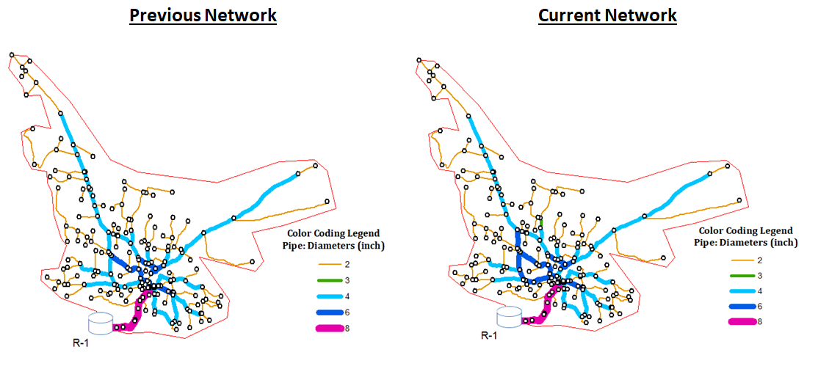
Alternative I (Business as usual)

Slide 16
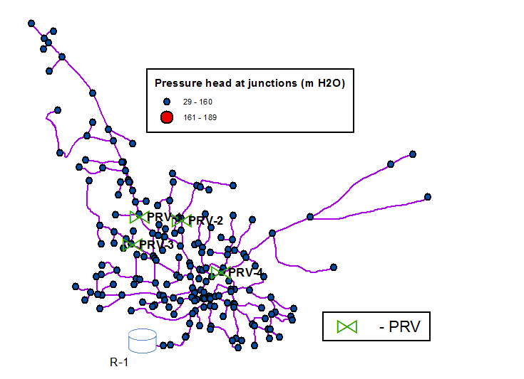
Alternative I (Business as usual)

Slide 17
Alternative I (Business as usual)

Slide 18
Alternative I Setbacks
High Pressure Head
Fittings damage
High leakage & wasted water
More maintenance
Expulsion of pipes

Slide 19
Pressure Zone Definition
Pressure zone is an area bounded by a lower and upper elevation, all of which receives water from a given reservoir and it is usually used when having an elevation difference of more than 120m.

Slide 20
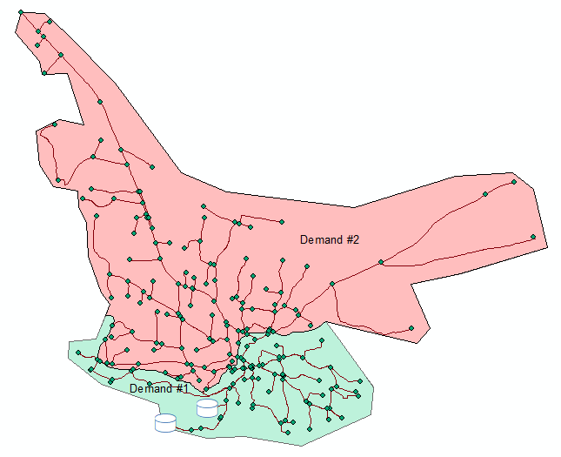
Alternative II(Pressure Zoning)
Existing Reservoir
648 m AMSL
New Reservoir
555m AMSL
535m AMSL
Separation Level
458 m AMSL
Lowest Node

Slide 21
New reservoir location was selected based on these factors:
Must be set at an elevation intermediate the elevation difference between the lowest and highest spots in the network
To be placed in an empty area of 0.5 dunums
To be close to the roads network

Slide 22
Alternative II(Pressure Zoning)
Existing Reservoir
648 m AMSL
New Reservoir
555m AMSL
535m AMSL
Separation Level
458 m AMSL
Lowest Node

Slide 23
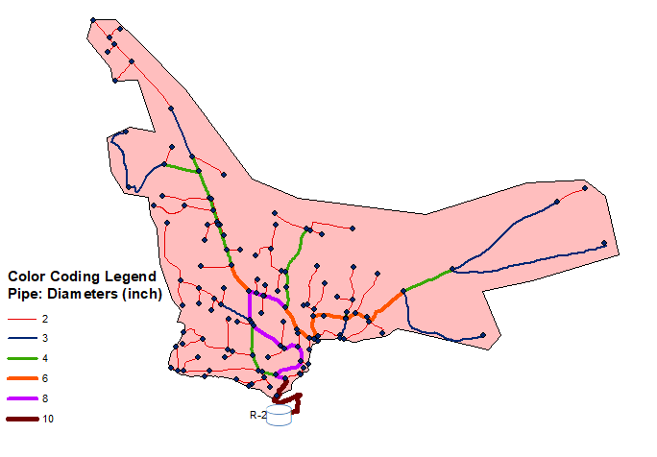
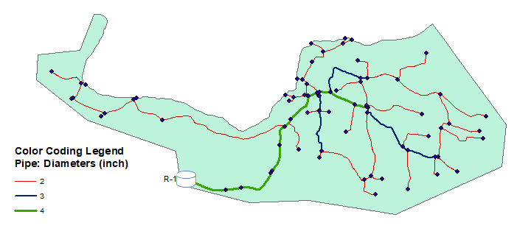
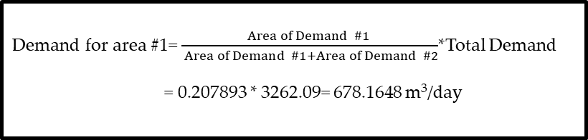
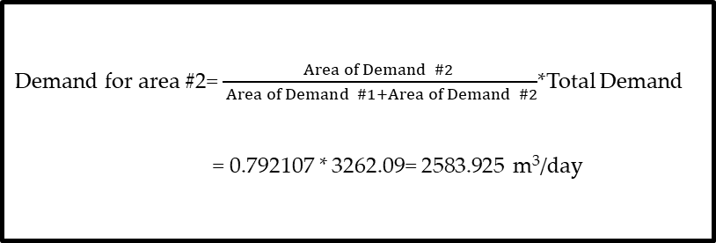
Demand for area #2= $\frac{Area of Demand \#2 }{ Area of Demand \#1+Area of Demand \#2}$*Total Demand
= 0.792107 * 3262.09= 2583.925 m³/day
Demand for area #1= $\frac{Area of Demand \#1 }{ Area of Demand \#1+Area of Demand \#2}$*Total Demand
= 0.207893 * 3262.09= 678.1648 m³/day

Slide 24
Alternative II(Pressure Zoning)

Slide 25
New Reservoir Size

Slide 26
Business As Usual
Pressure Zoning

Slide 27
Cost Consideration
Business As Usual
Pressure Zoning

Slide 28
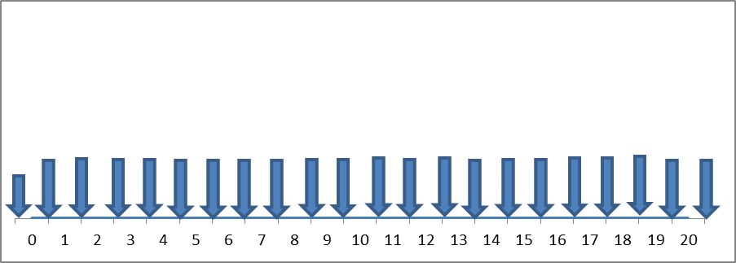
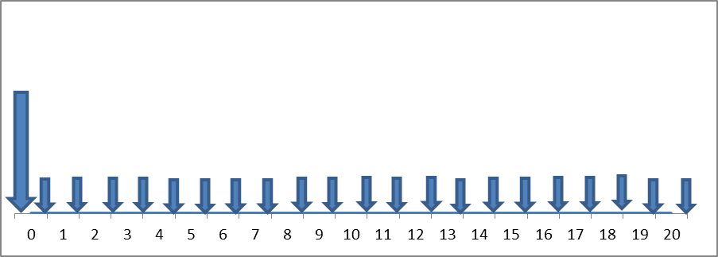
Cost Consideration
Business As Usual
Pressure Zoning
P= 107,964 $
P= 930,074 $
A= 130,399 $
A= 81,242.7 $

Slide 29
Conclusion
Pressure zoning is recommended for Beit Furik for these reasons:
Elevation difference more than 120 m (which is 190 m)
40% energy and cost saving
Lower mainenance costs & better management

Slide 30
Thank you for listening ☺

