Slide 1

An-Najah National University
Faculty Of Engineering
Material &Chemical Engineering Department
Graduation Project 2
Descaling of cooling tower and corrosion protection
Prepared by:
Dina Faidi
Haneen Madina
Muna khader
Taqwa Hariri
Supervision of Dr. Husni Odeh

Slide 2
OUTLINE
Introduction
Objective
Methodology
Chemical Analysis
Instrumental Analysis
Results
Feasibility Study
Conclusion

Slide 3
What is the problem ?
The main problem that scaling in cooling tower system in Aziza Company .

Slide 4
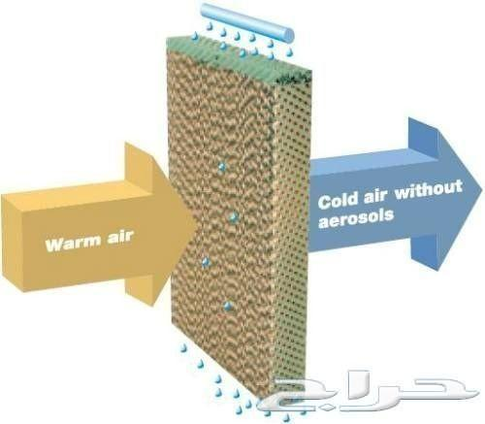
Principle of cooling tower:

Slide 5
The aim of this project:
To find solutions to mitigate scale formation and corrosion encountered in cooling towers
To understand the formed deposits

Slide 6
Description of aziza poultry farms
The farm contains 4 chicken indoor farms each of them has a width=14 m, it’s length= 111m and the height=3.5 m.
Each farm contains 2 sidewalls of cooling ,it’s height =180 cm and it’s length=18 m
12 suction fans
The source of water
Water has collected from arestian wells in auja area
The amount of water is used daily =90-1000cup
Cleaning and maintainance when the farm is evacuated

Slide 7
Analysis to know what is the deposited salt
Icp
XRD
Flame photometer
Ph meters

Slide 8
Methodology
Visit the website of Aziza Company
To see the problem are experiencing on the ground .

Slide 9
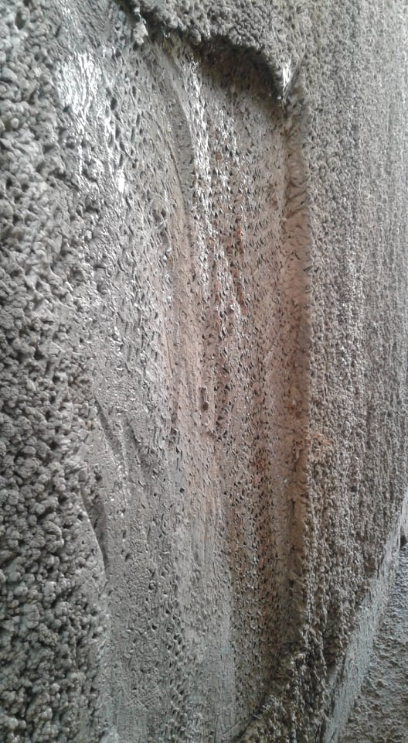
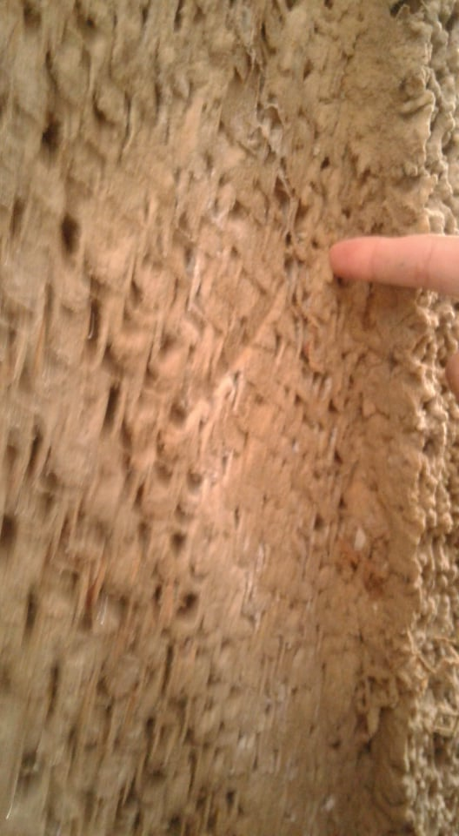
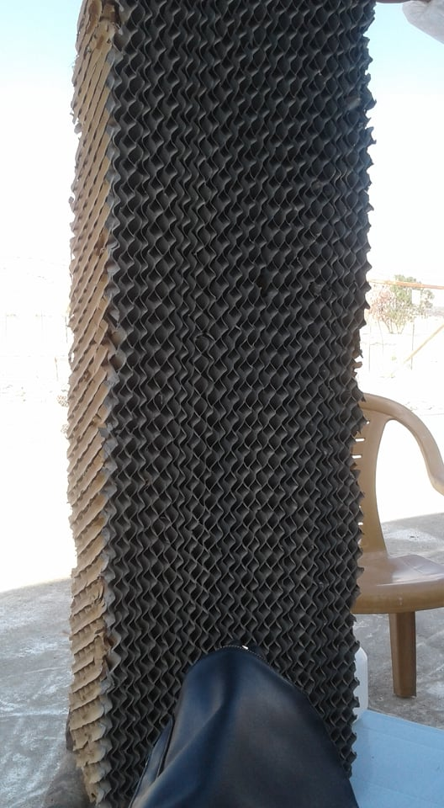

Slide 10
Methodology
Research Methodology :
Descaling of cooling tower and corrosion protection project began with searching in scientific articles and several journals for how to What are the causes of the problem of the scaling in the cooling tower and how to get rid of the scaling on the cooling towers and have been studied many scientific articles.

Slide 11
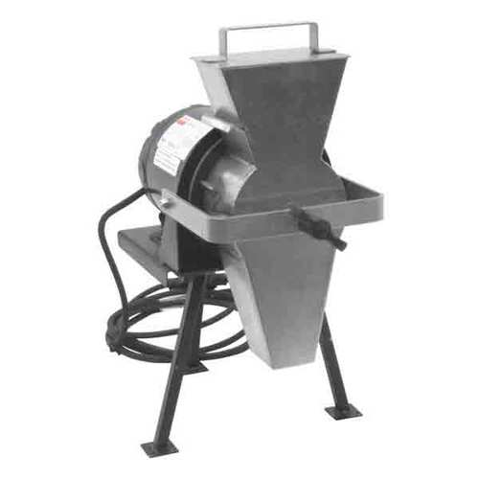
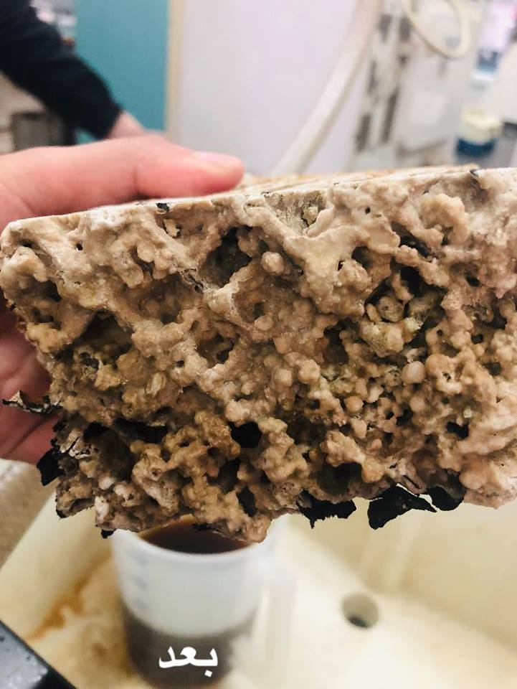
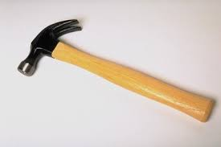
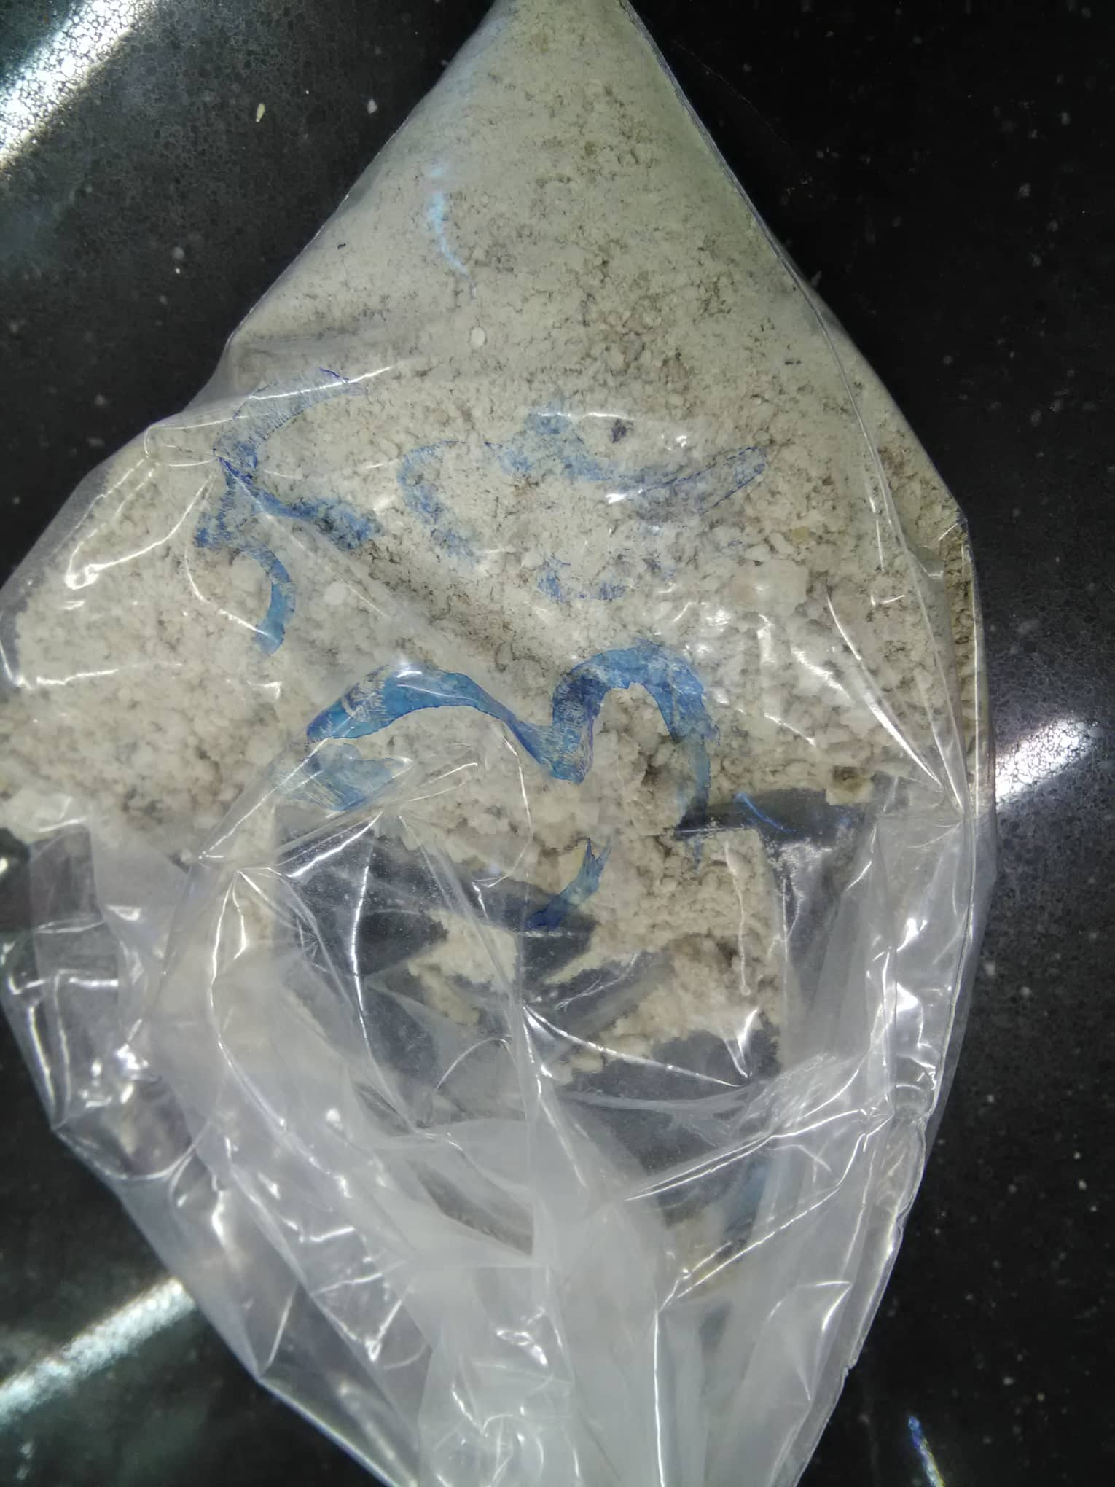
Methodology
Sampling :
1-Solid Sample
Using Hummer to cut and Graind it
Soil Grinder to transfer it to powder
Solid powder sample
Species of cooling tower conation scaling

Slide 12
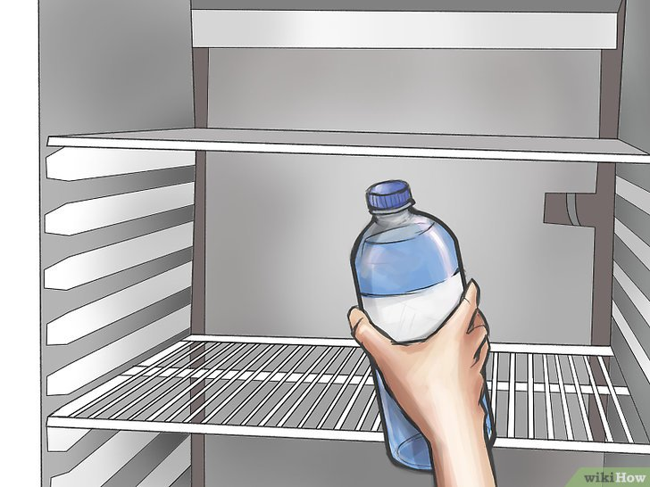
Methodology
Sampling :
2-Liqued water Sample

Slide 13
Methodology
Sample Analysis :
1-Chemical Analysis.
2-Instrumental Analysis.

Slide 14
Experimental Part
In last semester was made:
Acidulation experiments:
Determine amount of scaling remove by used Citric acid
Determine amount of scaling remove by used Acetic acid
Base experiments:
Determine amount of scaling remove by used Sodium phosphate solution

Slide 15
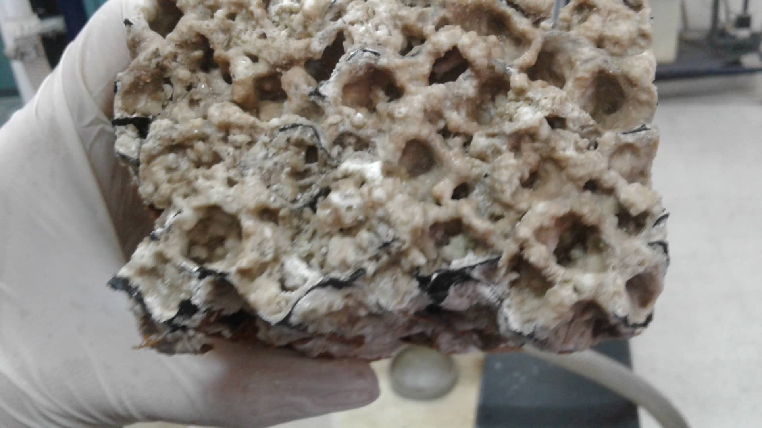
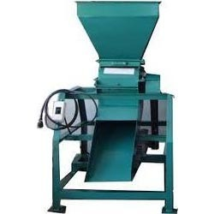
Experimental Part
Determination Check amount of sodium using a flame photometer
cooling tower
Broke the scale from it by use Hammer
grinded it by the soil grilling machine

Slide 16
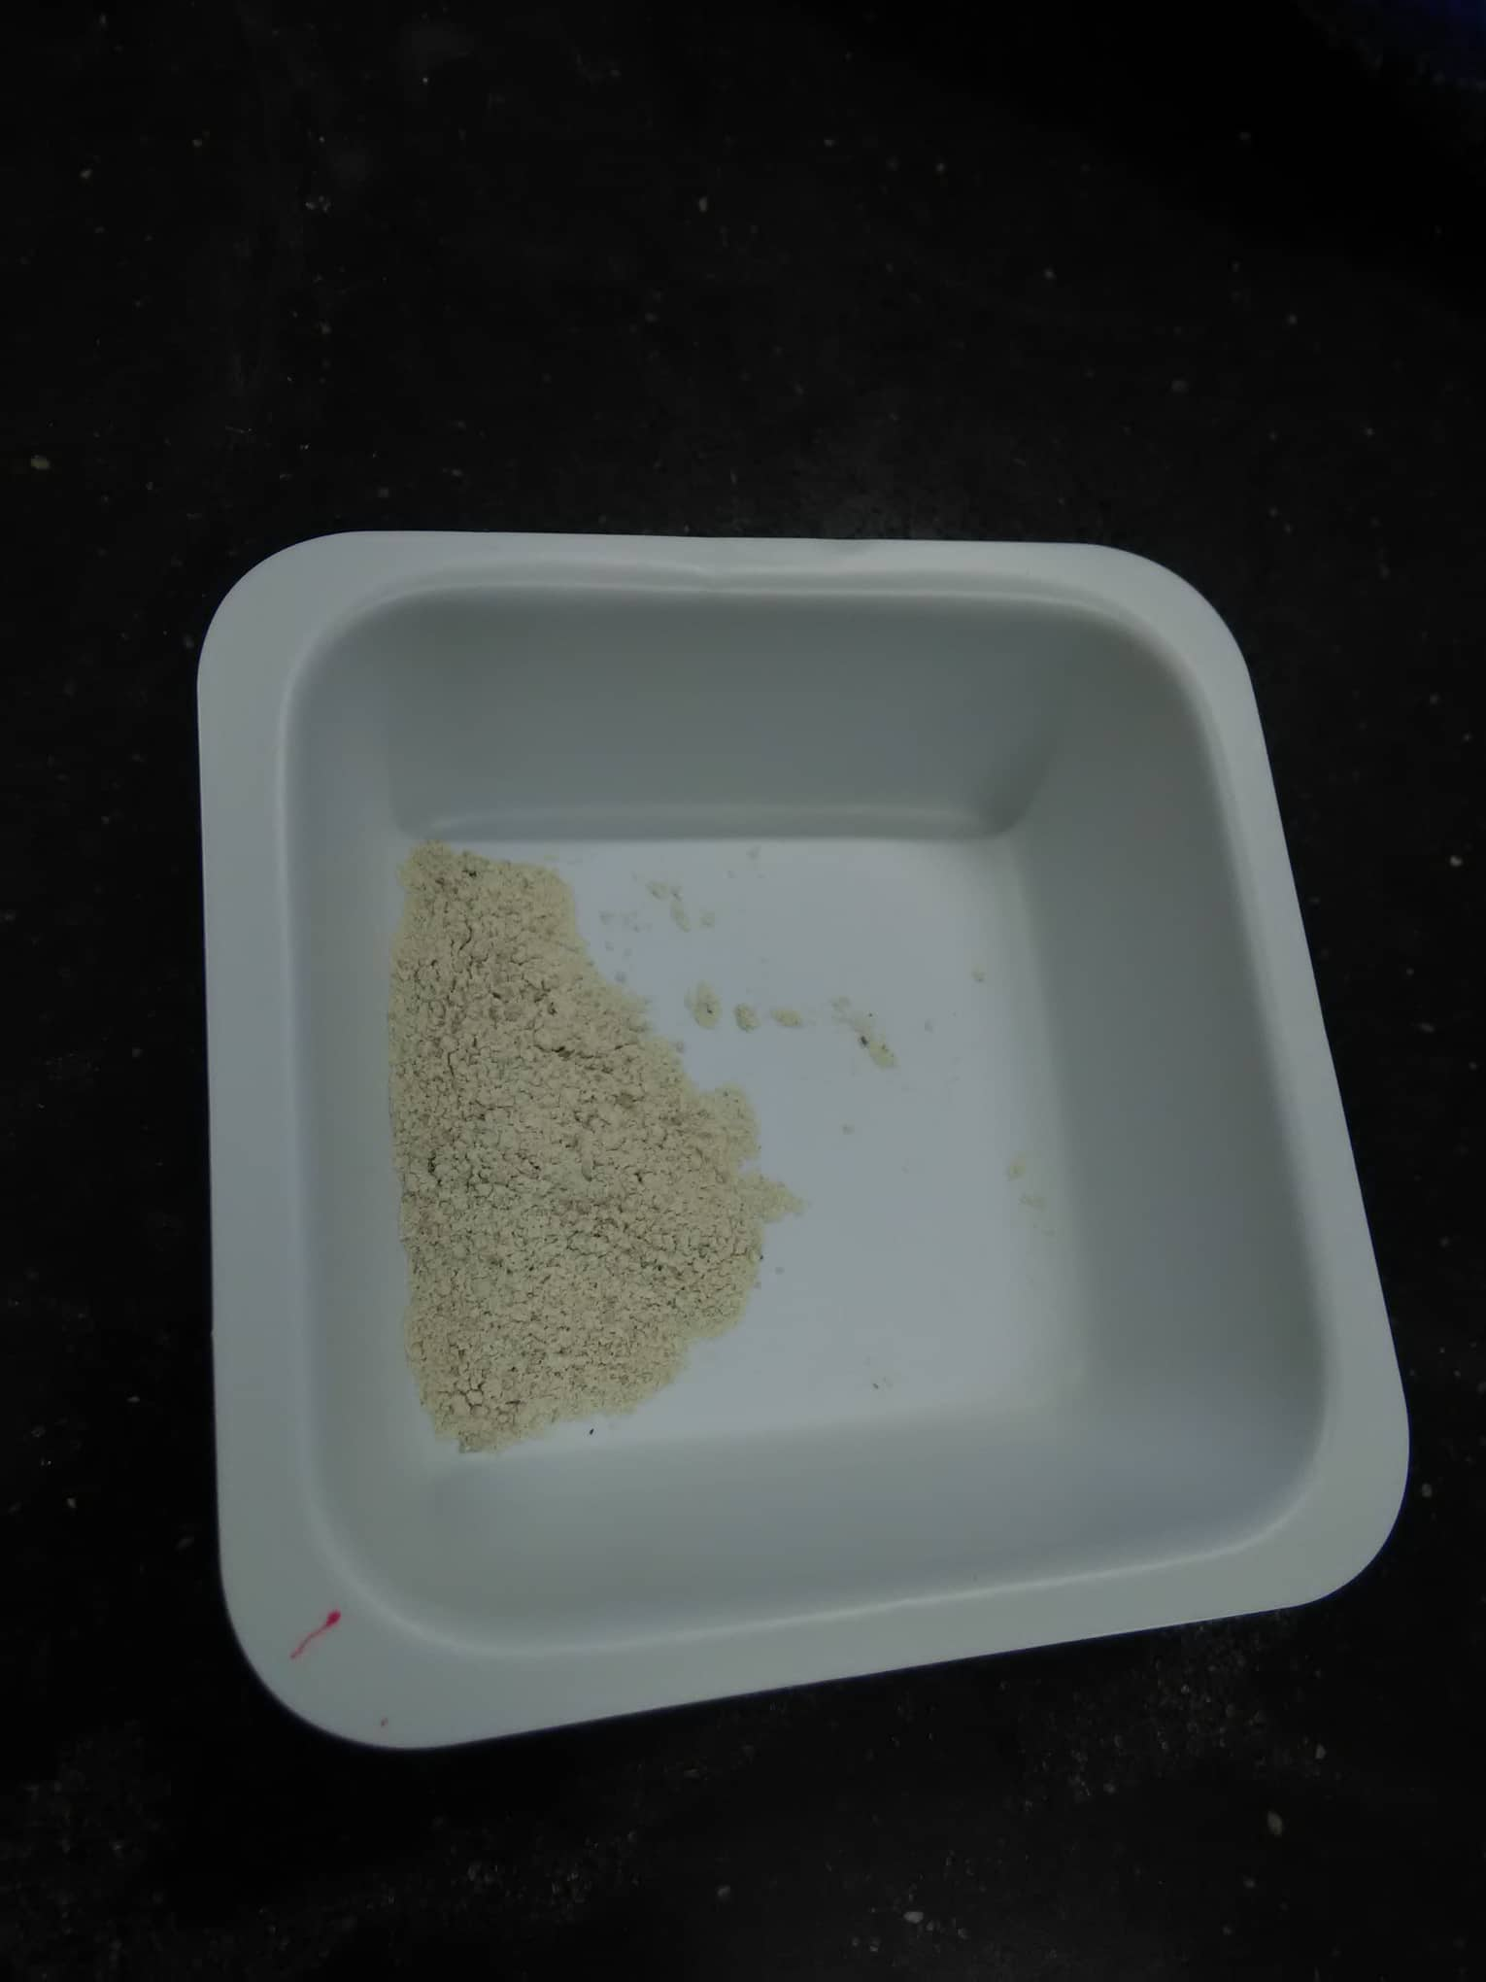
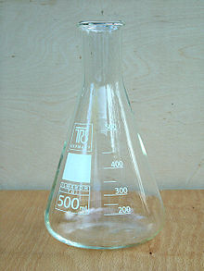
Experimental Part
Determination Check amount of sodium using a flame photometer
1.004 gr of the grinded scale sample
grinded scale sample
1 ml HNO₃
Distillated water to 1000ml

Slide 17
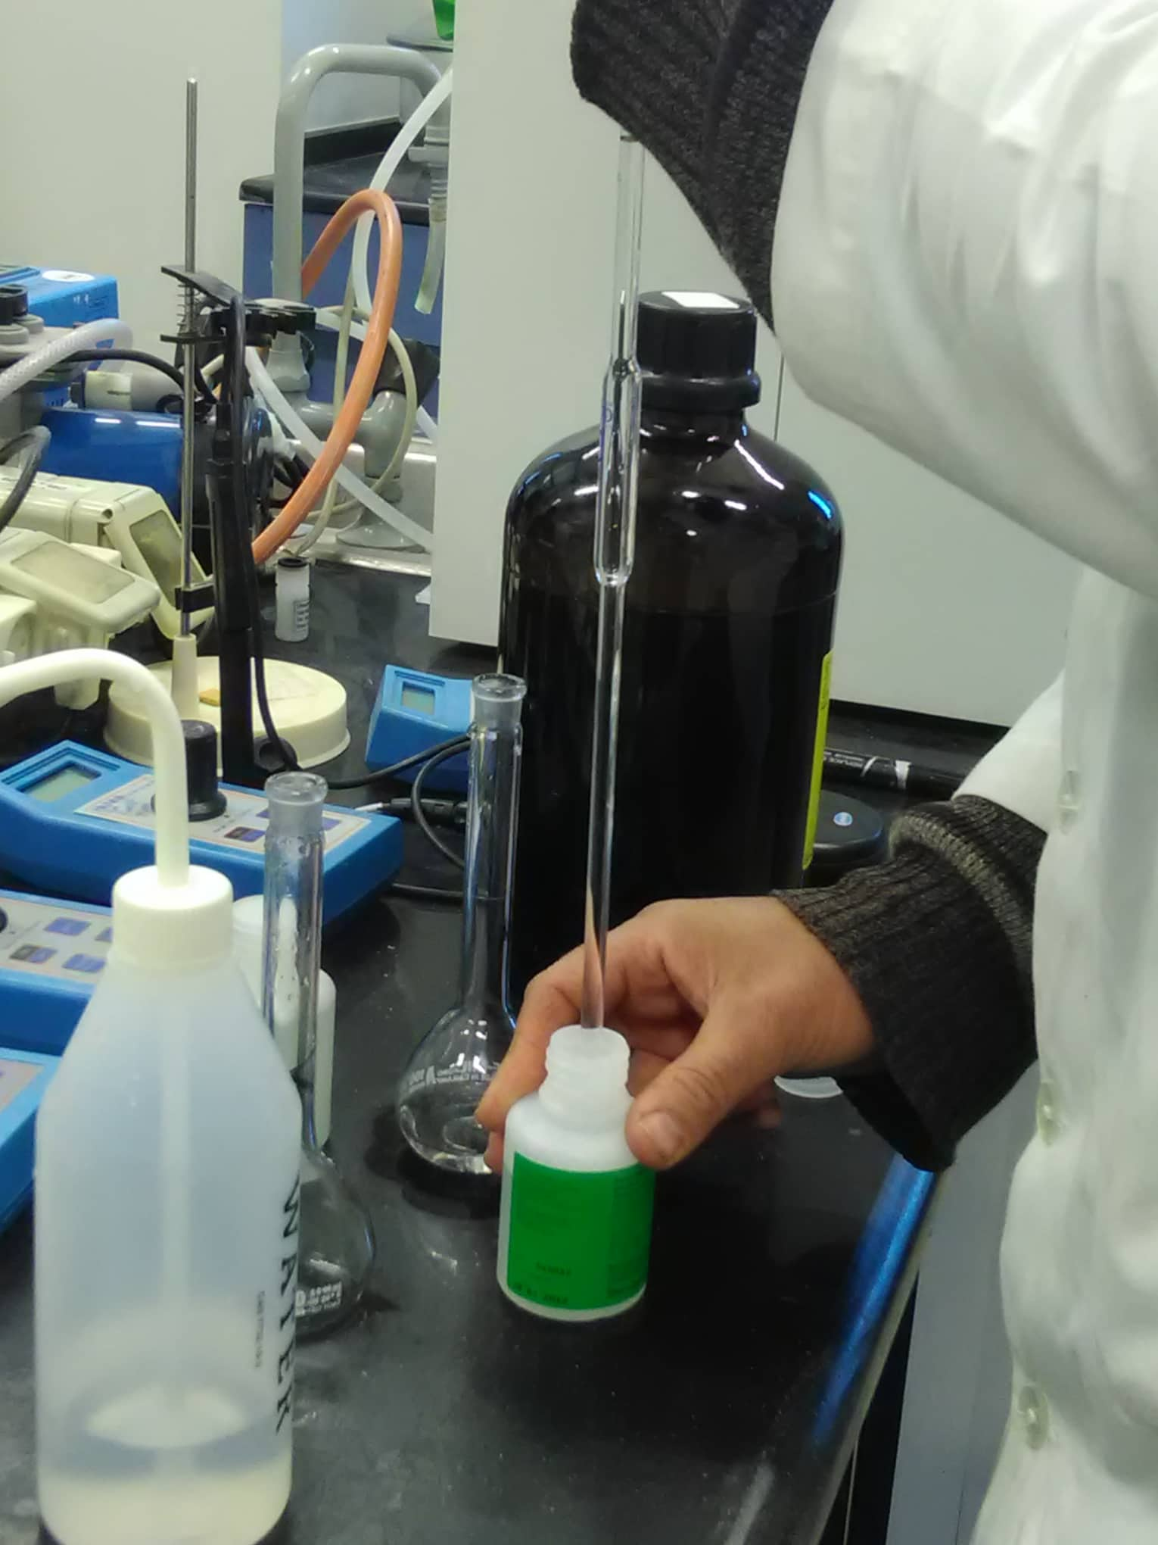
Experimental Part
Determination Check amount of sodium using a flame photometer
Standard solution of sodium 1000 ppm
10 ml of standard solution

Slide 18
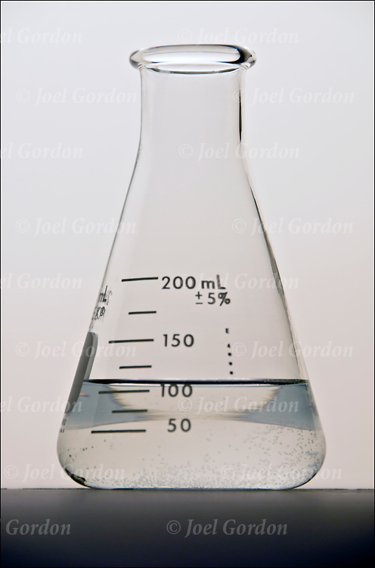
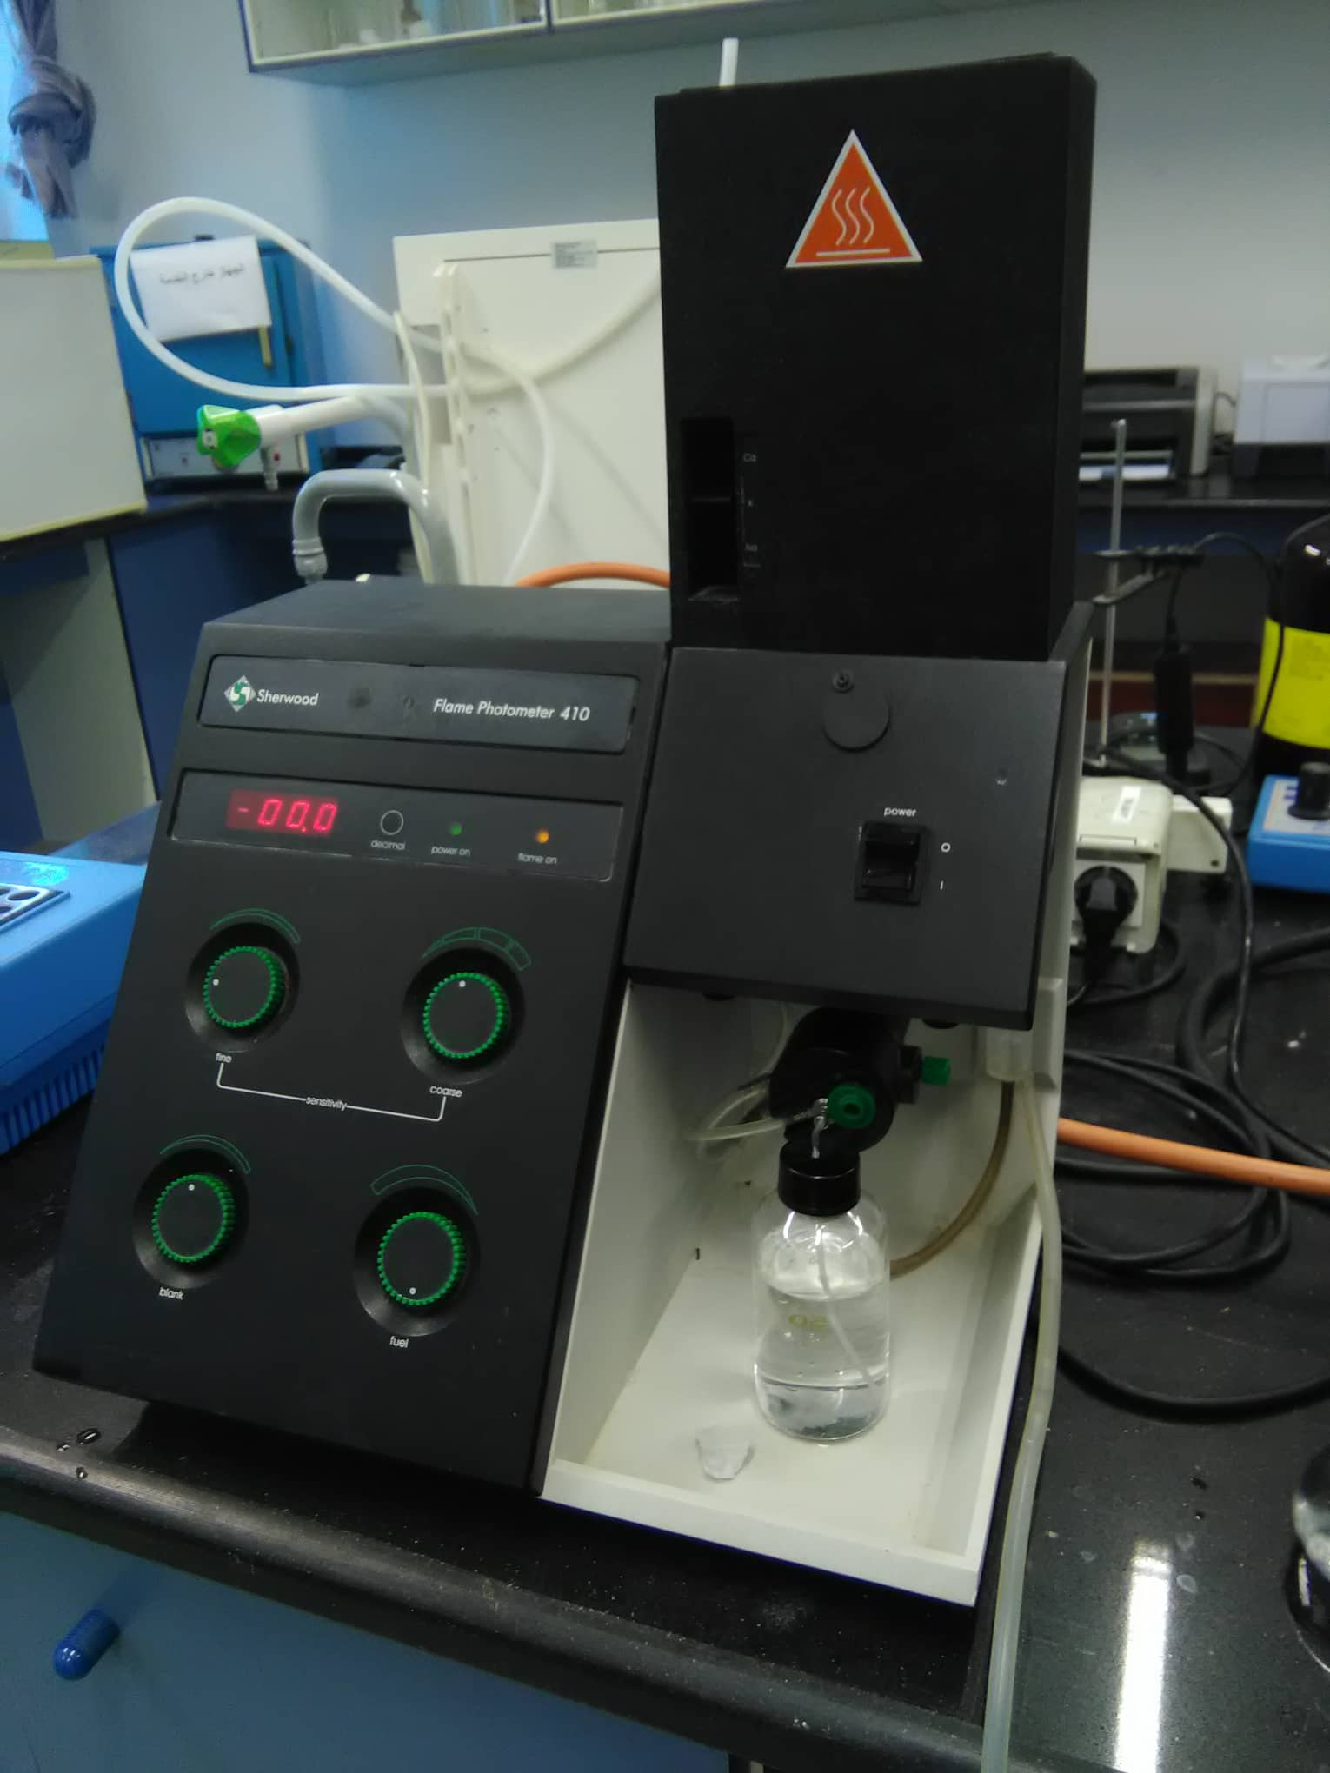
Experimental Part
Determination Check amount of sodium using a flame photometer
10 ml Sodium stock standard solution
Flame photometer become yellow
wire out of the device

Slide 19
Experimental Part
Determination Check amount of sodium using a flame photometer
10 ml Sodium sample solution
Flame photometer become yellow
wire out of the device

Slide 20
Experimental Part
Determination Check amount of Potassium using a flame photometer
cooling tower
Broke the scale from it by use Hammer
grinded it by the soil grilling machine

Slide 21
Experimental Part
Determination Check amount of Potassium using a flame photometer
1.004 gr of the grinded scale sample
grinded scale sample
1 ml HNO₃
Distillated water to 1000ml

Slide 22
Experimental Part
Determination Check amount of Potassium using a flame photometer
10 ml of standard solution
Standard solution of Potassium 1000 ppm

Slide 23
Experimental Part
Determination Check amount of Potassium using a flame photometer
10 ml Potassium stock standard solution
Flame photometer become Blue
wire out of the device

Slide 24
Experimental Part
Determination Check amount of Potassium using a flame photometer
10 ml Potassium sample solution
Flame photometer become Blue
wire out of the device

Slide 25
Experimental Part
Determination amount of Organic compounds
cooling tower
Broke the scale from it by use Hammer
grinded it by the soil grilling machine

Slide 26
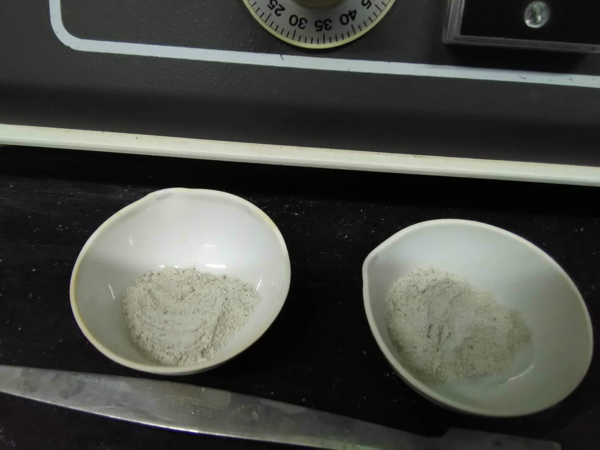
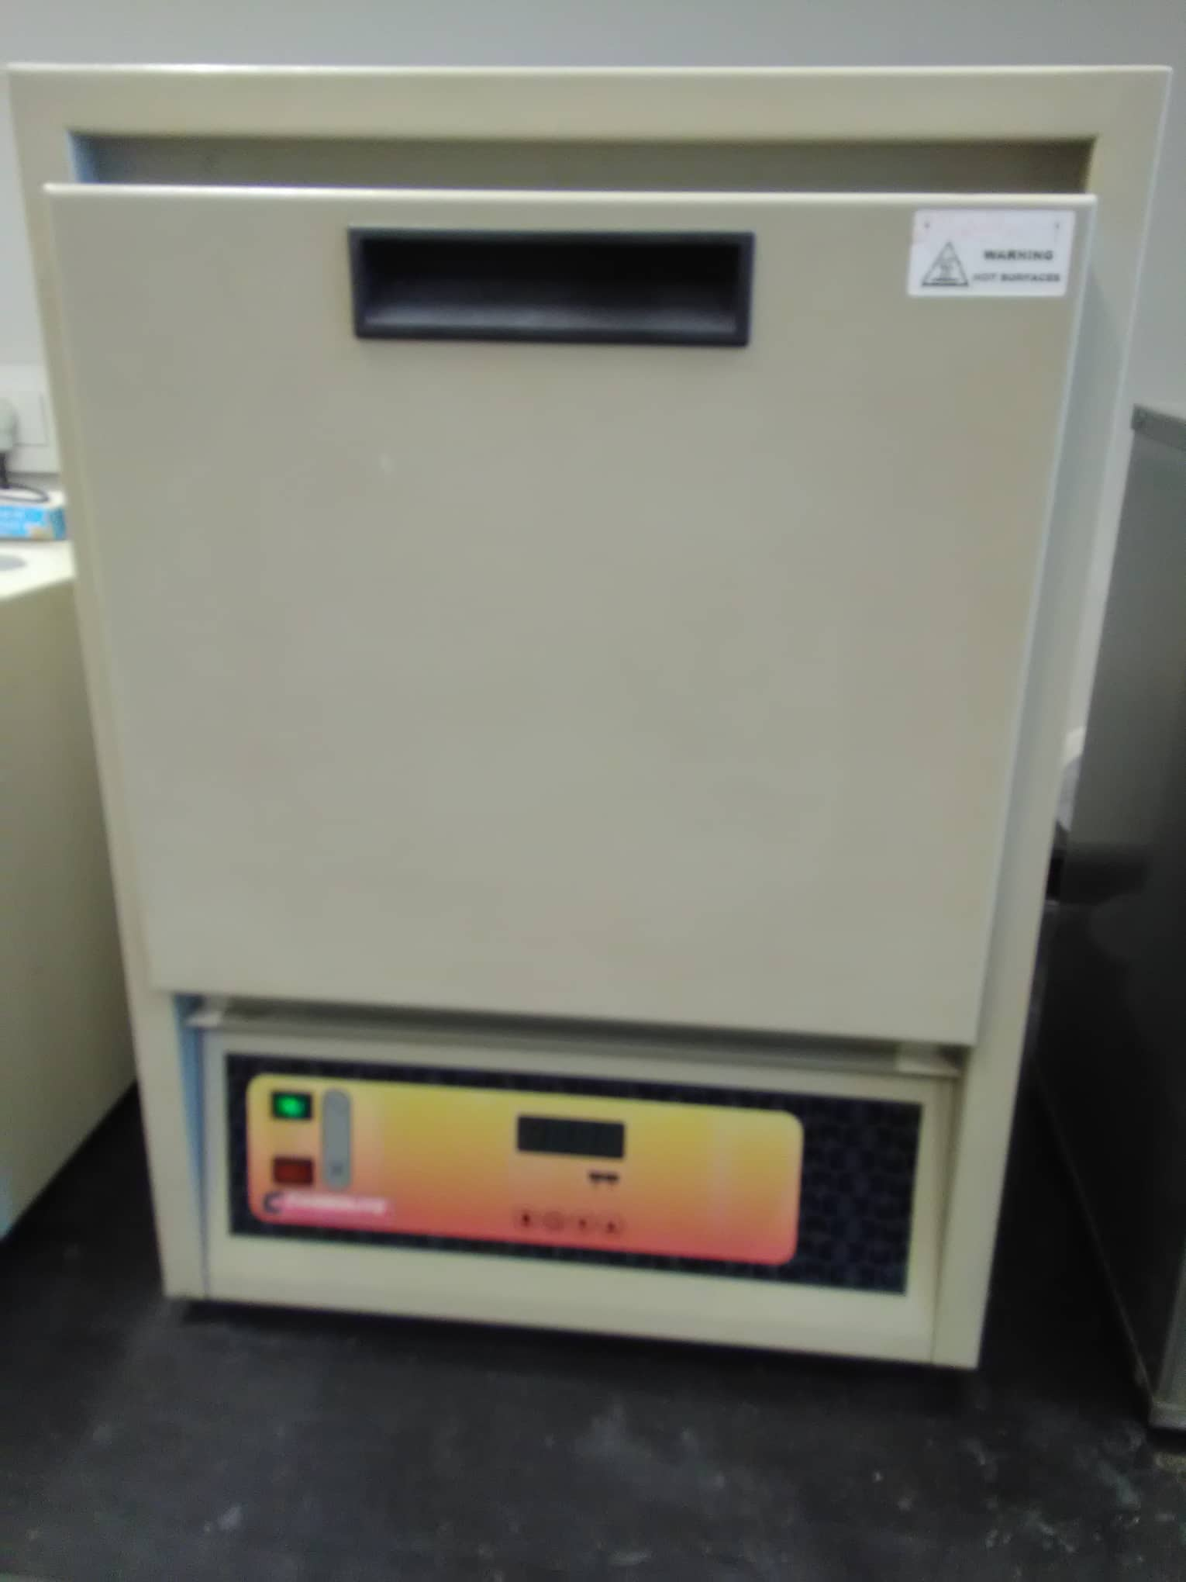
Experimental Part
Determination amount of Organic compounds
5 gr of each two samples
Placed both in the furnace for 2hr and 500ºC

Slide 27
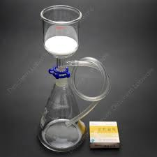
Experimental Part
Determination amount of Organic compounds
One of two samples was weighted
100 ml of water
The sample was filtered
One of two samples was weighted

Slide 28
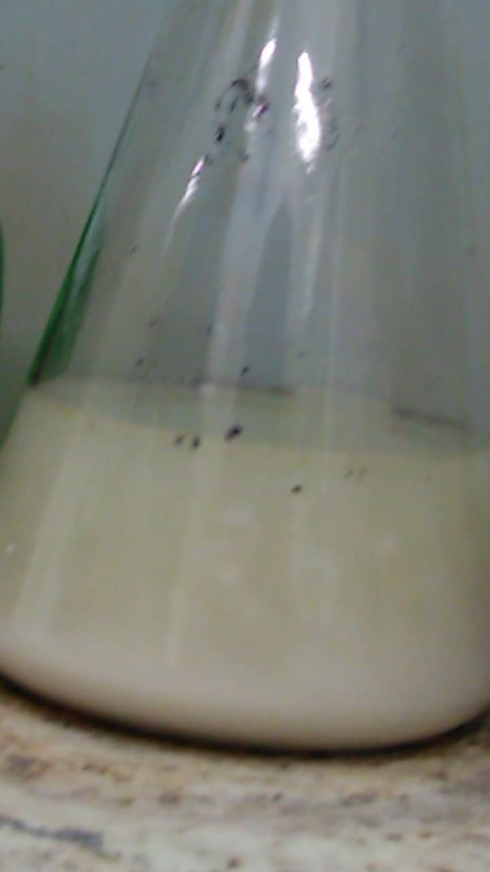
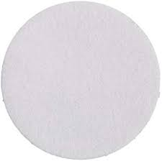
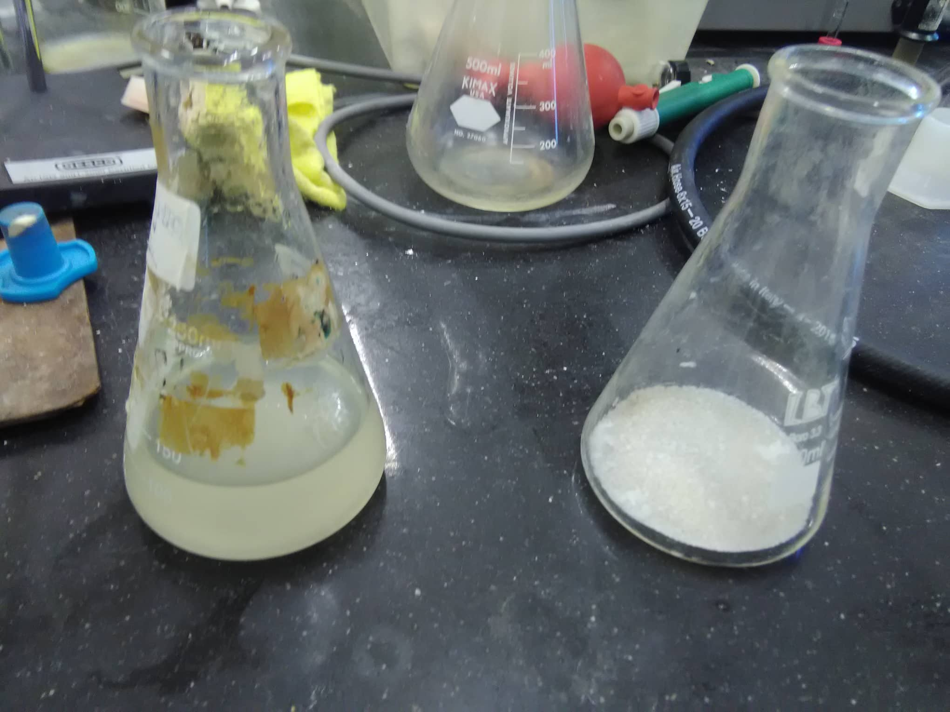
Experimental Part
Determination amount of Organic compounds
water remains after filtration used for another test
filter paper was weighed

Slide 29
Experimental Part
Determination amount of Organic compounds
Filter Paper was weighted
Filter Paper was weighted after cooled
Placed it in the furnace for 20min and 500ºC

Slide 30
Experimental Part
Determination amount of Organic compounds
20 ml of water
1ml of HNO₃ (68%)
1ml of H₂SO₄ (99.9%)
anther of two samples was weighted
another of two samples

Slide 31
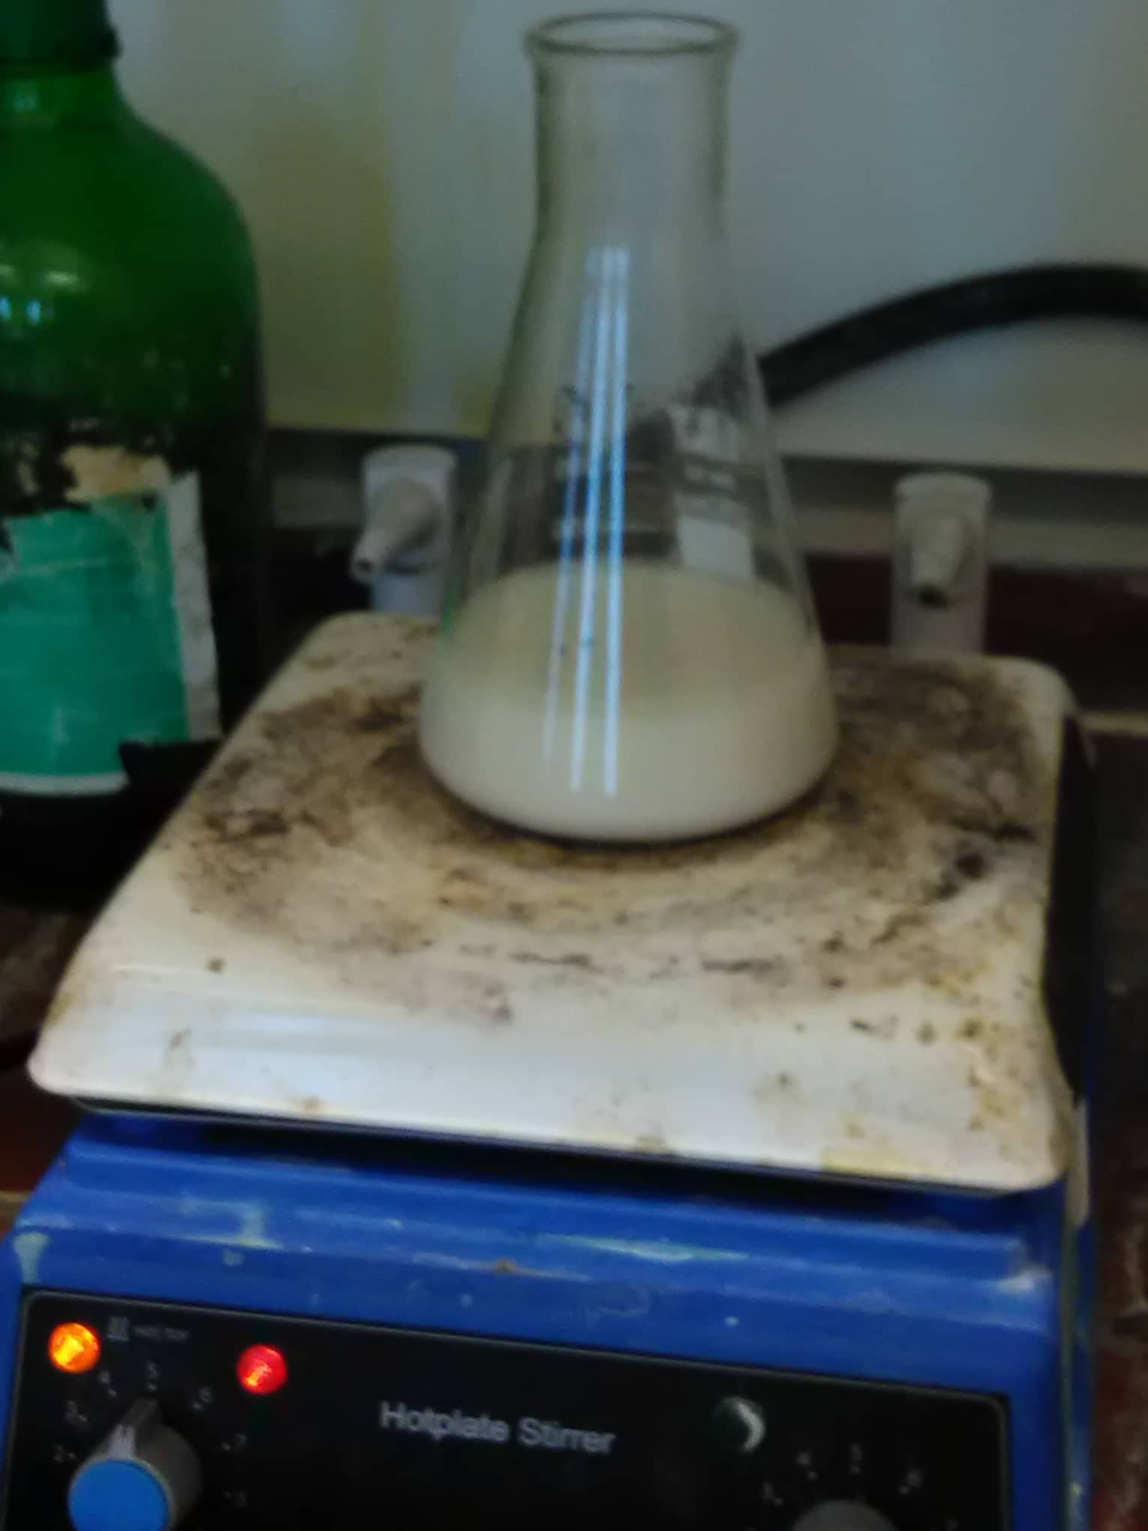
Experimental Part
Determination amount of Organic compounds
Heated to form a transparent layer.
The sample was filtered

Slide 32
Experimental Part
Determination amount of Organic compounds
water remains after filtration used for another test
filter paper was weighed

Slide 33
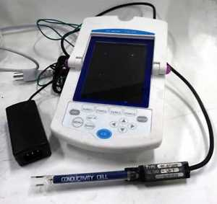
Experimental Part
Test of Electric Conductivity (E.C) for both samples:
water remains after filtration for first sample
measured amount of organic in sample by E.C

Slide 34
Experimental Part
Test of Electric Conductivity (E.C) for both samples:
water remains after filtration for another sample
measured amount of organic in sample by E.C

Slide 35
Experimental Part
Determination Check amount of Potassium using a flame photometer
5 g of the sample was weighted
grinded scale sample
5 ml HNO₃
20 ml of Distillated water
5ml of H₂SO₄

Slide 36
Experimental Part
Estimation amount of Silica
Heated to make all the turbidity under the liquid
The layer above the liquid was removed

Slide 37
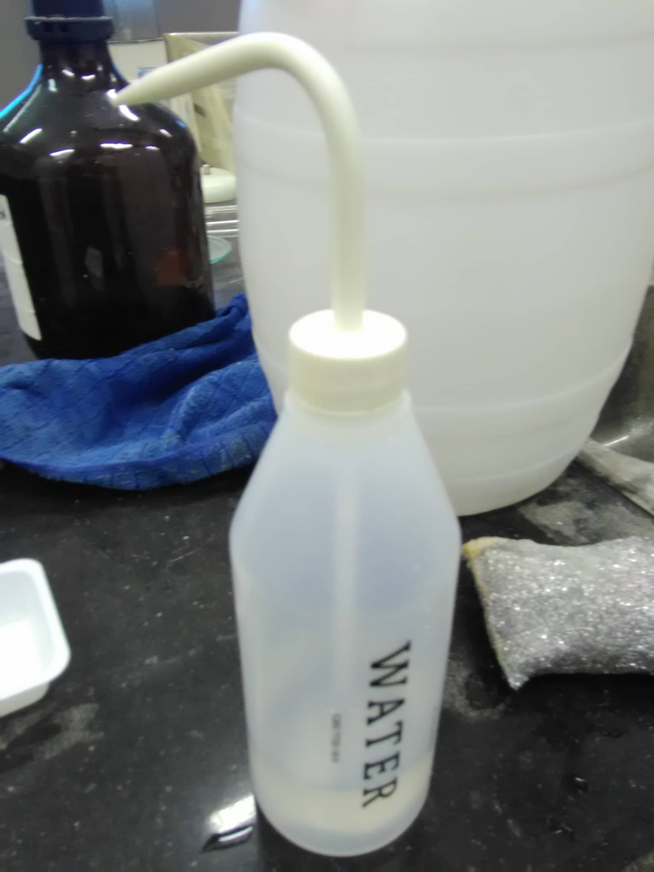
Experimental Part
Estimation amount of Silica
transparent layer was filtered and weighed amount
Distilled water was added to obtain a transparent layer of the silica

Slide 38
Induced Couple Plasma-Mass Spectrometry
We conducted an ICB test for the water used by Aziza Company in cooling towers.
This inspection was done at the Water and Scientific Research Canter.
The ICB test was carried out in order to identify the elements that were not observed and did not appear through the previous tests and were also done in order to know the quantities and proportion of the deposited elements. We put a sample of this water in the ICB device. It may have caused deposits on the cooling towers.

Slide 39
X-Ray Powder Diffraction
Ttechniques are a set of non-destructive analytical techniques that reveal information about crystalline structure, chemical composition, physical properties of materials and thin films.
These techniques depend on observing the scattered density of the x-ray beam that strikes a sample as a function of the sporadic and scattered angle, polarization, wavelength or energy

Slide 40
X-Ray Powder Diffraction
How to scan x-ray:
A sample was taken from the cooling towers and grinded and then sent to the American University in Jenin for an X-ray examination.
The sample was placed in the X-ray apparatus to identify the elements and compounds deposited on the roofs of the cooling towers. X-rays were directed towards the sample and During the shape that appeared on the device was known crystals and elements present and quantities.

Slide 41
Result
Result from Chemical Analysis
Result | Unit | Test
720 | Mg/l | Ca
3360 | Mg/l | Na
709 | Mg/l | Mg
5300 | Mg/l | Cl
290 | Mg/l | HCO3
0 | Mg/l | CO3
190 | Mg/l | K
19.8 | Mg/l | NO3
1499 | Mg/l | SO4

Slide 42
Result
Result from Chemical Analysis
Estimation Of Silica
Si =.1661g

Slide 43
Result
Result from ICP
Result | Unit | Analyte
0.03756 | Mg/l | Ag
2.7041 | Mg/l | Fe
0.60568 | Mg/l | Li
20.6985 | Mg/l | Sr
.07596 | Mg/l | Ba

Slide 44
Result
Result from XRD

Slide 45
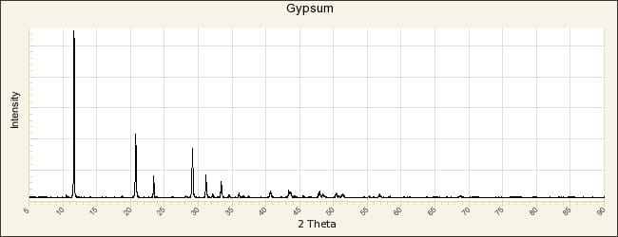
Result
Matching between our sample & Gypsum(CaSO4.2H2O) Peak
2Theta = 11.5
2Theta=20.55
2Theta =23.2
2Theta =28.9
2Theta =33.15

Slide 46
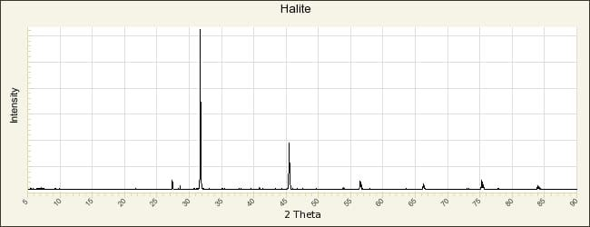
Result
Matching between our sample & Halite(NaCl) Peak
2Theta =31.9
2Theta=45.3
2Theta=56.5

Slide 47
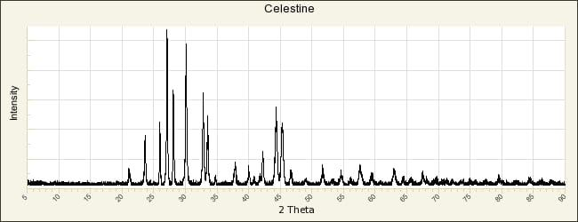
Result
Matching between our sample & Celestine(SrSO4) Peak
2Theta =40.45
2Theta=43.15

Slide 48
Cost analysis
This is a simple study for cleaning cooling tower costs
=cost of cleaning/session*# of times for cleaning
=7*3040=21280NIS
Cost of chemicals for 10 L | 500NIS
1 cube of salt water | .8 nis
Brushing operation(6-8) hrs | 5.5 nis (electricity)
1 cube of drinking water | 27 nis
Cost of pumping water | 5.5 nis
Worker cost | 2500 nis
 | 3040nis/session

Slide 49
Alternative method
After researching about an alternative way ,Reverese osmis system is the best way to reduce the cost of cleaning and it has a life time about 10 years
It’s cost =42000
Taking into consideration the life time of cooling tower in Jericho only 3 years

Slide 50
Conclusion
From Chemical Analysis
we found ( Cl =5300Mg/l , Na =3360Mg/l , SO4 = 1499 Mg/l )
From Instrumental Analysis
we found From ICP-MS ( Sr =20.68Mg/L ).
Most Peak we found in from XRD is Gypsum (CaSO4.2H2O) , Halite (NaCl) , Celeite(SrSO4)
The amount of silica is low ,that not cause the problem.
الاشي من الدراسة المالية

Slide 51
Thank you

