Slide 1
Hydraulic lift with the aid of energy storage
(accumulators)
Supervisor: Dr. Luqman Hirzallah
Group Members:
Ahmad Qasem (11105800)
Nidal Osama Khalil (11001983)
Numan Shahrour (11001898) Raia Khateeb (11143385)
May-2016

Slide 2
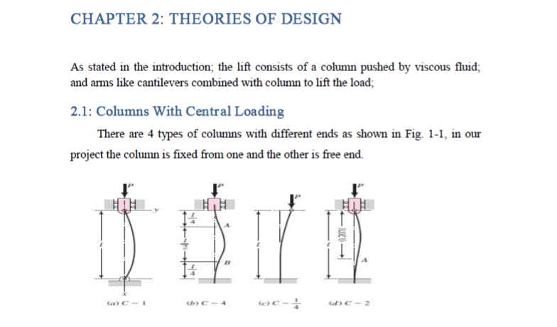

Slide 3
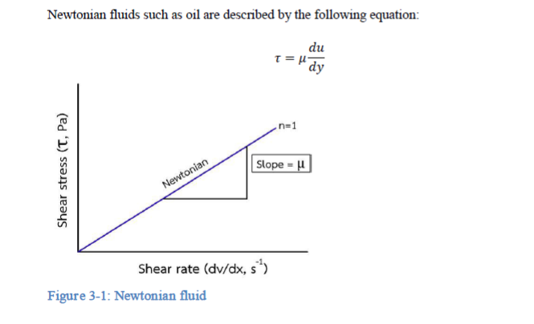

Slide 4
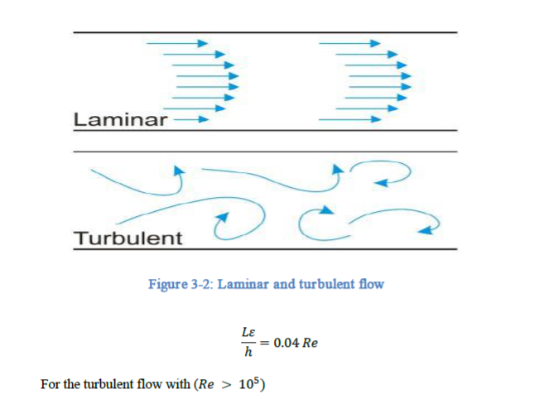

Slide 5
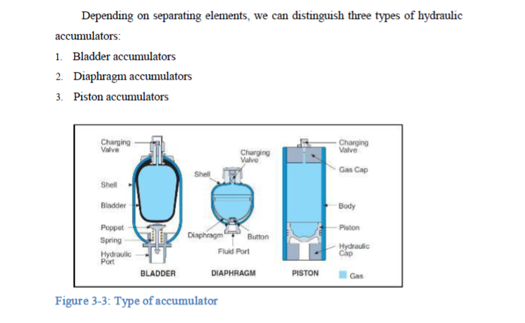

Slide 6
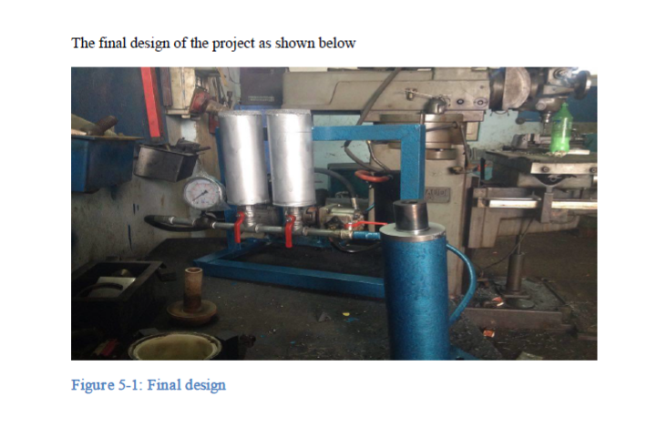

Slide 7


