Slide 1
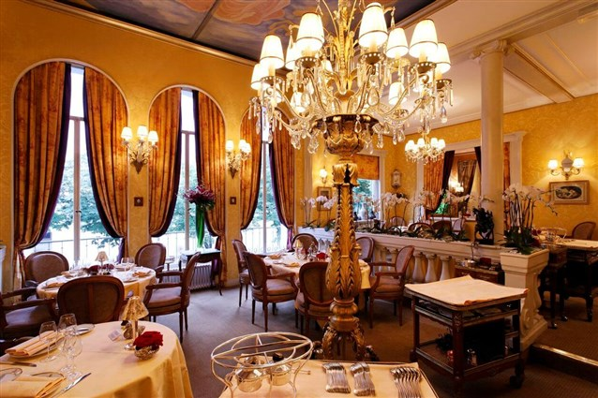
Design a New Restaurant Building.
An-Najah National university
Faculty of engineering
Building engineering departmenet
Graduation project |
Supervisor To:
Dr. Monther Dwaikat
Prepared By :
Salsabeel Haj-Mohammad
Hiba Daraghmah
Sahar Abu-Bshara

Slide 2
Outlines
Introduction
Architectural design
Structural Design
Environmental Design
Electromechanical Design
Quantity surveying
Site Description

Slide 3
Introduction

Slide 4
Site Description
Architectural plans
Location
Over Shadowing
Contour Lines
Profile
Shading
Climate conditions

Slide 5
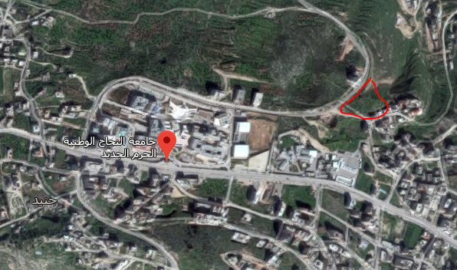
Site Location
Land of project is located in Beit-Wazan town in Nablus . The land is located on two streets, near by Al-Najah university.
The area of the land is 5583.24 square meter.

Slide 6
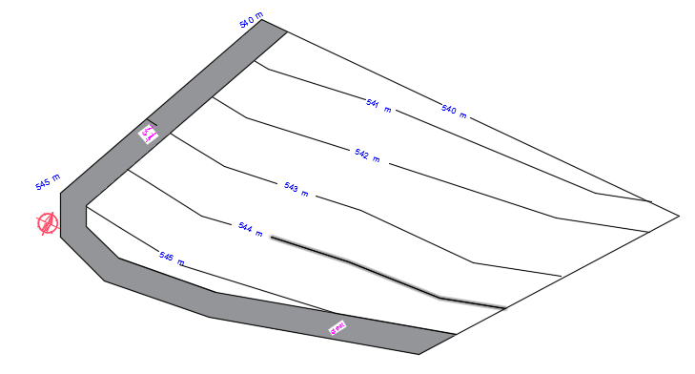
Contour line

Slide 7
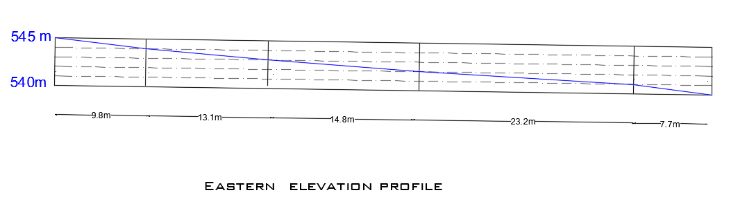
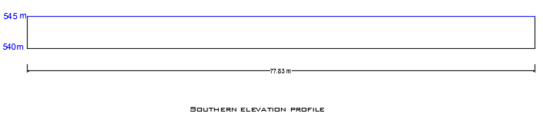
Land elevations profile

Slide 8
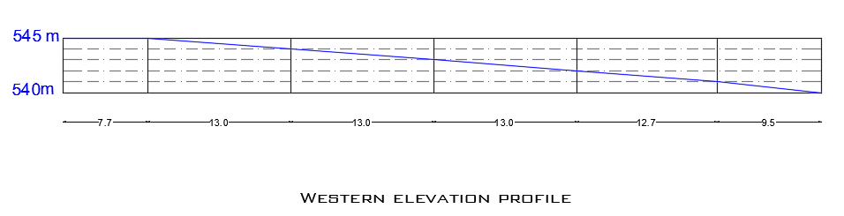
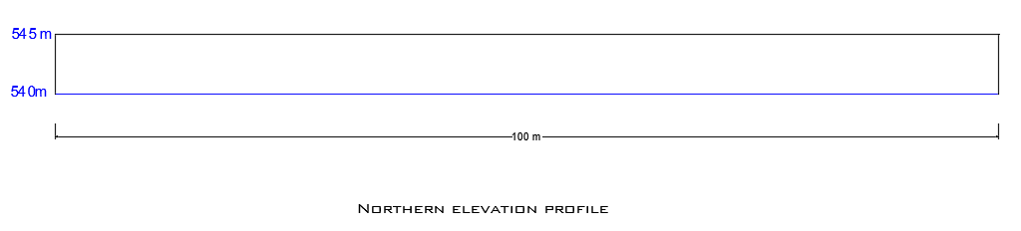

Slide 9
Climate Condition
Nablus has a moderately Mediterranean climate as it is located within the Mediterranean region on latitude
32.13 and longitude 35.25 . It has a hot, dry summer, and a cold, rainy winter.
The average temperatures is between 14°C in January and 30 °C in July.
The average relative humidity reaches 73% in January whereas in July 67%.
The average wind speed equals 7 mph.
The average rainfall is about 500 mm annually.

Slide 10
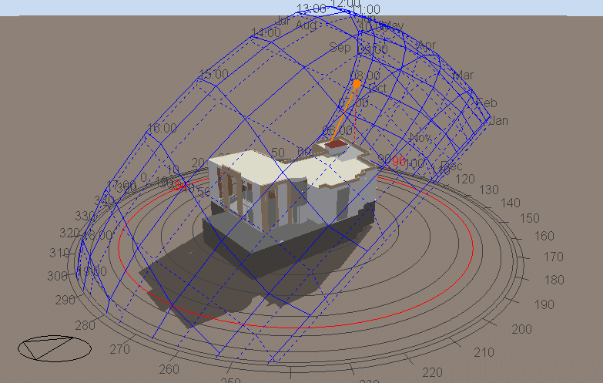
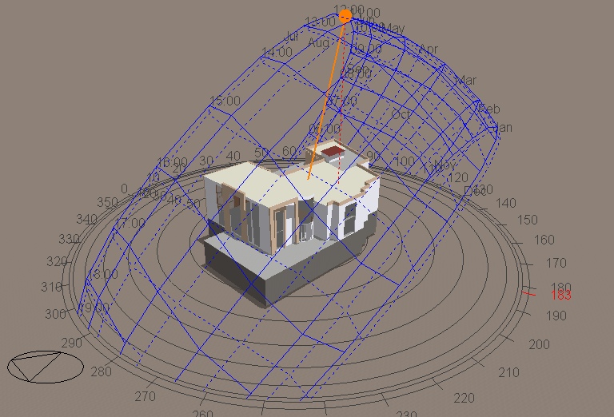
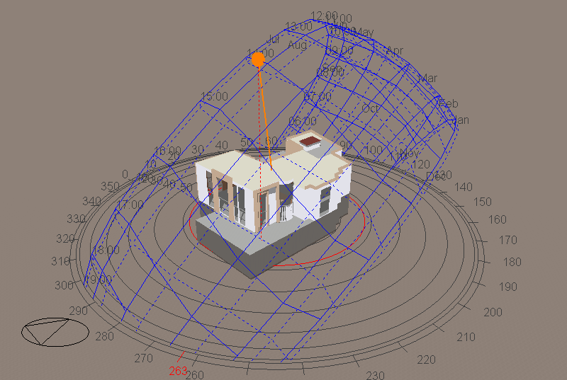
Shading
Shadow in July 21 @ 8.00 am
Shadow in July 21 @ 12.00 pm
Shadow in July 21 @ 2.00 pm

Slide 11
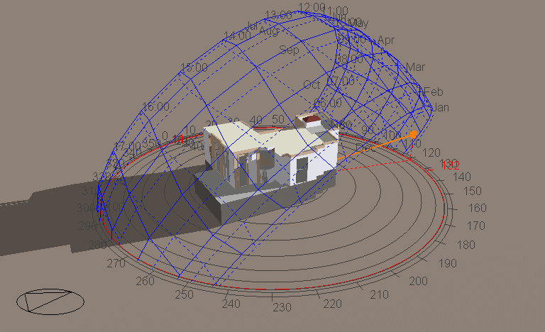
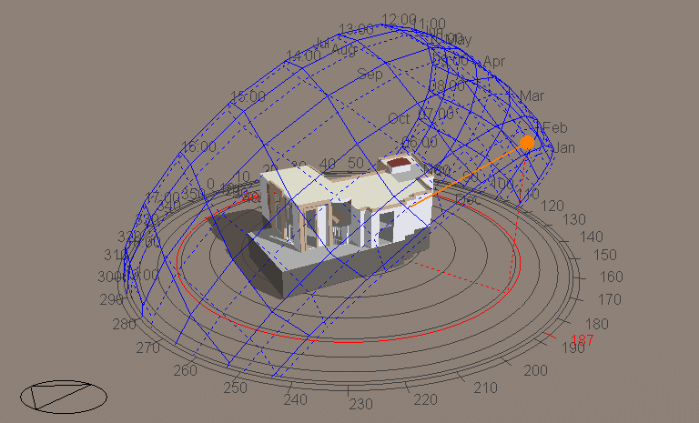
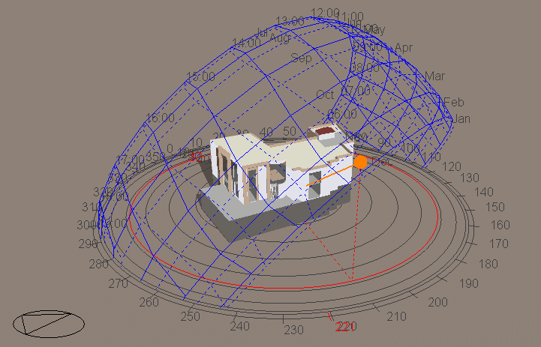
Shadow in Jan 21 @ 8.00 am
Shadow in Jan 21 @ 11.00 am
Shadow in Jan 21 @ 2.00 pm

Slide 12
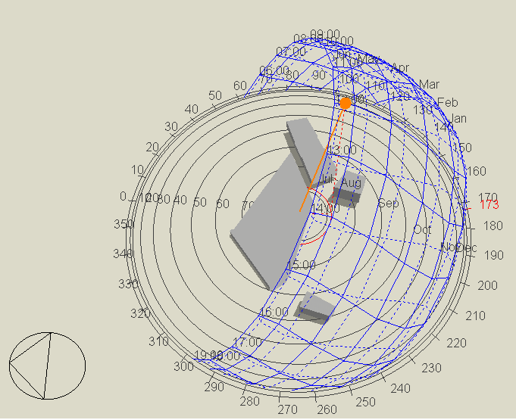
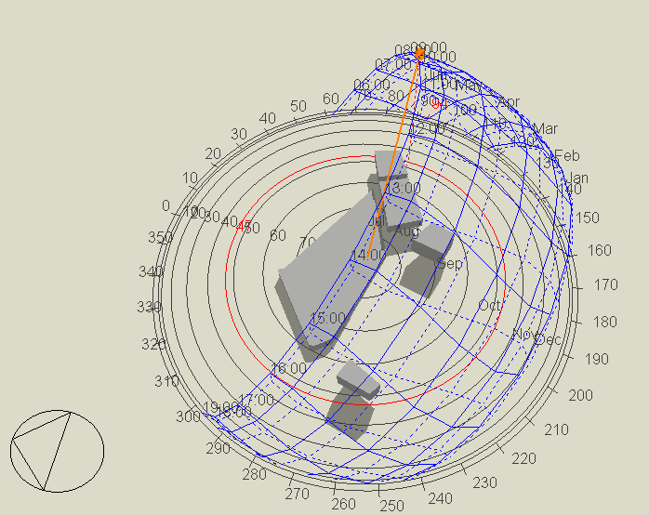
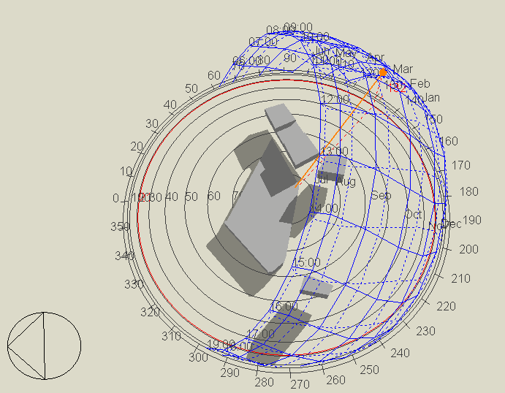
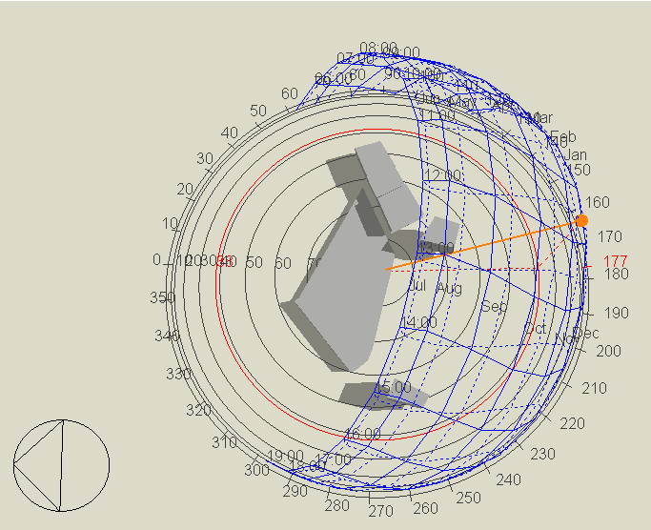
Over Shadowing
Shadow in July 21 @ 8.00 am
Shadow in July 21 @ 12.00 pm
Shadow in Jan 21 @ 8.00 am
Shadow in Jan 21 @ 12.00 pm

Slide 13
Architectural Design
Architectural plans
Site plan
Master plans
Furniture Layout
Sections
Elevations
3D-Views
Bubble diagram

Slide 14
Description
 | Floor
8400 square meter | Total Area of restaurant
400 | Total number of seating
76 | Total number of parking spaces
Height Of the floor(m) | 2)^Area of the floor(m | Floor
5.5 | 2297 | Ground Floor
5.5 | 1579 | First floor
4 | 2297 | Parking 1
4 | 2297 | Parking 2

Slide 15
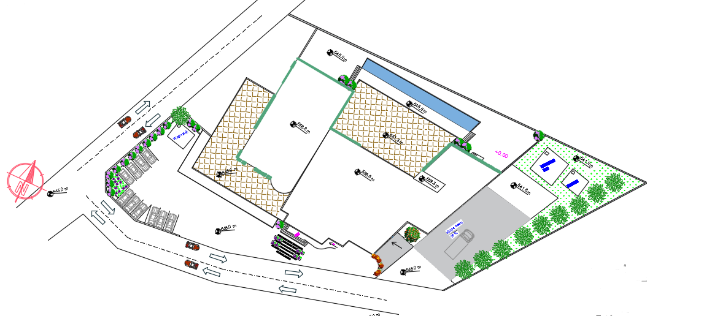
Site Plan

Slide 16
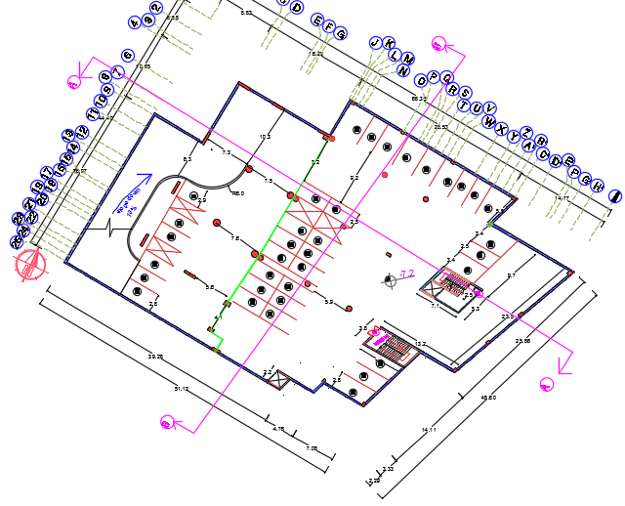
Parking 1-plan

Slide 17
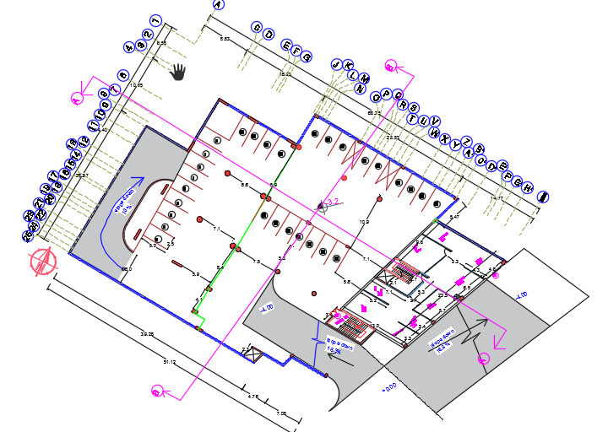
Parking 2-plan

Slide 18
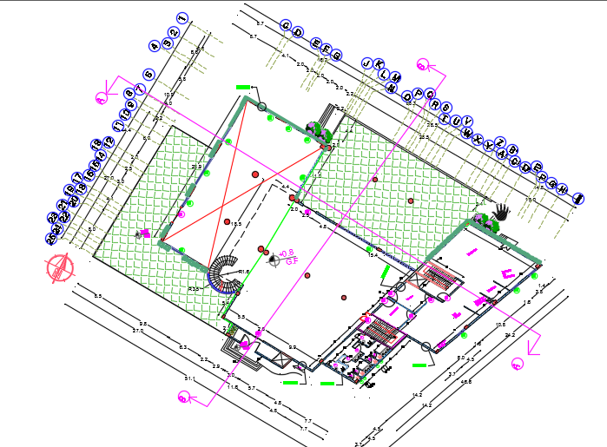
Ground-Plan

Slide 19
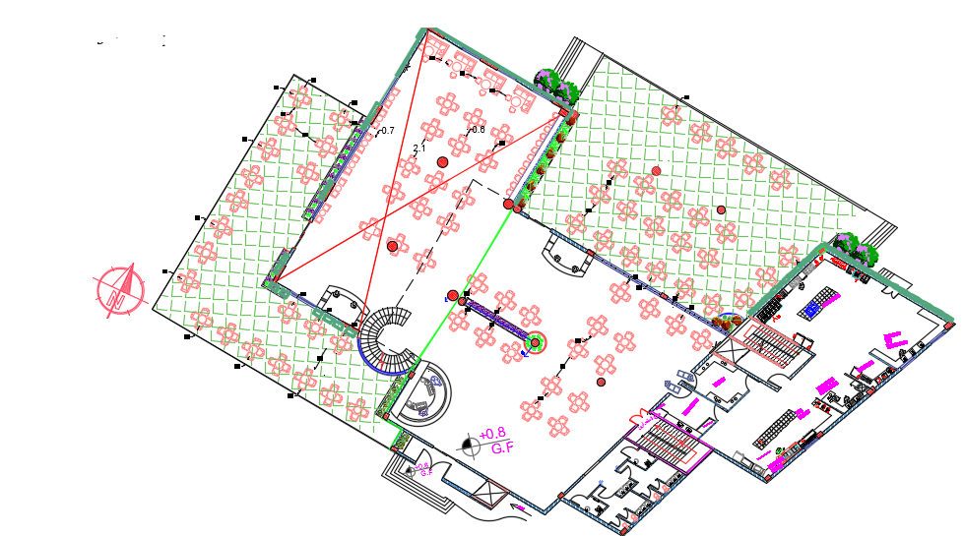
Ground Furniture Layout

Slide 20
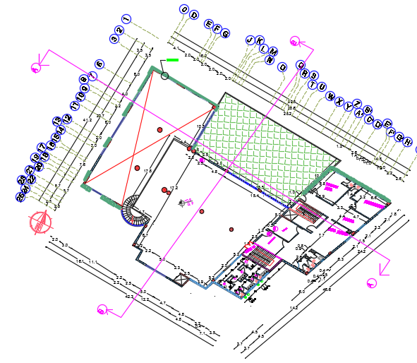
First floor plan

Slide 21
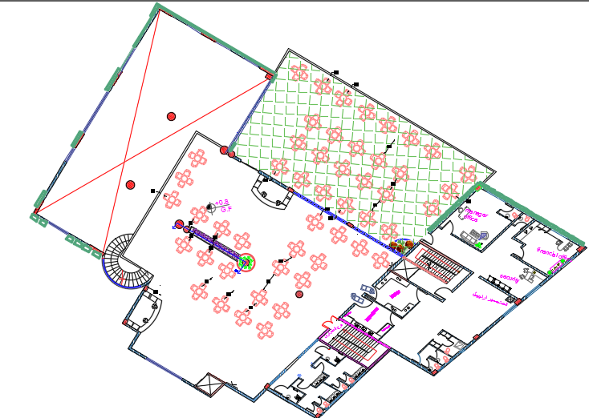
First floor furniture layout

Slide 22
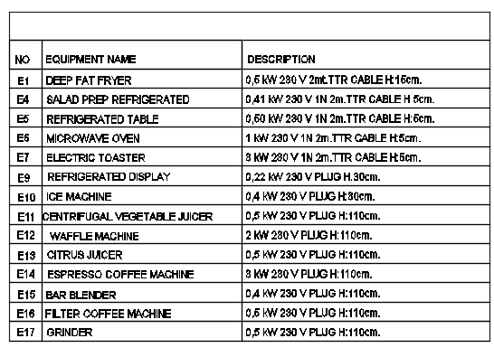

Slide 23
Ground floor for 300 seat
First Floor for 100 seat
Spaces | Standards |  | Areas and numbers according to standards | Design spaces
Dining hall-ground | 4.8 /seat |  | 1440 | 1700
Dining hall-First | 4.8 /seat |  | 480 | 580
Kitchen | 1.44/seat |  | 580 | 637
Manager office |  |  |  | 40
Financial office |  |  |  | 30
Service station | 1 service/40 places |  | 3 service | 4
Aisle width | main | Min=2m |  | 2.60 m
 | Intermediate | Min=0.9m |  | 3 m
 | Side | Min=1.20m |  | 3 m
Wc | Standard number | Existed | Standard dimension | Existed dimension
gents | 3 | 4 | 1.0 m×1.5m | 1.0 m×1.5m
Ladies | 4 | 4 | 1.0 m×1.5m | 1.0 m×1.5m
Worker | 2 | 2 | 1.0 m×1.5m | 1.4m×1.9m
Worker shower | - | 1 |  | 2.00m ×2.3m
People with special needs For ladies | 1 | 1 | 1.5 m* 2.0 m | 1.5m×2.0 m
People with special needs For gents | 1 | 1 | 1.5 m* 2.0 m | 1.5m×2.0 m

Slide 24
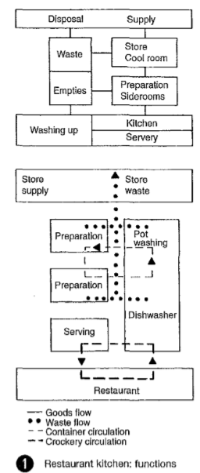
Space | Area (m2) | Temperature | Type of food or service
Cold kitchen | 30 | 22 ~24 | Prepare cold drink ,ice cream, vegetable salad
Vegetable preparation | 11 | 22 ~24 | Wash vegetable and put in dishes
Meat ,fish and poultry preparation | 22 | 22 ~24 | Wash fish, poultry and put in dishes after cooking
Hot kitchen | 55 | 22 ~24 | Cooking meat ,prepare hot drink
Freezer room | 25 | -25 ~-35 | Meat ,fish and poultry
Patisserie | 10 | 22 ~24 | Prepare dough and cook pasta
Dairy product room | 15 | 5 | butter, cheese, milk and curd
Cool room drink | 20 | 5 | Water ,Juice
Vegetable and fruit room | 15 | -5 ~0 | Tomato , potato
Store non food | 23 | 22 ~24 | Chair ,tables

Slide 25
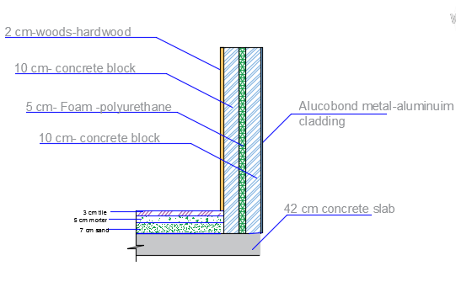
Finishes
finishes for walls
location | Wall finishes
Dining room wall | wood and alcubond
Internal wall | Wood
Kitchen wall s | Ceramic tile
Bath room wall | Glazed Porcelain
finishes for Floors
location | Floor finishes
Dining room | Ceramic tile
Kitchen floor include cooking area | Ceramic tile
Bath room Floor | Glazed Porcelain

Slide 26
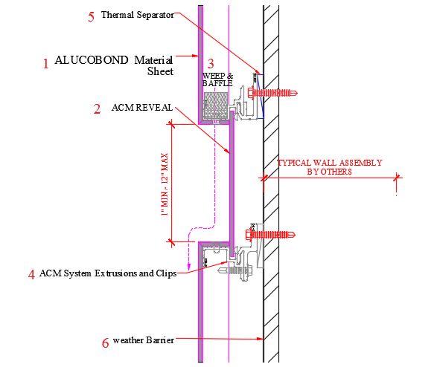
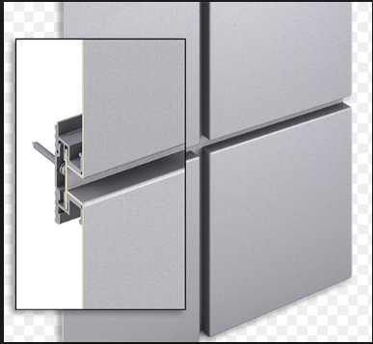
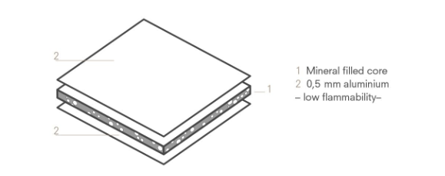
ALUCOBOND Cladding

Slide 27
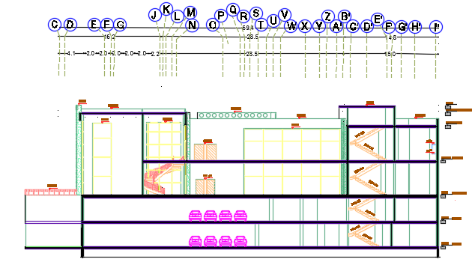
Sections
Section A-A

Slide 28
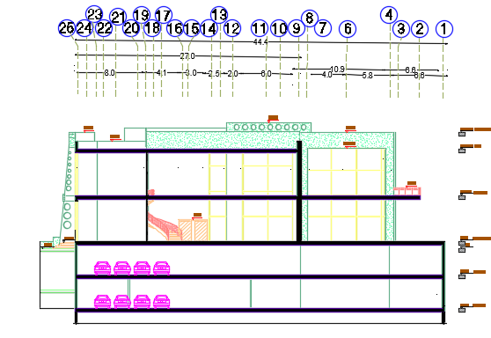
Section B-B

Slide 29
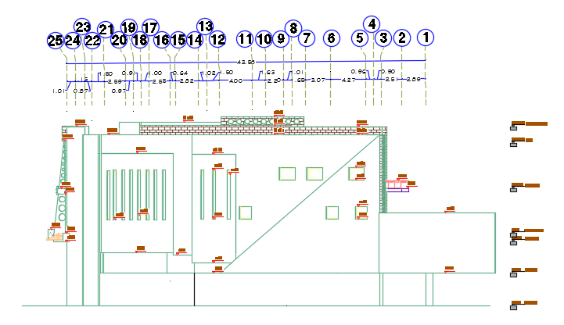
Elevations
Eastern Elevations

Slide 30
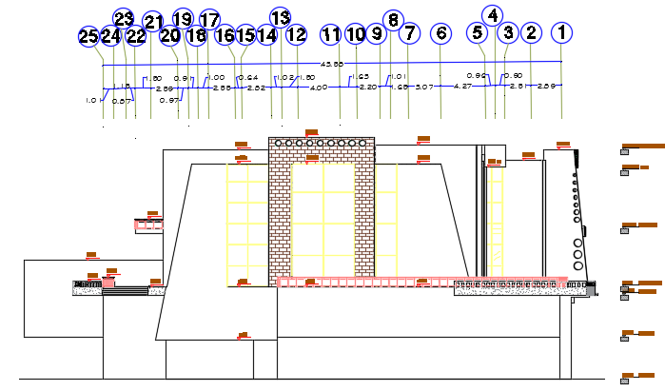
Western Elevations

Slide 31
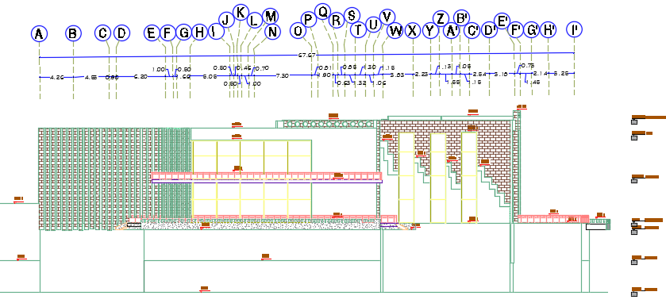
Northern Elevations

Slide 32
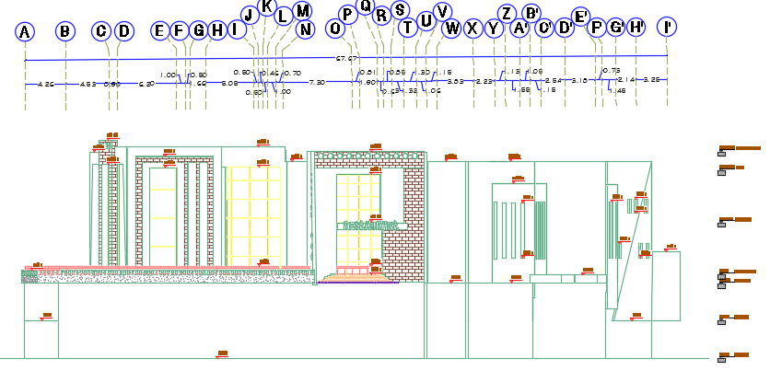
Southern Elevations

Slide 33
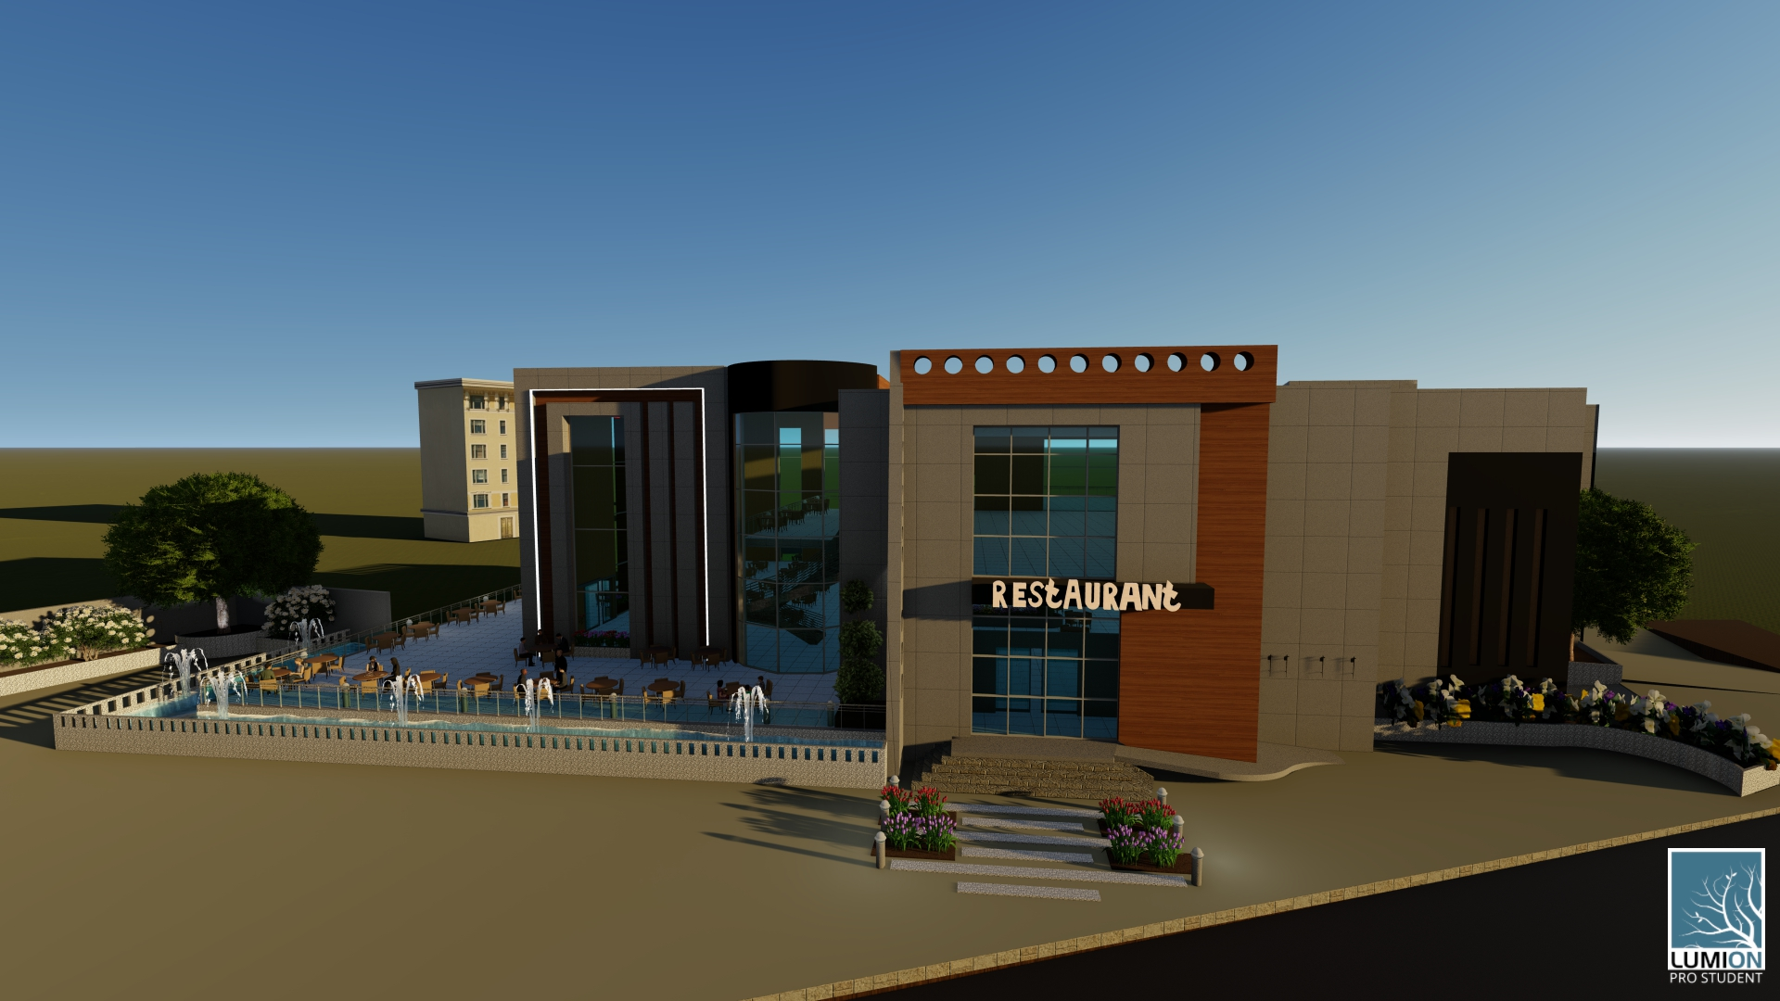
3D- Views

Slide 34
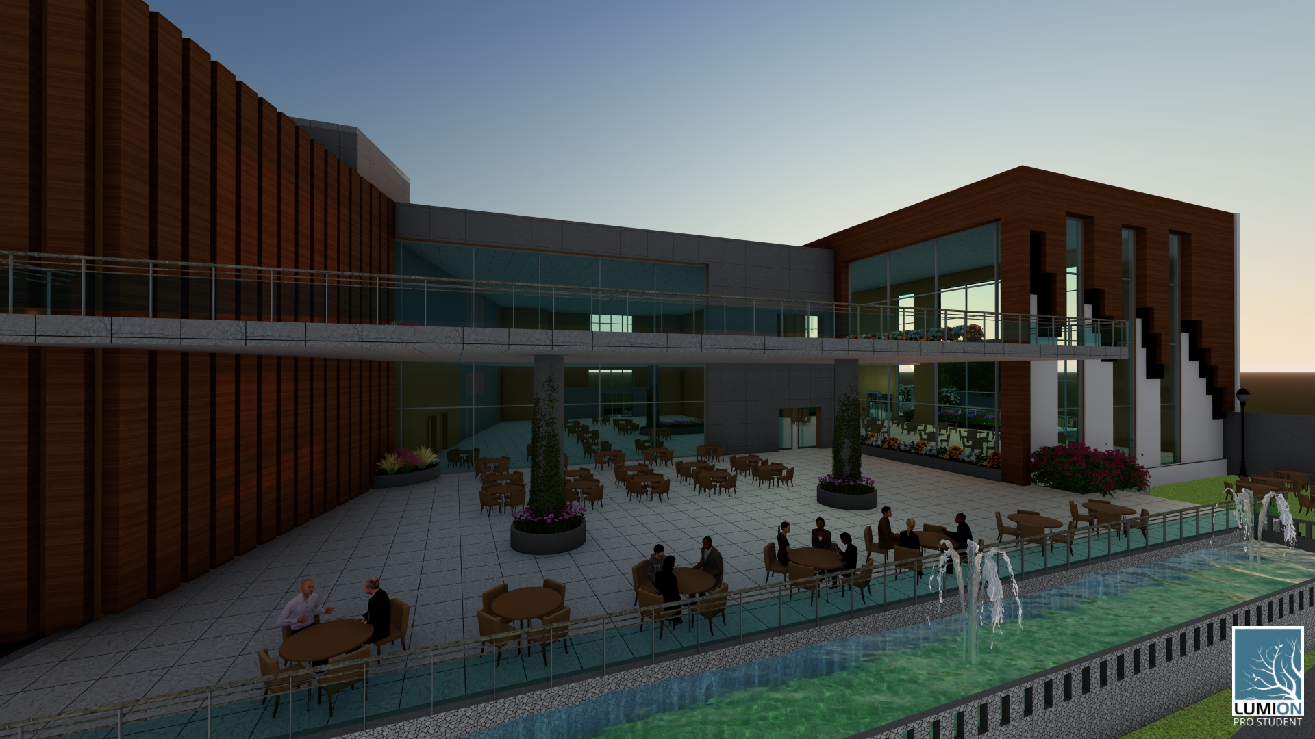

Slide 35
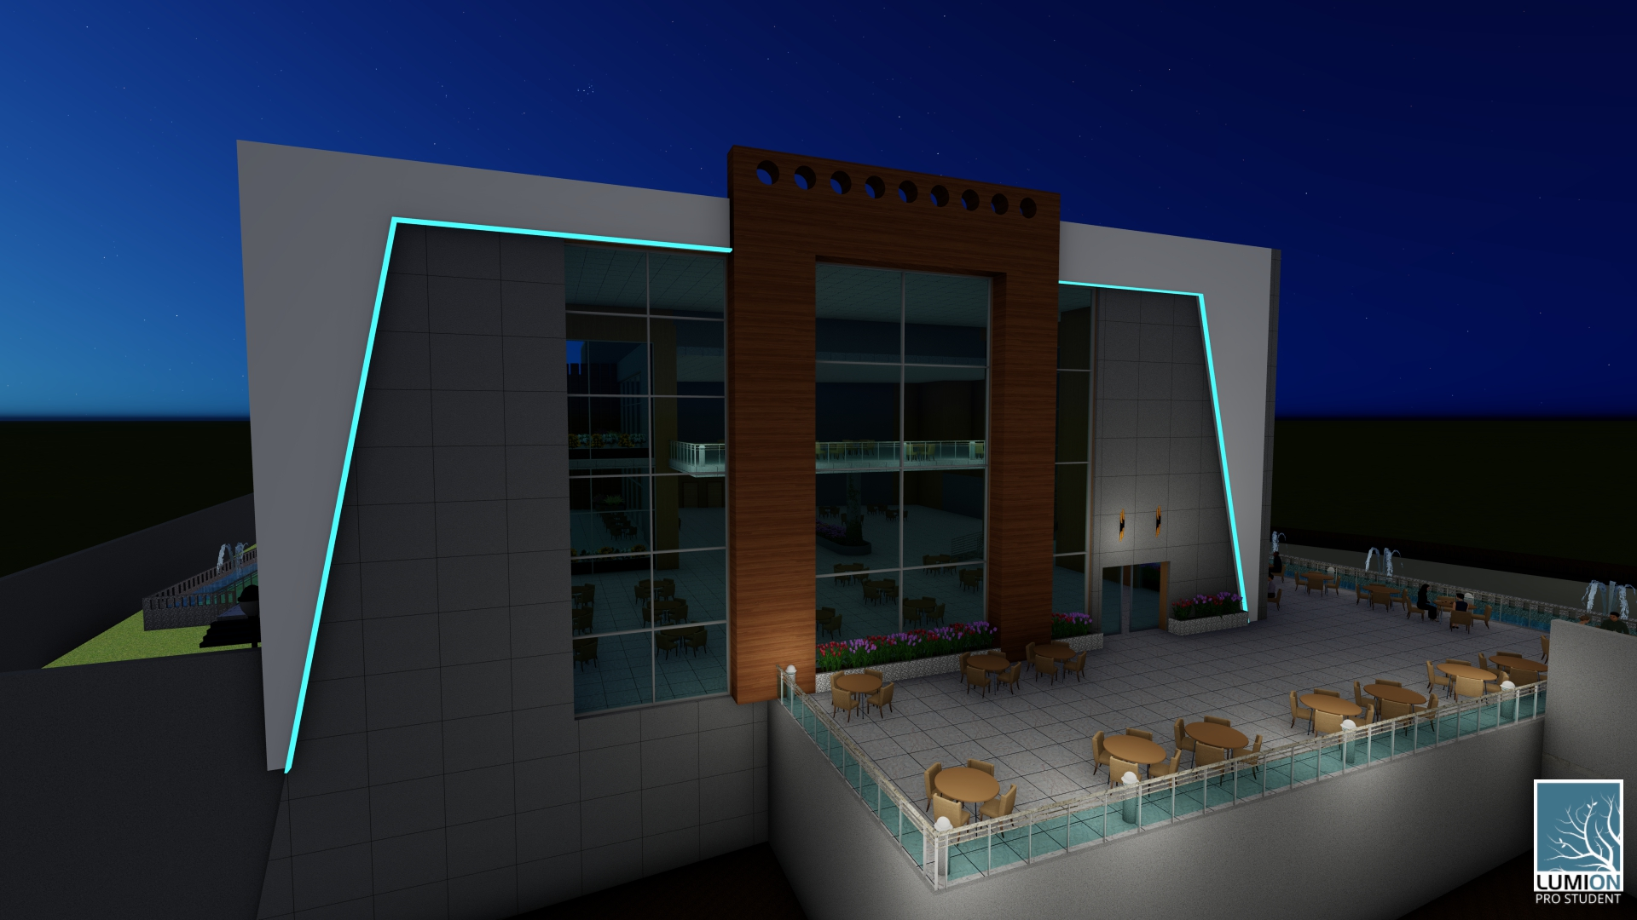

Slide 36
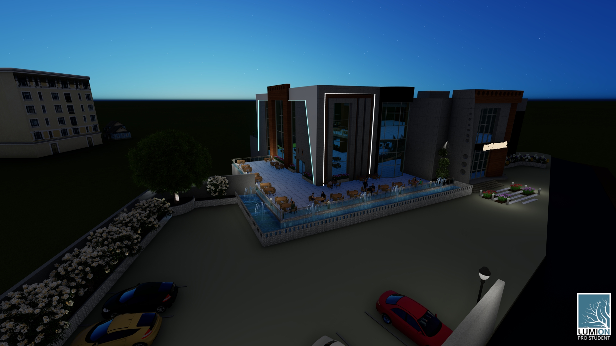

Slide 37
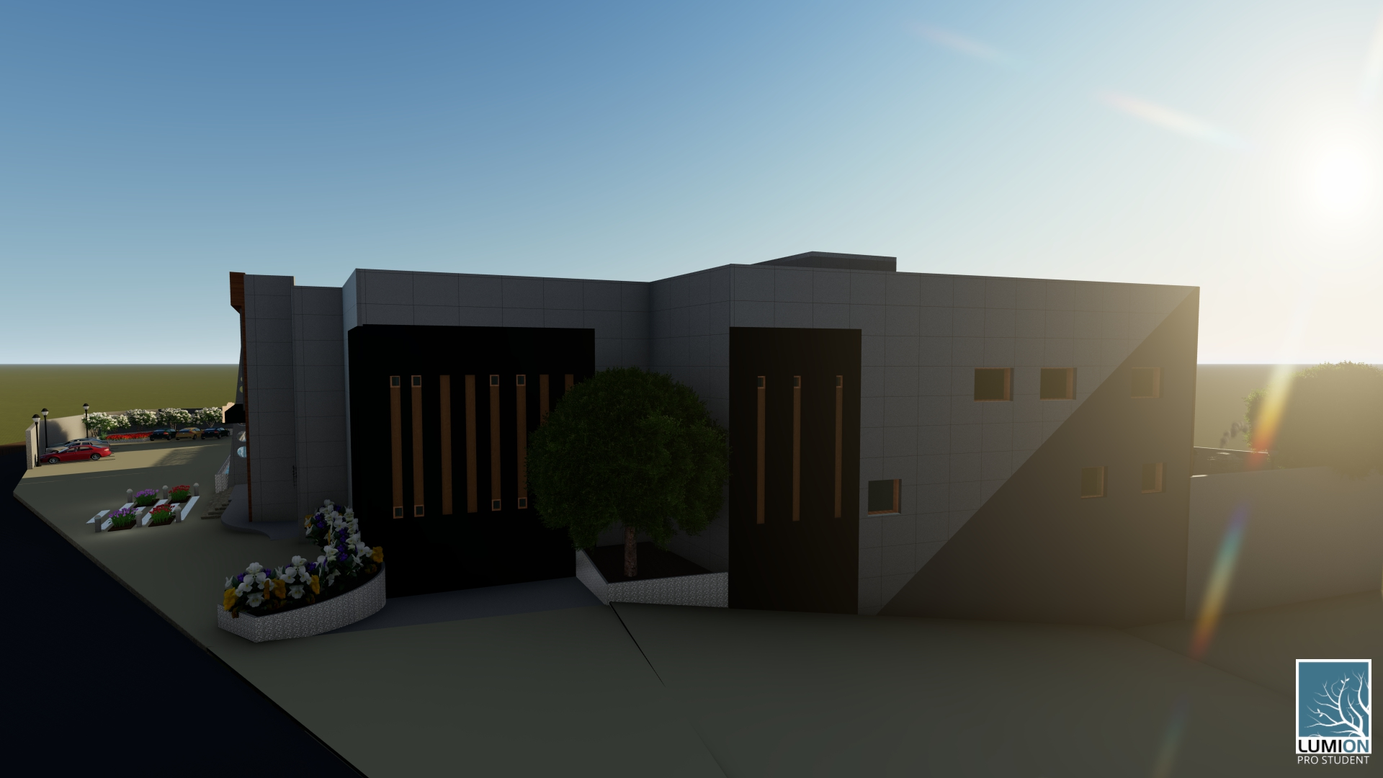

Slide 38
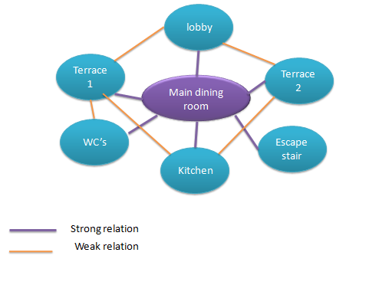
Bubble diagram

Slide 39
Structural Aspect
Structural Elements
Foundations
Beams
Slabs
Columns
Shear wall
Stair

Slide 40
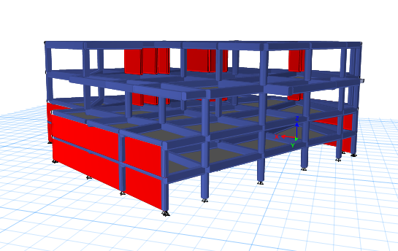
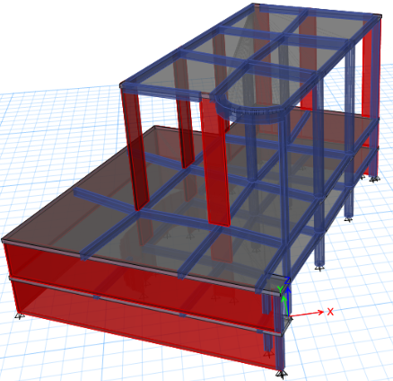
U-BOOT System with drop beam is used.

Slide 41
Standards and Codes
Building Code Requirements for Structural Concrete ACI 318-14(ACI Committee 318 2014).
UBC -97 for earthquake design.
ASCE for loads computations.

Slide 42
Design Data
Compressive strength of concrete for slabs and beams fʹ_{c} = 24 MPa.
Compressive strength of concrete for columns and shear walls fʹ_{c} = 28 MPa.
Yielding strength of steel fy = 420 MPa.
Bearing capacity of soil at street level = 250 KN/m².
Live loads = 5 KN/m².
Super imposed dead load = 4KN/m².

Slide 43
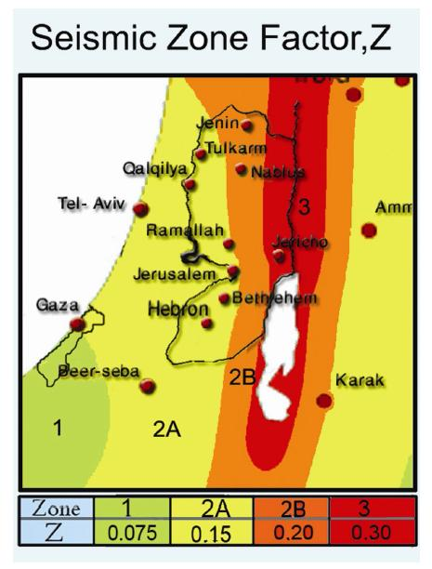
Seismic load
Lateral loads:
The seismic zone of Nablus is 2B (Z = 0.20)
The soil profile is type SC.
The acceleration seismic coefficient Ca=0.24
The velocity seismic coefficient Cv=0.32
The Seismic importance factor is 1.25
The structural design type is building frame R=5.5

Slide 44
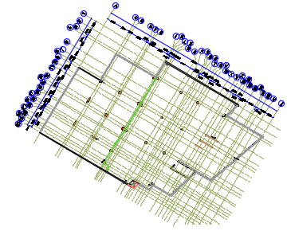
Center of columns

Slide 45
Verification of models
Compatibility check
Equilibrium check
Internal force check
Deflection check
Drift check
Period check
Model participating mass ratio check
Base shear check

Slide 46
Model 1

Slide 47
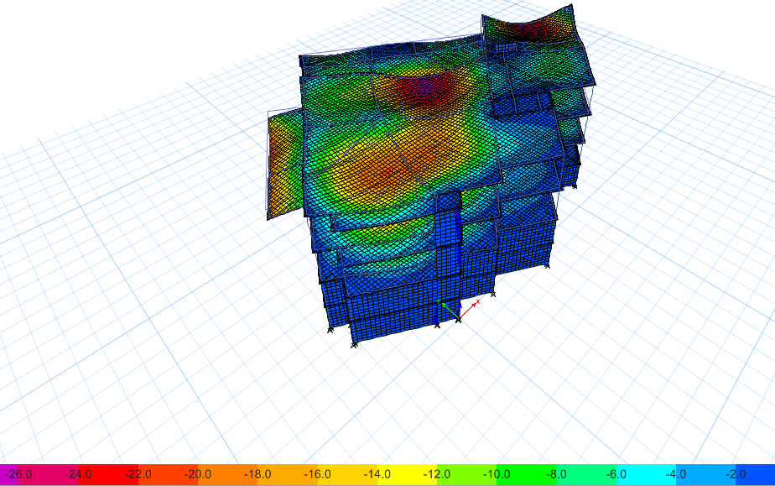
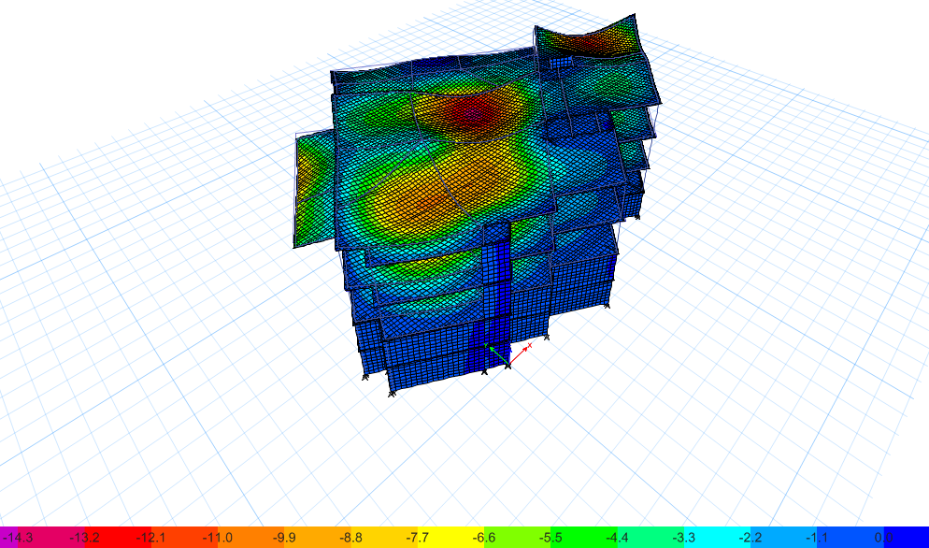
Compatibility Check
Deformed shape from dead load.
Deformed shape from live load.

Slide 48
Equilibrium check
Percentage of difference | FZ by manual (KN) | FZ from ETAB(KN) | Load Case
2.5% | 67633 | 69279 | Dead
1.5% | 26410 | 26009 | Live
0.8% | 26258 | 26045 | SID

Slide 49
Deflection check
Deflection check from live load.
Maximum allowable deflection = 41.7 mm
Maximum deflection from Etabs = 14 mm
this check is ok.

Slide 50
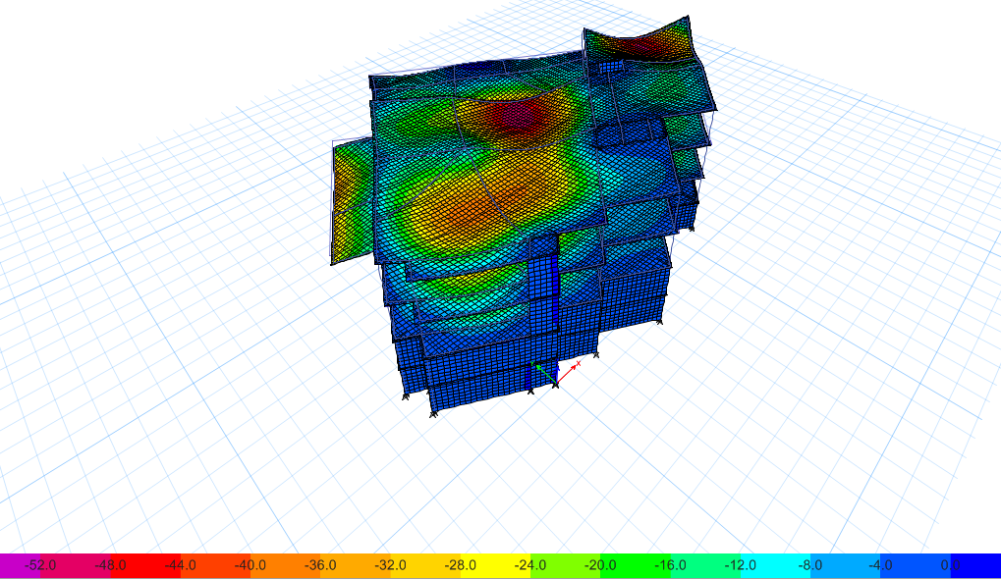
Deflection check from service load.
Maximum allowable deflection = 62 mm
Maximum deflection from Etabs = 52 mm
this check is ok.

Slide 51
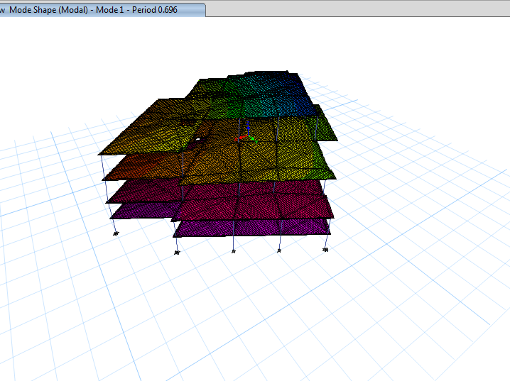
Period check
T manual= 0.43 sec
T ETABS = 0.696 sec
.

Slide 52
Modal mass participation ratio
Sum UZ | Sum UY | Sum UX | UZ | UY | UX | Period | Mode | Case
0 | 0.3306 | 0.1222 | 0 | 0.3306 | 0.1222 | 0.696 | 1 | Modal
0 | 0.478 | 0.1334 | 0 | 0.1474 | 0.0112 | 0.555 | 2 | Modal
0 | 0.5302 | 0.5085 | 0 | 0.0522 | 0.3751 | 0.351 | 3 | Modal
0 | 0.6403 | 0.5388 | 0 | 0.1101 | 0.0303 | 0.231 | 4 | Modal
0 | 0.7367 | 0.5448 | 0 | 0.0963 | 0.0059 | 0.187 | 5 | Modal
0 | 0.8021 | 0.5843 | 0 | 0.0655 | 0.0395 | 0.153 | 6 | Modal
0 | 0.8088 | 0.6053 | 0 | 0.0066 | 0.021 | 0.116 | 7 | Modal
0 | 0.8402 | 0.7034 | 0 | 0.0315 | 0.0982 | 0.105 | 8 | Modal
0 | 0.8579 | 0.7302 | 0 | 0.0176 | 0.0268 | 0.093 | 9 | Modal
0 | 0.9 | 0.7343 | 0 | 0.0421 | 0.0041 | 0.08 | 10 | Modal
0 | 0.9281 | 0.8451 | 0 | 0.0281 | 0.1108 | 0.078 | 11 | Modal
0 | 0.9366 | 0.8776 | 0 | 0.0085 | 0.0325 | 0.07 | 12 | Modal
0 | 0.9369 | 0.8807 | 0 | 0.0003 | 0.0031 | 0.059 | 13 | Modal
0 | 0.937 | 0.887 | 0 | 0.0001 | 0.0063 | 0.057 | 14 | Modal
0 | 0.9398 | 0.909 | 0 | 0.0028 | 0.022 | 0.056 | 15 | Modal

Slide 53
  Base shear check
V manual = 16143 KN.
 | V-manual | V-ETEABS
EQ-X | 13514 | 10904
EQ-Y | 10617 | 10904

Slide 54
  Drift Check
Story | height (m) | Dis- x (mm) | Dis– y (mm) | Drif-x (mm) | Drif-y (mm) | Delta_x 𝛥𝑚 | Delta_y 𝛥𝑚 | 𝛥_limit (mm)
1 | 4 | 5 | 10 | 5 | 10 | 38.5 | 19.25 | 110
2 | 4 | 7 | 12 | 2 | 2 | 7.7 | 7.7 | 110
3 | 5.5 | 16 | 25 | 9 | 13 | 50.05 | 34.65 | 110
4 | 5.5 | 20 | 30 | 4 | 5 | 19.25 | 15.4 | 110

Slide 55


  Slab detailing
Slabs is designed for moment, axial and shear force

Slide 56

  Beam Detailing

Slide 57


Slide 58


  Column detailing

Slide 59



  Shear wall detailing

Slide 60


Spiral Stair Detail

Slide 61

Frame section

Slide 62



Slide 63

Model 2

Slide 64

Compatibility Check
Deformed shape from dead load.

Slide 65
Equilibrium check
Percentage of difference | FZ by manual (KN) | FZ from ETAB(KN) | Load Case
1.08% | 27410.8 | 27712.2 | Dead
0.17% | 10865.25 | 10846.7 | Live
0.13% | 9934.74 | 9921.4 | SID

Slide 66

Deflection check
Deflection check from live load.
Maximum allowable deflection = 29.17mm
Maximum deflection from Etabs =5 mm
this check is ok.

Slide 67

Deflection check from service load.
Maximum allowable deflection =43.75 mm
Maximum deflection from Etabs =23 mm
this check is ok.

Slide 68
Modal mass participation ratio
Case | Mode | Period(sec) | UX | UY | UZ | Sum UX | Sum UY
Modal | 50 | 0.039 | 0.0004 | 4.80E-05 | 0 | 0.8982 | 0.8812
Modal | 51 | 0.039 | 0.002 | 0.0006 | 0 | 0.9001 | 0.8819
Modal | 52 | 0.038 | 0.0132 | 0.0129 | 0 | 0.9133 | 0.8947
Modal | 53 | 0.036 | 0.0007 | 0.0272 | 0 | 0.914 | 0.922
Modal | 54 | 0.035 | 1.60E-05 | 0.0011 | 0 | 0.914 | 0.9231

Slide 69
  Base shear check
V manual =5777.96 KN.
 | V-manual | V-ETEABS
EQ-X | 5777.96 | 3556.15
EQ-Y | 5777.96 | 1281.54

Slide 70
  Drift Check
story | Height (mm) | Displacement X( mm) | Displacement Y (mm) | Drift X(mm) | Drift Y (mm) | Delta X | Delta Y | Delta -limit(mm)
0 | 0 | 0 | 0 | 0 | 0 | 0 | 0 | 0
1 | 4000 | 0.608 | 0.287 | 0.608 | 0.287 | 2.35 | 1.11 | 80
2 | 4000 | 8.25 | 16.2 | 7.642 | 15.913 | 29.43 | 61.27 | 80
3 | 13000 | 65.4 | 29.6 | 57.15 | 13.4 | 220.03 | 51.59 | 260

Slide 71

  Slab detailing

Slide 72
  Beam Detailing

Slide 73

  Beam Detailing

Slide 74


  Column detailing

Slide 75
Footing
Three types of footing are used:
1- isolated footing.
2- wall footing.
3- mat foundation.

Slide 76

Footing Layout

Slide 77
Isolated footing results
Footing No. | service load (KN) | ultimate load (KN) | L | B | d | H | Longitudinal bar | length of bar | transverse bar | length of bar
1 | 2014 | 3162 | 3 | 3 | 540 | 600 | 6ø16 /m | 3.4 (Hook) | 8ø16 /m | 2.84
2 | 4700.2 | 6125.1 | 4.55 | 4.55 | 740 | 800 | 4ø25 /m | 4.43 | 4ø25/m | 4.43
3 | 5023.4 | 6551.7 | 4.7 | 4.7 | 840 | 900 | 6ø20 /m | 4.58 | 6ø20 /m | 4.58
4 | 6793.1 | 8924.7 | 5.5 | 5.5 | 940 | 1000 | 5ø25 /m | 5.38 | 5ø25 /m | 5.38
5 | 5667.2 | 7383.4 | 5.6 | 4.5 | 940 | 1000 | 6ø25 /m | 5.48 | 6ø20 /m | 4.34
6 | 5356.4 | 6979.6 | 5.5 | 4.3 | 840 | 900 | 6ø25 /m | 5.38 | 6ø20 /m | 4.17
7 | 4498.8 | 5858.6 | 4.5 | 4.4 | 740 | 800 | 6ø20 /m | 4.38 | 6ø20 /m | 4.28
8 | 4872.7 | 6327.8 | 4.8 | 4.5 | 740 | 800 | 7ø20 /m | 4.68 | 6ø20 /m | 4.35
9 | 4392.8 | 7545 | 5 | 5 | 840 | 900 | 7ø25 /m | 4.91 | 7ø25 /m | 4.91
10 | 4255 | 6478.34 | 5.2 | 4.2 | 840 | 900 | 7ø32 /m | 5.08 | 7ø25 /m | 4.08

Slide 78


Isolated footing details

Slide 79
Wall footing results
wall No. | service load (KN) | ultimate load(KN) | B (m) | d (m) | H (m) | Transverse bar | length of bar (m) | Longitudinal bar total
1 | 362 | 532.2 | 1.6 | 0.3 | 0.4 | 4ø18/m | 2.1 (Hook) | 12ø12
2 | 366 | 590.54 | 1.7 | 0.3 | 0.4 | 4ø18/m | 2.18 (Hook) | 11ø12
3 | 432.8 | 847.2 | 1.9 | 0.3 | 0.4 | 5ø18/m | 2.38 (Hook) | 13ø12
4 | 515 | 578 | 2.3 | 0.3 | 0.4 | 5ø18/m | 2.2 | 15ø12
5 | 230 | 620 | 1.1 | 0.2 | 0.3 | 5ø14 /m | 1.38 (Hook) | 4ø12
6 | 373.41 | 550.8 | 1.7 | 0.24 | 0.3 | 6ø14/m | 1.98 (Hook) | 9ø12

Slide 80


Wall footing details

Slide 81
Mat foundations
- Settlement check:
Maximum deflection is less than 10mm.
Punching check:
Punching ratio is less than 1.
Wide beam shear check:
Shear force is less than shear capacity.

Slide 82

Mat foundation reinforcement and details:

Slide 83



Slide 84
Environmental Aspect
Natural lighting
Thermal design
Acoustical design
Environmental Elements

Slide 85

  Thermal
Includes :
Envelops
Thermal performance
Comfort Curves

Slide 86


Envelops
Layer of External wall and material propriety for dining room

Slide 87


Layer of External wall and material propriety for Kitchen

Slide 88


Layer of External wall and material propriety for Basement

Slide 89




Layer and material propriety for Roof
Layer and material propriety for basement floor

Slide 90




U-value and Layer of Internal wall between dining and kitchen
U-value and Layer of Internal wall between kitchen zones

Slide 91


Window Type and U-value

Slide 92
Performance
Site and source energy for restaurant building
Cooling and heating load for restaurant building
Zone | cooling load (Kw) | heating load (Kw)
Ground floor | 56.46 | 50.93
First floor | 76.82 | 74.8

Slide 93

Comfort Curves
 | Facility [Hours]
Time Setpoint Not Met During Occupied Heating | 0.00
Time Setpoint Not Met During Occupied Cooling | 0.00
Time Not Comfortable Based on Simple ASHRAE 55-2004 | 861.50

Slide 94


  Natural lighting
Day light factor for ground floor
Day light factor for First floor

Slide 95
Day light factor and uniformity value:
Standard uniformity : (60-80)%
Standard avg daylight factor :(2-6)%
Zone | Average day light factor % | Uniformity (min/Avg)
Ground floor dining | 6.99 | 0.05
First floor dining | 7.79 | 0.08
Corridor | 1.11 | 0.01
Office 1 | 1.6 | 0.08
Office 2 | 0.78 | 0.27

Slide 96
  Acoustical Design
Noise level form street equals 80db ,noise in kitchen 80 db (measurement field )
The below table give total absorption coefficient at all frequencies in the restaurant building :
material | 125HZ | 250HZ | 500HZ | 1000HZ | 2000HZ | 4000HZ | surface area
gypsum board ceiling | 0.45 | 0.7 | 0.8 | 0.8 | 0.65 | 0.45 | 981.77
wood wall | 0.4 | 0.35 | 0.2 | 0.15 | 0.05 | 0.05 | 726.4
window | 0.09 | 0.05 | 0.05 | 0.03 | 0.02 | 0.02 | 361.1
ceramic floor | 0.01 | 0.01 | 0.01 | 0.02 | 0.02 | 0.02 | 981.77
door | 0.7 | 0.14 | 0.12 | 0.08 | 0.08 | 0.06 | 5.28
Total absorption (AR) | 0.26 | 0.32 | 0.32 | 0.31 | 0.23 | 0.17 | 3056.32

Slide 97


composite transmission loss
TLc from insul program for external wall for dining area :
noise reduction and sound level in dining room .
Frequency Hz | TLc | NR | L2
125 | 38 | 13 | 67
250 | 48 | 23 | 57
500 | 49 | 24 | 56
1000 | 56 | 31 | 49
2000 | 58 | 32 | 48
4000 | 66 | 39 | 41
As given in the table sound level in dining area more than (42-47)db

Slide 98


composite transmission loss
TLc from insul program for wall between dining and kitchen
Noise reduction and sound level in dining room :
Frequency Hz | TLc | NR | L2
125 | 40 | 14 | 66
250 | 45 | 20 | 60
500 | 54 | 29 | 51
1000 | 59 | 33 | 47
2000 | 60 | 33 | 47
4000 | 68 | 40 | 40
As given in the table sound level in dining area more than (42-47)db

Slide 99
Reverberation time
recommended Reverberation time equals (0.7-0.8) sec
FREQUNECY | 50% | Full
63Hz | 1.92 | 1.92
125Hz | 1.31 | 1.31
250Hz | 0.69 | 0.69
500Hz | 0.53 | 0.53
1kHz | 0.84 | 0.84
2kHz | 0.64 | 0.64
4kHz | 0.63 | 0.63
8kHz | 0.16 | 0.16
16kHz | 0.19 | 0.19
As given in the table RT60 in dining area need for treatment

Slide 100


Acoustic solution
There are acoustic problem in restaurant building ,the layer of wall insufficient to insulate noise from kitchen and street.
Acoustic solution :
1.Enhance wall and ceiling with modern Acoustic paneling 2.Adding focal point
(like Cloud Paintable acoustic panel)

Slide 101



3.Artistic solutions for vaulted ceilings
4. Incorporate sound buffering into furnishings
5.sound parries

Slide 102


  Load Speaker
Specification for loud speaker : Type of loud speaker

Slide 103


Loud speaker distribution
loud speaker for ground floor
loud speaker for double volume

Slide 104
Electrical Aspect
Electrical
Control Panel
Artificial lighting
Socket

Slide 105
  Artificial Lighting
Standard aspects
Spaces | Recommended illuminance (Lux) | Glare | Uniformity
Dining hall | 300 | 22 | -
Reception | 400 | 22 | 0.6
Office | 500 | 19 | 0.6
Kitchen | 500 | 22 | 0.6
Design
Spaces | illuminance (Lux) | Glare | Uniformity
Dining hall | 382 | 21.4 | -
Double dining hall | 346
Reception | 483 | 13.4 | 0.68
Office | 507 | 17.5 | 0.84
Kitchen | 538 | 17.5 | 0.84

Slide 106


Dining hall
Office

Slide 107


Kitchen

Slide 108



Lighting distribution

Slide 109


  Socket distribution

Slide 110



  Control Panel

Slide 111
Mechanical Aspect
mechanical
Drainage system
HVAC system
Mechanical design
Water supply system
Safety system

Slide 112


  Water supply system

Slide 113


Volume of water tanks:
Volume of rain water tank = 729 $m^{3}$
Rain water tank feeds 14% of the amount of daily water consumption.

Slide 114


  Drainage system

Slide 115



Slide 116

Drainage of rain water

Slide 117
  HVAC Design
VRF system is used in restaurant building :
diffuser is used for dining area .
split unit is used for corridor and office .
The below table give design capacity ,flow rate ,number of fan and number of diffuser :
Zone | Design capacity(Kw) | Design flow rate (m^2/s) | #of fan coil | #of diffuser
Ground floor dining | 56.46 | 3.84 | 6 | 30
First floor dining | 68.93 | 4.66 | 7 | 36

Slide 118

Duct diameter
Table give Duct velocity, diameter and volumetric flow rate for fan coil and diffuser.
Duct | Volumetric flow rate |  | Diameter(m) | Velocity (m/s)
A-B | 0.65 | 0.7 | 0.42 | 5
B-C | 0.55 | 0.7 | 0.38 | 5
C-D | 0.45 | 0.7 | 0.36 | 4.8
D-E | 0.35 | 0.7 | 0.33 | 4.5
E-F | 0.25 | 0.7 | 0.28 | 3.9
F-G | 0.125 | 0.7 | 0.22 | 3.4
G-H | 0.125 | 0.7 | 0.22 | 3.4
D-3 | 0.1 | 0.62 | 0.22 | 3
E-4 | 0.1 | 0.4 | 0.24 | 2.5
F-5 | 0.125 | 0.18 | 0.29 | 1.8
C-2 | 0.1 | 1.5 | 0.18 | 4.2
B-1 | 0.1 | 2.6 | 0.16 | 5

Slide 119

Diffuser and mechanical ventilation for ground floor

Slide 120

Diffuser ,split unit and mechanical ventilation for First floor

Slide 121


Mechanical ventilation for parking
Parking 1
parking 2

Slide 122
  Hood design
Back shelf hood was used with different length in kitchen .
Recommended velocity equals 2000 (fpm) foot per minute .
volumetric flow rate for back shelf =400 cfm per linear foot of hood.
Hood length(foot) | Cross section Area (cubic foot ) | Hood diameter (foot)
16.7 | 3.34 | 2.1foot=64 cm
13.1 | 2.62 | 1.83foot=56cm

Slide 123
  Fire Alarm System
Ionization smoke detector is used in restaurant building.
The below table gives served area for smoke detector according to Palestinian civil defense.
Location | Ceiling height | Served area | Distance between smoke detector
Dining area | 5.5m | 80 | 11m
Double volume | 13m | 130 | 12.5m

Slide 124


Smoke detector lay out for ground floor

Slide 125
Fire protection system
Sprinkler is used for dining area .
Extinguisher class B (Type 20B) used in kitchen with maximum distance 15 m.
The below table show served area for sprinkler :
Space | Space area(m²) | Hazard Classification | Max. Coverage area per sprinkler(m²) | Number of sprinkler
Dining-GF | 600 | Medium hazard | 12 | 50
Dining-FF | 600 | Medium hazard | 12 | 50
Office 1 | 41 | Medium hazard | 12 | 4
Office 2 | 30 | Medium hazard | 12 | 4

Slide 126

sprinkler layout
sprinkler layout for First floor

Slide 127

  Escape route
Escape rout layout for ground floor

Slide 128


  Emergency sign and Lighting

Slide 129

Quantity Surveying
Item | Total cost (NIS)
Architectural work | 3561578 | 490
Structural work | 4637285 | 620
Mechanical work | 454200 | 61
Electrical work | 211200 | 29
Total cost | 8864263 | 1200

Slide 130


