Slide 1
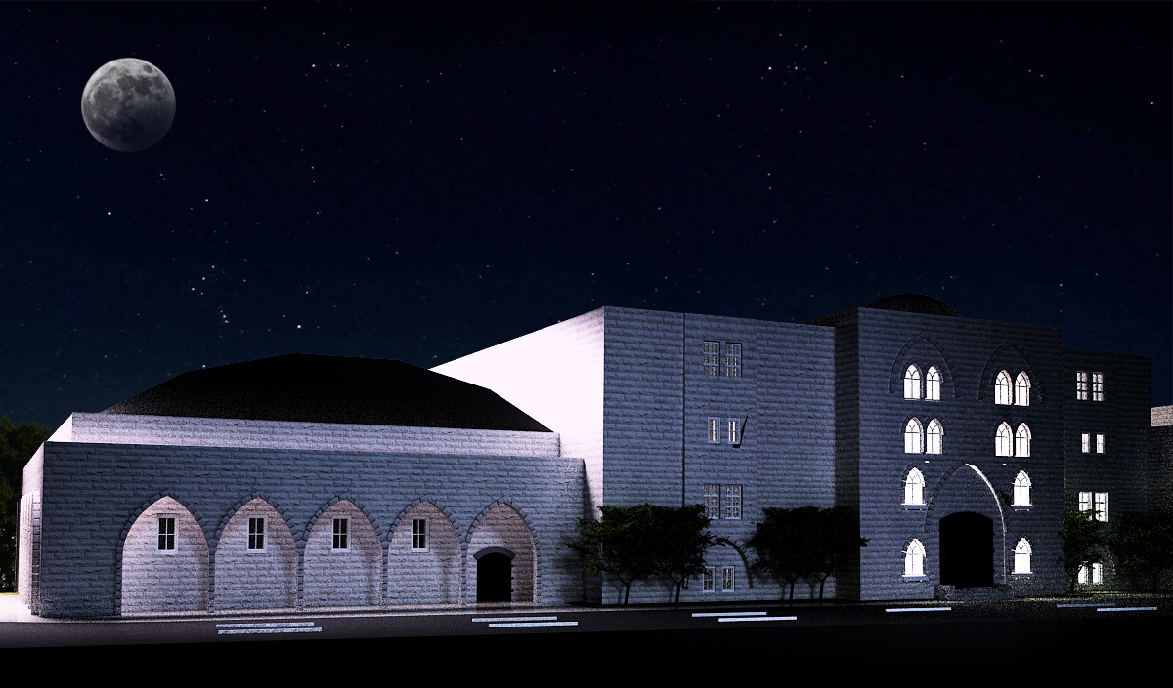

Structural Design for
International Hotel Building in Nablus
An-Najah National University
Faculty of Engineering
Civil Engineering Department
Graduation Project II
Prepared by :
Abdul-Rahman Sedih
Ihsan Taweel Supervisor:
Yazan Asia Ibrahim Arman

Slide 2
Outline
          Introduction
          Preliminary Design
3-D Modeling

Slide 3
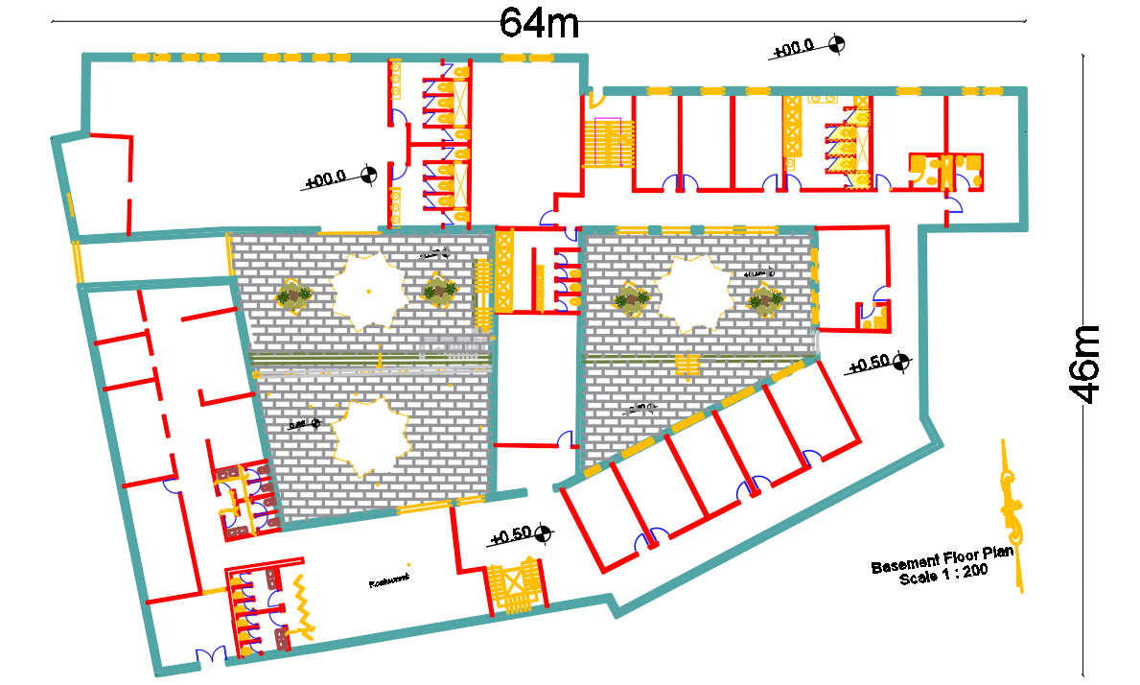
Introduction
Project Description :

Slide 4
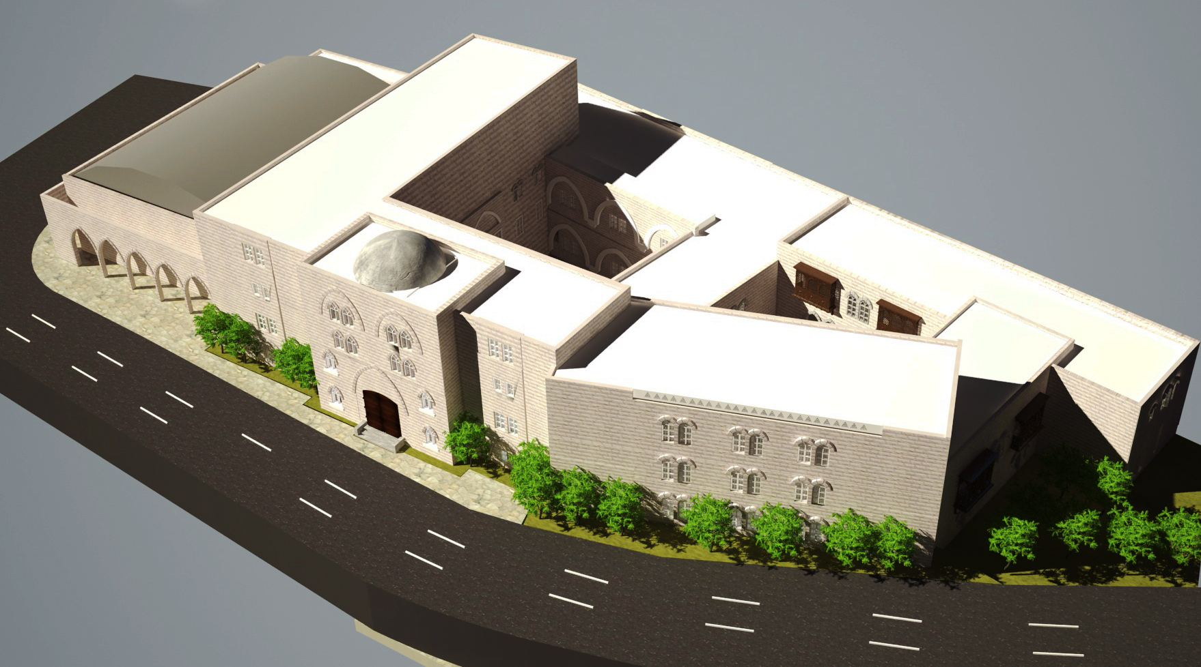

Slide 5
This project is about structural analysis and design for the International Hotel Building which is located in Nablus city - Rafedia , and it rises around 400m above mean sea level (AMSL).
The building is five floors concrete structure.
Floor | Height | Area of Part (m²)
Basement | 5 | 2100
Ground | 5 | 2100
First | 5 | 2100
Second | 5 | 1025
Third | 5 | 650

Slide 6

Codes and Standards
American Concrete Institute (ACI 318- 2014).
American Society for Civil Engineering – Minimum Design Loads for Buildings and Other Structures (ASCE 7-2010).
International Building Code (IBC- 2012).
Jordanian Code for Loads and Forces.
Unified Facilities Criteria (UFC).

Slide 7
Computer Programs Used
Computer programs
ETABS
Word and Excel
AutoCAD
SAFE

Slide 8
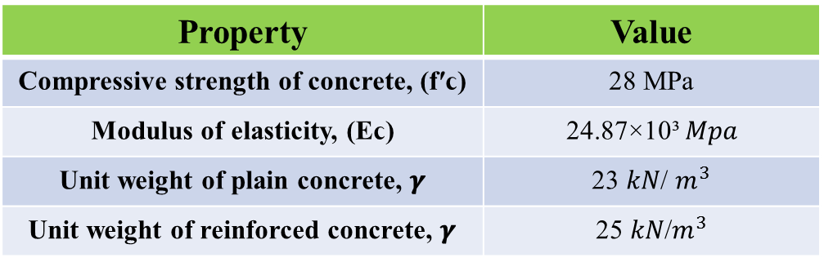
Materials
Structural Materials:
Property | Value
Compressive strength of concrete, (fʹϲ) | 28 MPa
Modulus of elasticity, (Eϲ) | 24.87×10³ 𝑀𝑝𝑎
Unit weight of plain concrete, 𝜸 | 23 𝑘𝑁/ $m^{3}$
Unit weight of reinforced concrete, 𝜸 | 25 𝑘𝑁/$m^{3}$
Concrete:
Steel:
Property | Value
Steel Grade | Grade 60
Yield strength (Fy) | 420 𝑀𝑝𝑎
Ultimate strength (Fu) | 620 𝑀𝑝𝑎

Slide 9
Materials
Nonstructural Materials:
Material | Unit weight, 𝜸 in KN\m³
Plaster | 23
Tiles | 25
Aggregate, fill | 18
Masonry stone | 26
Brick | 12
Concrete mortar | 23

Slide 10
Loads
Gravity
Dead
Live
Lateral
Snow
Seismic
Soil
Temperature

Slide 11
Gravity Loads
Dead Load:
  Slab superimposed dead load= 4.3 KN/m²
  Superimposed dead load of external walls = 4.4 KN/m²
  The maximum value of the live load which was obtained from table 4-1 in ASCE7-10 is 4.8 KN/m², But we used a live load value of 5 KN/m².
  According to Jordanian Code we found the value of snow load equals 1 KN/m².
Live Load:
Snow Load:
Temperature Load:
From Jordanian Code the expected value of temperature changes is 25 C˚.

Slide 12
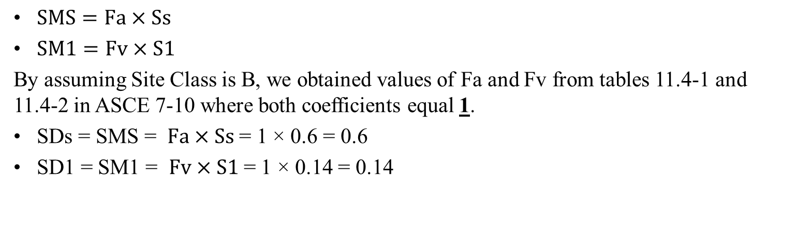
2. Site Coefficients and Adjusted Maximum Considered Earthquake (MCEᴿ) Spectral Response Accelerations(SMS & SM1):
Lateral Load
Seismic Loads:
1. Mapped Spectral Response Acceleration Parameters:
Ss and S1 parameters were obtained from Spectral Response Acceleration maps from Israeli code to be (Ss=0.6 and S1 = 0.14 ).
$SMS=Fa×Ss$
$SM1=Fv×S1$
By assuming Site Class is B, we obtained values of Fa and Fv from tables 11.4-1 and 11.4-2 in ASCE 7-10 where both coefficients equal 1.
SDs = SMS = $Fa×Ss$ = 1 × 0.6 = 0.6
SD1 = SM1 = $Fv×S1$ = 1 × 0.14 = 0.14

Slide 13
3. Importance Factor and Risk Category(Ie):
The risk Category was decided to be Ш from table 1.5-1 in ASCE7-10, so the Importance Factor is equal 1.25 according to table 1.5-2 in ASCE7-10.
4. Seismic Design Category:
According to the tables 11.6-1 and 11.6-2 in ASCE7-10, Since the value of SDs= 0.6, and the Risk Category is Ш. So, it’s found that the seismic design category is D.

Slide 14

5. Design Coefficients and Factors for Seismic Force-Resisting Systems:
Since the Seismic Design Category is D, considering the type of Seismic Force-Resisting System is Building Frame System with Special reinforced concrete shear walls, from table 12.2-1 it’s found that the response modification coefficient (R=6)and overstrength factor (Ωo=2.5) and deflection amplification factor(Cd=5).
6. Structure Fundamental Period:
$$T=Ct×{hn}^{x}$$
From table 12.8-2 below, it’s found that values of Ct and x equals 0.0488 and 0.75, respectively.
Since $hn$ = 25 m, then T= $0.0488 ×$ ${25}^{0.75 }$= 0. 545 sec.

Slide 15
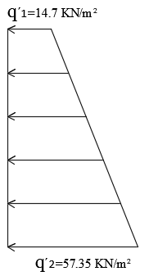
Lateral Loads
Soil Load:
Ɣ = 20 kN/m³
Ø = 35˚
Ko =1-sin (Ø) =1-sin (35) =0.43
the value of the surcharge live load (w) = 12 KN/m²
The figure below shows the total earth pressure on the basement shear wall including seismic earth pressure .

Slide 16
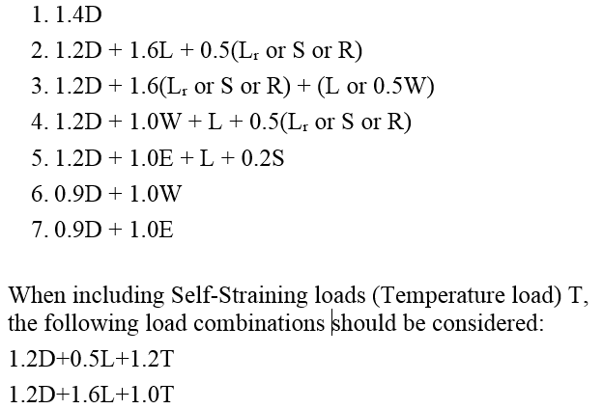
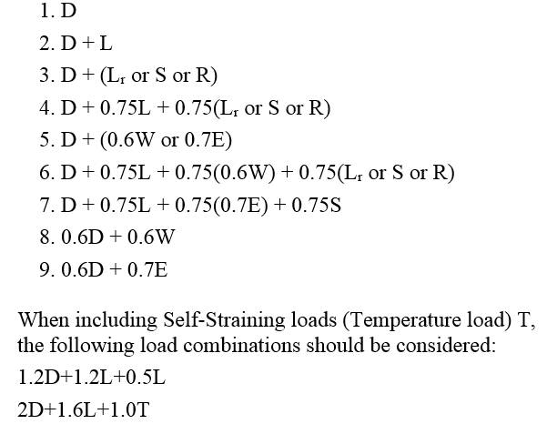
Load Combinations.
Ultimate Load Combinations Service Load Combinations

Slide 17

Preliminary Design
Notes:
Preliminary Design is the first phase of the design process. In this stage of the project a preliminary dimensions was selected in order to build the 3-D model. To check the validity of 3D model, three verification checks will be made which are compatibility, equilibrium and stress-strain relationships. After studying the 3D model and results, a change of these dimensions could be occurred to get the most suitable dimension that will achieve the strength needs.

Slide 18
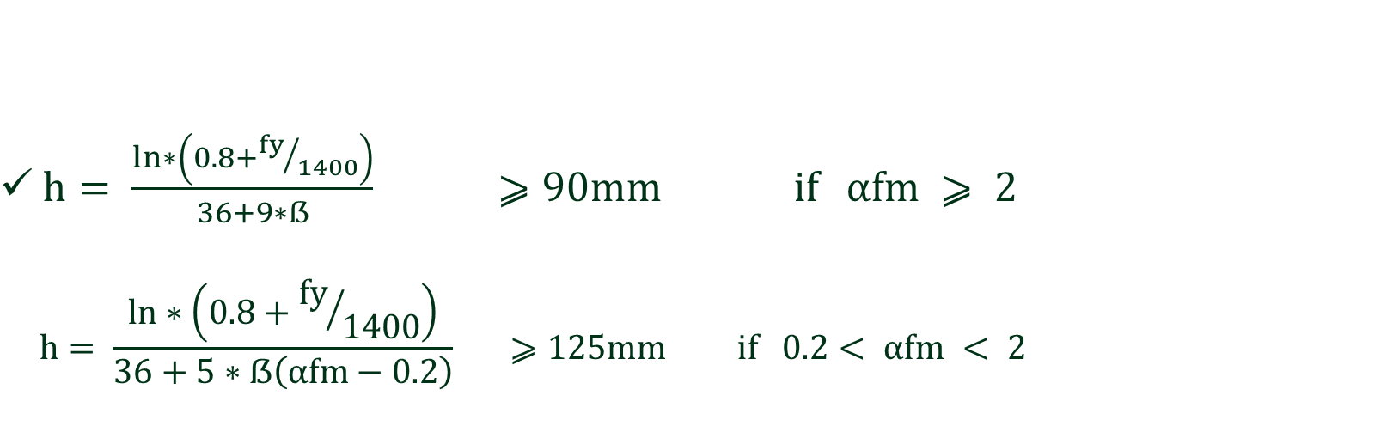
The structural system used is two way solid slab
Slab thickness
$h= \frac{ln∗\left(0.8+{fy}/{1400}\right)}{36+9∗ẞ} ⩾90mm if αfm ⩾ 2$
$$h= \frac{ln∗\left(0.8+{fy}/{1400}\right)}{36+5∗ẞ\left(αfm−0.2\right)} ⩾125mm if 0.2< αfm < 2$$

Slide 19
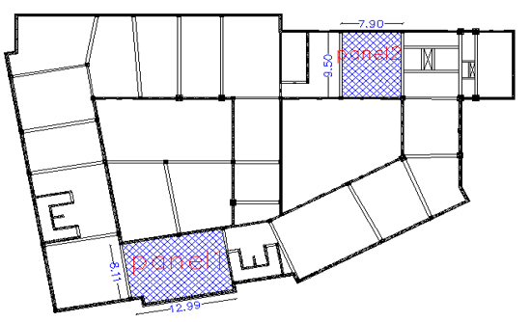
The Critical Panels
Panel 1 dimensions
(12.96m x 8.11m)
Panel 2 dimensions
(9.50m*7.90m)

Slide 20
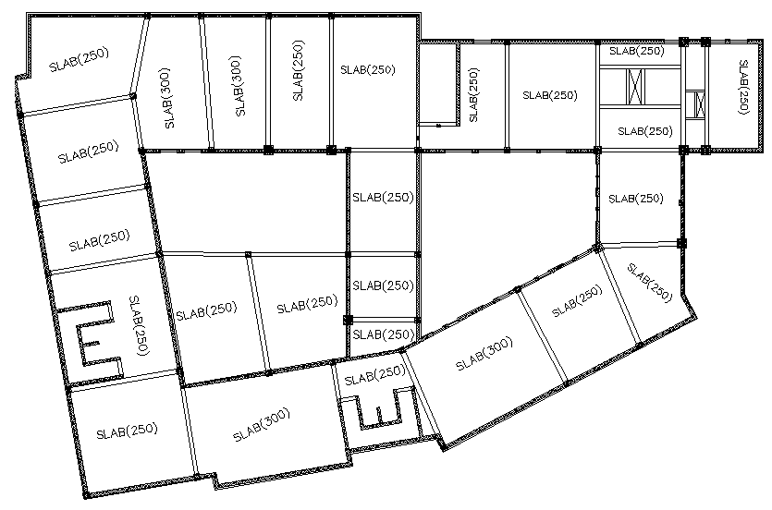

Slide 21
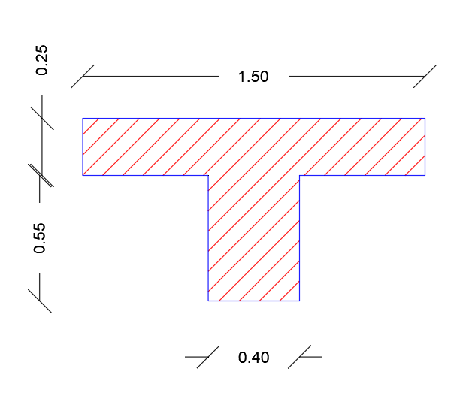
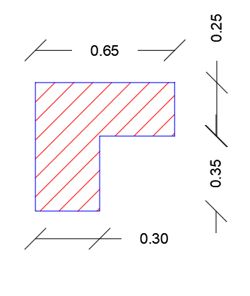
Beams
The preliminary sections of beams:
Beam | Dimensions (mm)
B1 | 250*500
B2 | 250*600
B3 | 250*800
B4 | 300*600
B5 | 300*800
B6 | 400*800
B7 | 500*1000
B8 | 500*1200

Slide 22
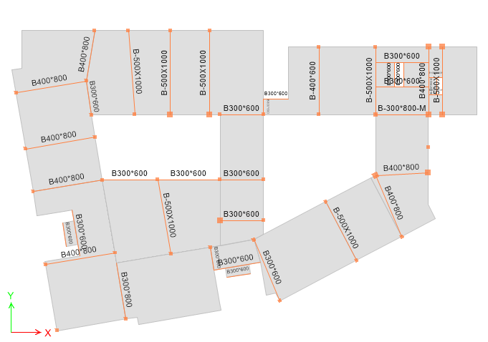

Slide 23
Columns dimensions are shown in table:
 | Preliminary Dimensions (mm) | Final Dimensions (mm)
C1 | 500*500 | 500*500
C2 | 500*500 | 600*600
C3 | 500*500 | 800*800

Slide 24
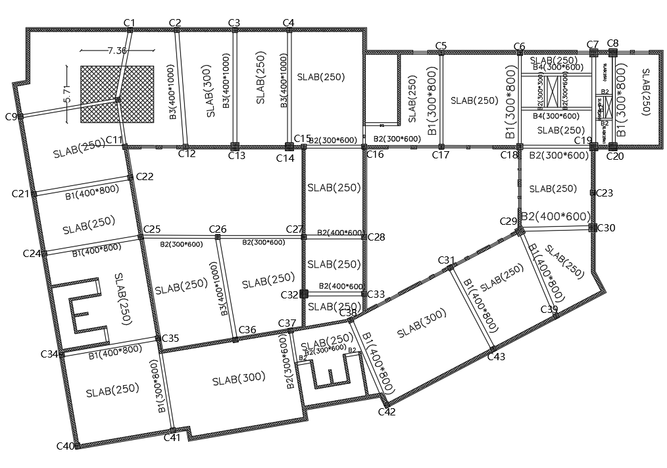
    Columns
By using tributary area method, we found the ultimate load and determine the dimensions of columns.

Slide 25
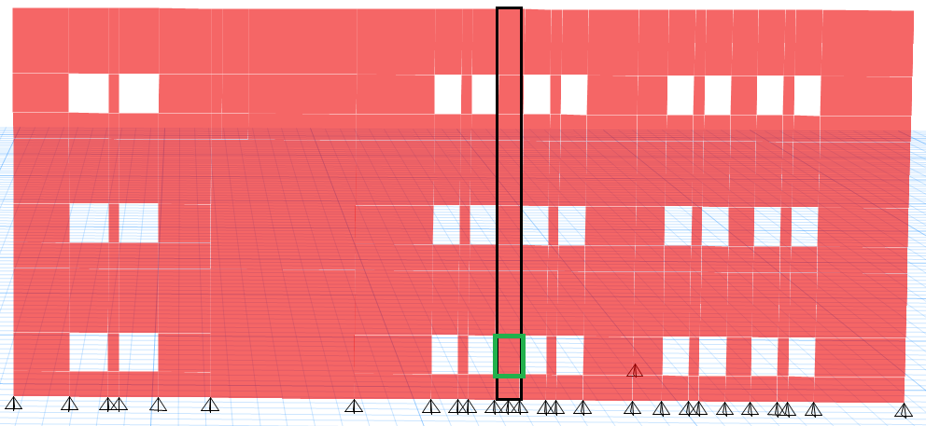
    Shear Walls
Wall | Thickness (mm)
Wall 1 | 250
Wall 2 | 300

Slide 26
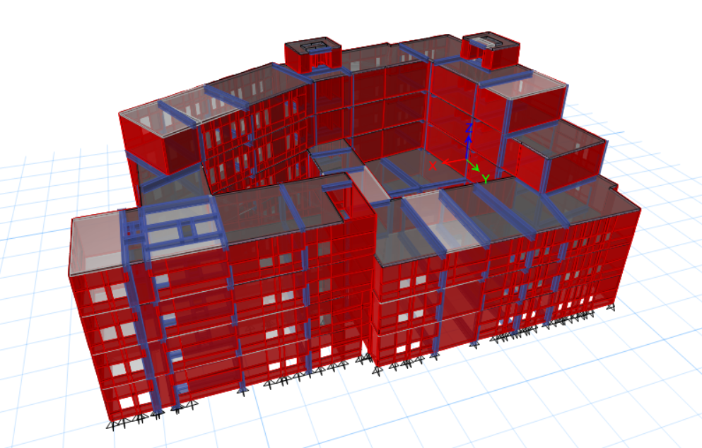
3-D Modeling
Structural Modeling in Etabs.

Slide 27
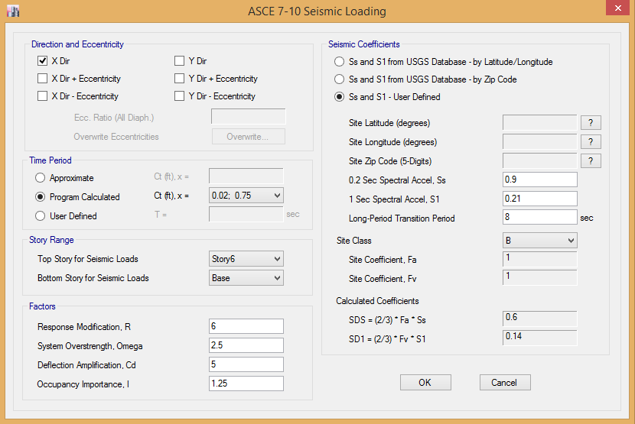
seismic loading data according to Equivalent Static Method

Slide 28
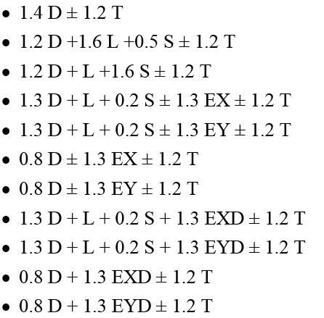
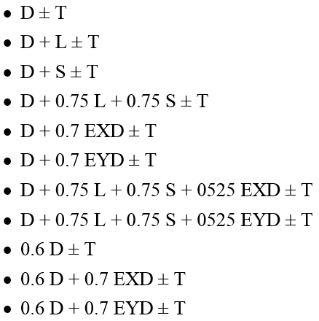
Design Load Combinations
Ultimate Load Combinations Service Load Combinations

Slide 29
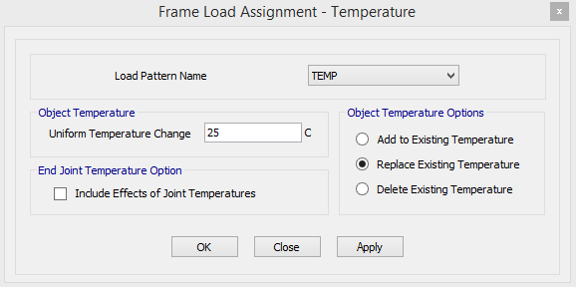
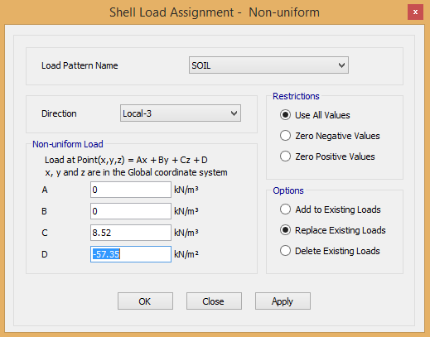
Loads Assignments
Temperature Load Assignment Soil Load Assignment

Slide 30
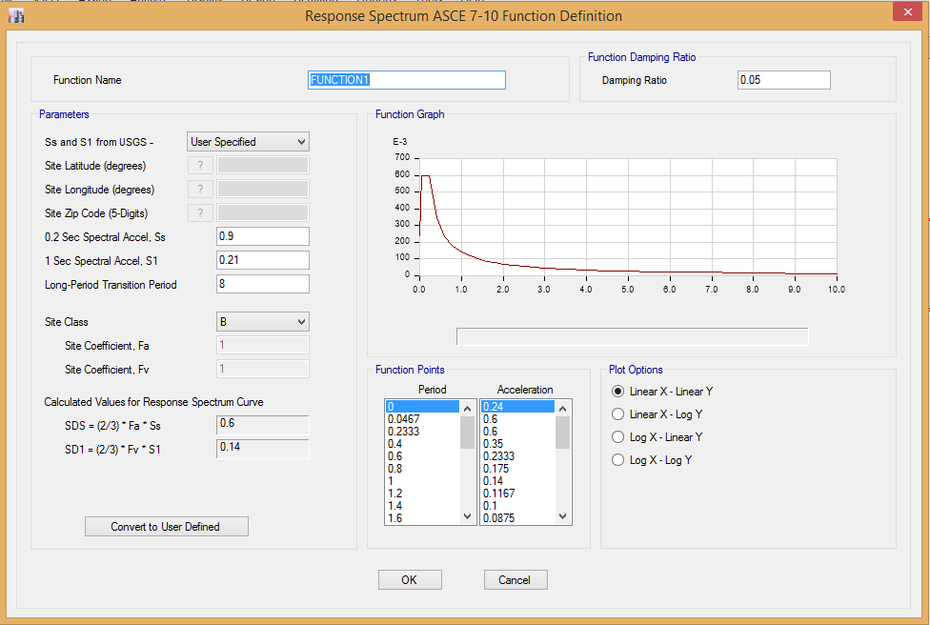
Response Spectrum Function

Slide 31
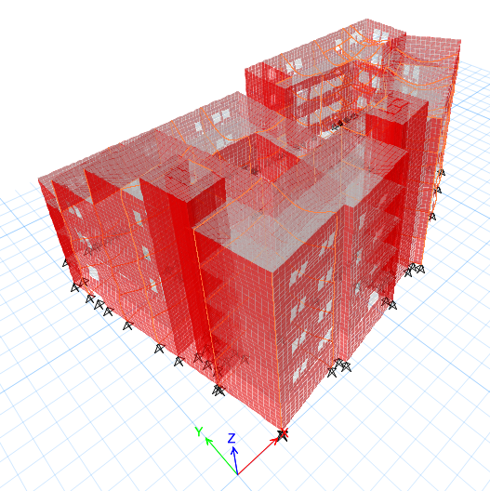
Compatibility Check

Slide 32
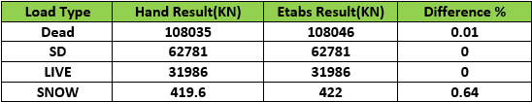
Equilibrium Check

Slide 33
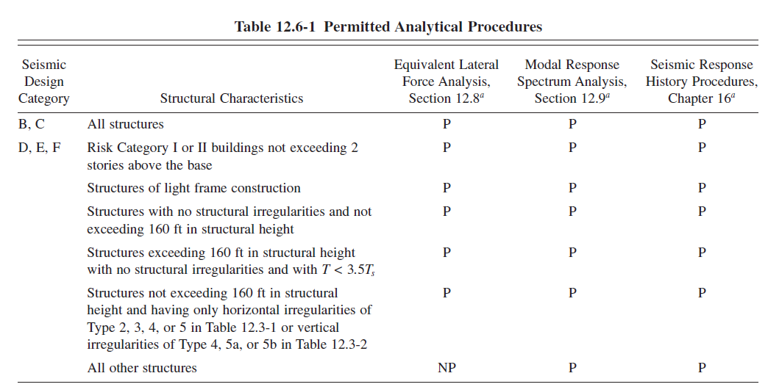
Seismic analysis method

Slide 34
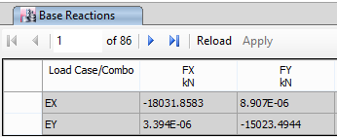
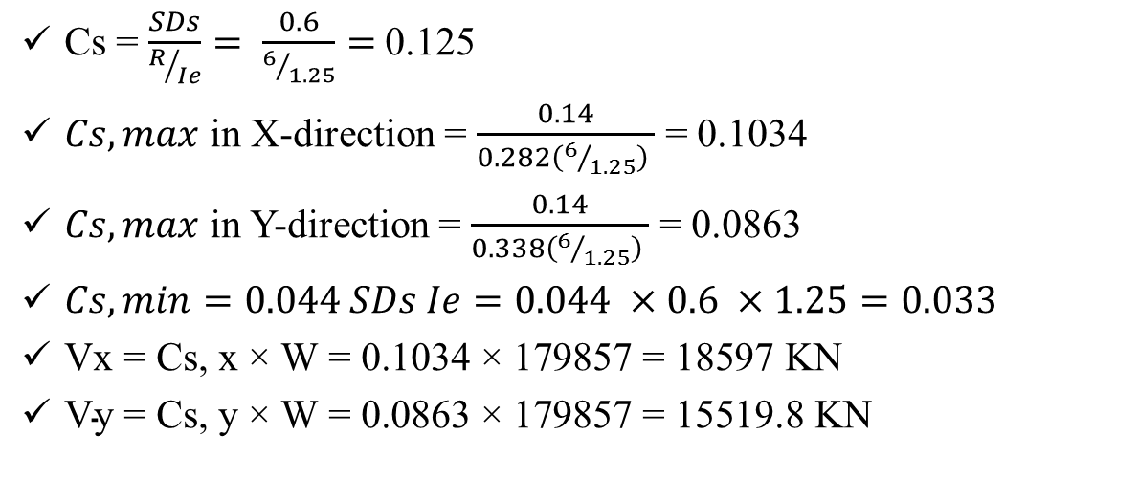

Check Base Shear Equilibrium
Cs = $\frac{SDs}{R/{Ie}}= \frac{0.6}{6/{1.25}}=$0.125
$Cs,max$ in X-direction = $\frac{0.14}{0.282\left(6/{1.25}\right) }$ = 0.1034
$Cs,max$ in Y-direction = $\frac{0.14}{0.338\left(6/{1.25}\right) }$ = 0.0863
$Cs,min=0.044 SDs Ie=0.044 ×0.6 ×1.25=0.033$
$\text{Vx}\text{ = }\text{Cs}\text{, }\text{x}\text{ × }\text{W}\text{ = 0.1034 × 179857 = 18597 }\text{KN}$
$\text{V}\text{y}\text{ = }\text{Cs}\text{, }\text{y}\text{ × }\text{W}\text{ = 0.0863 × 179857 = 15519.8 }\text{KN}$
Difference percentage for Vx = $\frac{18597−18031.8}{18597}$ × 100% = 3% → OK.
Difference percentage for Vy = $\frac{15519.8−15023.5}{15519.8}$ × 100% = 3.1%→ OK

Slide 35
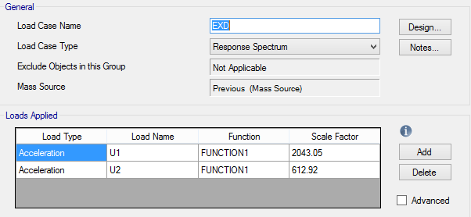
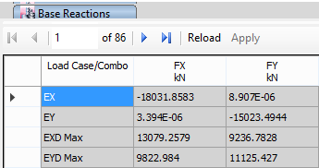
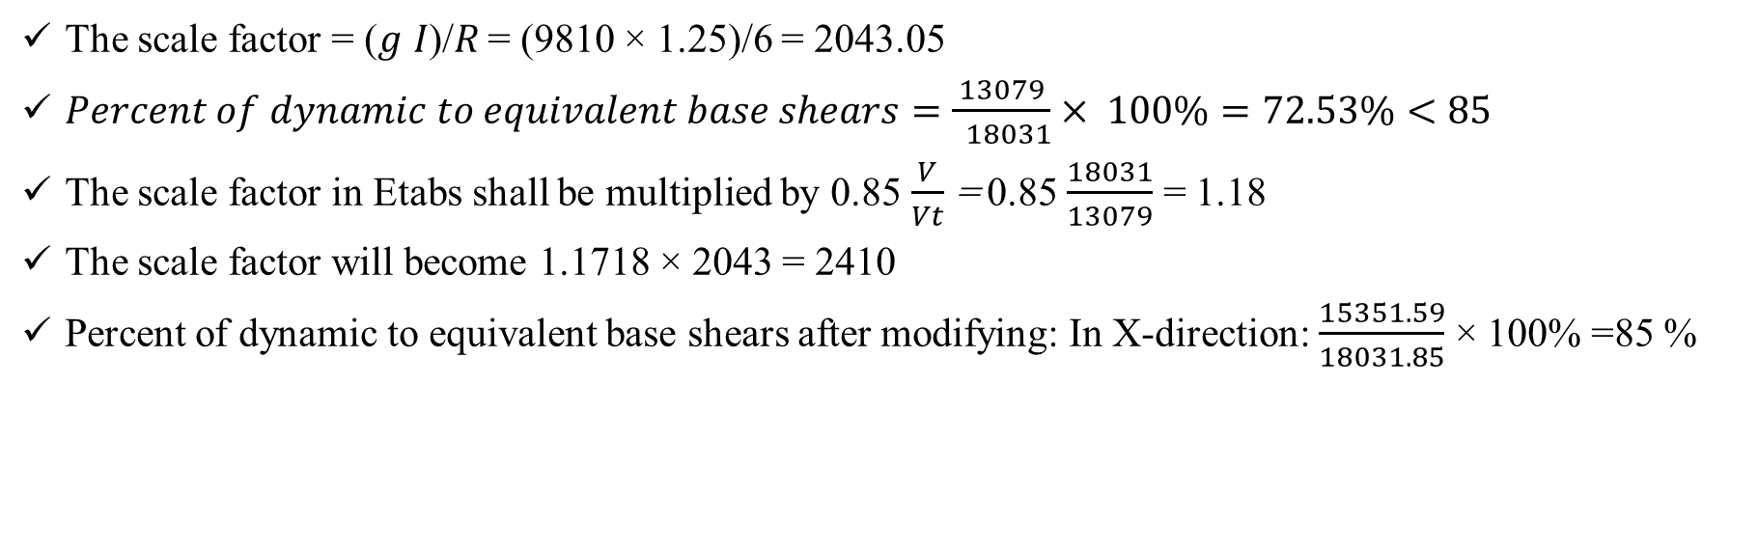
Checking for Dynamic Response Spectrum Analysis
The scale factor = (𝑔 𝐼)/𝑅 = (9810 × 1.25)/6 = 2043.05
$Percent of dynamic to equivalent base shears=\frac{13079}{ 18031}× 100\%=72.53\%<85$
The scale factor in Etabs shall be multiplied by 0.85 $\frac{V}{Vt}$ = 0.85 $\frac{18031}{13079}$ = 1.18
The scale factor will become 1.1718 × 2043 = 2410
Percent of dynamic to equivalent base shears after modifying: In X-direction: $\frac{15351.59}{18031.85}$ × 100% =85 %

Slide 36
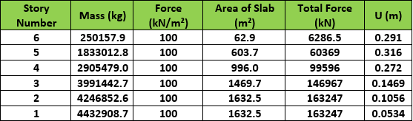
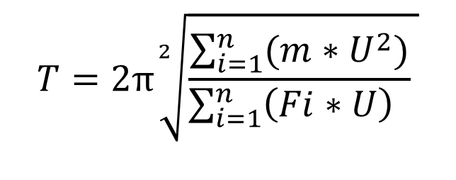
Check Period
Displacement values for each story of the structure
$$T=2π\sqrt[2]{\frac{\sum_{i=1}^{n}{(m∗U^{2})}}{\sum_{i=1}^{n}{\left(Fi∗U\right) }} }$$
By applying Rayleigh equation, T = 0.387 sec.
T in Y-direction from Etabs = 0.339 sec.
The difference between the two values is acceptable.

Slide 37
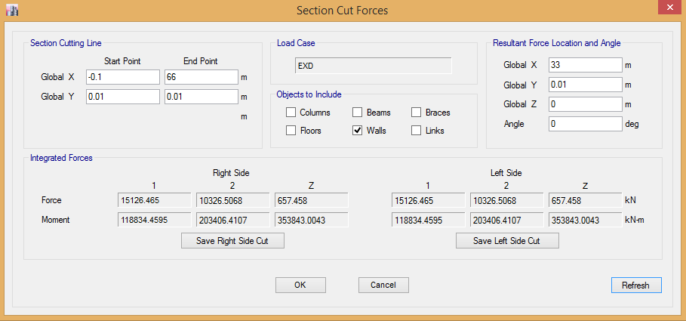
Checking Type of Lateral Force Structural System
Percent of base shear in shear walls= $\frac{base shear of shear walls}{total base shear}$=$\frac{15126.465}{15351.6}$ ×100%= 98.5%

Slide 38
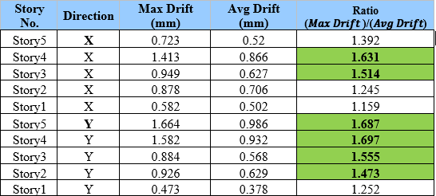
Horizontal Structural Regularity Check
Types 1a (Torsional Irregularity): maximum story drift >1.2 times the average of the story drifts of the two ends of the structure.
1b (Extreme Torsional Irregularity): maximum story drift >1.4 times the average of the story drifts of the two ends of the structure.

Slide 39
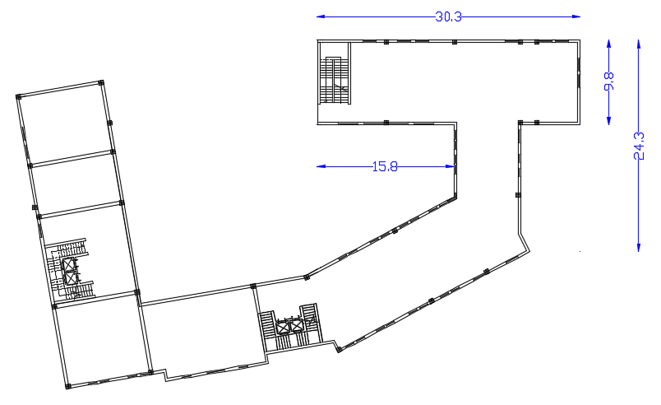
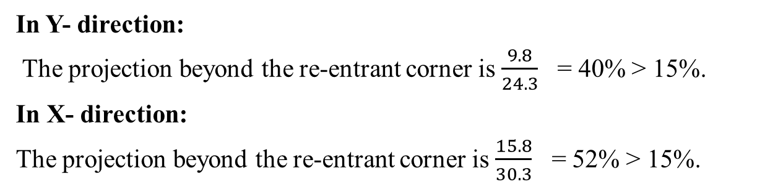
Type 2 (Reentrant Corner Irregularity): Projections of the structure beyond these reentrant corner >15% plan dimension of the structure in the direction considered.
In Y- direction:
The projection beyond the re-entrant corner is $\frac{9.8}{24.3}$ = 40% > 15%.
In X- direction:
The projection beyond the re-entrant corner is $\frac{15.8}{30.3}$ = 52% > 15%.

Slide 40
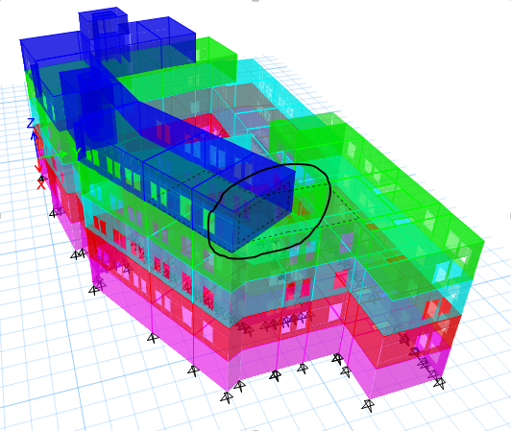
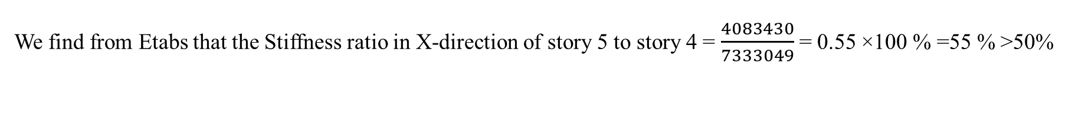
Type 4 (Out-of-plane offset irregularity):Exists when there are discontinuities in a lateral force path (diaphragms)
Type 3 (Diaphragm discontinuity irregularity): floor or roof has a large open area comprising >50 % of the gross enclosed area of the diaphragm
We find from Etabs that the Stiffness ratio in X-direction of story 5 to story 4 = $\frac{4083430}{7333049}$ = 0.55 ×100 % =55 % >50%
So, this type of irregularity is existing in this project.

Slide 41
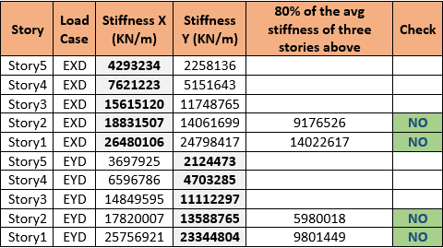
Vertical Structural Regularity Check
Types 1a (Stiffness – soft story Irregularity):story in which the lateral stiffness is less than 70% of that in the story above or less than 80% of the average stiffness of the three stories above.
Types 1b (Stiffness – Extreme soft story Irregularity):story in which the lateral stiffness is less than 60% of that in the story above or less than 70% of the average stiffness of the three stories above.

Slide 42
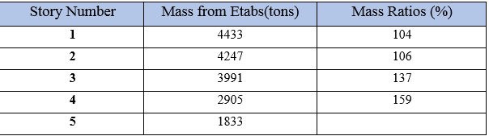
Type 2 (Weight (Mass) Irregularity):effective mass of any story is more than 150 percent of the effective mass of an adjacent story.
The mass ratios of story 4 to story 5 = $\frac{2905}{1833}$ × 100 % =159 % > 150 %. So, this type of irregularity is existing

Slide 43
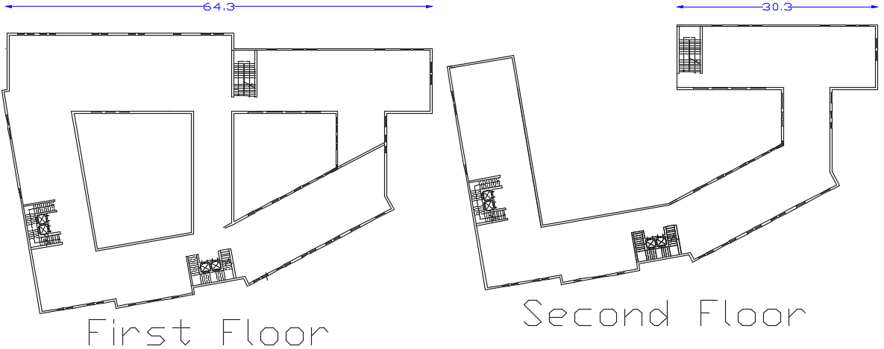

Type 3 (Vertical Geometric Irregularity):horizontal dimension of the seismic force-resisting system in any story is more than 130% of that in an adjacent story.
$\frac{64.3}{30.3}$ × 100 % = 212 % > 130 %.

Slide 44
Type of Diaphragm
Direction | X |  |  |  |  | Y
Number of Story | 1 | 2 | 3 | 4 | 5 | 1 | 2 | 3 | 4 | 5
First Point | 0.527 | 1.177 | 1.698 | 2.101 | 3.464 | 0.439 | 0.941 | 1.336 | 1.997 | 2.304
Mid-Point | 0.588 | 1.436 | 2.283 | 3.036 | 3.579 | 0.522 | 1.122 | 1.581 | 4.205 | 2.420
Last Point | 0.580 | 1.556 | 2.52 | 3.292 | 3.700 | 0.561 | 1.79 | 2.95 | 3.83 | 2.49
Avg(first+second)×2 | 1.107 | 2.733 | 4.21 | 5.393 | 7.164 | 1.00 | 2.73 | 4.28 | 5.83 | 4.80
Rigid/Flexible | rigid | rigid | rigid | rigid | rigid | rigid | rigid | rigid | rigid | rigid
U_{X, midpoint} = 0.588 mm < $2×\left(\frac{Ux first+Ux last }{2}\right)=2×\left(\frac{0.527+0.580}{2}\right)=1.107$mm.
U_{Y, midpoint} = 0.522 mm < $2×\left(\frac{U_{Y} first+U_{Y} last }{2}\right)=2×\left(\frac{0.439+0.561}{2}\right)=1.00$mm.

Slide 45

Immediate and Long Term Deflection
$∆_{LT }$ = $∆_{L }$ + $λ_{t }×∆_{D }$ + $λ_{t }×$ $∆_{LS }$
Load Case | Slab defelction(mm) | Average beams deflections (mm) | Relative deflection* (mm)
D | 12.593 | 2.032 | 10.561
D + L | 20.054 | 3.262 | 16.792
D + 0.25 L | 14.490 | 2.913 | 11.577

Slide 46

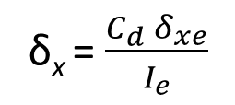
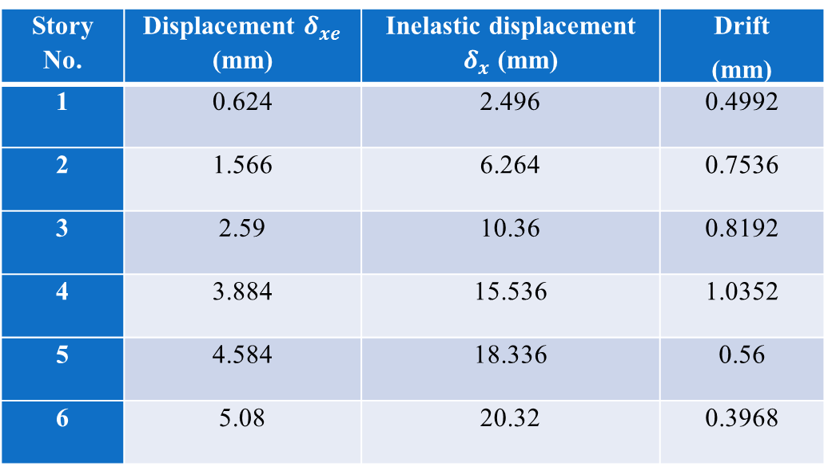
Elastic and Plastic Deflections and Story Drift
δ_{x} = $\frac{C_{d} δ_{xe}}{I_{e}}$
Story No. | Displacement $δ_{xe}$ (mm) | Inelastic displacement $δ_{x}$ (mm) | Drift (mm)
1 | 0.624 | 2.496 | 0.4992
2 | 1.566 | 6.264 | 0.7536
3 | 2.59 | 10.36 | 0.8192
4 | 3.884 | 15.536 | 1.0352
5 | 4.584 | 18.336 | 0.56
6 | 5.08 | 20.32 | 0.3968
The allowable drift is equal to 0.015 h_{SX}
$∆_{a}=$0.015$×$5 = 0.075m

Slide 47
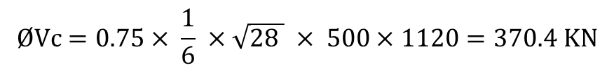
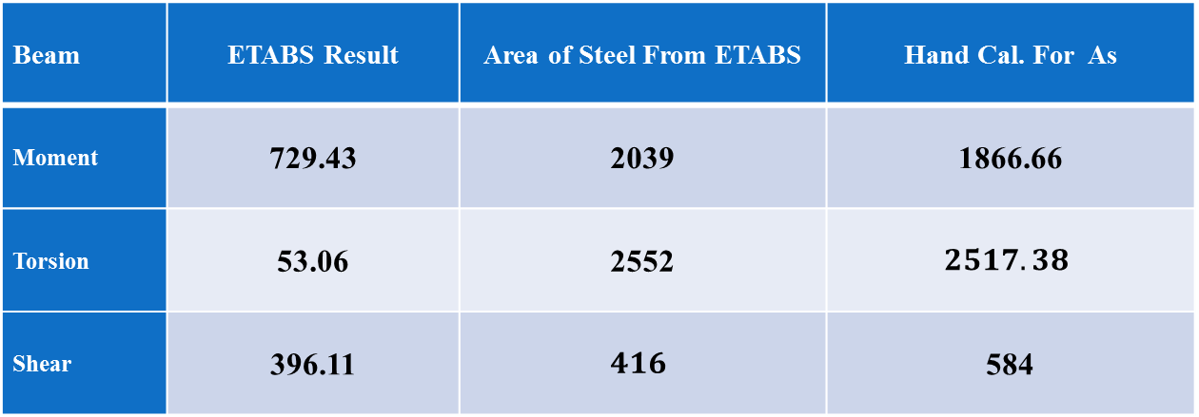
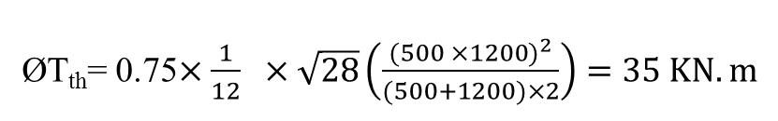
Verification of Structural Design for Beam
Beam | ETABS Result | Area of Steel From ETABS | Hand Cal. For As
Moment | 729.43 | 2039 | 1866.66
Torsion | 53.06 | 2552 | $$2517.38$$
Shear | 396.11 | $$416$$ | 584
$$ØVc=0.75× \frac{1}{6} ×\sqrt{28 } × 500×1120=370.4 KN$$
ØT_{th}= 0.75$×\frac{1}{12} ×\sqrt{28}\left(\frac{{(500 ×1200)}^{2}}{(500+1200)×2}\right)=35 KN.m$

Slide 48


Verification of Structural Design for Columns
Ultimate Axial Force on C10 = 2740 KN.
ØPn = 0.65x 0.8 ((0.85 x 28 (500x500 – A_{st}) +A_{st} 420(= 2740000N
Use Asmin

Slide 49
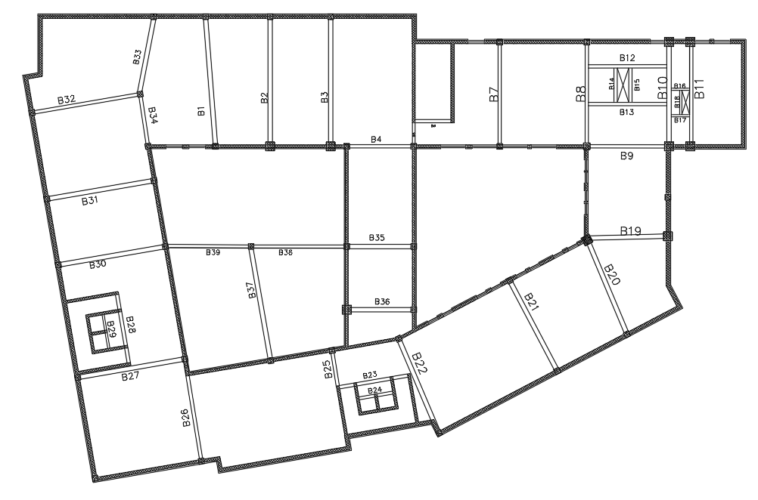
Design of Beams
Figure shows the location of B9 that used as a sample in design of beams.

Slide 50
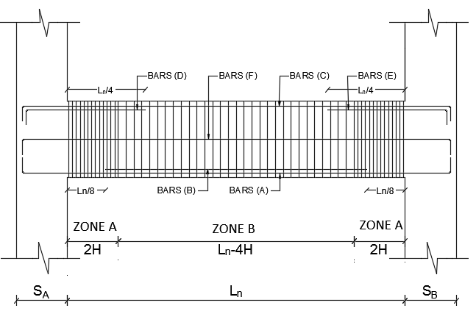
General Key for reinforcement distribution of simple beams

Slide 51


Flexural Design for Beams
Figure Shows Area of Longitudinal Reinforcement for B9 in the first floor from Etabs.
Figure Shows Torsional Longitudinal Reinforcement for B9 from Etabs.
Note: For torsional reinforcement, area of steel equals 1044 mm2, the torsional reinforcement shall be distributed along the perimeter of section of beam, in such a way that the torsional reinforcement will be divided into three parts, the first part will be added to (BARS C) and the second part will be added (BARS A) and the last will be put at the middle of the beam (BARS F).

Slide 52
Area of steel for BARS A = 3283 + 1/3 × 1044 = 3631 mm².
Try 8 Ø 25 mm = 491 x 8 = 3920 mm².
Area of steel for BARS B = 0, because the amount of reinforcement for the bottom middle of the span is covered by BARS A.
Area of steel for BARS C = 1681 + 1/3 × 1044 = 2029 mm².
Try 7 Ø 20 mm = 314 x 7 = 2198 mm².
Area of steel for BARS D = 0, because the amount of reinforcement for the top left joint is covered by BARS C.
Area of steel for BARS E = 4517-1681 = 2836 mm².
Try 4 Ø 32 mm = 804 x 4 = 3216 mm².
Area of steel for BARS F = 1/3 × 1044 = 348 mm².
Try 4 Ø 14 mm = 154 x 4 = 616 mm². (Two layers)

Slide 53


Length of BARS A, C and F = Ln + SA + SB – 0.08 + 2 (16 db /1000)
Length of BARS B = Ln – (2 Ln / 8) = 3 Ln / 4
Length of BARS D = Ln / 4 + SA – 0.04 + (16 db /1000)
Length of BARS E = Ln / 4 + SB – 0.04 + (16 db /1000)
Seismic Requirements of Longitudinal Bars:
1. All beams have more than two continuous bars at both top and bottom faces. And at any section the reinforcement ratio ρ is less than 0.025
2. Positive moment strength at joint face is not to be less than 1/2 of the negative moment strength provided at the face of the joint.
Figure shows that the ultimate negative moment at the face of joint = 768 KN.m.

Slide 54

$ρ=\frac{0.85 ×28}{420} \left(1−\sqrt{1−\frac{2.61 ×768 ×{10}^{6}}{28 ×300×{720}^{2}}}\right)$ = 0.015
One-half of moment equal 768 x 0.5 = 384 KN.m.
So, the reinforcement ratio (ρ) equal 0.015 / 2 = 0.0075,
But the minimum (ρ) equal $\frac{4}{3} ρ_{calc}=\frac{4 ×0.0075}{3}=0.01$,
The area of steel equal A_{s} = 0.01 x 300 x 720 = 2160 mm² < 3283 mm² from figure 3.58, OK
3. The negative or positive moment at any section along the member is not to be less than 1/4 the maximum moment strength provided at the face of either joint.
Ultimate negative moment at the face of joint = 768 KN.m.
One-fourth of moment equal 768 x 0.25 = 192 KN.m.
So, the reinforcement ratio (ρ) equal 0.015 /4 = 0.00375,
But the minimum (ρ) equals 4/3 ρ_calc=(4 ×0.00375)/3=0.005,
The area of steel equal As = 0.005 x 300 x 720 = 1080 mm2 <1681 mm2 from figure 3.58, OK

Slide 55
Shear Design for Beams
- Stirrups Ø 10 mm will be used, with area of steel 78.5 mm².
For Zone A, S min is:
d/4 = 720 x 0.25 = 180 mm.
6 d_{b} = 6 x 20 = 120 mm.
24 d_{s} = 24 x 10 = 240 mm.
150 mm
Use S min = 100 mm
For Zone B, at least S = d/2 = 720/2 = 360 mm, Use S = 350 mm.

Slide 56


Slide 57


Design of Columns
Seismic Requirements for Columns of Special Moment Frames:

Slide 58


Sample Detailing of Column C34
The required areas for reinforcement for all floors are 4230, 4266, 4295, 4327 and 4399 mm² in order from the first floor to the fifth floor.
For uniformity issues the required area for reinforcement is the maximum which is equal 4399 mm², use 12Ø 22 mm.
So, ρ =$\frac{12 ×380}{ 500×500}=0.0183<0.06 →Ok$.
Lap Splice for longitudinal bars shall be extended the value of 1.3 development length:
L_{dt} =$\frac{0.59 ×420×22}{\sqrt{28}}=1030 mm$.
Lap splice = 1.3 x 1030 = 1339 mm, use 1.4 m
Distance (Lo­):
L_{o} = max. of $\left\{\begin{aligned}0.5 m \\ \frac{1}{6} ×4.5=0.75 m \\ 0.45 m \end{aligned}\right.$
Assume L_{o} equal 0.8

Slide 59


Transverse Reinforcement
Stirrups of a diameter Ø12 mm will be used for this column.
S_{o} = $100+\left(\frac{350−350}{3}\right)=$100 mm.
Note: h_{x} (distance between legs) = 500 – (50+50) = 400 mm, but use h_{x} = 350 mm because by code h_{x} ≤ 350 mm.
Stirrups spacing within the distance L_{o,} (S₁) = min. of $\left\{\begin{aligned}0.25 ×500=125 mm \\ 6 ×22=132 mm \\ 100 mm \end{aligned}\right.$
So, S₁ = 100 mm.
Stirrups spacing beyond the distance L_{o}, (S₂) = min. of $\left\{\begin{aligned}6 ×22=132 mm \\ 150 mm\end{aligned}\right.$
Use S₂ = 100 mm.
equation:$A_{sh}= max{of \left\{\begin{aligned}0.3 \left(\frac{500×500}{400×400}−1\right)\frac{28}{420}×100×400=450 mm^{2} \\ 0.09 × \frac{28}{420}×100×400=240 mm^{2} \\ \end{aligned}\right.}$

Slide 60


Design of Tie Beams
Longitudinal Reinforcement
Design strength = $\frac{(Max Pu)× S_{DS}}{10}= \frac{3397×0.6}{10}=$ $204$ KN
$$As=\frac{F}{∅ Fy}=\frac{{204×10}^{3}}{0.9×420}=441 mm^{2 }$$
But ρ _{min} = 0.00333
As _{min} = 0.00333 x b x d
Where all tie beams has a cross section with b = 600 mm and h = 900 mm.
So, Asmin = 0.00333 × 600 × 820 =1639 mm2.
Use 6Ø20 at top and bottom of the tie beams.
At the middle of the tie beams cross section, skin reinforcement were used at 3 layers (each layer has 2Ø12 as shown in figure).

Slide 61

Transverse Reinforcement:
The first hoop shall be located at a distance not more than 50 mm from the face of the supporting member. Maximum hoop spacing is not to exceed the smallest of:
(a): d/4.
(b): 6 d_{b}, where d_{b} is the diameter of the smallest longitudinal bar.
(c): 150 mm
- Stirrups Ø 10 mm will be used, with area of steel 78.5 mm².
d/4 = 820 x 0.25 = 205 mm.
6 d_{b} = 6 x 20 = 120 mm.
150 mm
Use S min = 100 mm
Transverse reinforcement spacing shall not exceed d/2 throughout the length of the beam.
d/2 = 820 / 2 = 410 mm
Use S min = 400 mm

Slide 62


Design of Slabs
For shear reinforcement, by applying equation 3-12:
$∅$ Vc = $∅ λ\frac{1}{6} \sqrt{f^{′}c}×bw×d$ → $∅$ Vc = $0.75× \frac{1}{6} ×\sqrt{28}×220×1000$
$∅$ Vc = 145 KN.

Slide 63


Slide 64

$$ρ=\frac{0.85 \grave{f_{c}}}{F_{y}} \left(1−\sqrt{1−\frac{2.61M_{u}}{0.85∅\grave{f_{c}}bd^{2}}}\right)$$
$$For M=21.4 KN.m ρ=0.0014$$
For flexural design in both direction X and Y:
Width of rib (b) = 1000mm.
Effective depth (d):
= 220mm. (for slab of thickness = 250 mm)
So, minimum area of steel (As_{min}) for slab of thickness = 250 mm:
= 0.0018 x 200 x 1000 = 396 mm².
Use 4 Ø 12 mm / 1000mm. ( As_{min} = 452 mm²

Slide 65


Slide 66

Design of Shear Walls
Sample Design and Detailing for Shear Wall (SW1):
- Dimensions of shear wall:
Height per story = 5 m. (this shear wall extends for 3 stories)
Thickness of first floor shear wall (basement) = 0.3 m
Thickness of the second and third floors shear wall = 0.25 m
Length = 10.45 m
Effective depth of shear wall (d) = 0.8 L = 0.8 x 10450 = 8360 mm.
- Internal forces in shear wall in first floor.
M_{u (Major)} = 2561 KN.m M_{u (Minor)} = 210 KN.m
V_{u} = 1955 KN. P_{u} = 6660 KN.

Slide 67


For horizontal shear reinforcement:
$\frac{A_{t}}{S}=ρ_{t} h=0.0025 ×300=0.75 mm^{2}/mm$.
But, S from section 3.5.2.4.1, the maximum spacing for horizontal reinforcement:
S_{max}= $\left\{\begin{aligned}3h=3×300=900 mm \\ \frac{Lw}{5}= \frac{10450}{3}=3484 mm \\ 450 mm\end{aligned}\right.$
So, S_{max} = 450 mm.
For two curtains (layers) of reinforcement with Ø 10 mm.
$\frac{Av}{S}= \frac{2 ×78.5}{S}=0.75 ⟹S=210 mm$< 450 mm ⟹ Ok.
Use 2 Ø10 / 200 mm.

Slide 68


For vertical shear reinforcement:
$ρ_{l min}=0.0025+0.5 \left(2.5−\frac{h_{w}}{l_{w}}\right) \left(ρ_{t}−0.0025\right) ≥0.0025$.
So, $ρ_{l min}=0.0025$
$\frac{A_{l}}{S}=ρ_{l} h=0.0025 ×300=0.75 mm^{2}/mm$.
The maximum spacing for vertical reinforcement:
S_{max}= $\left\{\begin{aligned}3h=3×300=600 mm \\ \frac{Lw}{3}= \frac{10450}{3}=3484 mm \\ 450 mm\end{aligned}\right.$
So, S_{max} = 450 mm.
For two (layers) of reinforcement with Ø 10 mm.
$\frac{Av}{S}= \frac{2 ×78.5}{S}=0.75 ⟹S=210 mm$ < 450 mm ⟹ Ok.
Use 2 Ø10 / 200 mm.

Slide 69


- Concrete shear capacity of the wall as shown:
$Vc=0.27 \sqrt{f^{′}c} hd+\frac{Nu d}{4 Lw}=0.27 \sqrt{28} ×300×8360+\frac{6660×{10}^{3}×8360}{4×10450}=$ 4915 KN.
$∅ Vc=0.6 × 4915 =$ 2950 KN.
Vu (from Etabs) = 1955 KN
So, V_{u} < ØV_{c} ⟹ Ok.
As, _{provided =} 5 x 2 x 78.5 = 785 mm²/m
⟹ Ok.

Slide 70

- Special boundary elements check:
Special boundary elements are needed if the stress σ > 0.2 f'c
σ = 0.2 x 28 = 5.6 Mpa.
To compute stress from equation
σ = $\frac{P}{A}+ \frac{M C}{I}$
Where:
I: Moment of inertia equal $\frac{b h^{3}}{12}= \frac{300 ×{10450}^{3}}{12}=2.85 ×{10}^{13}$ mm⁴.
C: Equal 0.5 x 10450 = 5225 mm.
So, σ = $\frac{6660 ×{10}^{3}}{300 ×10450}+ \frac{2561×{10}^{6}×5225}{2.85 ×{10}^{13}}=2.59$ Mpa < 5.6 Mpa.
So, there is no need for boundary elements.

Slide 71


Wall pier design:
The dimensions for wall pier are:
Length = 965 mm. Thickness = 300 mm.
Height = 1500 mm. Effective depth (d) = 0.8 x 965 = 772 mm.
Since, L_{w} / b_{w} = 965 ÷ 300 = 3.2 > 2.5, so the piece can be as pier.
Ultimate shear force (V_{u}) = 32 KN.
Pu = 232 KN
Capacity of concrete for shear (V_{c}) = $0.27 \sqrt{28} ×300×772+\frac{232×{10}^{3}×772}{4×965}=$ 377 KN.
So, Ø V_{c} = 0.6 x 377 = 266 KN > 32 KN. ⟹ Ok.
So, As = 0.0025 x 1000 x 300 = 750 mm²/m.
Use 2 Ø 10 mm / 200 mm, in both directions (horizontal and vertical).
So, As_{, provided} = 5 x 2 x 78.5 = 785 mm² > 750 mm² ⟹ Ok.

Slide 72


Slide 73

Design of Footings

Slide 74


The assumed width of wall footing equal to 3.0 m, and with depth equal to 0.8 m, with effective depth equal 0.7 m.
Allowable bearing capacity of soil 450 KN/m²

Slide 75







- Design of Single Footing:
P service=4900 KN
Q allowable= 450
Af
$$=\frac{Pservice}{Qall}=\frac{4900}{450}=10.89m^{2}$$
The footing is square → B=L=$\sqrt{Af}=\sqrt{10.89}=3.3 m$
Use B=L = 3.5 m
Wide beam shear:
$$qu=\frac{Pu}{Af}=\frac{4900}{3.5×3.5}=400 KN/{m^{2}}$$
$\left.φVc=φ \frac{1}{6} \sqrt{fc} bw d=0.75 \frac{1}{6} \sqrt{28} \left(1000\right)(\frac{d×1000}{1000}\right)$ = Vu=400(1.5-d)
After solve two equations we found the value of d=0.565 m
Punching shear check:
$$Pu−qu A1≤ φ Vc,p$$
Try d=0.7m
$$Vu,p=4324 KN< φ Vc,p=4440 KN→O.K$$
ϕVc,p=3180 KN<Vu,p→Not O.K→Increse depth of footing

Slide 76




Design for flexural :
Mu=(W l^2)/2=(400×〖1.5〗^2)/2=450 KN.m
ρ=(0.85 fc)/fy (1-√(1-(2.61 Mu)/(bw d^2 fc))=0.0025
As= ρ b d=1750 〖mm〗^2→4ϕ25/m
As,min=As,shrinkage=0.0018 bh=1440 〖mm〗^2<As→O.K
Use As=1341.13 〖mm〗^2→1ϕ25/250mm
$$Use shrinkage steel for top and bottom , \\ As=\frac{0.0018}{2} ×1000×450=405 {mm}^{2}$$
$$Use shrinkage steel for top and bottom , \\ As=\frac{0.0018}{2} ×1000×450=405 {mm}^{2}$$
Use $4φ12/m$

Slide 77

Design of Stairs
For the first and second stairs:
1) Dimensions of stairs:
They have the following dimensions as shown in the architectural plans in Appendix A:
- Riser: 0.165 m. - Going: 0.30 m. - Landing length: 1.6 m.
- Step width: 1.5 m.
-span length= 1.5m.
- Assume the thickness of slab equal to 0.1m, d= 0.07m.

Slide 78


2) Loads on stairs:
- Live load: 5 KN/m - Super imposed dead load: 4.4 KN/m.
- Dead load: 0.1 x 25 = 2.5 KN/m.
3) Design of stairs:
Ultimate loads on slab equal (1.2D + 1.6L) = (1.2x (4.4+2.5) + 1.6x(5)) = 16.28 KN/m2.
M_{U}= (W L²)/8= (16.28 ×(1.5)²)/8=4.58 KN.m.
- Longitudinal reinforcement ratio (ρ) from equation:
$$ρ=\frac{0.85 ×28}{420} \left(1−\sqrt{1−\frac{2.61×4.58 ×{10}^{6}}{28×1000×{70}^{2}} }\right)=0.0025$$
So, the longitudinal area of steel As = 0.0026 x 1000 x 70 = 182 mm2.
As, Shrinkage = 0.0018 x 100 x 1000 = 180 mm2
To control crack
Smax ≤ 450mm
≤3h
≤250mm
Use 1Ø10 /250mm in each direction .
V_{u} = $\frac{Wu x L}{2}= \frac{16.28 x 1.5}{2}=12.21KN$
$ØVc=Ø \frac{1}{6} \sqrt{f^{′}c} bw d$
$$ØVc=\frac{0.75× \frac{1}{6} ×\sqrt{28 }× 1000×70}{1000}=46.3 KN˃12.21 KN ⇒OK.$$

Slide 79


